Slide 1


HGCCAL Status and Plans
Yong Liu (IHEP) for the DRD6-HGCCAL team
DRD-on-Calorimetry WP3 Meeting
Mar. 5, 2024

Slide 2
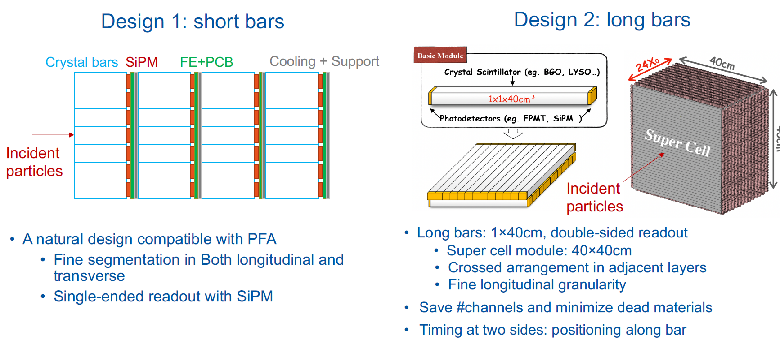
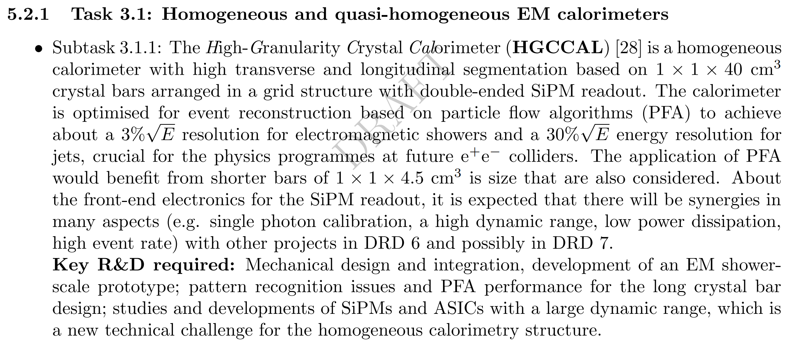
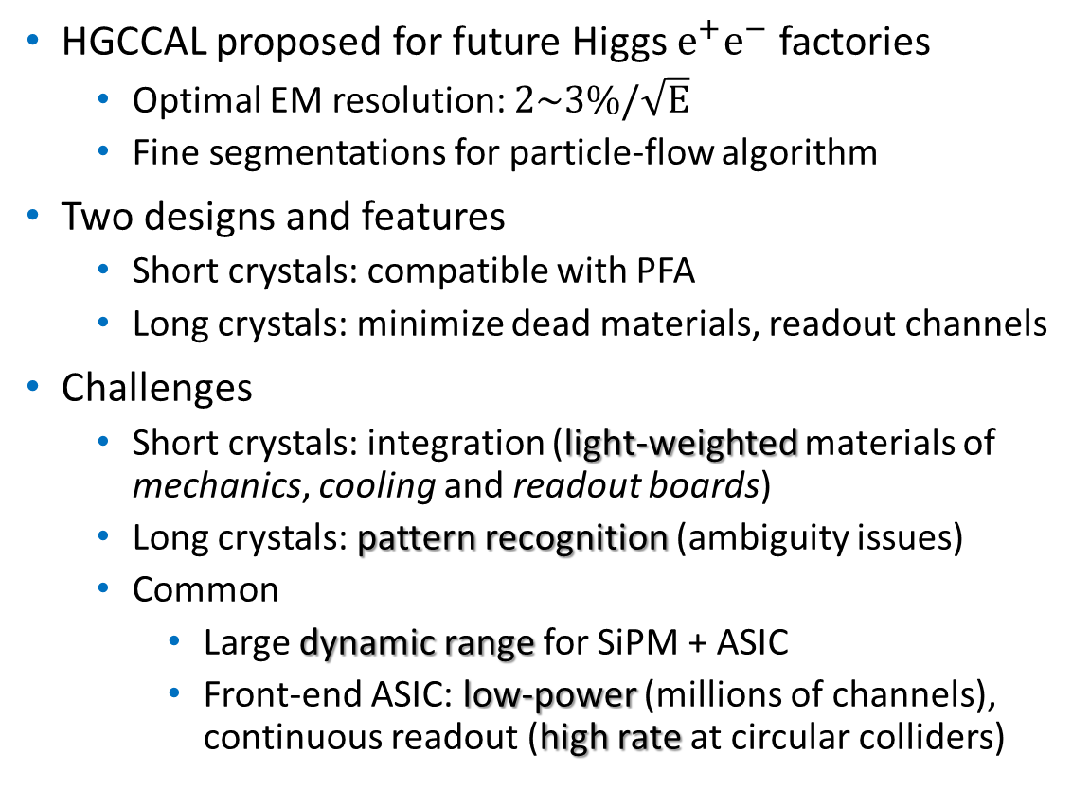
High-Granularity Crystal Calorimeter (HGCCAL)
HGCCAL proposed for future Higgs $e^{+}e^{−}$ factories
  Optimal EM resolution: $2\sim 3\%/\sqrt{E}$
  Fine segmentations for particle-flow algorithm
Two designs and features
  Short crystals: compatible with PFA
  Long crystals: minimize dead materials, readout channels
Challenges
  Short crystals: integration (light-weighted materials of mechanics, cooling and readout boards)
  Long crystals: pattern recognition (ambiguity issues)
  Common
    Large dynamic range for SiPM + ASIC
    Front-end ASIC: low-power (millions of channels), continuous readout (high rate at circular colliders)
DRD 6: Calorimetry (CERN-DRDC-2024-004)
HGCCAL team: IHEP, SIC-CAS, SJTU, TDLI, USTC

Slide 3
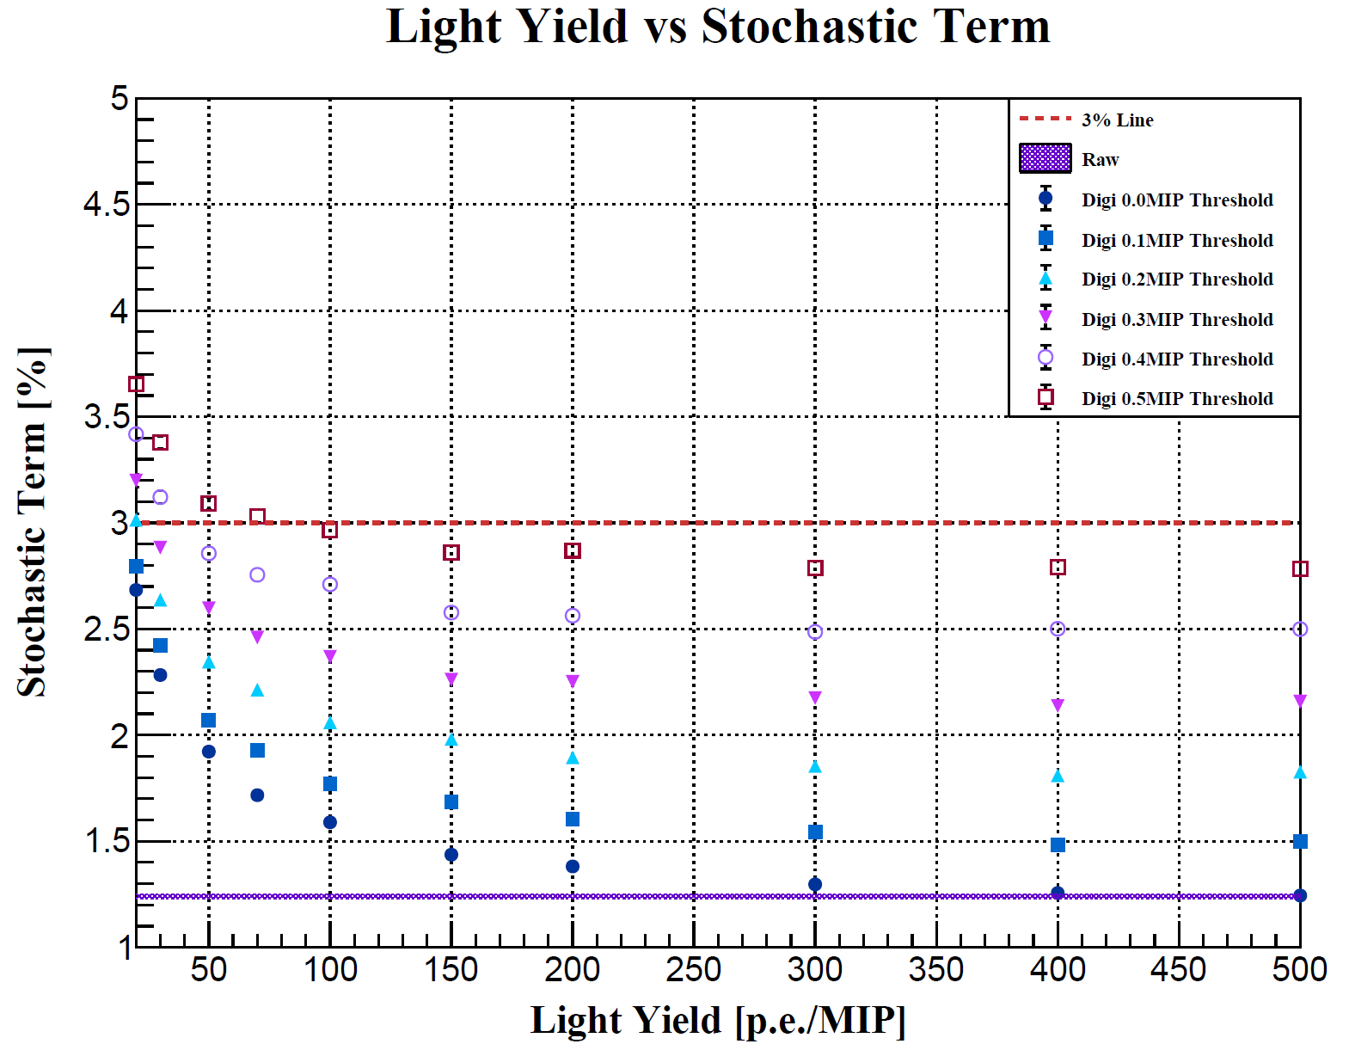
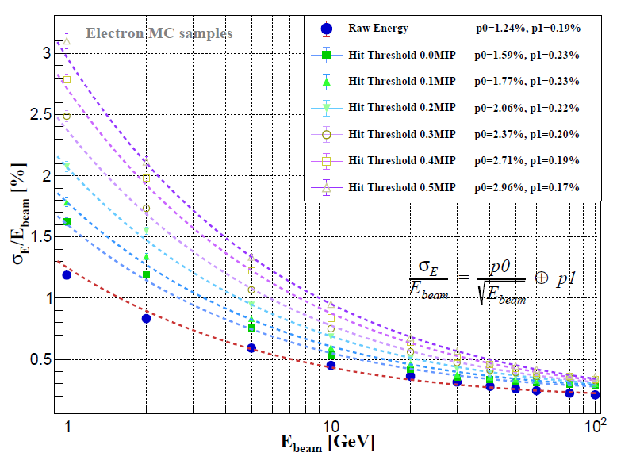
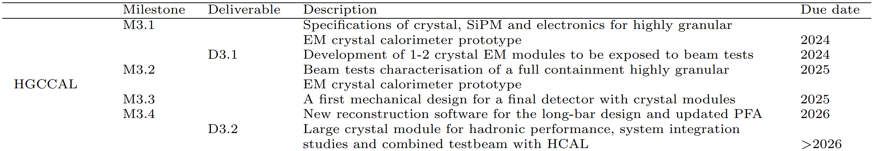
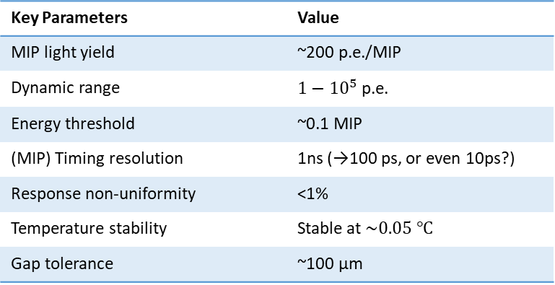
Status: simulation and specs
Geant4 full simulation and digitisation (2022-2023)
  To formulate a first set of specifications → to be validated with prototyping and tests
Key Parameters | Value
MIP light yield | ~200 p.e./MIP
Dynamic range | $1−{10}^{5}$ p.e.
Energy threshold | ~0.1 MIP
(MIP) Timing resolution | 1ns (→100 ps, or even 10ps?)
Response non-uniformity | <1%
Temperature stability | Stable at $\sim 0.05 ℃$
Gap tolerance | ~100 μm
DRD 6: Calorimetry (CERN-DRDC-2024-004)

Slide 4
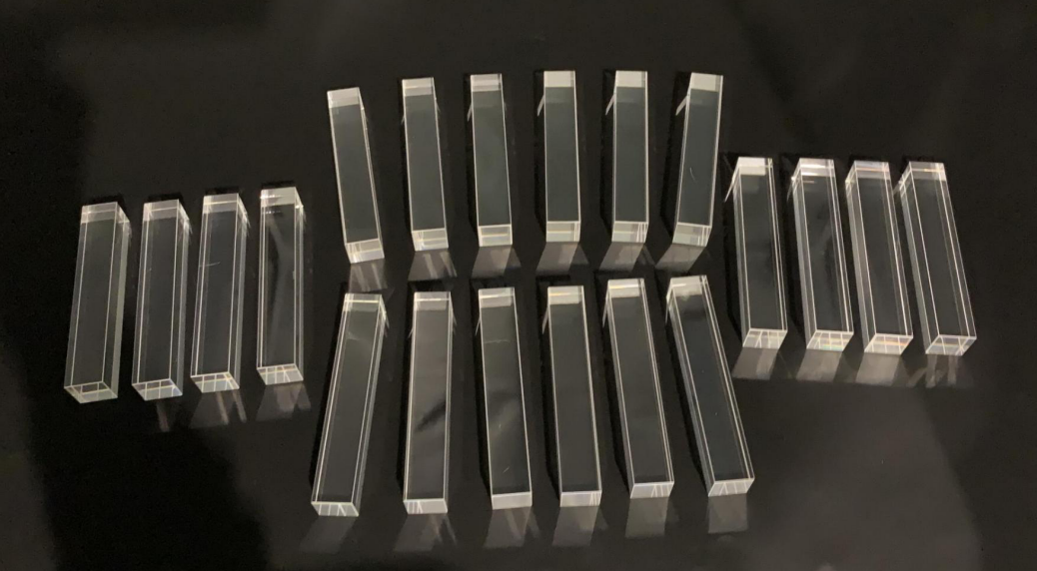
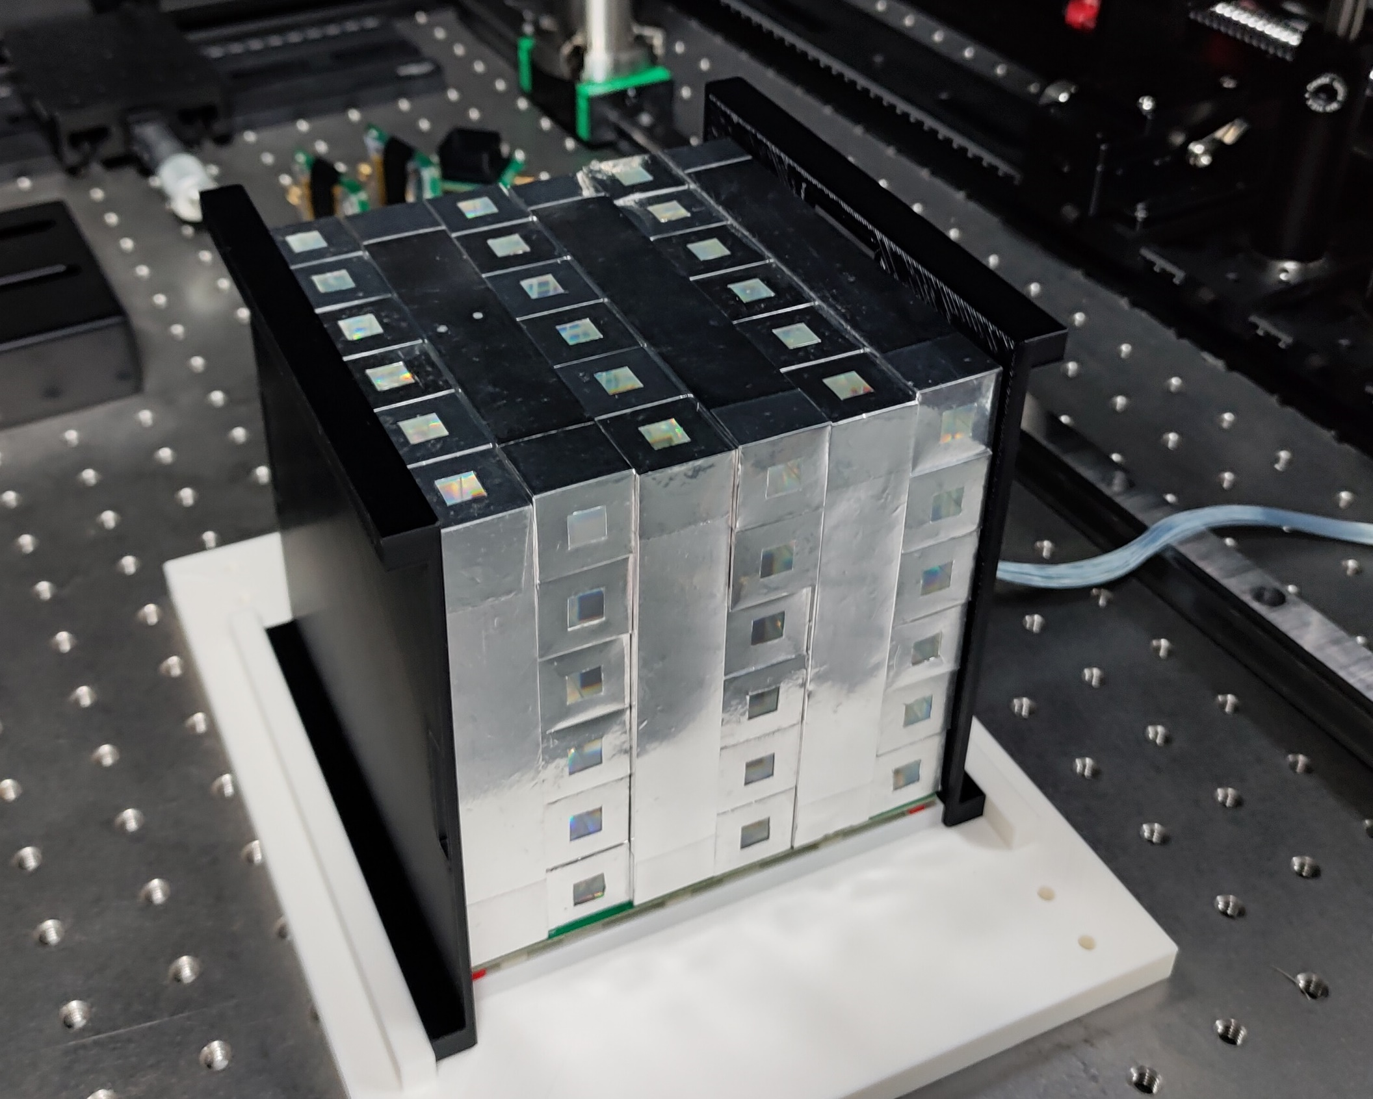
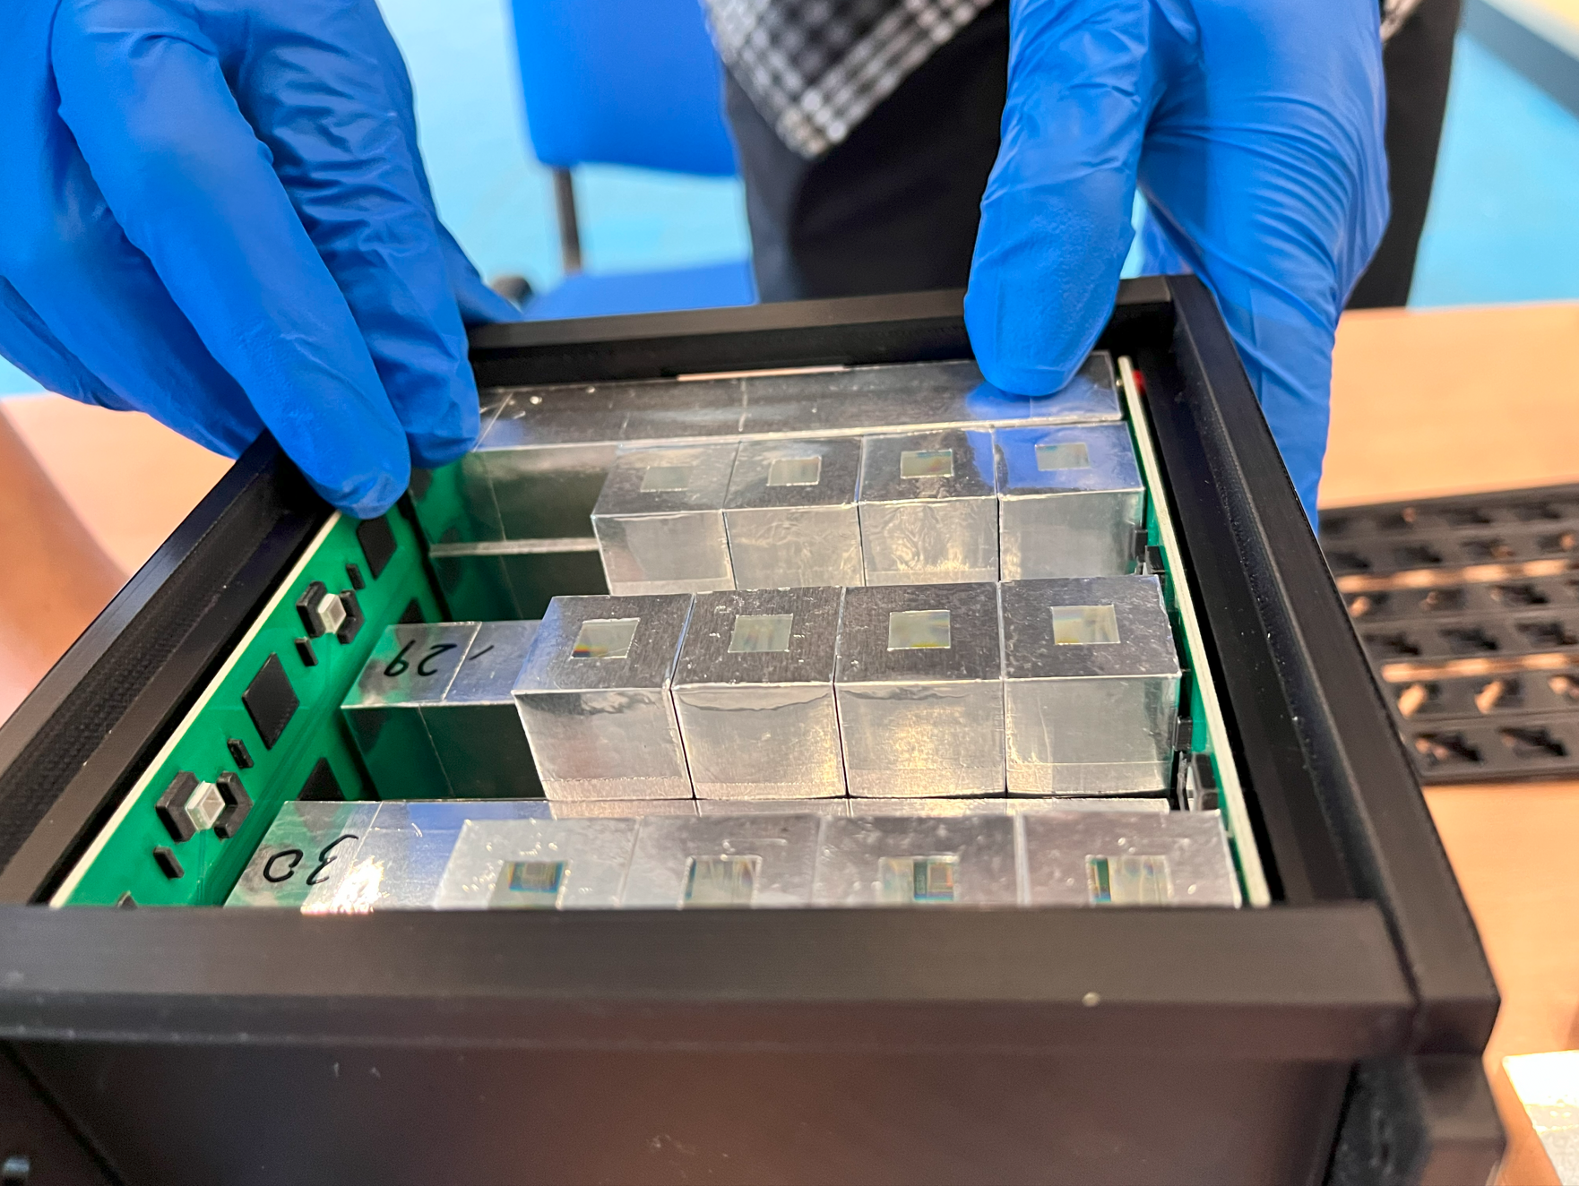
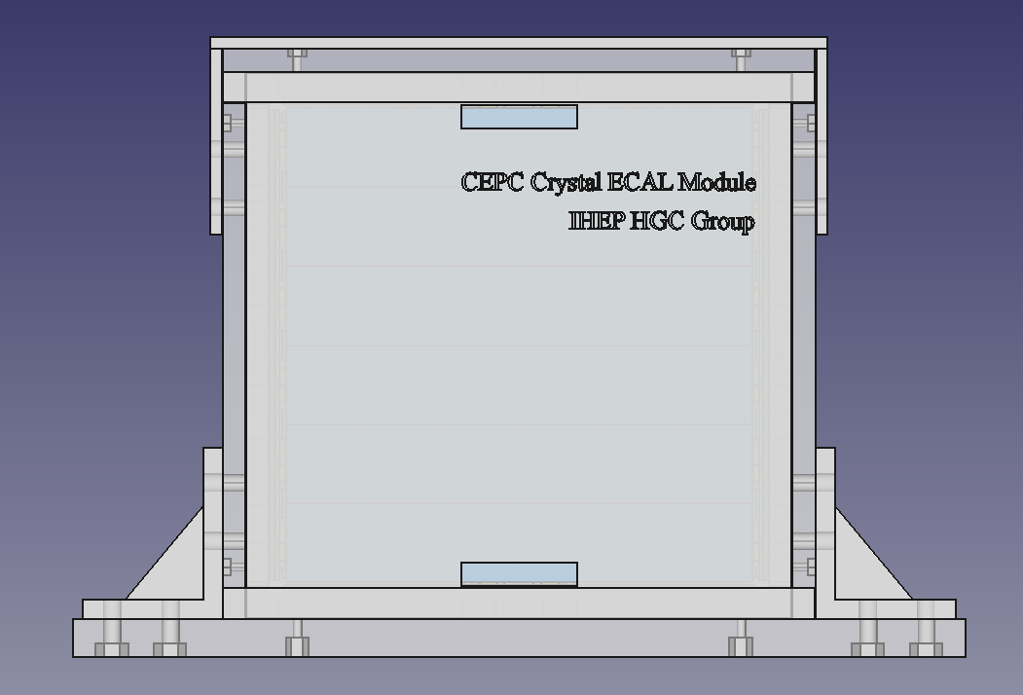
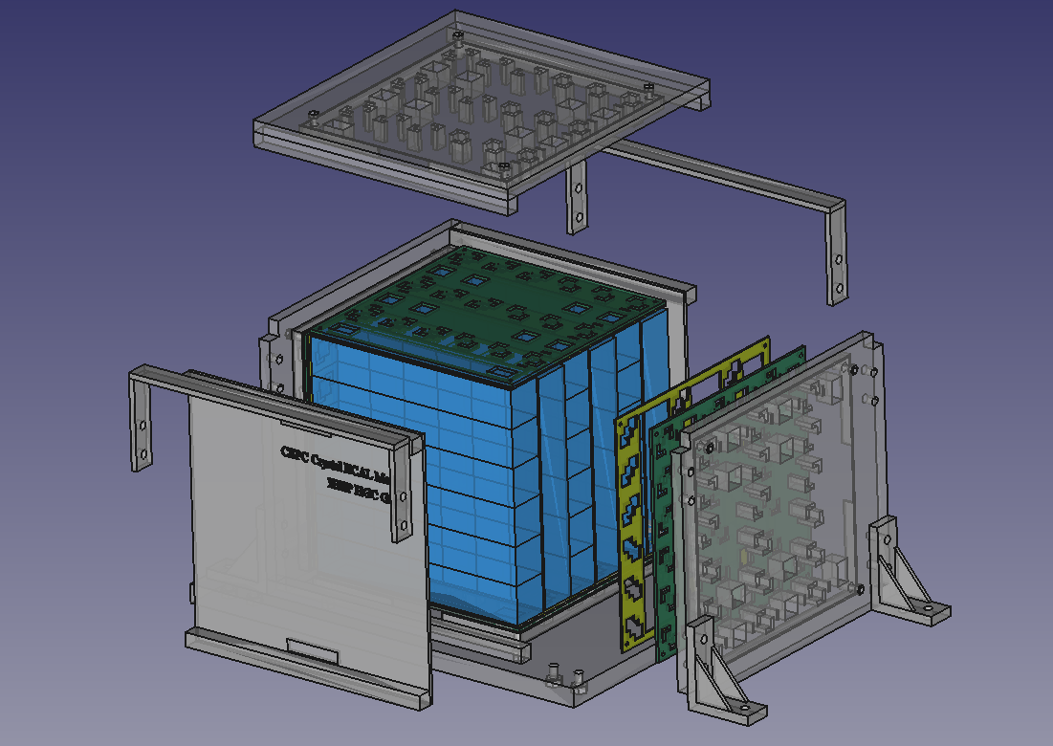
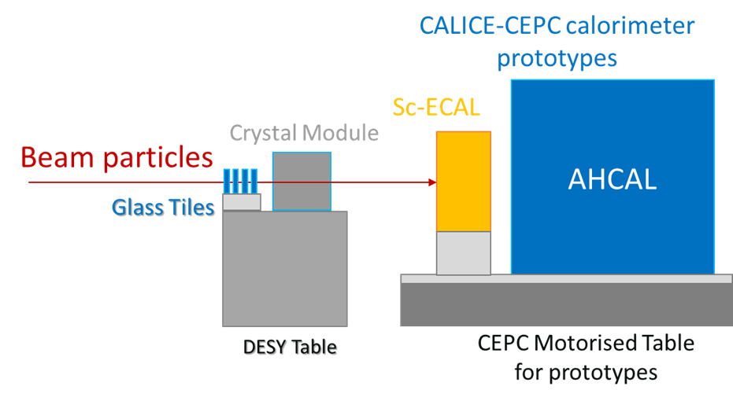
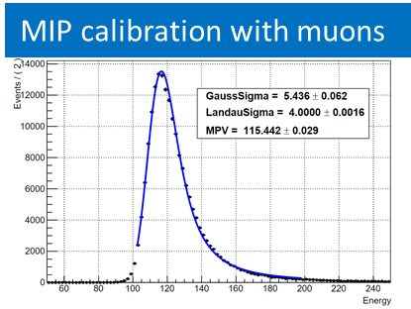
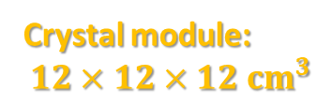
Status: crystal module and beamtest in 2023
BGO crystals from SIC-CAS
BGO crystal module
Crystal module:
$$12×12×12{ cm}^{3}$$
DRD 6: Calorimetry (CERN-DRDC-2024-004)
Developed the first crystal module
Parasitic runs with CALICE prototypes in May 2023 at CERN PS-T09
Data with muons and electrons

Slide 5
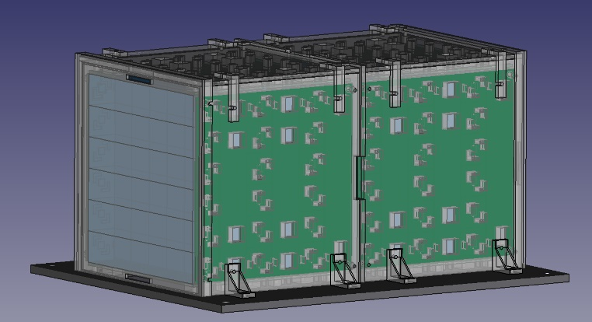
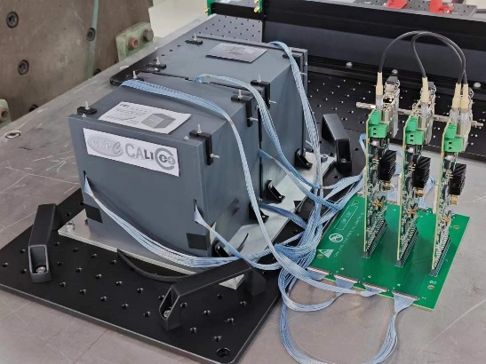
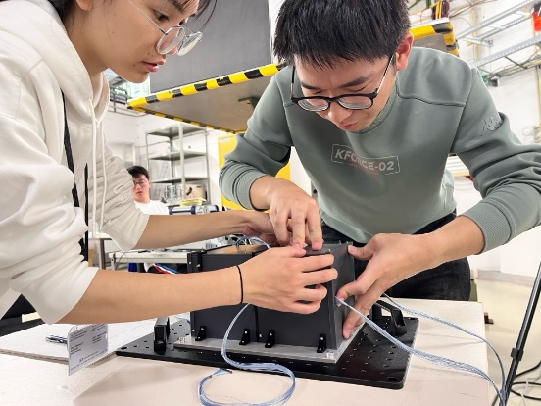
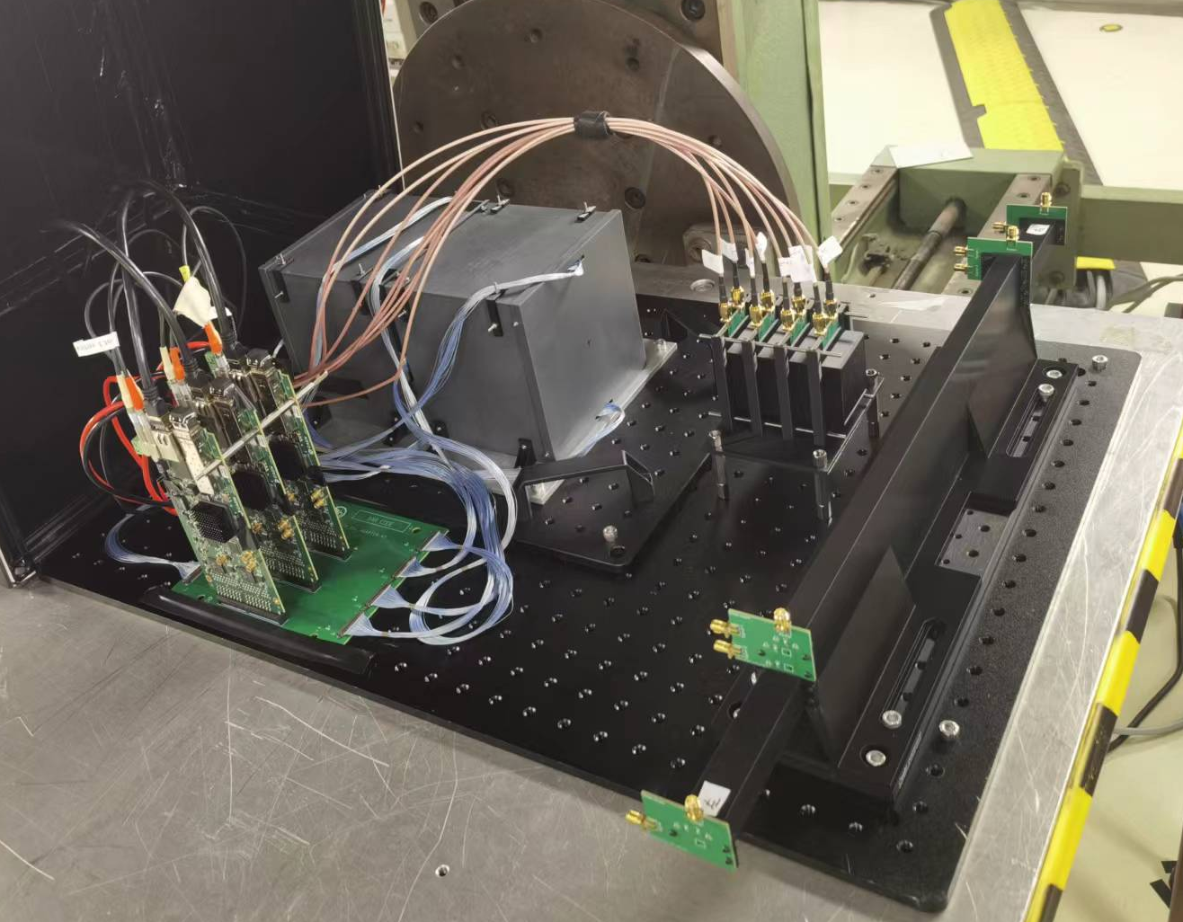
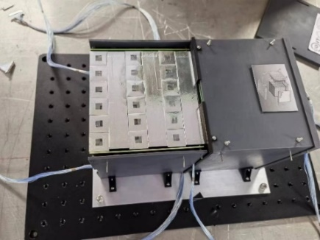
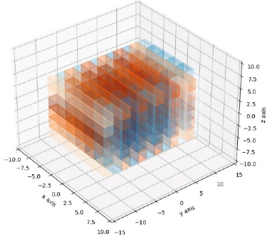
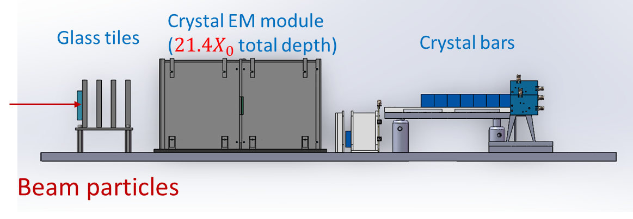
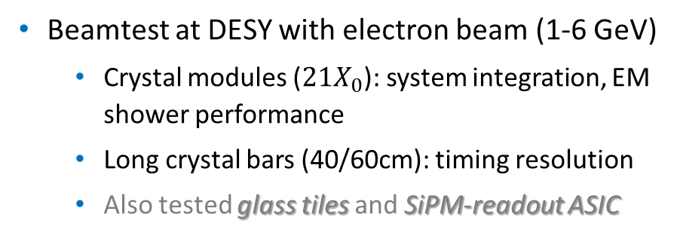
Status: crystal modules and beamtest in 2023
Crystal Modules
Two BGO crystal modules
ScintGlass Tiles
Long Crystal Bars
Beamtest at DESY TB22 (Oct. 2-15, 2023)
DRD 6: Calorimetry (CERN-DRDC-2024-004)
Beamtest at DESY with electron beam (1-6 GeV)
  Crystal modules ($21X_{0}$): system integration, EM shower performance
  Long crystal bars (40/60cm): timing resolution
  Also tested glass tiles and SiPM-readout ASIC

Slide 6
HGCCAL: ongoing studies and plans in 2024
New reconstruction software for the long-bar design: ongoing activities
  Integration in the CEPCSW with PFA: to evaluate jet performance
  Joint efforts within software, hardware and mechanics teams
Planning for 2024
  Further analysis of 2023 beamtest data sets (CERN, DESY)
    To fully explore potentials and understand possible limitations
  Crystal R&D activities:
    Light yield, scintillation time, radiation hardness
  SiPM and front-end ASIC: specs and validation
    Single photon calibration, dynamic range, power consumption, timing precision, …
  2024 CERN beamtests (details in next page)

Slide 7
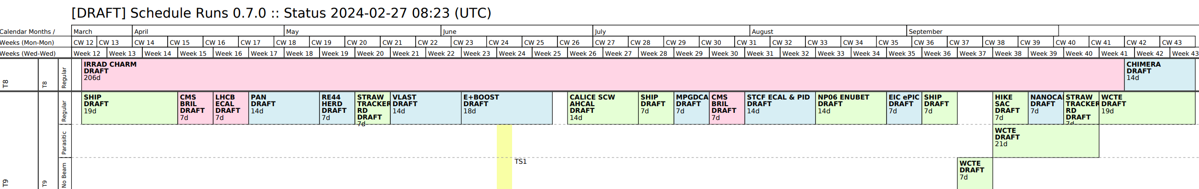
HGCCAL: beamtests in 2024
Beamtest planning for 2024
  2024 CERN PS-T09 beamtest: MIP calibration, EM performance (~0.1 – 5 GeV)
    Application on behalf of CALICE: 2 weeks as main user in CW26-28 (draft schedule)
  2024 CERN SPS beamtest: EM performance (10-120 GeV)
    Only applied for parasitic runs, but not scheduled (mostly all calorimeters at H2 in 2024 second half)
    Optional: hadronic performance, combined with a full-sized HCAL prototype (likely w/ EUDAQ+TLU)
Discussions: synergies with other projects in WP3
  To best exploit the beamtime (2 weeks) at PS-T09
  To continue planning and coordination for parasitic runs at SPS (H6, H8; or extended proton program if approved): e.g. combined beamtests with other projects in DRD6
  Your feedback/suggestions would be appreciated!

Slide 8
Backup

Slide 9
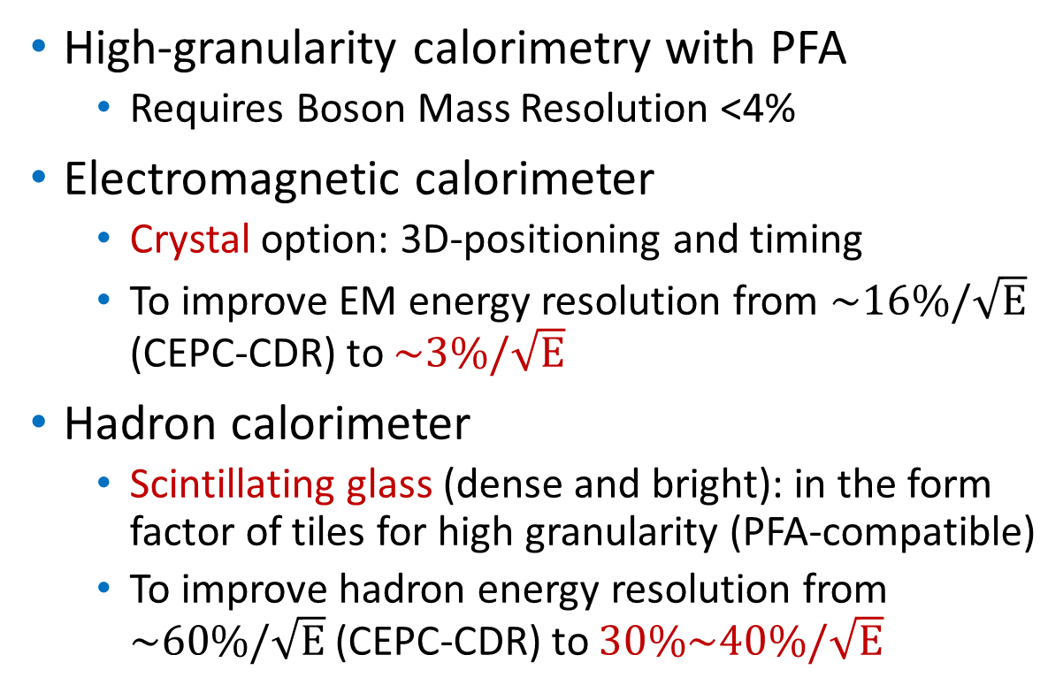
New concepts for CEPC calorimetry
High-granularity calorimetry with PFA
  Requires Boson Mass Resolution <4%
Electromagnetic calorimeter
  Crystal option: 3D-positioning and timing
  To improve EM energy resolution from $\sim 16\%/\sqrt{E}$ (CEPC-CDR) to $\sim 3\%/\sqrt{E}$
Hadron calorimeter
  Scintillating glass (dense and bright): in the form factor of tiles for high granularity (PFA-compatible)
  To improve hadron energy resolution from $\sim 60\%/\sqrt{E}$ (CEPC-CDR) to $30\%\sim 40\%/\sqrt{E}$
PFA-oriented Calorimetry
CEPC: the 4th Conceptual Detector Design
Jianchun Wang, “Status and Perspective of the CEPC” at CLHCP2023
Calorimeters: crystal ECAL and ScintGlass HCAL

Slide 10
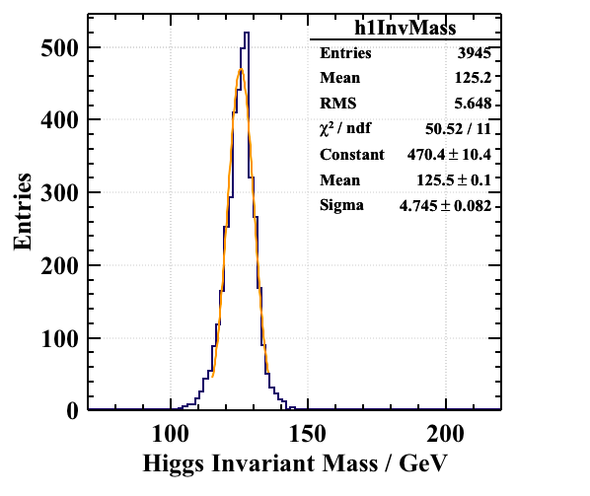
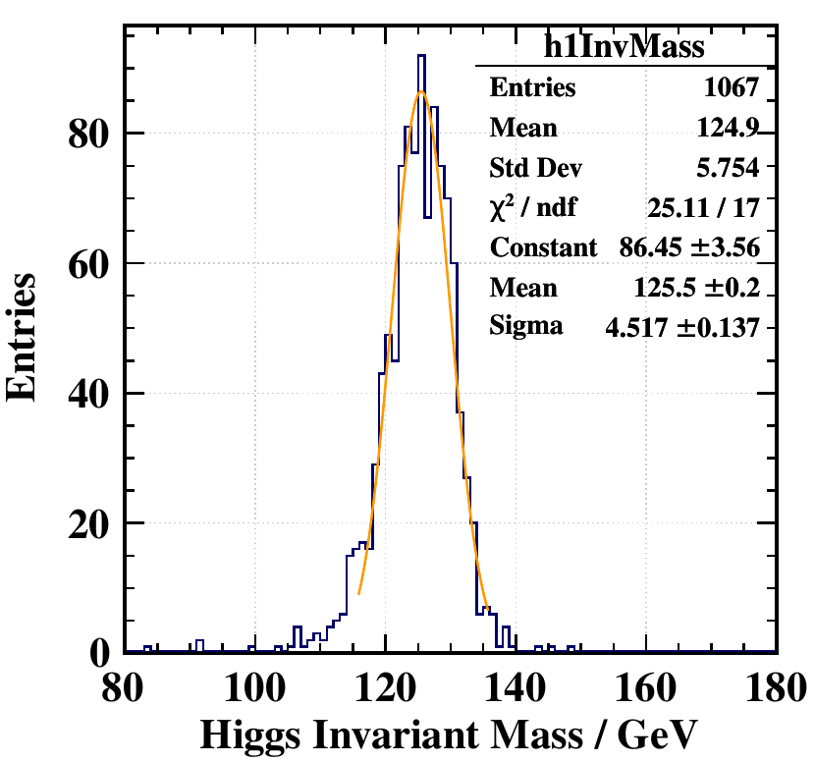
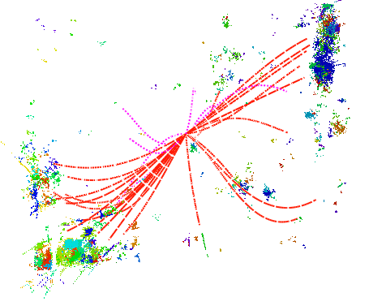
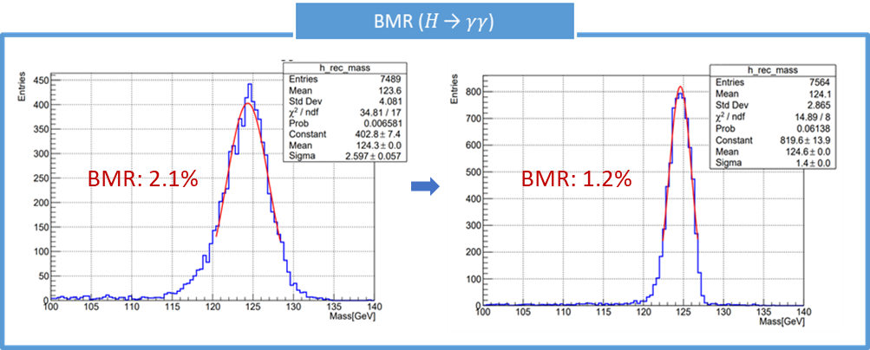
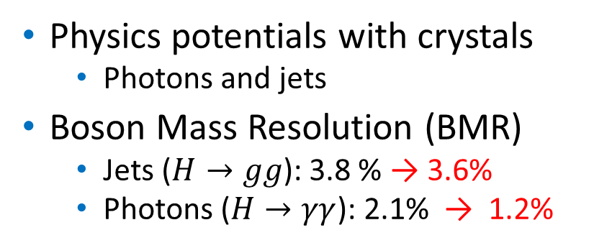
Higgs physics benchmarks
Baohua Qi, Dan Yu (IHEP); Zhiyu Zhao (SJTU)
Detector with SiW-ECAL option
Detector with crystal ECAL option
Physics potentials with crystals
  Photons and jets
Boson Mass Resolution (BMR)
  Jets ($H→gg$): 3.8 % → 3.6%
  Photons ($H→γγ$): 2.1% → 1.2%
BMR: 3.8 %
BMR: 3.6 %
𝐻 → 𝑔𝑔
Higgs to 2 gluon jets
(with crystal ECAL)
Work in Progress
Work in Progress
SiW-ECAL
Crystal
Work in Progress
Work in Progress
𝐻 → 𝑔𝑔

Slide 11
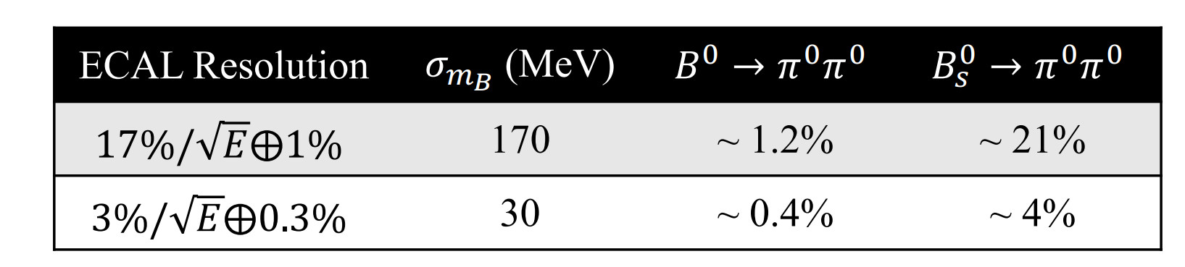
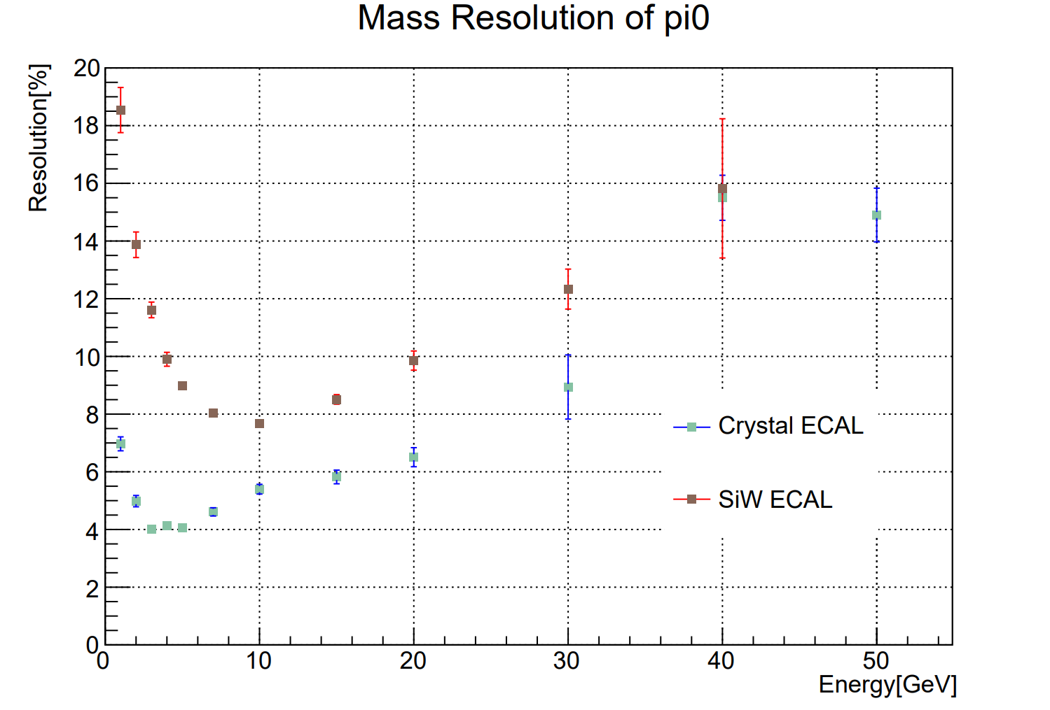
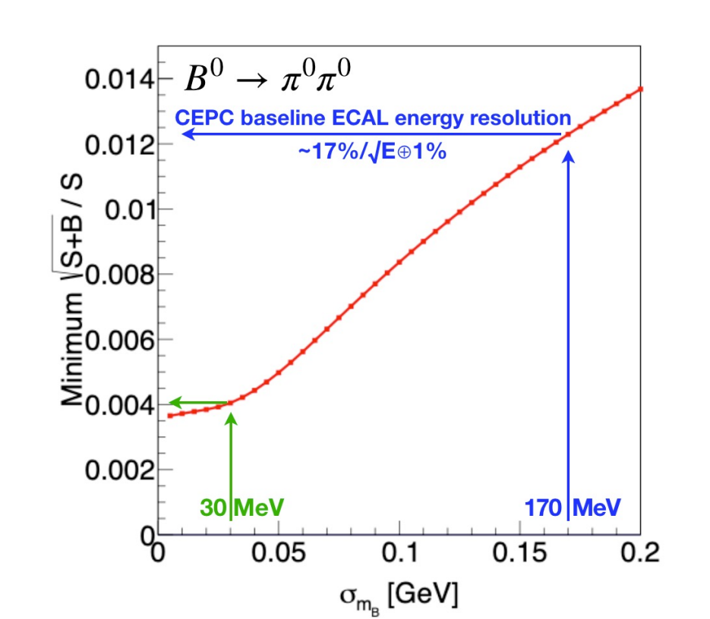
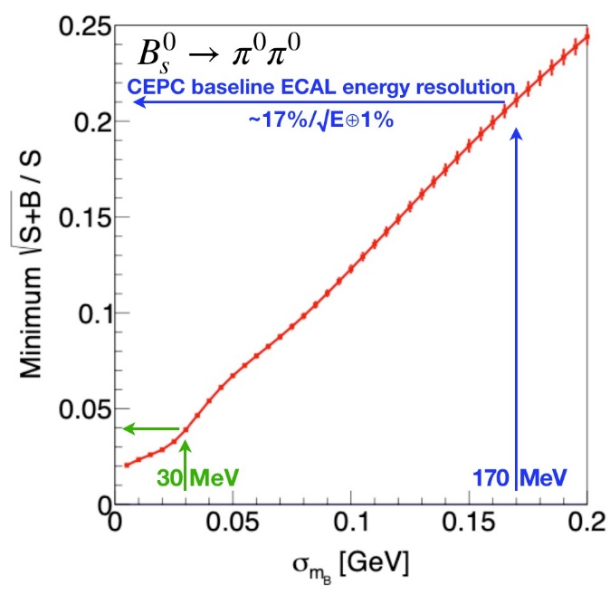



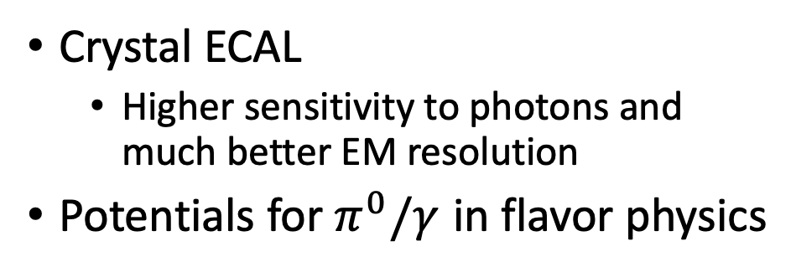
Flavor physics potentials
Zhiyu Zhao (SJTU), Yuexin Wang (IHEP)
  Crystal ECAL
    Higher sensitivity to photons and much better EM resolution
  Potentials for $π^{0}/γ$ in flavor physics
B0 to pipi @CEPC(CEPC Flavor Physics/New Physics/Detector Technology Workshop, Fudan, 2023), Yuexin Wang
$$π^{0}→γγ$$
$$9\% vs. 4\% @5GeV$$
JHEP12(2022)135

