Slide 1
GRAiNITA: fine sampling crystal grain calorimetry
Giulia Hull,
Université Paris-Saclay, CNRS/IN2P3, IJCLab
On Behalf of thr GRAiNITA Group:
IJCLab: S.Barsuk, I.Boyarintseva, D.Breton, S. Monteil, J.Lefrançois, MH.Schune;
ISMA: A.Boyarintsev, I.Tupitsyna,
LP-Clermont: H.Chanal, Y.Hou, M.Magne, S.Monteil, D.Picard, M.Yeresko;
TSNUK: O.Bezshyyko, A.Dubovik, A.Kotenko, N.Semkiv.

Slide 2
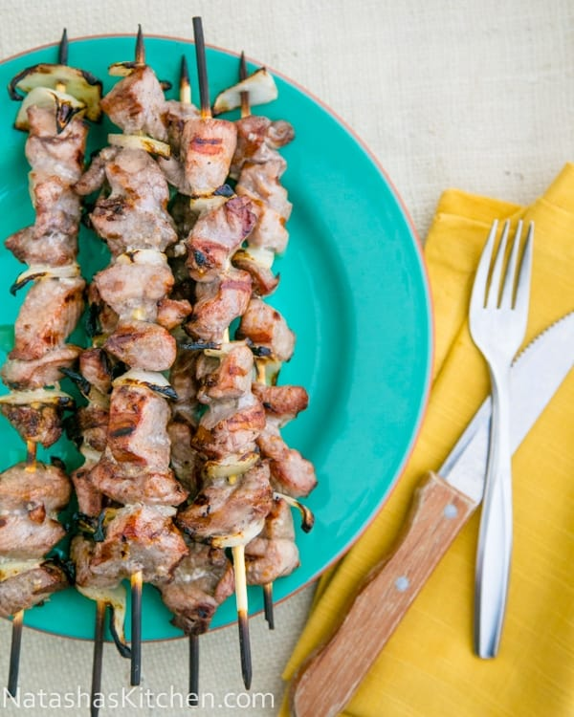
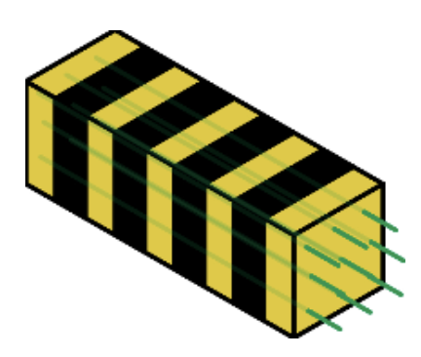
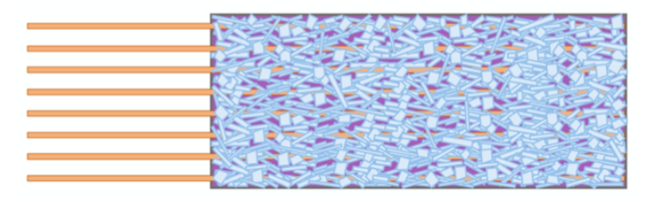
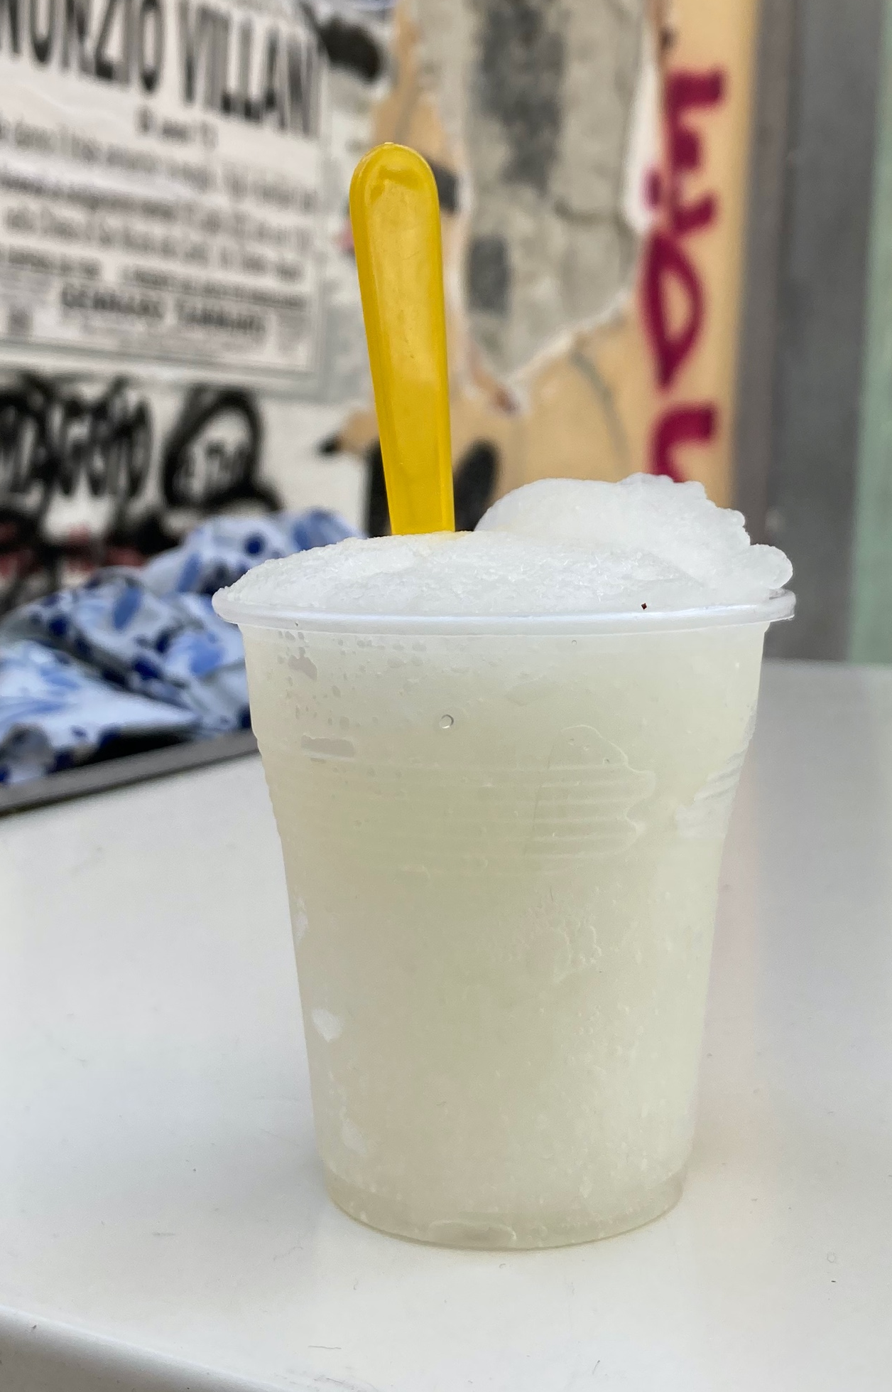


GRAiNITA concept
Shashlik calorimeter: alterning layers of scintillator and absorber
GRAiNITA: mix of scintillator grains soaked in a high-density liquid
$\frac{σ_{E}}{E}\sim \frac{1\%−2\%}{\sqrt{E}}$ is expected
$\frac{σ_{E}}{E}\sim \frac{10\%−15\%}{\sqrt{E}}$
High granularity
Modest energy resolution
High granularity
Good energy resolution
Inspired by LiquidO technique for neutrino detector
(A. Cabrera et al. LiquidO Commun Phys 4, 273 (2021) )

Slide 3
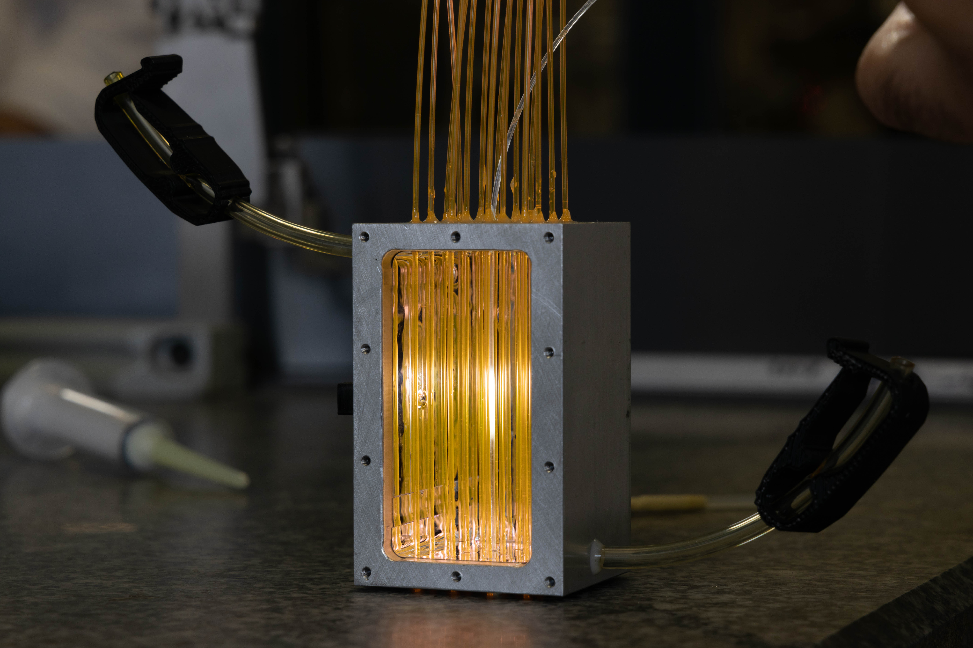
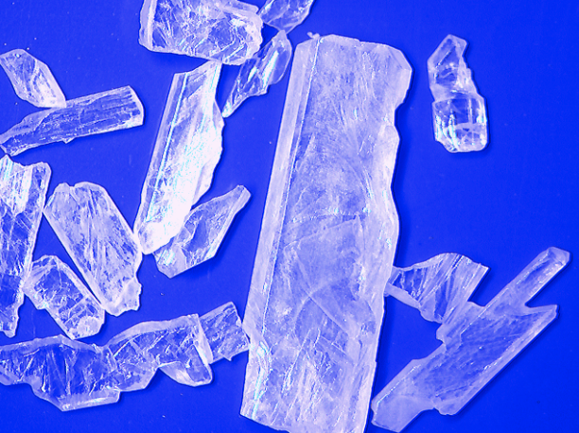
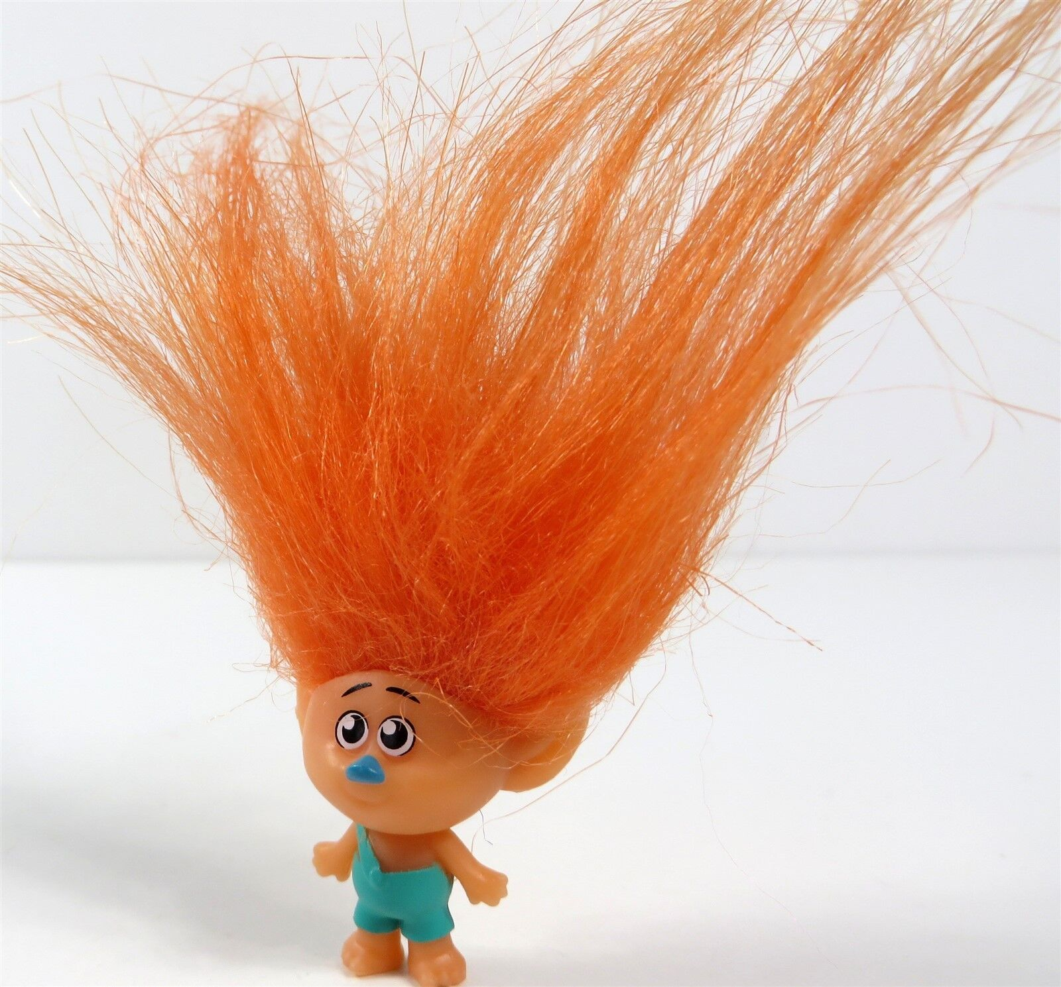
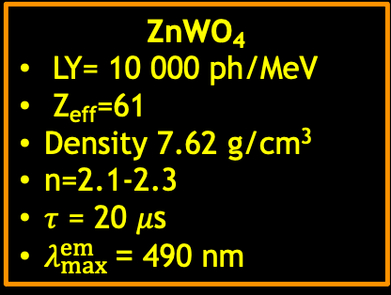
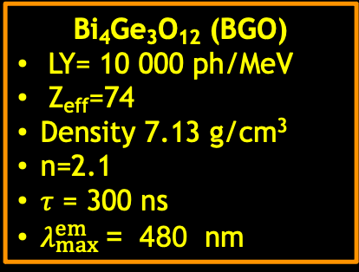
GRAiNITA prototype: the “Troll”
Development of two medium-size GRAiNITA prototypes, employing respectivement BGO and ZnWO₄ grains and equipped with 16 WLS fibres and SiPMs for the read-out of the scintillation light
ZnWO₄
LY= 10 000 ph/MeV
Z_{eff}=61
Density 7.62 g/cm³
n=2.1-2.3
𝜏 = 20 𝜇s
$λ_{max}^{em}$= 490 nm
Bi₄Ge₃O₁₂ (BGO)
LY= 10 000 ph/MeV
Z_{eff}=74
Density 7.13 g/cm³
n=2.1
𝜏 = 300 ns
$λ_{max}^{em}$= 480 nm

Slide 4
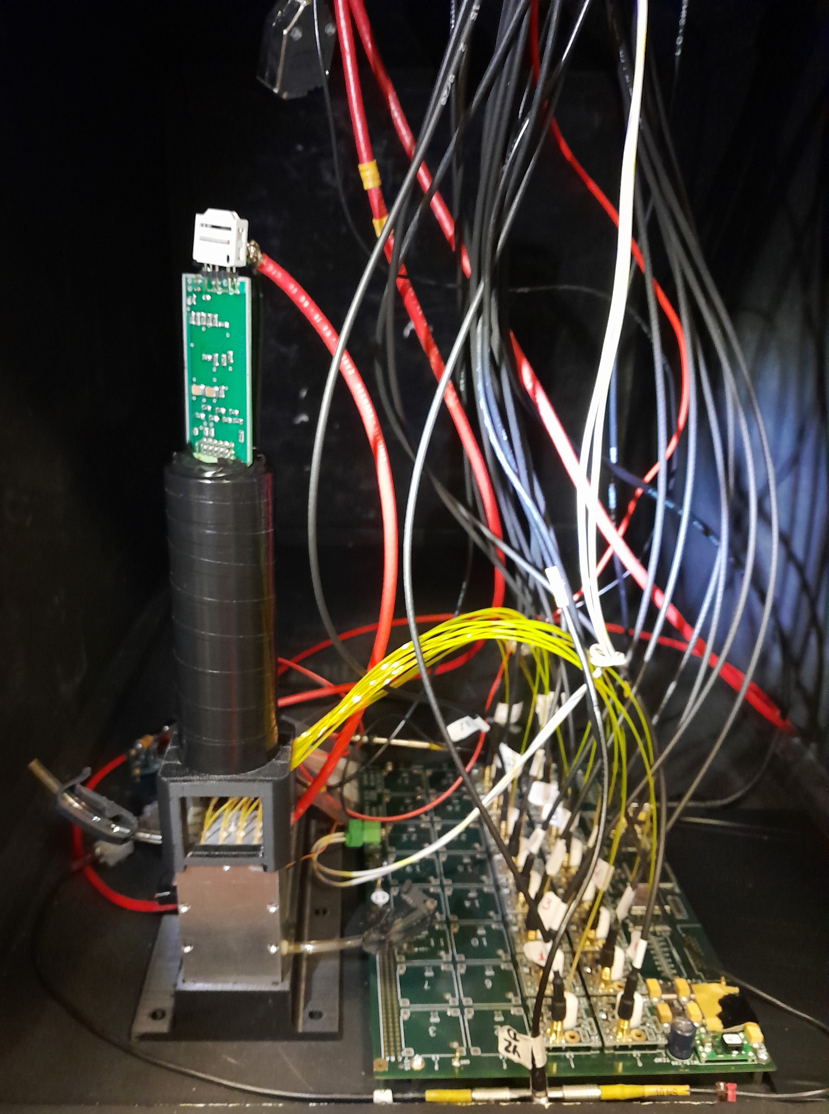
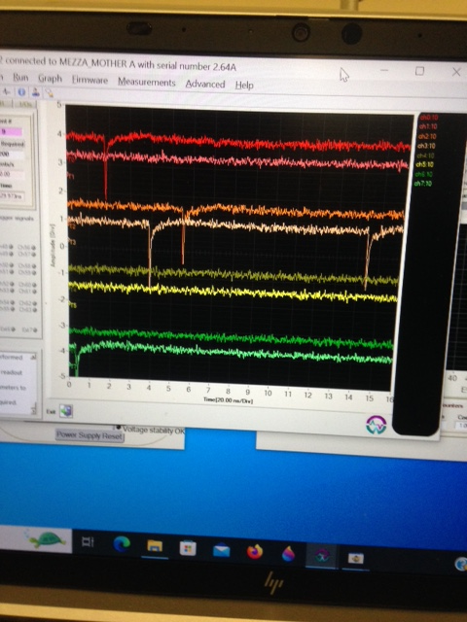
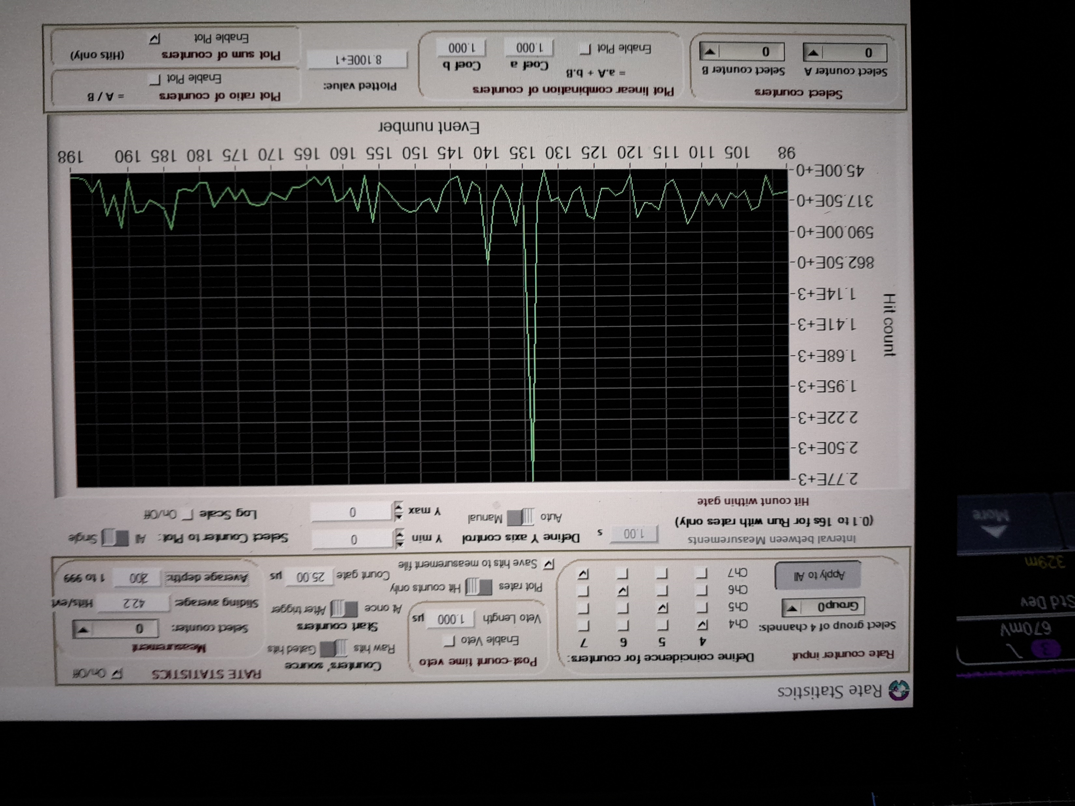
GRAiNITA cosmic rays test-bench
16 WLS fibers coupled to 16 SiPMs plugged on a PCB to amplify the signals
Two 8-ch WaveCatchers for the signal readout
Since ZnWO₄ has a long decay time τ≈20 μs, a special program has been implemented allowing to count the number of the single phe pulses on a time scale of 25 μs
Before and after each run with cosmic rays, we acquire 1000 ev. illuminating the grain volume with the green LED
Volume filled with:
Air
ZnWO₄
ZnWO₄ + water
ZnWO₄ + ethylene glycol

Slide 5

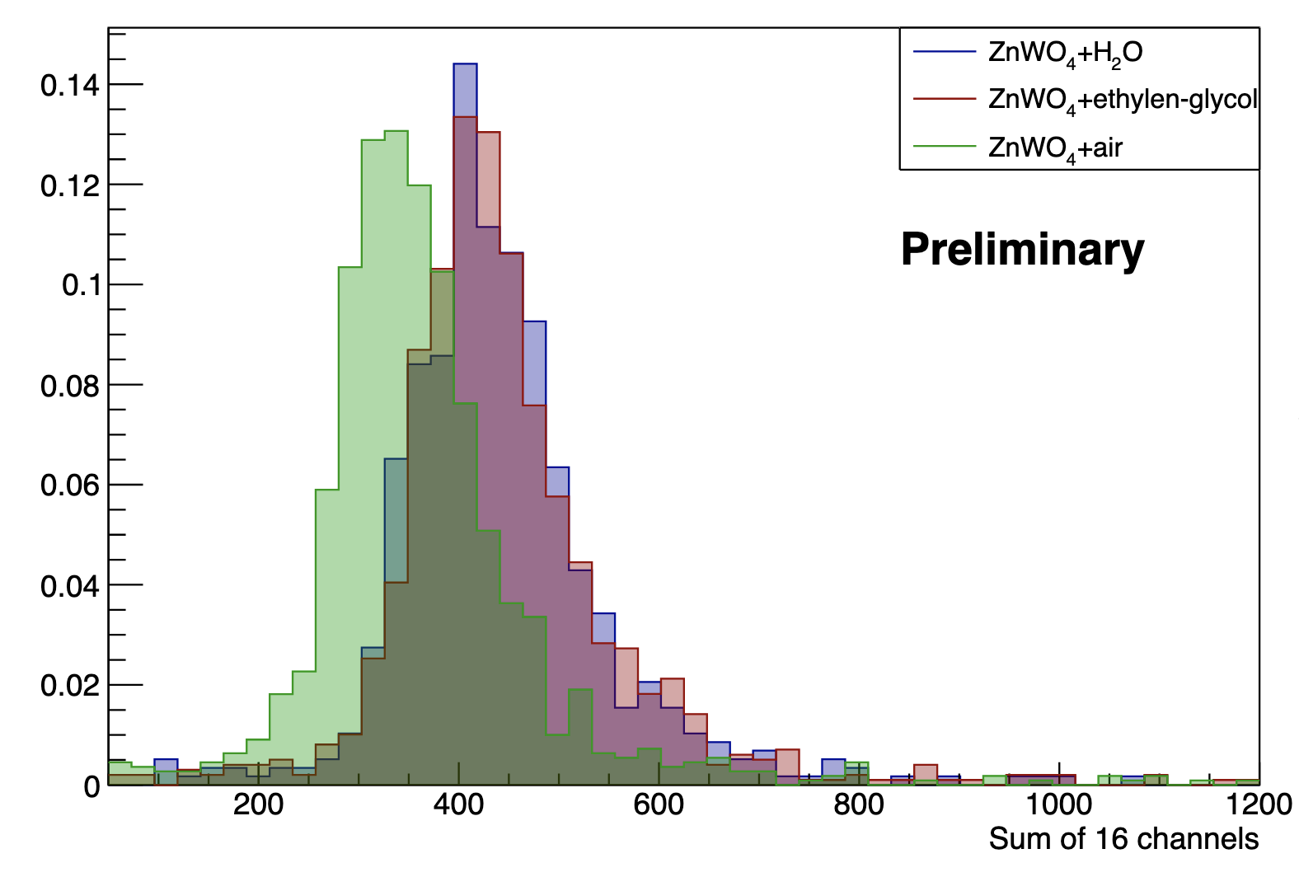
Light yield
Registered signals from cosmic rays
20-25% more light when we add liquide
LY = O(400phe/40MeV)
Ignored in the fit
10000 phe/GeV
➔ statistical contribution = 1% for 1 GeV high energy photon
Can be improved as the fiber ends are not covered with reflector
Peut être amélioré car les extrémités des fibres ne sont pas recouvertes de réflecteur

Slide 6
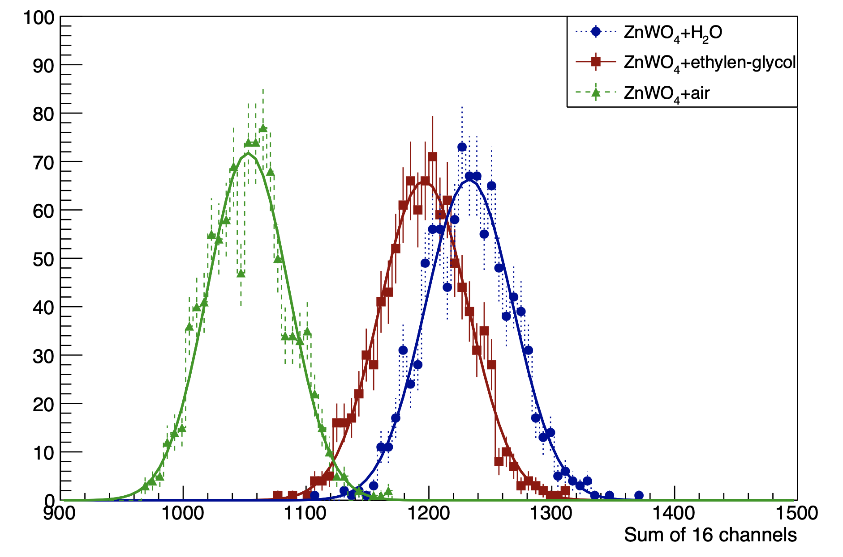
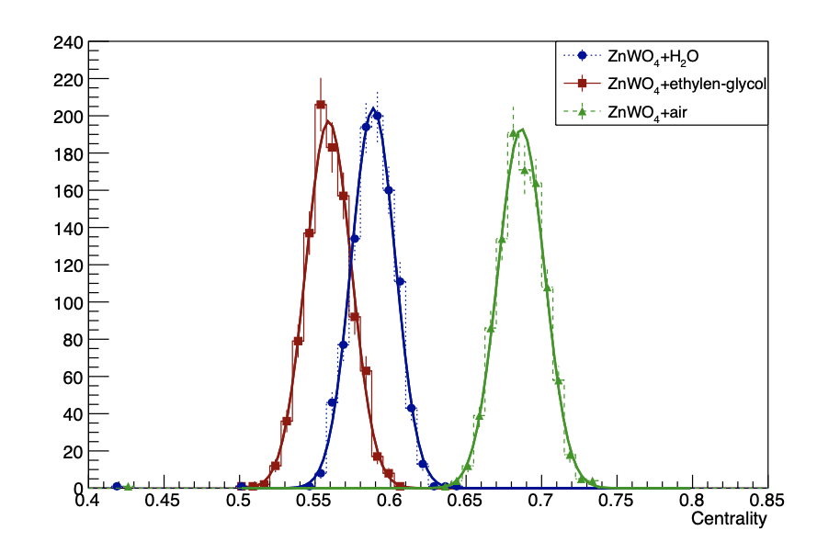
Light confinement
Top view
Ratio between the sum of the signal in the 4 central channels and the total
Sum of the signals in the 16 channels
16 WLS fibers
Green LED
Green LED light injected in the center of the prototype
Using just grains in the volume the scintillation light is more confined, this confinement decreases adding liquid with increasing refractive index

Slide 7
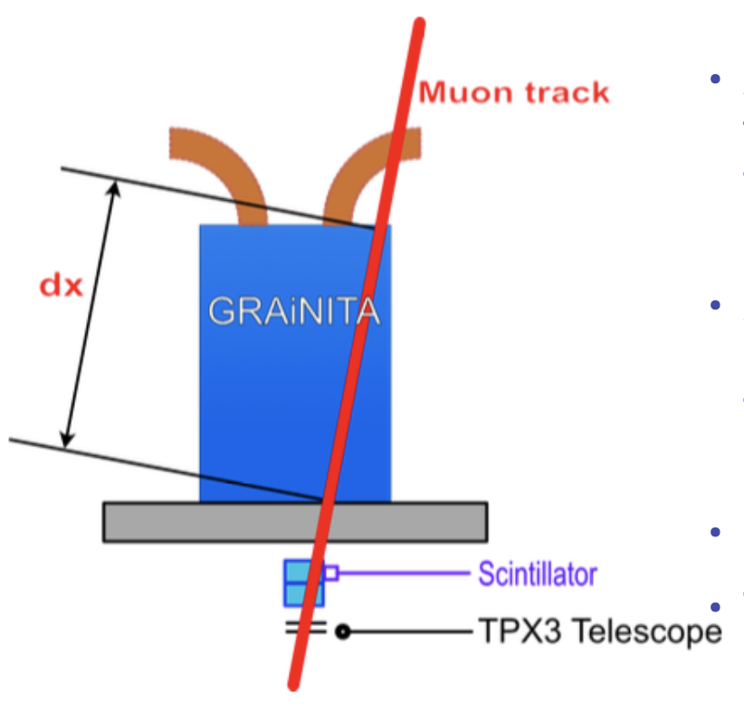
At present: the constant term
Non-uniformities and escaping energies are among the sources of energy resolution degradation → muon test beam and simulation
Accurate (1mm at 15 cm) knowledge of the muon trajectory in the prototype thanks to a Si telescope prototype(TPX3)
Aim at measuring the response of the GRAiNITA prototype as a function of the actual (length) passage of the particle, the distance to the fibre etc…
Start to address the non-uniformities
To be used further in muon test beam
Test beam (hopefully) before the summer

Slide 8
For the future: the GRAiNITA Demontrator
We are working at the proposal for the funding request
Full size demonstrator: 17cm x 17 cm x 40 cm:
45 kg ZnWO₄ grains, heavy liquid, 576 fibers, 36 SiPMs
Study of the PSD discrimination capability

