Slide 1
PART IV
Unitarity Triangle Formalism
How well we know CKM

Slide 2
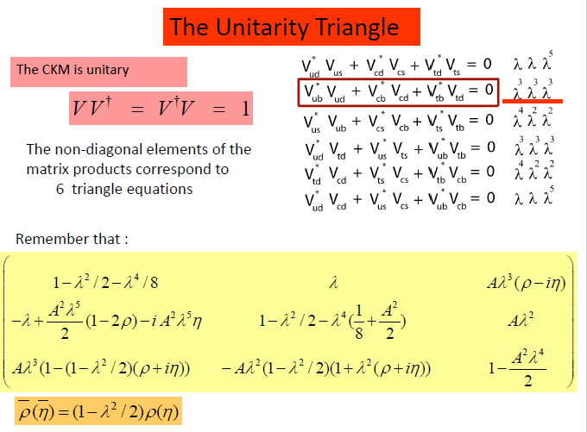

Slide 3
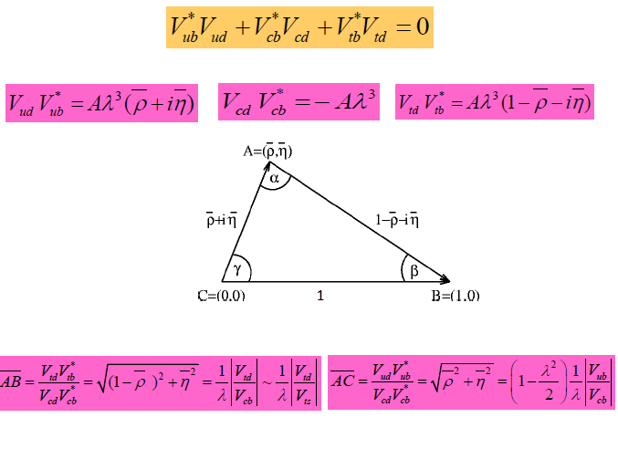

Slide 4
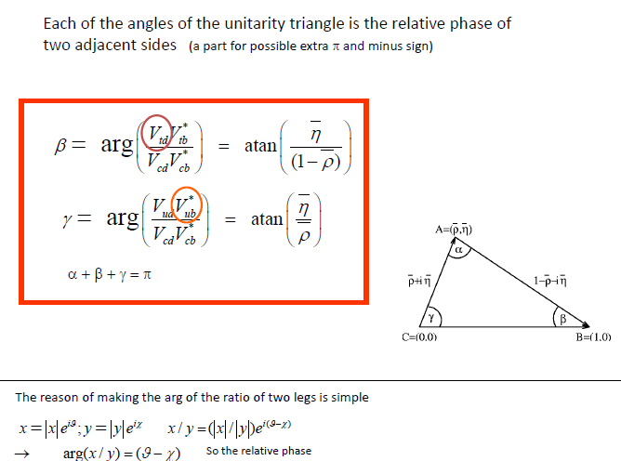

Slide 5
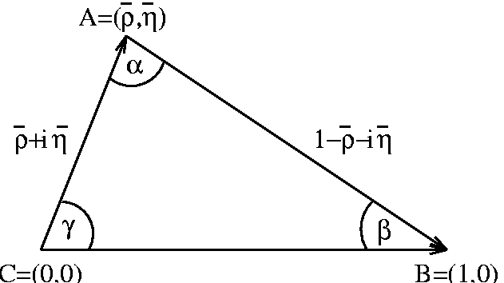
1
α + β + γ = π

Slide 6
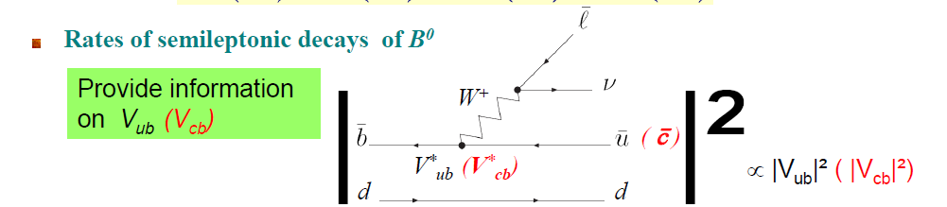
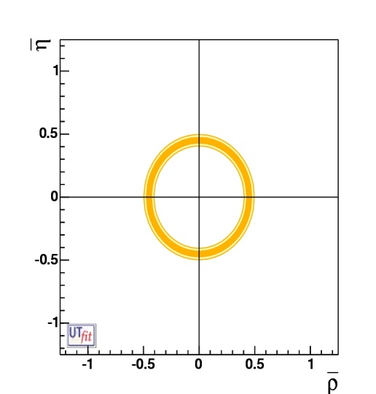
1
Circle around (0,0) in the ρ−η plane
You have to measure B decays b→c and b → c transitions

Slide 7
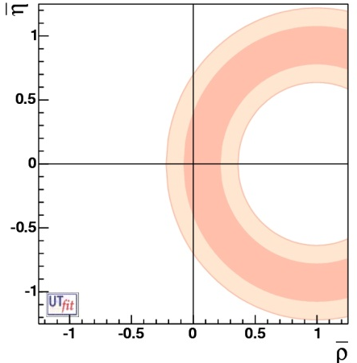
W⁻
d,s
b
B⁰_{d,s}
t,c,u
t,c,u
B⁰_{d,s}
W⁺
d, s
b
V_{td}
V_{ts}
Bs and Bd oscillations give acces to Vts abd Vtd
Circle around (1,0) in the ρ−η plane
You have to measure B meson oscillations
More precisely you have to measure Oscillation frequency

Slide 8
Introduction to mixing and CP phenomena
Pairs of self-conjugate mesons that can be transformed to each other via flavour changing weak interaction transitions are:
They are flavour eigenstates with definite quark content
useful to understand particle production and decay
Apart from the flavour eigenstates there are mass eigenstates:
eigenstates of the Hamiltonian
states of definite mass and lifetime
Since flavour eigenstates are not mass eigenstates, the flavour eigenstates are mixed with one another as they propagate through space and time

Slide 9
: the flavour state of a B meson that was a B⁰ (B⁰ ) at t = 0.
Schrödinger equation governs time evolution of the B⁰-B⁰ System:
T conservation  |H₂₁| = |H₁₂|
CP conservation  |H₂₁| = |H₁₂|, H₁₁ = H₂₂
CPT conservation  H₁₁ = H₂₂
=> H (effective Hamiltonian)
Mass states are eigenvectors of H
≈
eigenvalues
The time evolution of the mass eigenstates is governed by their eigenvalues :
+
Time evolution

Slide 10
Time evolution of the physical states
More general formulae
When ΔΓ is small they simplify to :
Probability to observe in the state f a B⁰ produced at time t=0:
Probability to observe in the state f a B⁰ produced at time t=0:

Slide 11
The two master formulae (having however neglected ΔΓ :

Slide 12
Considering only the mixing :
Starting from a B⁰
CP violation is neglected : q/p=1
Starting from a B⁰
If one does not neglect ΔΓ (useful for charm or B_{s}) the previous formulae become
So that one finds for the time dependent mixing asymmetry:
Mixed : B⁰ → B⁰ or B⁰ → B⁰
UnMixed : B⁰ → B⁰ or B⁰ → B⁰

Slide 13
Oscillations are characterized by Δm which is related to Vtd and Vts
The probability that the meson B⁰ produced (by strong interaction) at t = 0 transforms (weak interaction) into B⁰ (or stays as a B⁰ ) at time t is given by :
Δm_{q} is the oscillation frequency : 1 ps⁻¹ = 6.58 10⁻⁴ eV
W⁻
d,s
In SM :ΔF=2 process
b
GIM mechanism (Rate ~ m₁²- m₂²)
B⁰_{d,s}
t,c,u
t,c,u
B⁰_{d,s}
W⁺
Dominated by t exchange
d, s
b
Rate LARGE
V_{td}
V_{ts}
Allow to access fundamental parameters
of the Standard Model

Slide 14
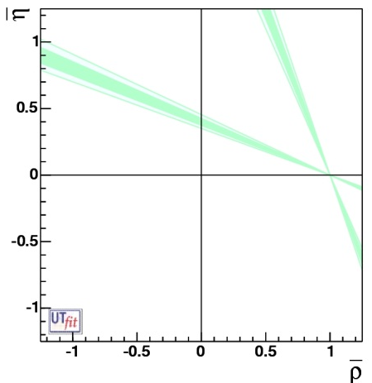
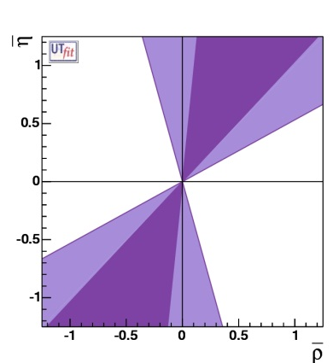
If we can access to the imaginary part of
the ampliutude involving V_{td} → access to β angle
β
14
If we can access to the imaginary part of
the amplitude involving V_{ub} → access to γ angle
γ
14

Slide 15
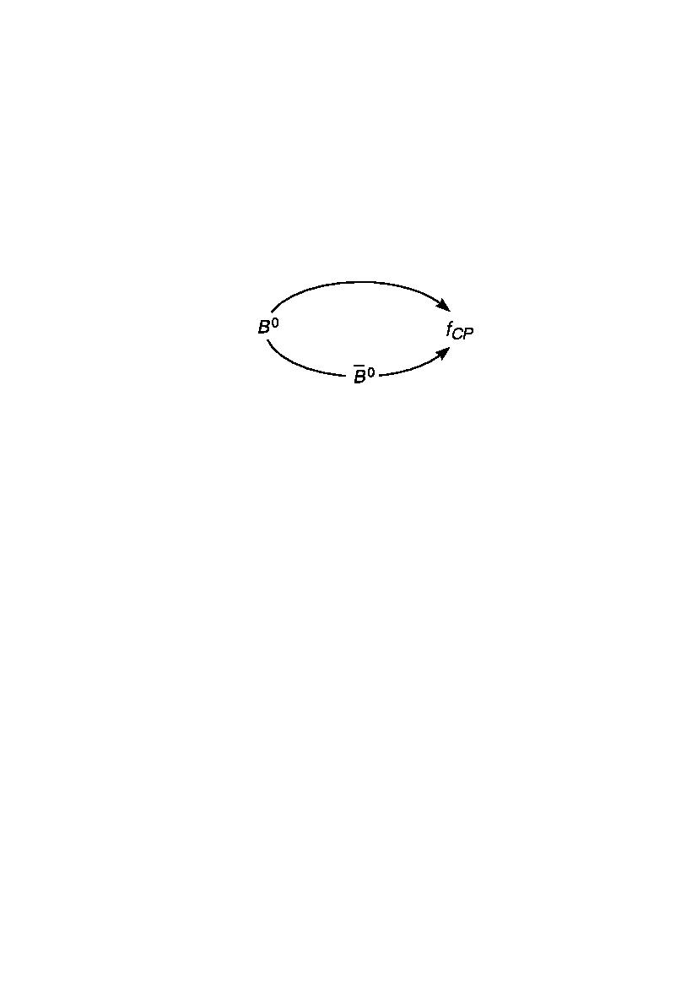
Angles are accessible through CP violating measurements
Direct also with B⁺
A₁
B⁰
direct
f_{CP}
γ
Interference
mixing-decay
A₂
α,β
A₁
M₁₂
mixing
Γ₁₂
A₂
B⁰
Analogy: “Double-Slit” Experiments with Matter and Antimatter
source
In the B experiment, we must choose final states that both a B⁰ and a B⁰ can decay into.
We perform the B experiment twice (starting from B⁰ and from B⁰). We then compare the results.
In the double-slit experiment, there are two paths to the same point on the screen.

Slide 16



Three types of CP violation
CP violation if
CP conjugate of
CP violation CP in mixing :
CP violation in decay (« direct CP») :
Only one existing for charged B
γ measurement
CP violation in the interference between mixing and decay :

Slide 17
CP violation in the decay
alters sign under CP
(weak phase)
CP-conjugated amplitudes :
CP invariant
(strong phase)
Direct CP violation requires at least two amplitudes with different weak and strong phases
u
K⁻
s
W
W
b
u
b
s
K⁻
B⁻
V_{ub}
π⁰
B⁻
t
u
u
u
u
u
u
π⁰
In this case weak phase difference : γ

Slide 18
Interferences between b->c and b->u transitions
α
γ
β
0
1
V_{us}
u
b
u
K⁻
V_{ub}
D⁰
W⁻
s
W⁻
c
b
c
B⁻
V_{cs}
s
B⁻
V_{cb}
D⁰
K⁻
u
u
u
u
Need to have modes for which D⁰ and D⁰ are undistinguishable …

Slide 19











CP
Sensitivity on γ depends strongly (linearly !) on the r_{B} value…
Direct CP violation occurs because there are
two different ways of reaching the same final state

Slide 20
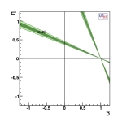
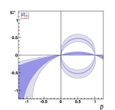
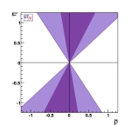
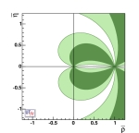
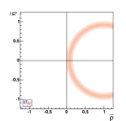
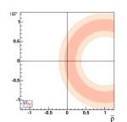
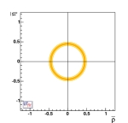
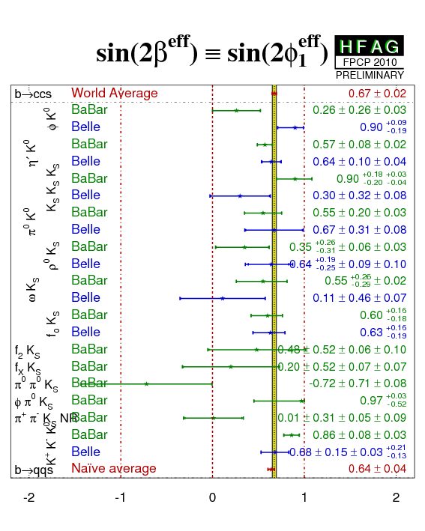
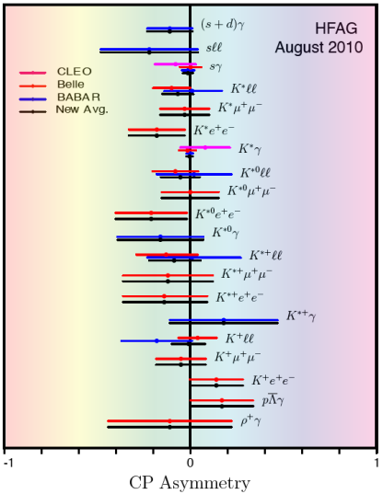
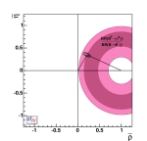
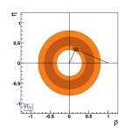
What happened since….
Many new (or more precise) measurements
to constraint UT parameters and test New Physics
sin(2β)
α
γ
sin(β+γ)
β_{s}
the angles..
Δm_{s}
Δm_{d}
V_{ub}/V_{cb}
the sides...
CP asymmetries in
radiative decays
B→Κ∗(ρ)γ
B→τν
…
Rare decays...
sensitive to NP

Slide 21
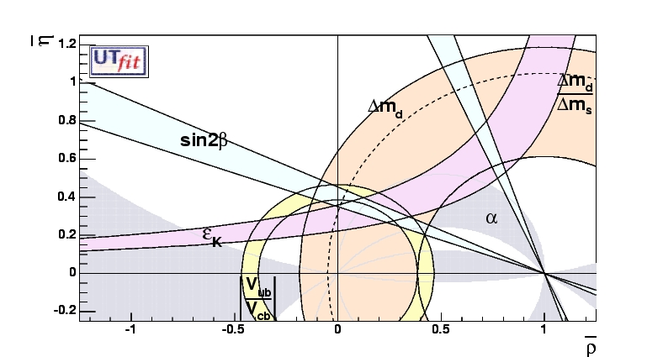
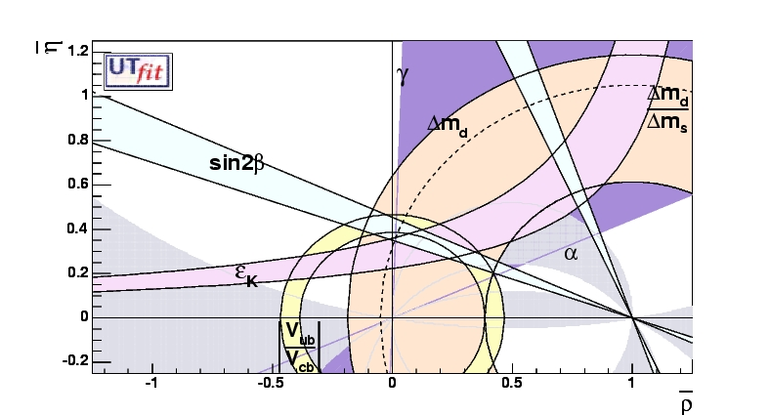
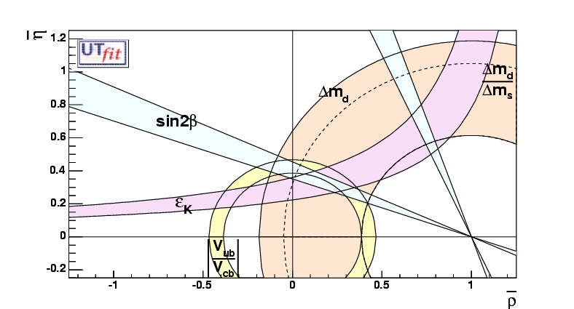
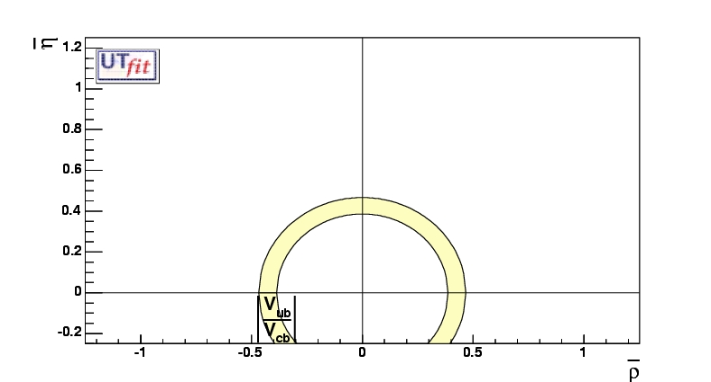
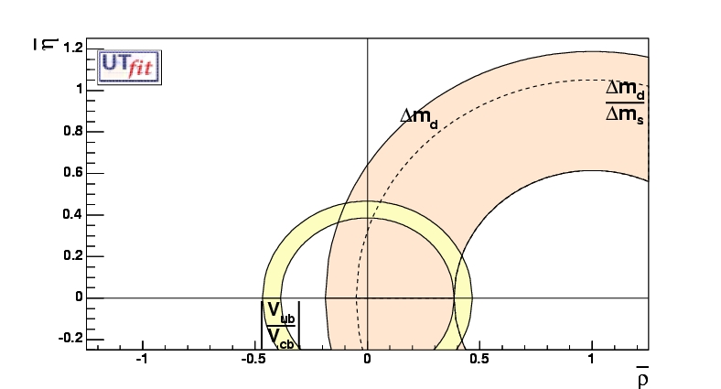
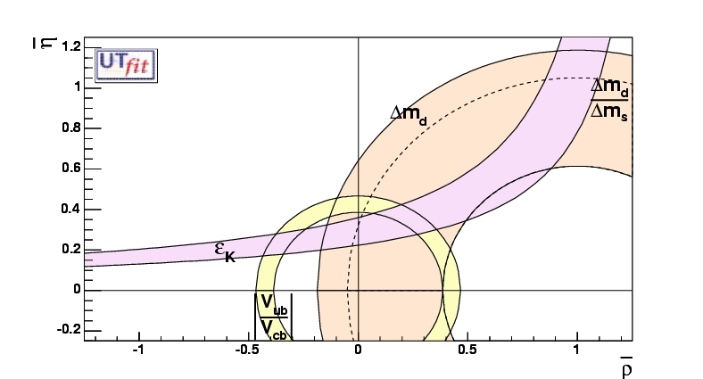
B→ccs : φ₁ /β
B→ππ/ρπ/ρρ : φ₂/α
ε_{K :} CPV in K decays
b→cℓν and b→uℓν
B_{d} and B_{s} mixing
B→DK : φ₃/γ

Slide 22
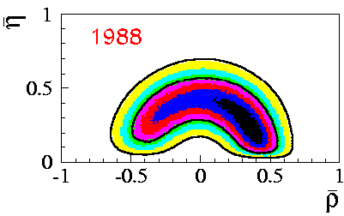
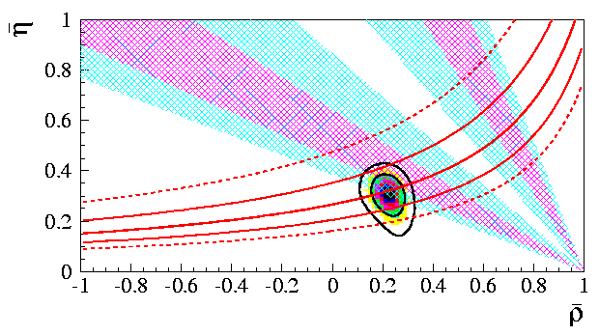
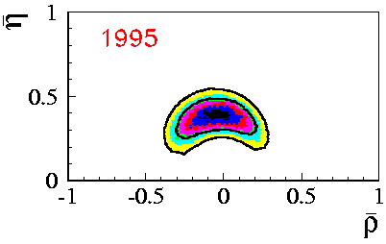
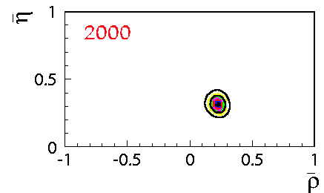
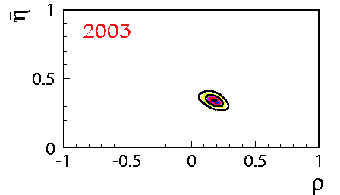
From Childhood
Dominated by
Δm_{d}, V_{ub},V_{cb}, εK, limit on Δm_{s} and Lattice
To precision era
In ~2000 the first fundamental
test of agreement between
direct and indirect measurements of sin2β

Slide 23
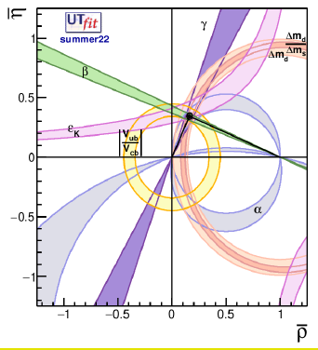
Global Fit within the SM
Coherent picture of FCNC and CPV processes in SM
All the constraints
Look compatibles !
CKM matrix is the dominant source of flavour mixing and CP violation

Slide 24
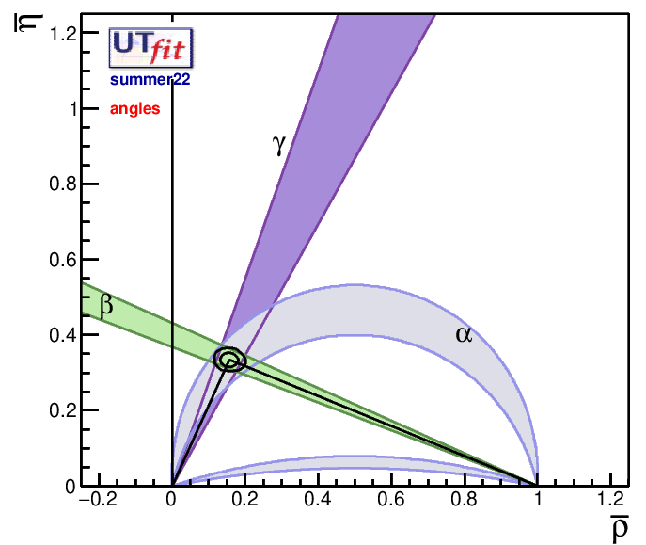
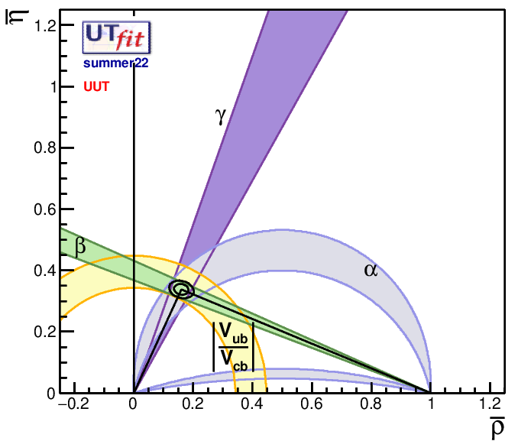
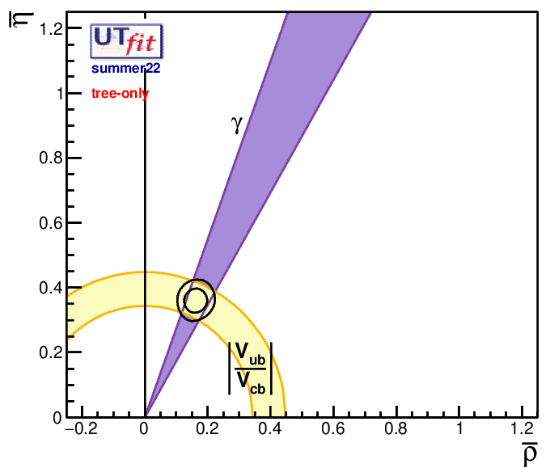
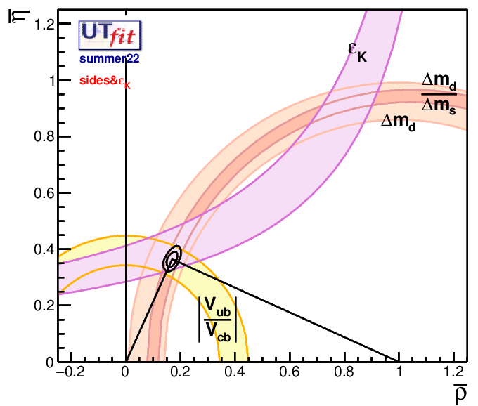
Some interesting configurations
~11%
ρ = 0.160 ± 0.017
η = 0.338 ± 0.011
Angles only
Universal Unitary Triangle
~3%
~15%
Tree-level
processes:
Semileptonic
and DK
B decays
ρ = ±0.162 ± 0.024
η = ±0.361 ± 0.025
~7%
Sides and e_{K}
→ reference
for model
building
“Tree-only”

Slide 25
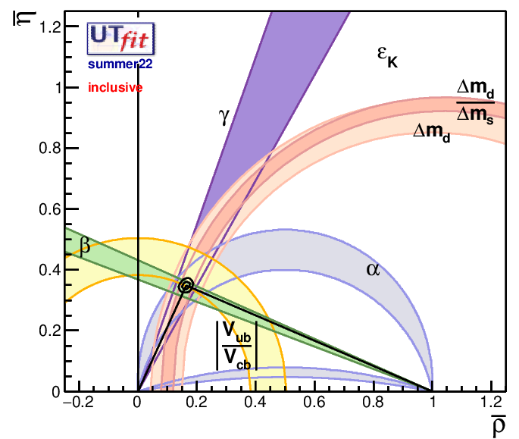
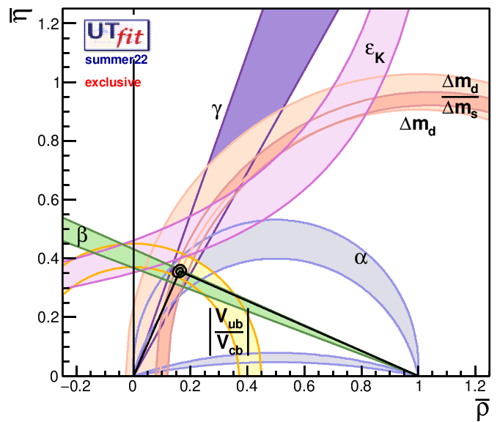
Inclusive vs Exclusive
only inclusive values
only exclusive values
ρ = 0.164 ± 0.009
η = 0.348 ± 0.009
sin2β = 0.753 ± 0.028
ρ = 0.162 ± 0.009
η = 0.356 ± 0.009
sin2β = 0.755 ± 0.020

