Slide 1
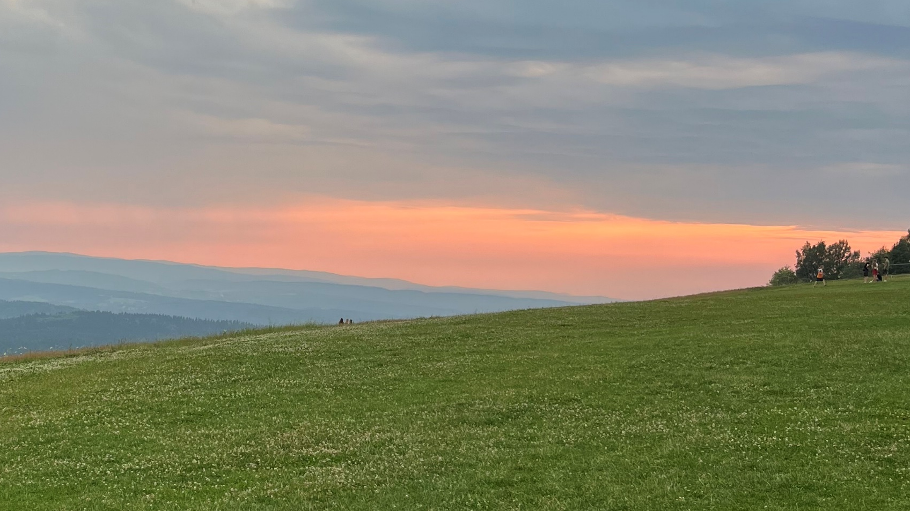
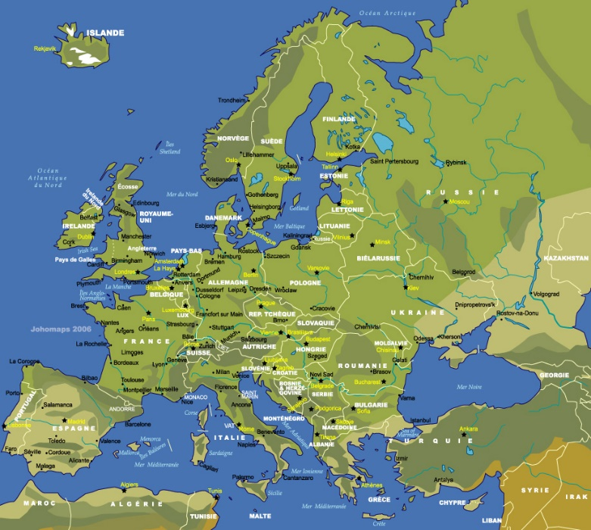









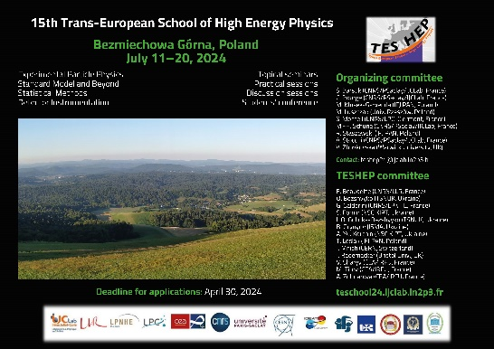

Concluding remarks
on behalf of the Organising/Program Commitee
19th July 2024
Kyiv, Kharkiv, Sumy, Paris-Orsay, Krakow, Warsaw, Rzeszow, Tbilisi, Bristol, Bologna, CERN, Warwick, Edinburgh, Olomouc Marrakech, Casablanca
Edinbourg
Bristol
Warwick
Warszawa
Kyiv
Sumy
Orsay
Krakow
Rzeszow
Kharkiv
Olomouc
CERN
Bologna
Trieste
Tbilisi
Casablanca
Marrakech

Slide 2
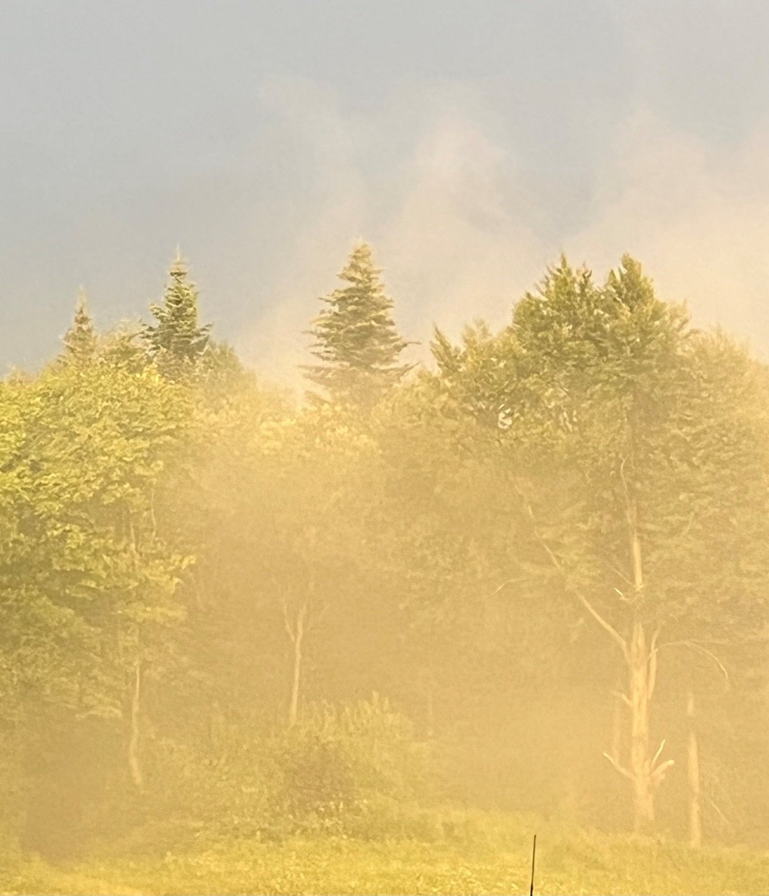
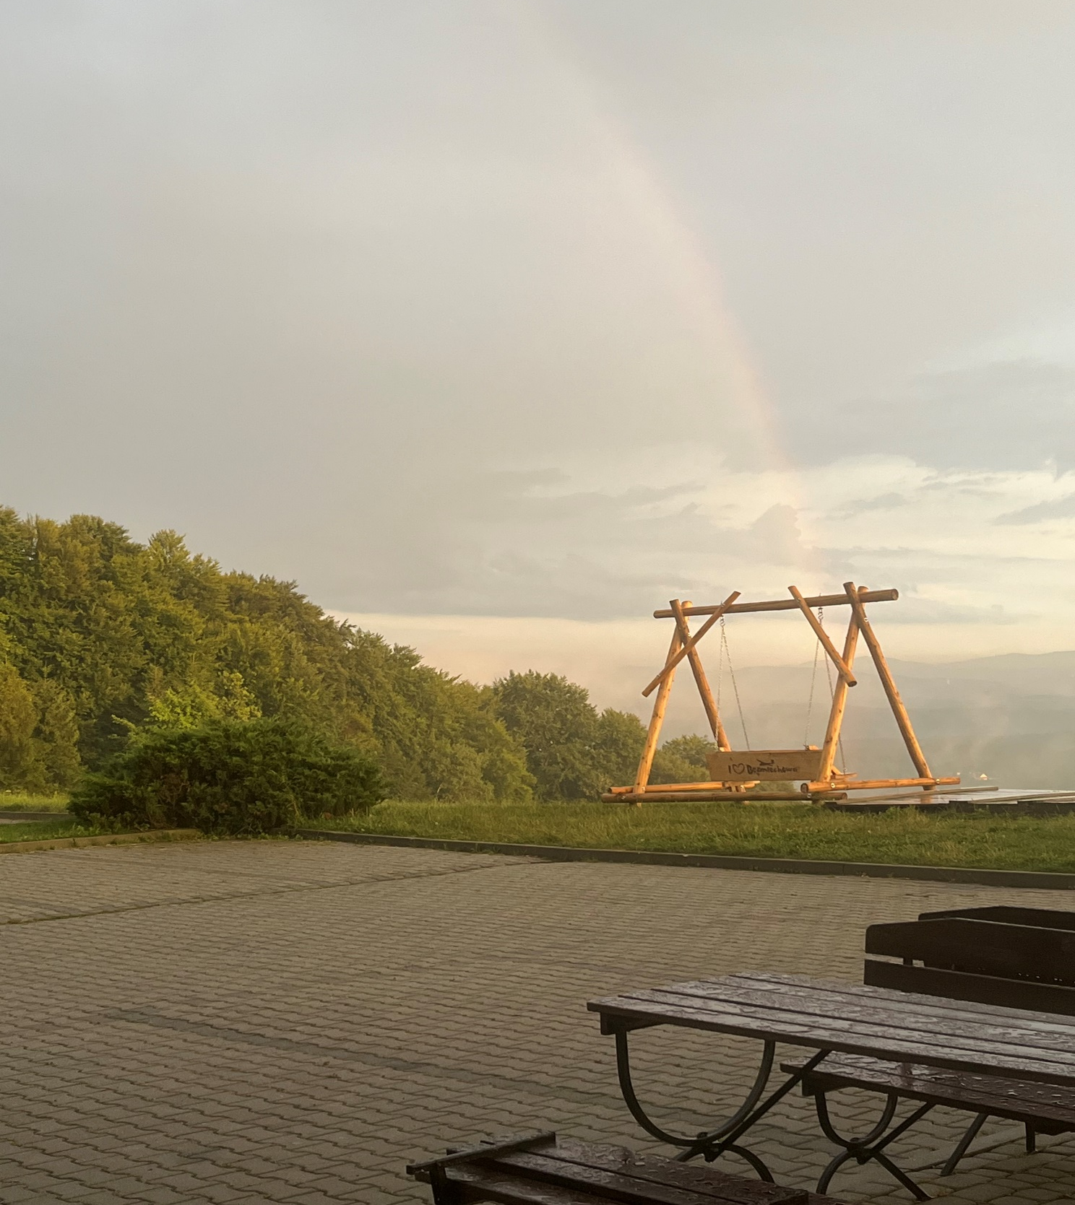
Nice and inspiring to have a school in a such wonderful place

Slide 3
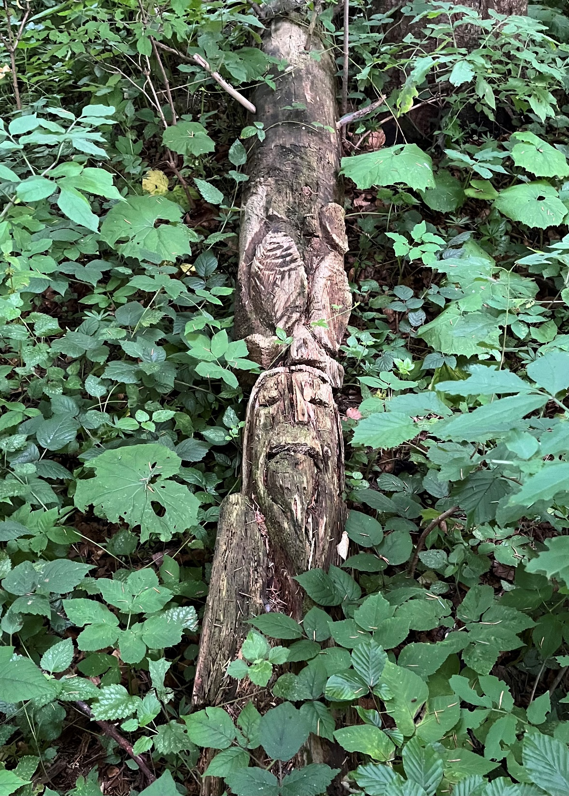
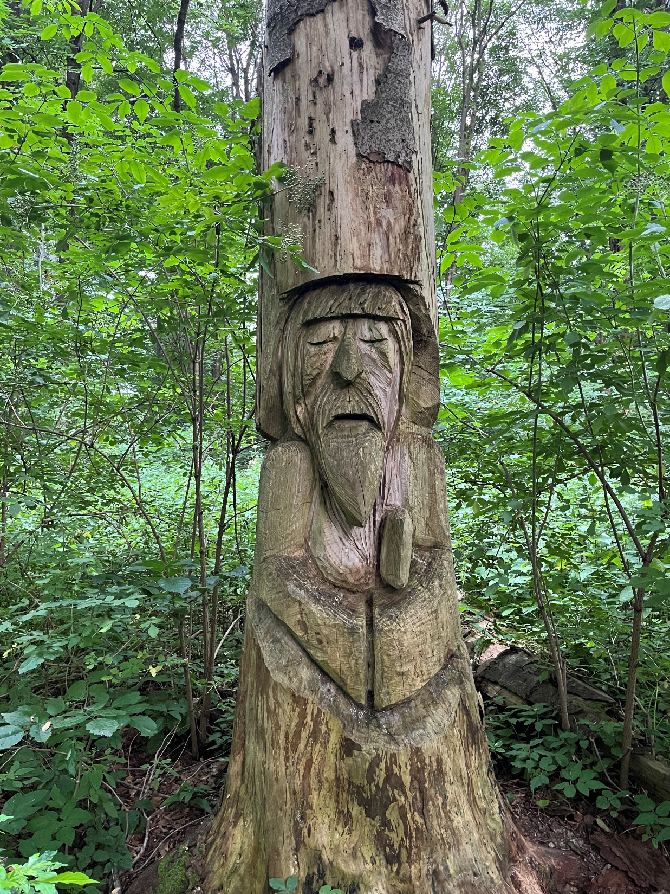
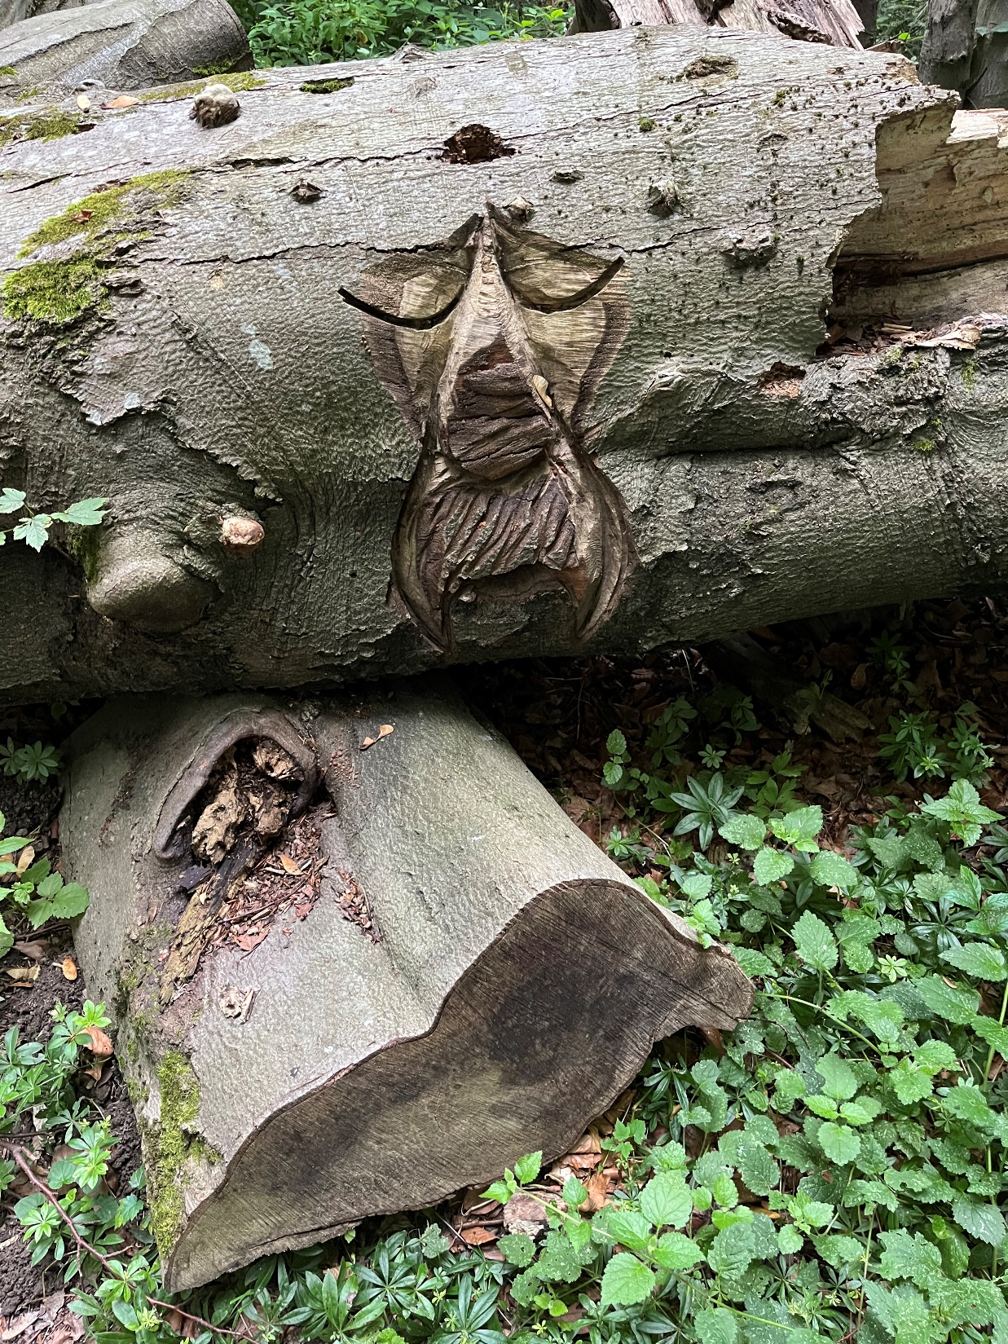
Ideal place to search for new … Strange … particles…and to find them !

Slide 4

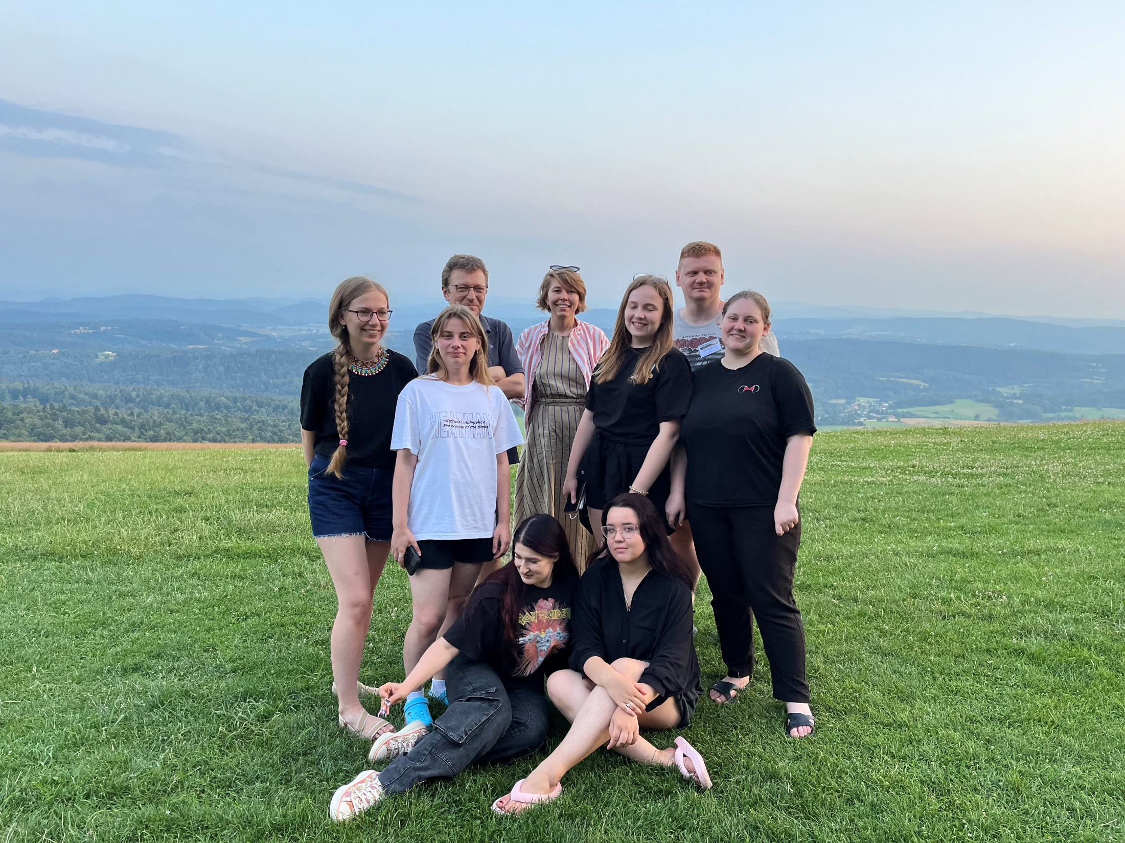
Ukraine is close by !
Ukraine

Slide 5
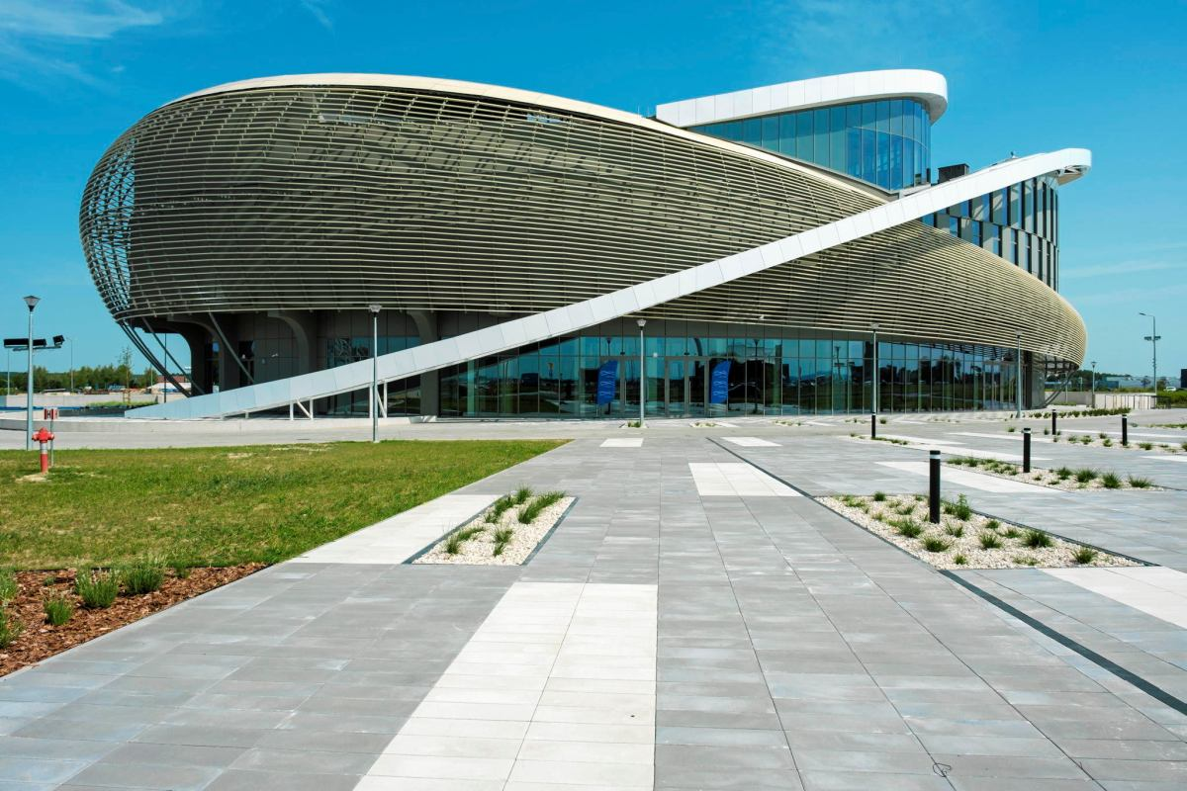
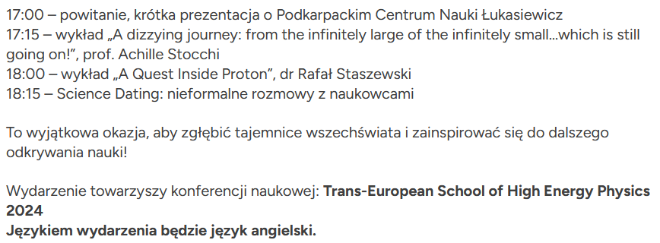
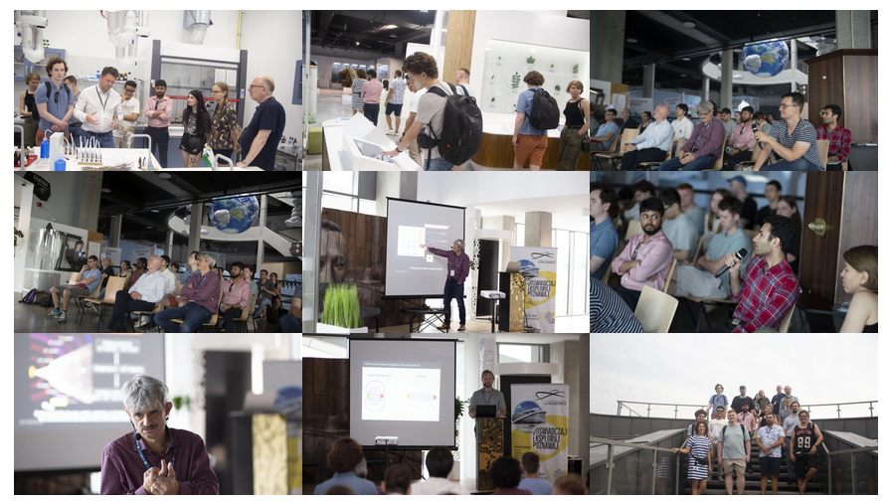
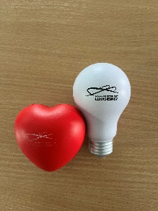
Event 100 years of Georges Charpak
Before the school an event was organised for the
100 years of Georges Charpak
Podkarpackie Centrum Nauki Łukasiewicz (Subcarpatian Science Centre Łukasiewicz)
Rzeszów-Jasionka

Slide 6
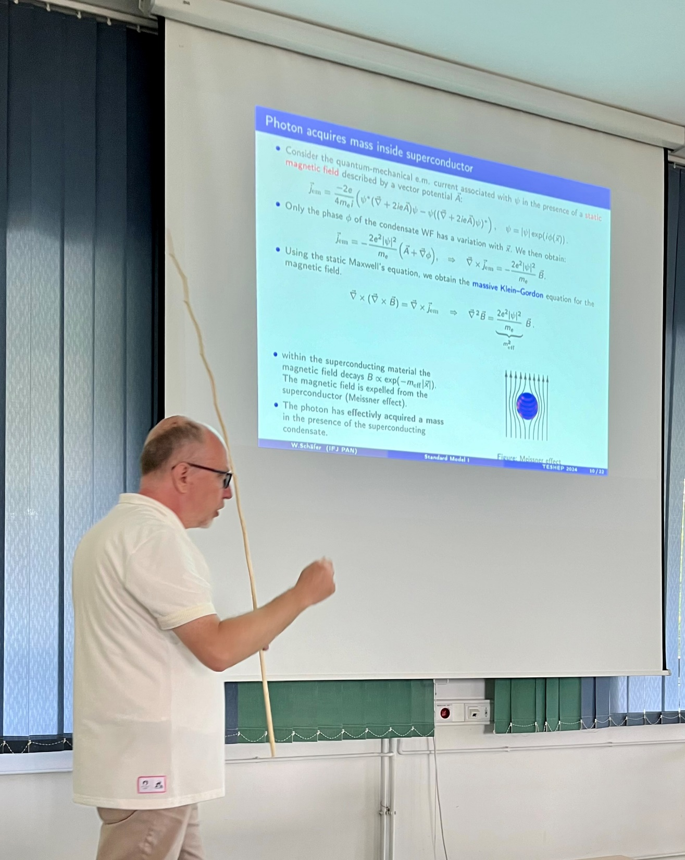
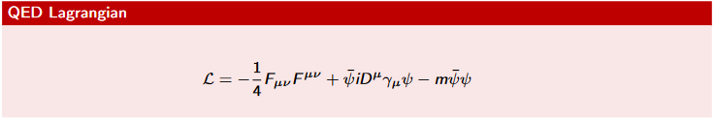

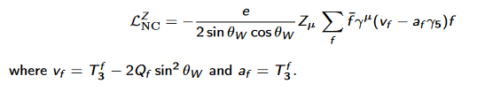
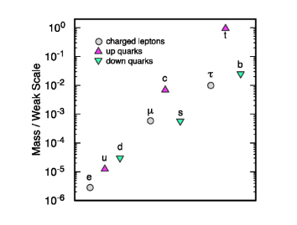
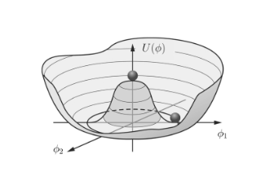
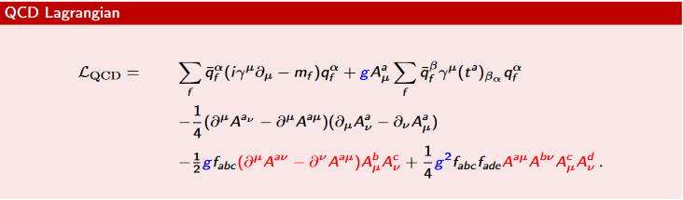
Standard Model in 4hours
The basics…
(Gauge) Symmetries are of prime importance
Wolfgang
Neutral sector is particuluarly new !
Higgs mechanism
Not forgetting QCD !
But we are all convinced that we should go beyond the SM !

Slide 7
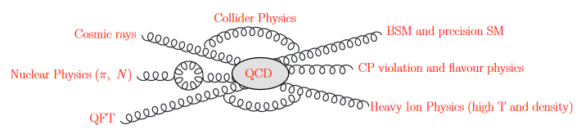
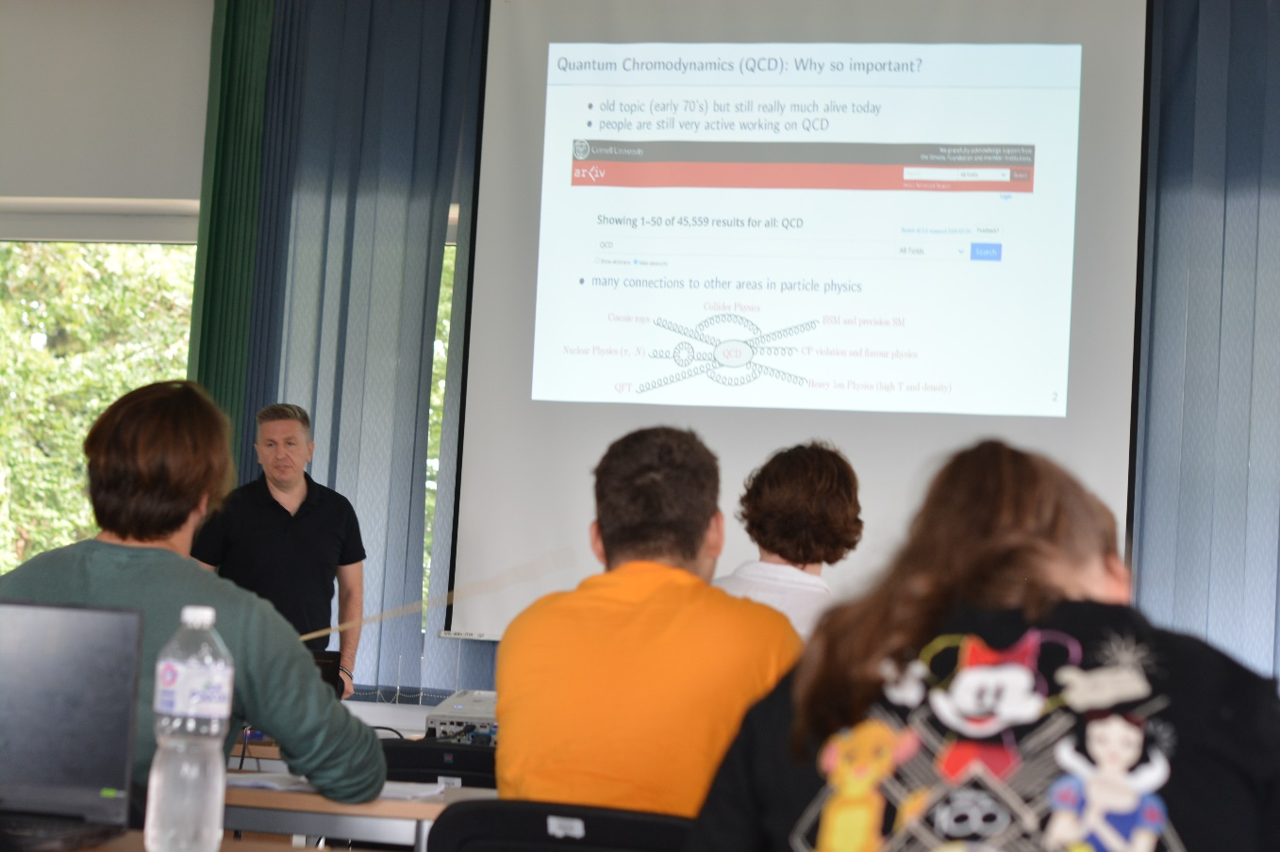
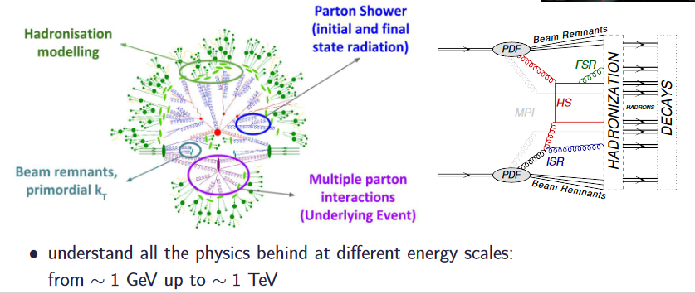
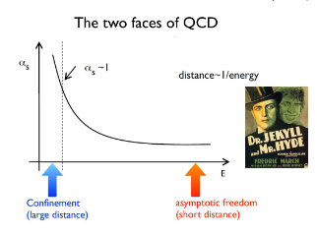
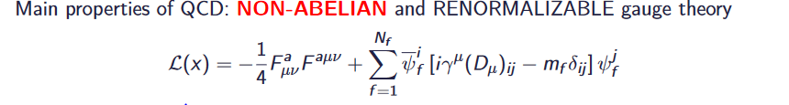
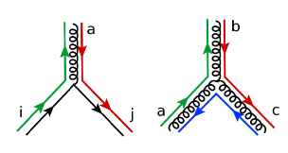
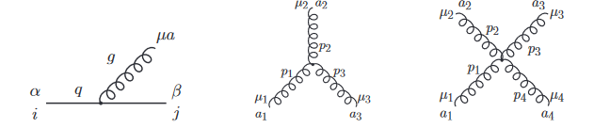
Introduction to QCD
Rafal
The global symmetries of Quantum Chromo Dynamics and their consequences
We learned a lot on QCD Lagrangian

Slide 8
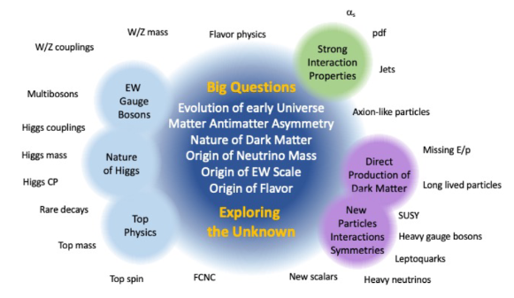
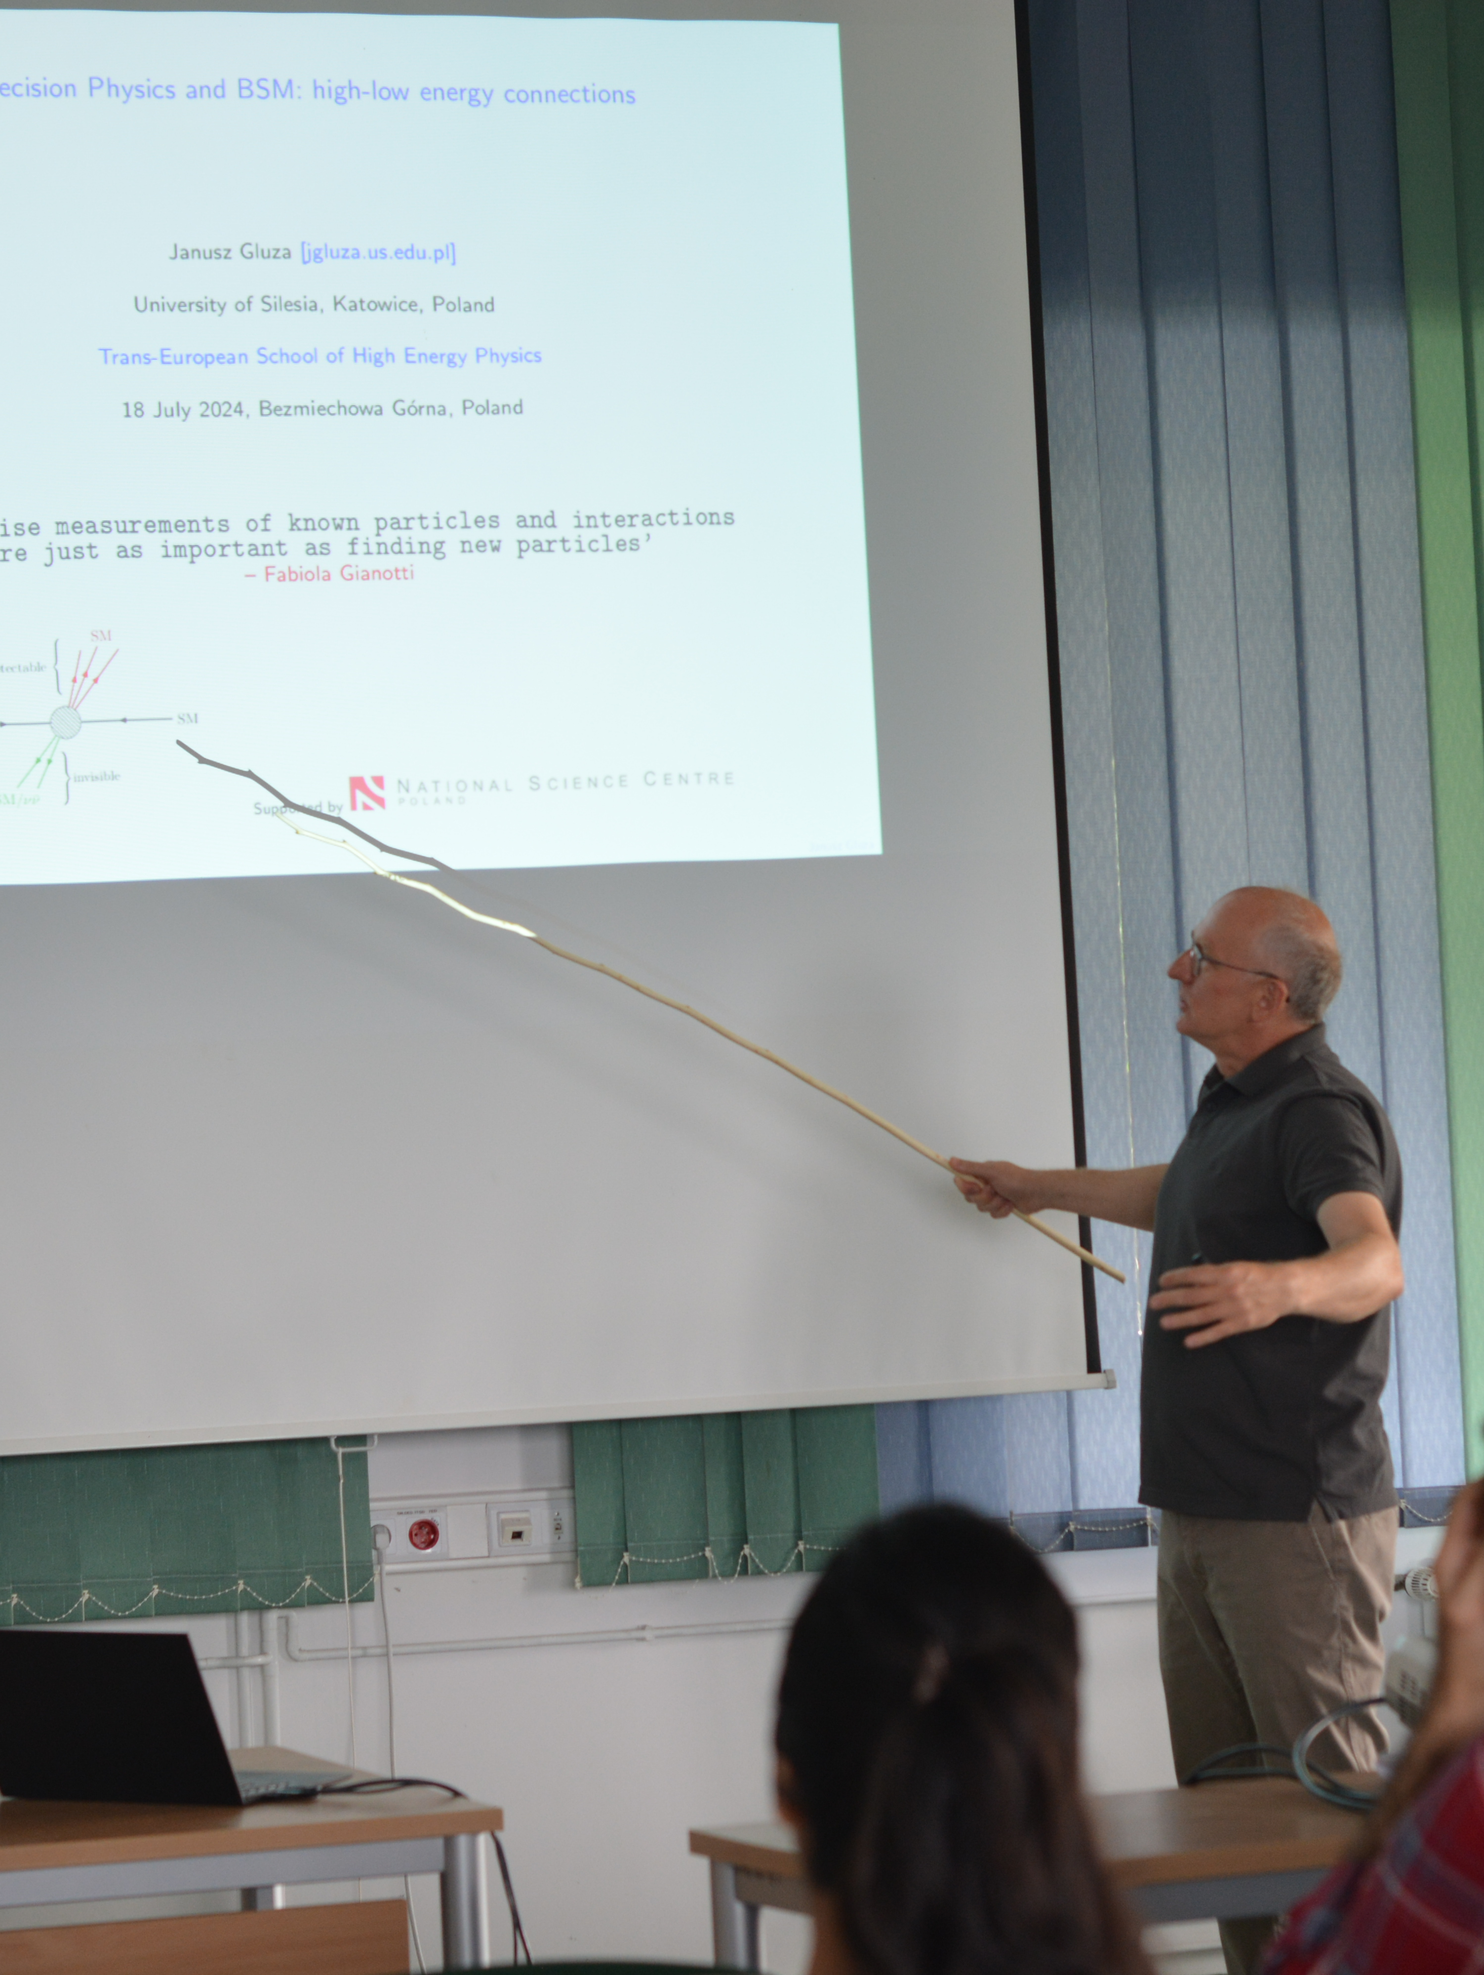
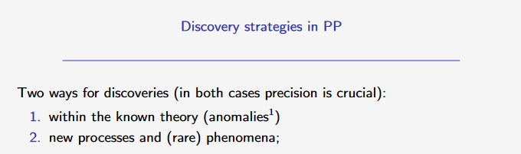
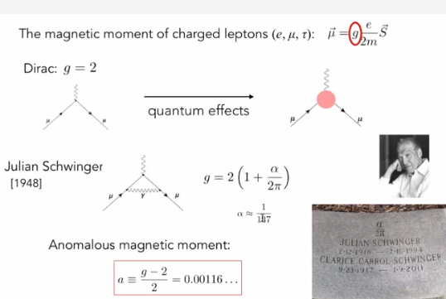
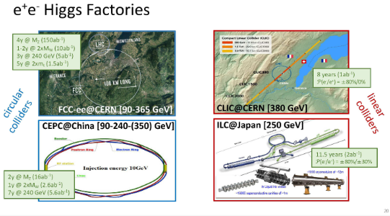
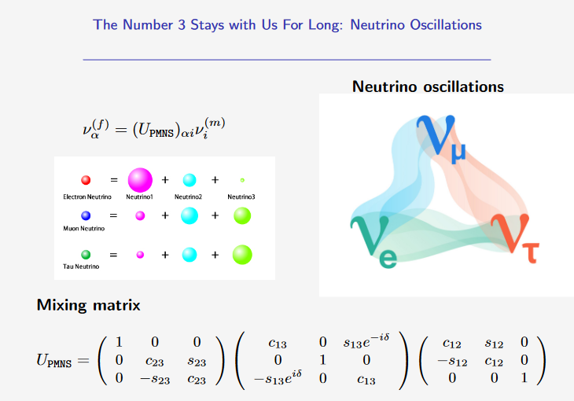
Beyond Standard Model
So far all it is working too well !!
Janusz
WE NEED PRECISION
And not forget neutrinos !

Slide 9
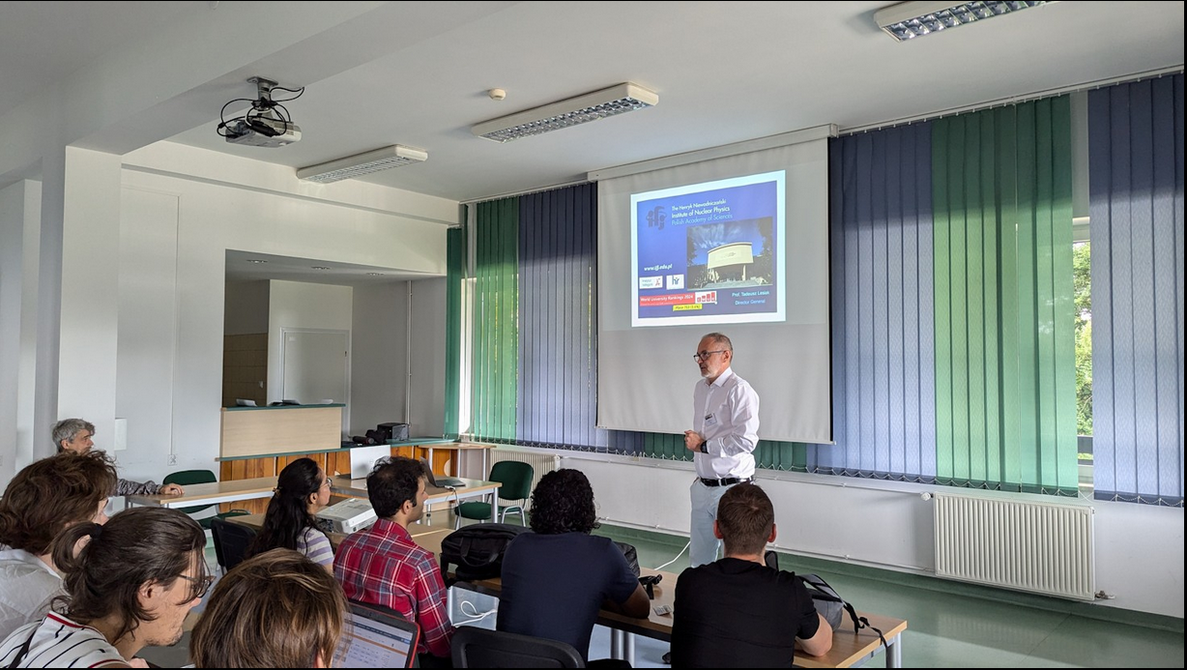
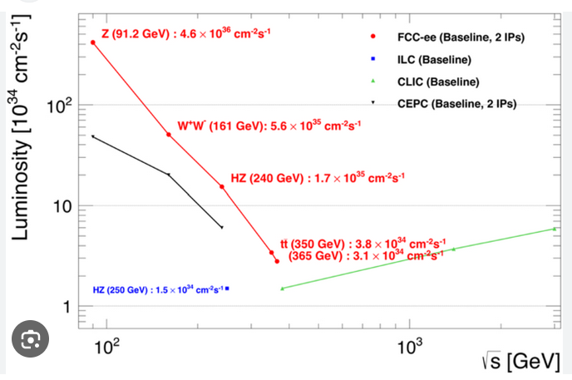
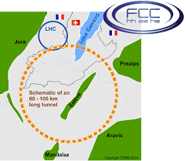
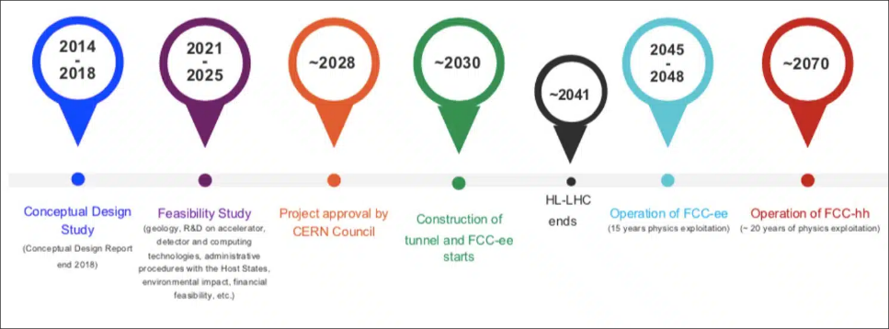
The future : FCC
Tadek
FCC – ee as a first step
To go to FCC-hh after ?

Slide 10
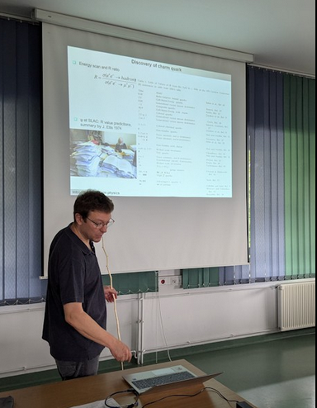
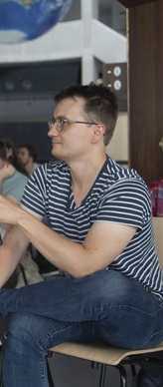
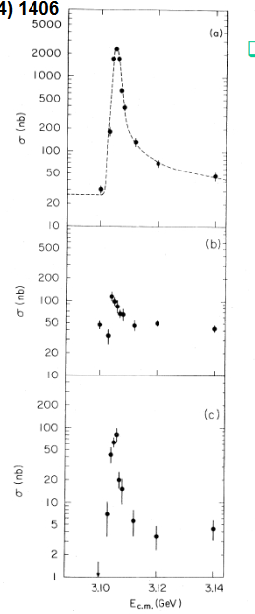
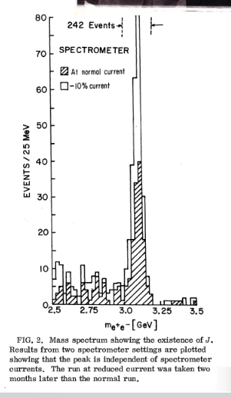
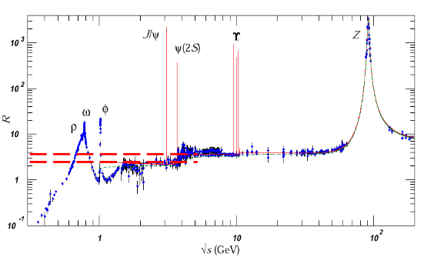
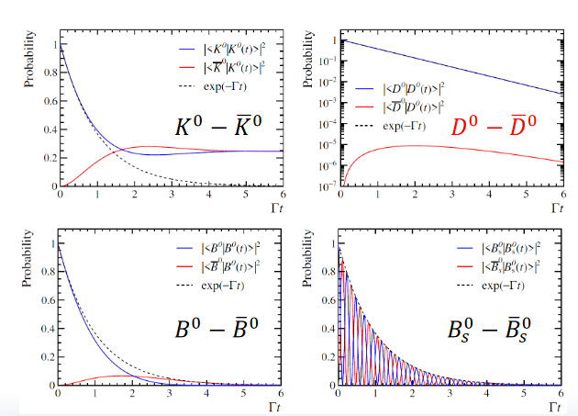
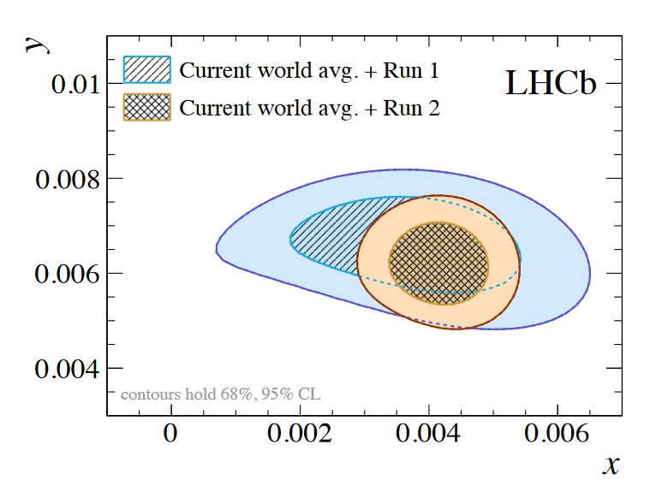
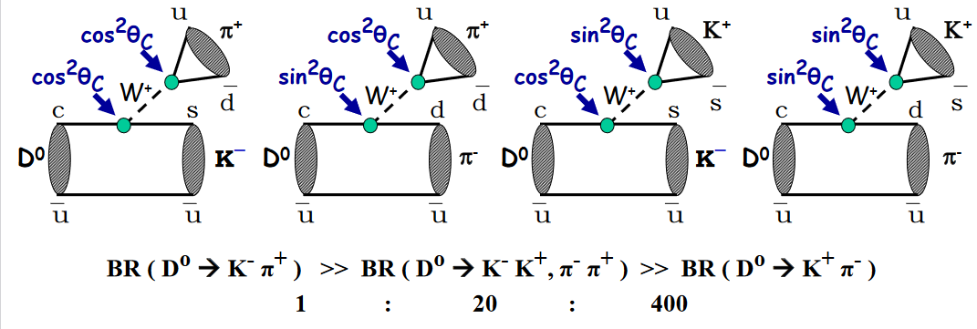
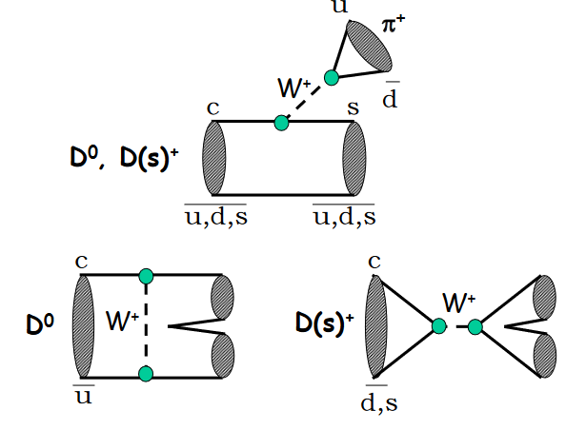
Charm discovery
From discovery…
Sergey and Guillaume
To oscillations…. and CP !
…To detailed studies of decays
CP Violation in charm discovered at LHCb !

Slide 11
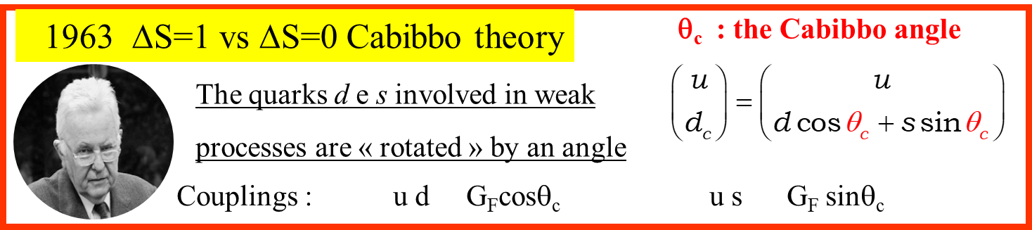
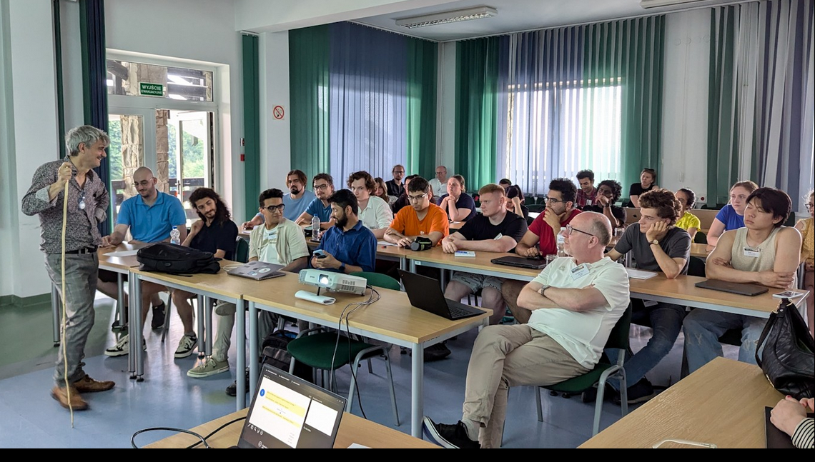
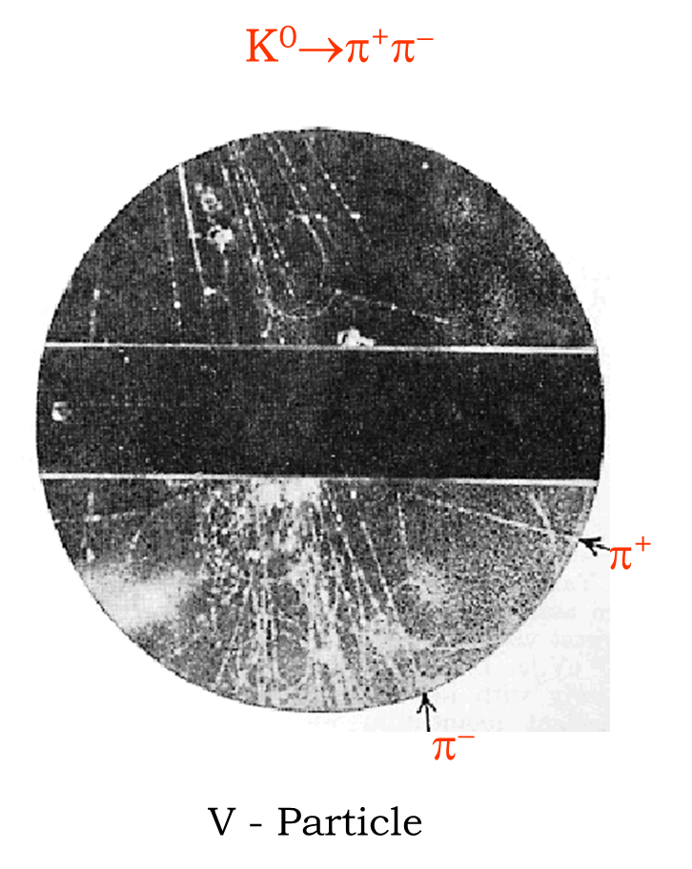
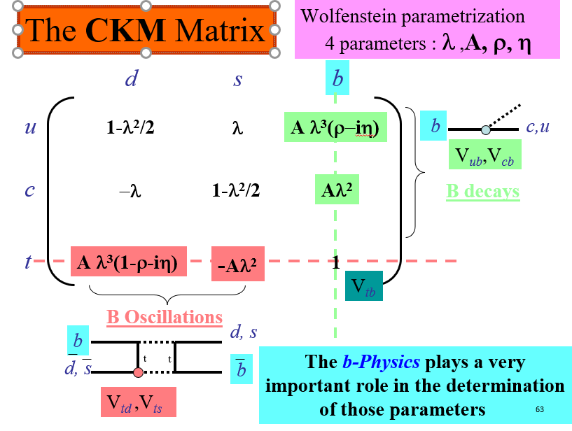
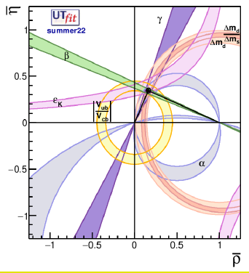

Flavour Physics…
And CP Violation
Achille
Discovery : absence of
New Particles up to the
~2×Electroweak Scale !

Slide 12





…if you want discovery… you have to be sure…
…if you want precision…you have to deal with small errors…and systematics..
…if you want to master all that…
you need JONAS !
MonteCarlo technique to calculate π
Jonas

Slide 13







Concepts for INSTRUMENTATION and building detector
From concepts
Sergey
To complex detector

Slide 14









Accelerator Physics
Accelerators are essential instruments for our research
Pascal
Linac 4
Transfert lines
LHC is the machine of all the challanges !
Dump
Collimations
Synchrotron oscillations:

Slide 15



Cosmic rays and CREDO
Gravitational waves
Robert

Slide 16








Challenging Future physics
Vincenzo
We have never seen anything like this!

Slide 17



Seminars from professors !
Mariola
Event-by-event correlations
in heavy ions
Marta
Iwona
Photon induced processes in pp collisions
Photon induced processes
in pp collisions
photon-photon fusion
in heavy-ion collisions

Slide 18


From theory → experiments → data analyses : the Hands-On !
And you have to be smart and well educated to perform analysis…
Rafal
Valeriia
And you need Rafal and Valeriia
and Guillaume !

Slide 19

We had a seminar of the CERN History and his mission.
Christoph
Thanks to CERN for supporting the School since the beginning !

Slide 20





LectureTime @ TESHEP2024
And we also had two interesting
« Hot Topic discussion »
Class were almost everytime full !
Class were almost everytime full !
Asking many intersting questions
Very concentrated !
Which are the open questions in particle physics / at large ?
From observations … and/or From other reasons
Which are the priority in the next decades : Experiment / Theory
Is particle physics (high energy) useful ?
Has particle physics an important impact on other domains ?
… participating…

Slide 21



The preparation of the presentations was very intense

Slide 22






RELAX AND FUN TIME !
Excursion at Sanok
we discovered a very nice region
Back to school

Slide 23

RELAX AND FUN TIME !
Excursion at Sanok
we discovered a very nice region
Back to school

Slide 24


Slide 25






NICE MOMENTS@Bezmiechowa Górna
Nice night singing session

Slide 26



MAGIC MOMENTS@Bezmiechowa Górna

Slide 27










The main actor of the week …
Cytrynowka : The polish limoncello ! …

Slide 28





Football as usual as always !!
Spectators were passionated in the stadium !
Contacts were… friendly !!
Ball control not always perfect…
At the end everybody was happy, tradition was kept… professors win !

Slide 29

Student’s presentation were good and
professionally prepared…
We had a Conference
22
fast communications..
?
?
?
?
?
ALL STUDENTS WOULD DESERVE A PRIZE

Slide 30


Prize for the best presentation
Oleksandr Povitchan
But we want also to mention for their presentation :
Vitali Dididze, Renata Osypova, Zak Williams, Baraa Yahya and Shenghui Zeng

Slide 31

Prize for the best questions
Zak Williams
Really one of the best school in terms of questions asked and quality of the questions!
But we want also to mention for their questions and participation :
Saleh Bashiri, Vitali Dididze, Frantisek Hruby, Oleksandr Povitchan, Jan Straka, Shreya Sharma, Adam Watroba, Baraa Yahya, Shenghui Zeng

Slide 32
Prize for the best lecture
?

Slide 33



To the local organisers
- for making this school possible
- for the UNPECCABLE organisation in
a such beautiful and convenient place
Thanks to
Czeslan –Dean Politechnik of Rzeszow
Tadek – Director of IFJ
Marta – Dean University of Rzeszow
But this it has been possible also thank to practical organization and in particular to
Catherine Bourge

Slide 34

BUT MAINLY AND ABOVE ALL …
MANY THANKS TO
RAFAL
MARIOLA
The school was only possible thank to your work, enthusiasm
The organisation was more than perfect

Slide 35
We would like to have your feedback
A questionnaire will be sent to you !
Please take time to fill it up
Thanks for coming, have a safe
journey back home

