Slide 1
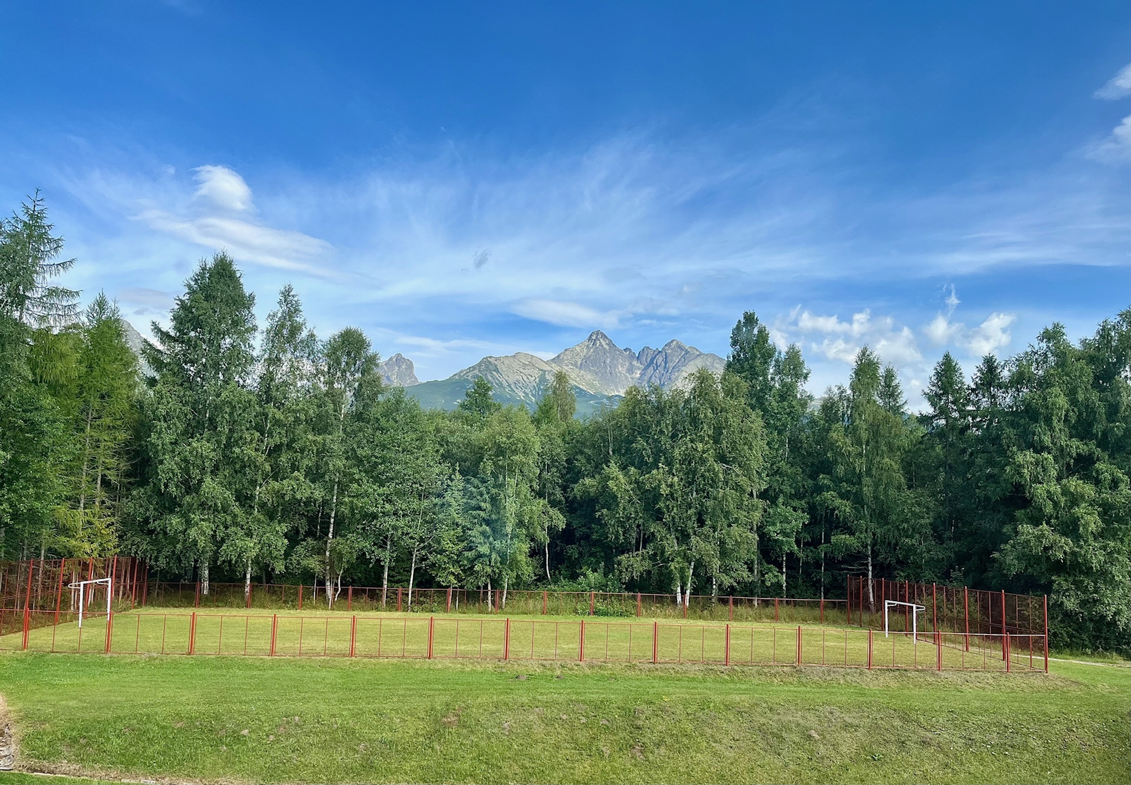
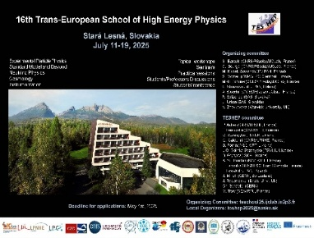

Concluding remarks
on behalf of the Organising/Program Commitee
18th July 2025
TESHEP 2025@ Stará Lesná

Slide 2
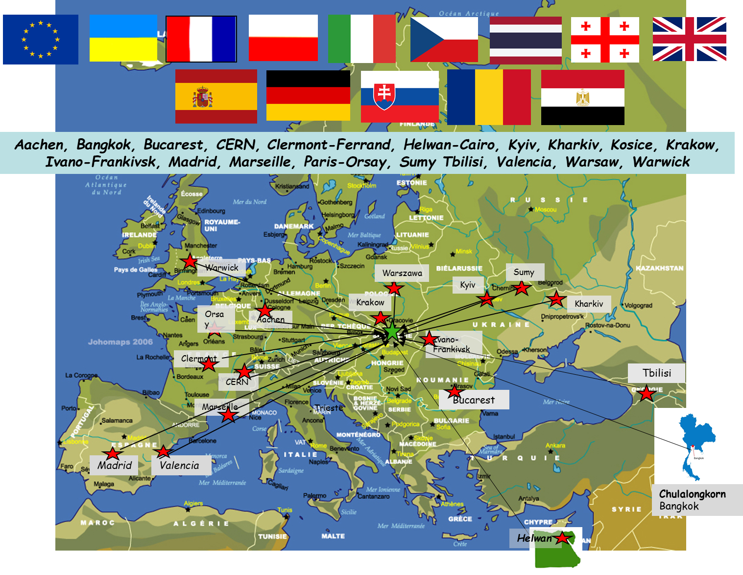
TESHEP 2025@ Stará Lesná

Slide 3
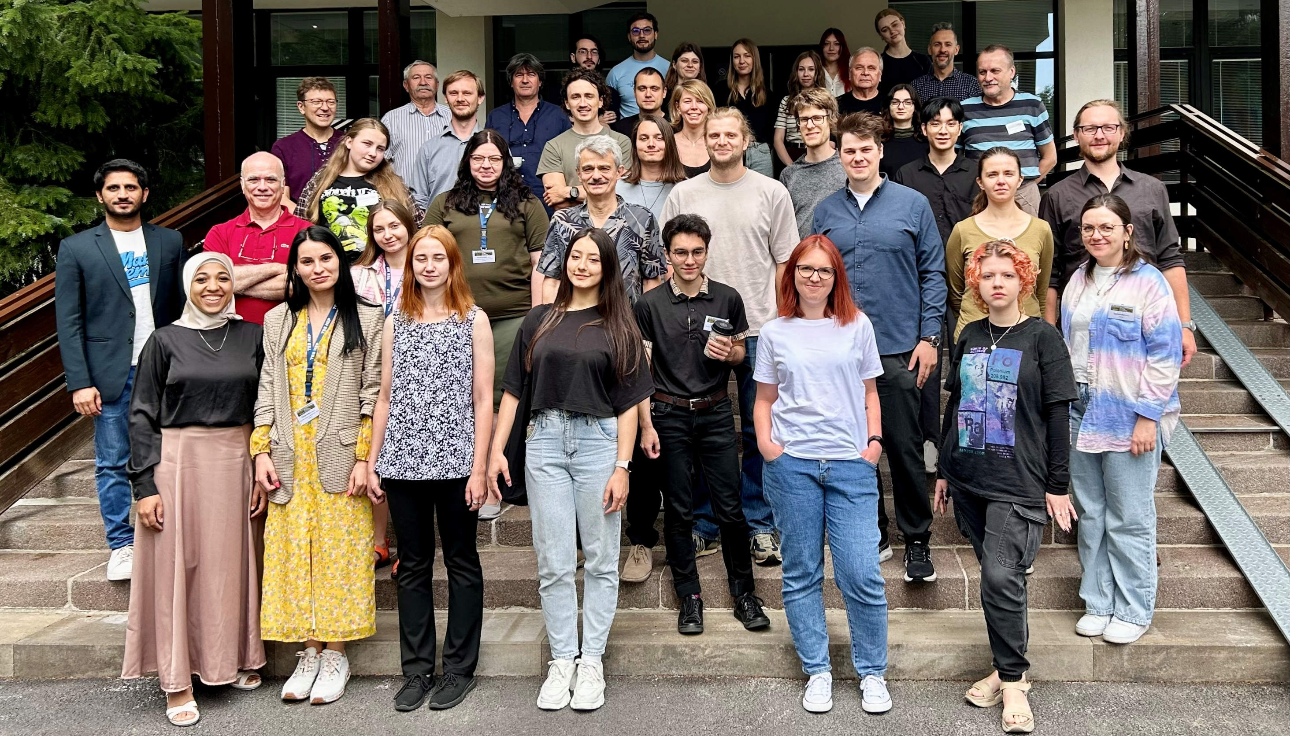
TESHEP 2025@ Stará Lesná

Slide 4
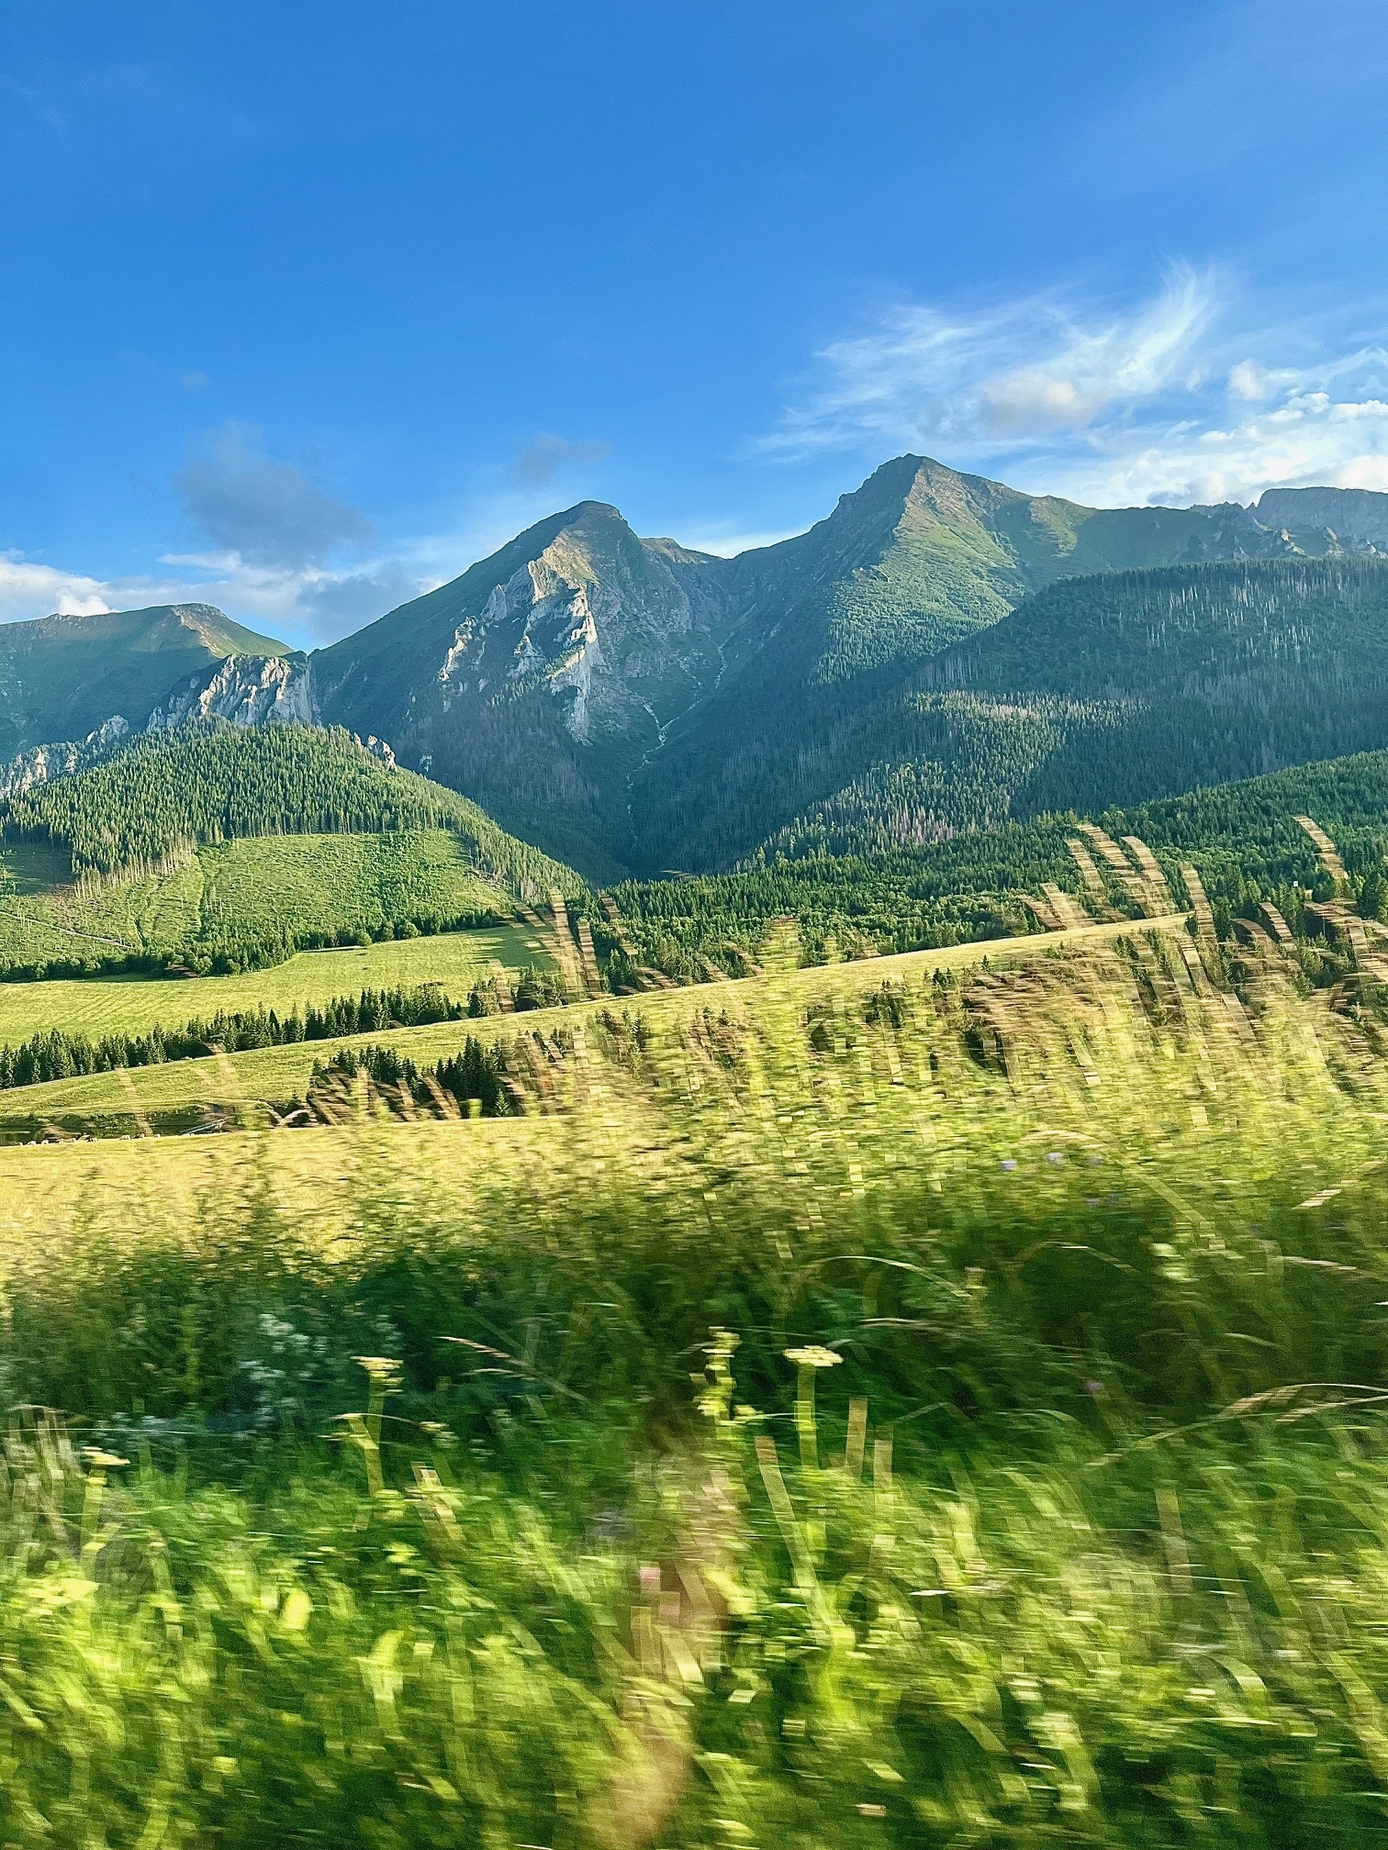
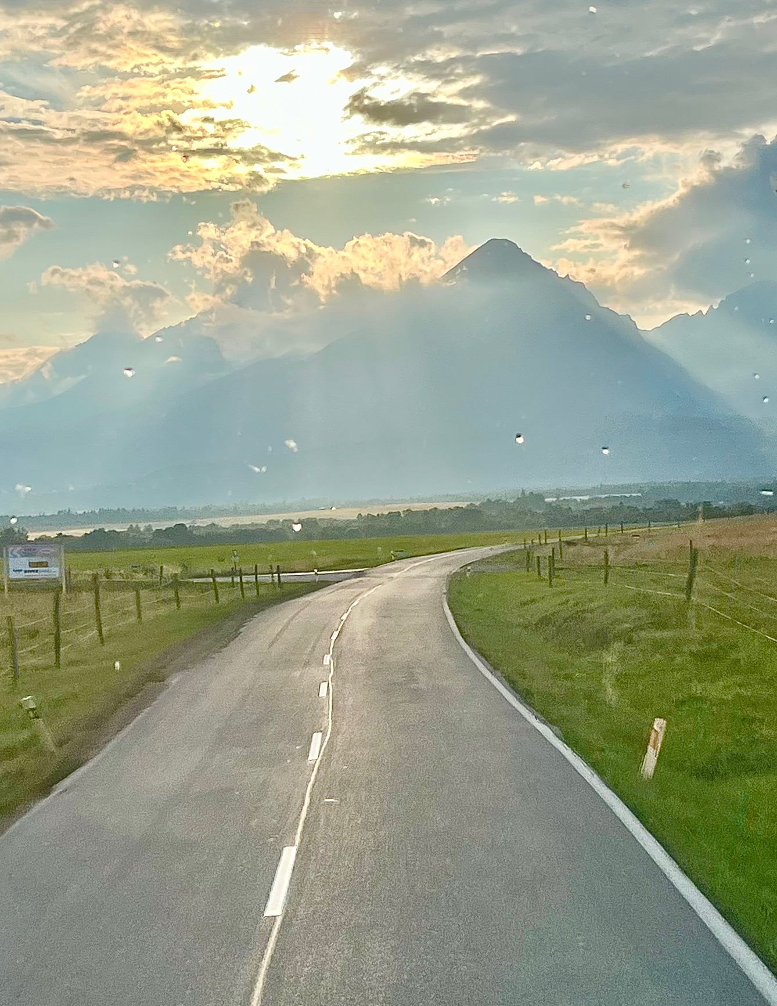
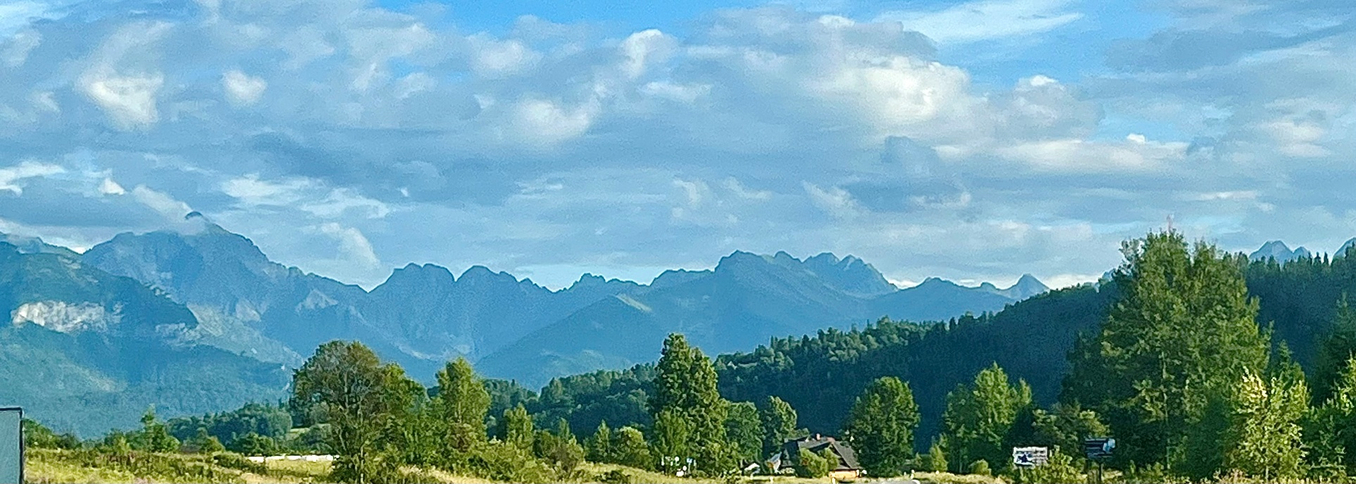
Nice and inspiring to have a school in a such wonderful place

Slide 5

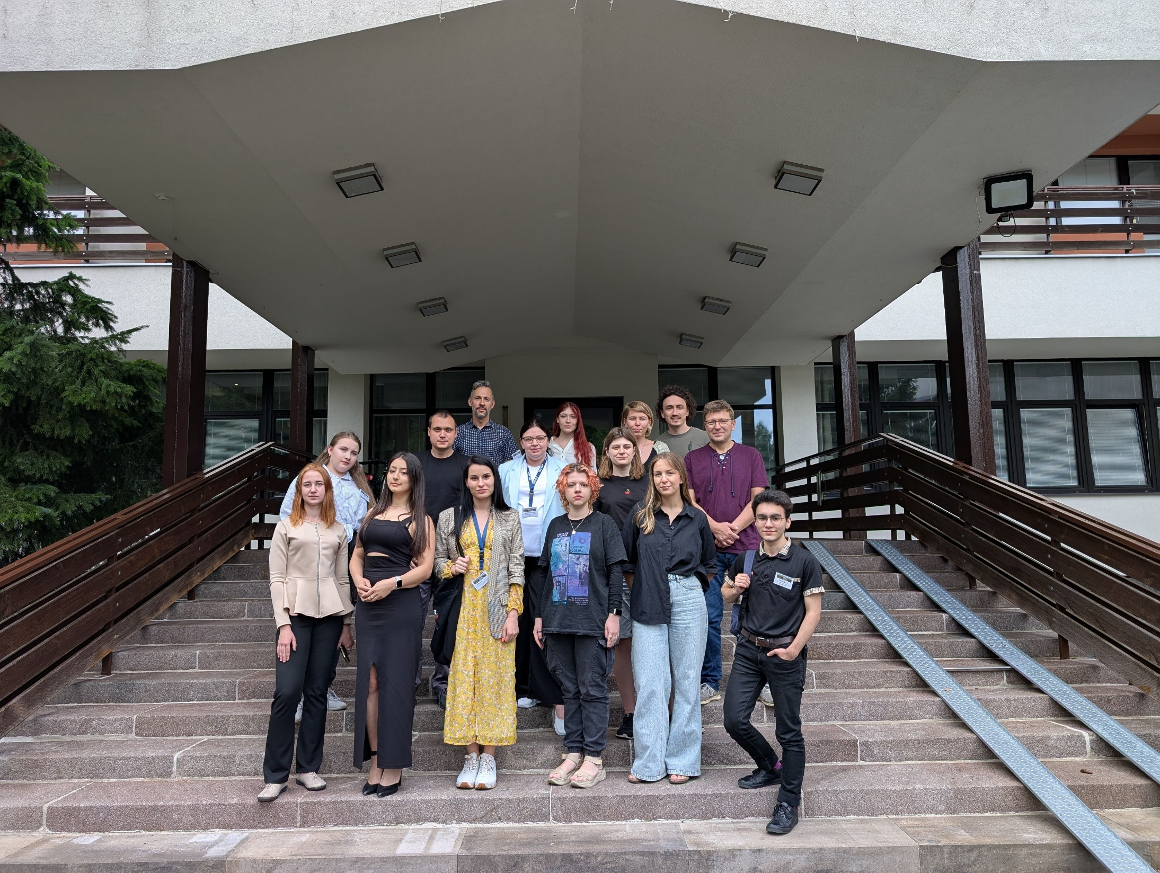

Ukraine
Ukraine is close by !

Slide 6
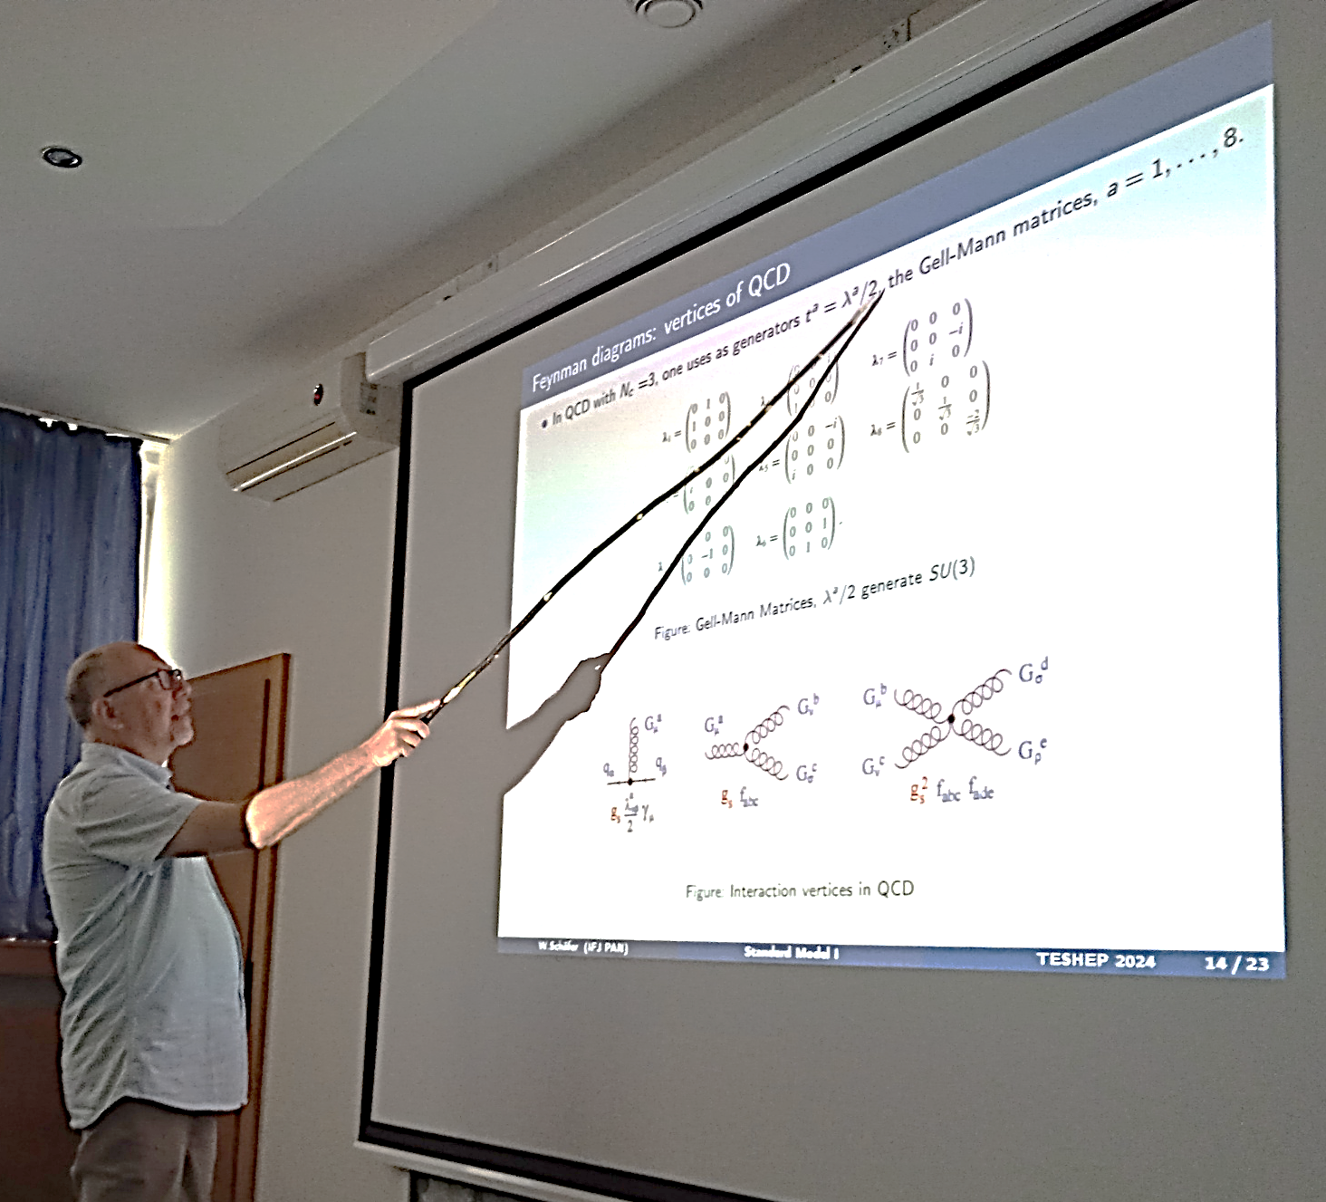
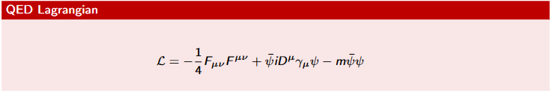

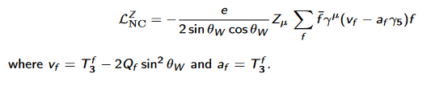
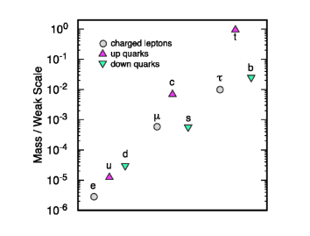
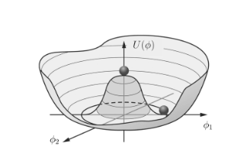
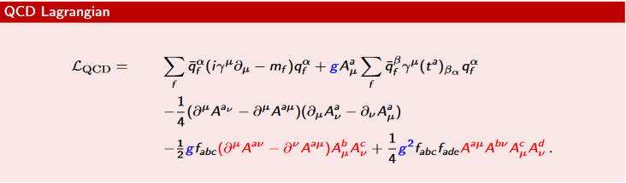
Standard Model
The basics…
(Gauge) Symmetries are of prime importance
Wolfgang
Neutral sector is particuluarly new !
Higgs mechanism
Not forgetting QCD !
But we are all convinced that we should go beyond the SM !

Slide 7
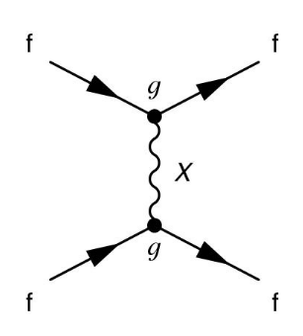
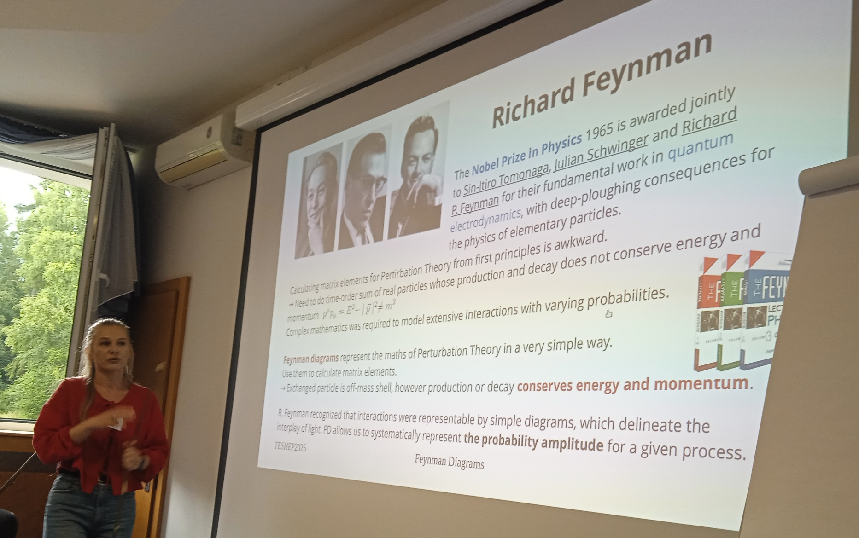
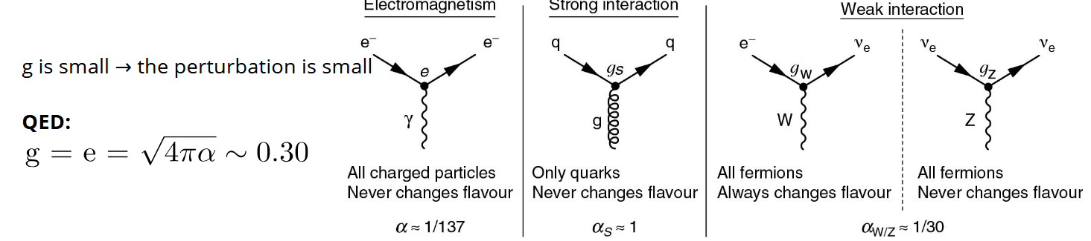
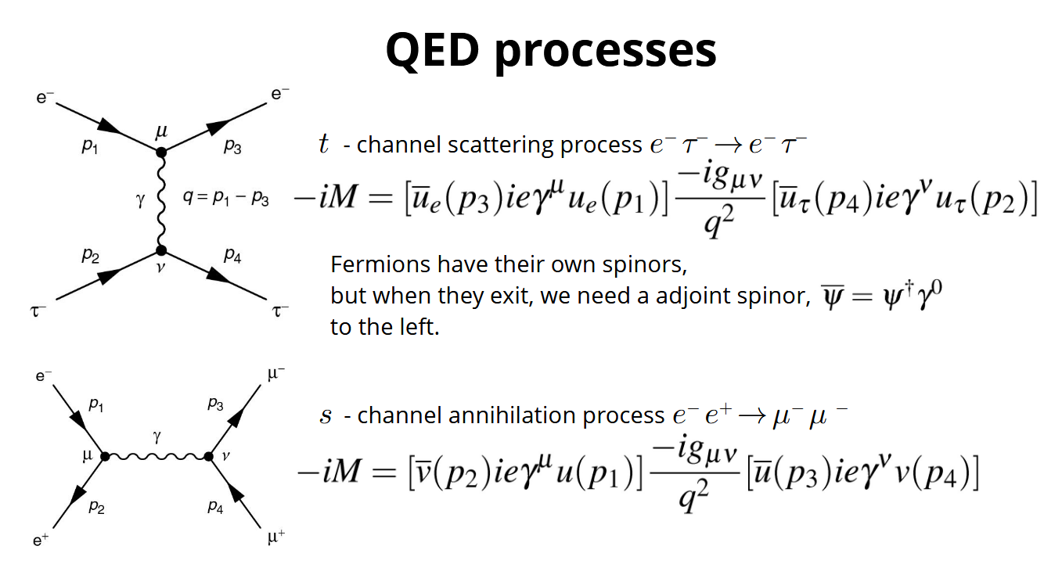
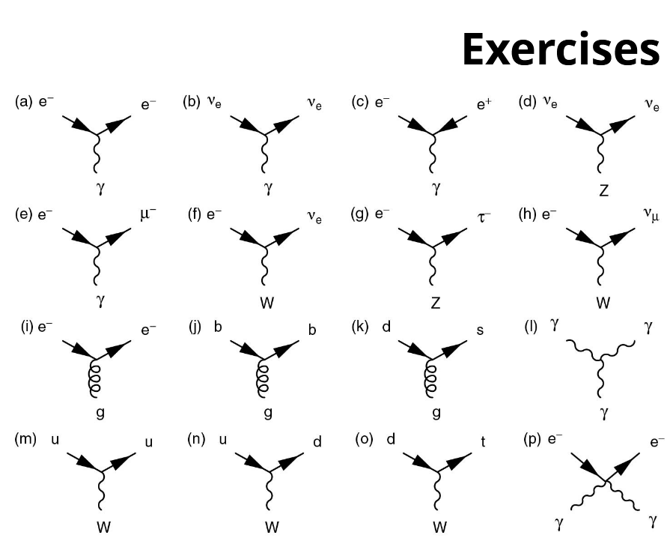
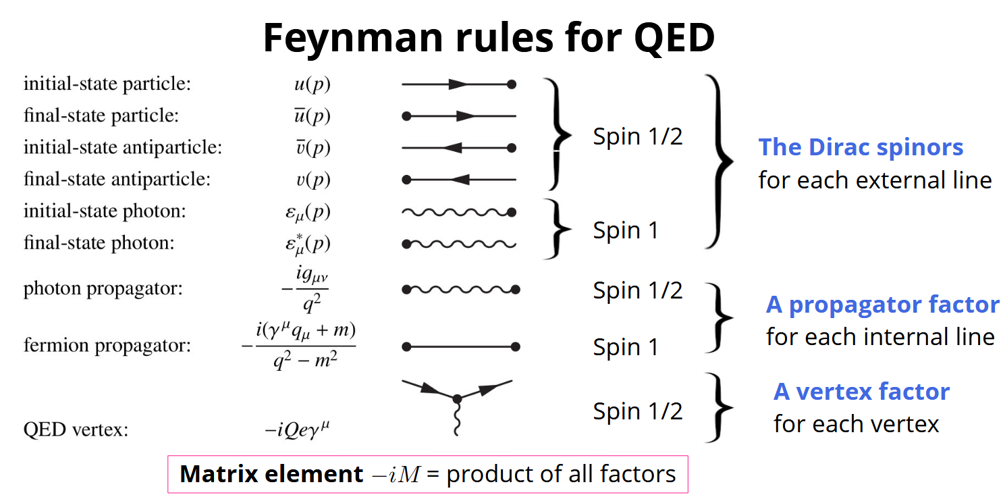
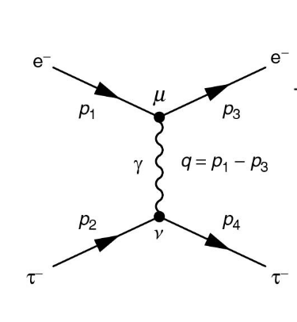

Feynmann Diagrams
The transition matrix
Mariola
..not forget to do the exercises !
To calculations…

Slide 8
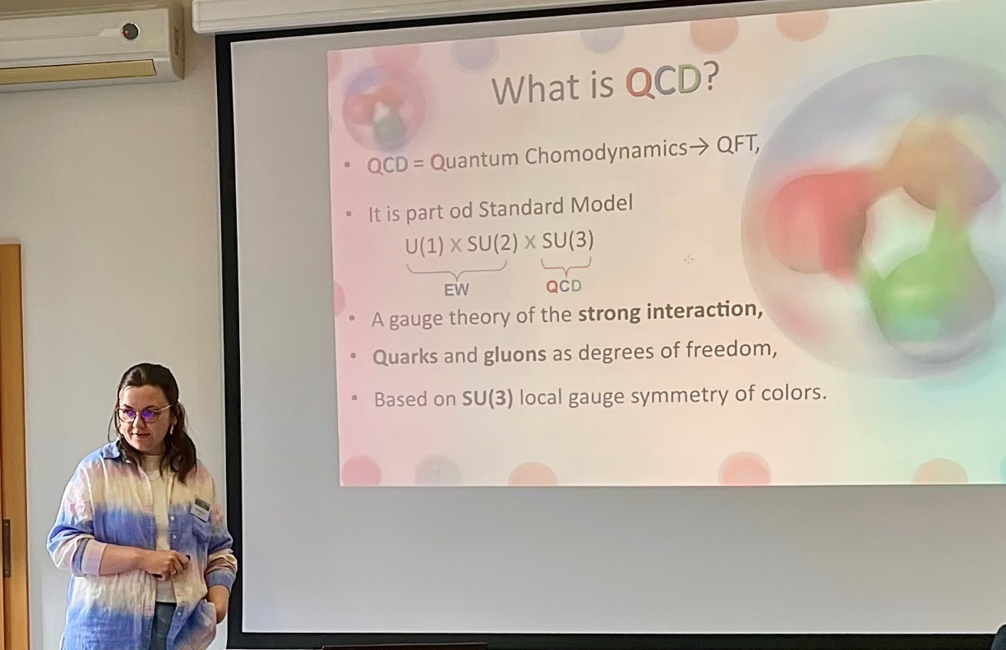
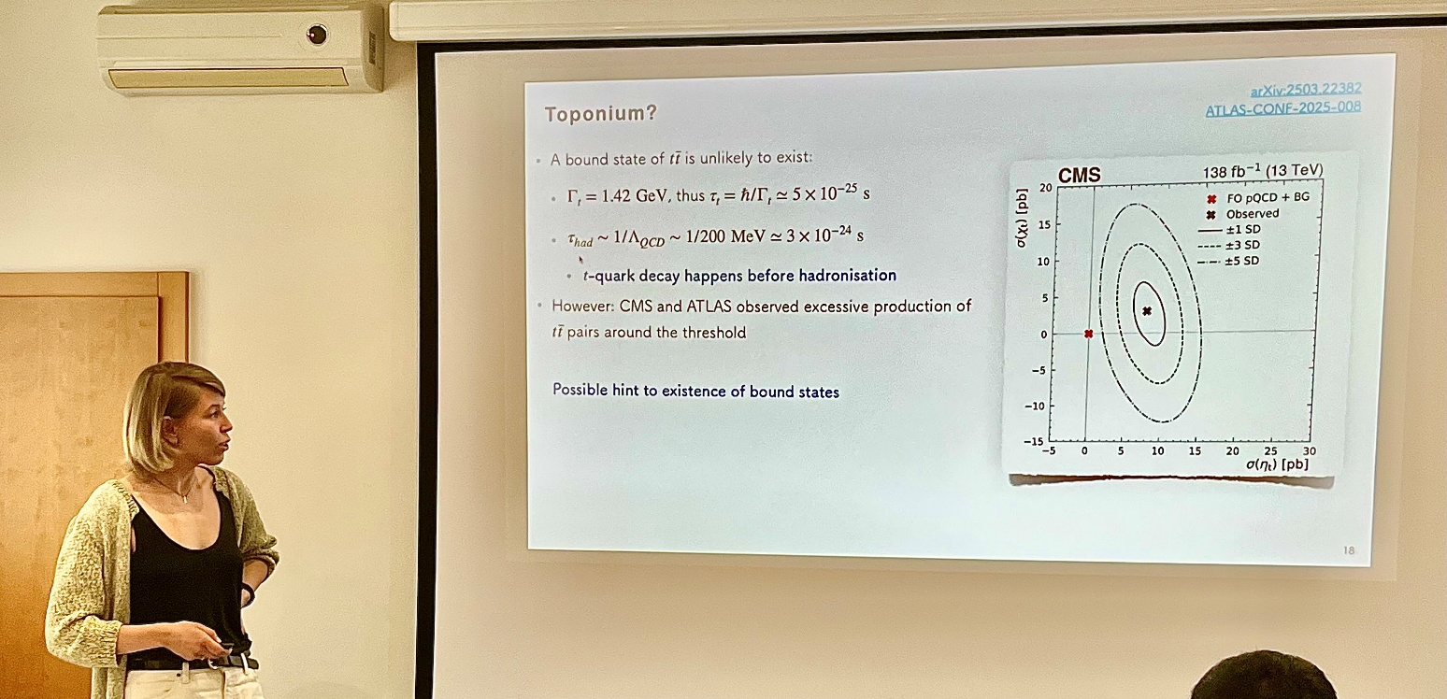
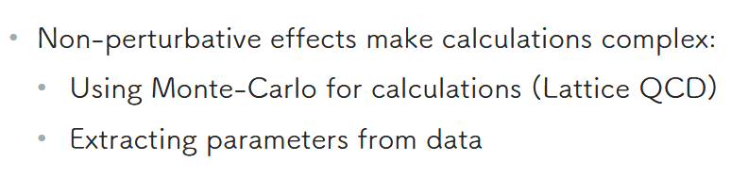
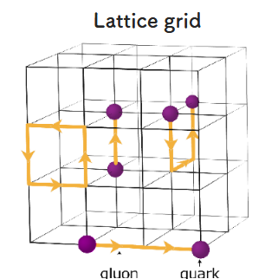
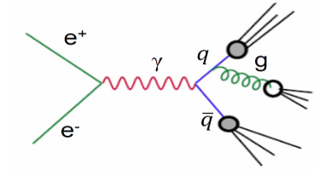
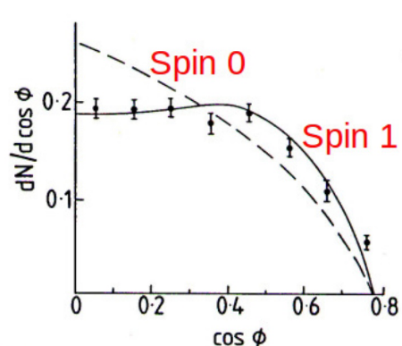
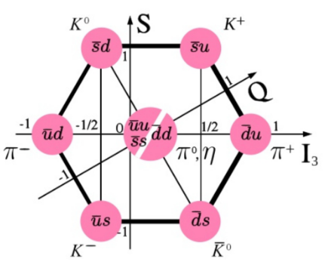
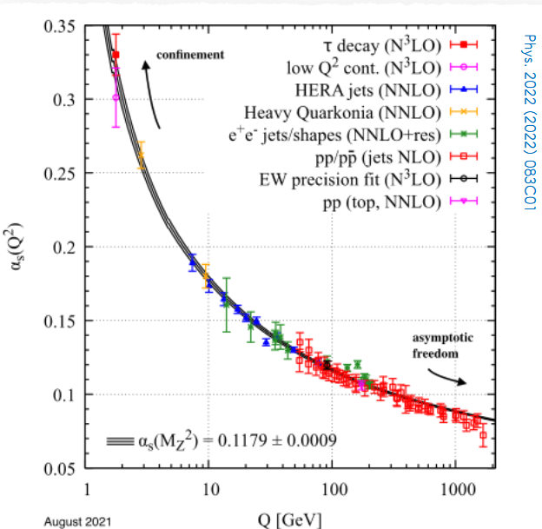
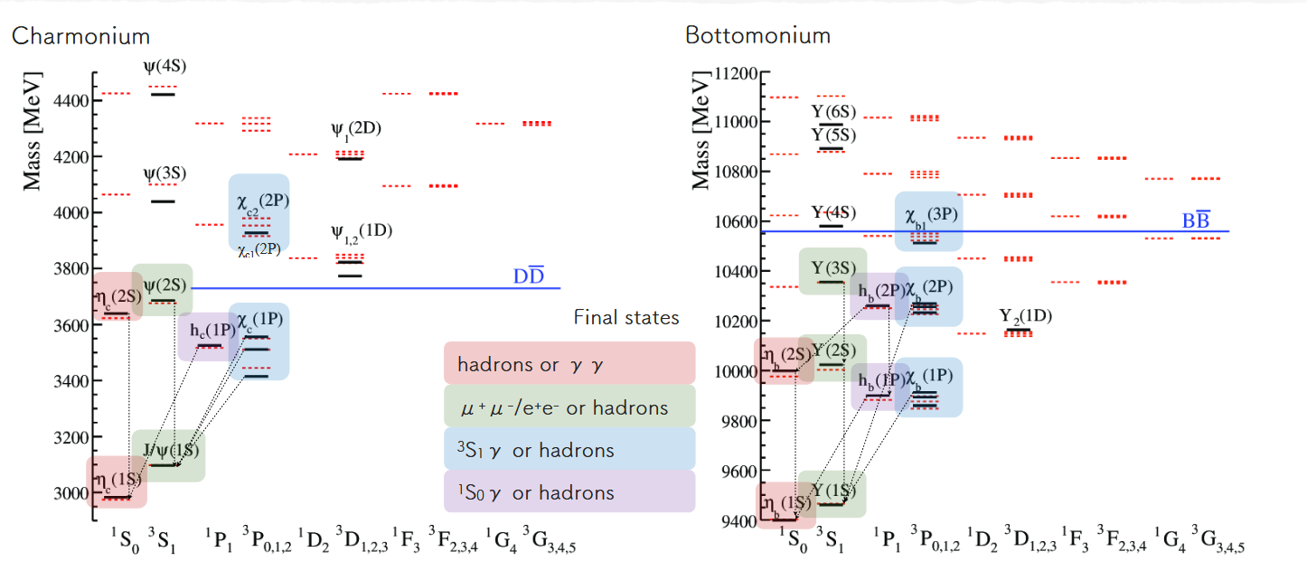
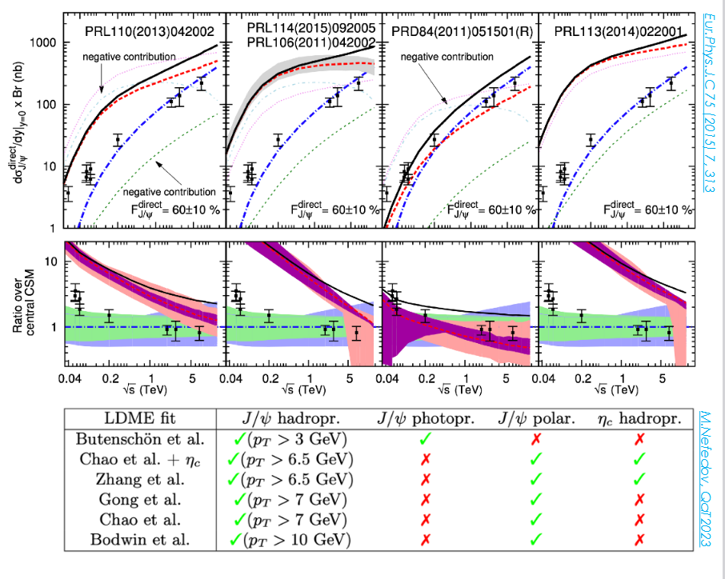
Iwona
Introduction to QCD
Valeriia
… gluon
From quark model
Quarkonium is a fantastic laboratory for QCD
Decays Production (?)
… to colors… to QCD
SU(3), Carrying color, gluon self couplings, asymptotic freedom, confinement→ no free quarks
Intrinisic scale Λ(QCD) ~200MeV
+Quarkonium
important in the QGP studies !

Slide 9

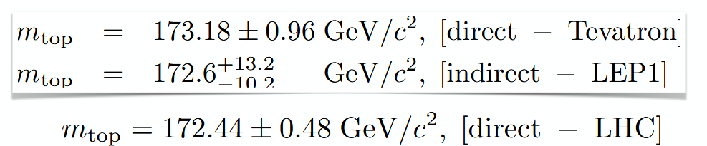
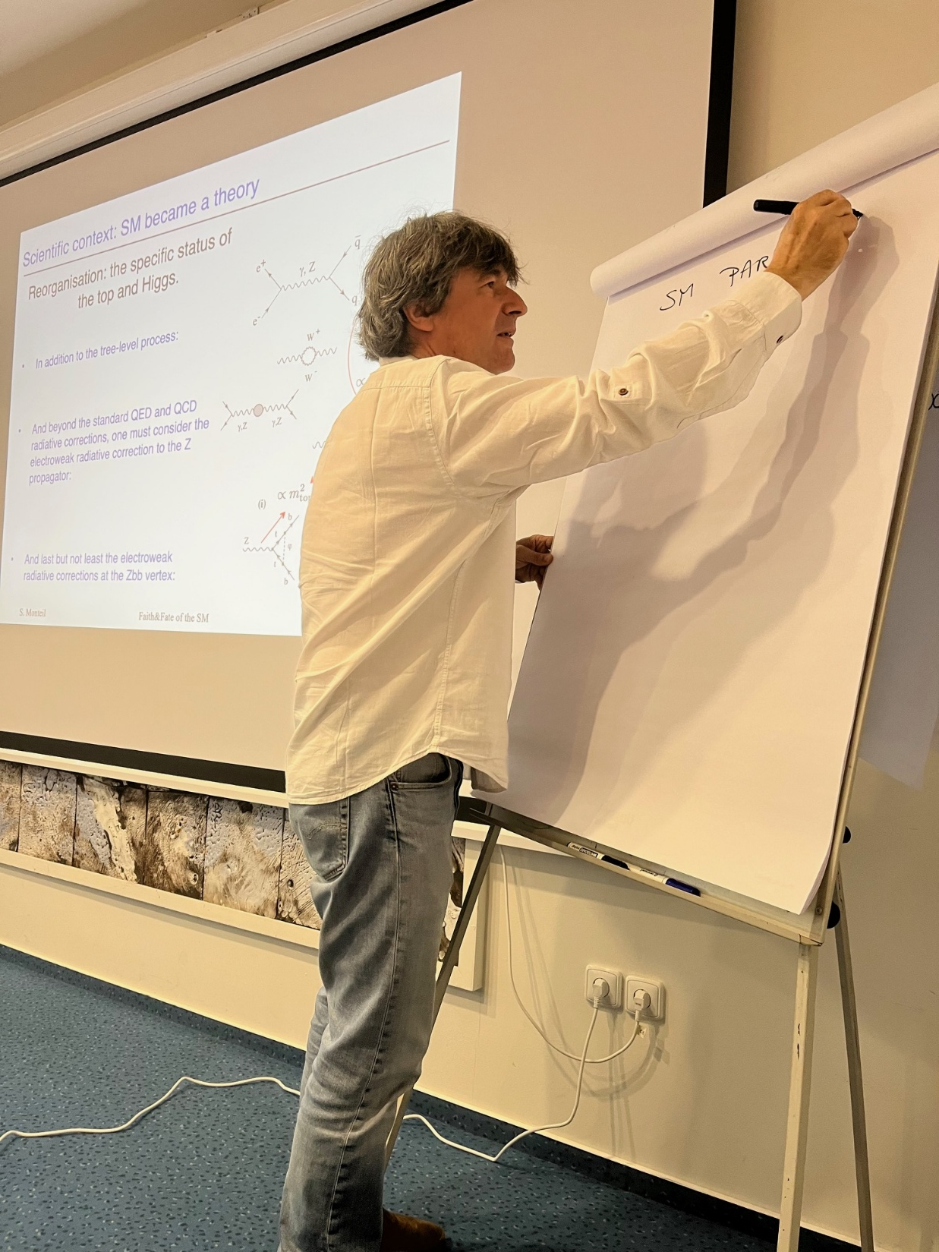
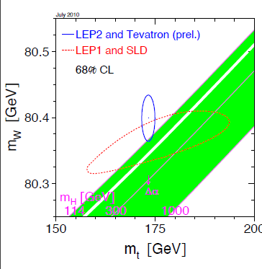
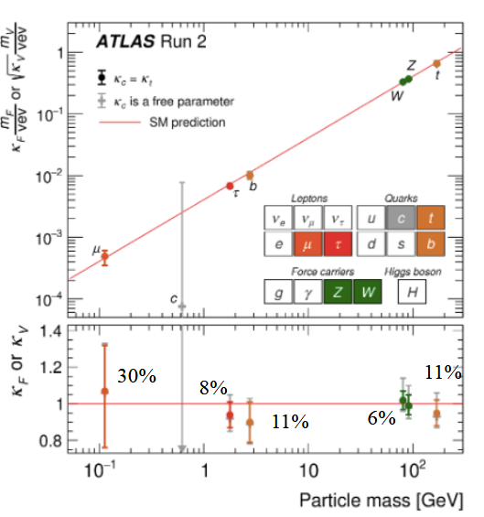
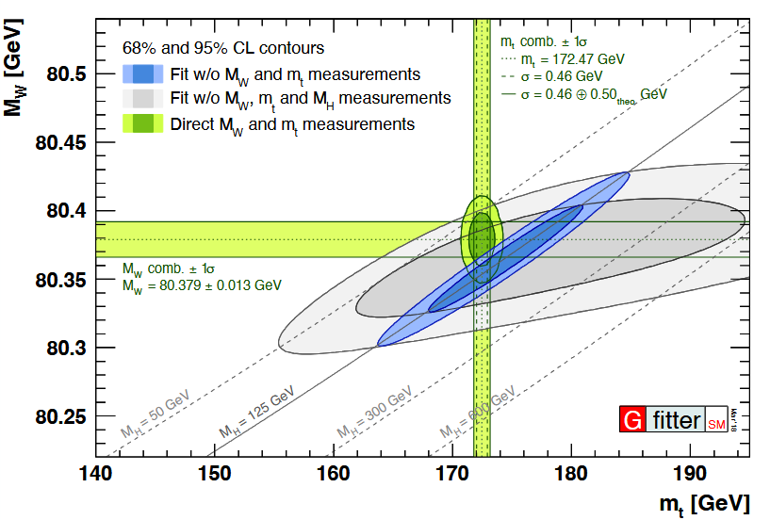
Stéphane
Higgs mass prediction
SM became a theory
?
Sofar all it is working too well !!

Slide 10
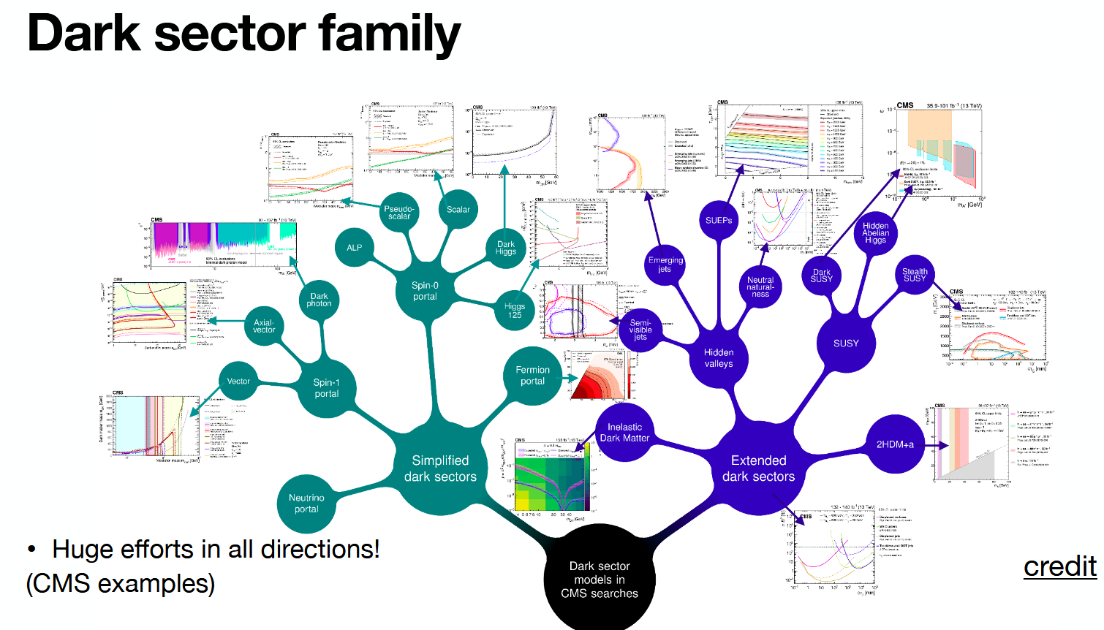
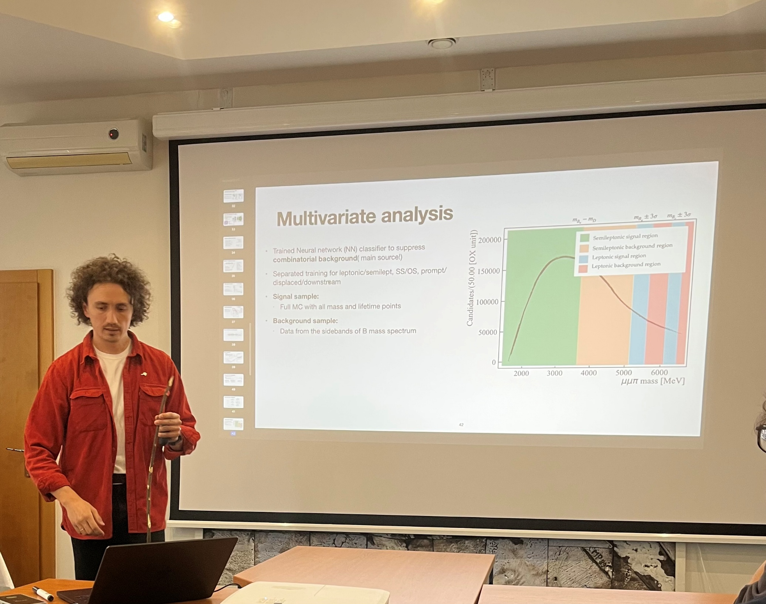
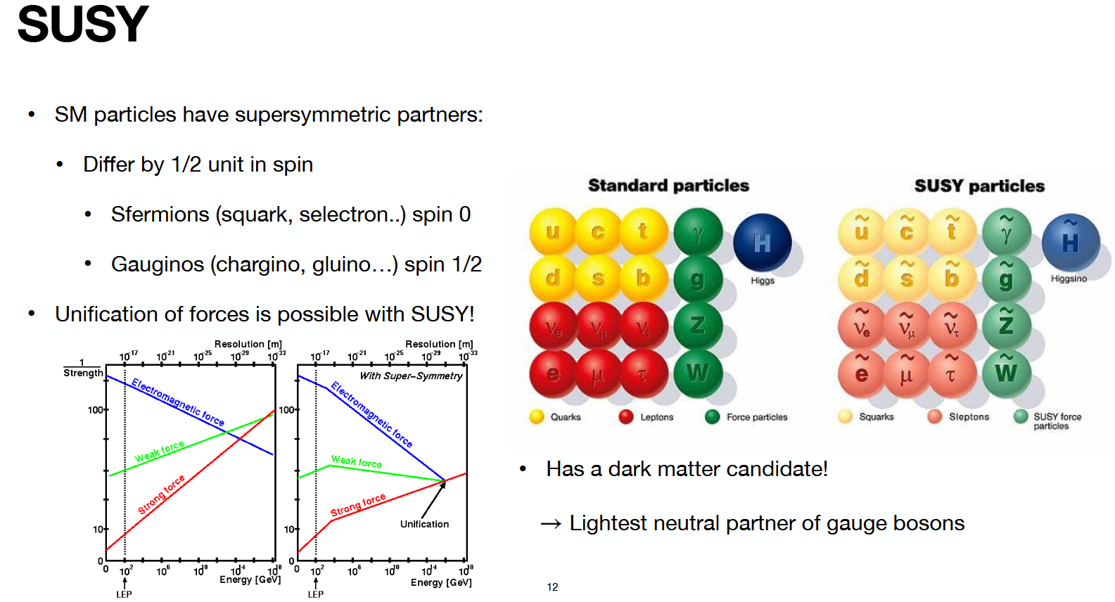
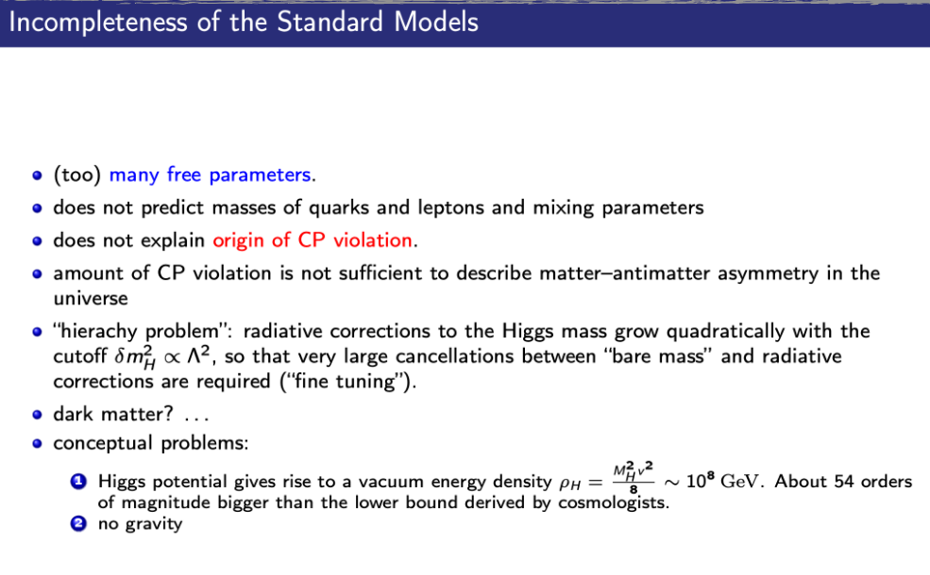

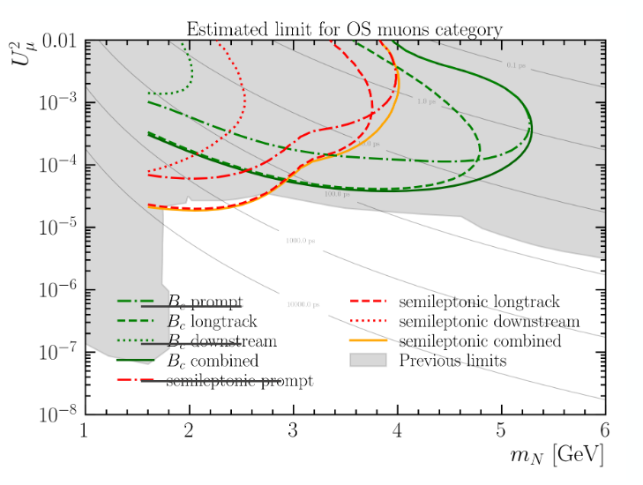
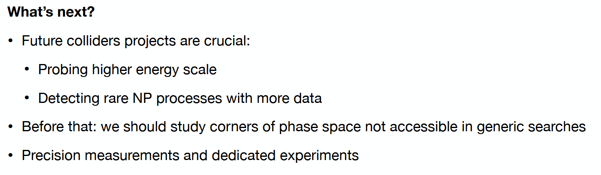
Beyond Standard Model
Sergii
origins of neutrino masses and the
baryon asymmetry of the Universe

Slide 11
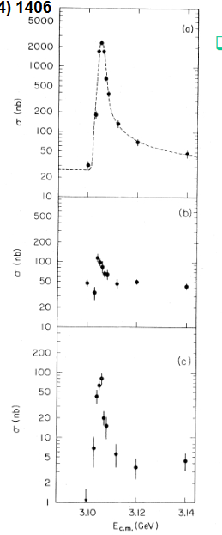
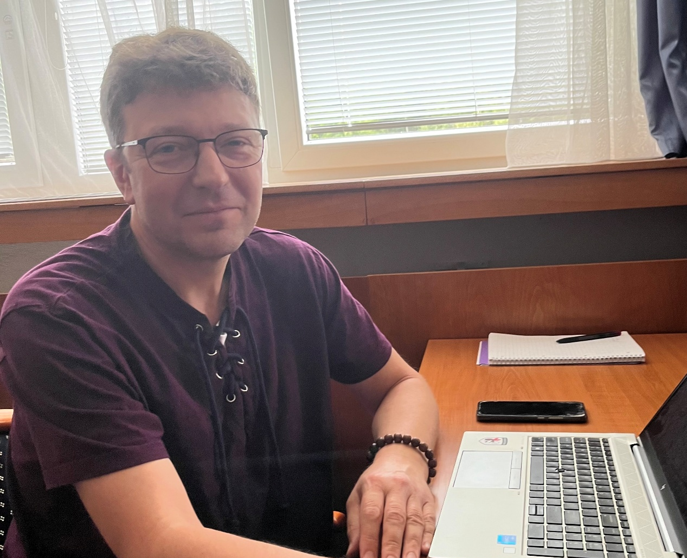
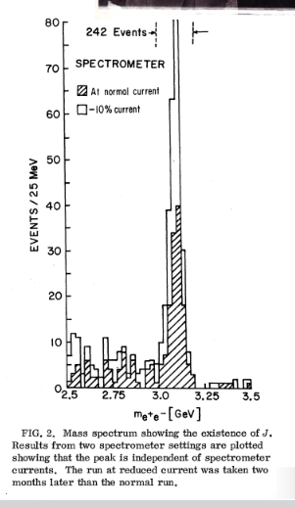
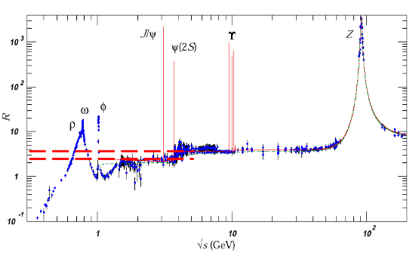
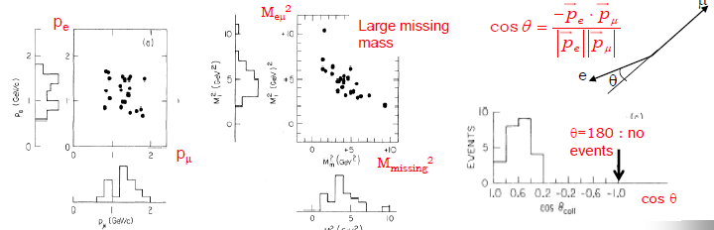
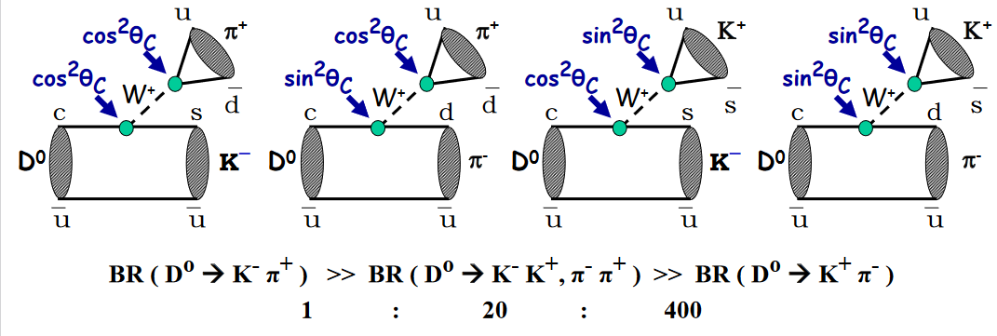
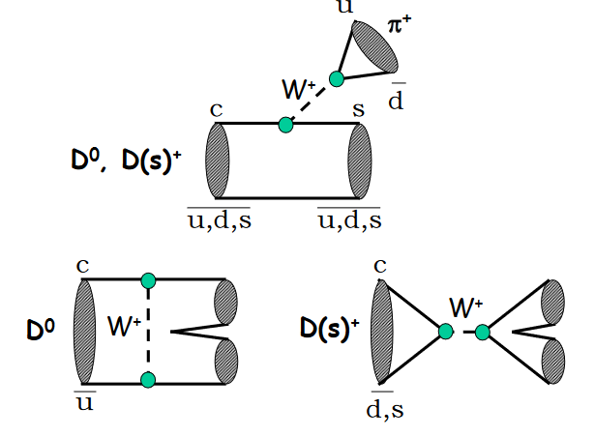
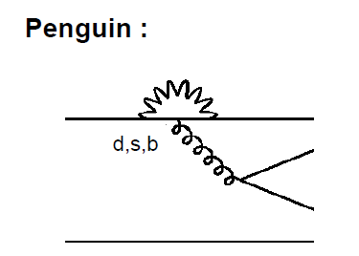
Charm and tau discovery
CHARM
From discovery…
Sergey
τ
From discovery…
…To detailed studies of decays
To massive production and study of taus !
…rare…NP !

Slide 12





Flavour Physics…
And CP Violation
Achille
Where do we expect the scale of New Physics??
This IS THE QUESTION !
Absence of
New Particles up to the
~4×Electroweak Scale !

Slide 13








Top Physics
Top is special!
Stanislav
Already precise top cross section …even for single top !
Precision measurment of the top mass!
Precision on Mt,MH,αS
tell us if the vacuum is stable
Many new analyses : example ttbar spin correlations at 8 TeV

Slide 14













Neutrino Physics
Inés
Next to come, for exemple
Long basline neutrino factory
PMNS and oscillation parameters
→CP violation in neutrino sector !
Neutrino Oscillates →
have a mass !
Mass of the neutrino and
Dirac or Majorana neutrinos ?

Slide 15










Concepts for INSTRUMENTATION and building detector
Maxim and Giovanni
From concepts
To complex detector
Cruciality of tracking ,
→ Silicon detectors !

Slide 16










Accelerator Physics
Accelerators are essential instruments for our research
Pascal
Linac 4
Transfert lines
Dump
Collimations
LHC is the machine of all the challanges !
Synchrotron oscillations:

Slide 17








ERL and PERLE
Acceleration in an RF cavity via Standing Wave
Alex
PERLE Project (250MeV, 20mA), a front edge ERL ulti turn 5MW ERL
… and in further future..
ERL Higgs factory

Slide 18






Machine Learning HEP Physics
Arantza
Neural networks
Strong impact in improving analyses
Some concepts…
score and
penalities
(over)fitting

Slide 19









Alice, H1
Lucia
P-ONE
Paweł
Quark Gluon Plasma (QGP) -Relativistic heavy-ion collisons
ALICE@LHC
Neutrino undersee detectors near by Vancouver
Correlations, particle flows show very interesting features

Slide 20


From theory → experiments → data analyses : the Hands-On !
And you have to be smart and well educated to perform analysis…
Rafal
Valeriia
And you need Rafal and Valeriia and Dominik and Olena
Let's begin the hands-on session – it's time to put theory into practice!

Slide 21





LectureTime @ TESHEP2025
Student Very concentrated !
Class was almost everytime full !
… participating…
Thank you !
It was very enjoyable to teach in this nice and stimulating atmosphere
Asking many intersting questions

Slide 22







The preparation of the presentations was very intense

Slide 23








NICE MOMENTS@TESHEP
we discovered that in the region
Learning how to row
All .. ?
We all safely reached the end of the trip

Slide 24






Music evening @TESHEP
All the available beers were consumed !
Nice night sessions ! Music
But not only !

Slide 25






Football as usual as always !!
Ball control …always perfect…
Contacts were… friendly !
Spectators were passionated in the stadium !
Professors have used all possible tricks to preserve tradition…
Finally, tradition was kept… professors win !

Slide 26

And a nice film made by Anastasiia collecting some nice moments !

Slide 27



To the local organisers
- for making this school possible
- for the UNPECCABLE organisation in
a such beautiful and nice place
MANY THANKS
Ďakujem veľmi pekne
Judita
Jozef
Pavol
But this it has been possible also thank to practical organization and in particular to
Thanks to our institution which are sponsoring the school
Catherine Bourge

Slide 28



Student’s presentation were good and
professionally prepared…
We had a Conference
27
fast communications..
?
?
?
?
?
?
?
ALL STUDENTS WOULD DESERVE A PRIZE
Valeriia chairwomen

Slide 29


Prize for the best presentation
Sofiia Sadivnycha
Many excellent presentations !
But we want also to mention for their presentation : Anna Butenko, Raoul Henderson, Lucas Karwatzki, Julia Leszczynska, Yakiv Paroviak and Kateryna Vilchynska

Slide 30

Prize for the best questions/participation
Lucas Karwatzki
A lot of questions asked and
of an excellent quality
But we want also to mention for their questions and participation : Rehman Ashraf, Raoul Henderson, Blazej Rozwoda, Anastasiia Ryzhkova, Sofiia Sadivnycha and Kateryna Vilchynska

Slide 31
Prize for the best lecture
?

Slide 32
We would like to have your feedback
A questionnaire will be sent to you !
Please take time to fill it up
Thanks for coming, have a safe
journey back home
And good luck for your future !

