Slide 1


Overview of Radiation Protection aspects for the 1st HL-LHC WP8 LS3 Readiness meeting
Robert Froeschl, Angelo Infantino, Anna Anchini, Davide Bozzato, Patrycja Dyrcz, Tommaso Lorenzon
EDMS 3162301 v1
1st HL-LHC WP8 LS3 Readiness meeting
With inputs from:
C. Celce, P. Bertreix, G. Dumont

Slide 2
Outlook
HSE-RP contribution to HL-LHC WP8 over many projects/activities
This talk main focus on:
Recall on ALARA at CERN, LS3 dose objective, and more
Removal of the TAS in ATLAS/CMS
TAN to TAXN conversion
WDP, transport and waste aspects

Slide 3
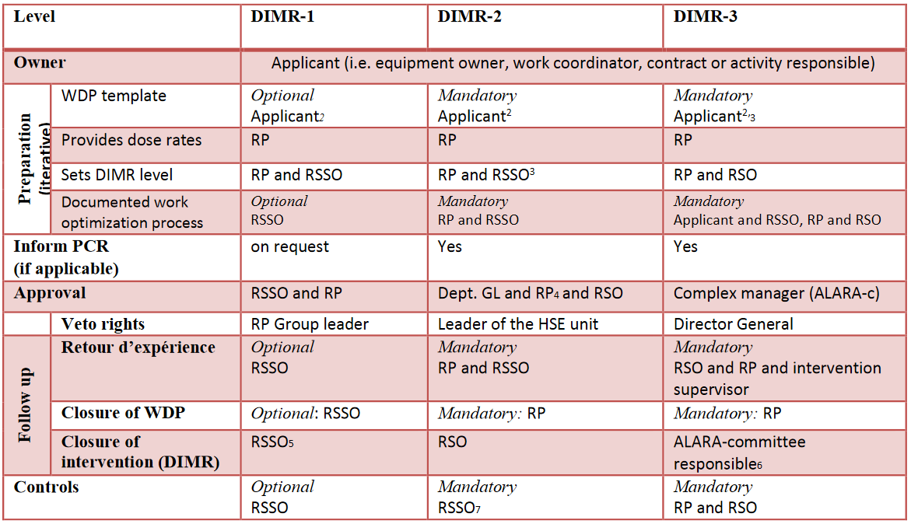
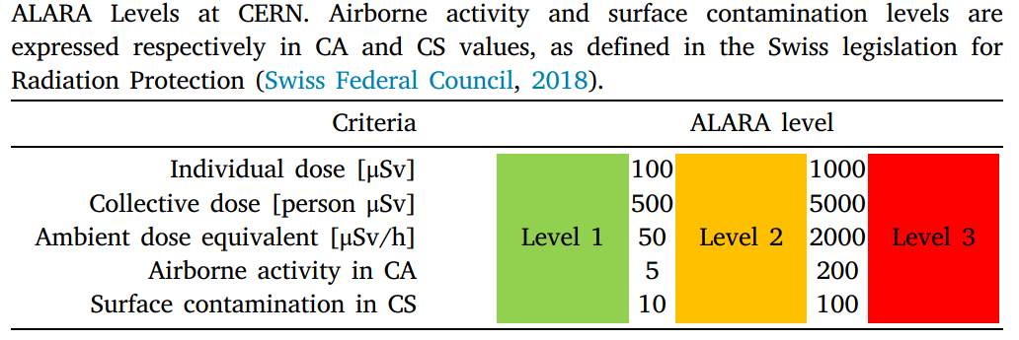
Recall on ALARA at CERN
EDMS 1751123
ALARA level → Radiological risk assessment based on different criteria
WDP/optimization mandatory for ALARA II & III
ALARA III approval by “ALARA committee” (complex manager, GL responsible for the equipment, RSO, RP GL, and more)

Slide 4
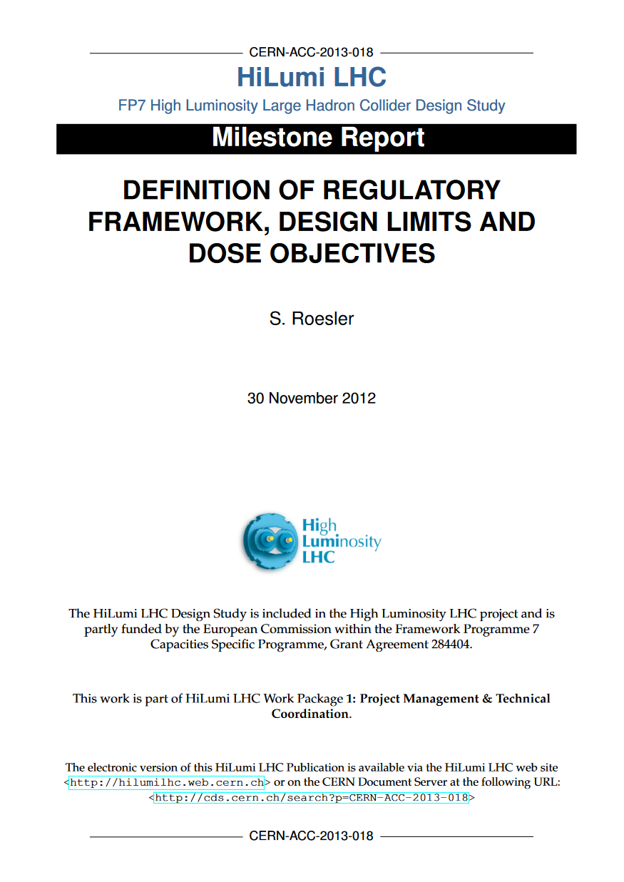
Dose objective
CERN-ACC-2013-018 (EDMS 1509373) summarizes the Radiation Protection regulatory framework as well as the related design constraints and dose objectives to be followed by the HL-LHC project.
Safety code F, design constraints, ALARA and dose objectives.
Personal dose objectives apply at CERN:
Long Shutdowns -> max 3 mSv
The dose is to be counted for any consecutive 12-months period.
As it is not a limit it can be exceeded. However, the latter requires the approval by the RP group leader as well as the group leader responsible for the respective person.
RP objectives from LS2:
Dose per person < 3mSv in 12-months period
Number of radioactive transports: < 150/month

Slide 5
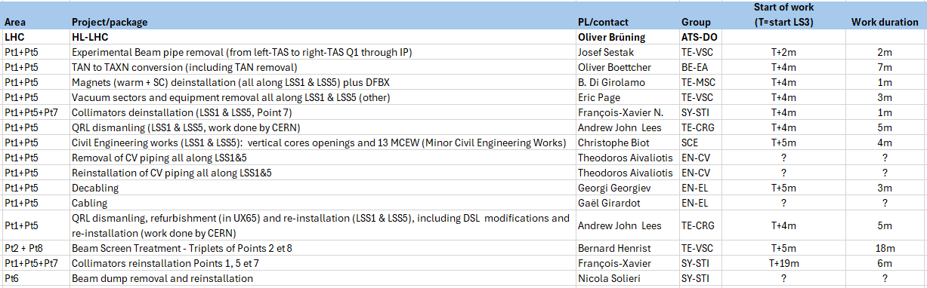
DIMR
Courtesy A. Pardons and RSOC
Tentative list – ALARA Level to be confirmed by WDP
DIMR granularity/ownership discussed and agreed on a dedicated meeting on 09.07.2024 with HL-LHC PSO, RP, RSOs and WP/group representatives.
Two main activity impacting WP8: TAS removal and TAN/TAXN conversion

Slide 6
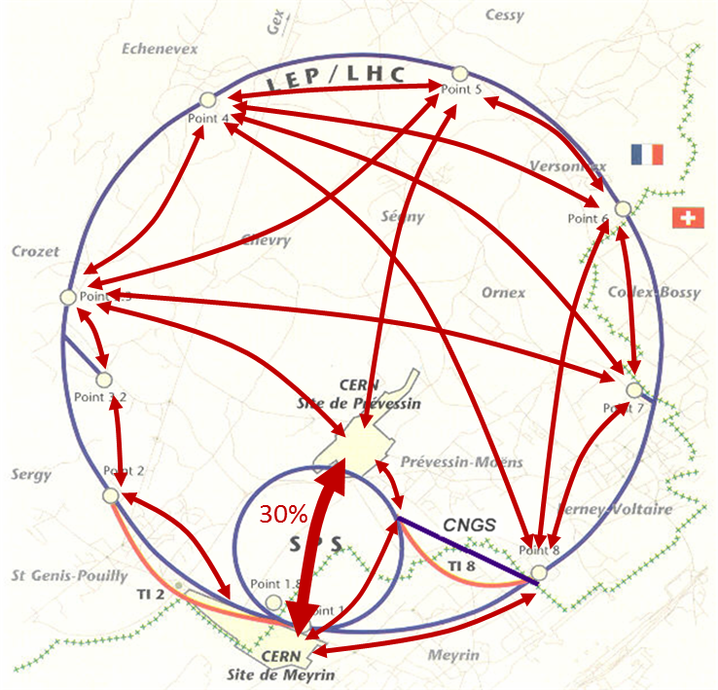
Internal transport
Radioactive transport mostly depends on :
Nuclide inventory / activity (classification)
External dose rate (labelling)
Size/mass of the content (packaging)
All the above must be known to guarantee the feasibility of the transport in due time.
Few triggers for “critical” transport:
Size/mass of the content exceeding currently available means (590*235*233cm / 20,6t )
Dose rate at contact exceeding 2 mSv/h or/and 100 μSv/h at 2 m
Presence of alpha emitters / “heavy” radionuclides
Total activity > 10¹¹ Bq
Possible issues for transport :
Certified packaging not available (size / mass too high)
Dose rate too high – need specific shielding (to be determine and manufactured)
Activity too high – transport not possible (unless specific derogation from the authorities which can take years to have approved after submission of the dossier and is valid for one specific transport only!)
Derogation not accepted from authorities.

Slide 7
Radioactive Waste disposal pathways
From 2010, tripartite agreement between CERN and Host States, represented by Swiss Federal Office of Public Health (OFSP) and the French Nuclear Safety Authority (ASN) -> link
“Fair Share” principle revised in March 2022, with three indicators: the volume eliminated, radiotoxicity and elimination costs.
With these indicators, it will now be possible to better compare and measure the share between the two Host States
CERN RW classification | Disposal pathway
Clearance candidates – CL (Candidats à la Liberation Inconditionelle) | Release from regulatory control in Switzerland (clearance ↔ “free release”)
Very Low-Level Waste – TFA (Très Faibles Activités) | Surface disposal in France, as defined by the acceptance criteria of the ANDRA CIRES repository.
Intermediate & Low-Level Waste – FMA-VC (Faibles et Moyennes Activités a Vies Courtes) | ﻿Short-lived intermediate and low level waste, half-life <30 years. Surface disposal in France as defined by acceptance criteria in ANDRA CSA repository.
Intermediate & Low-Level Waste – FA-MA (Faibles Activites et Moyennes Activités) | ﻿Intermediate and low-level waste which does not fulfil the FMA-VC criteria and disposal in Switzerland (PSI).

Slide 8
Removal of the TAS in ATLAS/CMS

Slide 9
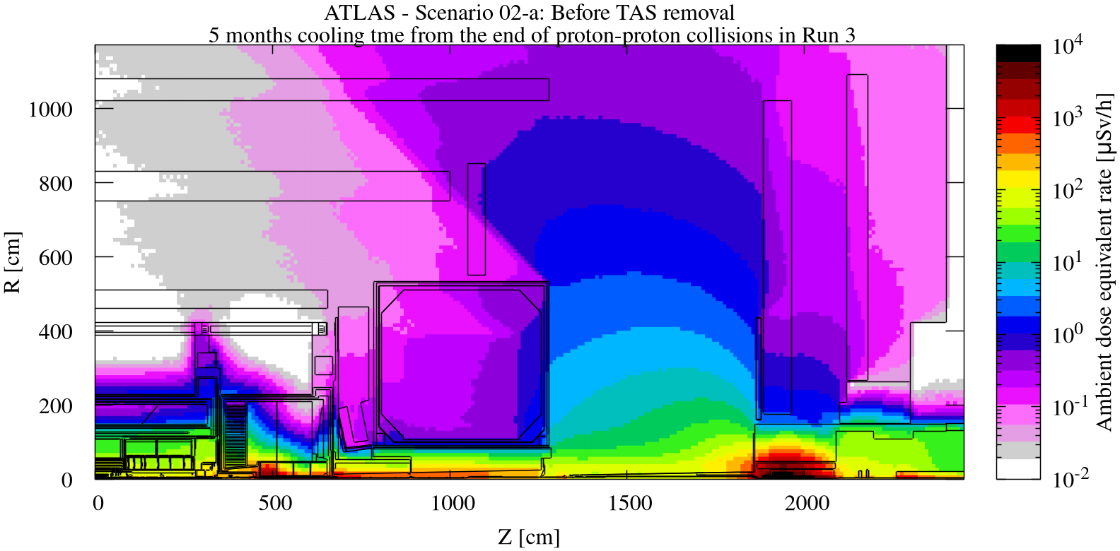
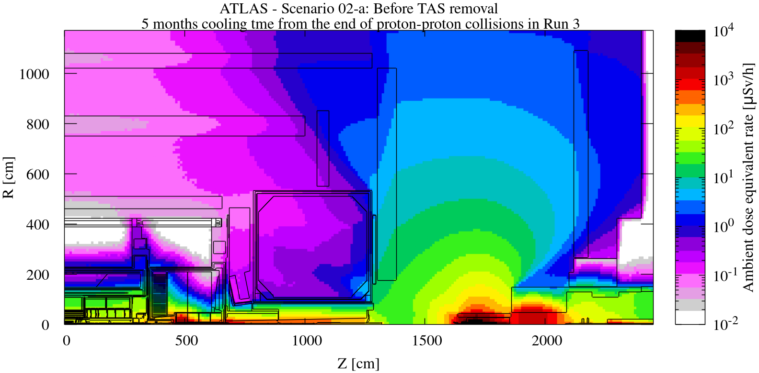
ATLAS open scenarios
Several configurations studied and discussed with ATLAS representatives.
Results summarized in T. Lorenzon et al., EDMS 3061416
The most representative configurations for the TAS extraction scenario are the configuration 02-a “Before TAS removal” and configuration 02-b “TAS removal”
To stay on the conservative side, the cooling time that can be considered is 5 months from the end of proton physics in Run 3 (consistent with TAS dose rate estimates).

Slide 10
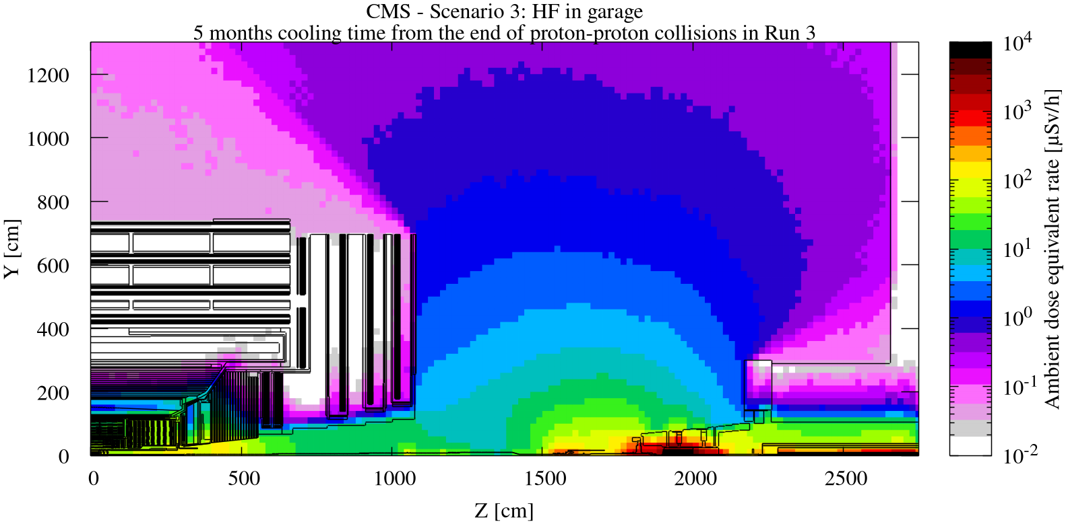
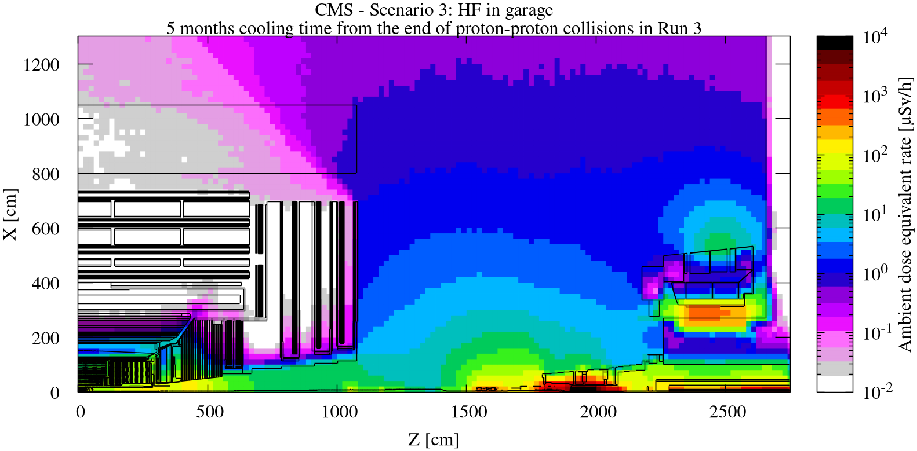
CMS open scenarios
Several configurations studied and discussed with CMS representatives.
Results summarized in T. Lorenzon et al., EDMS 2748870
The most representative configuration for the TAS extraction scenario is the configuration so-called “HF in garage”:
HF detector removed
New Forward Shielding removed
Rotating shielding open
To stay on the conservative side, the cooling time that can be considered is 5 months from the end of proton physics in Run 3 (consistent with TAS dose rate estimates).

Slide 11
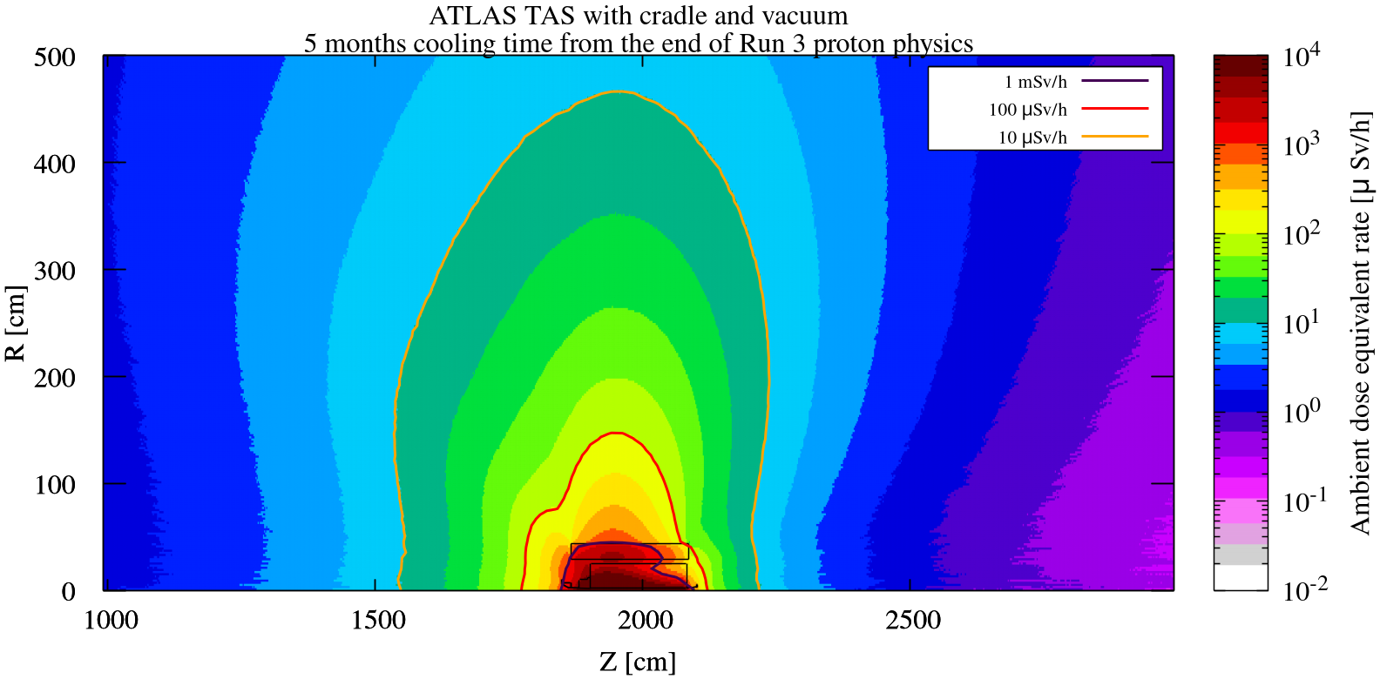
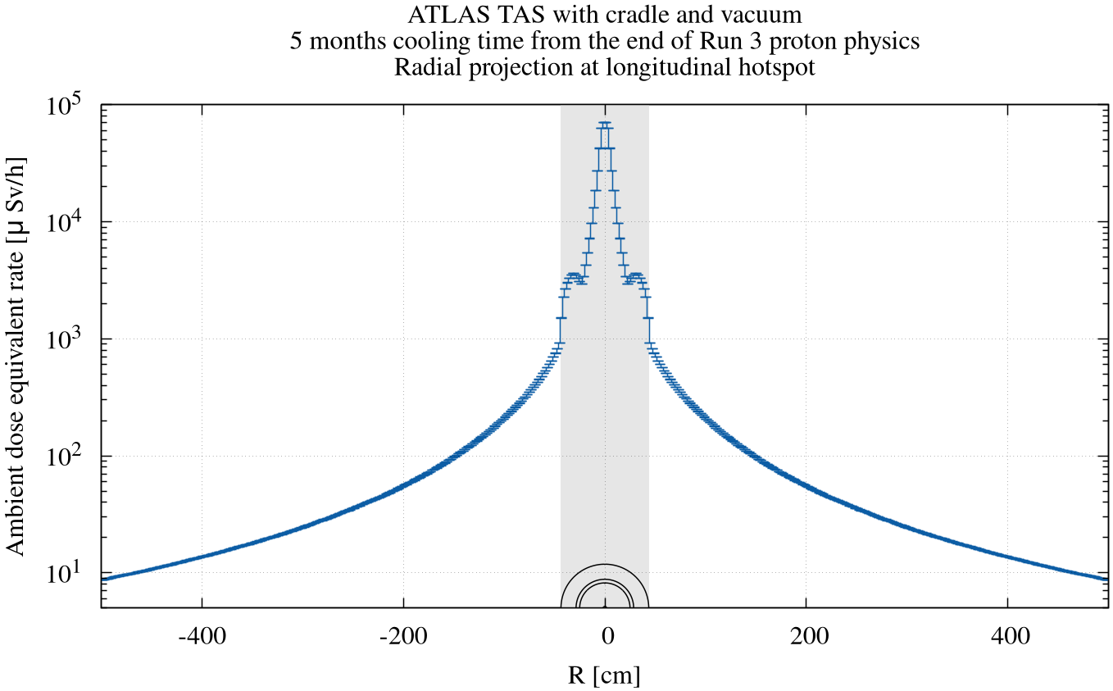
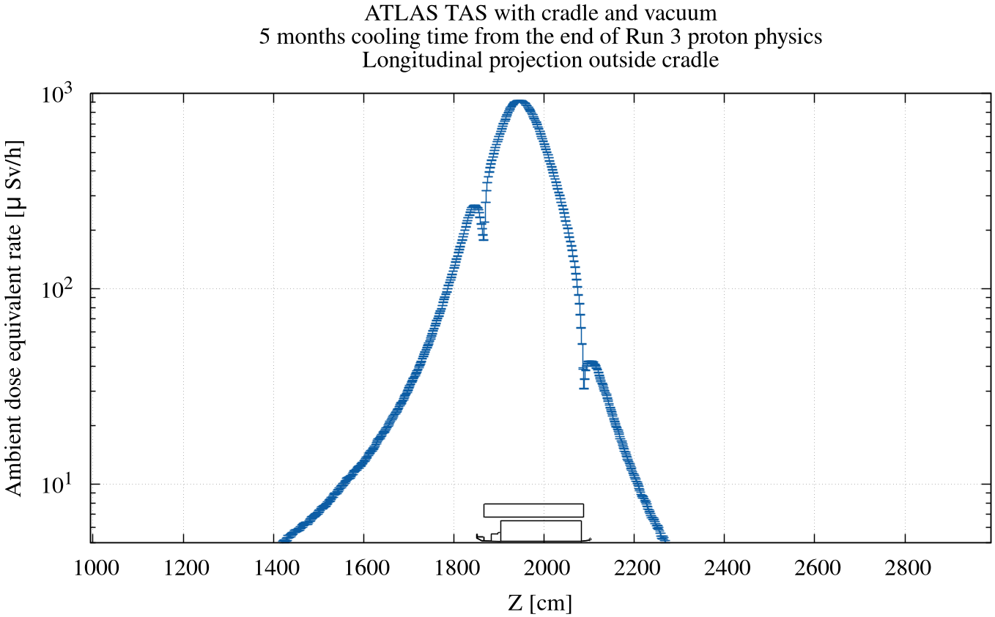
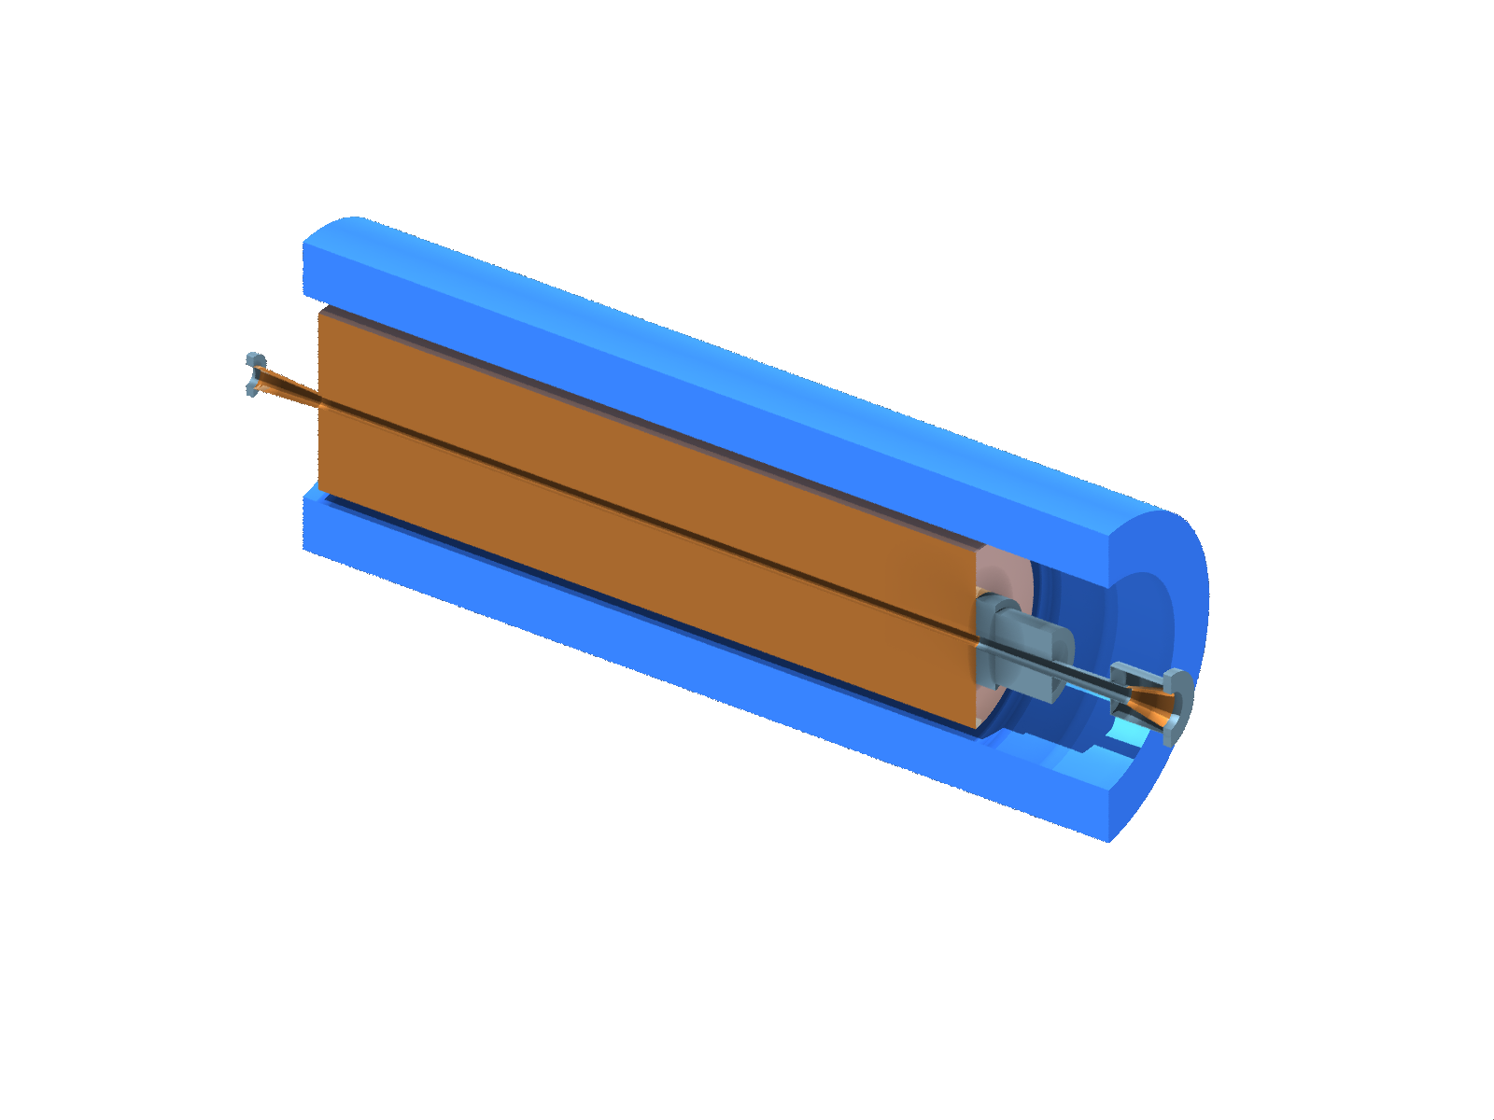
ATLAS TAS and cradle
Residual dose rates have been estimated and results have been summarized in D. Bozzato et al., EDMS 3129308.
To stay on the conservative side, the cooling time that can be considered is 5 months from the end of proton physics in Run 3.
Unreachable parts in shaded area

Slide 12
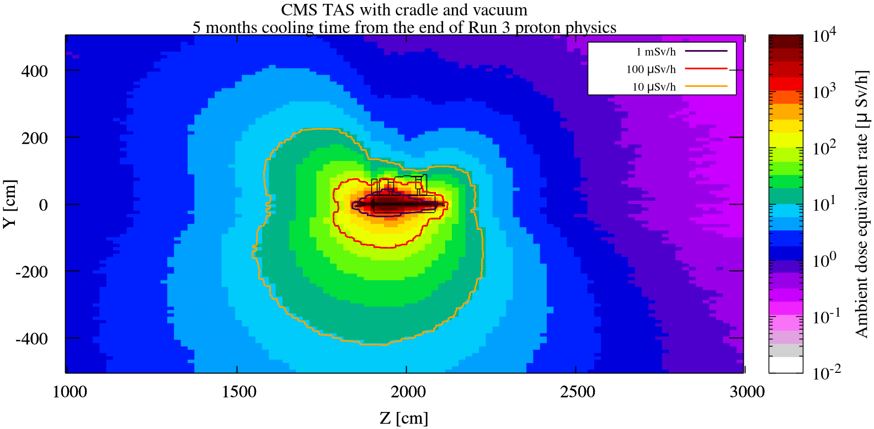
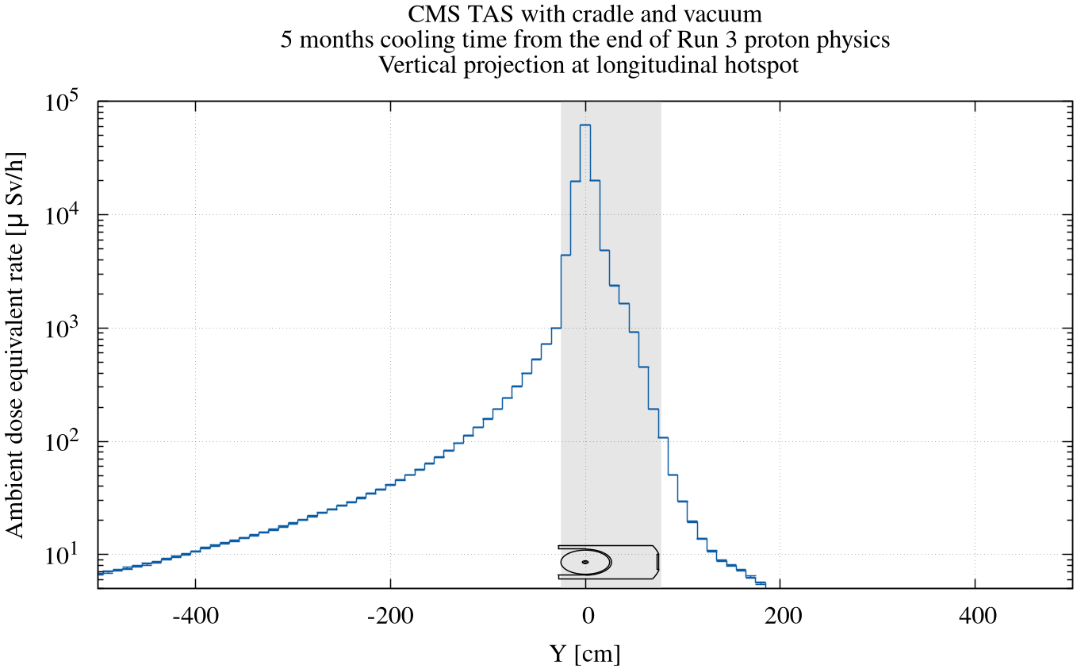
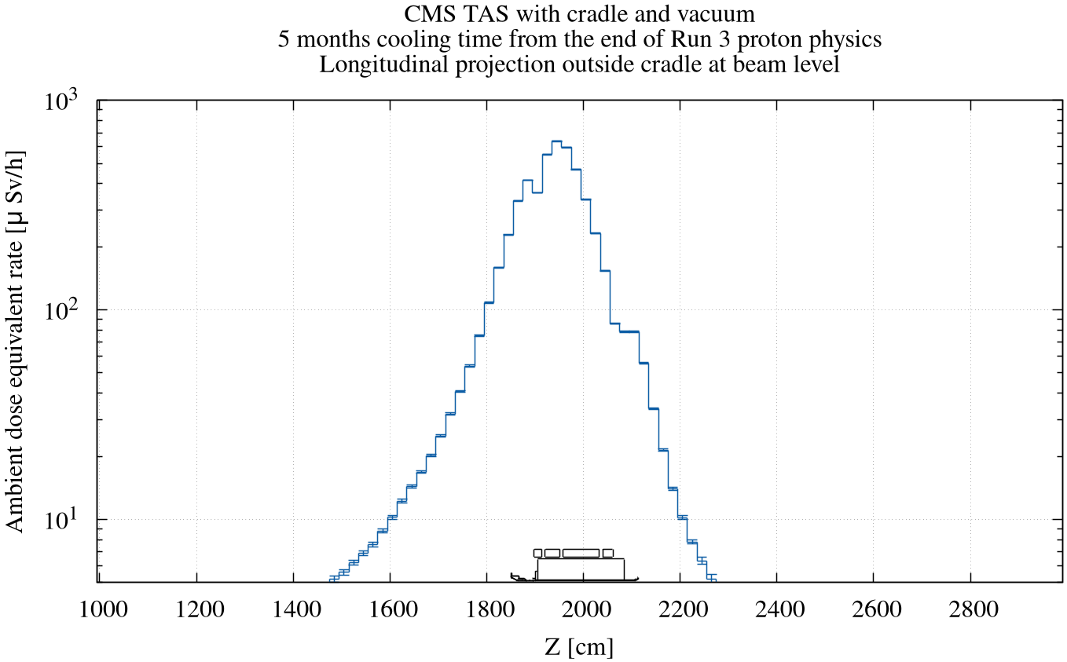
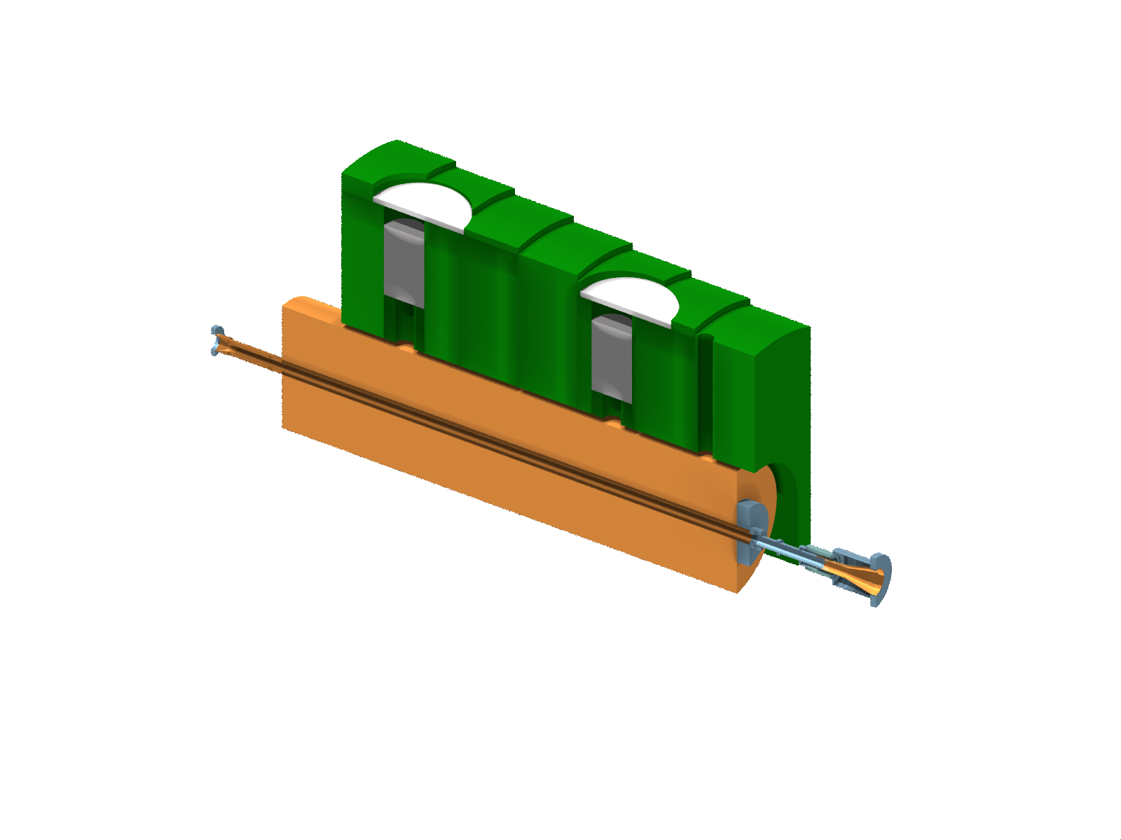
CMS TAS and cradle
Residual dose rates have been estimated and results have been summarized in D. Bozzato et al., EDMS 3129308.
To stay on the conservative side, the cooling time that can be considered is 5 months from the end of proton physics in Run 3.
Unreachable parts in shaded area

Slide 13
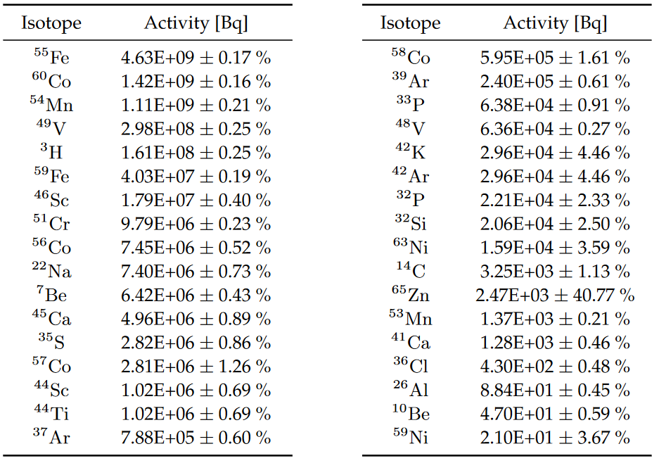
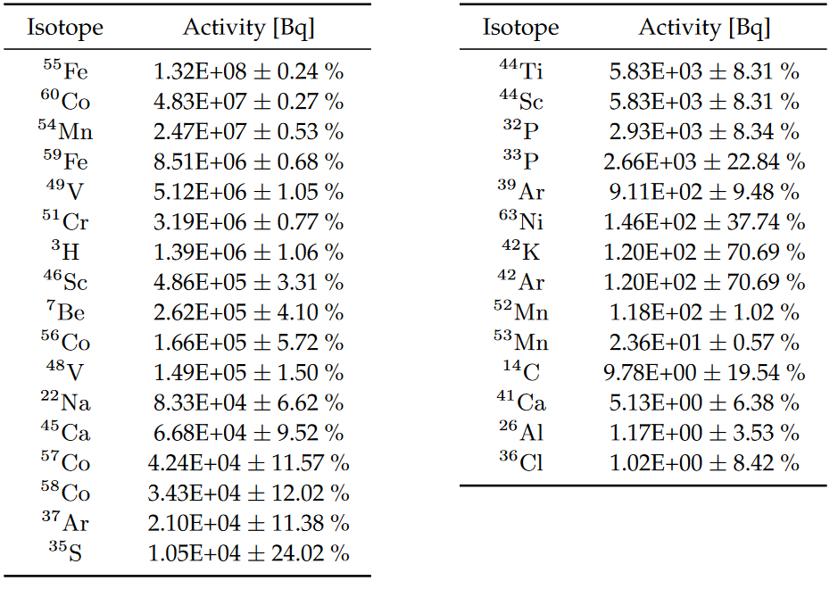
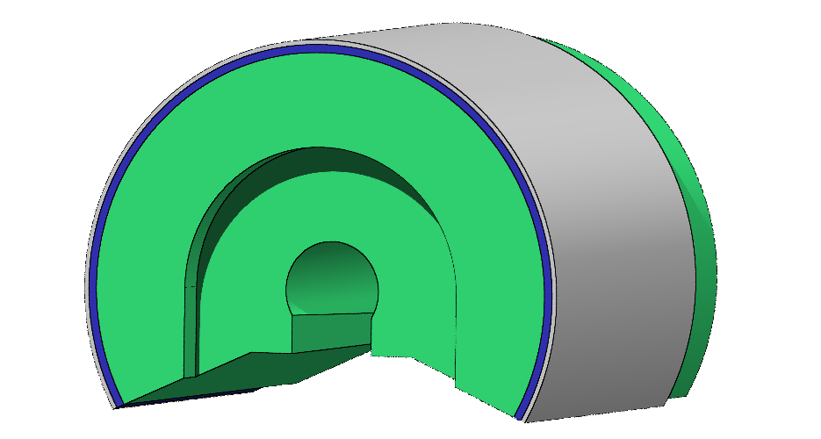
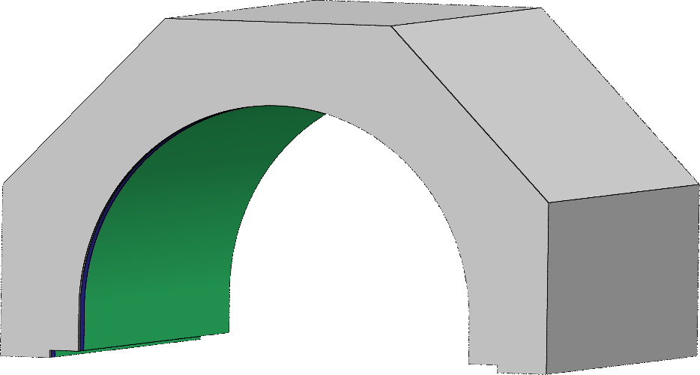
ATLAS JFC3 and JFSU
The radionuclide inventories of the ATLAS JFC3 and JFSU shielding have been estimated and results have been summarized in T. Lorenzon et al., EDMS 2914560
Results have already been communicated to HSE-RP-CS to define the appropriate transport classification from the ATLAS surface buildings to Building 191 (Meyrin) where they will be machined:
The two shieldings would meet the requirements for LSA-1 type transport (input from P. Bertreix)
Radionuclide activities for one ATLAS JFC3 for 7 months cooling time from the end of proton physics in Run 3.
Radionuclide activities for one ATLAS JFSU for 3 months cooling time from the end of proton physics in Run 3.
ATLAS JFC3
ATLAS JFSU

Slide 14
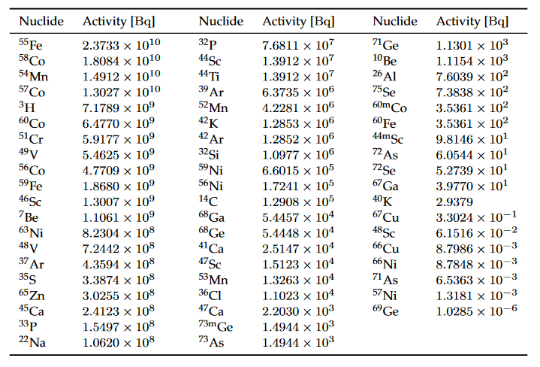
ATLAS TAS and cradle
The radionuclide inventories of the different components have been estimated and results have been summarized in D. Bozzato et al., EDMS 3129308:
To stay on the conservative side, the cooling time to be considered is 2 months from the end of proton physics in Run 3.
In the table the inventory for the full assembly is summarized.
Results have already been communicated to HSE-RP-CS to define the appropriate transport classification:
The full TAS assembly , or even the TAS alone, would not meet requirements for LSA-1 type transport (input from P. Bertreix): a packed transport in a dedicated container is required (see next slides).
Radionuclide activities for one full ATLAS TAS assembly (TAS and cradle) for 2 months cooling time from the end of proton physics in Run 3. Only activities above 10-6 Bq are reported.

Slide 15
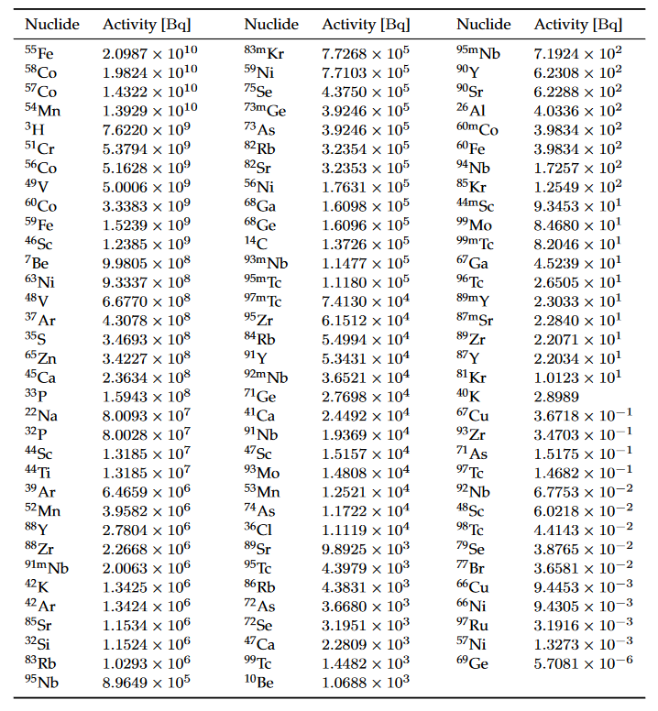
CMS TAS and cradle
The radionuclide inventories of the different components have been estimated and results have been summarized in D. Bozzato et al., EDMS 3129308:
To stay on the conservative side, the cooling time to be considered is 2 months from the end of proton physics in Run 3.
In the table the inventory for the full assembly is summarized.
Results have already been communicated to HSE-RP-CS to define the appropriate transport classification:
The full TAS assembly , or even the TAS alone, would not meet requirements for LSA-1 type transport (input from P. Bertreix): a packed transport in a dedicated container is required (see next slides).
Radionuclide activities for one full CMS TAS assembly (TAS and cradle) for 2 months cooling time from the end of proton physics in Run 3. Only activities above 10-6 Bq are reported.

Slide 16
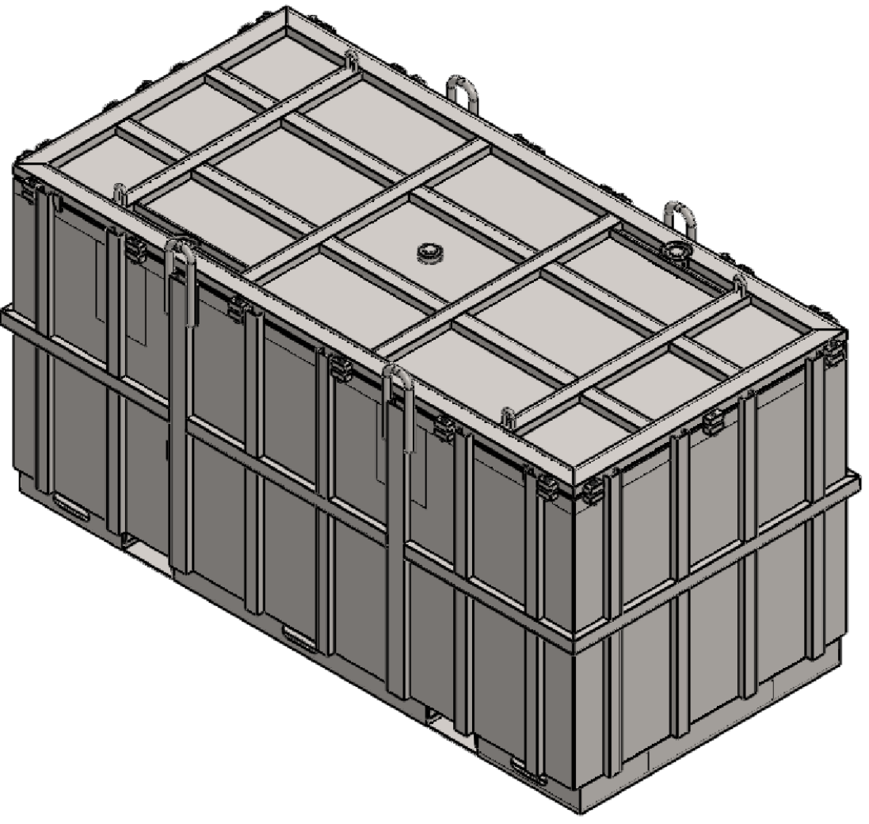
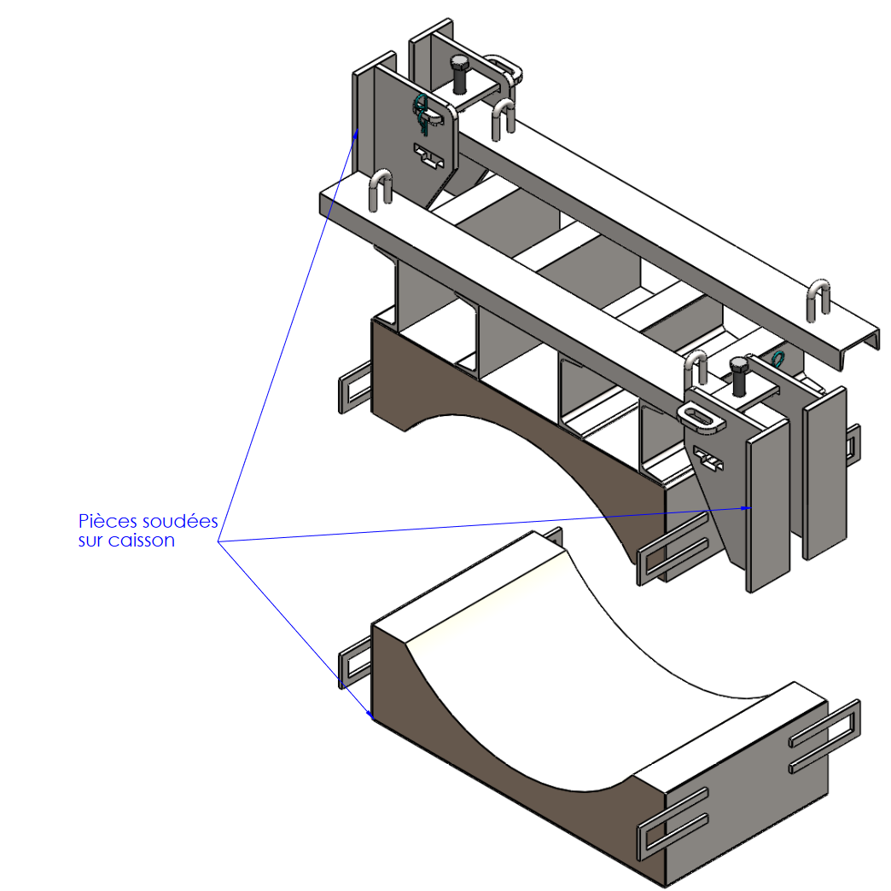
Transport of the TAS – preliminary solutions
Solutions for the transport of the TAS and cradle have been investigated (input from C. Celce and G. Dumont).
The option currently under consideration is a naked 10m³ container
The estimated residual dose rates at contact are already close to 2 mSv/h:
The bottom part of the container will be the weakest point (generally less shielding provided by the cradle)
If the dose rate at contact will be higher than 2 mSv/h, the container will be placed in a 6.05 m x 2.59 m x 2.59 m transport container whose bottom will be lined with an iron slab.

Slide 17
TAN to TAXN conversion

Slide 18
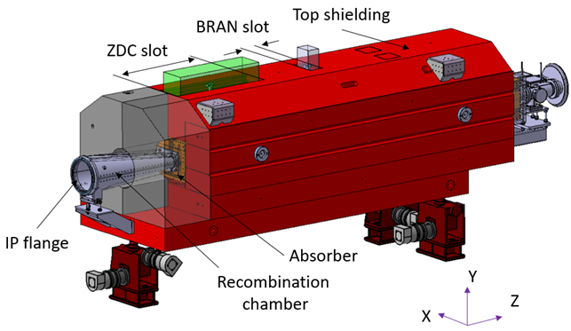
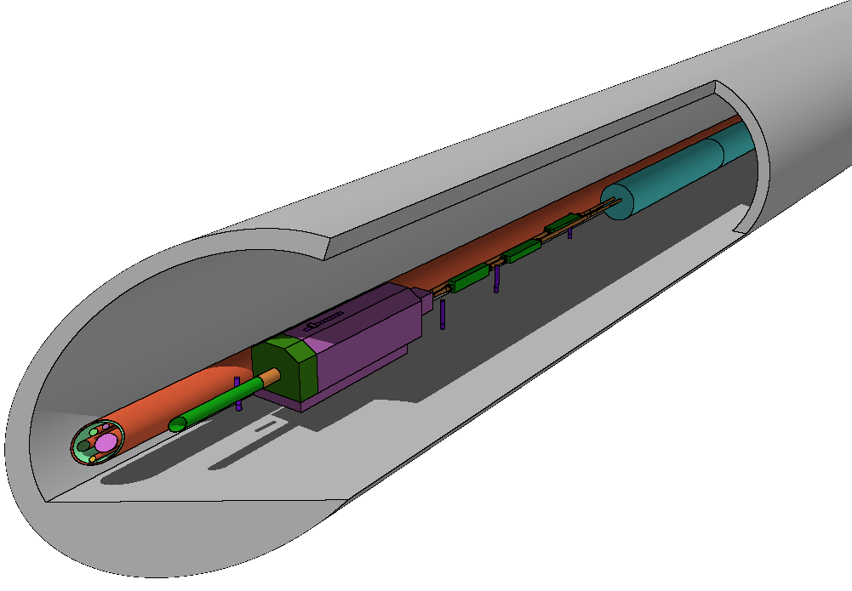
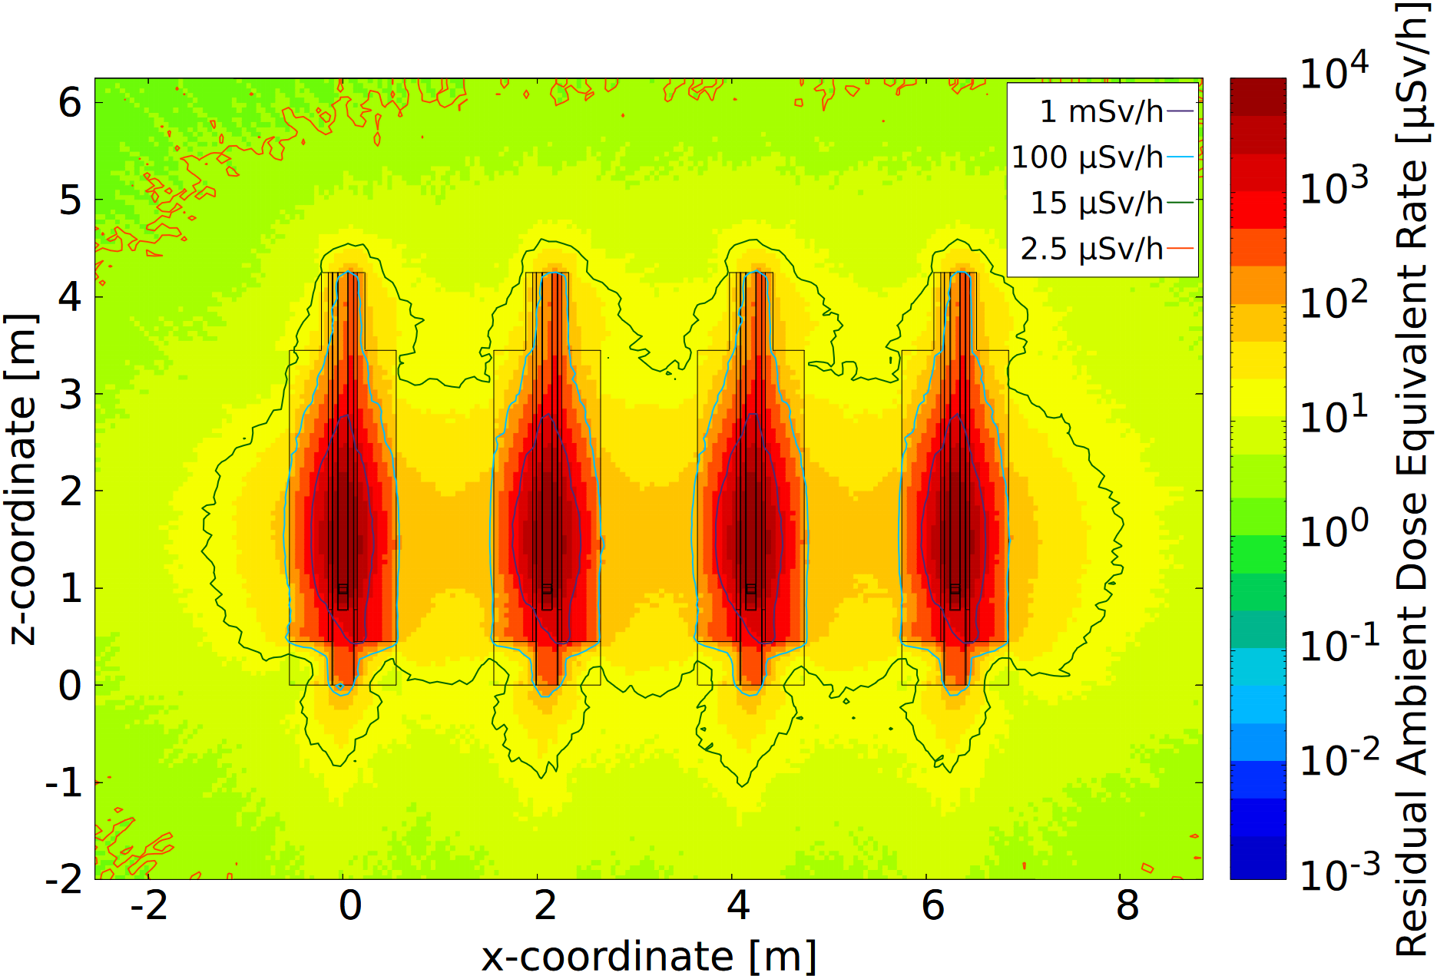
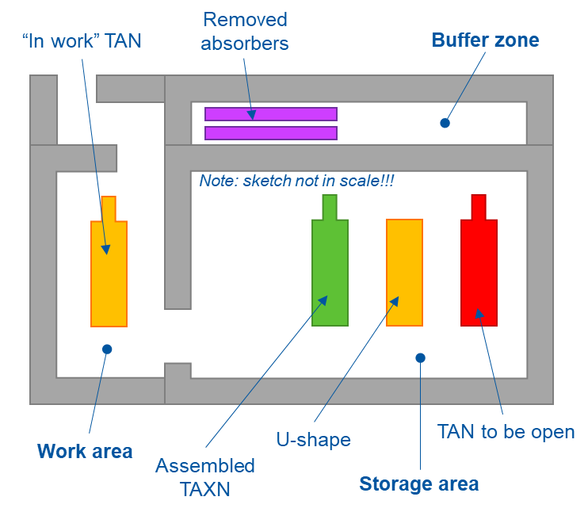
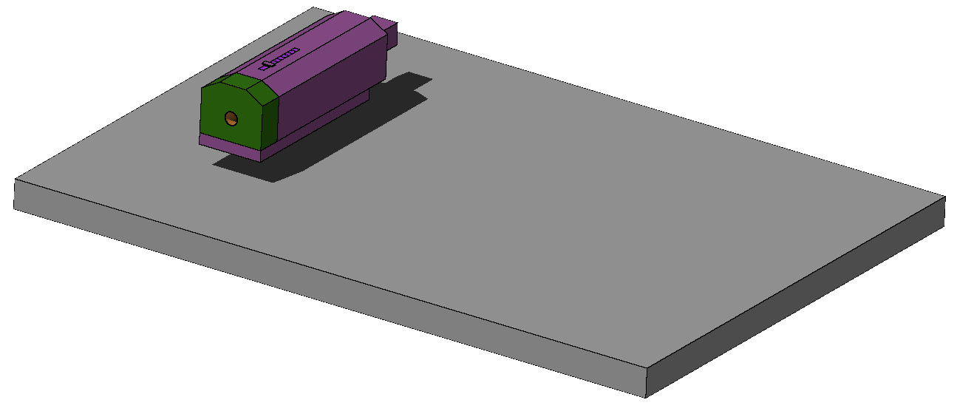
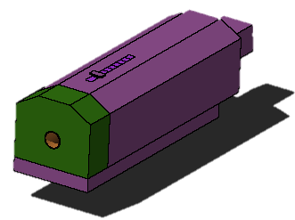
TAN/TAXN conversion
See detailed study by L. Elie in EDMS 2649832
Prompt transport
Residual transport
A number of studies were developed by HSE-RP in the past years on TAXN design and TAN/TAXN conversion.
A non-exhaustive list here: EDMS 2467997, 2596841, 2649832, and more.

Slide 19
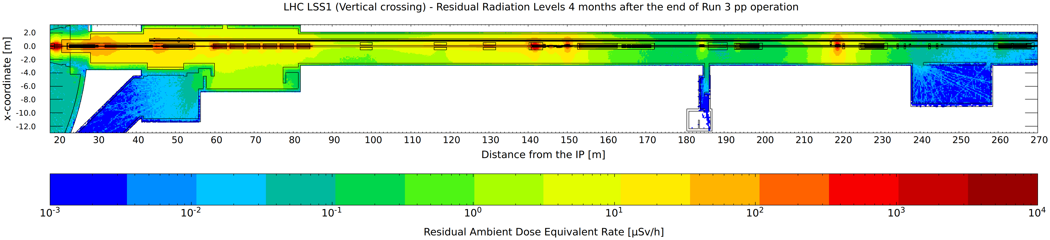
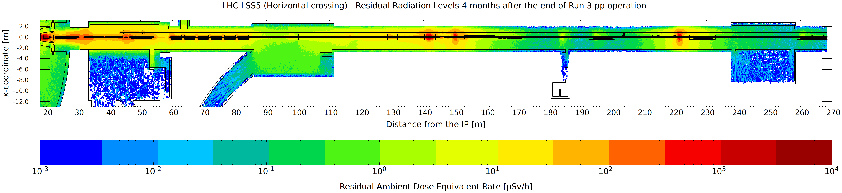

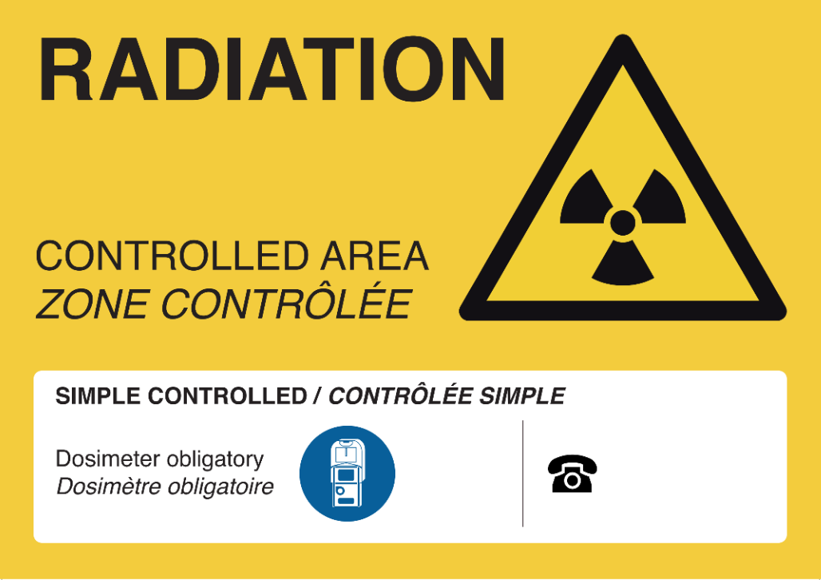
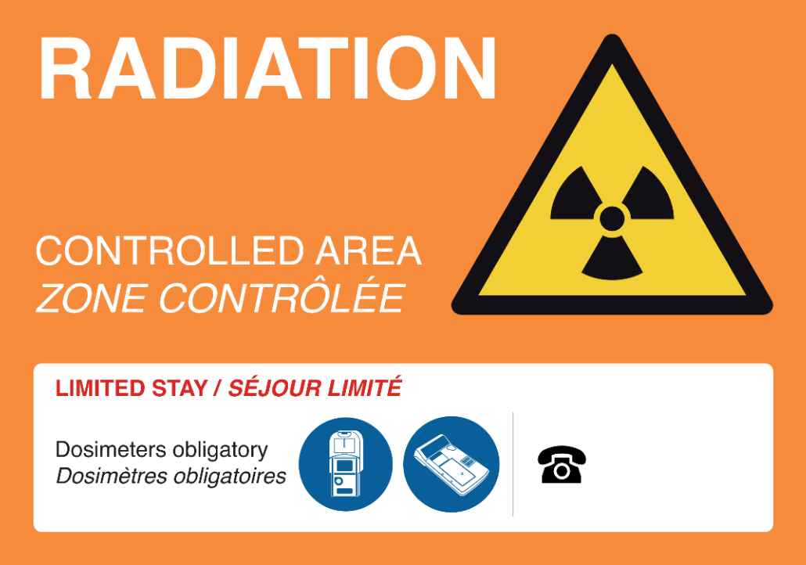
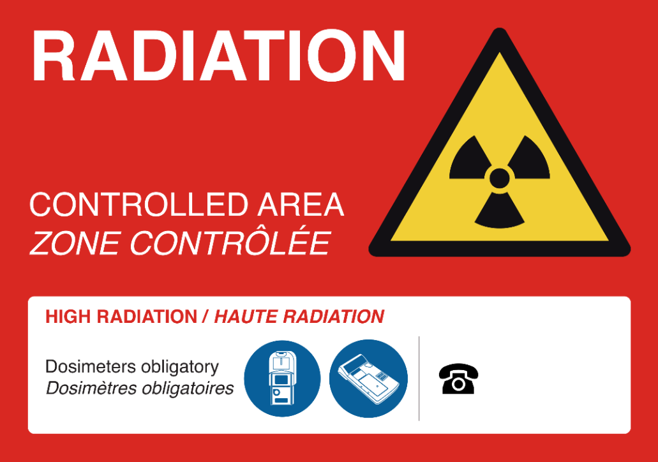
LS3: Residual H*(10) for LSS1/5
Permanent workplace
Low-occupancy area (<20 % of working time)
4 months after Run 3

Slide 20
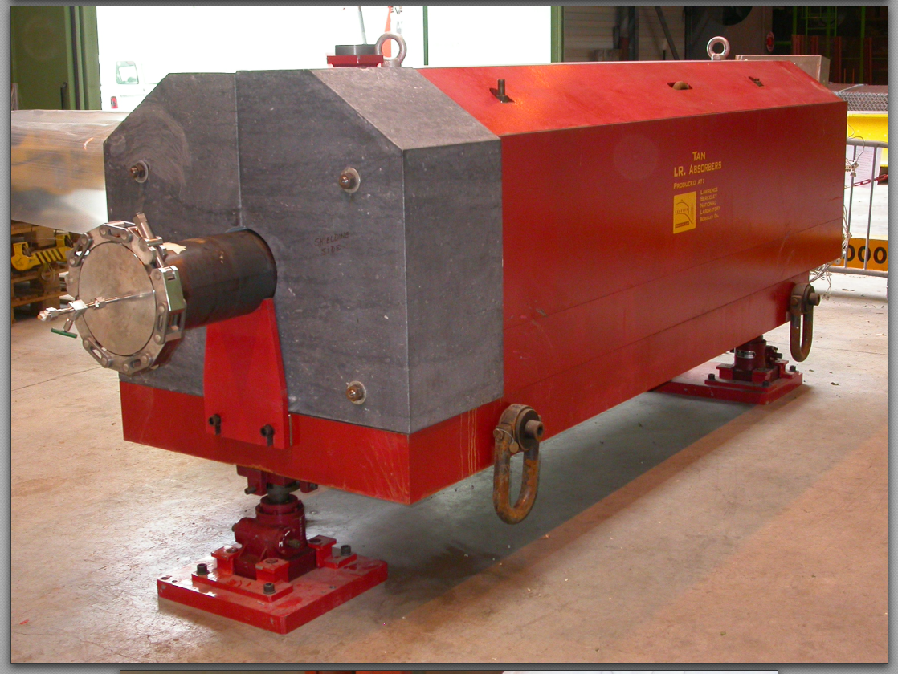
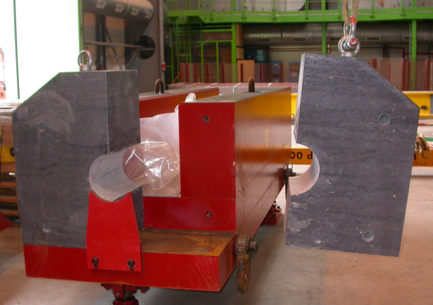
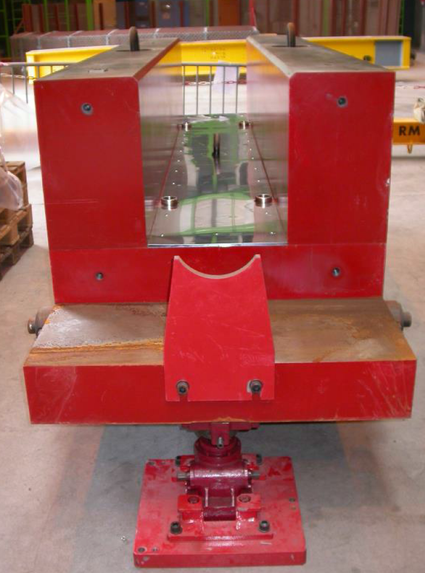
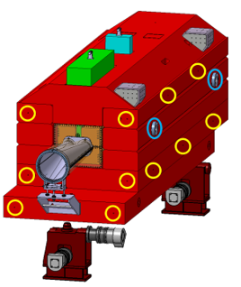
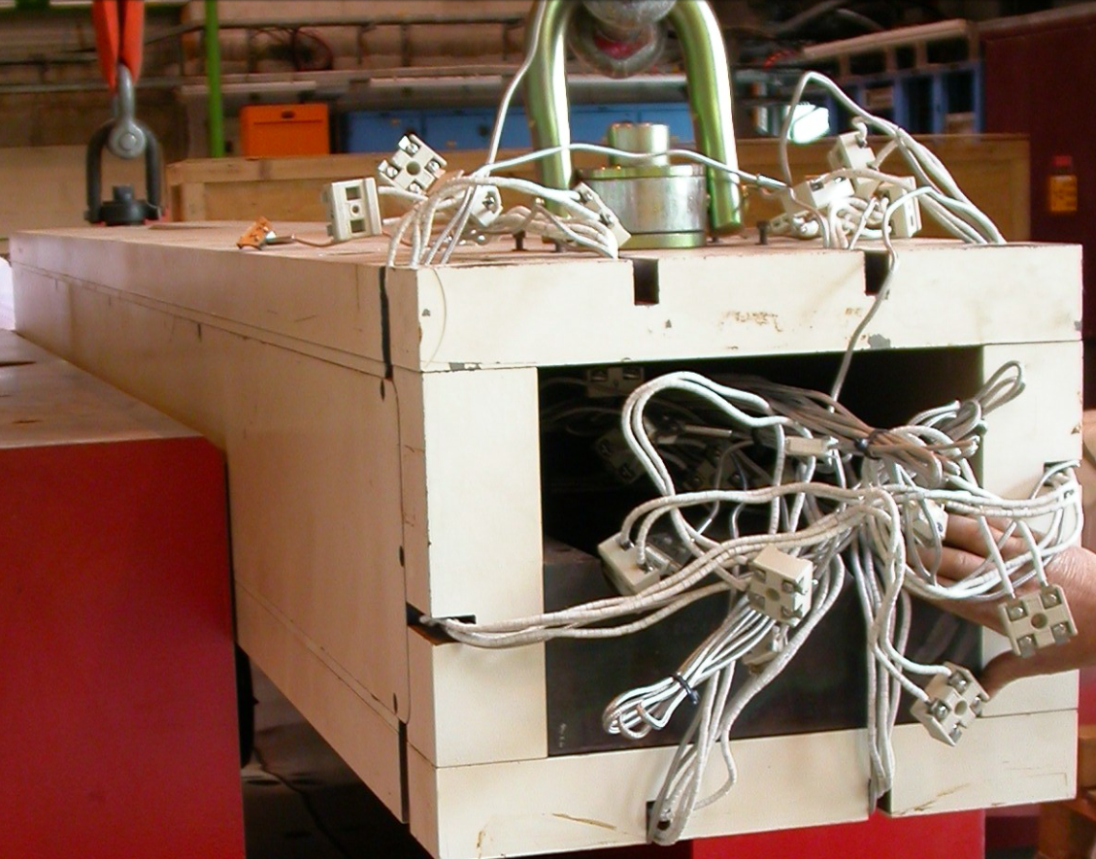
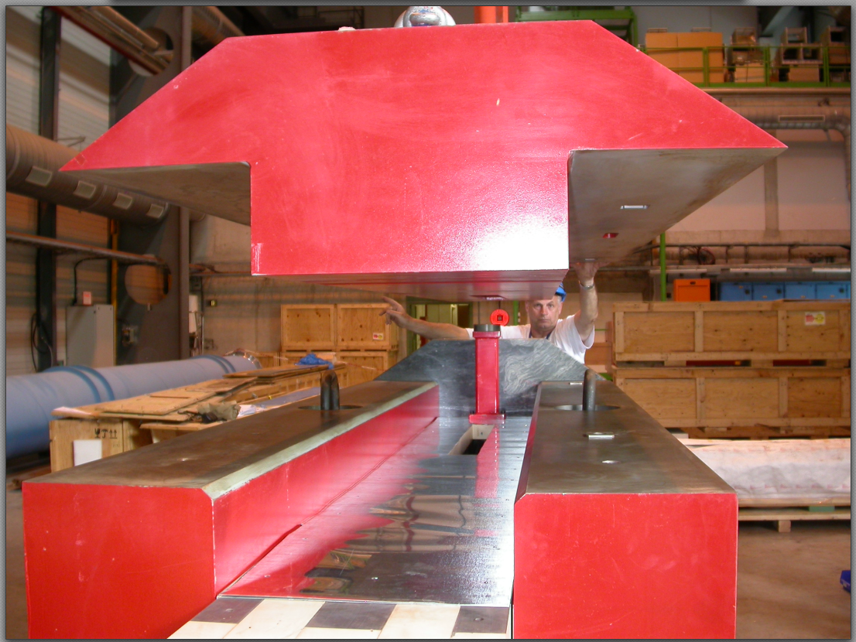
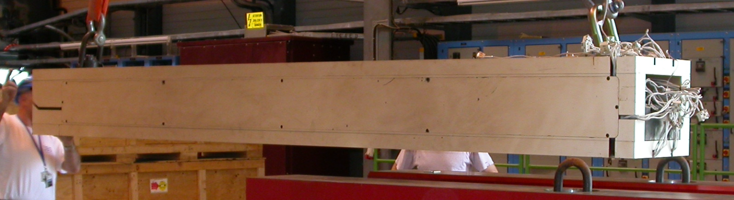
TAN/TAXN conversion
0
Removal of TAN from LHC tunnel + transport
1
3
5
6
4
2
7
Assembly HL-LHC TAXN
8
Transport/installation in the tunnel
To be repeated 4x!

Slide 21
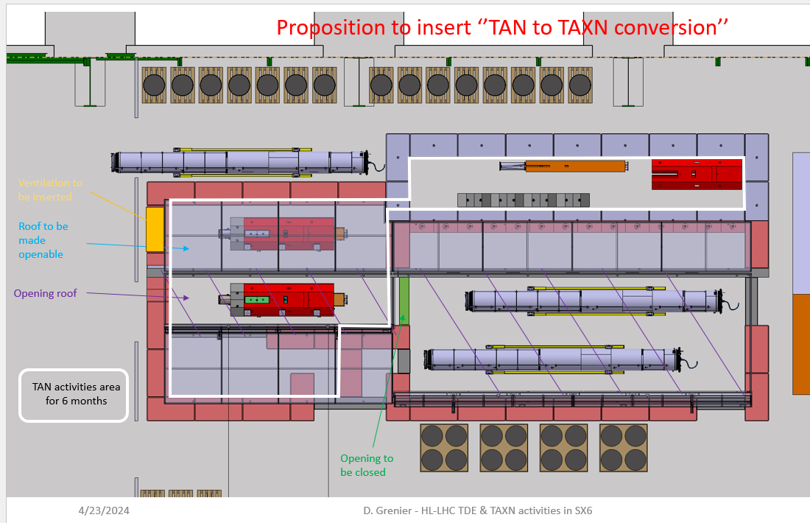
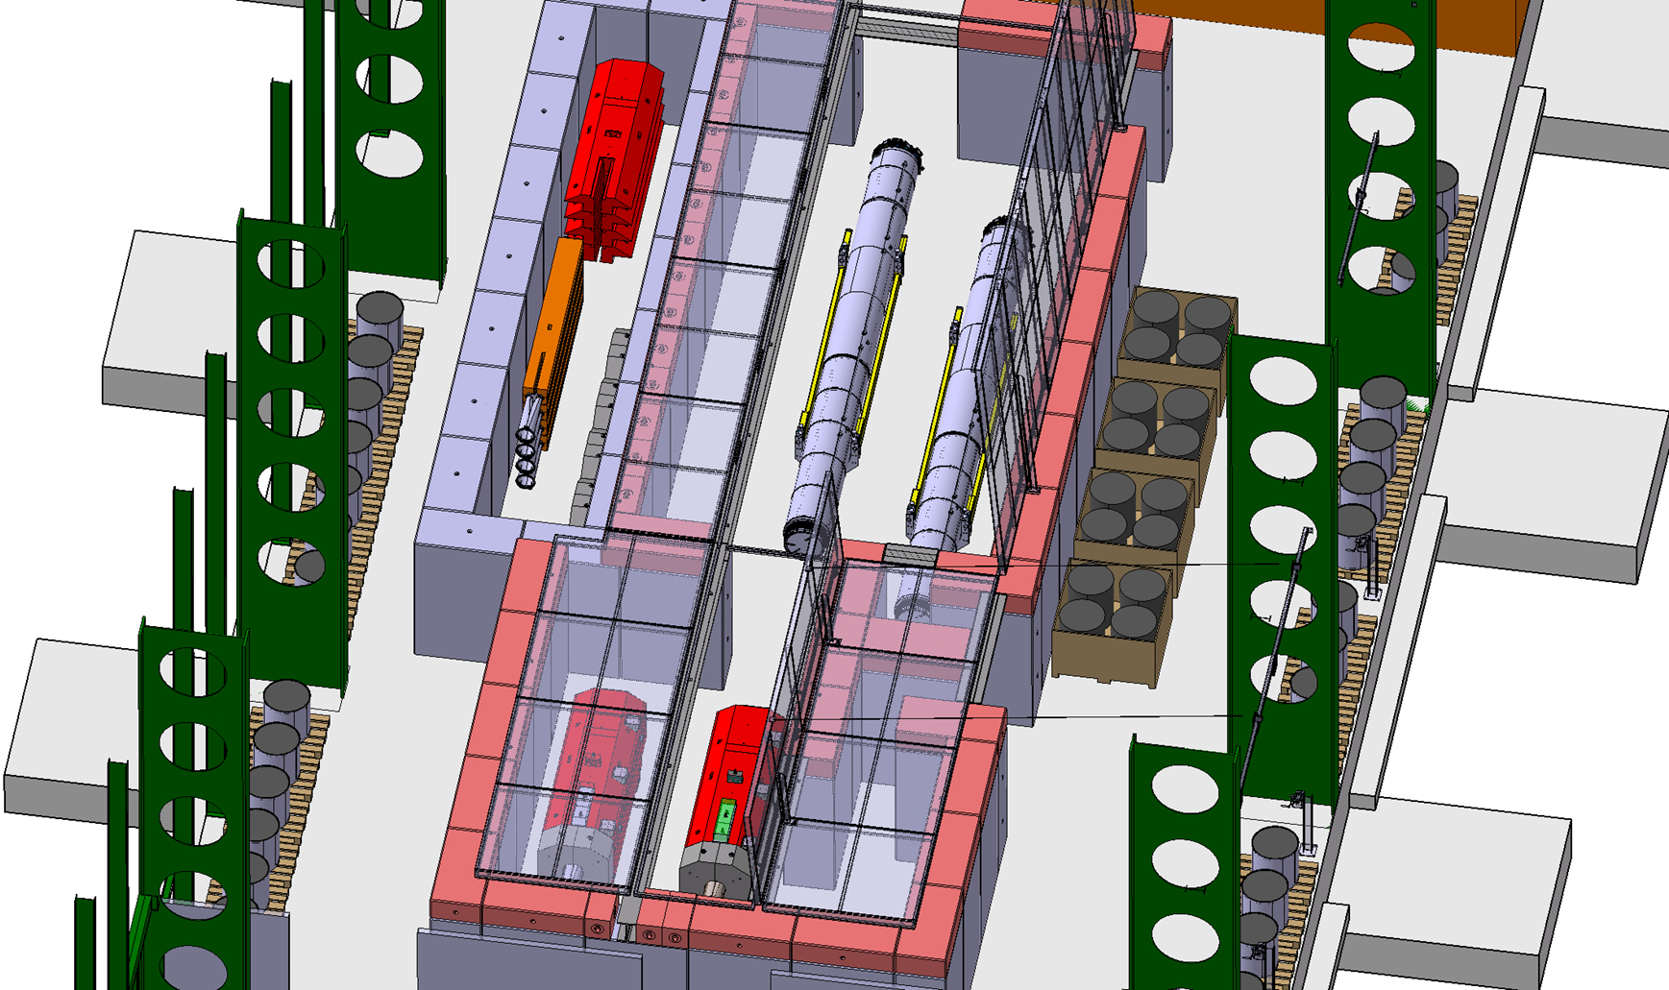
TAN/TAXN conversition
Shared worksite (with HL-LHC TDE) in SX6 building
Dedicated working area for TAN to TAXN conversion (1x TAN at the time)
Storage of TAN to convert/completed TAXN in UX65
Courtesy O. Boettcher (WP8)
SX6

Slide 22
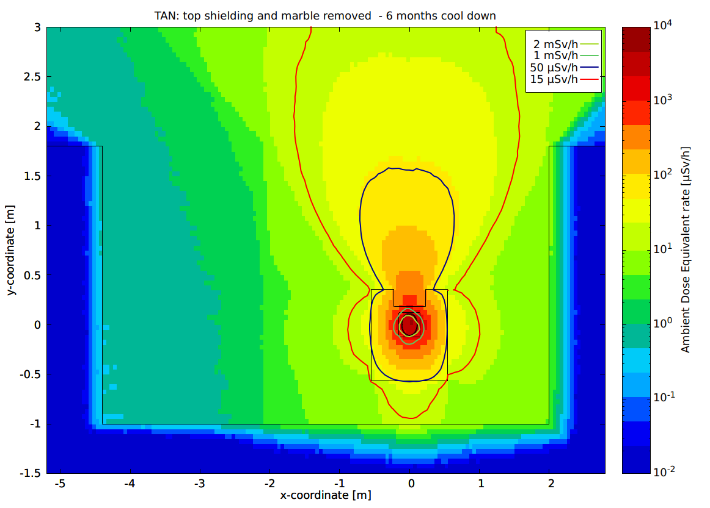
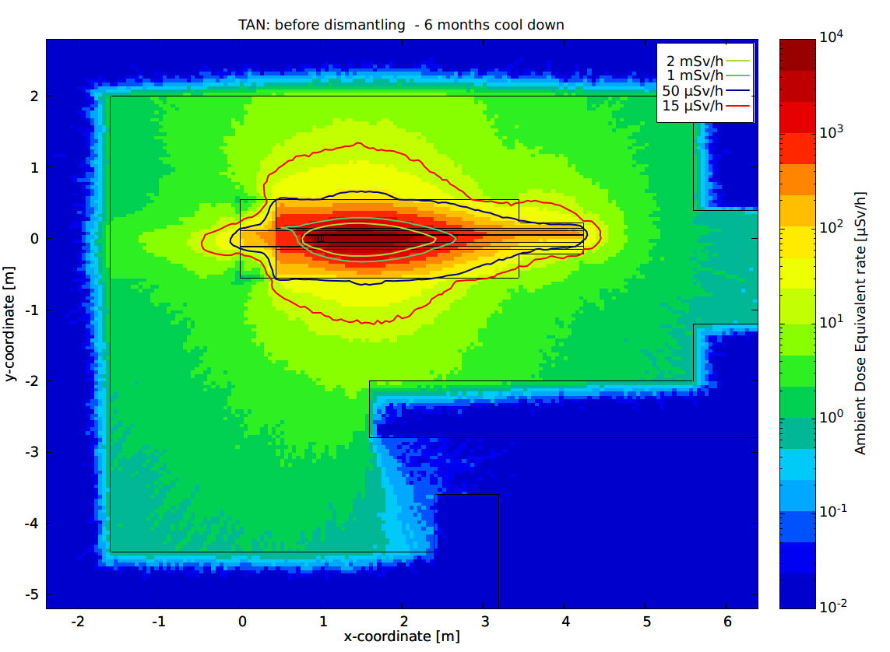
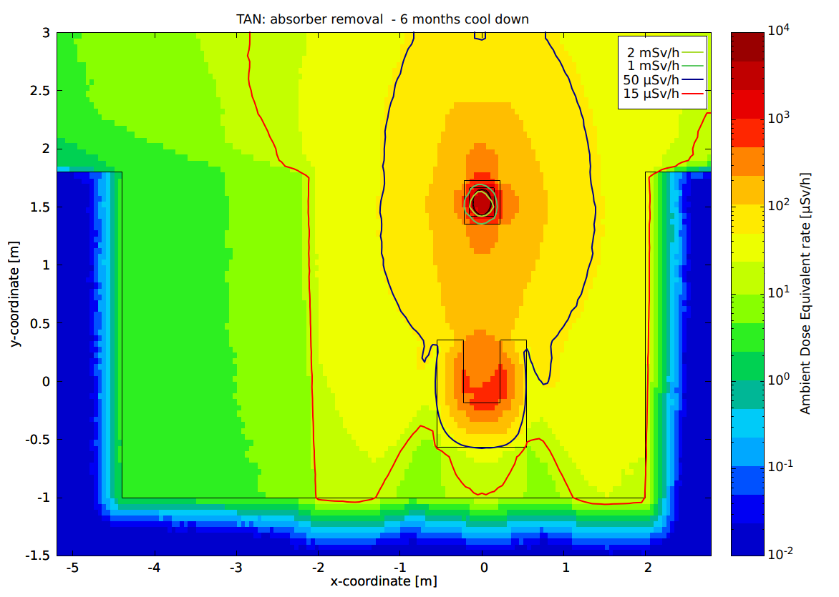
TAN/TAXN conversion
2
See detailed study by P. Dyrcz in EDMS 3088721
1
4
Several configuration studied, in terms of cool down and phases of the conversion.
Availability (time slot) of the SX6 building took in account.
Baseline: TAN removal in March/April 2026; conversation as from mid-2026 (~6 months cool down).

Slide 23
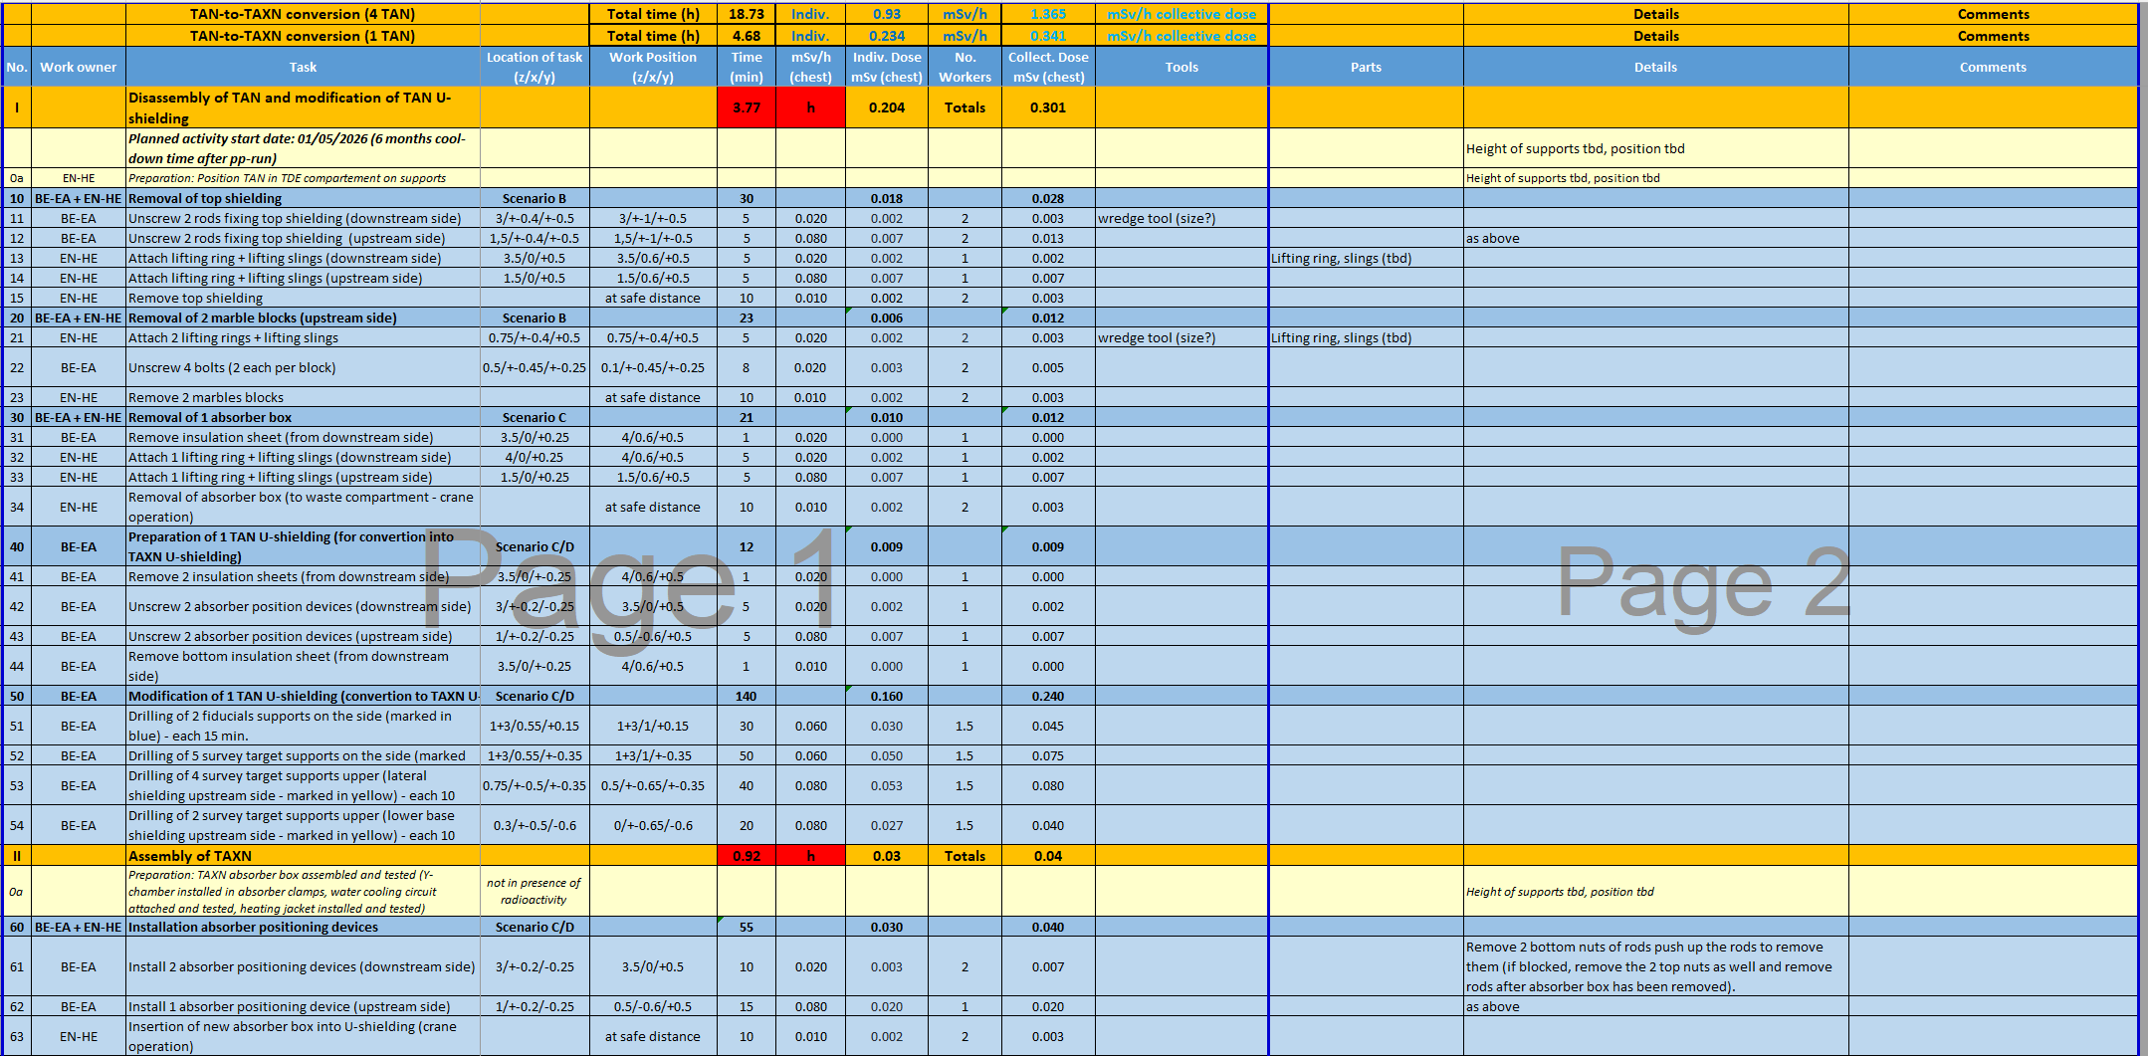
TAN/TAXN conversion
Preliminary WDP in work with WP8.
Residual dose rate, working locations, and potential optimization in work together with HSE-RP.
Activity potentially ALARA Lev. 3 (to be confirmed).
More iteration needed on this subject.
DRAFT

Slide 24
TAN/TAXN conversion
TAN shielding: specific activity in Bq/g
Top shielding (5 months c.d.)
Cu-absorber (5 months c.d.)
RN | 6 m | 1 y | 2 y
Fe-55 | 1.07E+03 | 9.45E+02 | 7.33E+02
Mn-54 | 4.48E+02 | 2.98E+02 | 1.32E+02
V-49 | 8.68E+01 | 5.91E+01 | 2.74E+01
H-3 | 2.47E+01 | 2.40E+01 | 2.27E+01
Co-60 | 1.82E+01 | 1.71E+01 | 1.49E+01
RN | Contribution to LL (%)
Mn-54 | 93
Co-60 | 5
Sc-46 | 1
Sum of LL | 3.05E3
RN | Contribution to LL (%)
Mn-54 | 35
Co-60 | 30
Co-56 | 16
Sum of LL | 1.24E4
NB: Sum of LL>1 means an item need to be treated as radioactive material
Radionuclide inventory in the main TAN components have been computed.
Next step: transport classification (HSE-RP-CS)
RW declared in the HSE-RP-RWM SharePoint (classification to be confirmed).

Slide 25
Take away points (I) - TAS
Residual dose rates for relevant open detector configurations and isolated TAS assemblies have been estimated for both ATLAS and CMS and can be used to provide the necessary input to the WDP preparation.
The radionuclide inventories for the ATLAS shielding, ATLAS TAS, and CMS TAS have also been estimated and the results have been provided to HSE-RP-CS for the transport classification.
A possible solution for the transport container for the TAS has been found:
In case the dose rate at contact of the container will be greater than 2 mSv/h, additional shielding will be added in the transport container.
A possibly delay of LS3 by 1 year would not change the global picture, provided that the planning is translated accordingly. The transport classification most likely will not change and compensation measures are already being envisaged (i.e. additional shielding in the transport container).

Slide 26
Take away points (II) - TAN
Close collaboration between WP8 and HSE-RP
HSEP-RP studies for the TAN to TAXN conversion quite advanced, with several options considered depending on the availability of the SX6 building (presently as from mid-2026).
The radionuclide inventories for the TAN components have been computed and the results will be soon provided to HSE-RP-CS for the transport classification.
At present: TAN from Pt.5 will be transported via the tunnel; TAN from Pt.1 need an IP2-container.
Radioactive Waste: declared in HSE-RP-RWM SharePoint; classification to be confirmed.
A possibly delay of LS3 by 1-year would not change the global picture, provided that an ion run is kept before the end of Run 3 beam operation (assuming 4 weeks ion run) and that the conversion planning is translated by 1-year accordingly. If one of the two is not confirmed, the RP impact would need to be re-evaluated.

Slide 27
BACKUP SLIDES

Slide 28
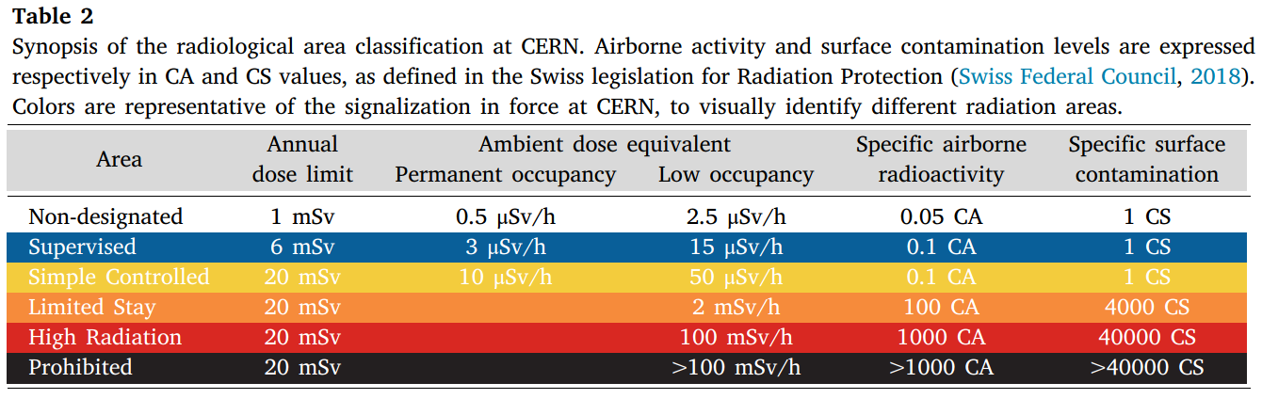
Radiation Area classification
EDMS 810149
Low-occupancy: < 20% working time

Slide 29

LS3 preparation (RP): Interventions
Interventions:
The optimization of an intervention according to the ALARA principle and its final approval is based on a radiation protection risk assessment.
All interventions of ALARA Level 2 and 3 are optimized based on individual RP risk assessments.
When the radiological risk associated with an activity is classified as ALARA level 3 it must be reviewed and approved by the ALARA Committee.
ALARA 3 preparation: iterative process which may profit form ALARA-like exercise (dry-runs in technical management meetings within departments).
Collecting needs possibly through RSOs and presentations in the RSOC meetings.
Defying a person coordinating the activity on-site/presenting the activity to the ALARA committee.
DIMR: granularity to be defined (split by point? split by macro-activity).
IMPACT: grouping to be discussed.
EDMS 1751123

