Slide 1

CERN TH – BSM Forum
21 March 2024
Measuring spin correlations of bottom
and charm quark pairs at the LHC
Yevgeny Kats
Yevgeny Kats and David Uzan, JHEP 03 (2024) 063 [arXiv:2311.08226]

Slide 2
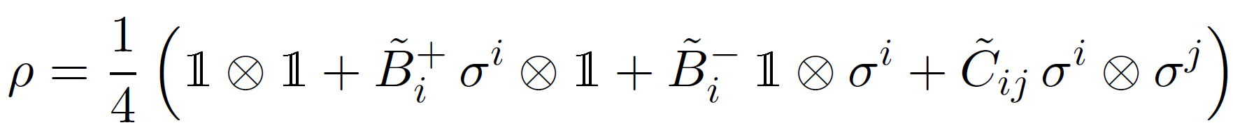
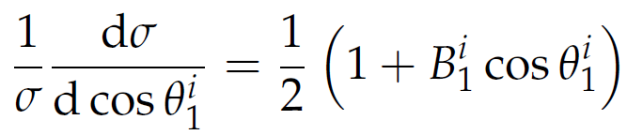
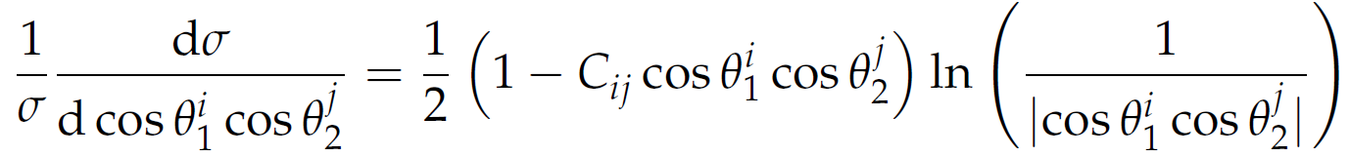
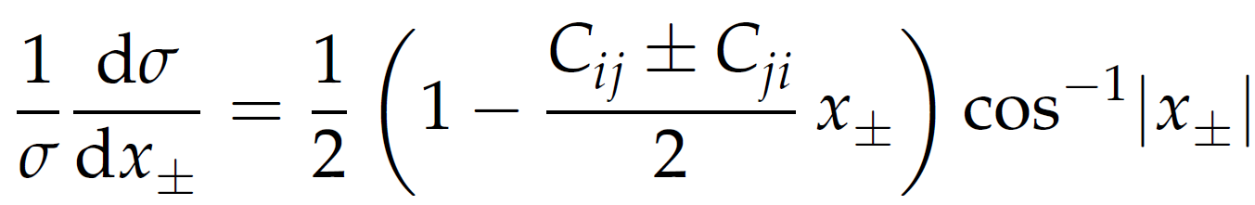
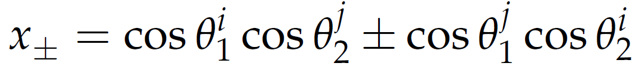
Motivation
ATLAS and CMS already measure spin correlations in $pp→t\overline{t}$.
Density matrix for the $t$ and $\overline{t}$ spins:
Angular distributions of leptons from top decays:

Slide 3
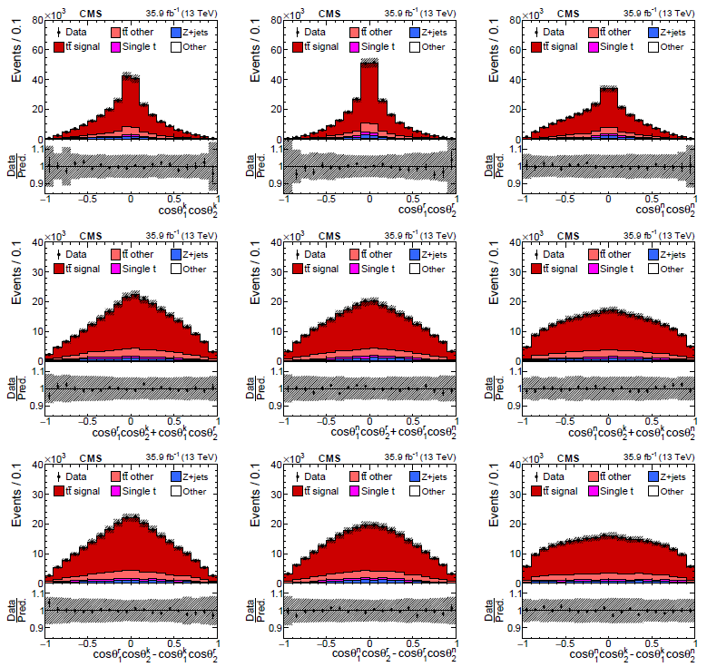
Motivation
ATLAS and CMS already measure spin correlations in $pp→t\overline{t}$.
CMS Collaboration
PRD 100, 072002 (2019)
[arXiv:1907.03729]

Slide 4
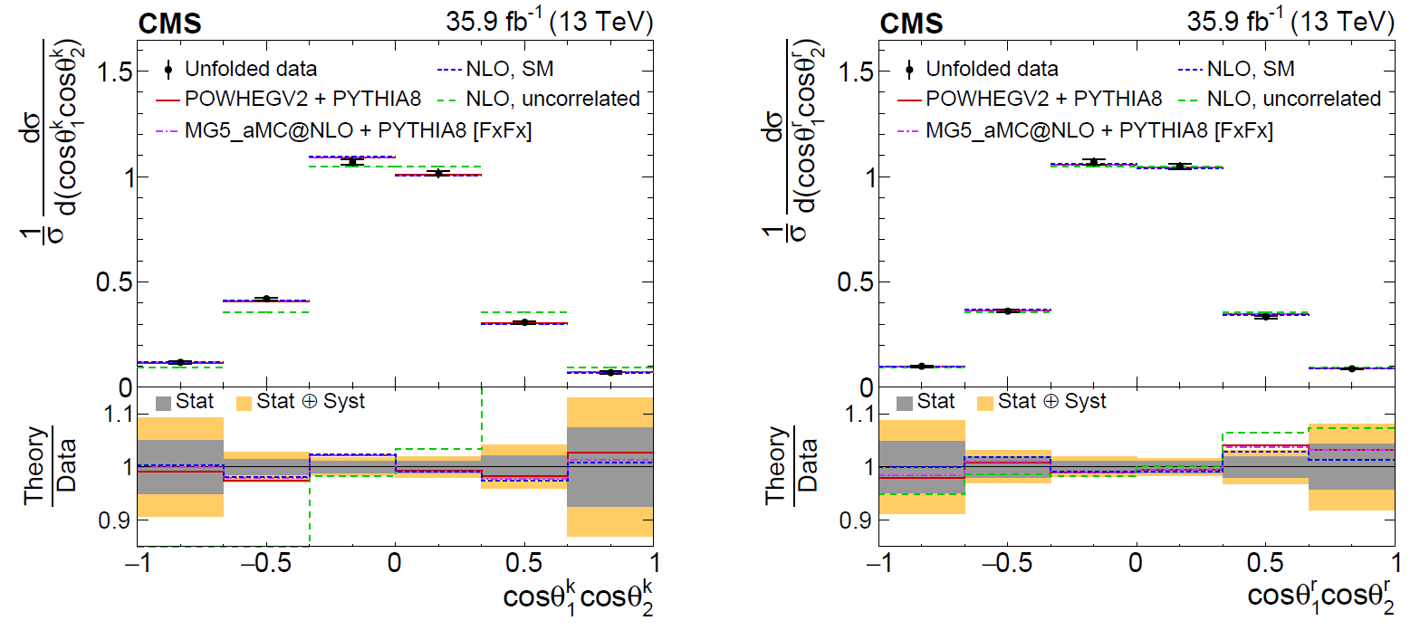
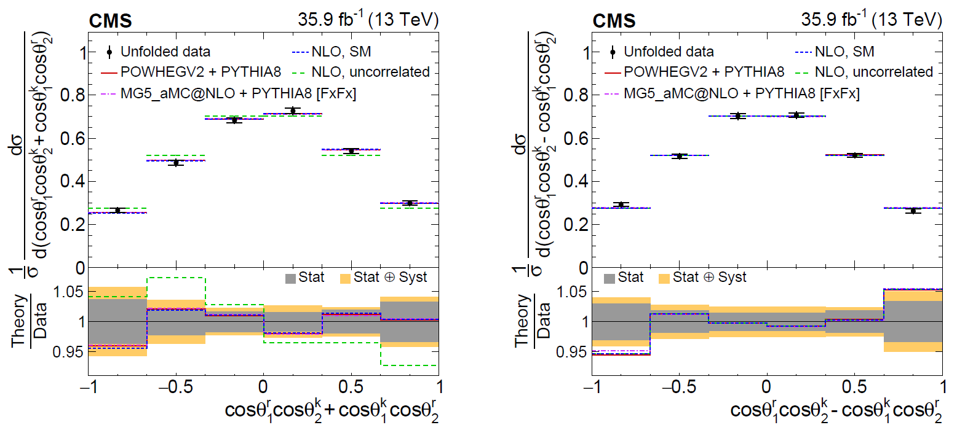
Motivation
ATLAS and CMS already measure spin correlations in $pp→t\overline{t}$.
CMS Collaboration
PRD 100, 072002 (2019)
[arXiv:1907.03729]

Slide 5
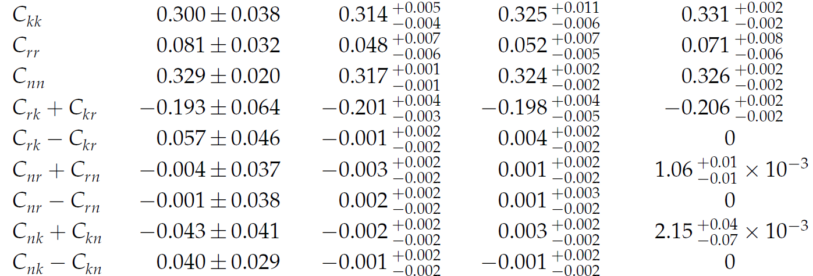
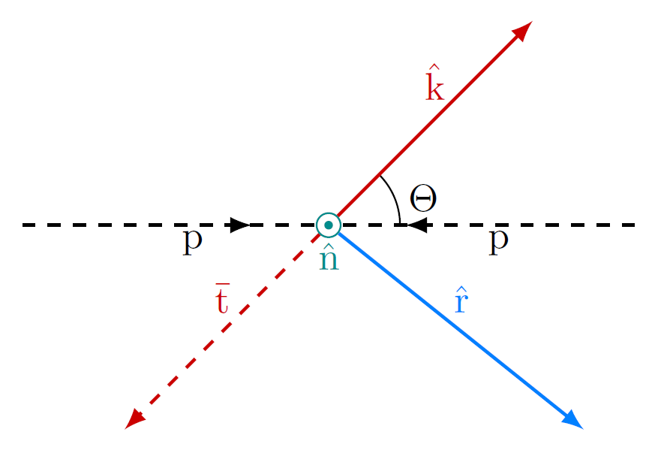
Motivation
ATLAS and CMS already measure spin correlations in $pp→t\overline{t}$.
CMS Collaboration
PRD 100, 072002 (2019)
[arXiv:1907.03729]

Slide 6
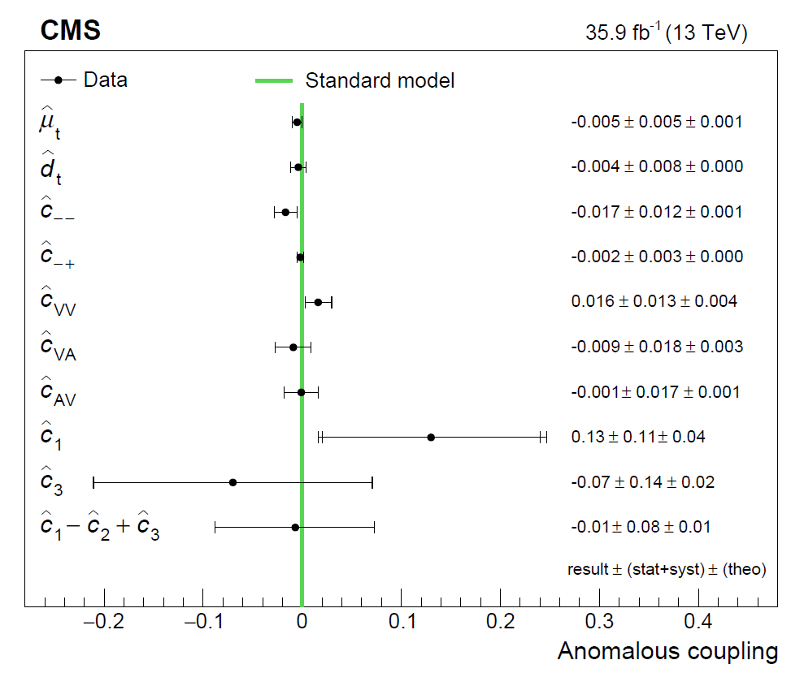
Motivation
ATLAS and CMS already measure spin correlations in $pp→t\overline{t}$.
CMS Collaboration
PRD 100, 072002 (2019)
[arXiv:1907.03729]

Slide 7
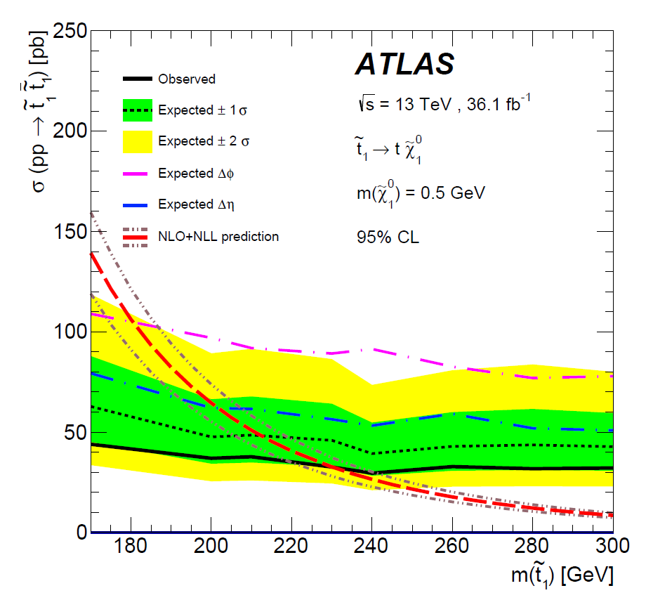
Motivation
ATLAS and CMS already measure spin correlations in $pp→t\overline{t}$.
ATLAS Collaboration
EPJC 80 (2020) 754
[arXiv:1903.07570]

Slide 8
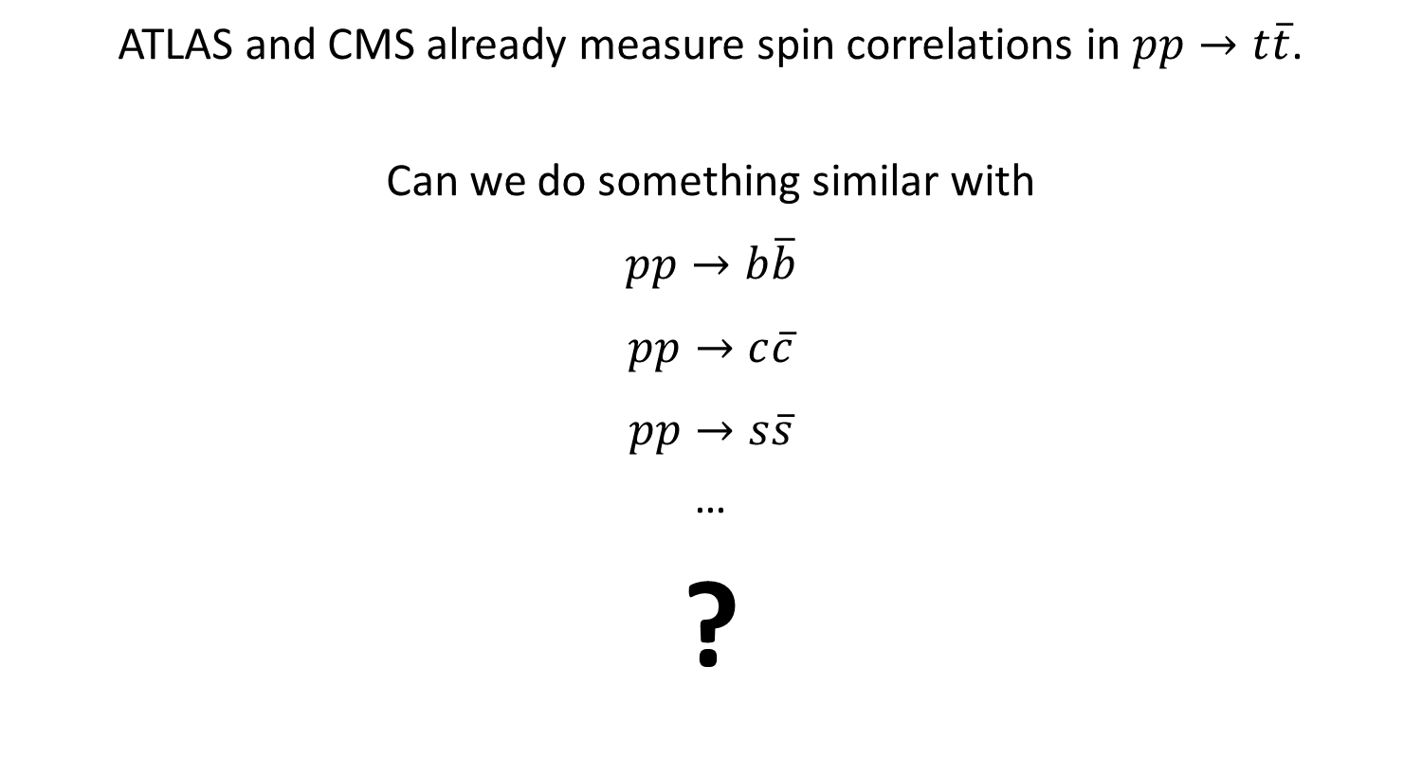
Motivation
ATLAS and CMS already measure spin correlations in $pp→t\overline{t}$.
Can we do something similar with
$$pp→b\overline{b}$$
$$pp→c\overline{c}$$
$$pp→s\overline{s}$$
…
?

Slide 9
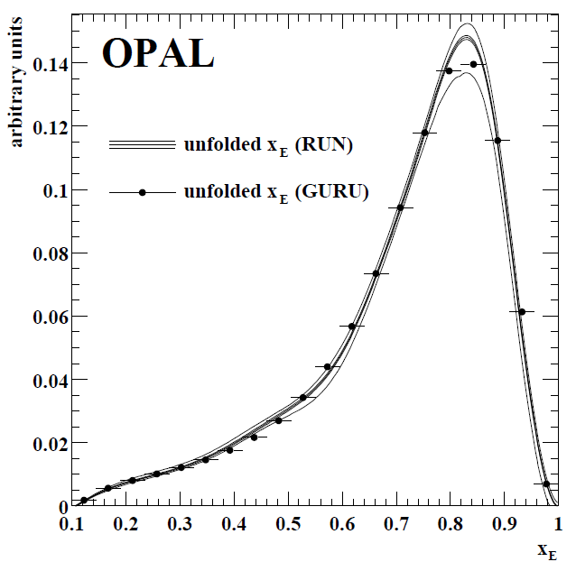

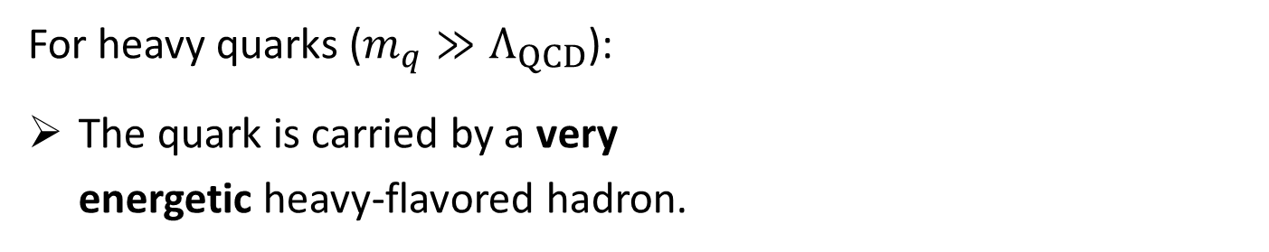
Heavy quarks ($b$, $c$)
For heavy quarks ($m_{q}≫Λ_{QCD}$):
The quark is carried by a very
energetic heavy-flavored hadron.
EPJC 29, 463 (2003)
[hep-ex/0210031]

Slide 10

Heavy quarks ($b$, $c$)
For heavy quarks ($m_{q}≫Λ_{QCD}$):
The quark is carried by a very
energetic heavy-flavored hadron.
When it is a baryon, $𝒪(1)$ fraction
of the polarization is expected to
be retained.
EPJC 29, 463 (2003)
[hep-ex/0210031]
Mannel and Schuler, PLB 279, 194 (1992)
Close, Körner, Phillips, Summers, J. Phys. G 18, 1703 (1992)
Falk and Peskin, PRD 49, 3320 (1994) [hep-ph/9308241]

Slide 11
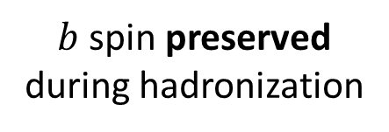

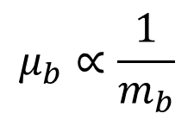

$b$-quark polarization retention
$$m_{b}≫Λ_{QCD}$$
chromomagnetic
moment
$$μ_{b}∝\frac{1}{m_{b}}$$
$b$ spin preserved
during hadronization

Slide 12



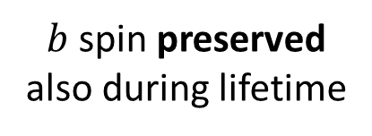
$b$-quark polarization retention
$$m_{b}≫Λ_{QCD}$$
chromomagnetic
moment
$$μ_{b}∝\frac{1}{m_{b}}$$
$b$ spin preserved
during hadronization
$$Λ_{b}$$
$b$ spin preserved
also during lifetime
1/2
0
$$b$$
$$qq$$

Slide 13
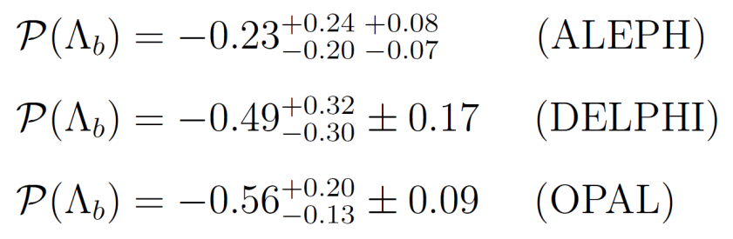
$b$-quark polarization retention
$$m_{b}≫Λ_{QCD}$$
chromomagnetic
moment
$$μ_{b}∝\frac{1}{m_{b}}$$
$b$ spin preserved
during hadronization
$$Λ_{b}$$
$b$ spin preserved
also during lifetime
1/2
0
$$b$$
$$qq$$
Evidence observed at LEP in $Z→b\overline{b}$, where $𝒫\left(b\right)≃−0.94.$
PLB 365, 437 (1996)
PLB 474, 205 (2000)
PLB 444, 539 (1998) [hep-ex/9808006]

Slide 14
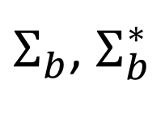
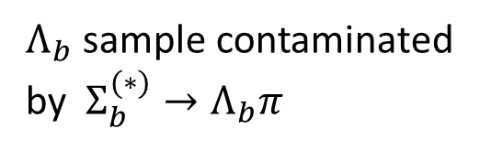
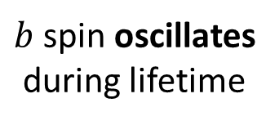
$b$-quark polarization retention
$$m_{b}≫Λ_{QCD}$$
chromomagnetic
moment
$$μ_{b}∝\frac{1}{m_{b}}$$
$b$ spin preserved
during hadronization
$$Λ_{b}$$
$b$ spin preserved
also during lifetime
1/2
0
$$b$$
$$qq$$
1/2
1
$b$ spin oscillates
during lifetime
$Σ_{b}$, $Σ_{b}^{∗}$
$Λ_{b}$ sample contaminated
by $Σ_{b}^{(∗)}→Λ_{b}π$

Slide 15
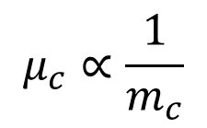

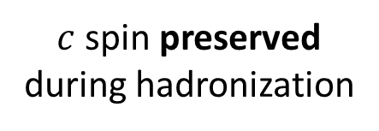


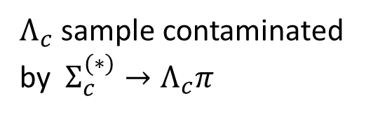

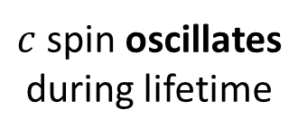
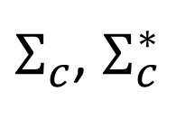
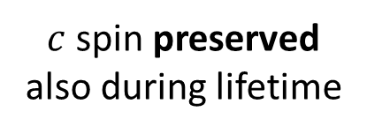


$c$-quark polarization retention
$$m_{c}≫Λ_{QCD}$$
as a rough
approximation
chromomagnetic
moment
$$μ_{c}∝\frac{1}{m_{c}}$$
$c$ spin preserved
during hadronization
$$Λ_{c}$$
$c$ spin preserved
also during lifetime
1/2
0
$$c$$
$$qq$$
$Σ_{c}$(2455)
$c$ spin oscillates
during lifetime
1/2
1
$Σ_{c}$, $Σ_{c}^{∗}$
$Λ_{c}$ sample contaminated
by $Σ_{c}^{(∗)}→Λ_{c}π$
$Σ_{c}$(2520)

Slide 16
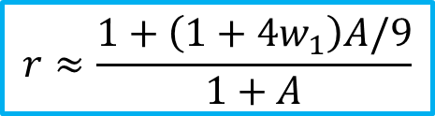

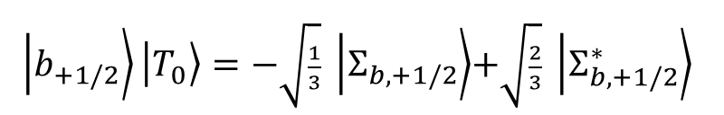


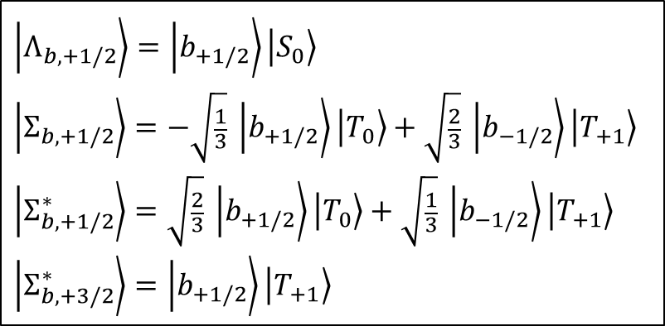
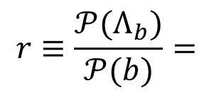

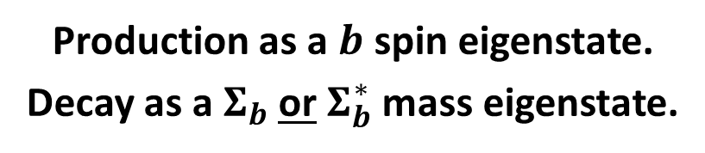

$b$-quark polarization retention
Dominant polarization loss effect
$Σ_{b}^{(∗)}→Λ_{b}π$ decays
$$r≡\frac{𝒫(Λ_{b})}{𝒫(b)}=$$
$$?$$
“diquarks”
$$\left.\left|Λ_{b,+1/2}\right.\right\rangle =\left.\left|b_{+1/2}\right.\right\rangle \left.\left|S_{0}\right.\right\rangle$$
$$\left.\left|Σ_{b,+1/2}\right.\right\rangle =−\sqrt{\frac{1}{3}}\left. \left|b_{+1/2}\right.\right\rangle \left.\left|T_{0}\right.\right\rangle +\sqrt{\frac{2}{3}}\left. \left|b_{−1/2}\right.\right\rangle \left.\left|T_{+1}\right.\right\rangle$$
$$\left.\left|Σ_{b,+1/2}^{∗}\right.\right\rangle =\sqrt{\frac{2}{3}}\left. \left|b_{+1/2}\right.\right\rangle \left.\left|T_{0}\right.\right\rangle +\sqrt{\frac{1}{3}}\left. \left|b_{−1/2}\right.\right\rangle \left.\left|T_{+1}\right.\right\rangle$$
$$\left.\left|Σ_{b,+3/2}^{∗}\right.\right\rangle =\left.\left|b_{+1/2}\right.\right\rangle \left.\left|T_{+1}\right.\right\rangle$$
$$S$$
$$T$$
spin-0
isosinglet
spin-1
isotriplet
$$A=\frac{prob\left(Σ_{b}^{\left(∗\right)}\right)}{prob \left(Λ_{b}\right)}=9 \frac{prob\left(T\right)}{prob\left(S\right)}$$
$$w_{1}=\frac{prob\left(T_{±1}\right)}{prob\left(T\right)}$$
Production as a $b$ spin eigenstate.
Decay as a $Σ_{b}$ or $Σ_{b}^{∗}$ mass eigenstate.
along axis of
fragmentation
$\left. \left|b_{+1/2}\right.\right\rangle \left.\left|T_{0}\right.\right\rangle =−\sqrt{\frac{1}{3}}\left. \left|Σ_{b,+1/2}\right.\right\rangle$+$\sqrt{\frac{2}{3}} \left.\left|Σ_{b,+1/2}^{∗}\right.\right\rangle$
$$r≈\frac{1+\left(1+4w_{1}\right)A/9}{1+A}$$
e.g.
Falk and Peskin, PRD 49, 3320 (1994) [hep-ph/9308241]

Slide 17
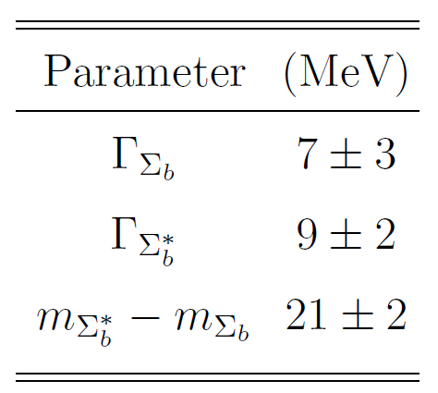
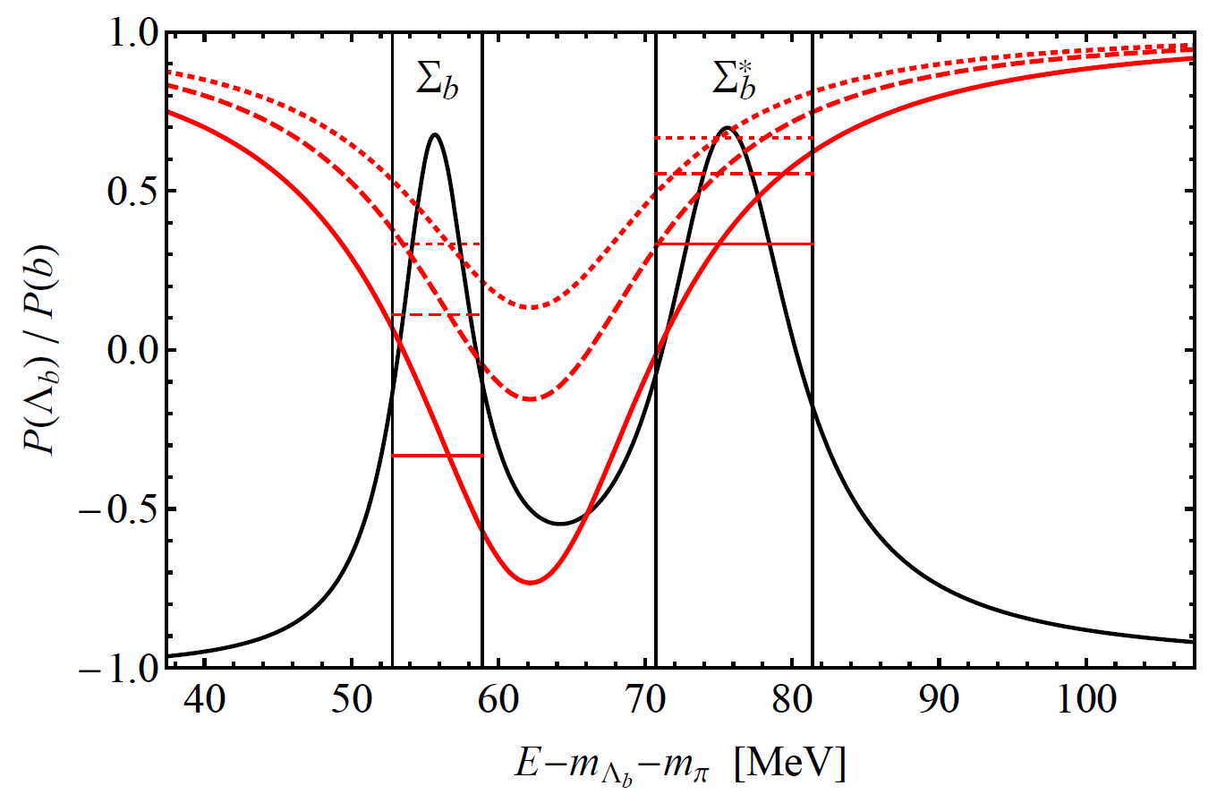
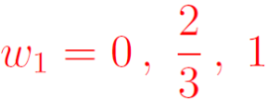
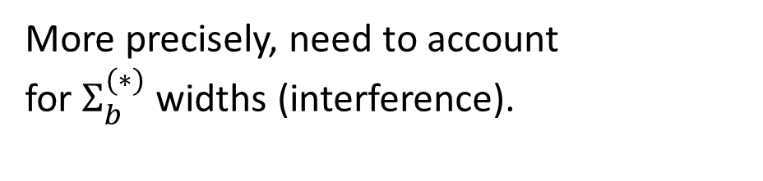
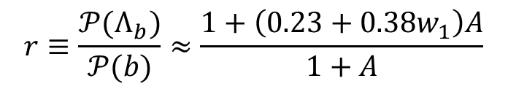
$b$-quark polarization retention
More precisely, need to account
for $Σ_{b}^{(∗)}$ widths (interference).
Galanti, Giammanco, Grossman,
Kats, Stamou, Zupan
JHEP 11 (2015) 067
[arXiv:1505.02771]
$$r≡\frac{𝒫(Λ_{b})}{𝒫(b)}≈\frac{1+\left(0.23+0.38w_{1}\right)A}{1+A}$$

Slide 18
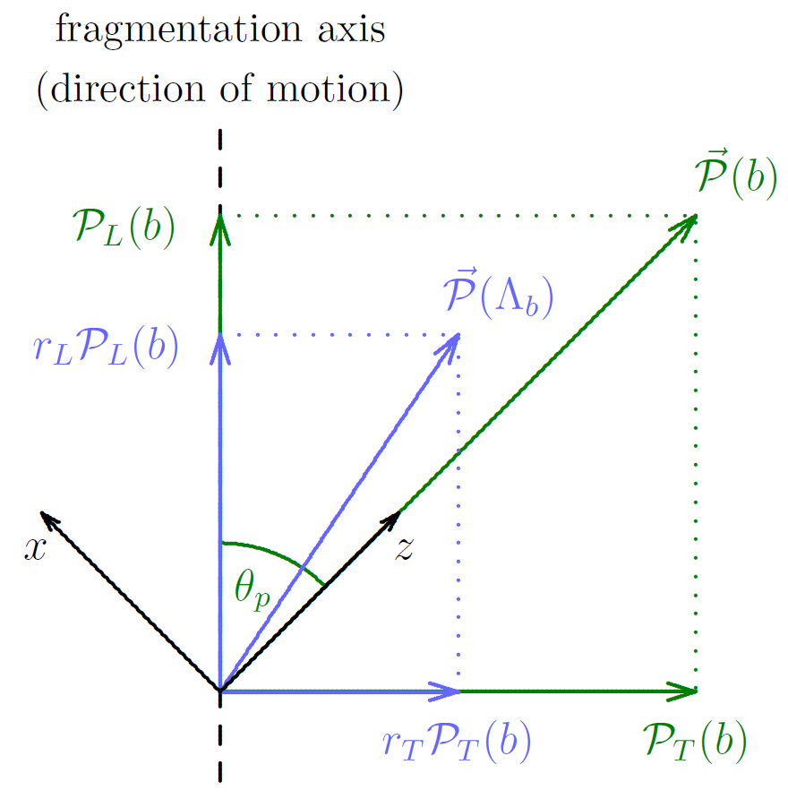
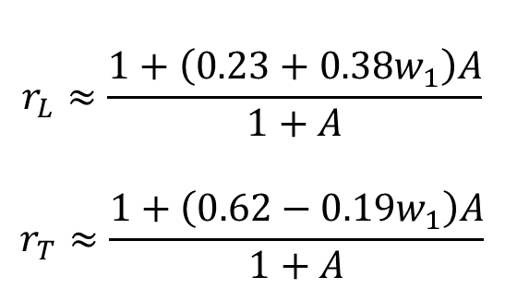

$b$-quark polarization retention
$$r_{L}≈\frac{1+\left(0.23+0.38w_{1}\right)A}{1+A}$$
$$r_{T}≈\frac{1+\left(0.62−0.19w_{1}\right)A}{1+A}$$
Directional dependence, since
holds along the fragmentation
axis.
$$w_{1}=\frac{prob\left(T_{±1}\right)}{prob\left(T\right)}$$
Galanti, Giammanco, Grossman, Kats, Stamou, Zupan
JHEP 11 (2015) 067 [arXiv:1505.02771]

Slide 19
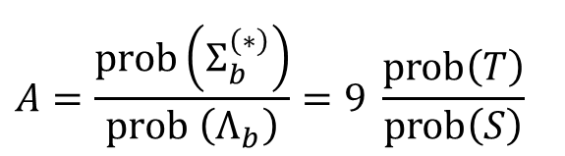

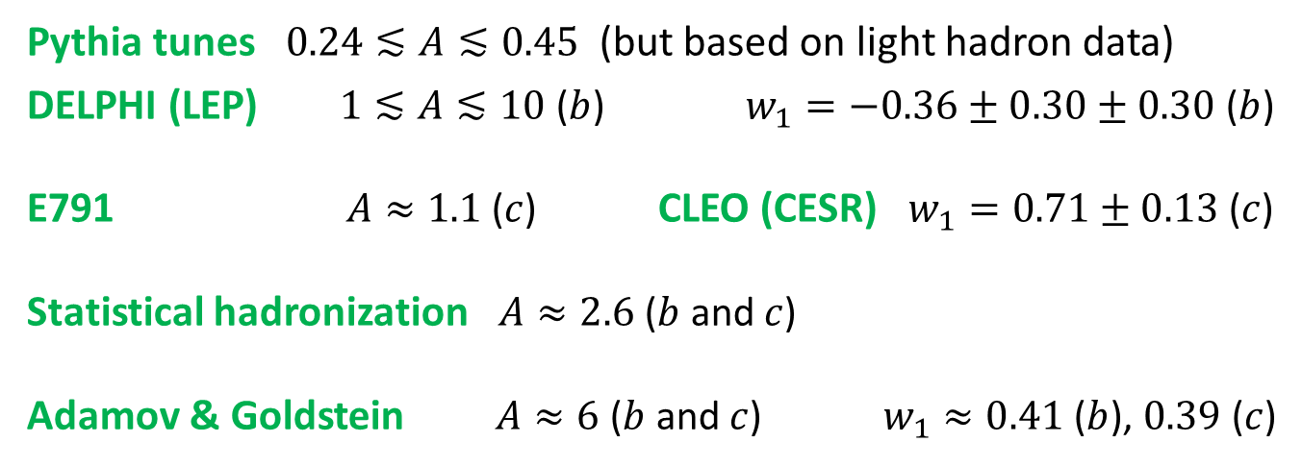
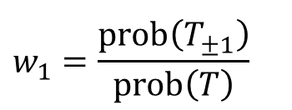
Heavy quark polarization retention
$$r_{L}≈\frac{1+\left(0.23+0.38w_{1}\right)A}{1+A}$$
$$r_{T}≈\frac{1+\left(0.62−0.19w_{1}\right)A}{1+A}$$
$$A=\frac{prob\left(Σ_{b}^{\left(∗\right)}\right)}{prob \left(Λ_{b}\right)}=9 \frac{prob\left(T\right)}{prob\left(S\right)}$$
$$w_{1}=\frac{prob\left(T_{±1}\right)}{prob\left(T\right)}$$
What is known about $A$ and $w_{1}$ (for both $b$ and $c$ quarks)?
Pythia tunes $0.24≲A≲0.45$ (but based on light hadron data)
DELPHI (LEP) $1≲A≲10$ ($b$) $w_{1}=−0.36±0.30±0.30$ ($b$)
E791 $A≈1.1$ ($c$) CLEO (CESR) $w_{1}=0.71±0.13$ ($c$)
Statistical hadronization $A≈2.6$ ($b$ and $c$)
Adamov & Goldstein $A≈6$ ($b$ and $c$) $w_{1}≈0.41$ ($b$), $0.39$ ($c$)
DELPHI-95-107
PLB 379, 292 (1996)
PRL 78, 2304 (1997)
review: PLB 678, 350 (2009)
PRD 64, 014021 (2001)

Slide 20
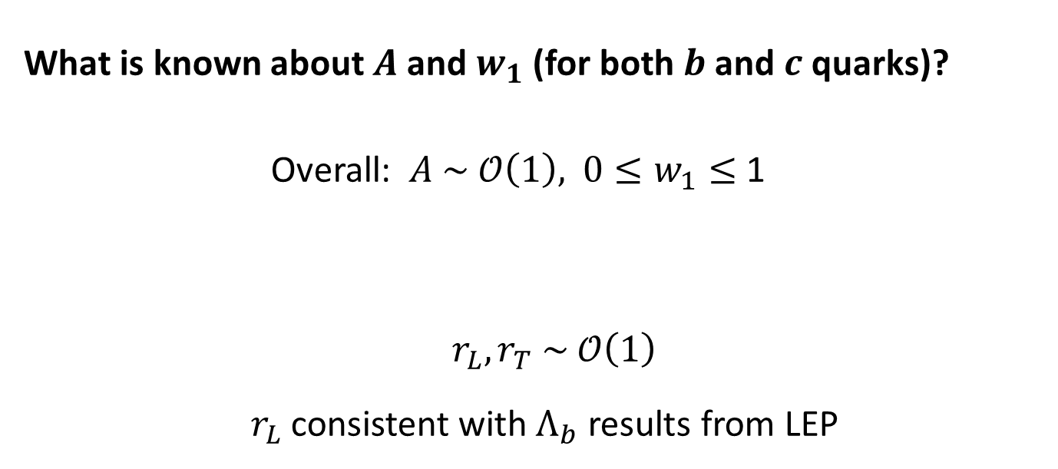
Heavy quark polarization retention
$$r_{L}≈\frac{1+\left(0.23+0.38w_{1}\right)A}{1+A}$$
$$r_{T}≈\frac{1+\left(0.62−0.19w_{1}\right)A}{1+A}$$
$$A=\frac{prob\left(Σ_{b}^{\left(∗\right)}\right)}{prob \left(Λ_{b}\right)}=9 \frac{prob\left(T\right)}{prob\left(S\right)}$$
$$w_{1}=\frac{prob\left(T_{±1}\right)}{prob\left(T\right)}$$
What is known about $A$ and $w_{1}$ (for both $b$ and $c$ quarks)?
Overall: $A \sim 𝒪\left(1\right),$ ${0≤w}_{1}≤$ 1
$r_{L},r_{T} \sim 𝒪\left(1\right)$
$r_{L}$ consistent with $Λ_{b}$ results from LEP

Slide 21

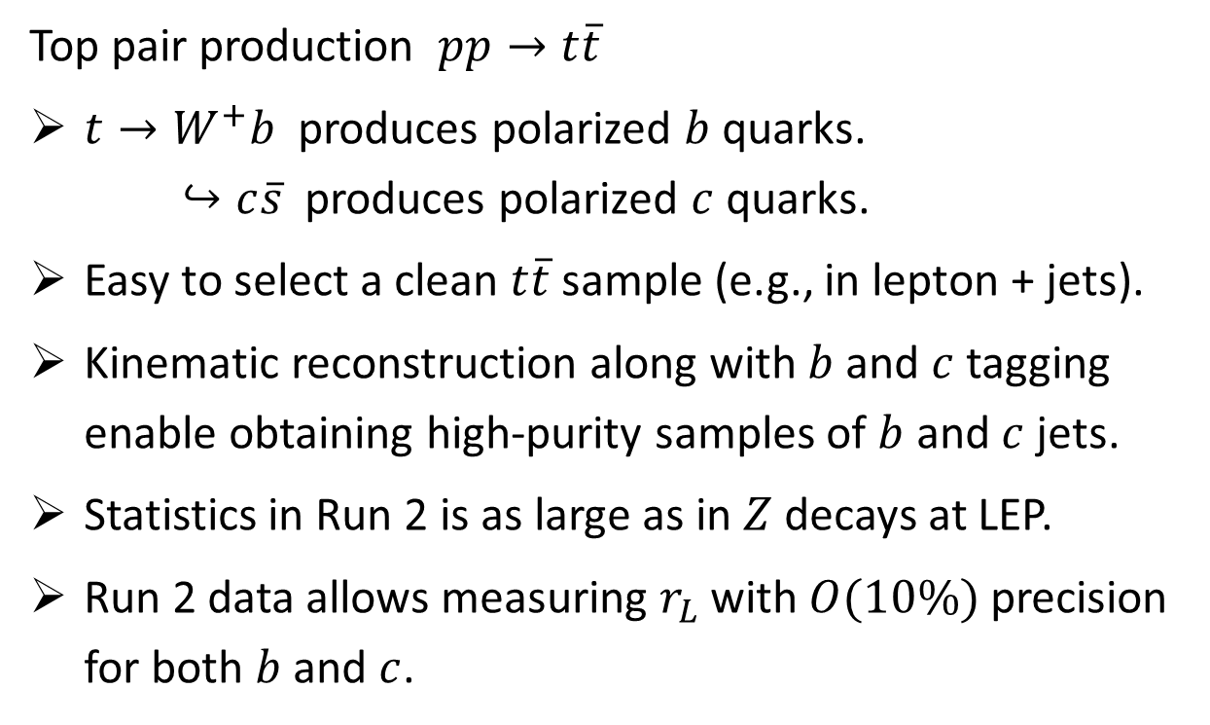
Measuring $r_{L}$ via ATLAS/CMS $t\overline{t}$ samples
Top pair production $pp→t\overline{t}$
$t→W^{+}b$ produces polarized $b$ quarks.
$↪c\overline{s}$ produces polarized $c$ quarks.
Easy to select a clean $t\overline{t}$ sample (e.g., in lepton + jets).
Kinematic reconstruction along with $b$ and $c$ tagging enable obtaining high-purity samples of $b$ and $c$ jets.
Statistics in Run 2 is as large as in $Z$ decays at LEP.
Run 2 data allows measuring $r_{L}$ with $O(10\%)$ precision for both $b$ and $c$.
Galanti, Giammanco, Grossman, Kats, Stamou, Zupan
JHEP 11 (2015) 067 [arXiv:1505.02771]

Slide 22
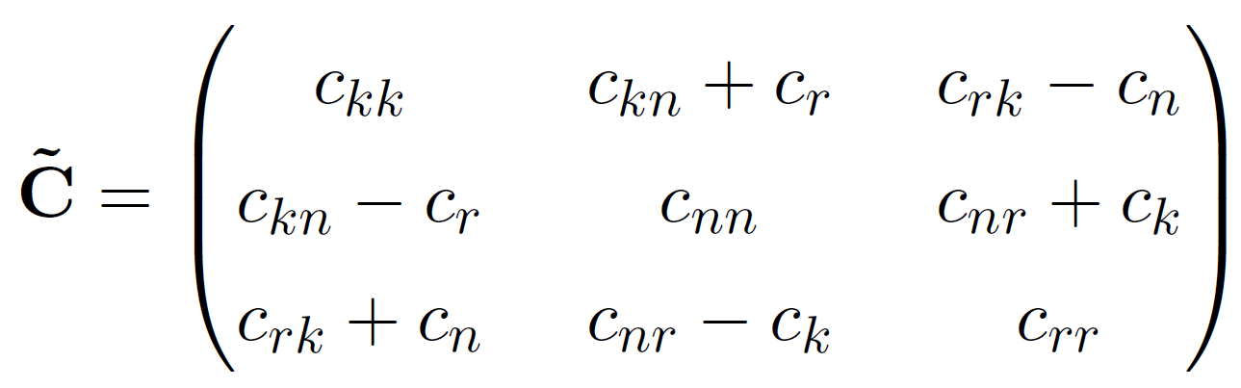
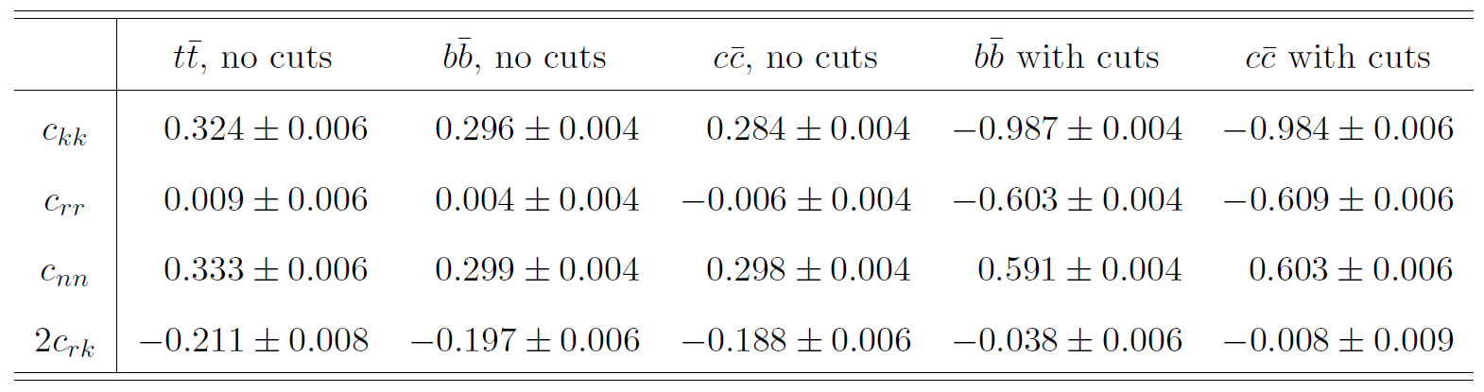


Spin correlations in $b\overline{b}$ and $c\overline{c}$
MadGraph + MadSpin, LO QCD, $\sqrt{s}=13$ TeV

Slide 23
Spin correlations in $b\overline{b}$ and $c\overline{c}$
MadGraph + MadSpin, LO QCD, $\sqrt{s}=13$ TeV

Slide 24
Spin correlations in $b\overline{b}$ and $c\overline{c}$
MadGraph + MadSpin, LO QCD, $\sqrt{s}=13$ TeV

Slide 25

Baryon decays of interest

Slide 26






Angular distributions
spin analyzing power
polarization retention factor
($r_{L}$ or $r_{T}$)
sample purity

Slide 27

Standard datasets

Slide 28



Special dataset: CMS parked data
Data parking: record the data when bandwidth allows and process it later.
Trigger: muon with a low $p_{T}$ threshold (7 and 12 GeV) and impact parameter significance.
Operated during part of Run 2 ($\sim 42 {\text{fb}}^{−1}$)
First papers using this dataset appeared just recently:

Slide 29


Selection for $b\overline{b}$ analysis
Pair of opposite-sign muons (inside jets) satisfying the offline trigger cuts and carrying $>20\%$ of the jet momentum.
At least one of the jets is “b tagged” (with assumed efficiency 80%), e.g. by muon impact parameter.
Dominant remaining background:
semileptonic $B$-meson decays
Possible approaches to dealing with it:
Inclusive keep it (to keep the signal efficiency high)
Semi-inclusive demand $Λ→pπ^{−}$ coming from the $b$ vertex
(significant cost in efficiency because the $Λ$ decays far)
Exclusive demand a fully-reconstructible $Λ_{c}$ decay
Mixed (one choice for one jet, another choice for the second)

Slide 30

Selection for $b\overline{b}$ analysis

Slide 31



Event counts for $b\overline{b}$ analysis
Run 2
HL-LHC

Slide 32


Run 2 precision for $b\overline{b}$
Note: Since the performance of the different channels is comparable, sensitivity can be improved by combining channels.

Slide 33
Run 2 precision for $b\overline{b}$
Note: Since the performance of the different channels is comparable, sensitivity can be improved by combining channels.

Slide 34


HL-LHC precision for $b\overline{b}$
Note: Since the performance of the different channels is comparable, sensitivity can be improved by combining channels.

Slide 35


Hadronic selection for $c\overline{c}$ analysis
$$Λ_{c}^{+}→pK^{−}π^{+}$$
Three hadron tracks consistent with a common vertex and the $Λ_{c}^{+}$ mass hypothesis.
Backgrounds:
  Other charmed hadron decays,
  e.g., $D^{+}→π^{+}K^{−}π^{+}(π^{0})$.
  Charmed hadrons from $b$ jets.
  Combinatorial background due to random track combinations.

Slide 36

Hadronic selection for $c\overline{c}$ analysis
$$Λ_{c}^{+}→pK^{−}π^{+}$$
CMS Collaboration
JHEP 01 (2024) 128
[arXiv:2307.11186]

Slide 37


Semileptonic selection for $c\overline{c}$ analysis
Pair of opposite-sign muons (inside jets) satisfying the offline trigger cuts.
$Λ→pπ^{−}$ decay in each jet (will help reconstruct the $Λ_{c}^{+}$ and eliminate the $D$-meson background).
The inferred $Λ$ trajectory should form a displaced vertex with the muon, or the $Λ$ should carry a significant fraction of the jet momentum (to ensure that the $Λ$ originates from the $Λ_{c}^{+}$ decay).
Charm tagging against $b$ jets with 40% signal efficiency (which likely makes the background from $b$ jets negligible; see paper for more details).

Slide 38

Mixed selection for $c\overline{c}$ analysis
One side – semileptonic selection (including triggering, which allows high statistics).
Other side – hadronic selection (high BR and reconstruction efficiency, cleaner reconstruction, but also larger background).

Slide 39


Event counts and precision for $c\overline{c}$ analysis
HL-LHC

Slide 40




Spin correlations opportunities summary
promising borderline purity < 10%

Slide 41


Conclusions and discussion
$b\overline{b}$ spin correlation measurements could be possible even with Run 2 datasets, especially with the CMS parked data.
$c\overline{c}$ spin correlation measurements may become possible at the HL-LHC.
Can measure the polarization retention factors $r_{L}$ and $r_{T}$
(more refined: the polarized fragmentation functions):
Measuring $r_{L}$ via the polarized $b$ and $c$ quarks in $t\overline{t}$ samples could be a simpler first step.
Can spin correlations be useful for discovering or characterizing new physics? Work in progress.
JHEP 11 (2015) 067 [arXiv:1505.02771]

Slide 42
Supplementary Slides

Slide 43



Statistical uncertainties
Uncertainties from fitting to statistically fluctuated data:

Slide 44





Statistical uncertainties

Slide 45

Statistical uncertainties
Dependence on the value of the coefficient:

