Slide 1

HL-LHC-BGI:
Assessing Potential Magnets
Clara Fleisig (SY-BI-XEI)
HL-LHC BGI Meeting – 4th March 2024

Slide 2
Introduction to BGI Electric and Magnetic Fields
Clara Fleisig, 04 Mar 2024

Slide 3
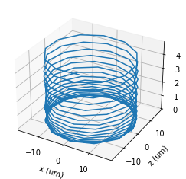
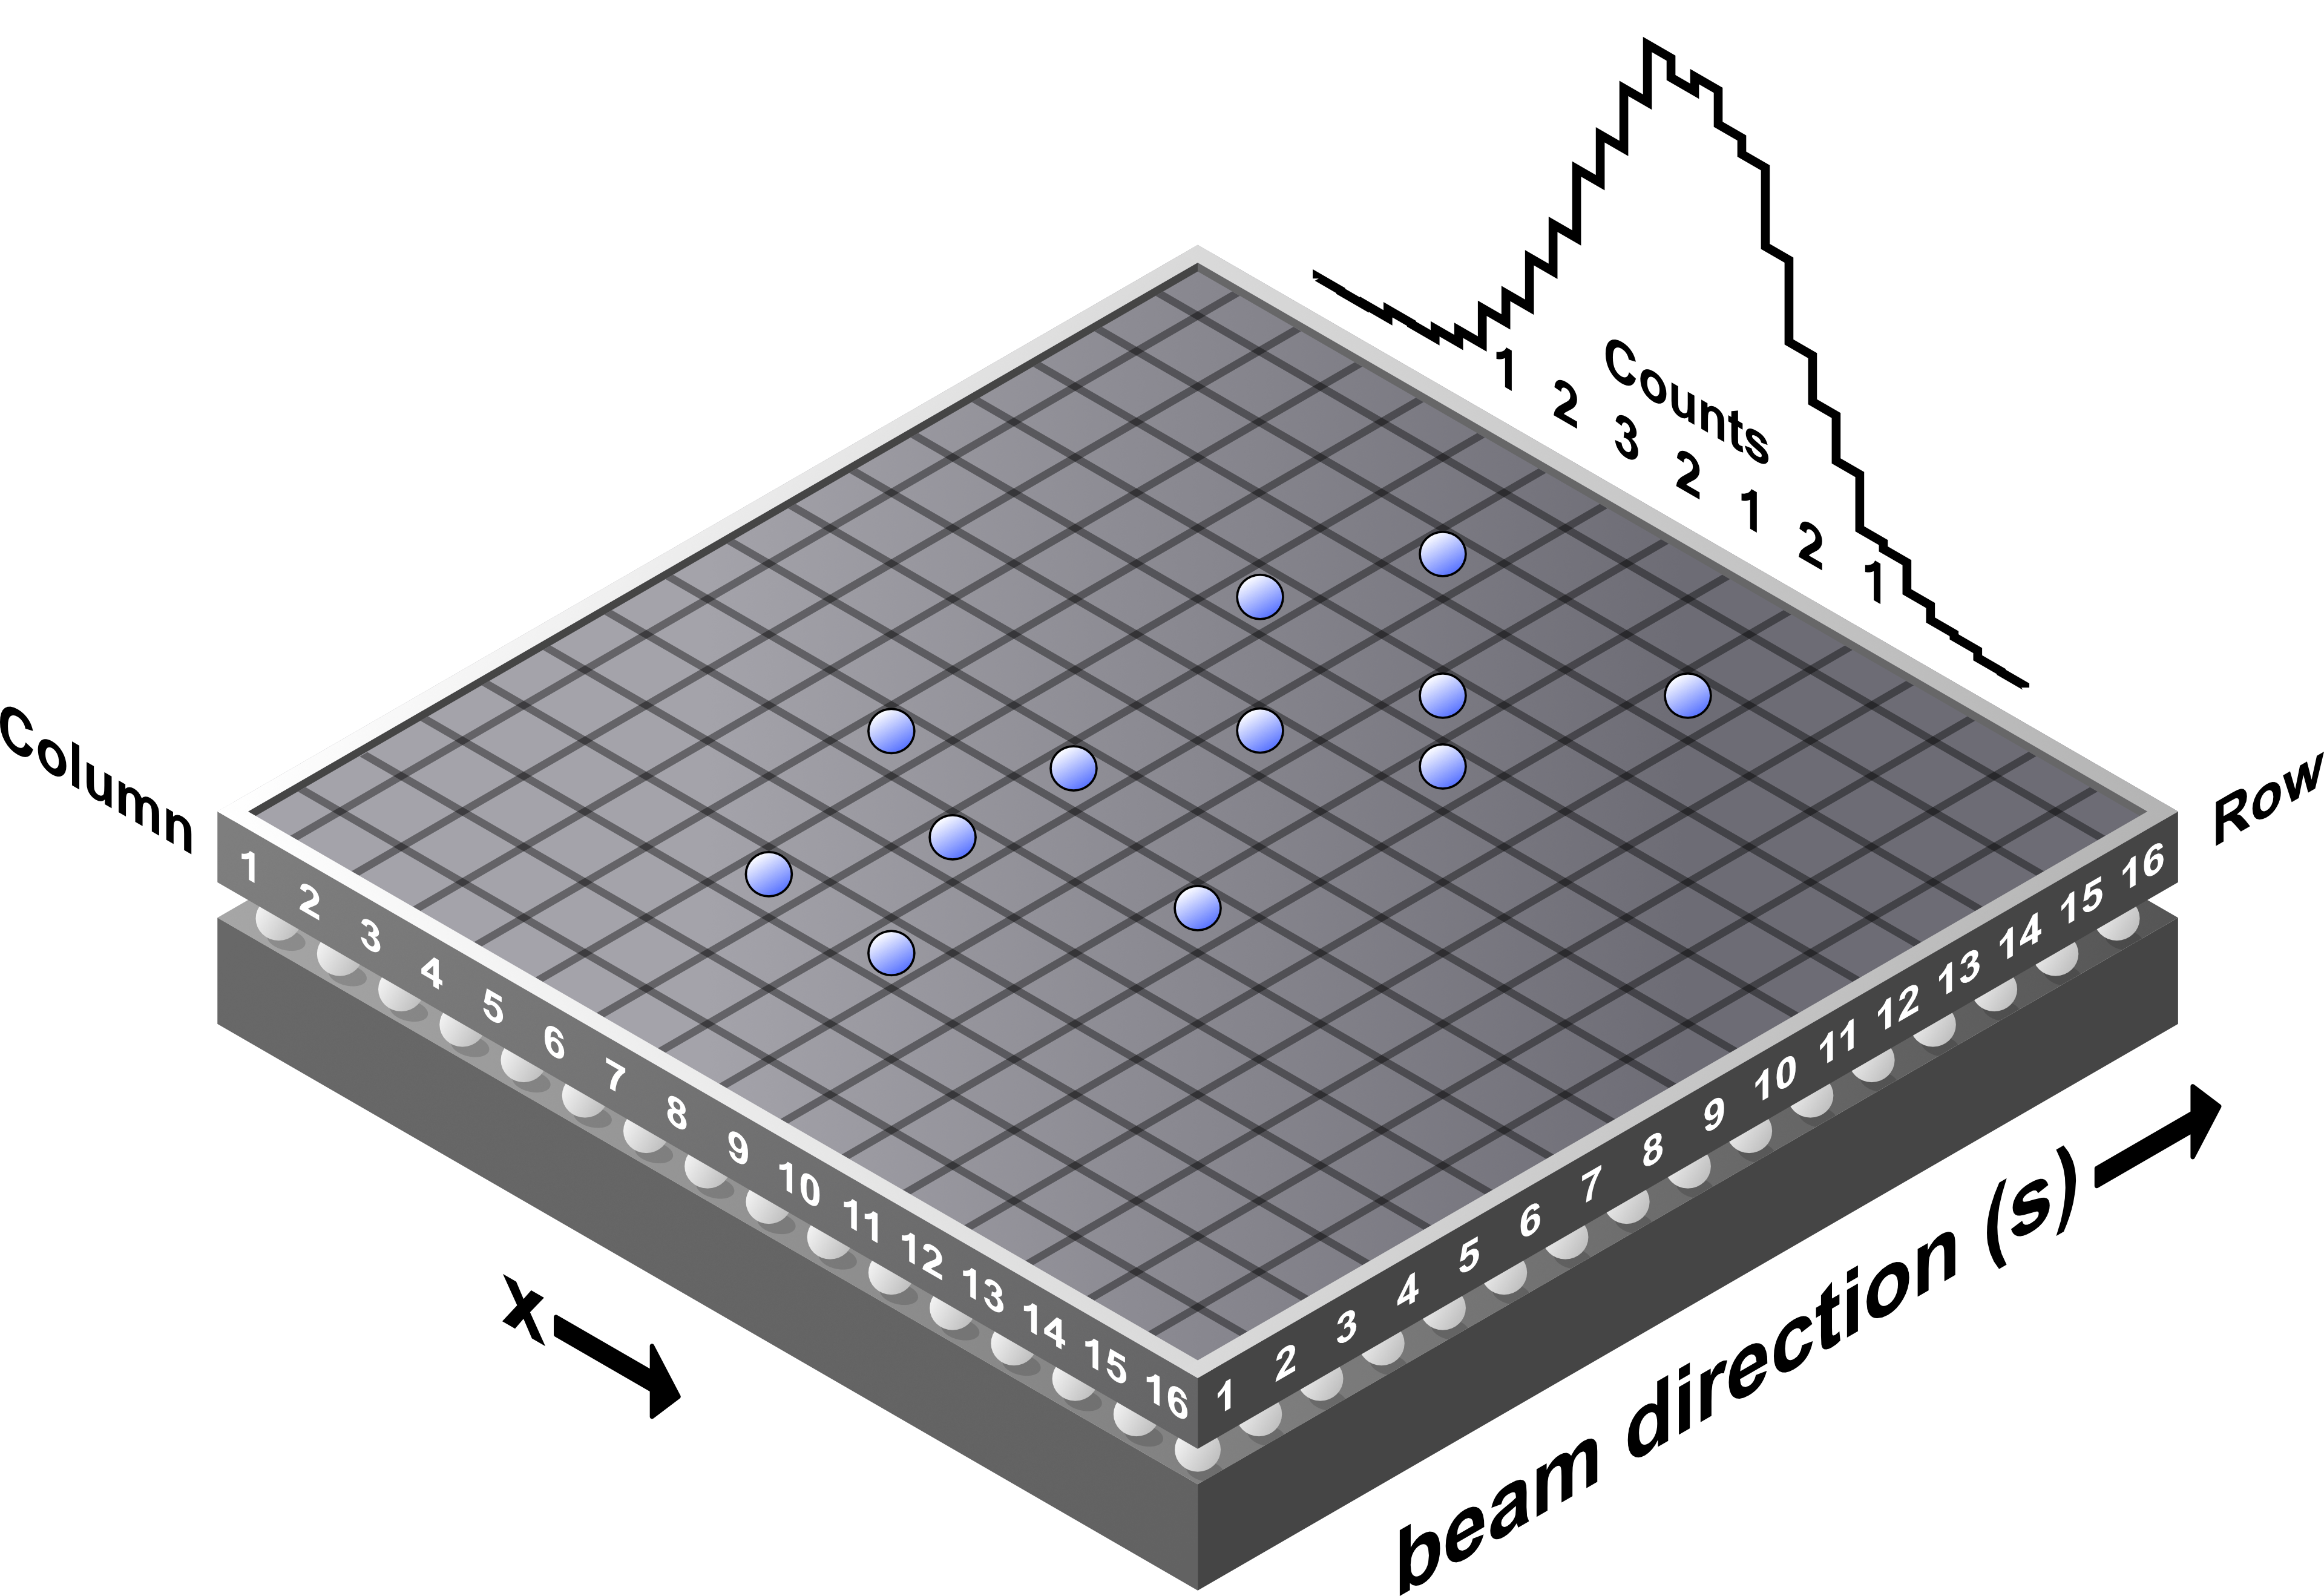

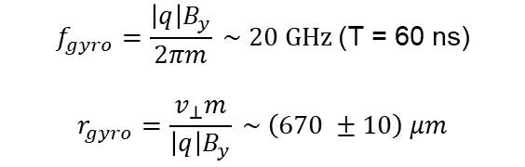
Ideal Electric and Magnetic Fields
$$\dot{\vec{r}}\left(t\right)=\vec{Ω_{c}}×\vec{r_{c}}+\frac{q}{m}\left(\begin{matrix}0 \\ E_{y} \\ 0\end{matrix}\right)t$$
$$f_{gyro}=\frac{\left|q\right|B_{y}}{2πm} \sim 20 GHz \text{(}\text{T}\text{ = 60 }\text{ns}\text{)}$$
$$r_{gyro}=\frac{v_{⊥}m}{\left|q\right|B_{y}} \sim \left(670 ±10\right) μm$$
Clara Fleisig, 04 Mar 2024

Slide 4
BGI Requirements
Clara Fleisig, 04 Mar 2024

Slide 5

Requirements
$\frac{Δ_{ε_{n}}}{ε_{n}}<5\% ⇒ \frac{Δ_{σ}}{σ}<2.5\%$
Beam size uncertainty comes from:
$$Δ_{ε_{n}}^{2}={\left(\frac{∂ε_{n}}{∂σ}Δσ\right)}^{2}+{\left(\frac{∂ε_{n}}{∂β}Δβ\right)}^{2}+{\left(\frac{∂ε_{n}}{∂γ_{r}}Δγ_{r}\right)}^{2}+{\left(\frac{∂ε_{n}}{∂β_{r}}Δβ_{r}\right)}^{2} ⇒ \frac{Δ_{ε_{n}}}{ε_{n}}=2\frac{Δ_{σ}}{σ}$$
Beam size systematic uncertainties are dependent on:
      Space charge
      Electric field uniformity and strength
      Magnetic field uniformity and strength
Clara Fleisig, 04 Mar 2024

Slide 6
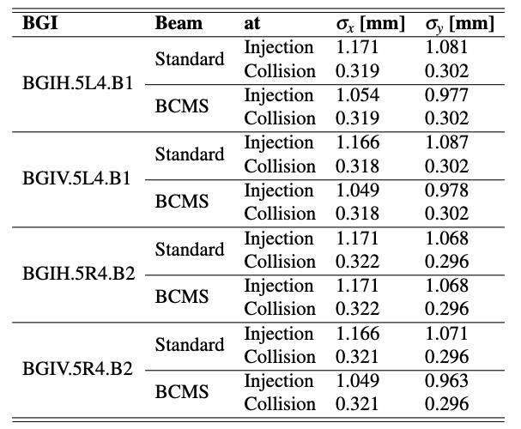
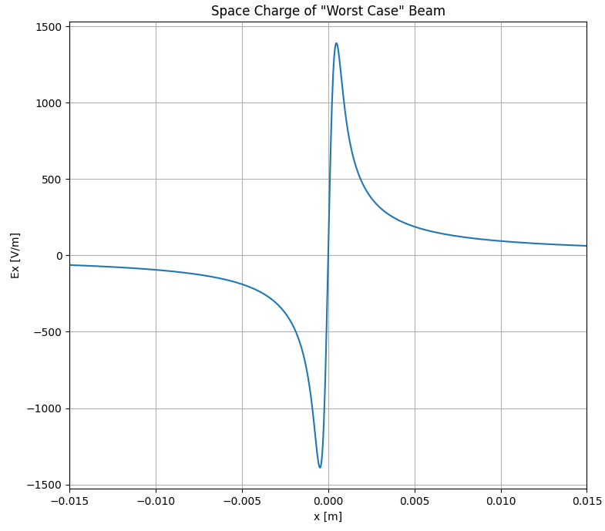
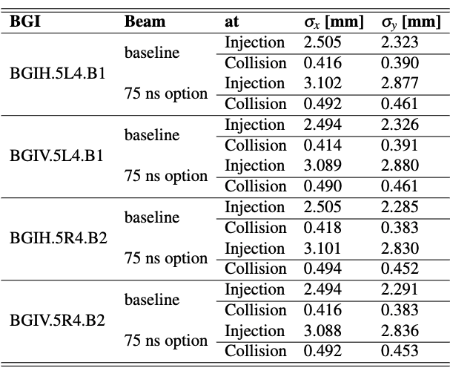
Beam Type Used
2.2e11 protons/bunch
Simulated 60,000 ionization electrons
  ~ 15 ms integration time
  ~ 0.29 % statistical uncertainty
protons
ions
***Tables from BGV/BGI Review on 19th October 2022
Clara Fleisig, 04 Mar 2024

Slide 7

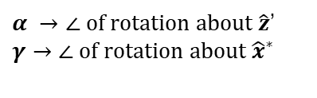
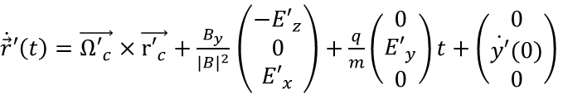
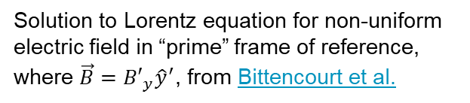
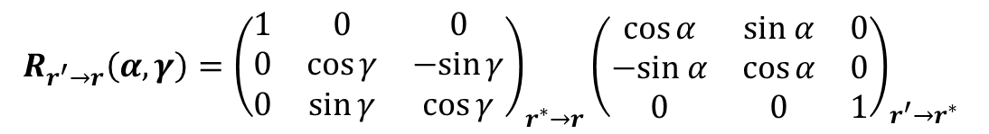
Complications from Non-Uniform Fields
(neglecting space charge)
$\dot{\vec{r}}′\left(t\right)=\vec{{Ω′}_{c}}×\vec{{r′}_{c}}+\frac{B_{y}}{{\left|B\right|}^{2}}$ $\left(\begin{matrix}{−E′}_{z} \\ 0 \\ {E′}_{x}\end{matrix}\right)+\frac{q}{m}\left(\begin{matrix}0 \\ {E′}_{y} \\ 0\end{matrix}\right)t+\left(\begin{matrix}0 \\ \dot{y′}(0) \\ 0\end{matrix}\right)$
Solution to Lorentz equation for non-uniform electric field in “prime” frame of reference, where $\vec{B}={B′}_{y}{\hat{y}}^{′}$, from Bittencourt et al.
ExB Drift
Rotate to BGI’s frame of reference to consider non-uniform magnetic field
$$\dot{\vec{r}}\left(t\right)=R_{r′→r}(α, γ)\dot{\vec{r}}′\left(t\right)$$
$α →∠ of rotation about \hat{z}$’
$$γ→∠ of rotation about {\hat{x}}^{∗}$$
$$R_{r^{′}→r}\left(α, γ\right)={\left(\begin{matrix}1 & 0 & 0 \\ 0 & \cos{γ} & −sin{γ} \\ 0 & \sin{γ} & \cos{γ}\end{matrix}\right)}_{r^{∗}→r}{\left(\begin{matrix}\cos{α} & sin α & 0 \\ −sin α & \cos{α} & 0 \\ 0 & 0 & 1\end{matrix}\right)}_{r^{′}→r^{∗}}$$
Clara Fleisig, 04 Mar 2024

Slide 8
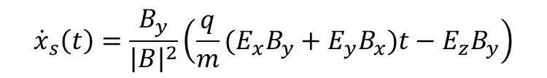

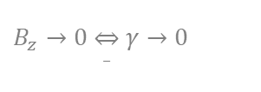
Understanding Profile Shift
(neglecting space charge, omitting cyclotron motion)
$${\dot{x}}_{s}\left(t\right)=\frac{E_{x}\sin{α\cos{α}\sin{γ+E_{y}\sin{γ\cos^{2}{α−E_{z}\cos{γ\cos{α}}}}}}}{\left|B\right|}+\frac{q}{m}\left(E_{x}\sin{α\cos{γ+E_{y}\cos{α\cos{γ+E_{z}}}}}\sin{γ}\right)\sin{α}t$$
$B_{z}→0 \overset{⇔}{_} γ→0$
$${\dot{x}}_{s}\left(t\right)=−\frac{E_{z}B_{y}}{\left|B\right|}\cos{α+\frac{q}{m}(E_{x}\sin^{2}{α+E_{y}\sin{α}\cos{α})t }}$$
$$\sin{α=\frac{B_{x}}{|B|}; }\cos{α=\frac{B_{y}}{|B|}; }$$
$${\dot{x}}_{s}\left(t\right)=\frac{B_{y}}{{\left|B\right|}^{2}}\left(\frac{q}{m}(E_{x}B_{y}+E_{y}B_{x})t−E_{z}B_{y}\right)$$
ExB Drift
Accelerating drift
Clara Fleisig, 04 Mar 2024

Slide 9
Magnetic Fields
Clara Fleisig, 04 Mar 2024

Slide 10
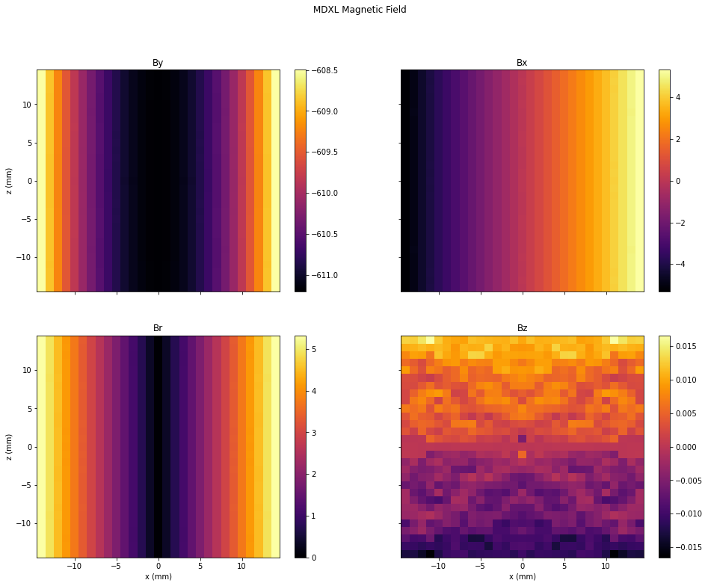
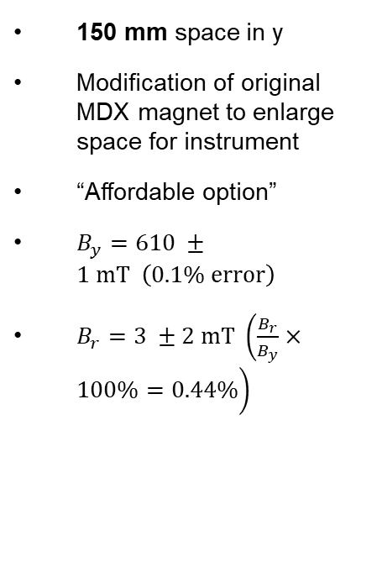
MDXL Magnet
150 mm space in y
Modification of original MDX magnet to enlarge space for instrument
“Affordable option”
$B_{y}=610 ±1 mT \left(0.1\% error\right)$
$B_{r}=3 ±2 mT \left(\frac{B_{r}}{B_{y}}×100\%=0.44\%\right)$
Clara Fleisig, 04 Mar 2024

Slide 11
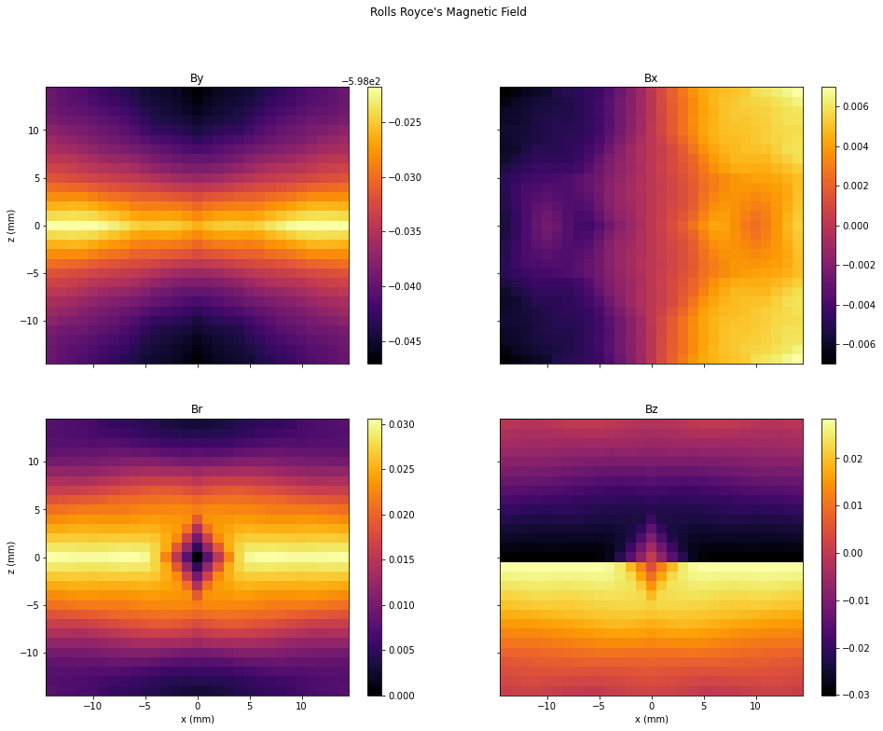
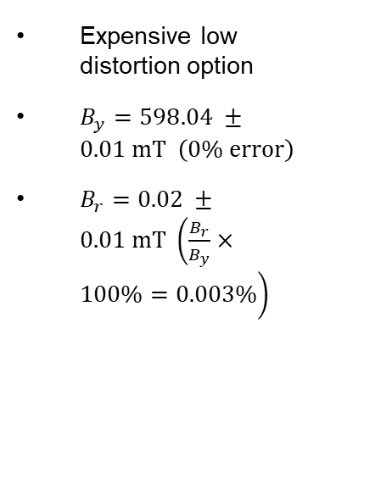
Rolls Royce Magnet
Expensive low distortion option
$B_{y}=598.04 ±0.01 mT \left(0\% error\right)$
$B_{r}=0.02 ±0.01 mT \left(\frac{B_{r}}{B_{y}}×100\%=0.003\%\right)$
Clara Fleisig, 04 Mar 2024

Slide 12
Electric Fields
Clara Fleisig, 04 Mar 2024

Slide 13
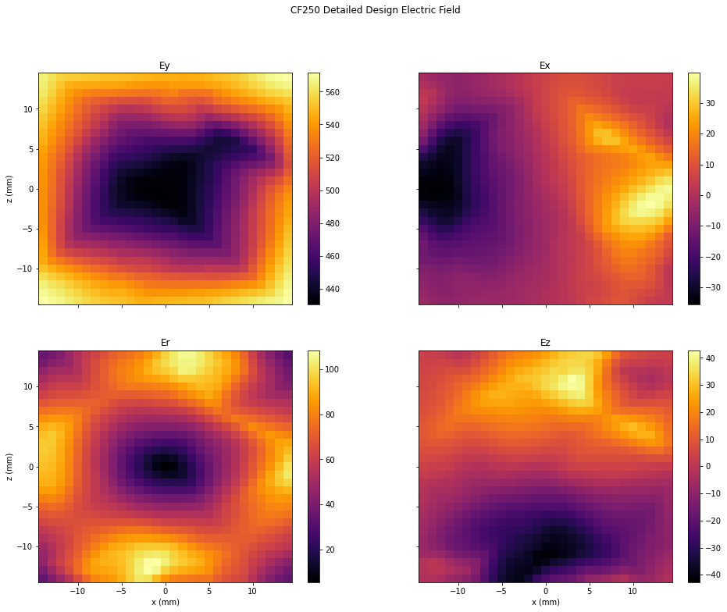
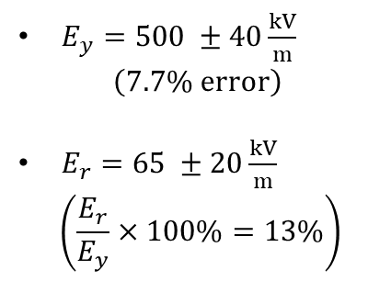
CF250 Design Electric Field
$E_{y}=500 ±40\frac{kV}{m}$
$$\left(7.7\% error\right)$$
$E_{r}=65 ±20\frac{kV}{m}$
$$\left(\frac{E_{r}}{E_{y}}×100\%=13\%\right)$$
Clara Fleisig, 04 Mar 2024

Slide 14
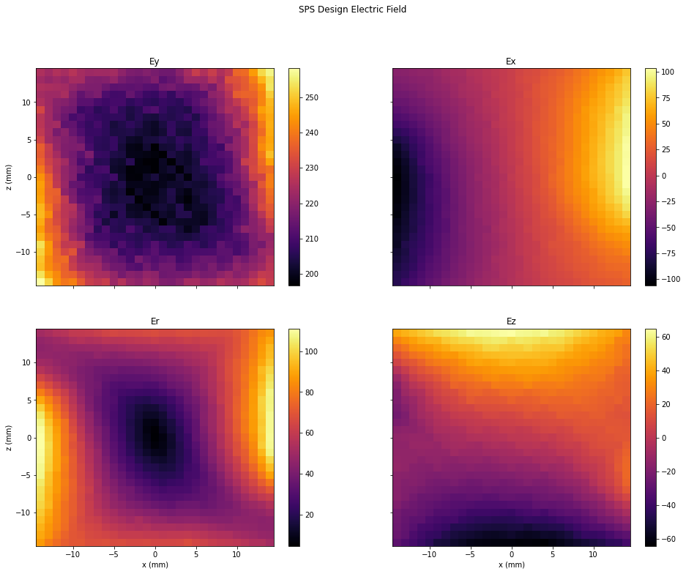
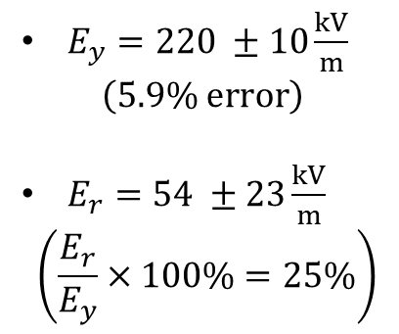
SPS Design’s Electric Field
$E_{y}=220 ±10\frac{kV}{m}$
$$\left(5.9\% error\right)$$
$E_{r}=54 ±23\frac{kV}{m}$
$$\left(\frac{E_{r}}{E_{y}}×100\%=25\%\right)$$
Clara Fleisig, 04 Mar 2024

Slide 15
Results
Clara Fleisig, 04 Mar 2024

Slide 16
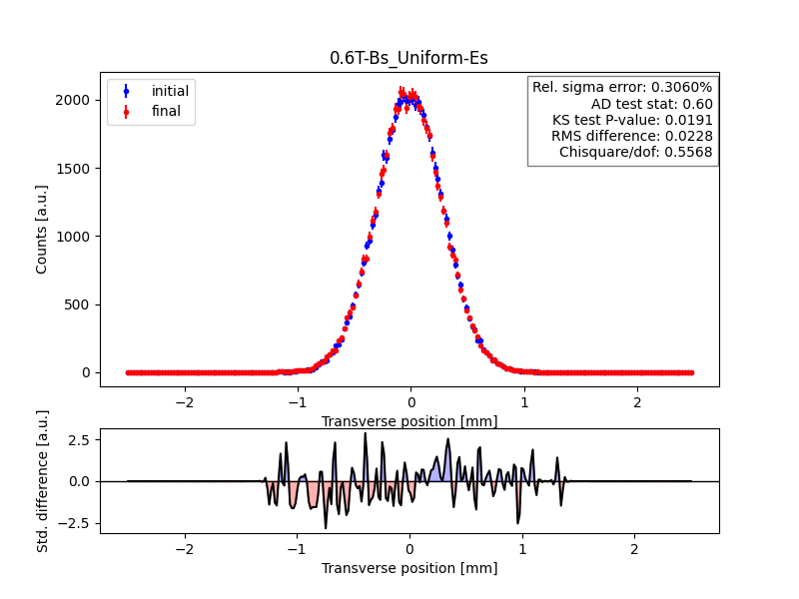
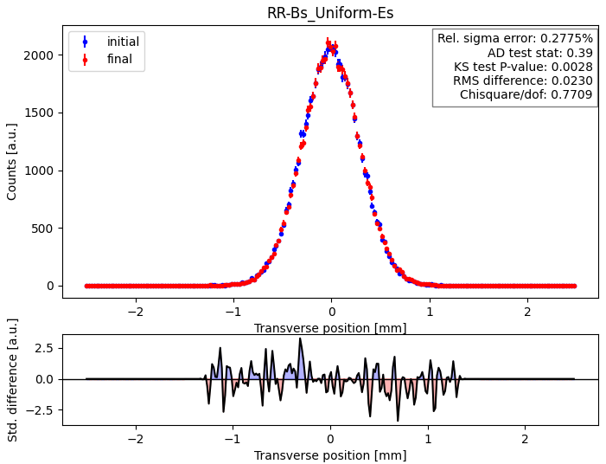
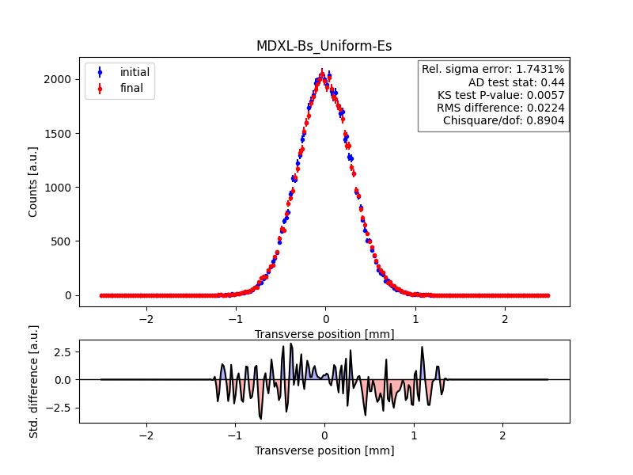
Uniform Electric Field (Centered)
Clara Fleisig, 04 Mar 2024

Slide 17
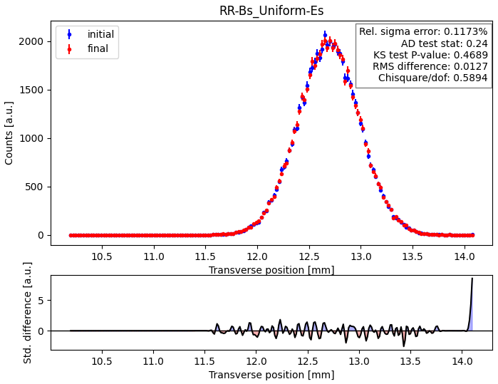
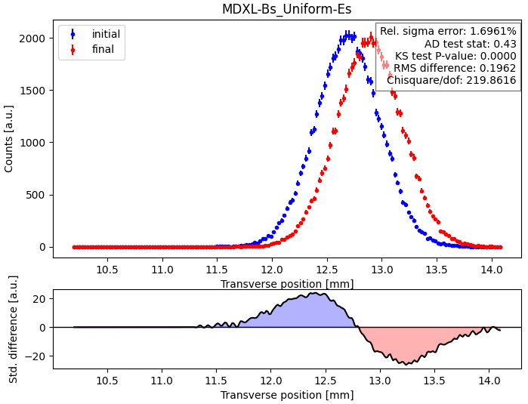
Uniform Electric Field (Worst Case)
Clara Fleisig, 04 Mar 2024

Slide 18
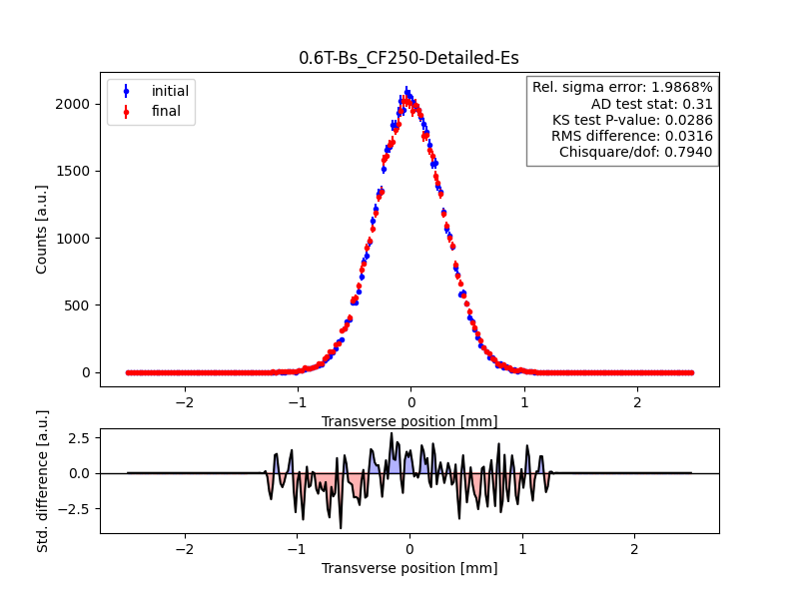
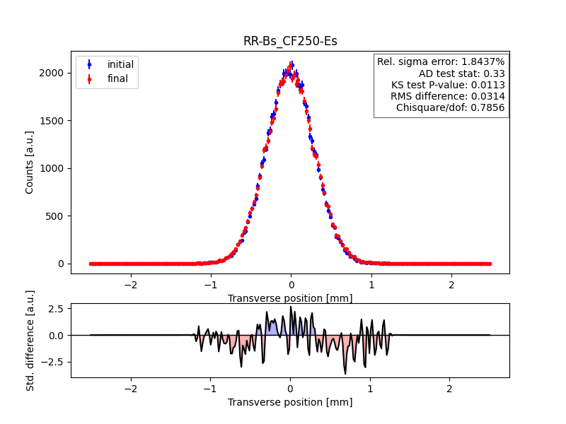
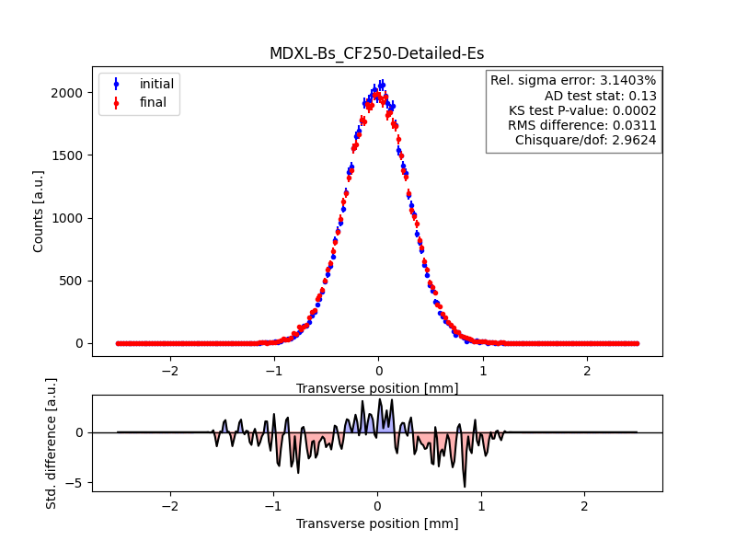
CF250 Design Electric Field (Centered)
Clara Fleisig, 04 Mar 2024

Slide 19
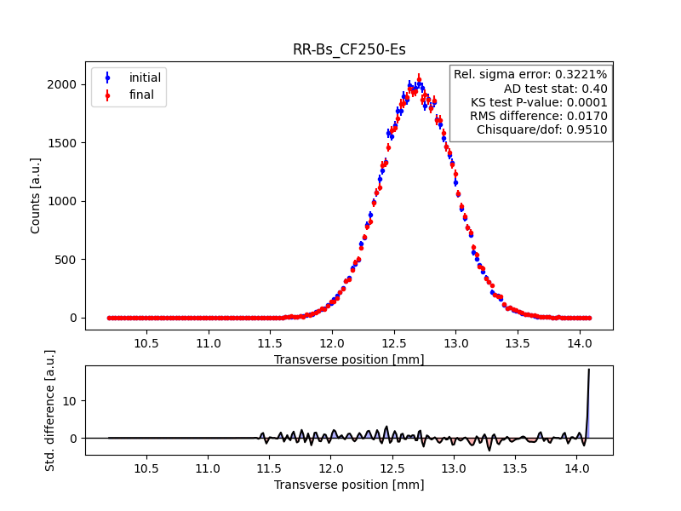
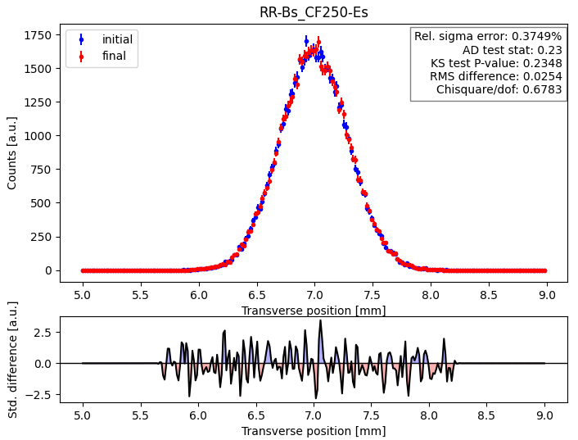
CF250 Design Electric Field (Worst Cases)
Clara Fleisig, 04 Mar 2024

Slide 20
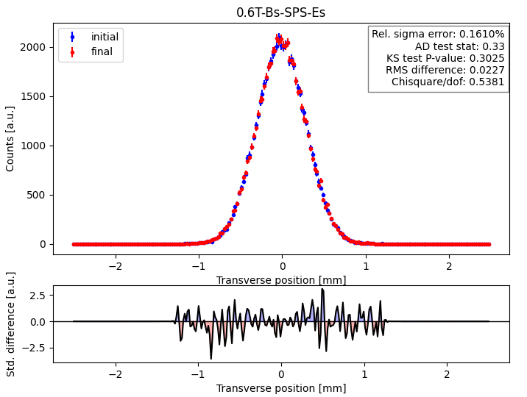
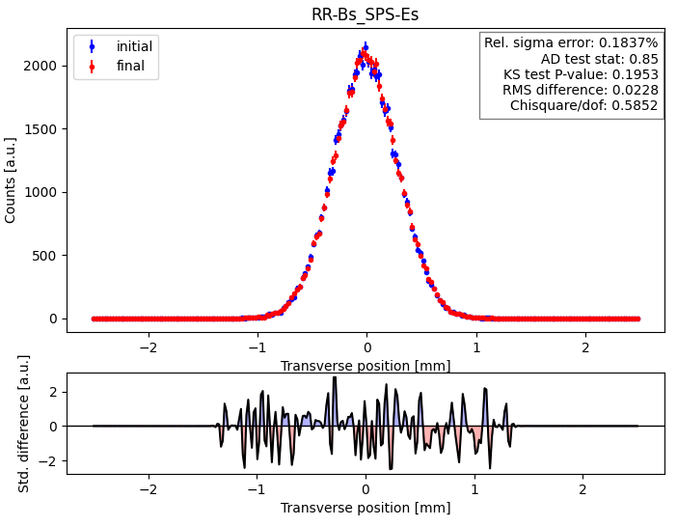
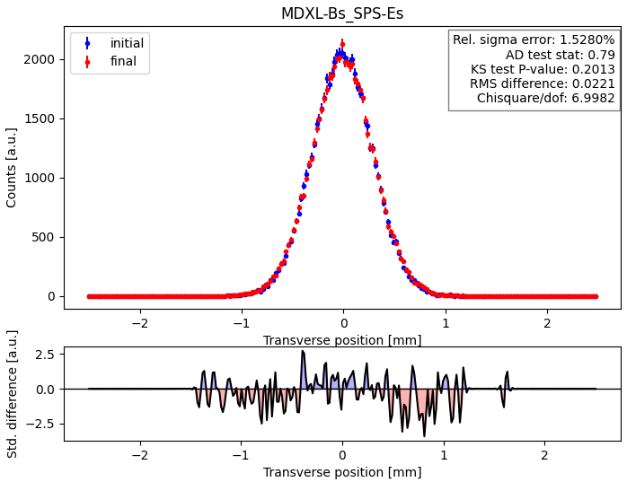
SPS Design Electric Field (Centered)
Clara Fleisig, 04 Mar 2024

Slide 21
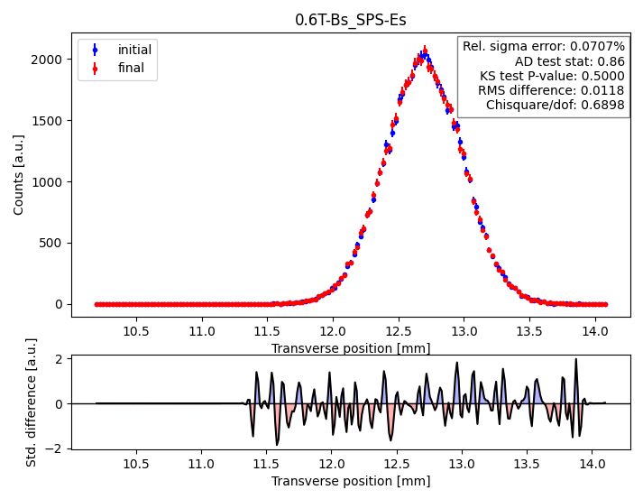
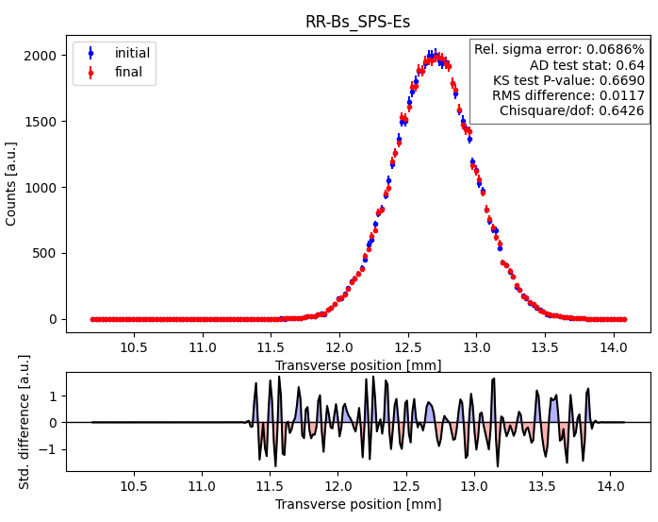

SPS Design Electric Field (Worst Case)
Clara Fleisig, 04 Mar 2024

Slide 22
Appendix
Clara Fleisig, 04 Mar 2024

Slide 23
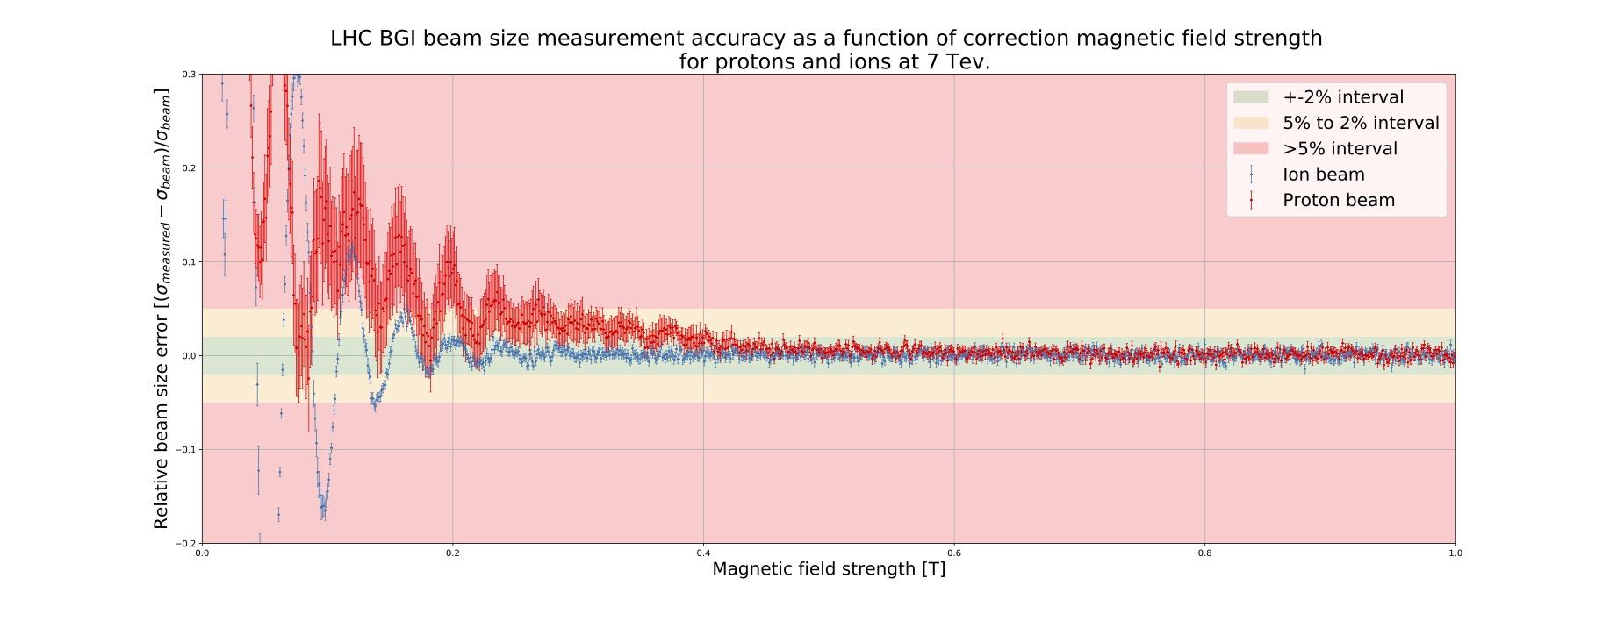
Clara Fleisig, 04 Mar 2024

Slide 24
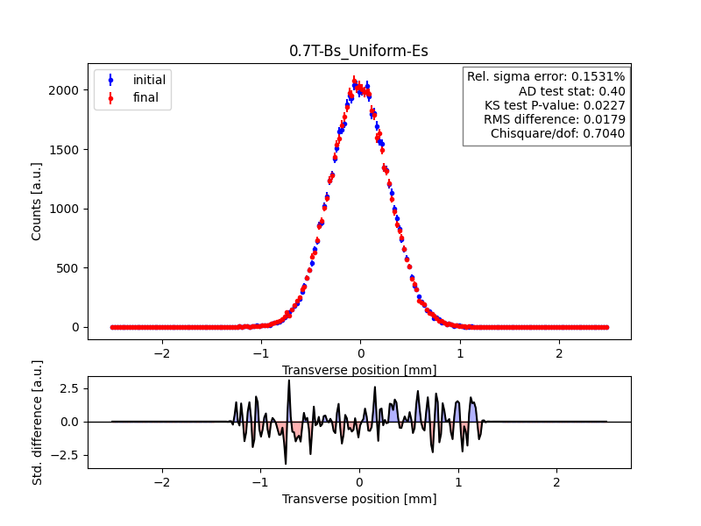
Uniform Electric Field
Clara Fleisig, 04 Mar 2024

Slide 25
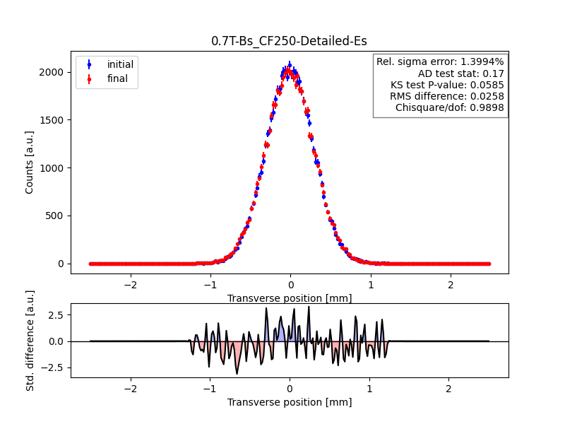
CF250 Design Electric Field
Clara Fleisig, 04 Mar 2024

