Slide 1
NA-Operation 2024
Users Meeting – Installation
Michael Lazzaroni BE-EA-DC

Slide 2
Installation Organization in North Area
Users Installation Coordinator
Michael Lazzaroni
Installation of users in exp. areas
Sylvain Girod & Michael Lazzaroni
Moveable tables (i.e DESY)
Michael Lazzaroni : Booking
Vincent Marchand: Maintenance
Control Rooms
Nicolas Perez
I am your main contact for your installation

Slide 3

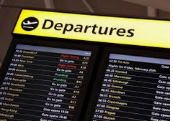

Installation Process
Before your arrival –
Preparation
Your arrival in EHN1-
Installation
End of your beam time - Removal
Technical meeting ~3 weeks prior the experiment installation to ensure an efficient installation.
(see details in the next slide)
- Please ensure that your equipment are ready to be craned in the PPE early in the morning (~9am). Don’t forget to do a Handling Request (EDH).
- All late requests will be treated at the end of the day
- Priority of installation is given to main users.
- Please remove of all equipment in the EA and CR the Wednesday ASAP (8am).
- Make your Handling request (EDH) at least 48h in advance

Slide 4
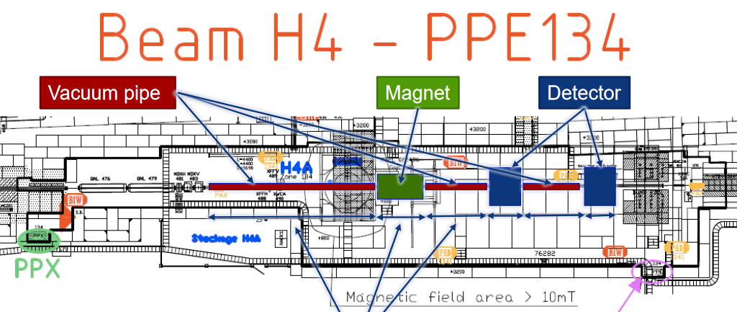
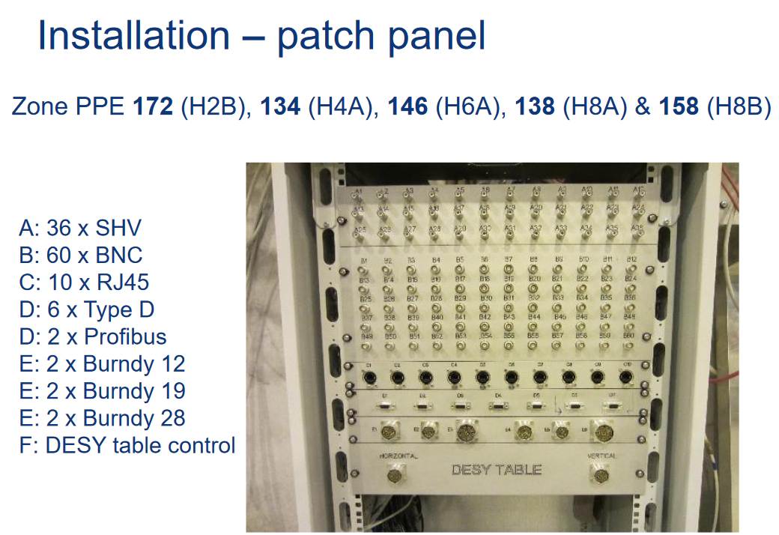
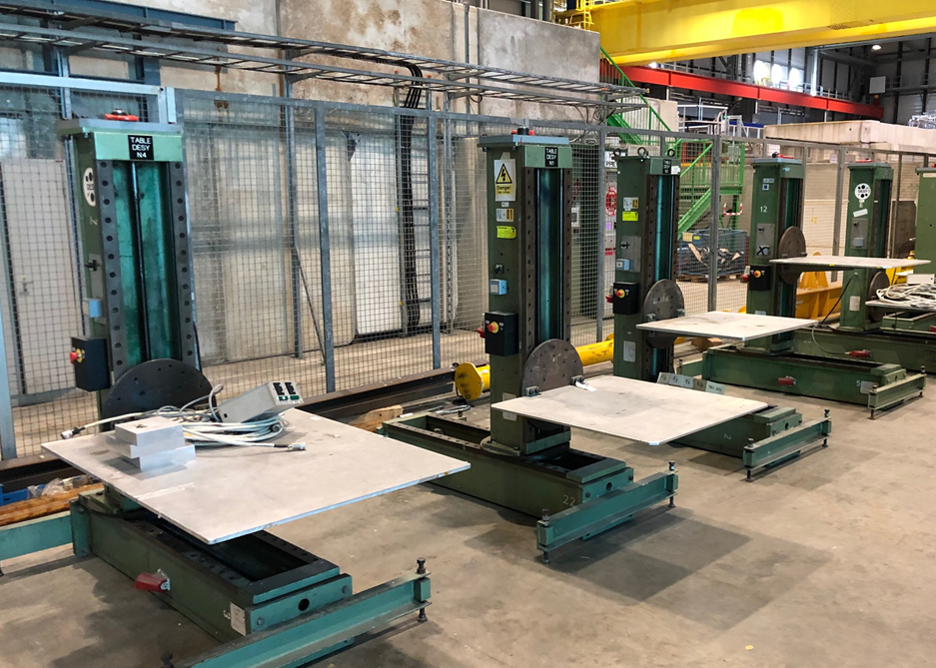
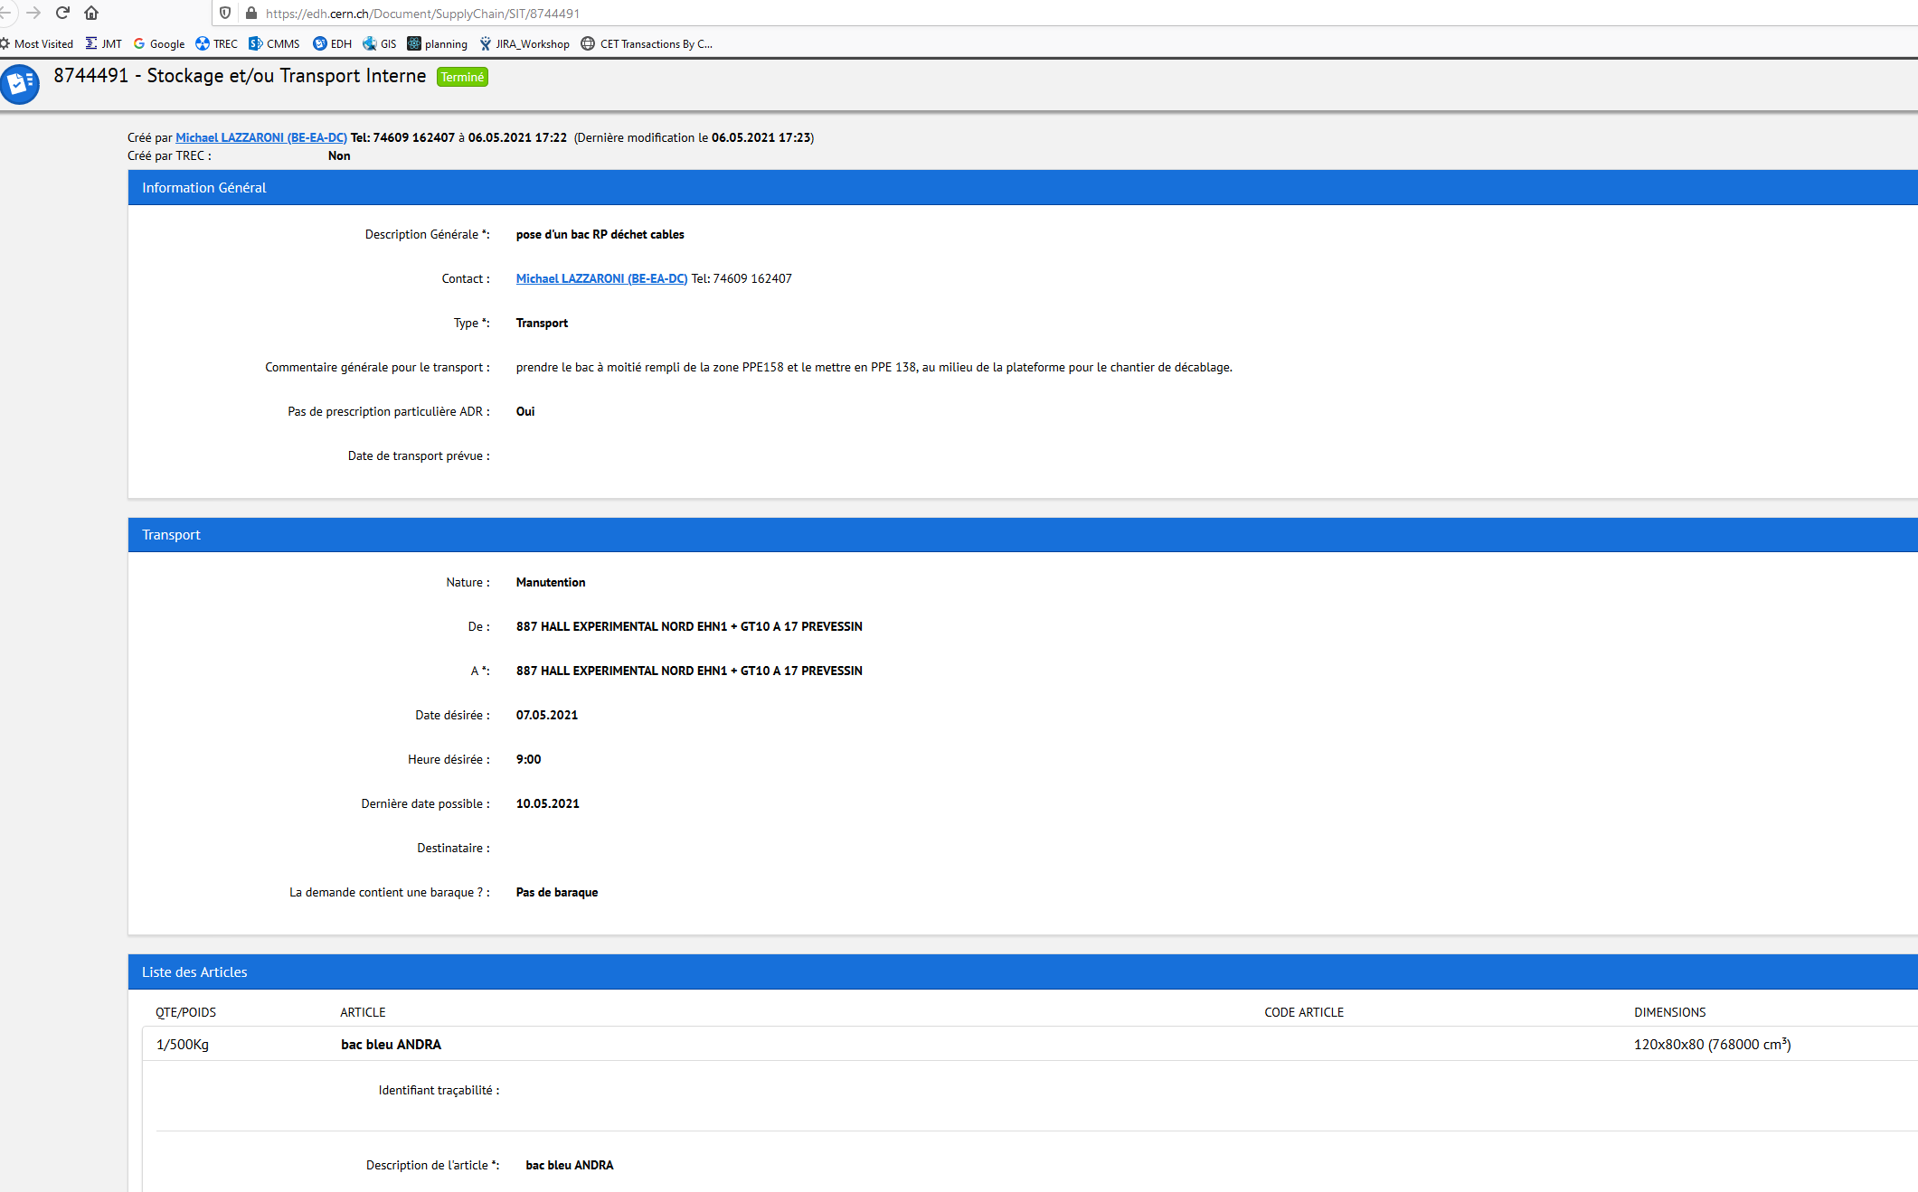
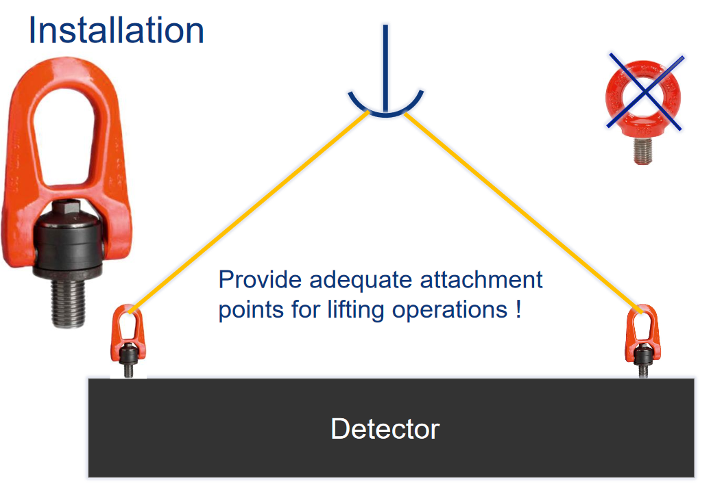
Technical meeting (~3 weeks prior your installation)
Technical points to discuss concerning your installation:
  Preparation of the zone according your requirements, in term of:
    Beam line configuration (your detectors, vacuum pipes …)
    Cabling, patch panel needs
    Mechanical support for your set-up (DESY tables, concrete blocks…)
    General Services: electrical power needs…
    Gas (Reminder : make your gas request ASAP to David Jaillet)
  Preparation of your arrival:
    Quantity of material (storage place)
    How to prepare “handling request” via EDH to move your material
    Handling of your equipment: lifting points mandatory
    (swivel hoist ring)
      In case of doubt please contact Caterina.Bertone@cern.ch

Slide 5
Services in BE-EA – Useful technical contacts
BE-EA provides technical services to users, in term of:
Cabling
Connectors, cables, cabling…
EA cabling team
Vincend.Marchand@cern.ch
Moveable tables
Workshop
Machining, installation…
Maintenance of Desy tables, XSCA…
Vincent.Marchand@cern.ch
Gas
be-dep-ea-gas@cern.ch (David Jaillet)
Supply of CO2, He, N2….

Slide 6
Thanks for your attention!
Questions?

