Slide 1
Access and control of user zones
Bastien Rae

Slide 2
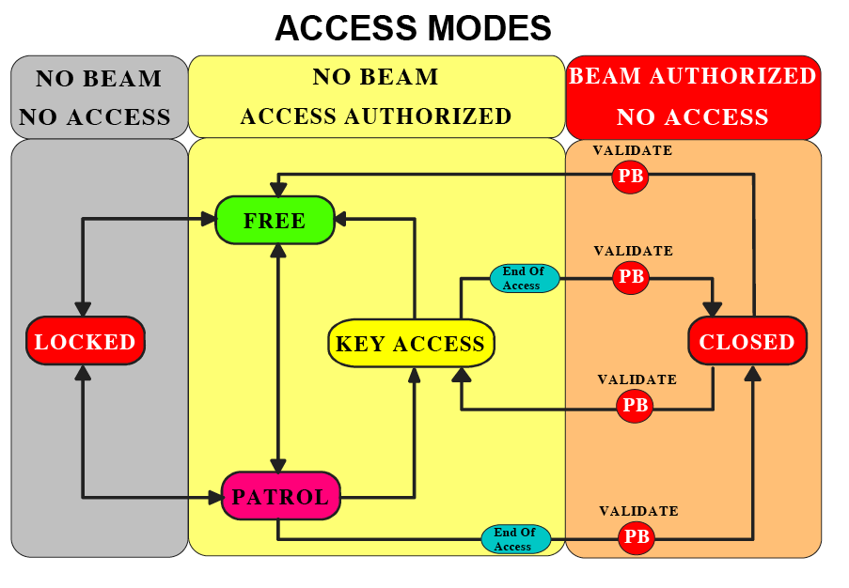
ACCESS MODES OF A SECONDARY BEAM AREA
‘CLOSED’ area: no access permitted, beam potentially present;
‘LOCKED’ area: no access possible (except for fire brigade and radiation protection)
‘ACCESS WITH KEY’: entering is possible by taking a key, one key per person entering (short KEY ACCESS)
‘FREE’ access: access without restrictions
‘PATROL’: It has a very limited duration and serves changing a zone status from “FREE” to any other mode.

Slide 3
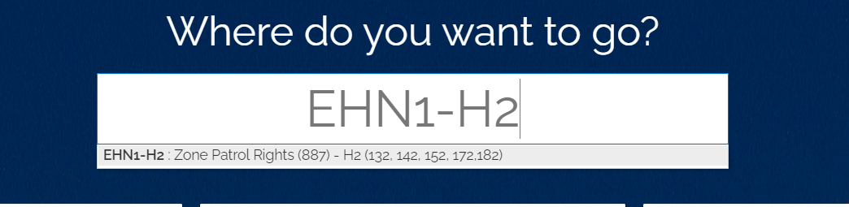
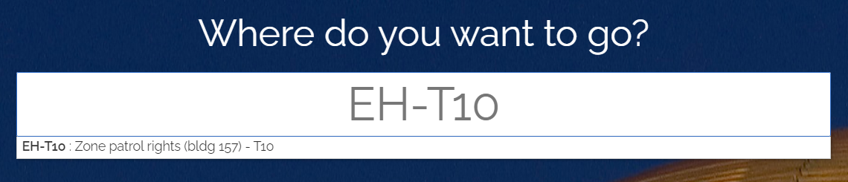
ACCESS MODES OF A SECONDARY BEAM AREA
Information about Patrol Right
Patrol Right are not necessary to enter in the user zones or the EHN1. The personal dosimeter is enough.
2 peoples max per test beam group (3 if justified) can ask for patrol rights (after the training)
Contact me (bastien.rae@cern.ch) for organizing a training prior your test (usually on Wednesday)
To ask for patrol right please follow this link below and right in the first text box (EH-xx) you corresponding beam line.

Slide 4
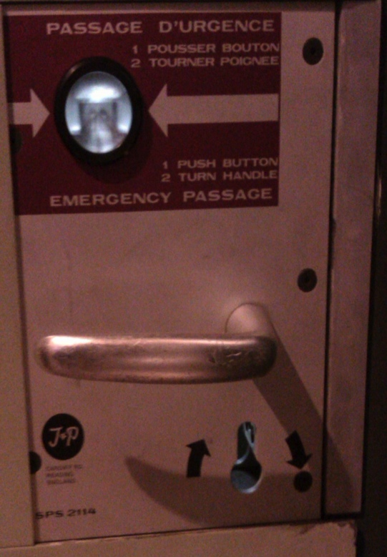
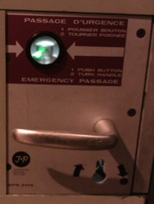
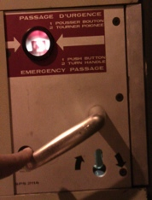

REMARK
EMERGENCY BUTTON
On each door there is an emergency button above the handle. It’s also give you information if you have enter or not.
YOU MUST USE THE EMERGENCY BUTTON ONLY IN CASE OF EMERGENCY !
Light is green,
you can enter
Emergency passage
Light is red,
you can’t have an access
Door handle

Slide 5
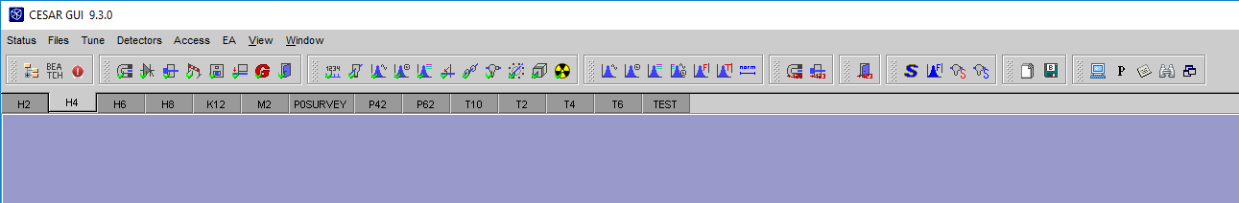
CESAR
Access control
Beam Devices
Scans
Beam Line selection
Profile monitors
Beam Instrumentation
Beam file selection
CESAR is the software that allow you ton control the beam, and ask for Beam on or off:
When opening CESAR in the control PC you just click on “logging by location”
When you request for Beam on you should enter your NICE credential.
Please contact me (bastien.rae@cern.ch) to organize a small training (~45min).

Slide 6
CONTACT
If you have any question or problem, please do not hesitate to contact :
During working hours (8:30 to 17:30) :
The Physicist responsible for you line
  You can find all their phone numbers on this link
You can also send an e-mail to sba-physicists@cern.ch
At Any time, you can call the CCC :
For the PS call : 76677
For the SPS call : 77500 or 70475

Slide 7
Questions ?

