Slide 1

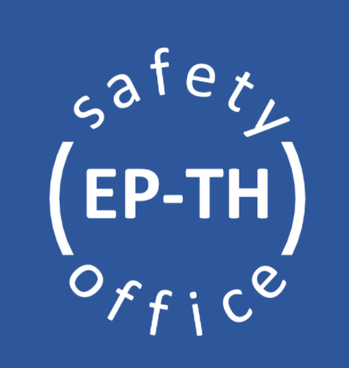
General Safety for
EHN1 users

Slide 2

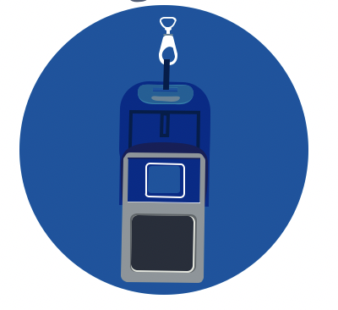
General Safety in EHN1
Necessary PPEs (Personal Protective Equipment) mandatory to enter the EHN1 Beam Facility are:
  personal dosimeter
  helmet, safety shoes (can be taken from counting rooms as soon as entering the building, if stored there – must enter the building from the door closer to the counting room)
Every experimental area is equipped with safety installations, as fire extinguishers and AUG (General Emergency Stop – cut the power in the entire building). Please, take some time to familiarise with their position the first time you enter the building!
Any professional incident shall be declared ASAP via the EDH form: https://edh.cern.ch/Document/General/IncidentDeclaration
Additional PPEs might be required, depending on the activities to be performed.

Slide 3
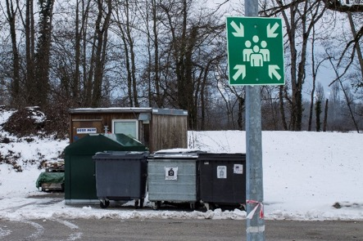
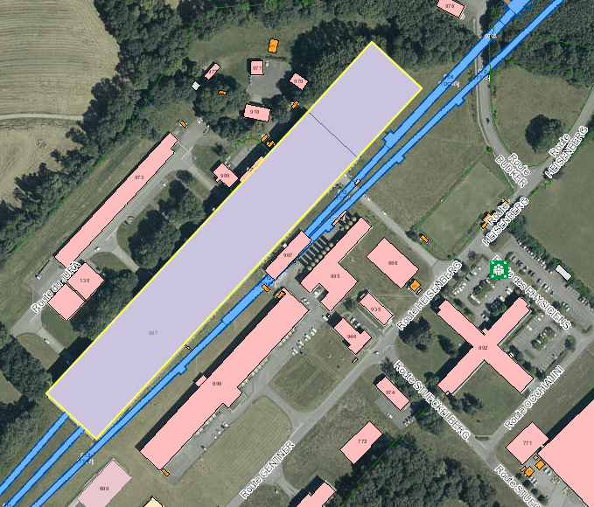
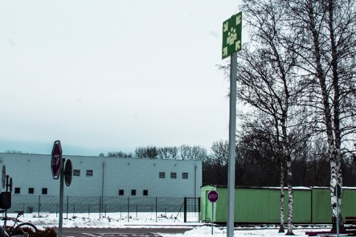
Assembly points in EHN1
There are two assembly points, located at the sides of EHN1. Please, take some time familiarise with their location!
NP Hall
EHN1
Jura side: close to picnic area
In case of evacuation alarm, leave immediately the building and go to the assembly point!
Salève side: car park by the ramp, close to building 892

Slide 4
Early Safety Instructions for Temporary Experiments
The information contained in this EP Safety Office web page shall be considered as early as possible in the design of the experiment to facilitate the safety validation process. You will find details about:
  List of materials allowed and forbidden at CERN
  Instructions and recommendations to be followed for specific hazards and risks brought by the experiment to CERN
  Best safety practices for installation and operations of detectors at CERN
  Safety contacts for any additional questions

Slide 5
ISIEC Form & Safety Clearance process
Every set-up must undergo this safety process, before operations. This includes:
Main users set-ups
Set-ups taking parasitic beam
Set-ups coming back with the same installation as the previous month/year/etc.
The EP Safety Office should be contacted (and the ISIEC process started) from few weeks/months to 1 week before your experiment is installed at CERN, depending on the hazards and risk implications.

Slide 6
ISIEC Form & Safety Clearance process
Go on the website: https://ep-th-safety.web.cern.ch/isiec-safety-clearance (you must Sign In to access the ISIEC form)
Submit the ISIEC (Initial Safety Information for Experiments at CERN) form with the details related to your experiment (description, hazards, etc) at least 1 week before the operation
You will receive a confirmation email and you will be contacted by the EP Safety Office to organise the inspection visit on site (once the installation of the set-up is completed!)
After the inspection, the remarks (if any) will be communicated to you. If no major remarks are present, you will receive the Safety Clearance form via email. If present, minor remarks will be listed in this form. Make sure they are all resolved before taking beam!
The Safety Clearance is valid for an operation time of 3 weeks. Please, contact the EP Safety Office if your beam time is extended.

Slide 7
Safety contacts
In case of any safety related questions, different safety actors will be available:
TSO – Territorial Safety Officer
Contact: EHN1-TSO@cern.ch
DSO – Department Safety Officer
Contact: ep-safety-office@cern.ch

Slide 8

Thank you!
Questions?

