Slide 1
IdeaSquare -
The Innovation Space at CERN
L. Valtonen & G. Gaddi

Slide 2
IdeaSquare
IdeaSquare is the innovation space at CERN using
collaborative methodologies,
access to CERN expertise and
cross-connectivity
to ideate solutions for the future of humankind.
A place where people have the licence to dream.
Notes:
Future of humankind: The activities carried out at IdeaSquare tie science innovation to the United Nations’ Sustainable Development Goals (SDGs), and work towards laying out a better future for our society

Slide 3
Why IdeaSquare?
We believe that for fundamental change, we need more than traditional innovation methods and mindsets.
We enable students and innovators to imagine a future worth fighting for, and we give them the tools and confidence to start building that future.
IdeaSquare is our human experiment for “colliding” minds and ideas towards laying out a better future

Slide 4
Project-based student courses
tackling challenges derived from the United Nation’s Sustainable Development Goals
Executive programmes
for business schools and corporates embracing uncertainty as a key capability for product and organizational innovation
Notes:
Student programmes:
CBI: +22 active program collaborations;
Universities from 8 different countries;
Design Thinking methods to solve global challenges, intersected with deep tech;
UN Sustainable Development Goals as a lens in the process;
Multidisciplinary teams of students: business, design, engineering, social sciences…
Moving to I2P: What if we could begin again, how would you build society?
Executive programmes:
In embracing increasing uncertainty, people need to embrace orders of magnitude thinking instead of incremental change. In the executive programmes we harness this orders of magnitude thinking of CERN that is required to imegine and build collaborations years in the future.

Slide 5
ATTRACT
Creating a co-innovation ecosystem between fundamental research and industrial communities to develop breakthrough detection and imaging technologies.
Green Village
In collaboration with SCE: Using the CERN campus as a testbed for sustainability innovation.
Notes:
ATTRACT: Funding instrument aimed at absorbing and reducing risk to market.

Slide 6
Neutrino Platform
CERN & IdeaSquare provide a facility for R&D on future technologies (HW and SW) and partner in several neutrino research programs.

Slide 7
Like yours!
Innovation events, workshops, and hackathons for scientists, students, and innovators to meet to push the boundaries of knowledge.

Slide 8
Spaces
Open space for ideation and labs for 3D-printing, mechanical, and electric work
Courses
Trainings organized monthly to CERNies by our prototyping Huldra to use the machines
Notes:
CLEAR is doing research in medical radiation therapy. Put very simply they research the impact of doing radiation therapy in short, intense bursts, compared to the conventional way of giving small doses of radiation over a longer period of time.
In order to test this they have built a robot which picks up a sample and places it in front of their beam, since they cannot be in the room while the beam is running. The collaboration with IdeaSquare consisted mostly of prototyping parts for the robot. Many different iterations of the sample holders were tested before a final design was chosen. The holders were 3D printed, along with the gripper of the robot. The laser cutter was also used to cut radiation sensitive film, which could not be cut with conventional tools.

Slide 9
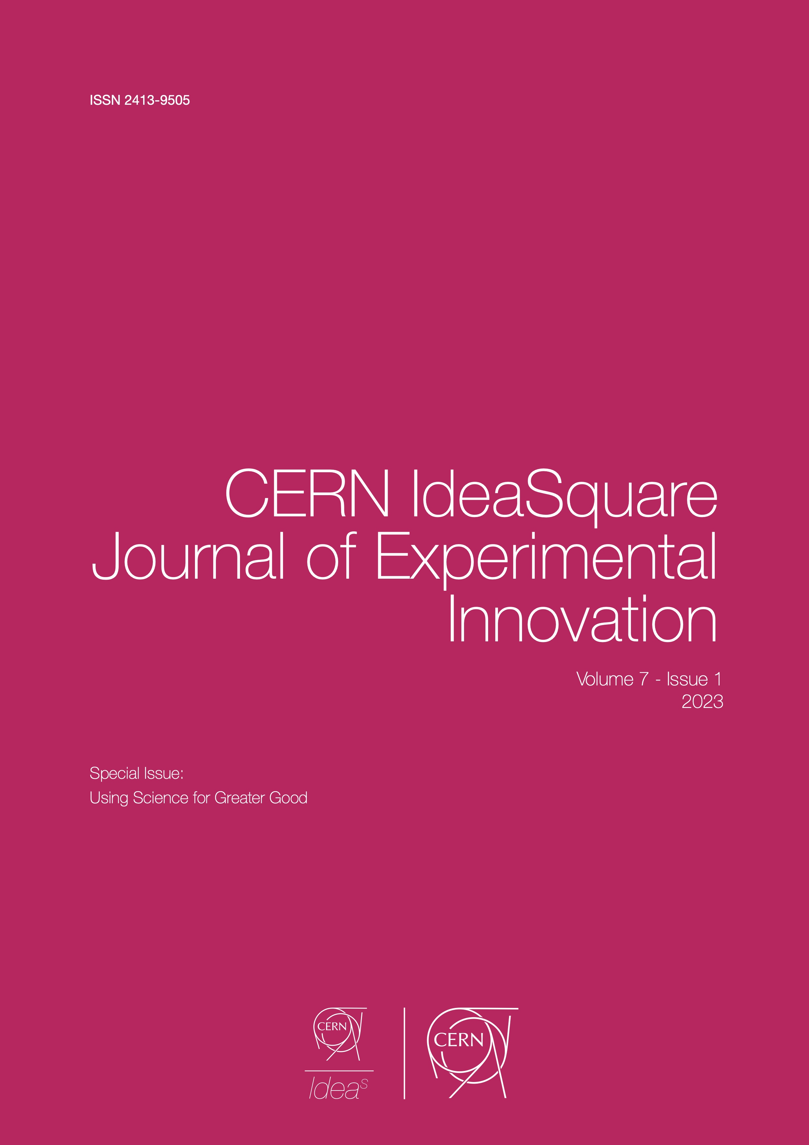
The CERN IdeaSquare Journal of Experimental Innovation
CIJ communicates thought-provoking, contemporary, and recent findings in experimentation-driven innovation research.
Notes:
Innovation knowledge: I2 is uniquely positioned to collect and share knowledge generated about innovation.
Open access journal with three issues published per year.

Slide 10
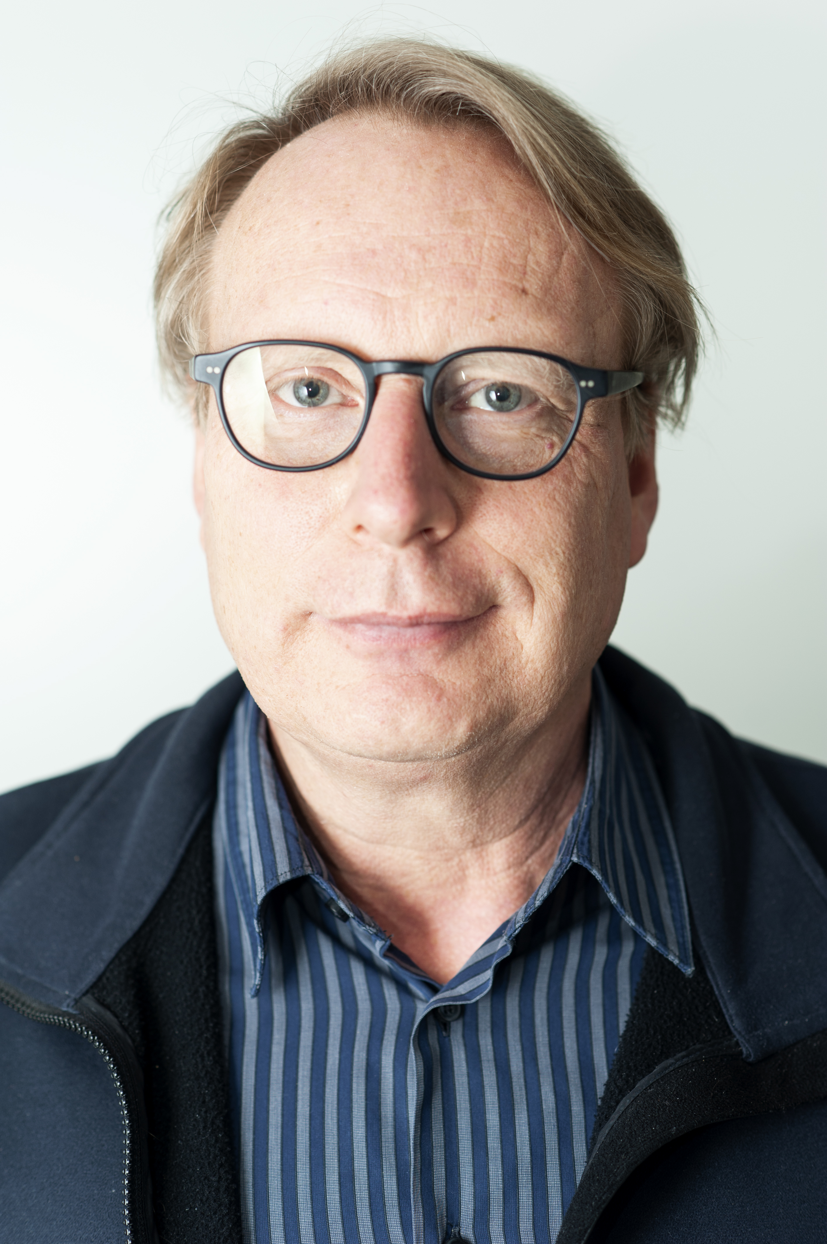
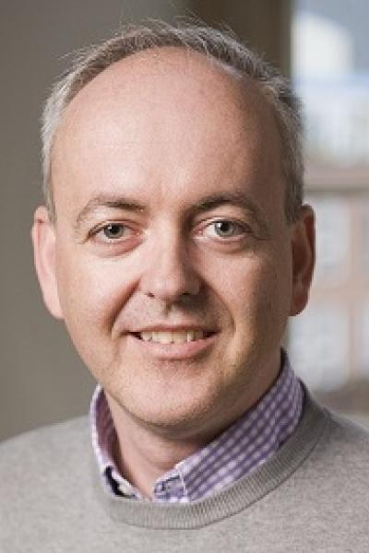
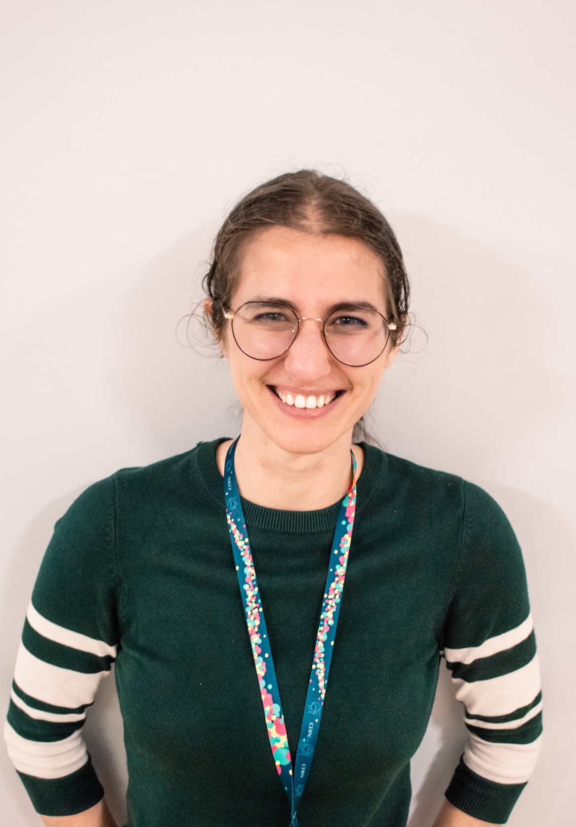

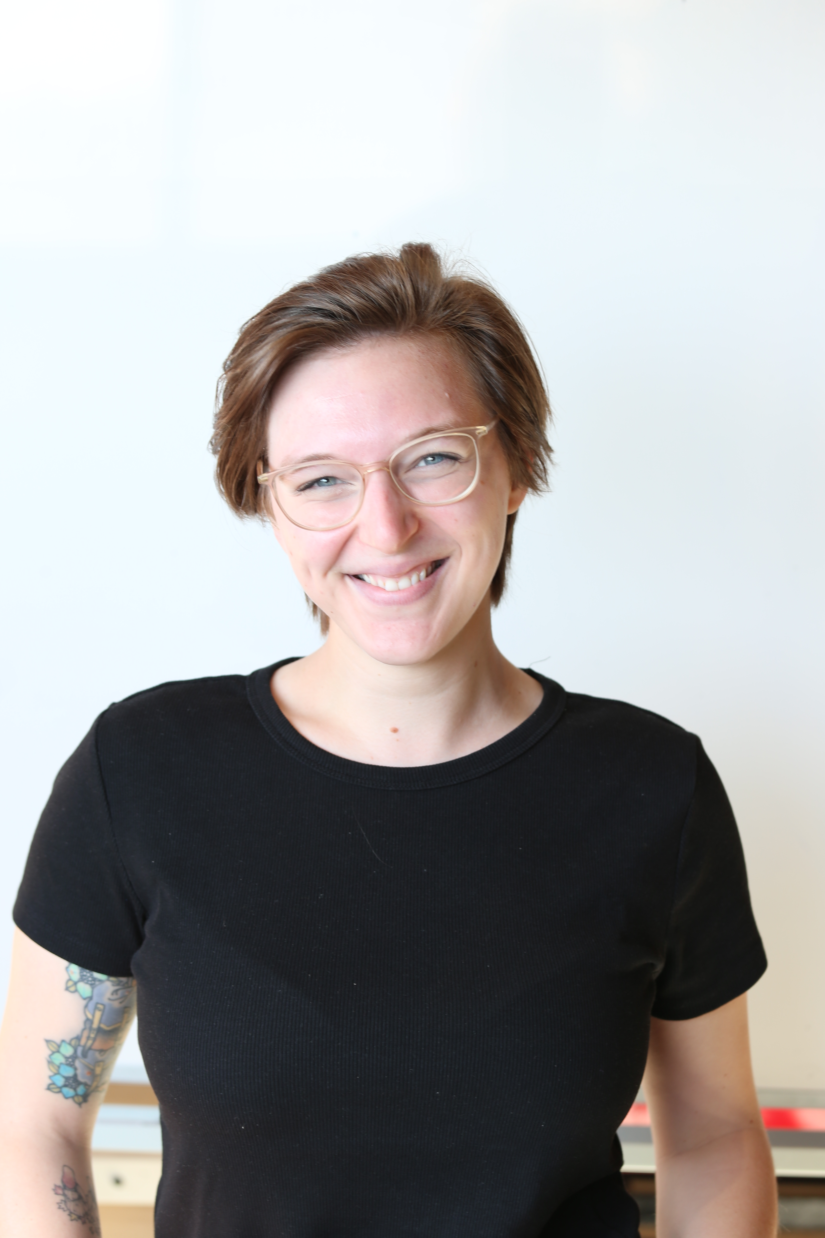
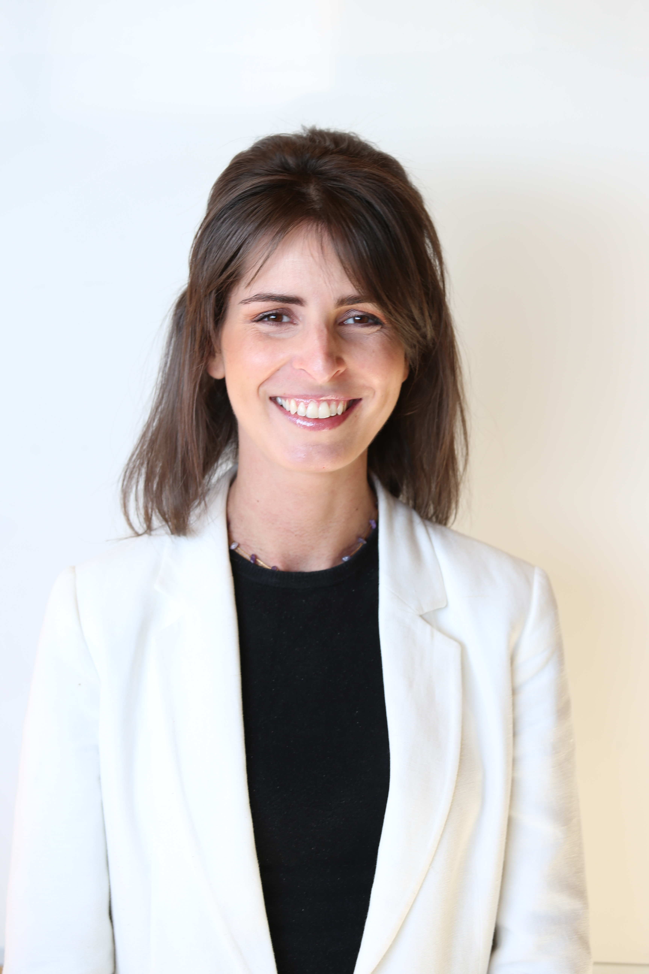
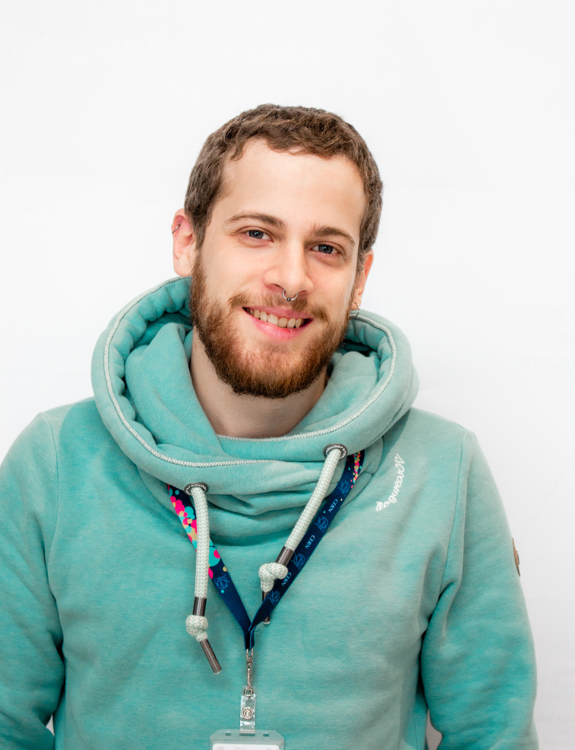
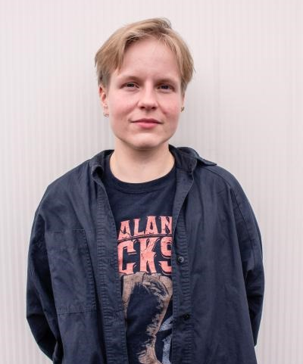
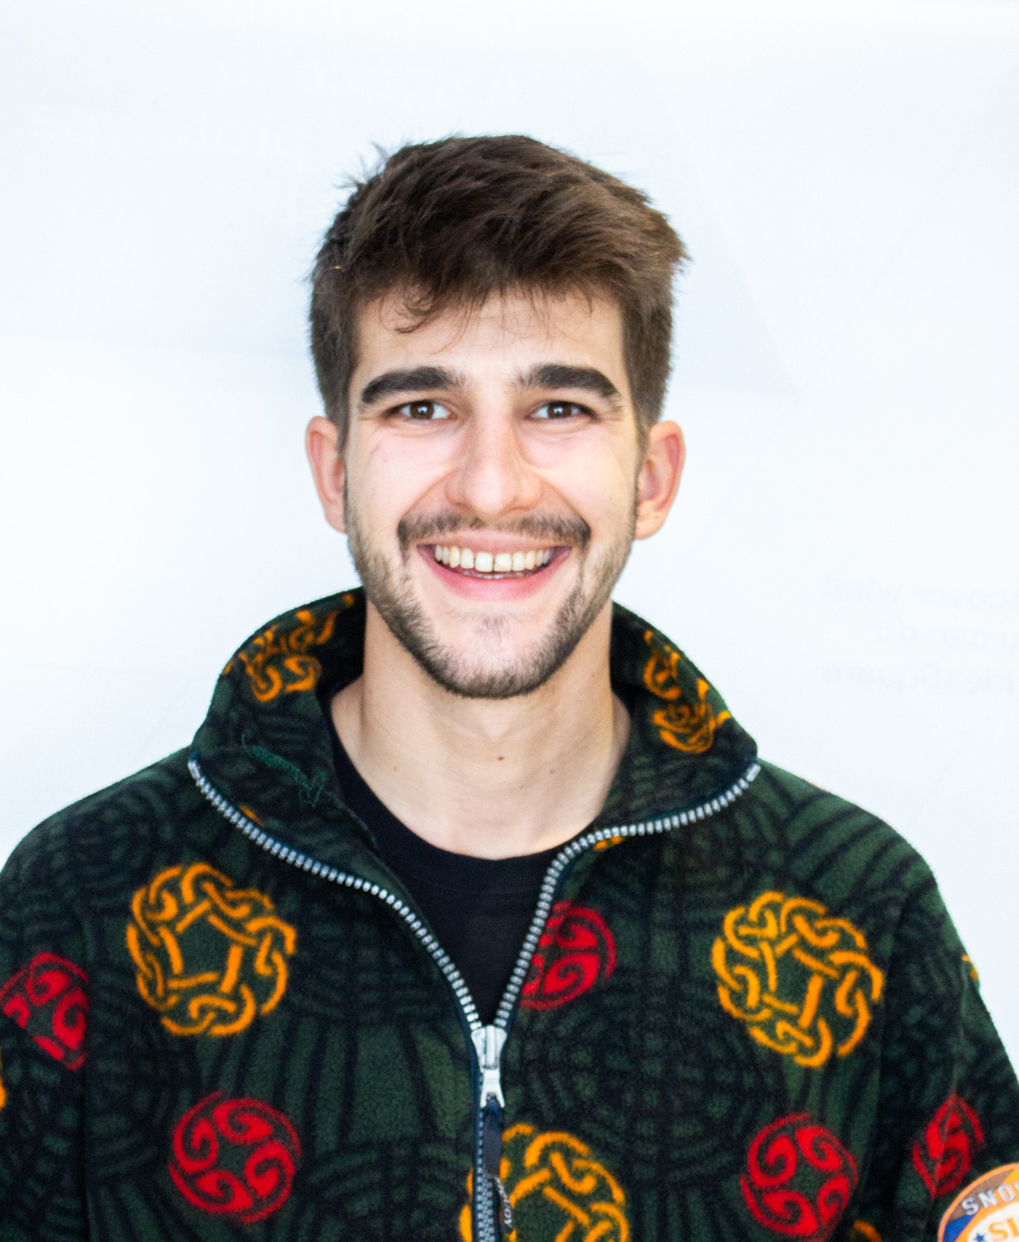
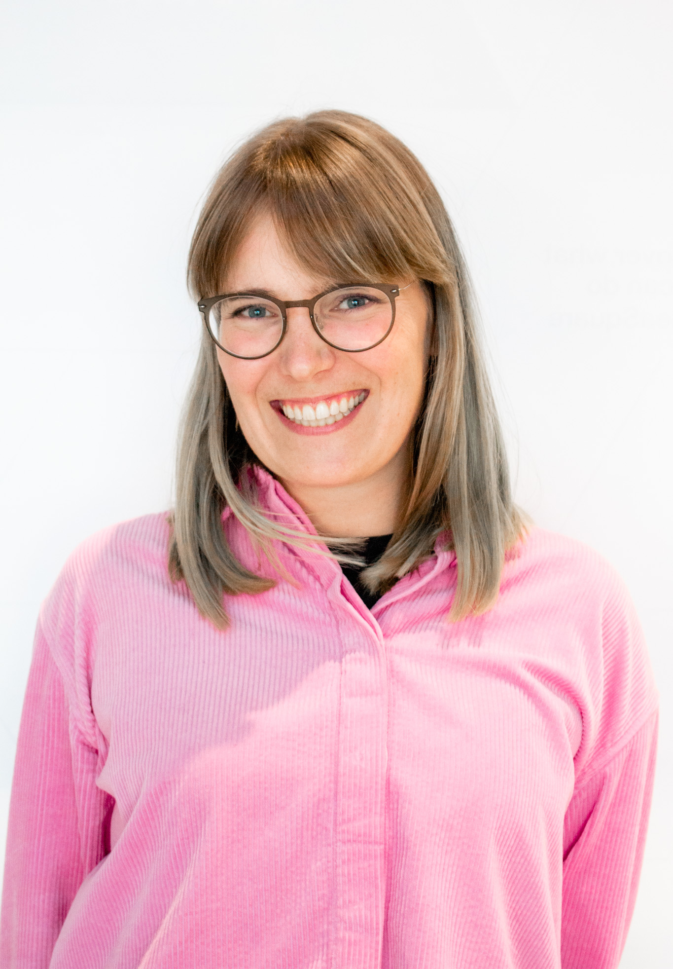
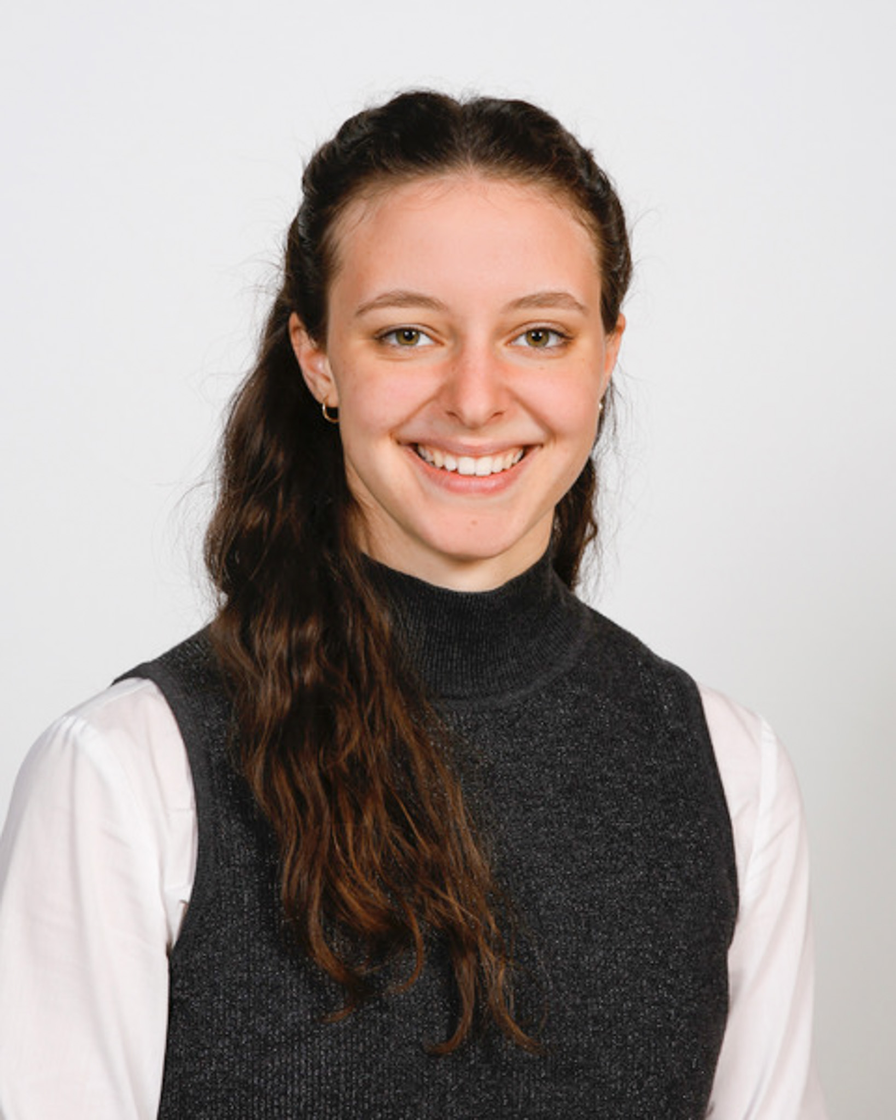
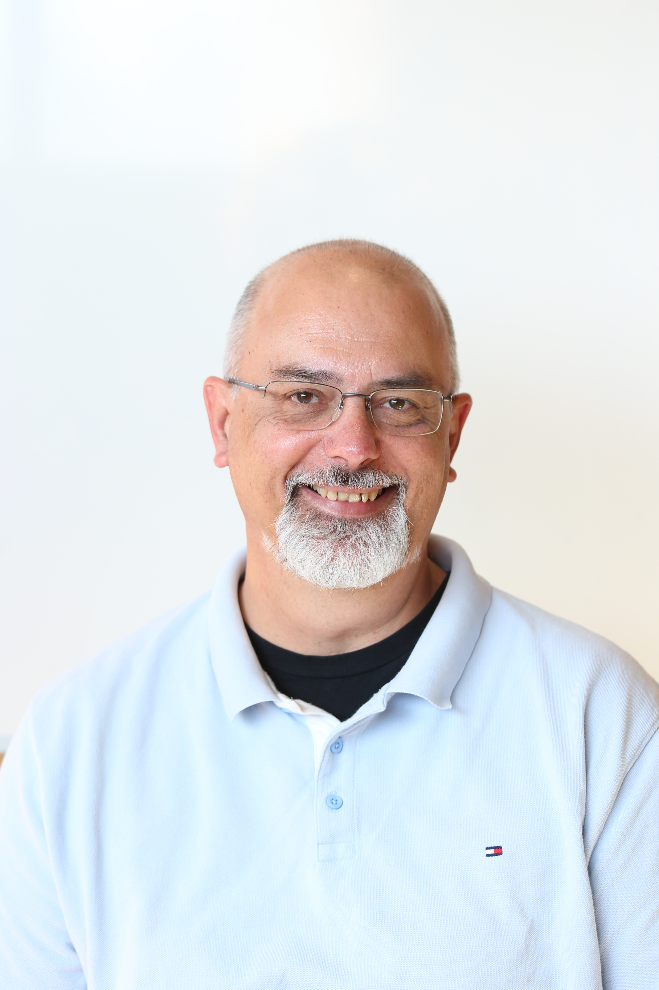
The CREW
Mirabelle Breidvik
Communications
Catarina Batista
Edu programmes
Markus Nordberg
Fixing things
Laëtitia Pedroso
Events
Roy Pennings
Projects & finance
Giulia Gaddi
People watcher
Jimmy Poulaillon
Communications
Pablo Garcia Tello
EU Wizard
Lauri Valtonen
CIJ
Ole Werner
Edu Programmes
Laura Wirtavuori
Edu programmes
Dina Zimmermann
Prototyping

Slide 11
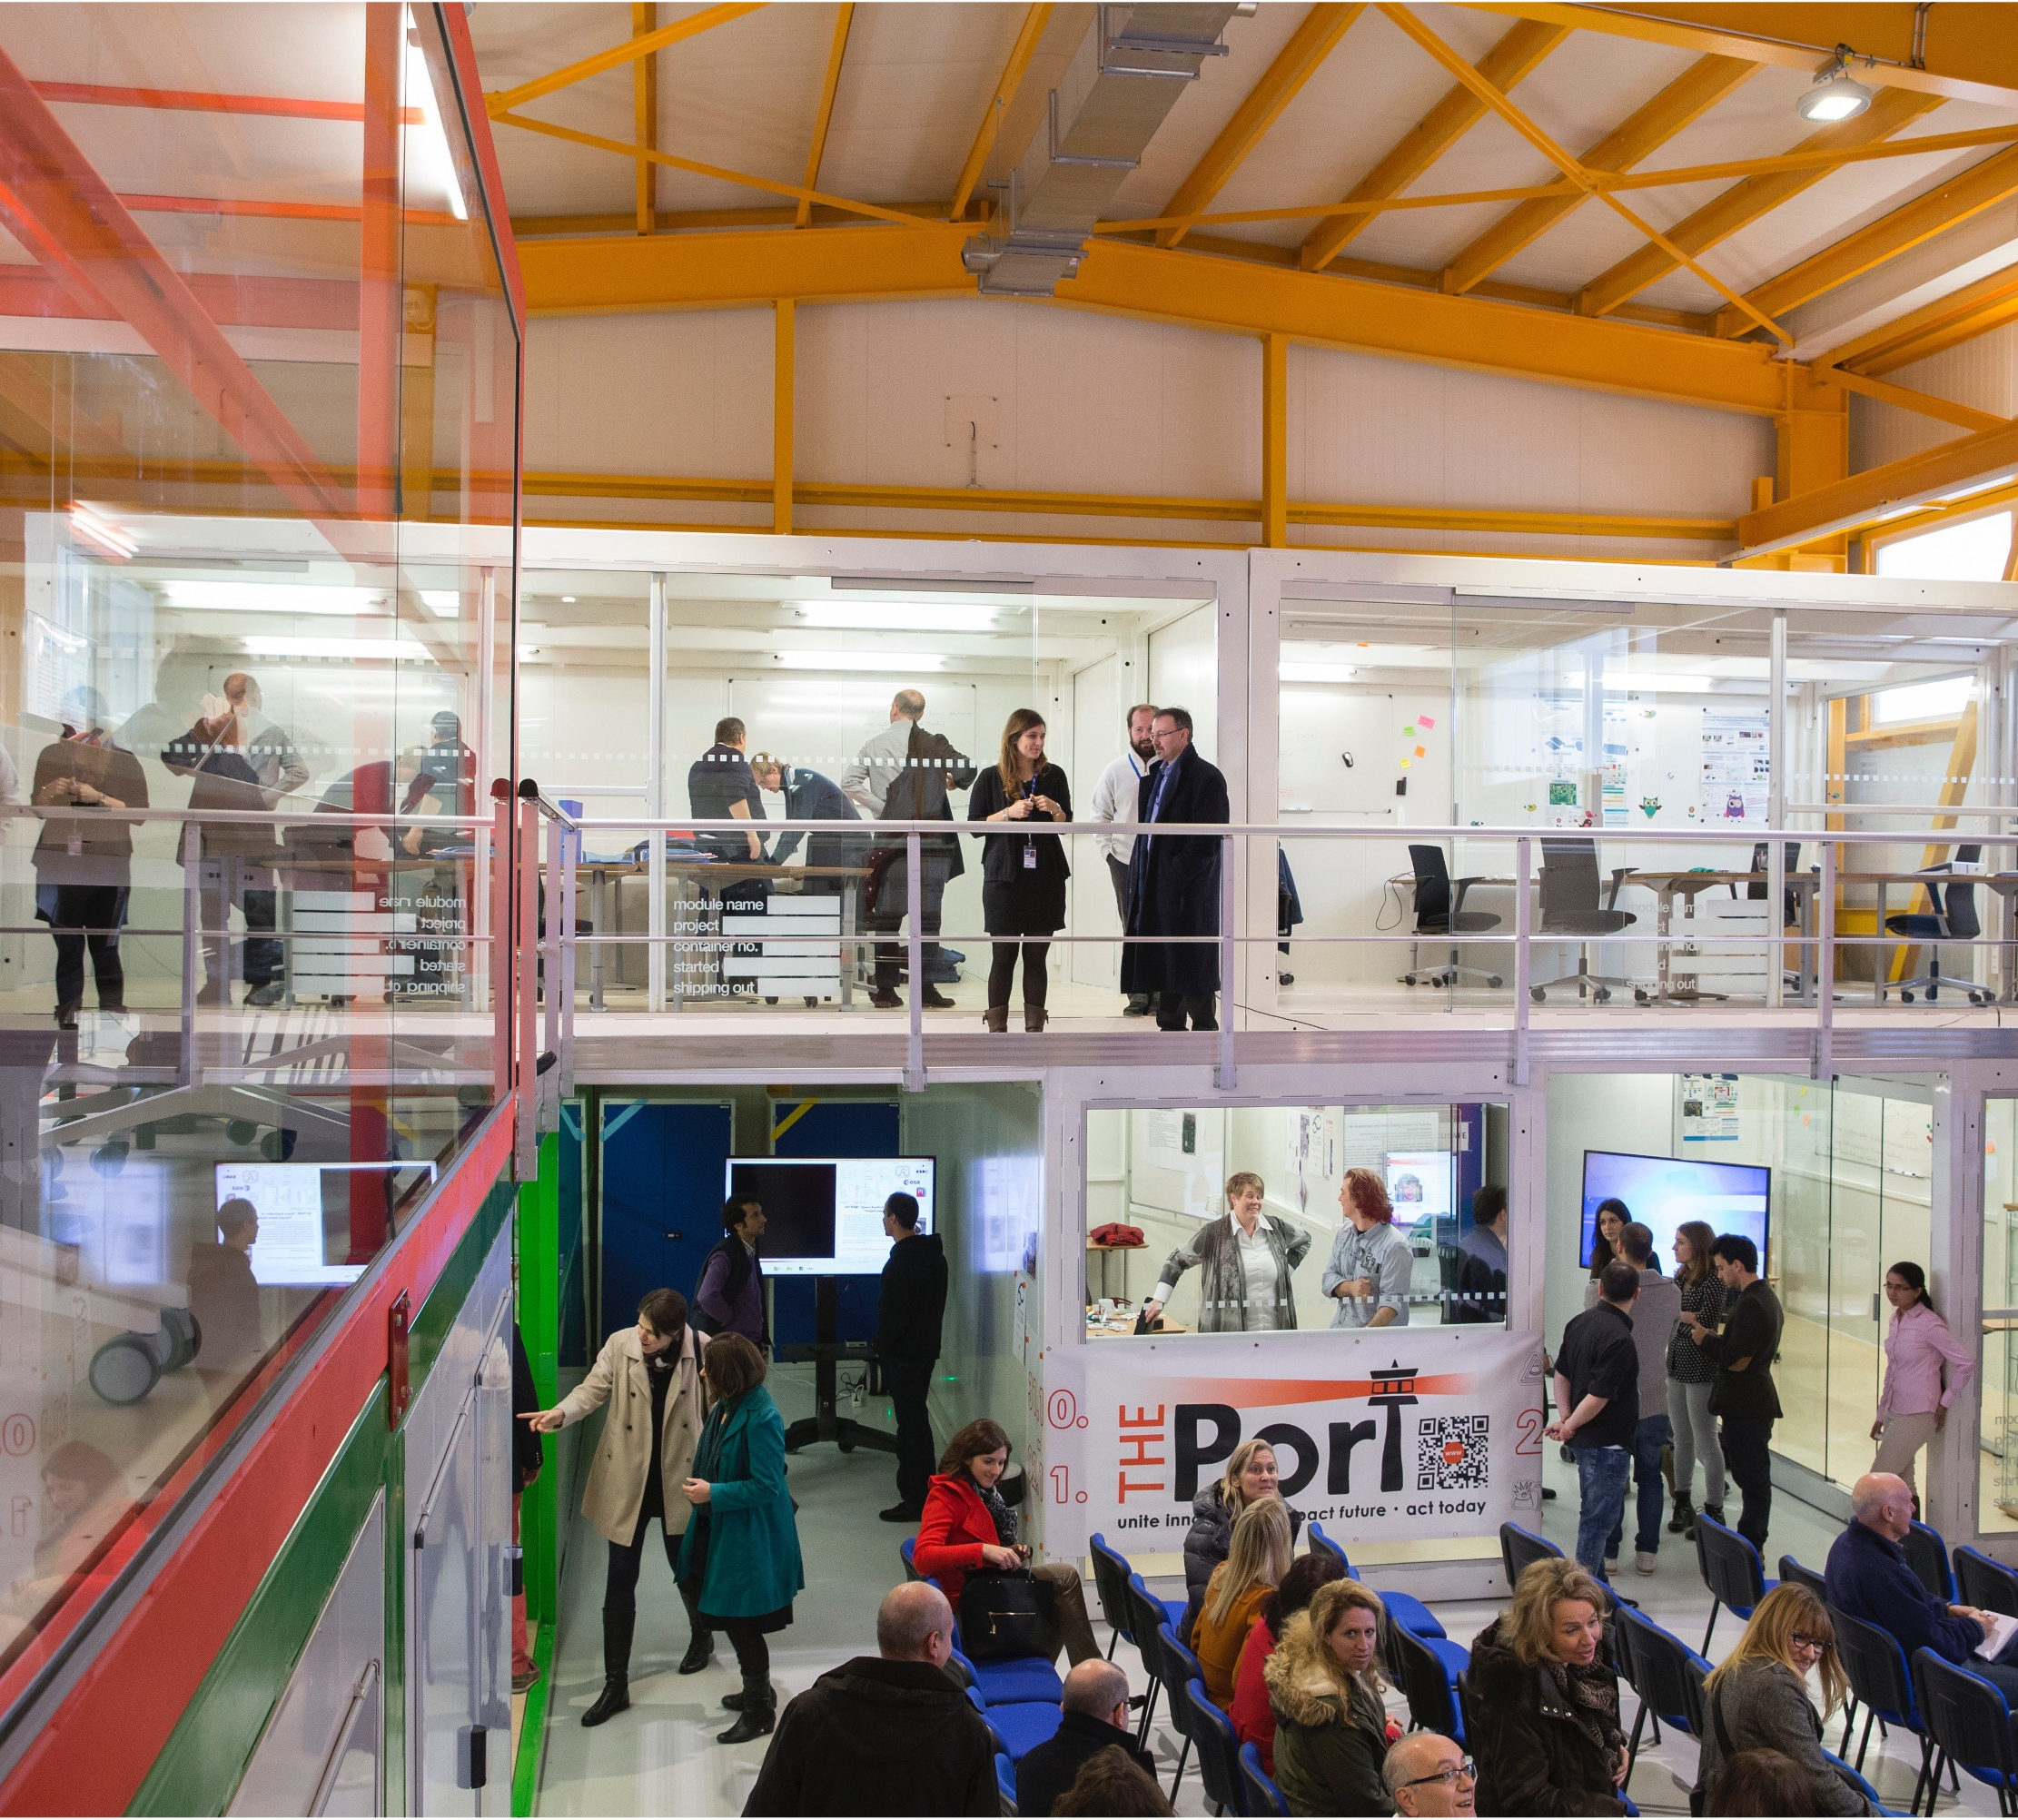
B3179: Building safety
In all inside areas of Building 3179 smoking & alcoholic beverages is strictly forbidden.
Working is possible 24/7 with CERN access card, sleeping is prohibited as in all CERN buildings.
Eating, drinking, coffee breaks are encouraged in the kitchen (and open) area. But not in the Red Bus, please!

Slide 12
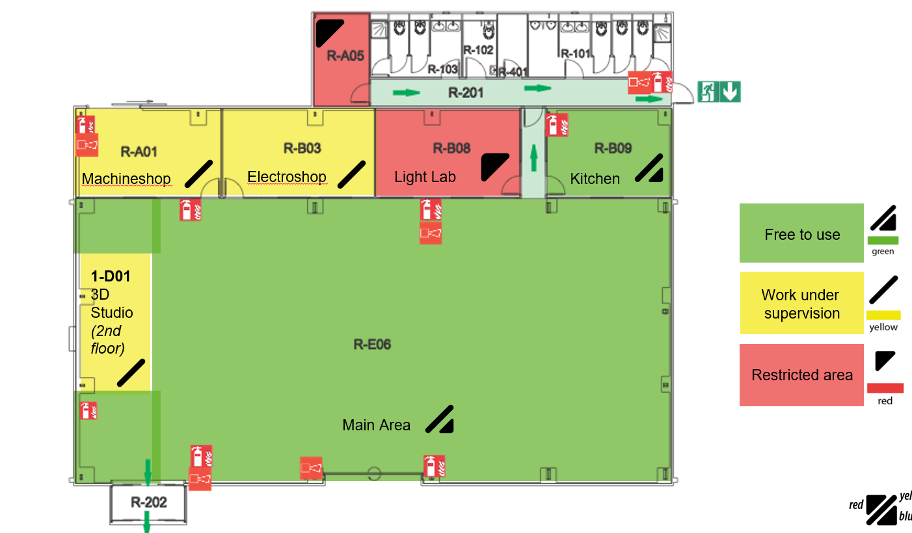


Slide 13
In the kitchen
You are encouraged to use the kitchen, fridges and appliances. Here are a few things to keep in mind:
Food should be labelled
Only use the dishwasher with the status “dirty” – if there is no available “dirty” dishwasher, handwash.
Leave the place cleaner than you found it ☺

Slide 14
Welcome to IdeaSquare
We’re happy to have you here!

