Slide 1
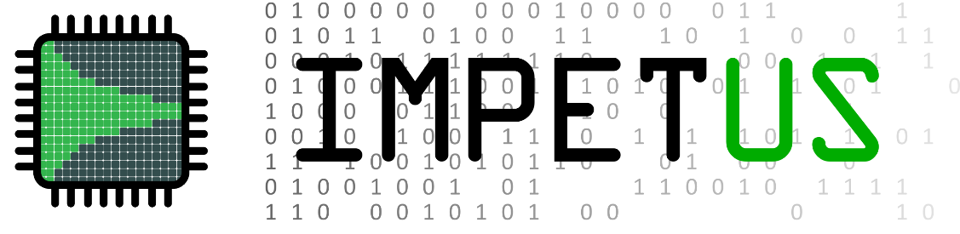

rule4ml: Resource Utilization and Latency Estimation for ML on FPGA
Mohammad Mehdi Rahimifar, Hamza Ezzaoui Rahali,
Audrey Corbeil Therrien
FastML 2024
Notes:
Good afternoon, I’m Hamza, a phd student from the University of Sherbrooke, Canada. And in this talk, I’m going to be introducing rule4ml, which is an open-source tool we’re developing, where one of the main goals is to predict resource usage and latency of ML algorithms on FPGA.

Slide 2
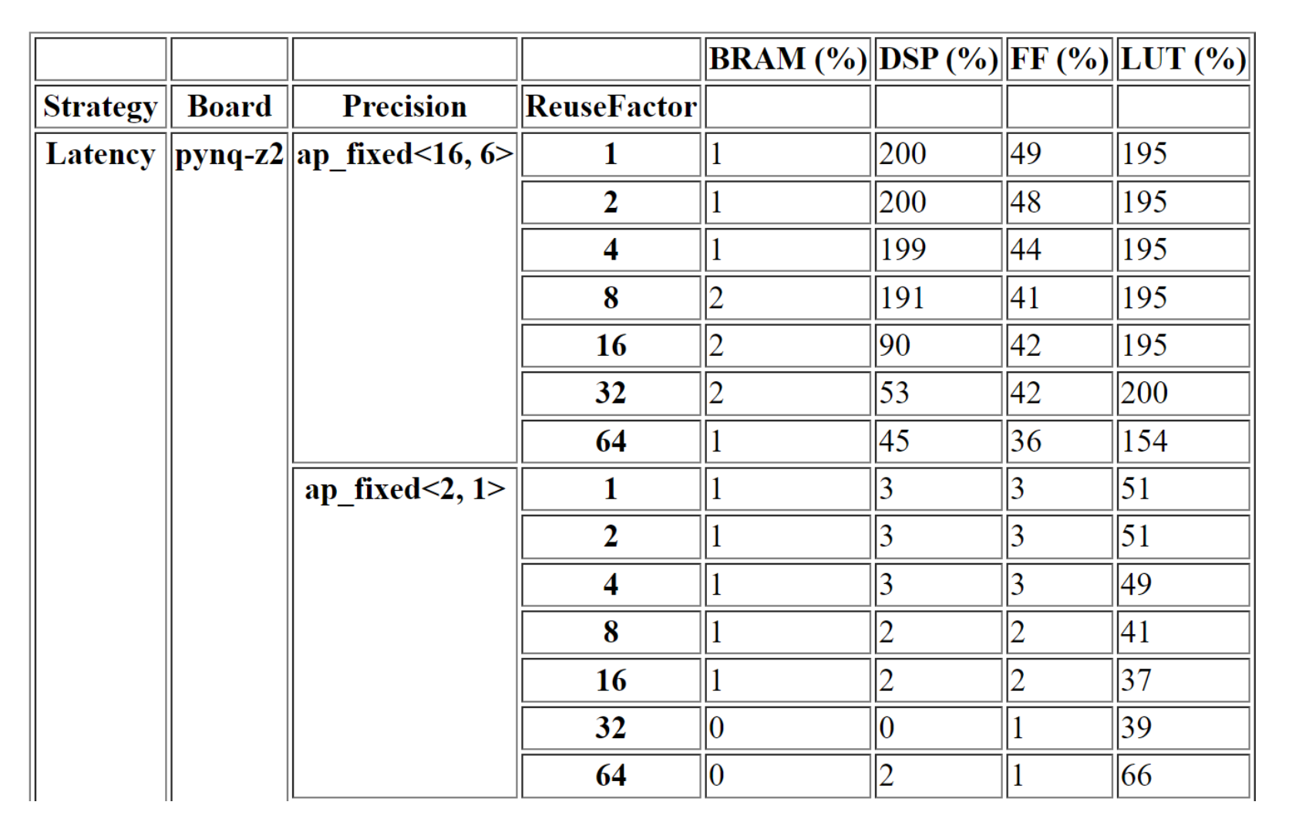
1
/
14
rule4ml: Resource Utilization and Latency Estimation for ML on FPGA
Motivation
Data Generation
If synthesis fails or exceeds available resources, latency constraints
Predictions for all input combinations as Pandas Dataframe
Keras, Pytorch or ONNX Architecture
Larger models take hours
Model Synthesis
Resources and Latency Reports
Vivado Implement.
hls4ml Configuration
Fast approximation using ML
Takes model architectures and synthesis configs as input
Trained Predictor(s)
Inputs
Outputs
Generate a Dataset of Synthesized NNs
Feature Engineering and Training
Notes:
Some of the previous talks showed how edgeML is becoming a popular solution for processing huge data rates close to the sources, especially in physics experiments with low-latency requirements. And I think a lot of us here are familiar with existing NN-to-FPGA pipelines such as hls4ml. Those who used such conversion pipelines in the past might also be familiar with the time-consuming cycle: You try to synthesize your model, but it either fails or exceeds the available resources of your board, or goes past your latency constraints. You then have to go back, modify your architecture or the config, possibly retrain your NN, and re-synthesize. This is where rule4ml comes in and offers an ML-based solution to estimate the resource and latency reports, using only input model architectures and conversion parameters. To do this, we first need to collect a large dataset composed of NN architectures and configs as inputs and resource and latency reports as outputs. Then we can train predictors for the regression task. At the end, the user can pick the most optimal architecture and parameters and do the synthesis while hopefully avoiding the time-consuming design cycle. This sounds great, but there are a few difficulties we face in practice, and the main one is the need for a large, high-quality dataset.

Slide 3
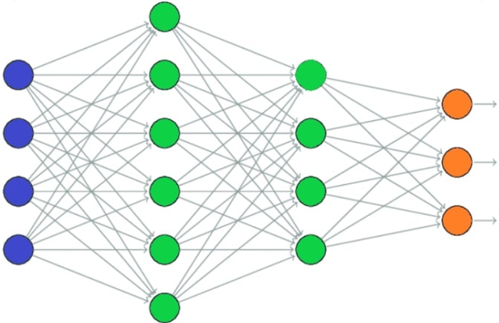
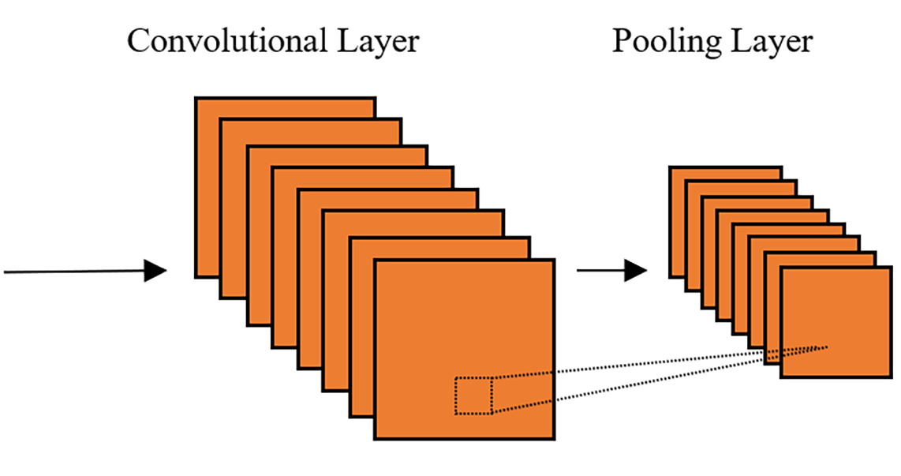
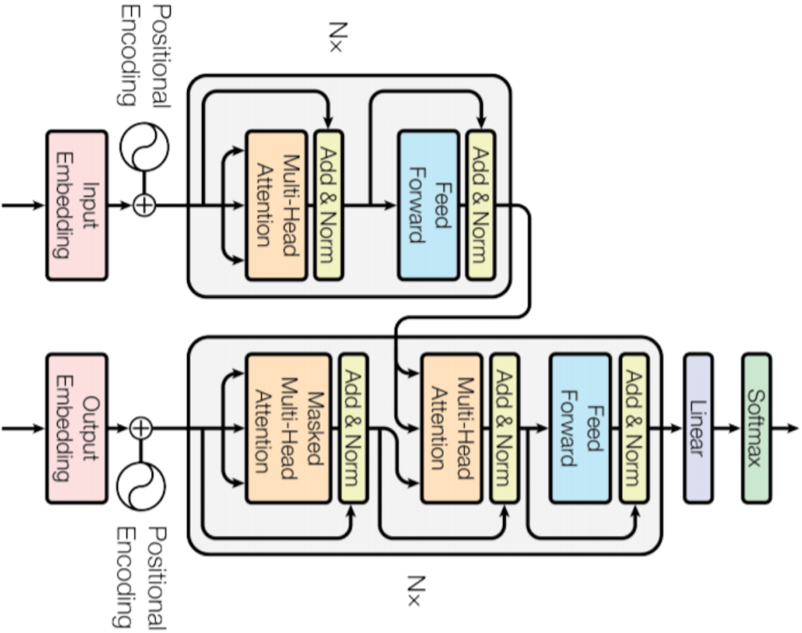
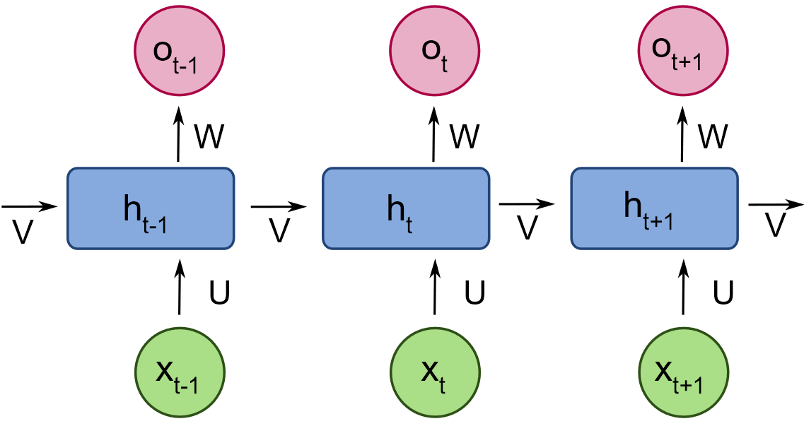
Motivation
2
/
14
rule4ml: Resource Utilization and Latency Estimation for ML on FPGA
Data Generation
Inputs & Targets
Large variety of NN architectures
Wide range of hls4ml parameters
FCNN
RNN
CNN
Transformer
Precision
Reuse Factor
Board
Strategy
When to collect resource and latency reports?
C/RTL Synthesis
Logic Synthesis
Implementation
Least
Report Accuracy
Most
Most
Ease of Production
Least
Notes:
Some of the previous talks showed how edgeML is becoming a popular solution for processing huge data rates close to the sources, especially in physics experiments with low-latency requirements. And I think a lot of us here are familiar with existing NN-to-FPGA pipelines such as hls4ml. Those who used such conversion pipelines in the past might also be familiar with the time-consuming cycle: You try to synthesize your model, but it either fails or exceeds the available resources of your board, or goes past your latency constraints. You then have to go back, modify your architecture or the config, possibly retrain your NN, and re-synthesize. This is where rule4ml comes in and offers an ML-based solution to estimate the resource and latency reports, using only input model architectures and conversion parameters. To do this, we first need to collect a large dataset composed of NN architectures and configs as inputs and resource and latency reports as outputs. Then we can train predictors for the regression task. At the end, the user can pick the most optimal architecture and parameters and do the synthesis while hopefully avoiding the time-consuming design cycle. This sounds great, but there are a few difficulties we face in practice, and the main one is the need for a large, high-quality dataset.

Slide 4
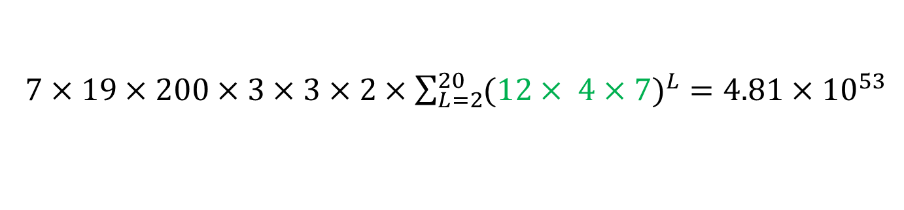
Motivation
3
/
14
rule4ml: Resource Utilization and Latency Estimation for ML on FPGA
Data Generation
Inputs & Targets
First Dataset Iteration
Parameter | Value Range | Range Type
Input Size | [16, 1024] | Powers of 2
Layer Count | [2, 20] | Increments of 1
 | [2, 4096] | Powers of 2
Output Size | [1, 200] | Increments of 1
 | ReLU, Tanh, Sigmoid, Softmax | -
Precision | 2, 8, 16 | -
 | [1, 64] | Powers of 2
Board | Pynq-z2, ZCU102, Alveo-u200 | -
Strategy | Latency, Resource | -
Focus on generating FCNNs using parameters randomly sampled from pre-defined ranges
Neurons Count
Collect RTL synthesis resource and latency reports
Activations
Make data generation an accessible part of rule4ml
Reuse Factor
Content set to evolve, either through user contribution, or group collaboration
$7×19×200×3×3×2×\sum_{L=2}^{20}{{(12× 4×7)}^{L}}=4.81×{10}^{53}$

Slide 5

Motivation
4
/
14
rule4ml: Resource Utilization and Latency Estimation for ML on FPGA
Data Generation
Inputs & Targets
Generated and synthesized ~15000 FCNNs (~29k CPU-core hours @ 2.2 GHz)
TF 2.15.1 + Keras 2.15.0
hls4ml 0.8.1
Vivado 2019.1 (small changes with neighboring versions)
Saved as a large JSON file
Meta data
Model + hls4ml configs
Resource information
Latency information
Training set: 95% of synthetic data.
Test set: 500+ models split from synthetic data.
Benchmark models: MNIST + 7 models from scientific applications + 3 custom models using several hls4ml configs; 900+ samples in total.
https://borealisdata.ca/dataverse/rule4ml

Slide 6
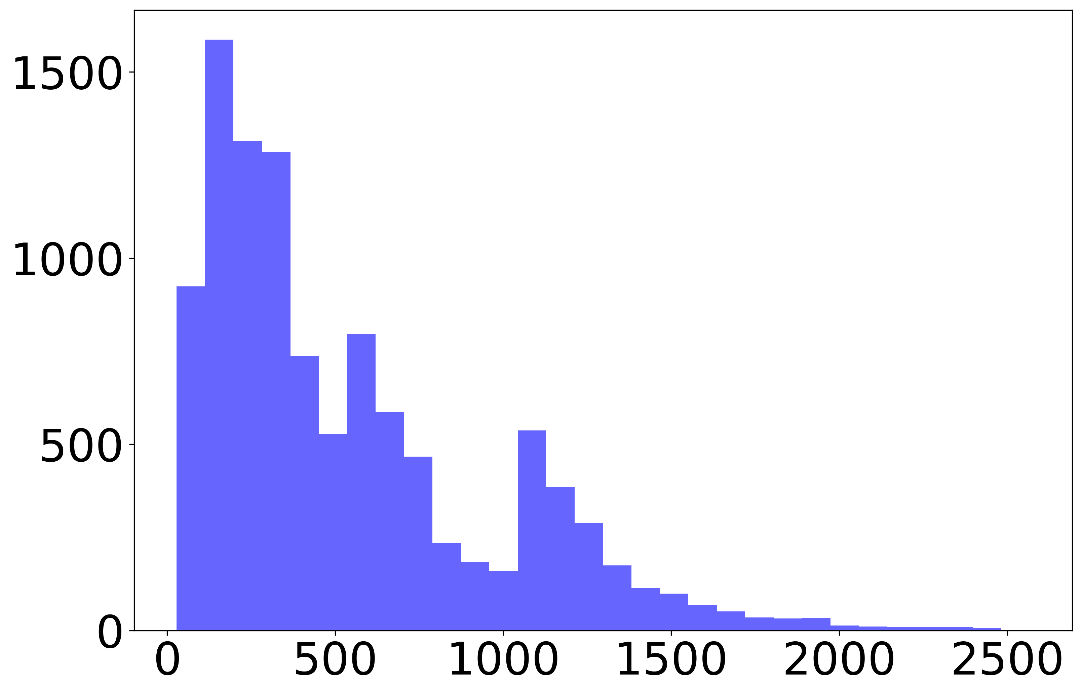

Data Generation
5
/
14
rule4ml: Resource Utilization and Latency Estimation for ML on FPGA
Inputs & Targets
Baseline Predictor
Sequential Features
Prediction Targets
Layer Type
Input Size
Output Size
Number of Parameters
Activation Function
Reuse Factor
BRAM
DSP
Input Layer
Layer Type
I/O Size
Reuse Factor
FF
LUT
Global Features
$$min⁡(200\%,\frac{value}{board_max})$$
Layer Type
I/O Size
# Parameters
Reuse Factor
Dense Layer
Board
Precision
Strategy
Layer Counts (per type)
# Parameters (total and per layer type)
Averages (I/O, reuse, params)
Cycles (Absolute Terms)
Layer Implementation
Add Op
Mult Op
Logical Op
Lookup Op
Layer Type
I/O Size
Act Function
Reuse Factor
Activation Layer
Frequency
…
Values

Slide 7
Inputs & Targets
6
/
14
rule4ml: Resource Utilization and Latency Estimation for ML on FPGA
Baseline Predictor
Test Results
Categorical Inputs
Numerical Inputs
Predictor | R2 Score
 | BRAM | DSP | FF | LUT | CYCLES
LSTM | 0.81 | 0.03 | 0.48 | 0.74 | 0.80
Transformer | 0.78 | 0.93 | 0.85 | 0.74 | 0.88
Random Forest | 0.89 | 0.88 | 0.79 | 0.83 | 0.86
GB Trees | 0.84 | 0.86 | 0.77 | 0.86 | 0.88
MLP | 0.92 | 0.85 | 0.72 | 0.85 | 0.87
Embeddings
Dense Block
Concatenate
Dense Block

Slide 8

Baseline Predictor
7
/
14
rule4ml: Resource Utilization and Latency Estimation for ML on FPGA
Test Results
Benchmark Results
Does it work?
WE
70%

Slide 9
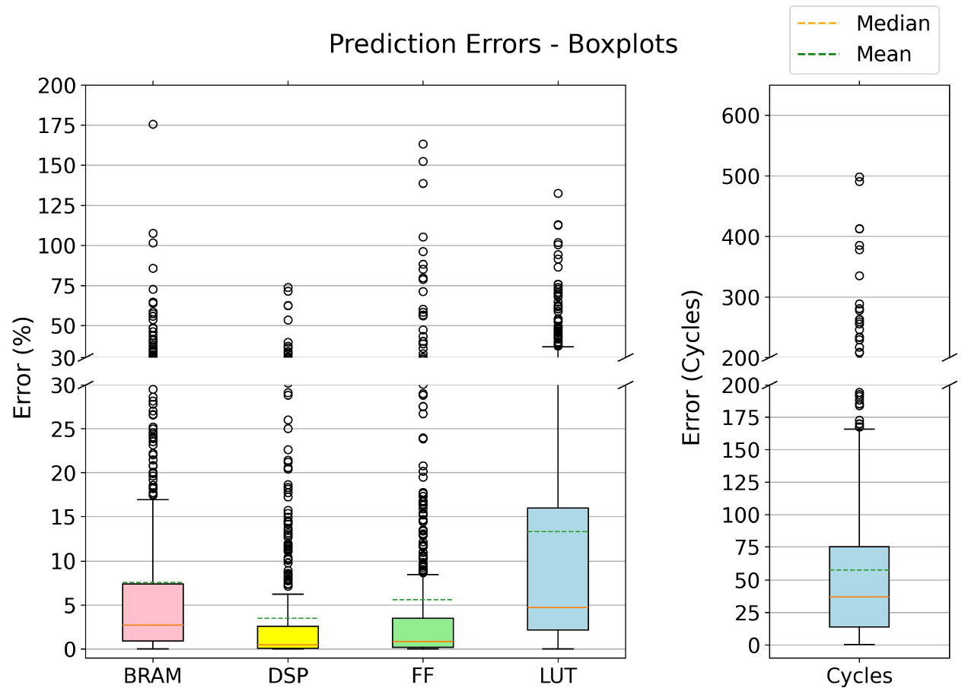


Baseline Predictor
8
/
14
rule4ml: Resource Utilization and Latency Estimation for ML on FPGA
Test Results
Benchmark Results
Resources values
are capped <= 200%
Test set: 500+ models split from synthetic data.
80% BRAM
89% DSP
88% FF
66% LUT
$< 10\%$ Error
MAE (%)
MAE (Cycles)
85% Cycles Predictions
$< 100$ Cycles
(10 ns clock period => 1 μs)

Slide 10
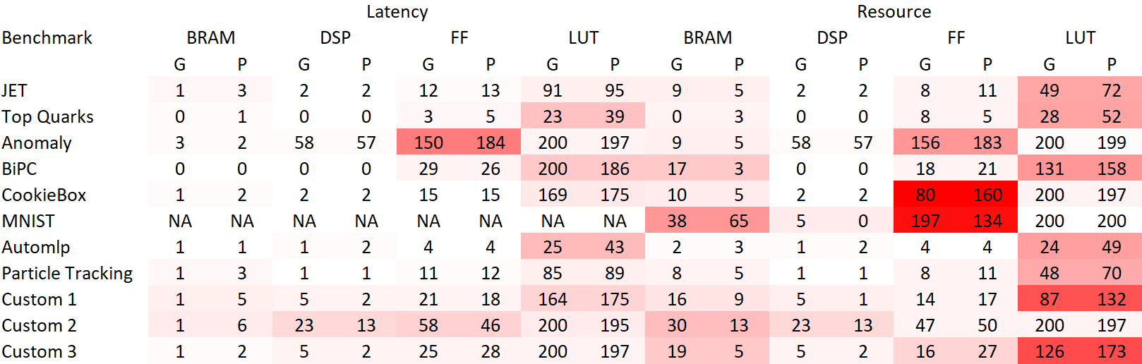
Test Results
9
/
14
rule4ml: Resource Utilization and Latency Estimation for ML on FPGA
Benchmark Results
Package Structure
Pynq-z2, ap_fixed<8,3>, Reuse Factor 32
1
2
3
1: Ground Truth
2: Prediction
3: Failed Synthesis

Slide 11
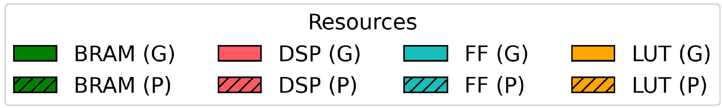
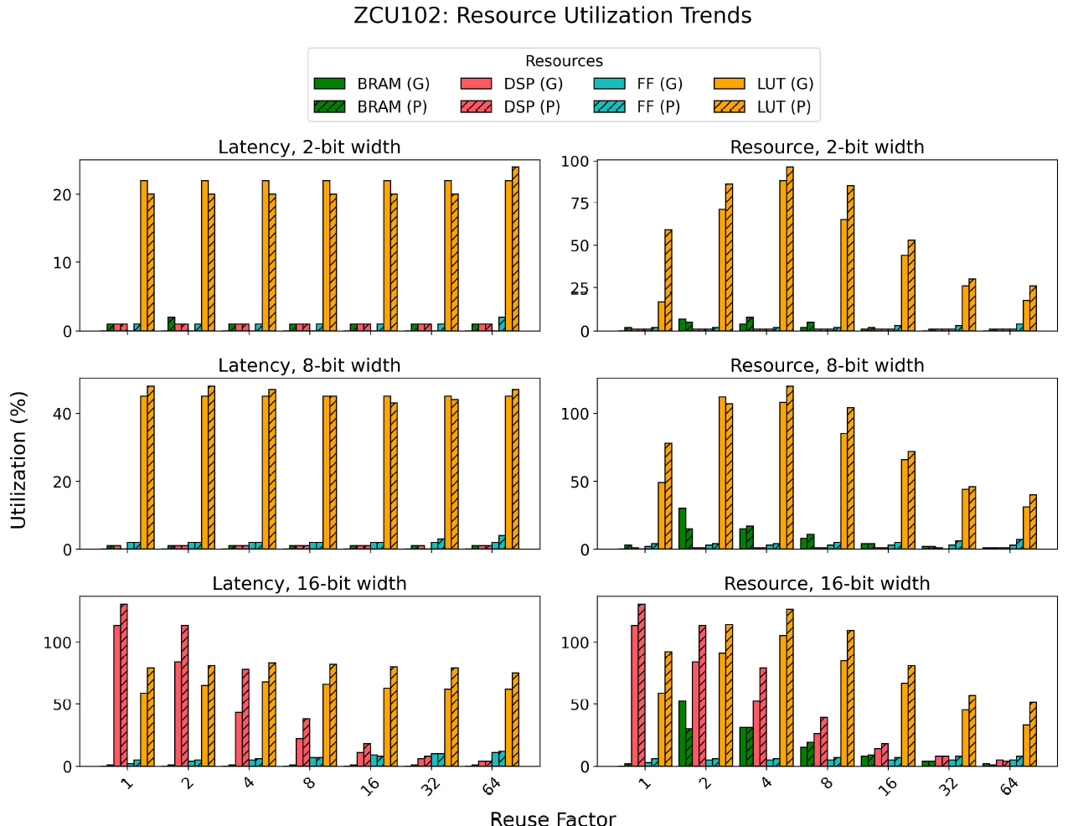
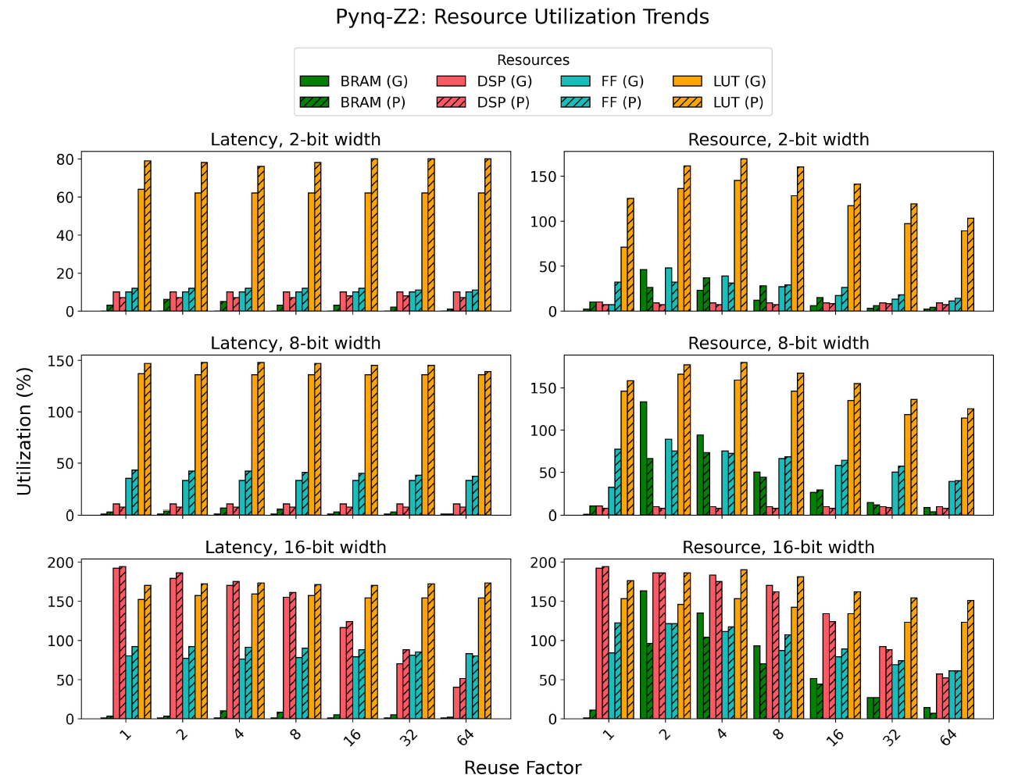
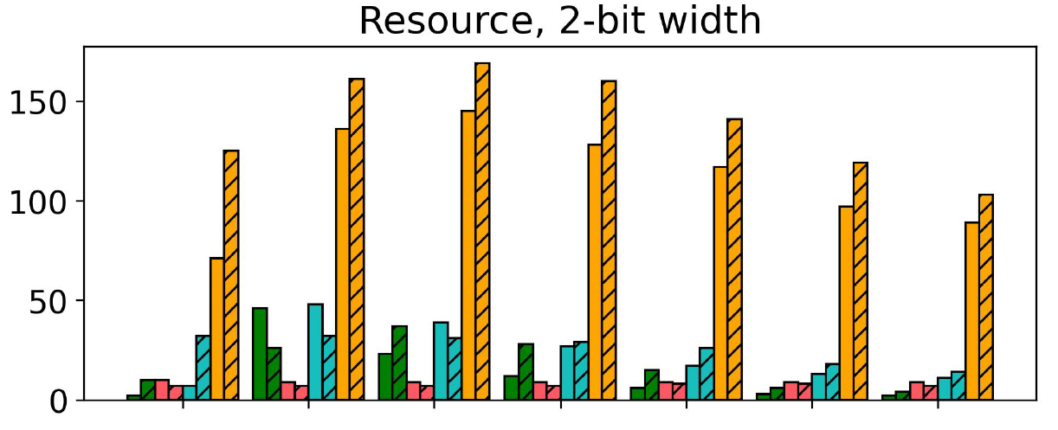
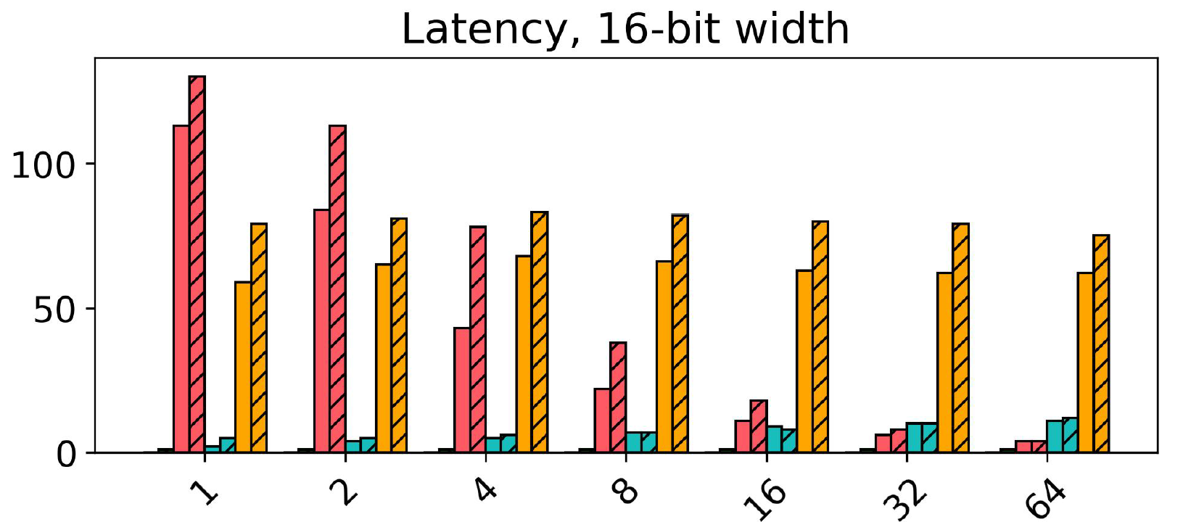
Test Results
10
/
14
rule4ml: Resource Utilization and Latency Estimation for ML on FPGA
Benchmark Results
Package Structure
Pynq-z2, Resource, 2-bit width
ZCU102, Latency, 16-bit width
%
1
2
4
8
16
32
64
1
2
4
8
16
32
64
Reuse Factor

Slide 12
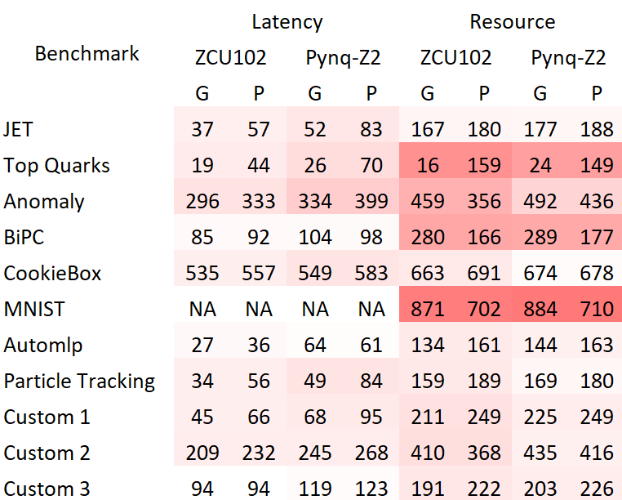
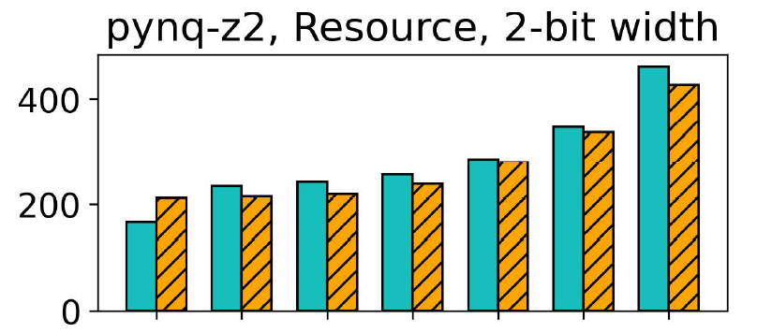
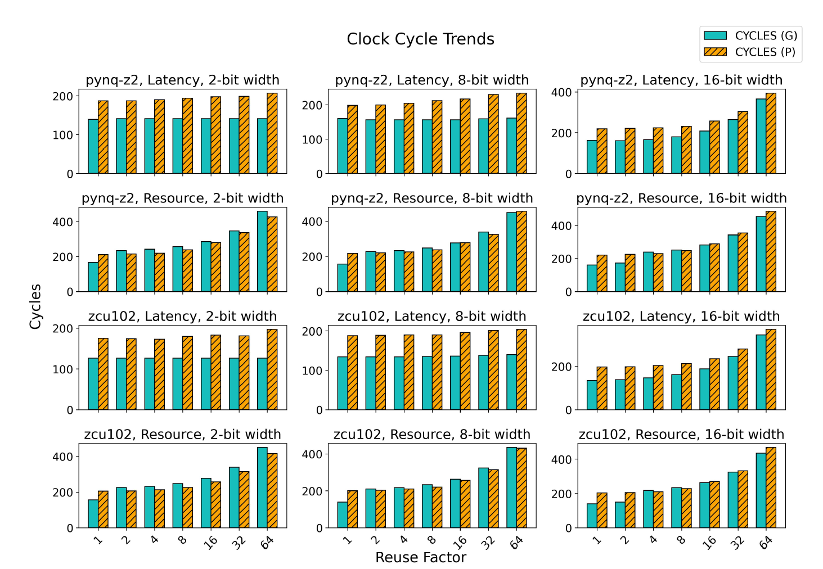
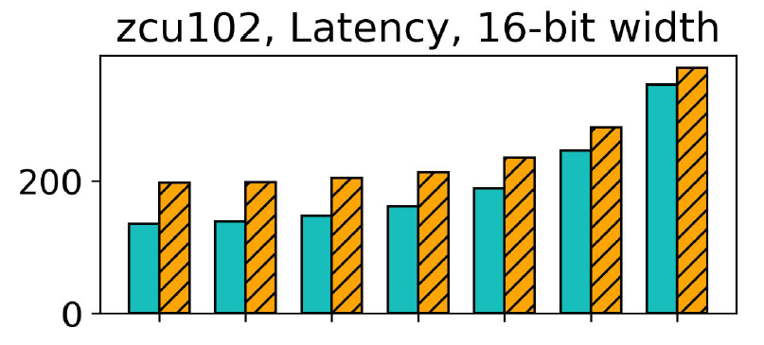
Test Results
11
/
14
rule4ml: Resource Utilization and Latency Estimation for ML on FPGA
Benchmark Results
Package Structure
Cycles
1
2
4
8
16
32
64
Reuse Factor

Slide 13

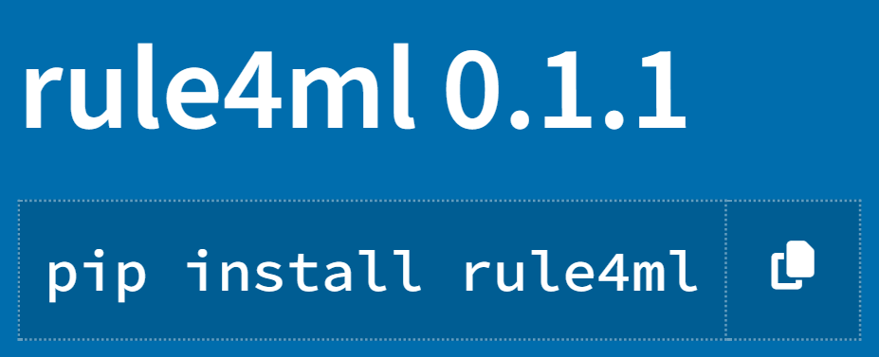
Bench. Results
12
/
14
rule4ml: Resource Utilization and Latency Estimation for ML on FPGA
Package Structure
Quick Demo
rule4ml
data_gen
notebooks
parsers
models

Slide 14
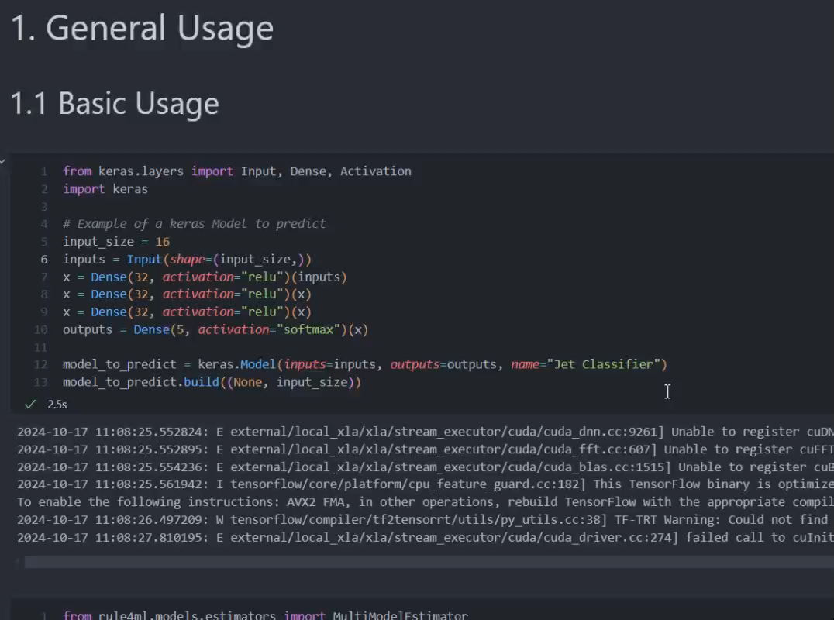
Package Structure
13
/
14
rule4ml: Resource Utilization and Latency Estimation for ML on FPGA
Quick Demo
Outlook
~30 lines of code
Preprocess + Inference 1.7s
21 Synthesis Prediction

Slide 15
Quick Demo
14
/
14
rule4ml: Resource Utilization and Latency Estimation for ML on FPGA
Outlook
Continue efforts to build a community around rule4ml.
What we
explored
Expand the dataset, include more architectures and configurations.
Formalize a benchmark for contributors.
(Ben Hawks lightning talk)
Experiment beyond resource and latency estimation.
~15000 FCNNs

Slide 16

Thank You!

Slide 17
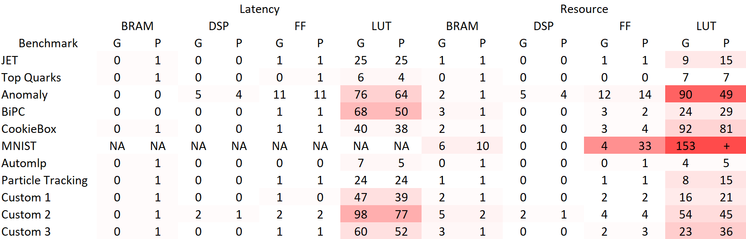
rule4ml: Resource Utilization and Latency Estimation for ML on FPGA
ZCU102, ap_fixed<8,3>, Reuse Factor 32

Slide 18
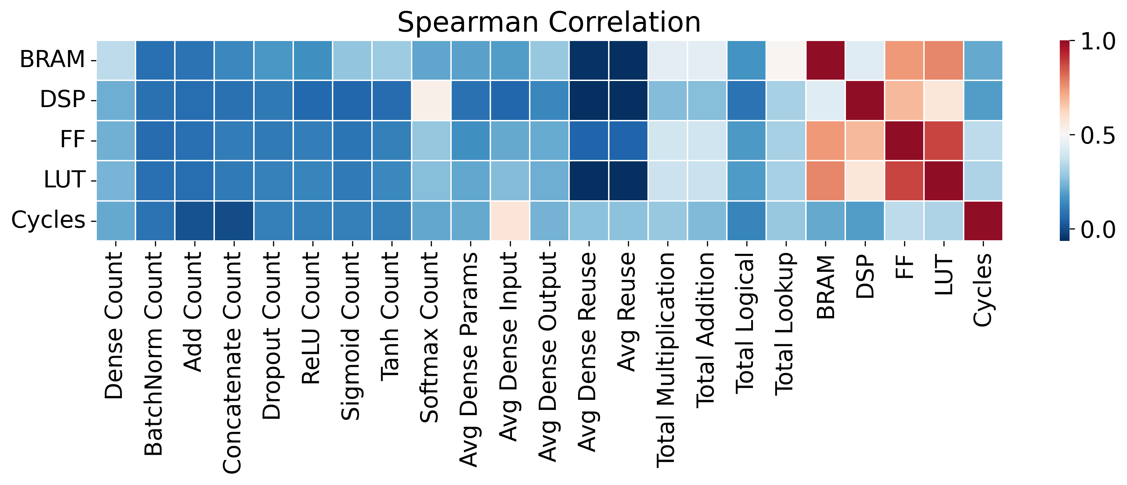
rule4ml: Resource Utilization and Latency Estimation for ML on FPGA

Slide 19
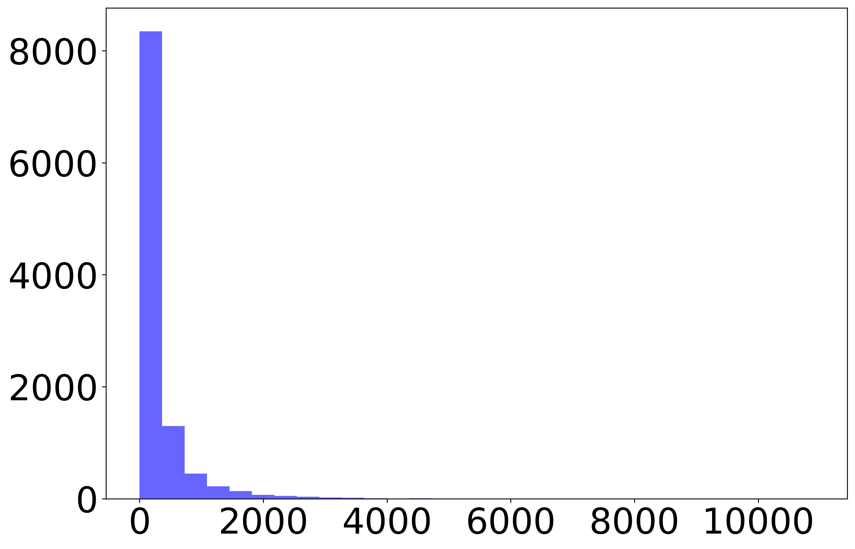
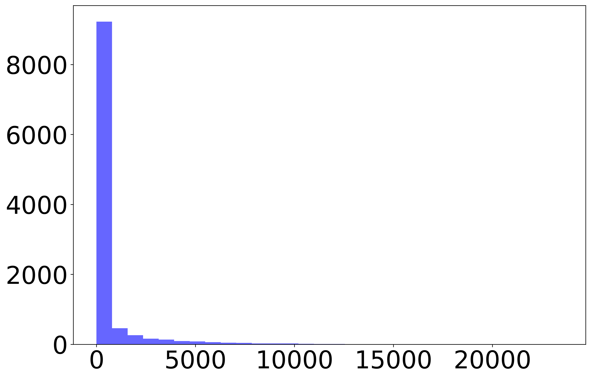
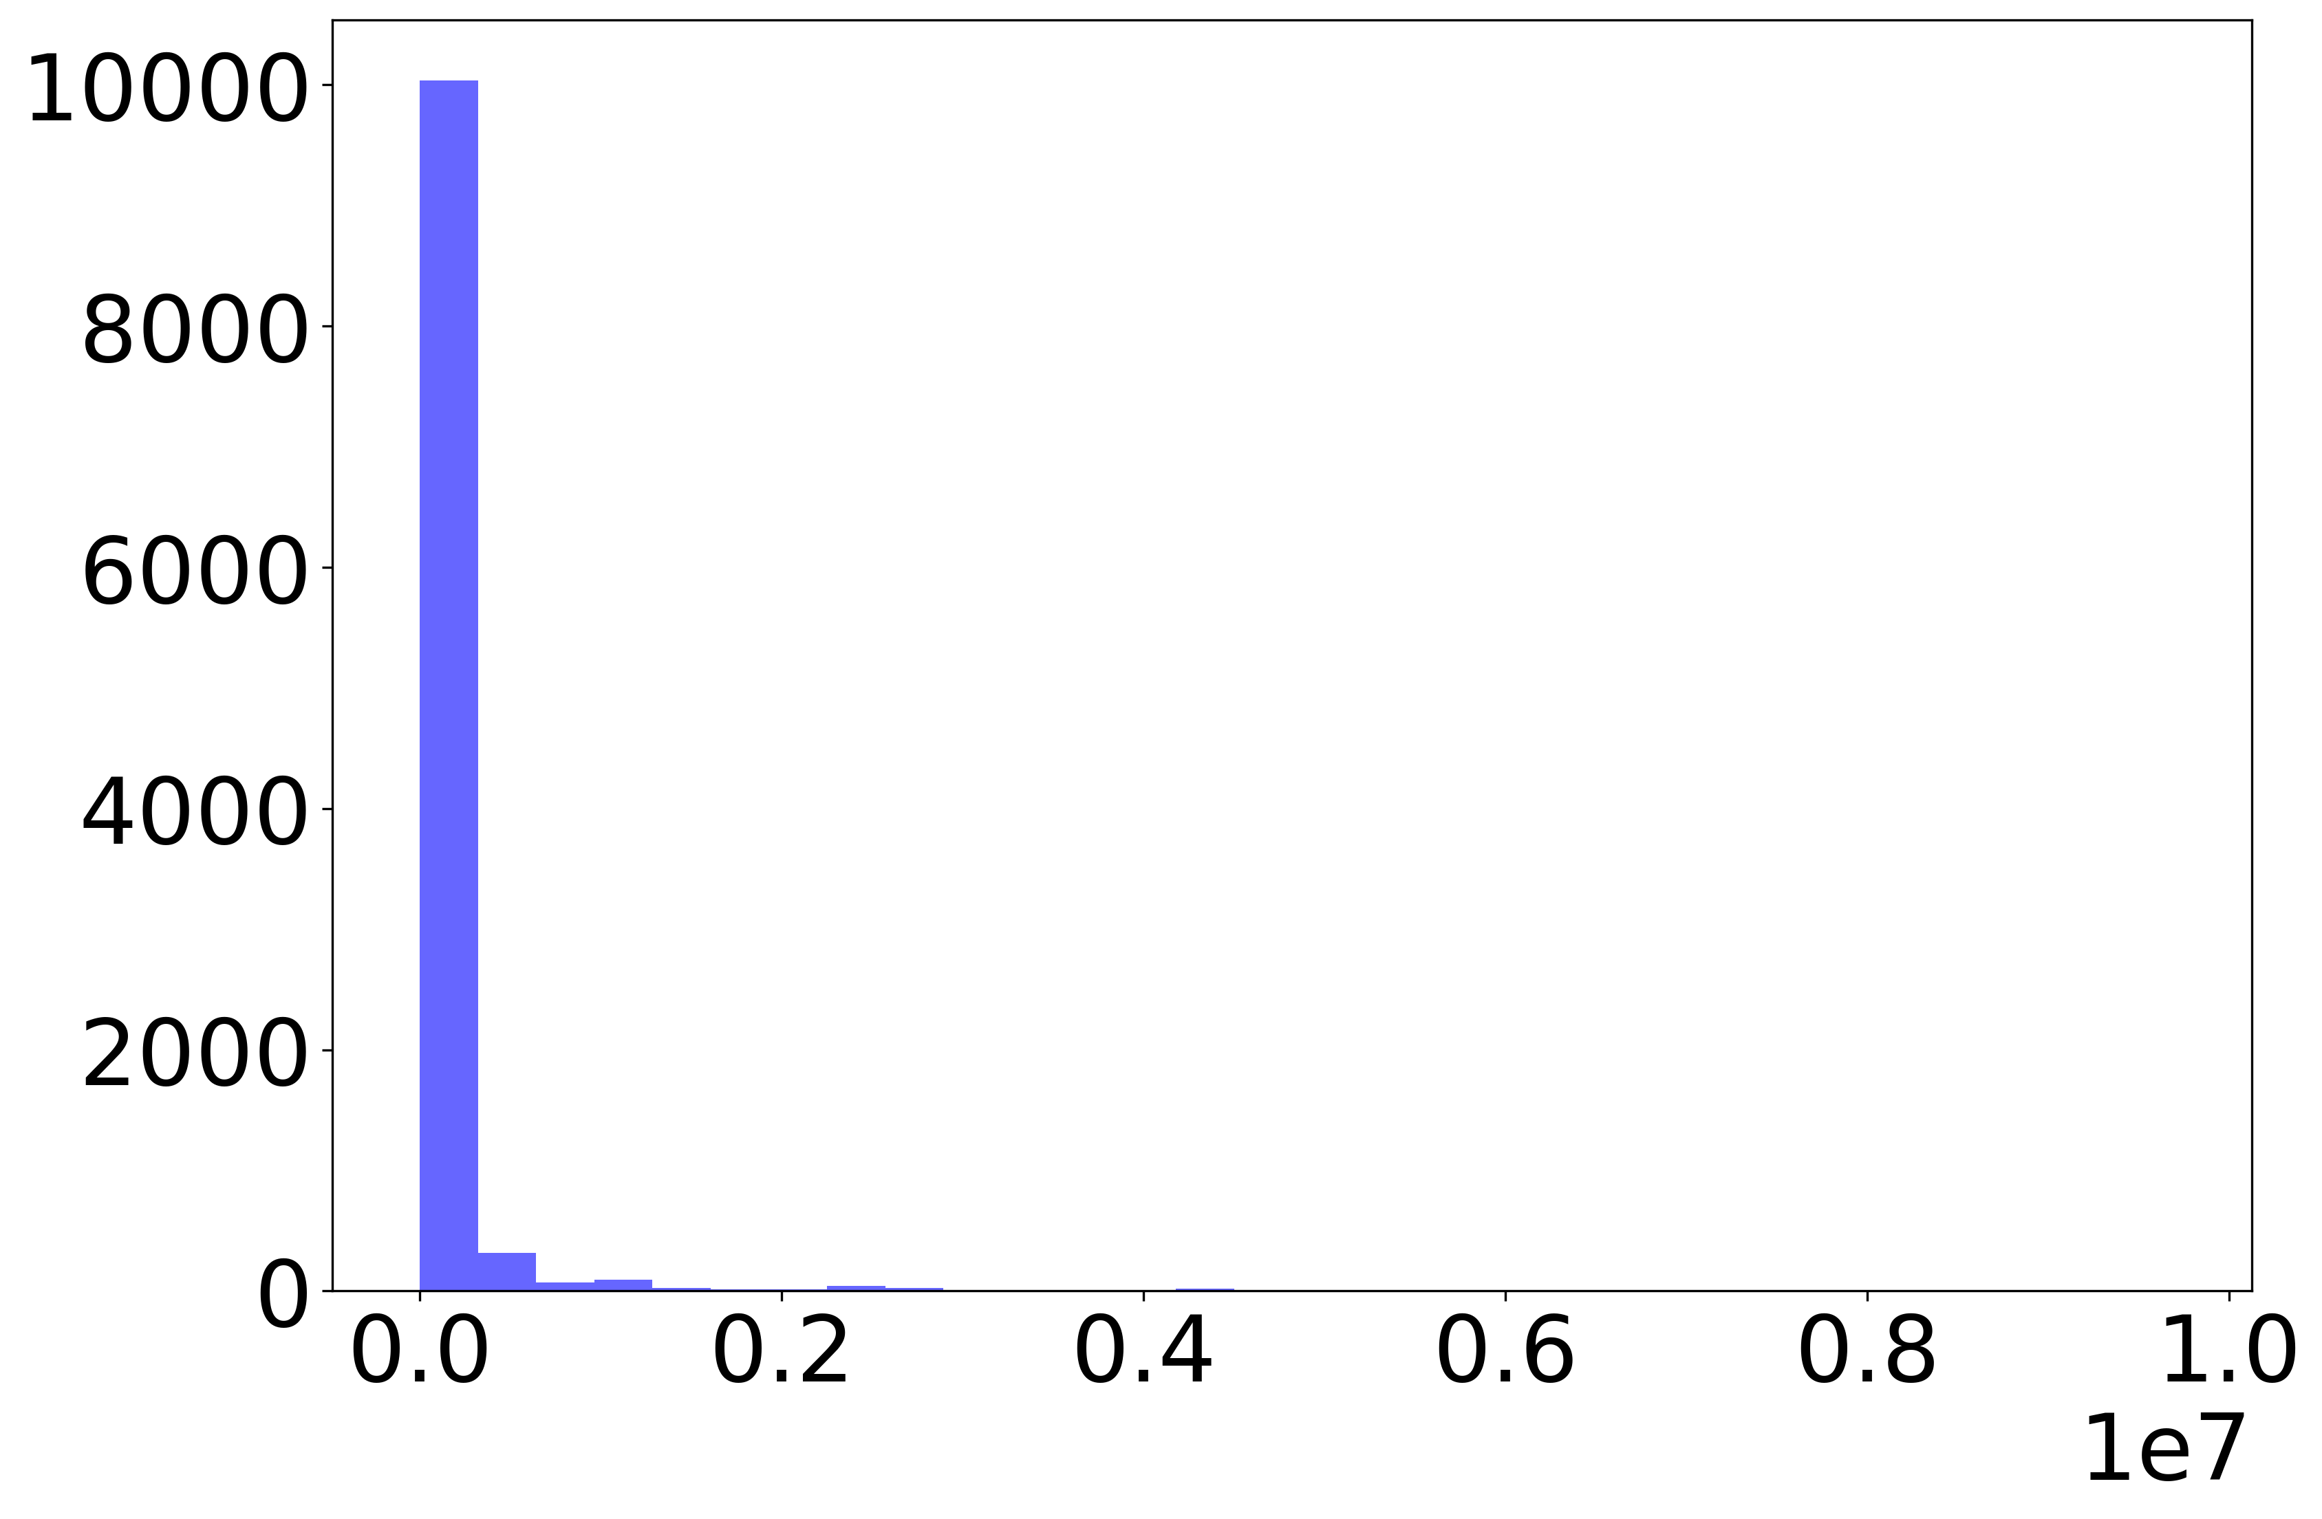
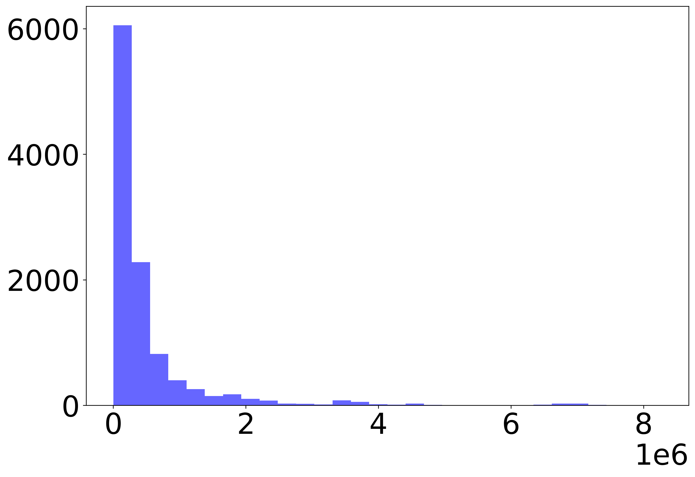
rule4ml: Resource Utilization and Latency Estimation for ML on FPGA
BRAM
DSP
Cycles
FF
LUT

Slide 20
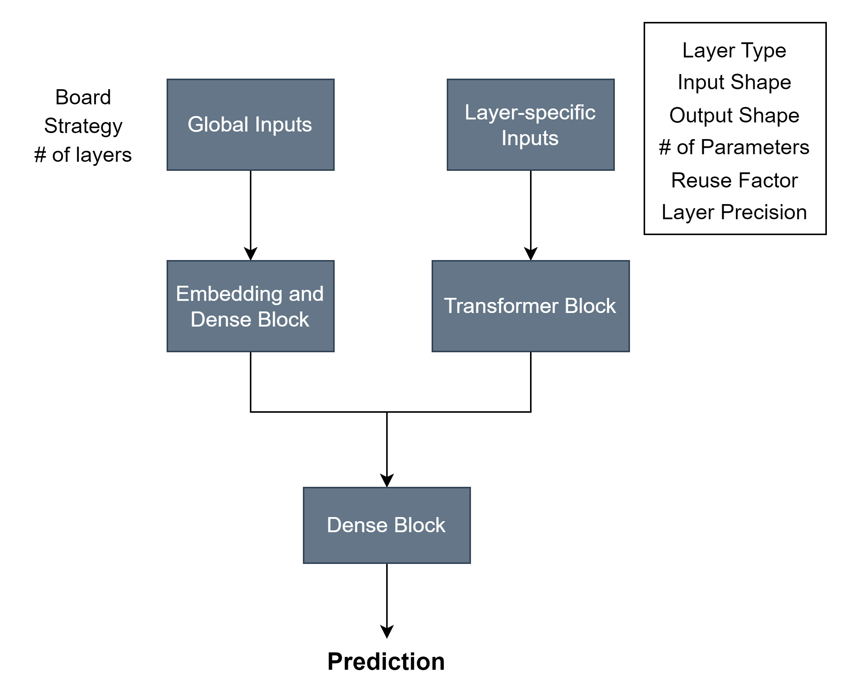
rule4ml: Resource Utilization and Latency Estimation for ML on FPGA
Transformer Architecture
Each layer is treated as a “token” in the sequence

