Slide 1
Task 3 of mmWG
Dynamic analysis of fast-ramping normal conducting magnets

Slide 2
AGENDA
1 System description and constraints
6 Overview
2 Magnet equations
3 Surrogate parameter estimation
4 Dynamic losses
5 Pulse duration

Slide 3
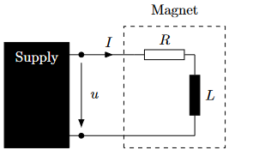
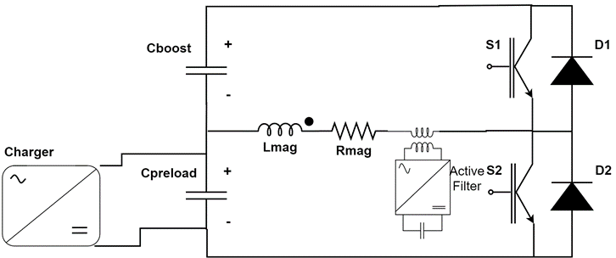
SysTem Description
Supply circuit: non-linear
Magnet: normal conducting, non-linear, hysteretic
Separate design challenges
  Supply circuit → CERN
  Magnet → Bologna (Static) + Darmstadt (Dynamic)
Simplifications
  Every magnet as one-port powered by its own supply
  …
Switched Resonance Cell

Slide 4
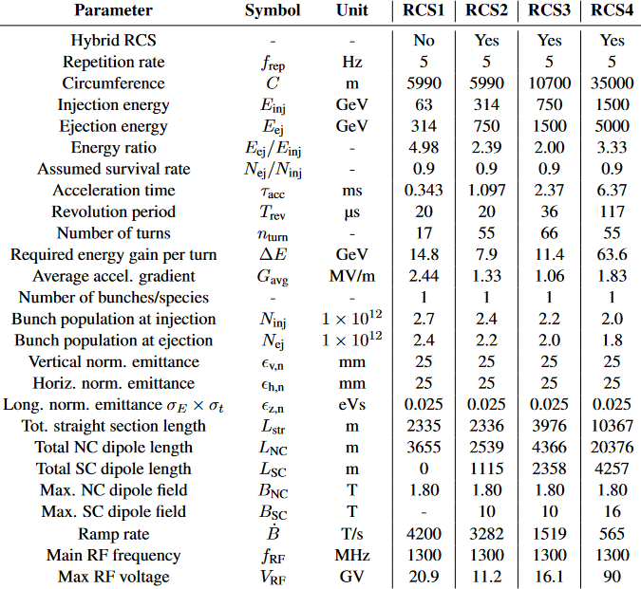
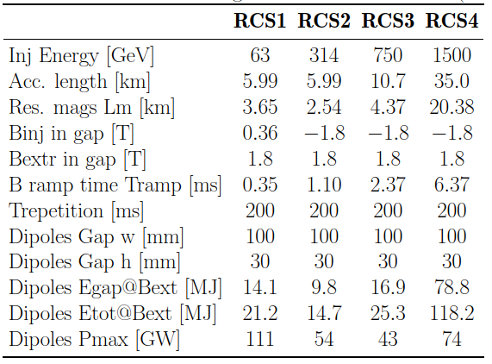
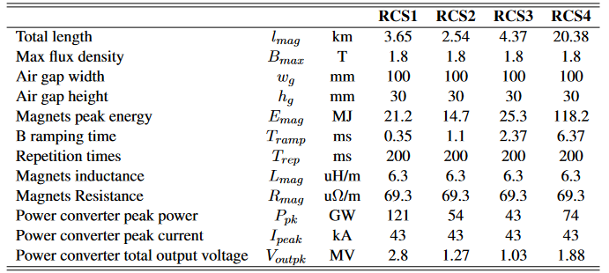
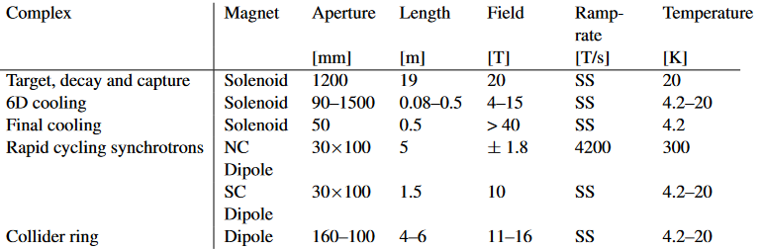
Constraints
IMCC Parameters pg 13, 17, 18

Slide 5
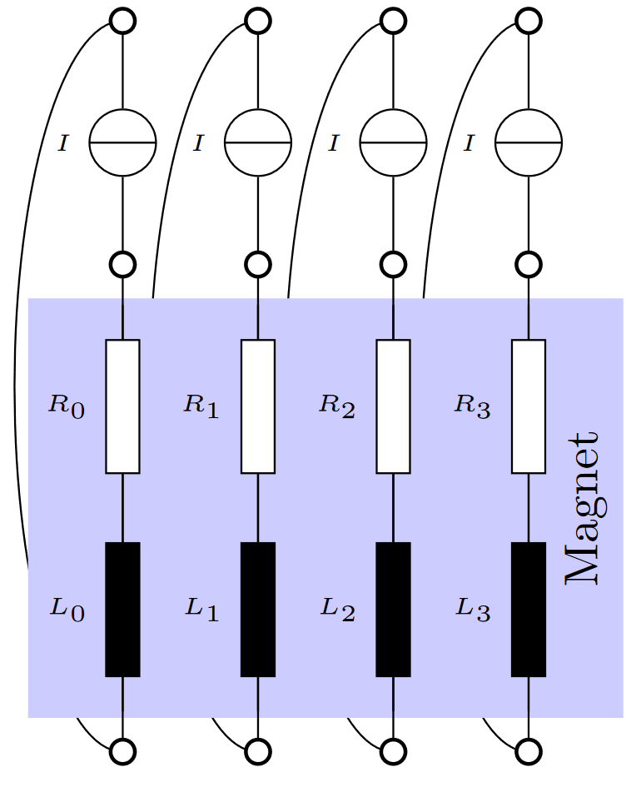
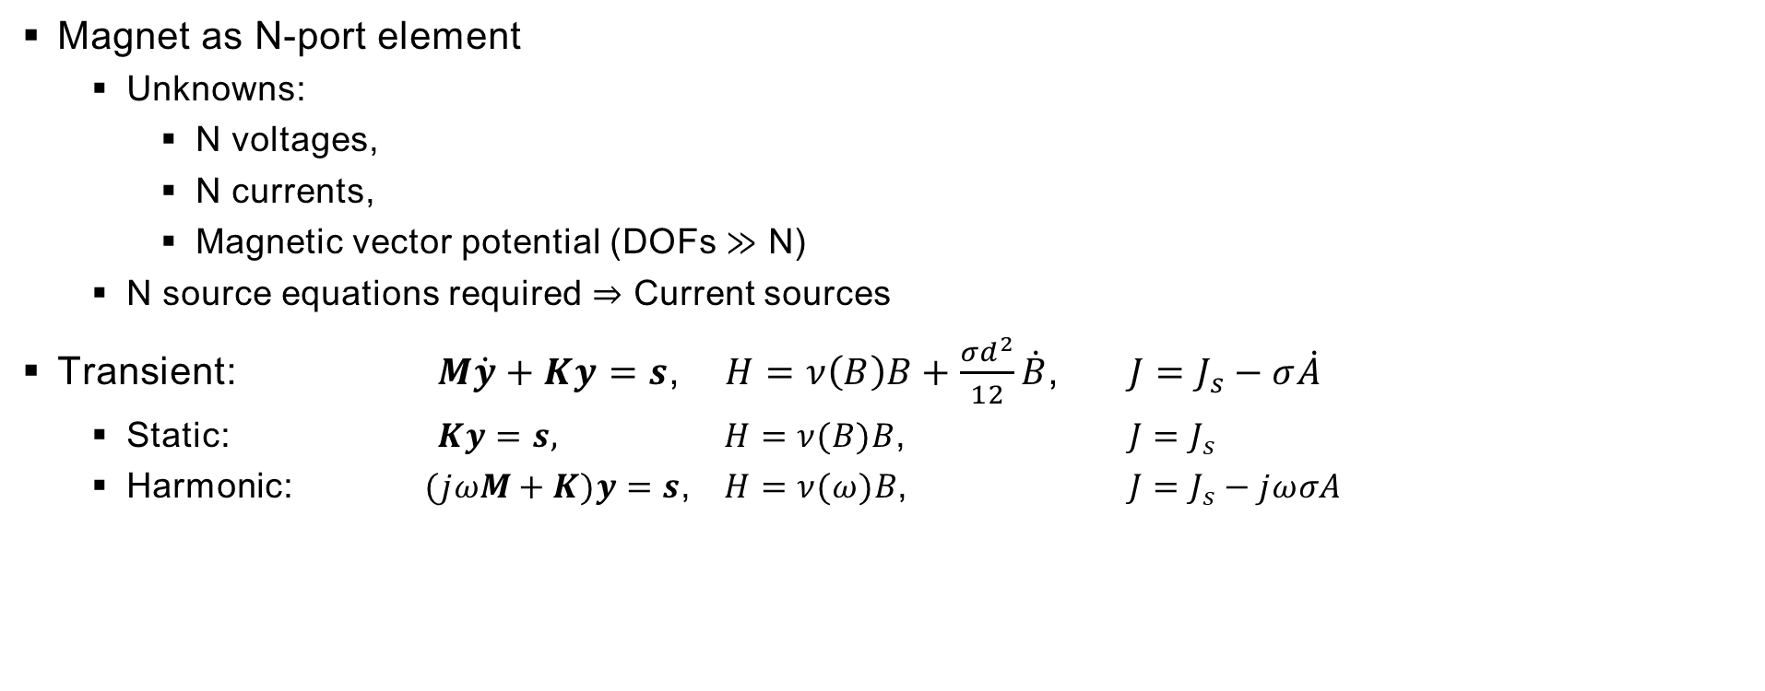
MAgNET equations
Magnet as N-port element
  Unknowns:
    N voltages,
    N currents,
    Magnetic vector potential (DOFs $≫$ N)
  N source equations required $⇒$ Current sources
Transient: $M\dot{y}+Ky=s$, $H=ν\left(B\right)B+\frac{σd^{2}}{12}\dot{B}$, $J=J_{s}−σ\dot{A}$
  Static: $Ky=s,$ $H=ν(B)B$, $J=J_{s}$
  Harmonic: $(jωM+K)y=s$, $H=ν(ω)B$, $J=J_{s}−jωσA$

Slide 6
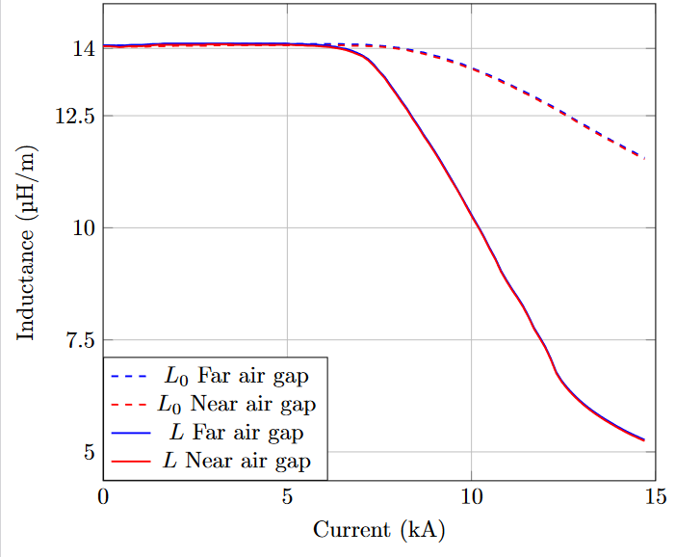
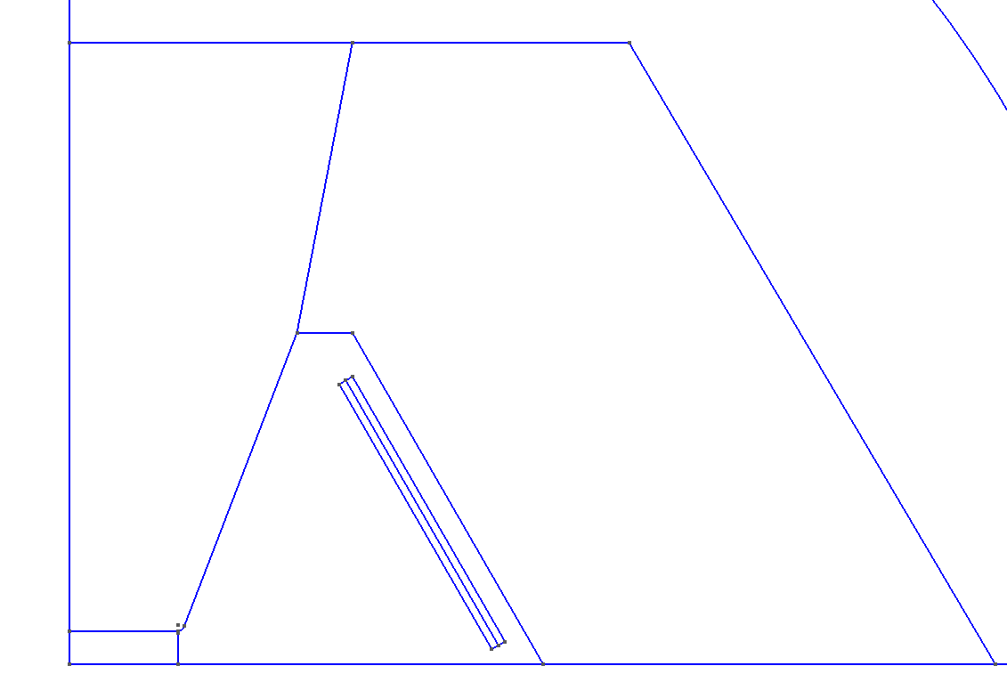

Inductance
Estimation
Inductance mainly dependent on current
  Static analysis
  $L_{0}=\frac{Φ}{I}, L=\frac{dΦ}{dI}, Φ as magnetic flux$
model_002, solely M235-35A
MAP Hourglass 30x100 mm² gap, enlarged coils

Slide 7
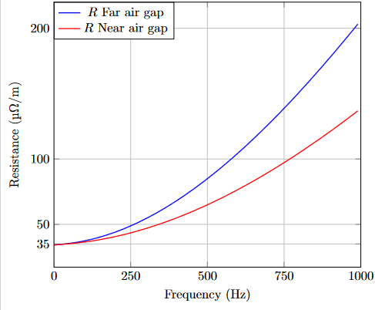
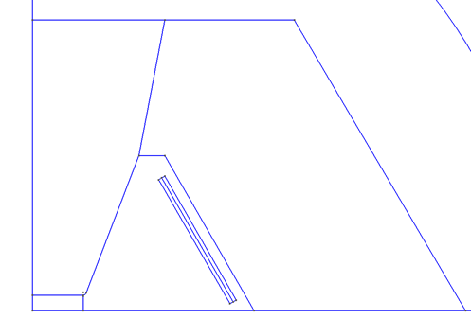

Resistance
Estimation
Resistance mainly dependent on frequency
  Harmonic analysis
  $\min_{R, L} |U−\left(R+jωL\right)I|$

Slide 8
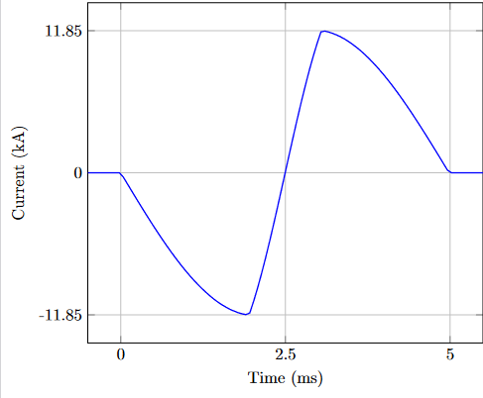
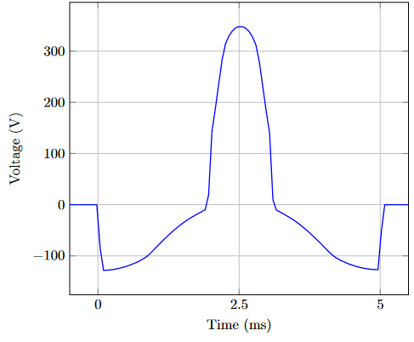

Transient parameter fitting
Transient parameter fitting
  $\min_{R, L} |U−\left(RI+L∂_{t}I\right)|$
Far air gap: $L=13.15µ\frac{H}{m}, R=46.60µ\frac{Ω}{m}$
Near air gap: $L=13.13µ\frac{H}{m}, R=41.94µ\frac{Ω}{m}$

Slide 9
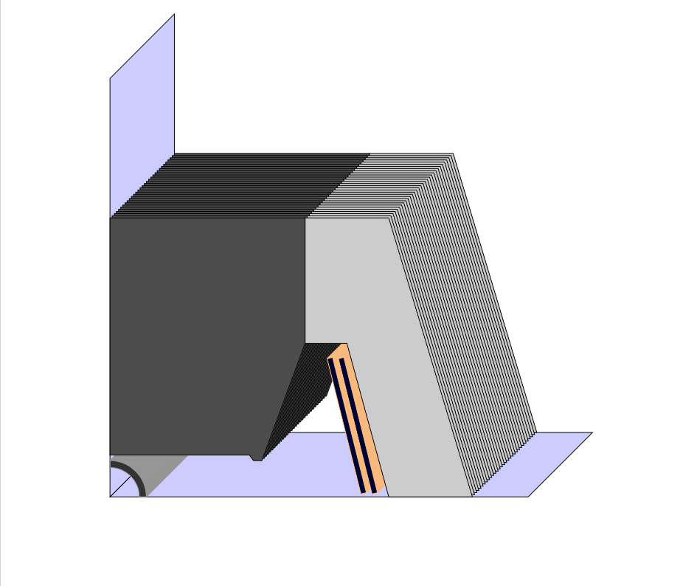
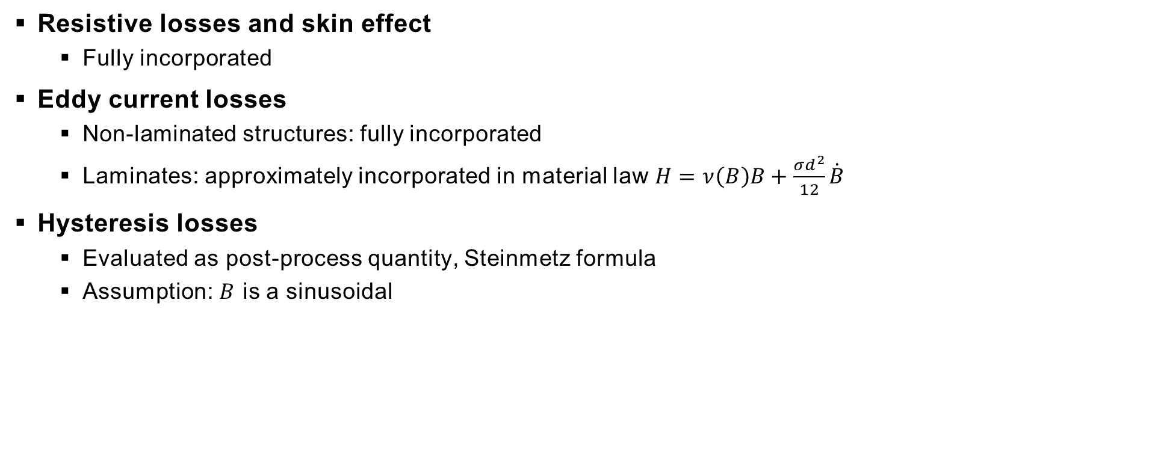
Dynamic losses
Resistive losses and skin effect
  Fully incorporated
Eddy current losses
  Non-laminated structures: fully incorporated
  Laminates: approximately incorporated in material law $H=ν\left(B\right)B+\frac{σd^{2}}{12}\dot{B}$
Hysteresis losses
  Evaluated as post-process quantity, Steinmetz formula
  Assumption: $B$ is a sinusoidal

Slide 10
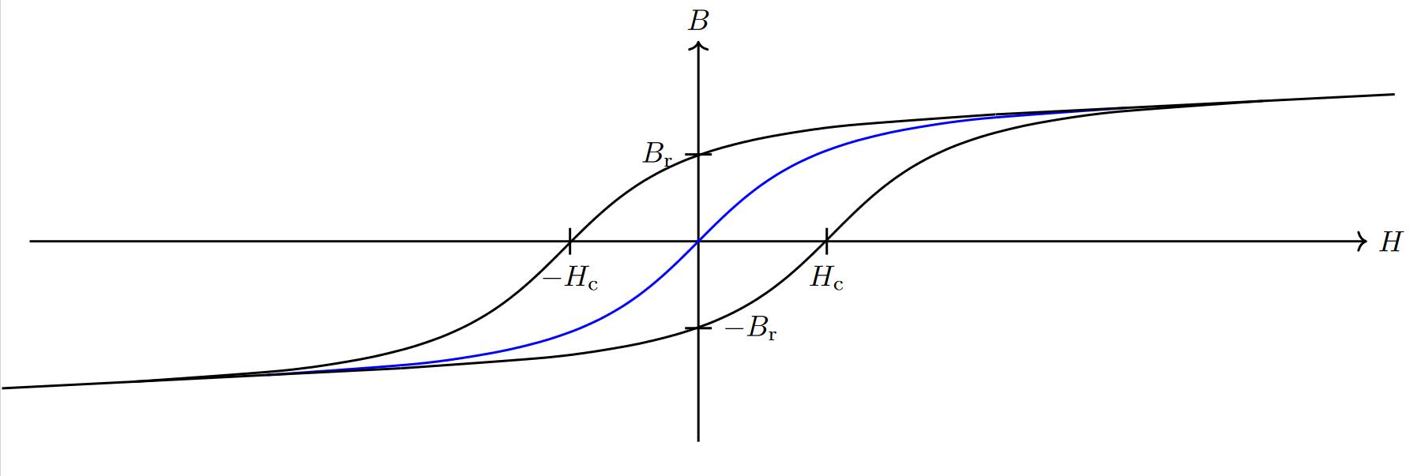
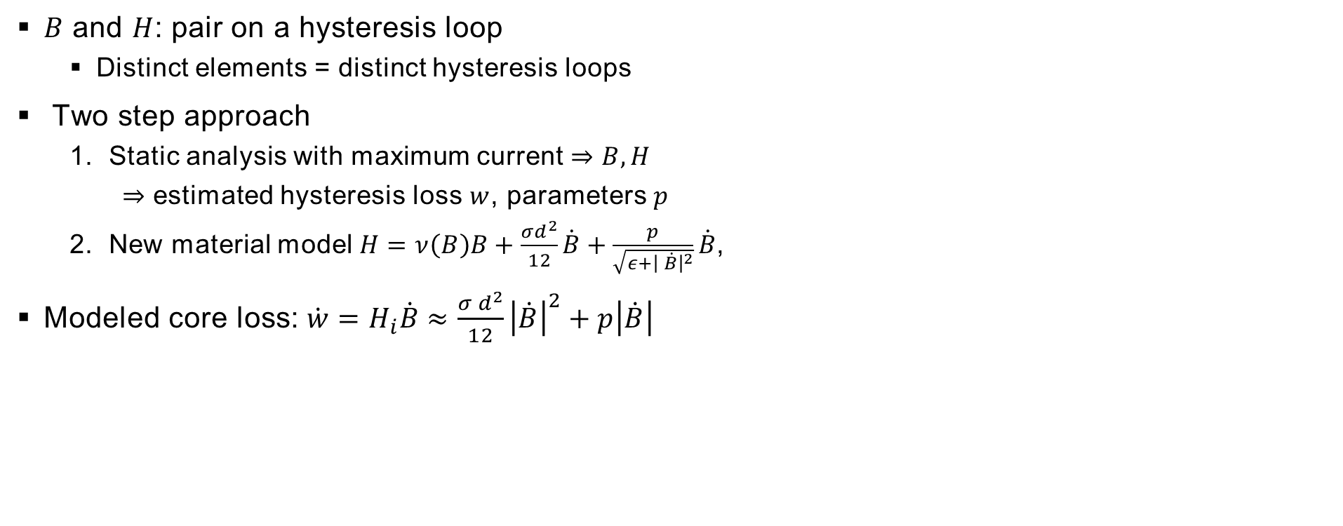
Hysteresis
$B$ and $H$: pair on a hysteresis loop
  Distinct elements = distinct hysteresis loops
Two step approach
  Static analysis with maximum current $⇒B,H$
    $⇒$ estimated hysteresis loss $w$, parameters $p$
  New material model $H=ν\left(B\right)B+\frac{σd^{2}}{12}\dot{B}+\frac{p}{\sqrt{ε+{\left| \dot{B}\right|}^{2}}}\dot{B}$,
Modeled core loss:$\dot{w}=H_{i}\dot{B}≈\frac{σ d^{2}}{12}{\left|\dot{B}\right|}^{2}+p\left|\dot{B}\right|$

Slide 11
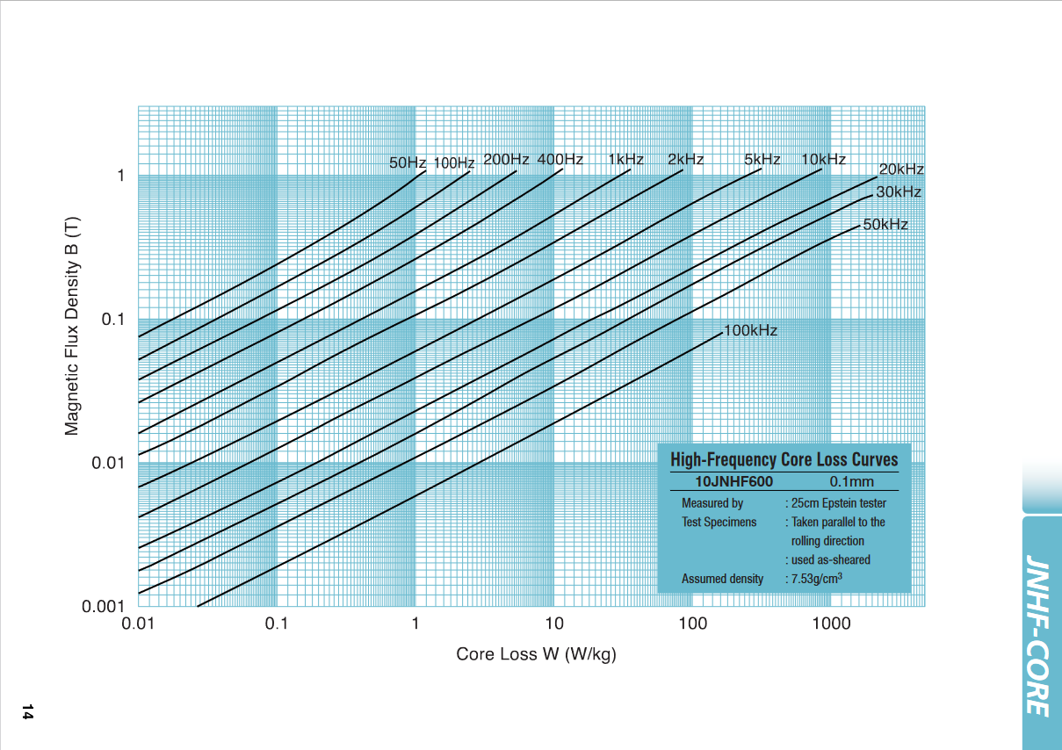

Hysteresis – Parameters & Datasheets
Modeled loss:$\dot{w}=H_{i}\dot{B}≈\frac{σ d^{2}}{12}{\left|\dot{B}\right|}^{2}+p\left|\dot{B}\right|$
Datasheet core loss: $\dot{w}≈{a_{0}\left|\frac{B}{B_{0}}\right|}^{c_{0}}$
  Model fitting $⇒p$
  Worst case analysis
Required: Measurement data of $B up to 2T$.

Slide 12
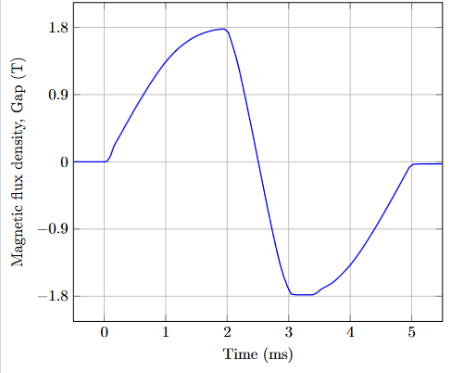
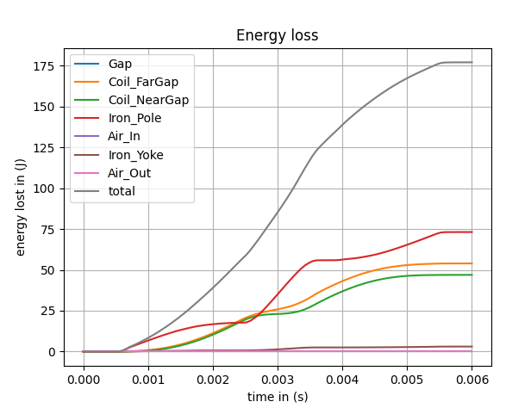
Hysteresis
Preliminary simulation with new material model. Parameter selection unphysical.

Slide 13
Pulse Duration
TODO – Quantitative effect of the pulse duration on losses

Slide 14
Overview
Done
Specialized on RCS2 (±1.8 in 1.1ms) Dipoles
Tools to couple circuit and field model (2D)
  Magnet as multi-port element
  Supply as ideal current source
Results for two magnet models: H-Type and Hourglass
Eddy current losses via core homogenization
Entire core loss via Steinmetz formula
  Hysteresis description added
To Do
Other Dipoles, Quadrupoles
Accurate hysteresis and core loss description
  Use of Datasheets
Temperature development, cooling
Beam pipe
Forces, stress, coil displacement
End effects

