Slide 1
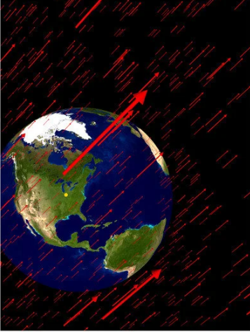

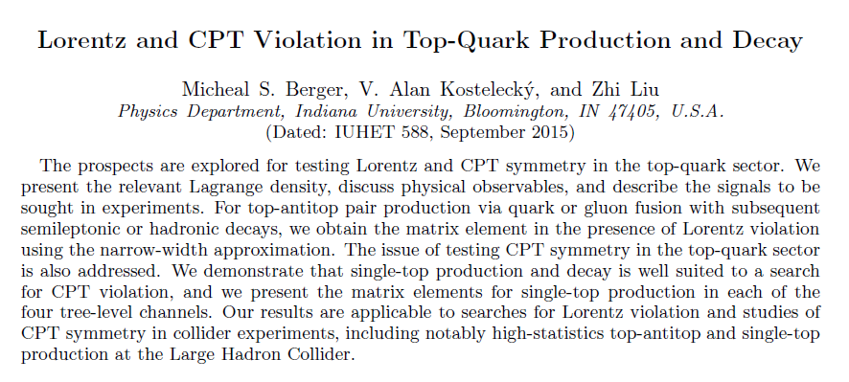
Lorentz and CPT Violation in Top-Quark Sector in the SME
Arshin Khaje Borj Sefidi
March 2024

Slide 2
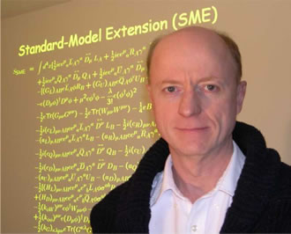
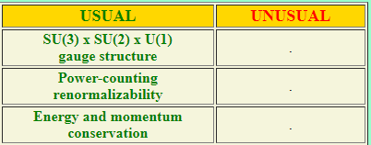
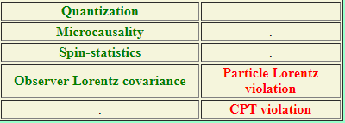


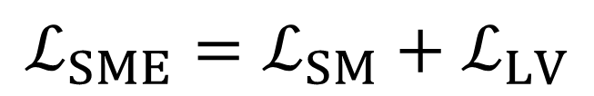
Standard Model Extension $(SME)$
$$ℒ_{SME}=ℒ_{SM}+ℒ_{LV}$$
https://lorentz.sitehost.iu.edu/kostelecky/faq.html

Slide 3
Motivation
Study of symmetries
understanding the behavior of nature
Standard model (SM)
Lorentz and CPT symmetry
models of quantum gravity
Lorentz and CPT symmetry
Large Hadron Collider (LHC)
a top-quark factory
Testing Lorentz and CPT symmetry in Top quark sector

Slide 4

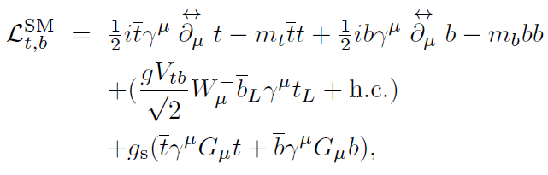
SM Lagrange density for the top quark

Slide 5
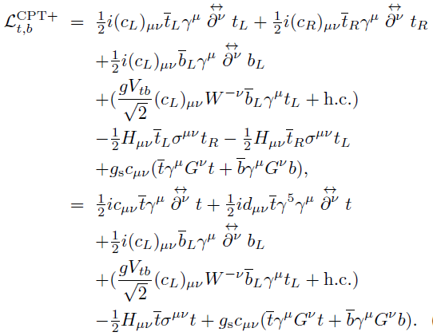
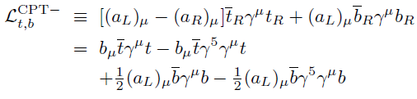
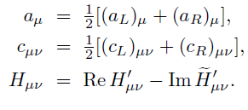

SME Lagrange density for the top quark

Slide 6
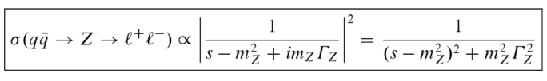
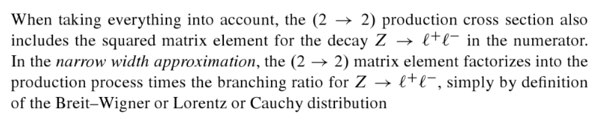

Narrow-Width Approximation

Slide 7
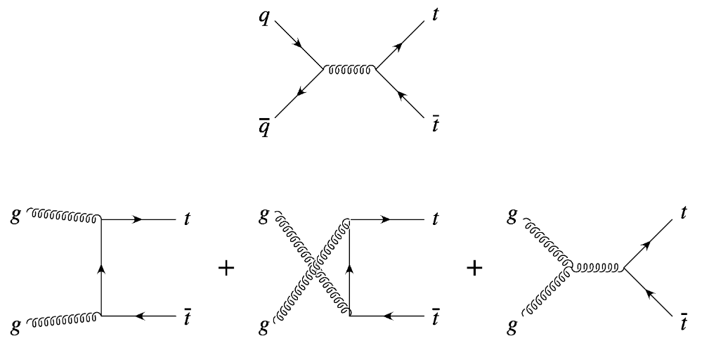


Top-Antitop Pair Production

Slide 8
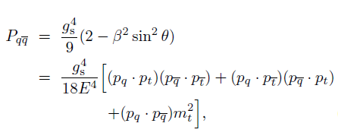
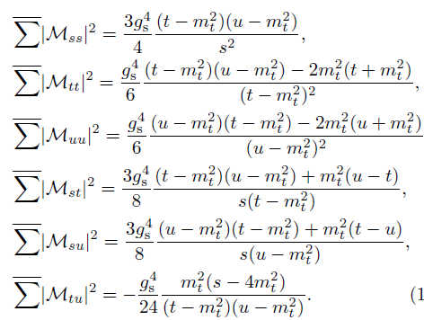

Top-Antitop Pair Production :Lorentz-invariant case

Slide 9


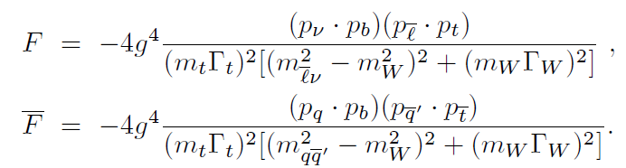
Top-Antitop Pair Production: Lorentz-invariant case

Slide 10
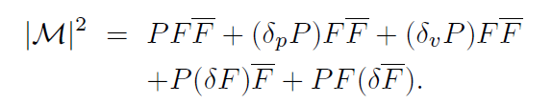
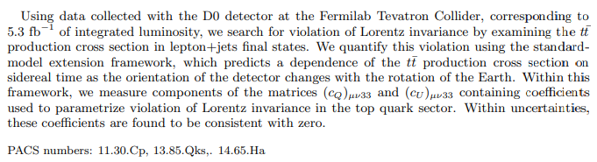
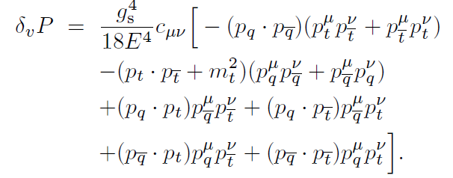
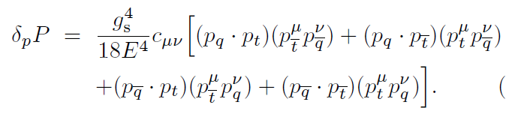
Top-Antitop Pair Production: Lorentz-violating case
Production via quark fusion

Slide 11
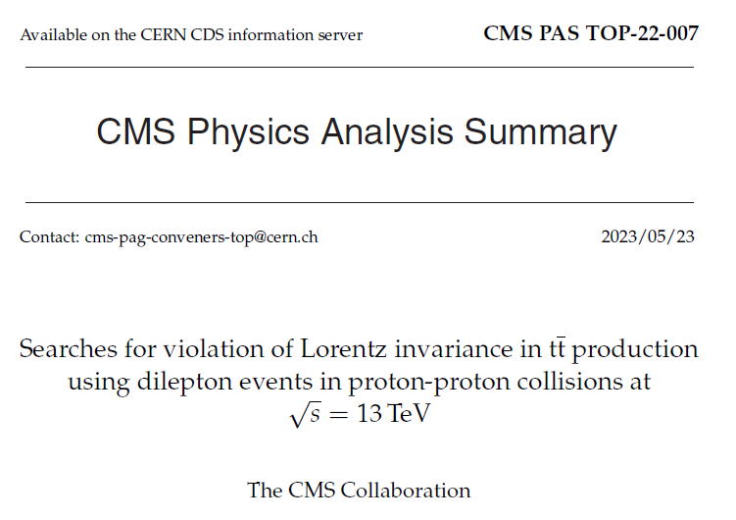
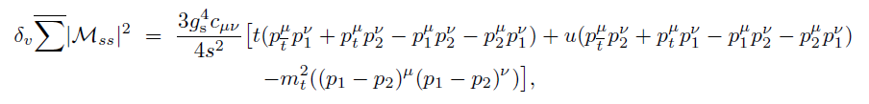
Top-Antitop Pair Production: Lorentz-violating case
Production via gluon fusion

Slide 12
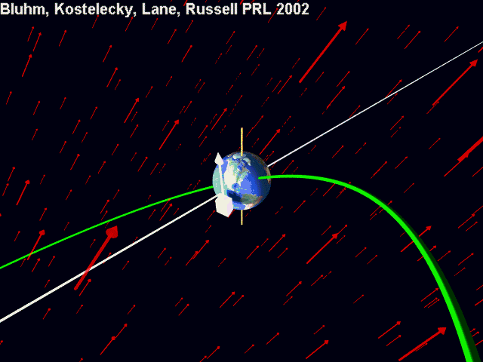
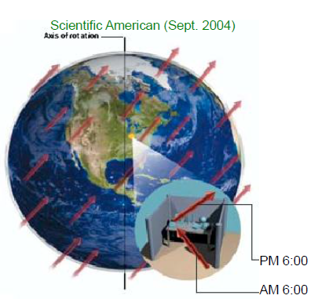
Bluhm, Kostelecky, Lane, Rassel 2002

Slide 13



Signal and background
Main background
Single top
tW
background
$$t\overline{t}+X$$
$$t\overline{t}W+t\overline{t}Z$$
Diboson
WW,WZ,ZZ
W/Z+jets

Slide 14
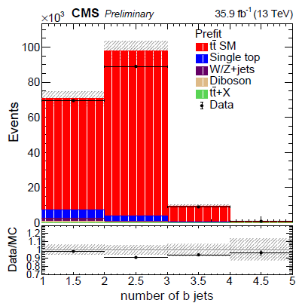
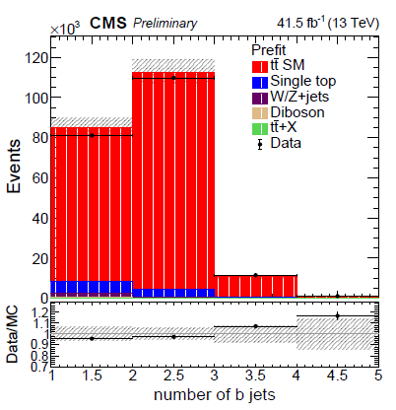


Slide 15
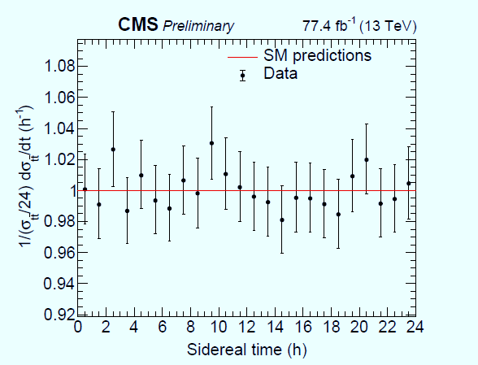
Measurement of the tt normalized differential cross section with sidereal time

Slide 16
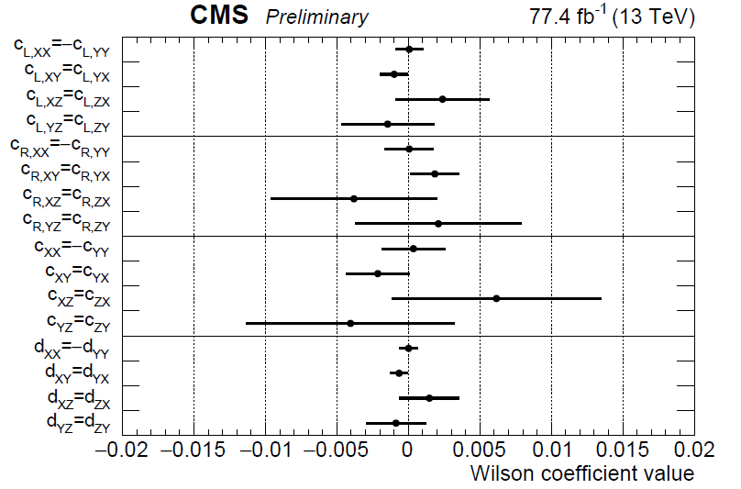
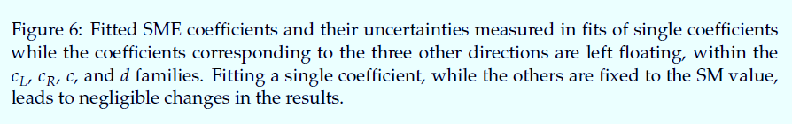

Slide 17
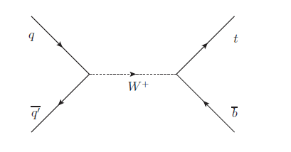
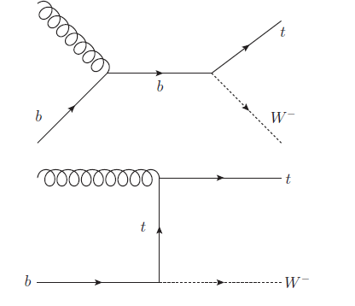
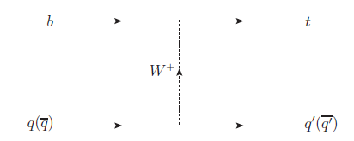

single-top Production :Lorentz-invariant case

Slide 18



single-top Production :Lorentz-invariant case

Slide 19
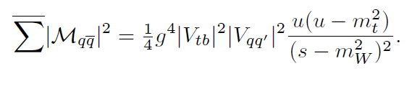
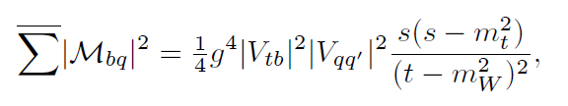
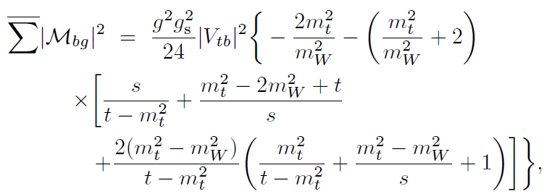
single-top Production :Lorentz-invariant case

Slide 20
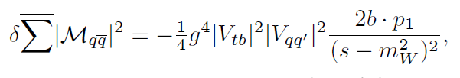
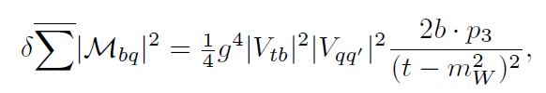
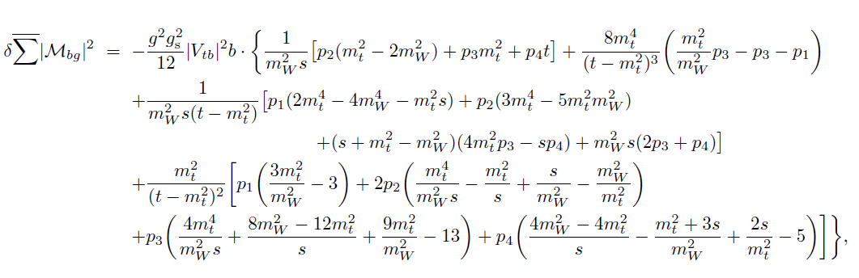
single-top Production :Lorentz-violating case

Slide 21

single-top Production :Lorentz-violating case

Slide 22

TOP

