Slide 1
Medipix beam test
Benedikt Bergmann on behalf of the Medipix team at the Institute of Experimental and Applied Physics

Slide 2
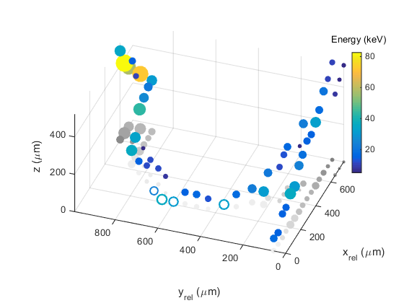
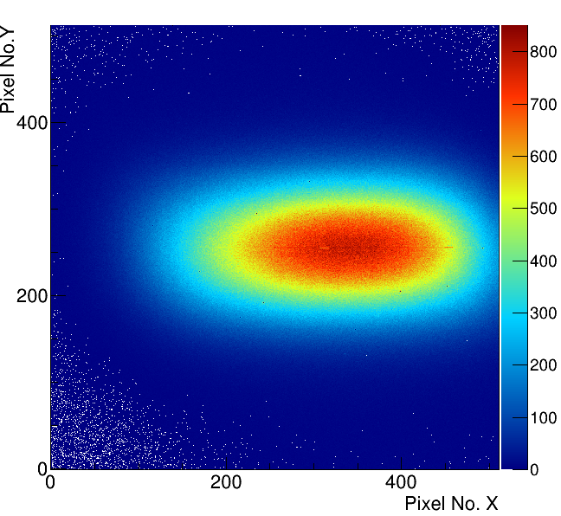
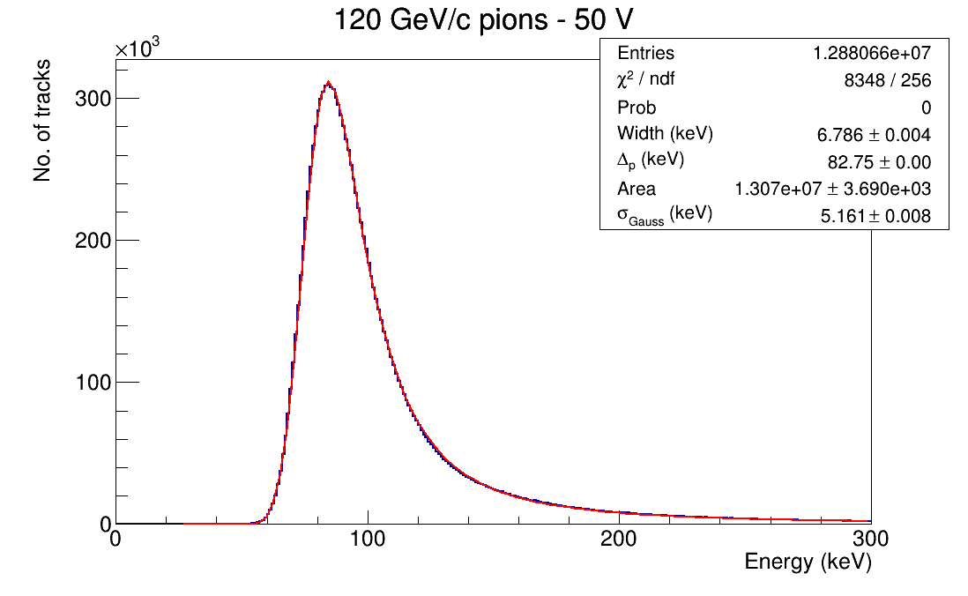
Motivation - Addressed detector development
Timepix3 for single-layer particle tracking
Characterization of different sensor materials – This time Si, LGAD
Timepix4 R/O system
Characterization of the response of ATLAS-Timepix3
Test of software for real-time analysis and data compression
Si – 500 µm
FWHM_{x} = 7.10 mm
FWHM_{y} = 16.8 mm
Event characterization using Timepix3 as solid-state TPC
CdTe – 2 mm
Beam spot and stopping power measurement with Timepix3 Quad (September 2021)

Slide 3
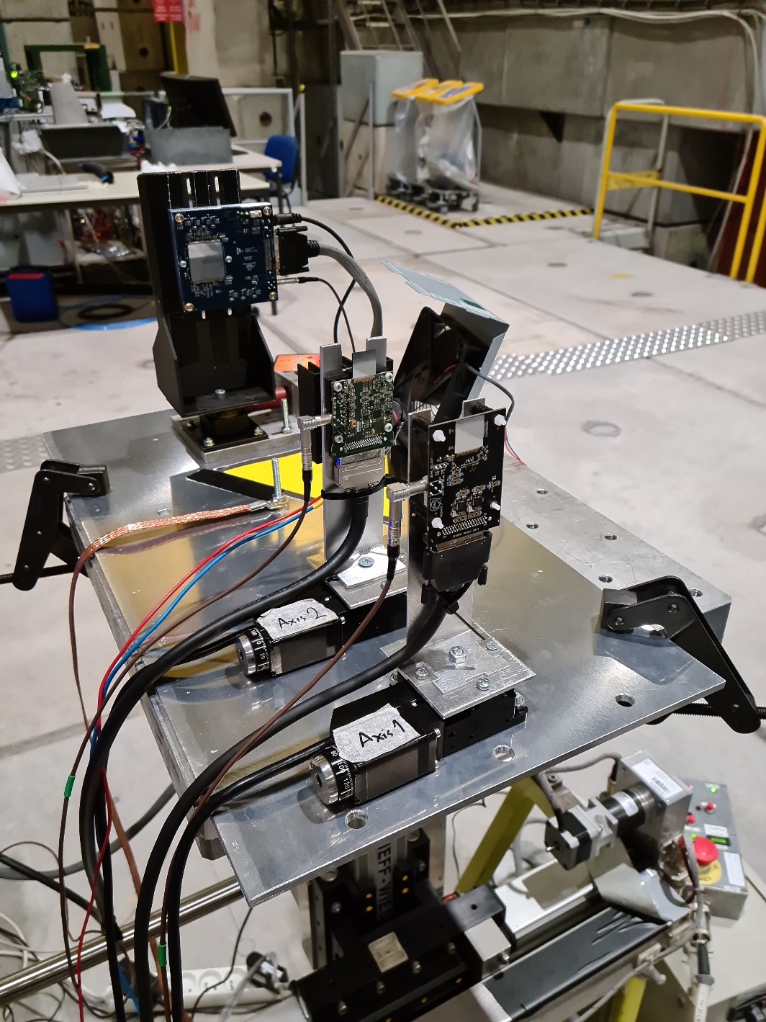
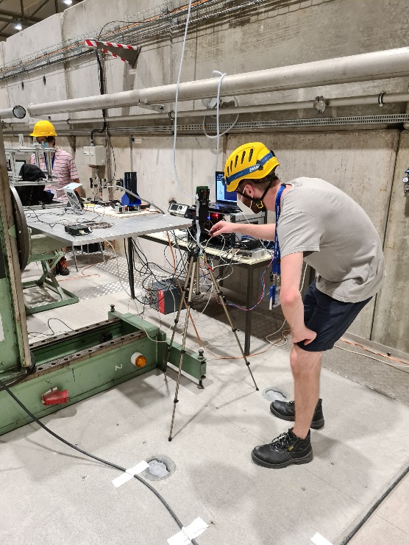
Beam and infrastructure requirements
SPS 2021 - Setup September
Beam requirements:
~300 kParticles/spill
Infrastructure requirement:
Moveable table (e.g., DESY, XSCA)
Standard table for PCs, readout, voltage source
SPS Setup August

