Slide 1
HTS Cavity Copper Cold Test S₁₁
4 MAR 2024
Greg P. Le Sage

Slide 2
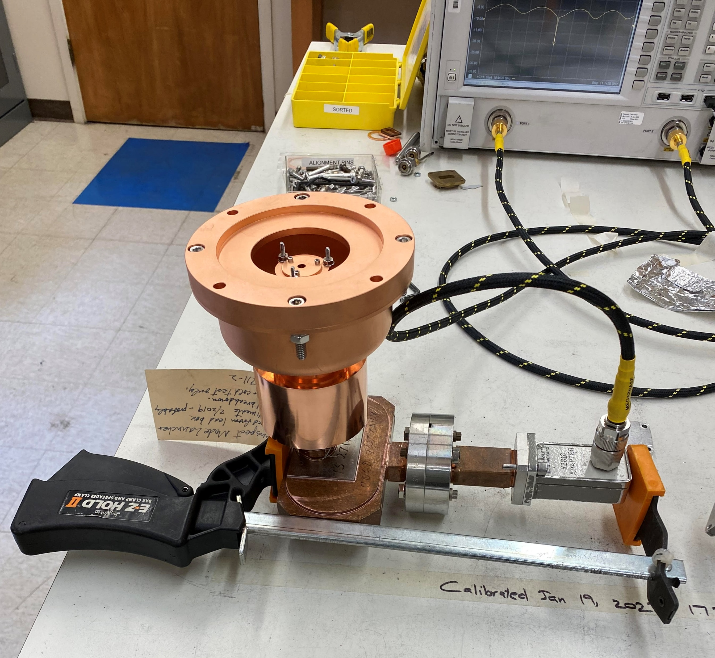
A copper spool was made to attach the cavity to the TM₀₁ mode converter
Small steps on the faces ensure good electrical contact.

Slide 3
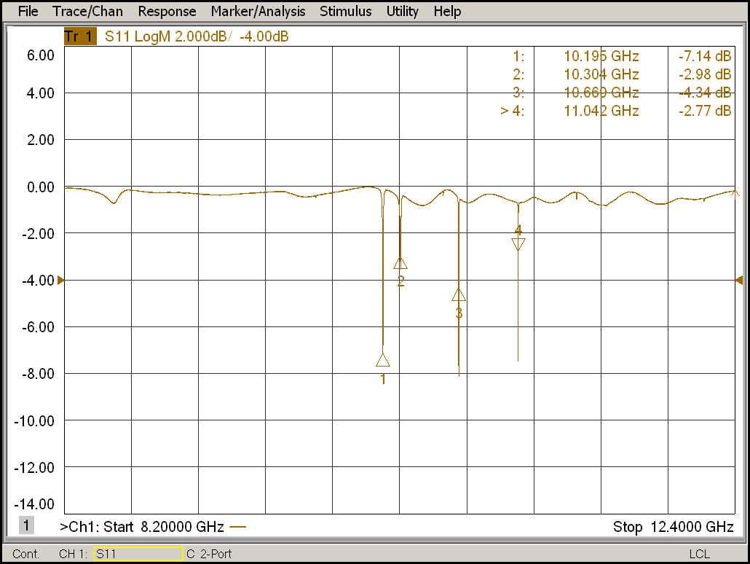
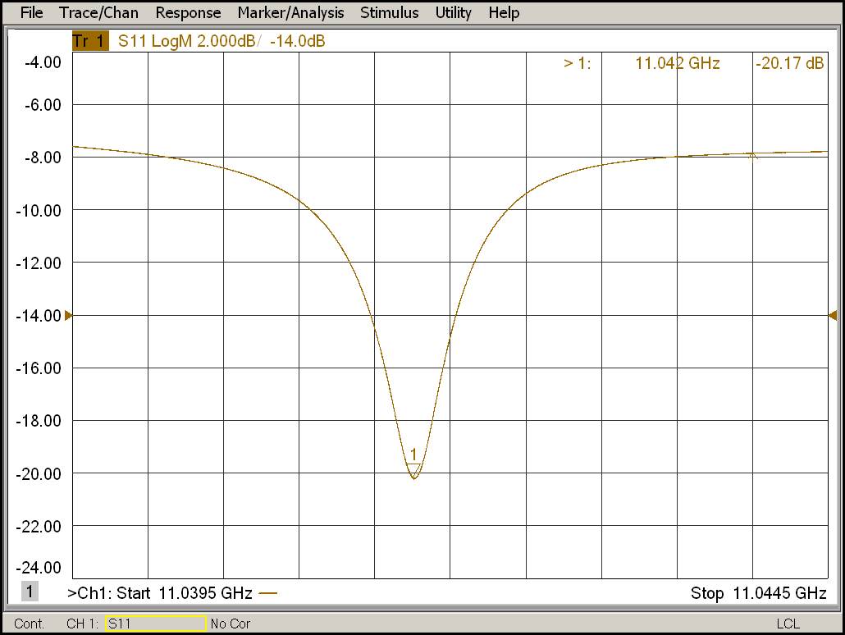
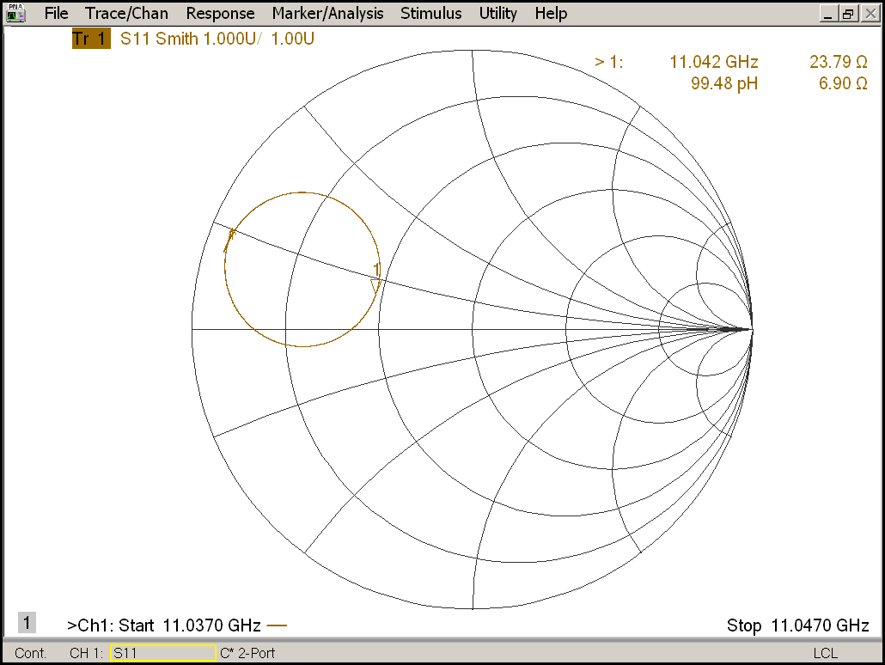
S₁₁ measurement was performed
Maximum number of samples
Narrow band calibration
Other modes did not move with cavity probing, so they are external and irrelevant.

Slide 4
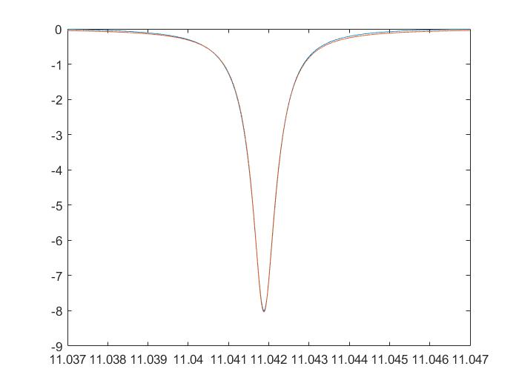
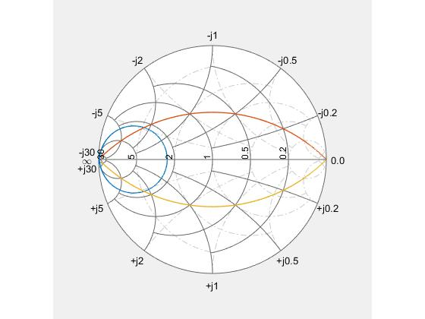
Compare measurement to simulation
MATLAB Fit of S₁₁ Data 28 FEB 2024: MEASUREMENT
Beta = 0.4321 SE 0.000069394
Q₀ = 13,896.293 SE 3.3289
f₀ = 11.04188 GHz SE 0.0000000642
Q_{E} = 32,162.916 calculated
Q_{L} = 9,703.712 calculated
HFSS Eigenmode SIMULATION
Copper Cavity with PML Q_{L} = 12,058.9 at 11.4278 GHz, Δf = 0.0003498
PEC Cavity with PML Q_{E} = 56,148.1 at 11.4282 GHz, Δf = 3.67716e-5
Copper Cavity with Short Q₀ = 15,385.5 at 11.40088 GHz, Δf = 0.008132
HFSS Beta = Q₀/Q_{E} = 0.2740
|Q_{L} – (1/Q₀ + 1/Q_{E})⁻¹| = 17.475
Recall S₂₁ Q₀ measurement was 12,800

Slide 5
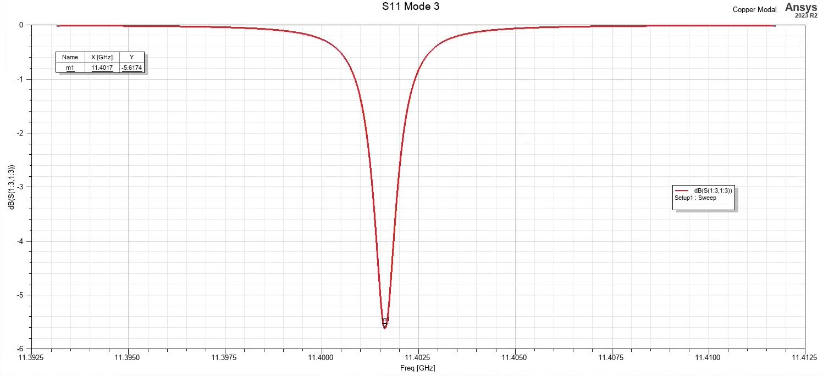
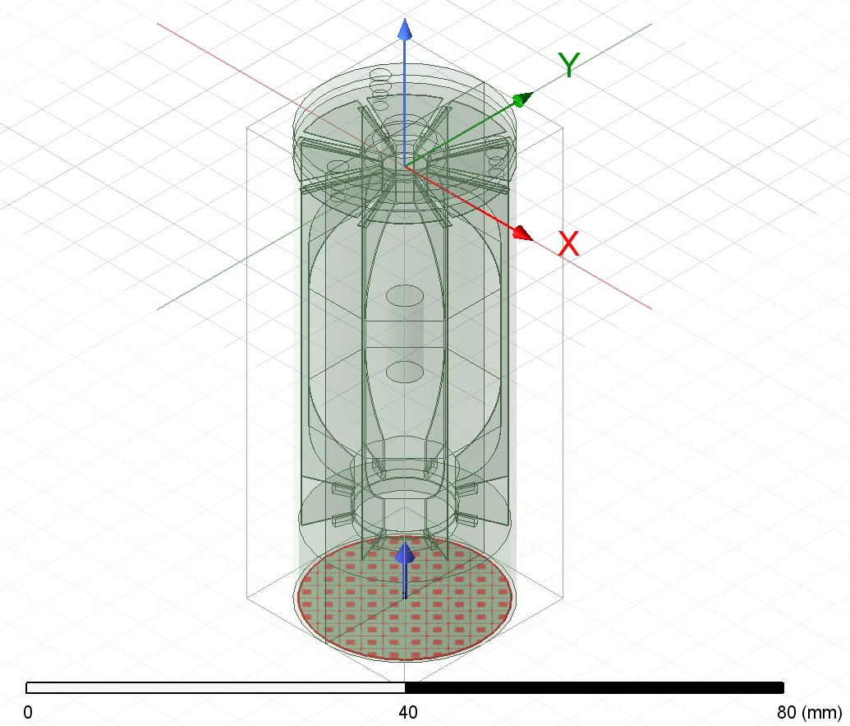
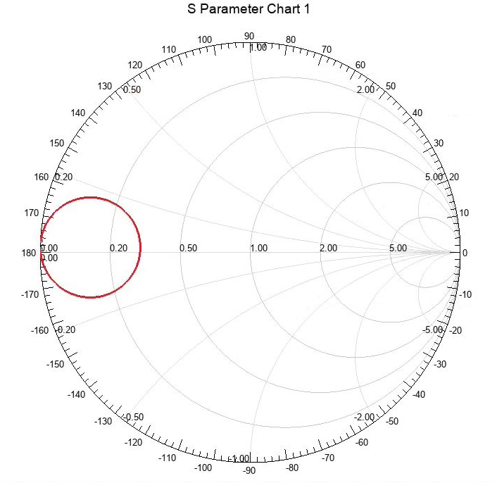
HFSS modal solution
(Thanks to the cluster!)
Discrete frequency sweep
Use same MATLAB fit
Beta = 0.3127 SE 0.000018240
Q₀ = 15,311.27 SE 1.7853e-10
f₀ = 11.4016 SE 3.0106e-08
Q_{E} = 48,968.74 calculated
Q_{L} = 11,664.18 calculated
Beta calc = 0.3127

