Slide 1
Facet Metrology
Greg P. Le Sage
4 MAR 2024

Slide 2
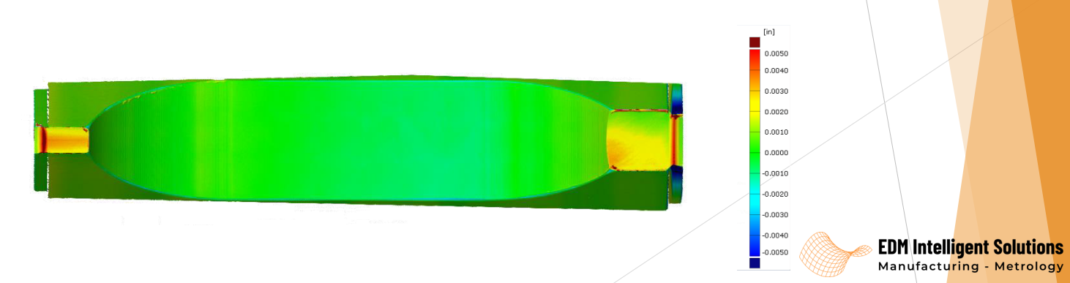
We sent the facets to be measured
EDM performed metrology

Slide 3
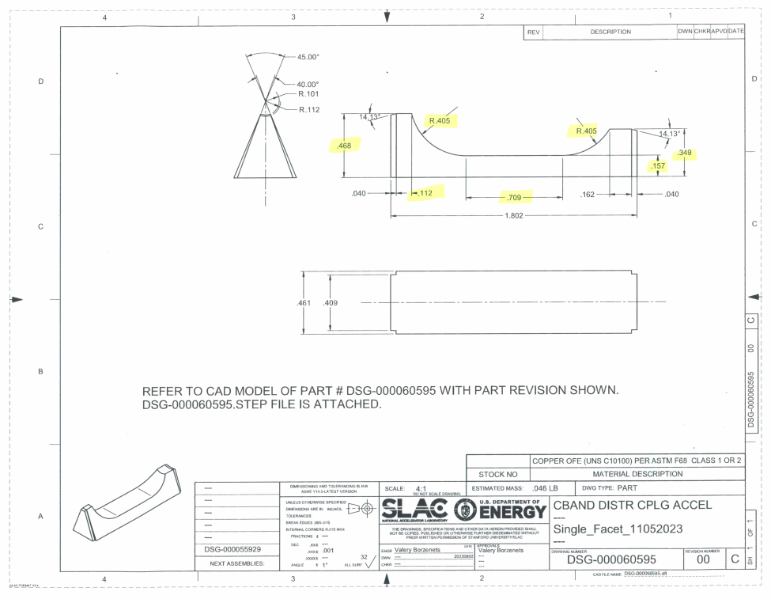
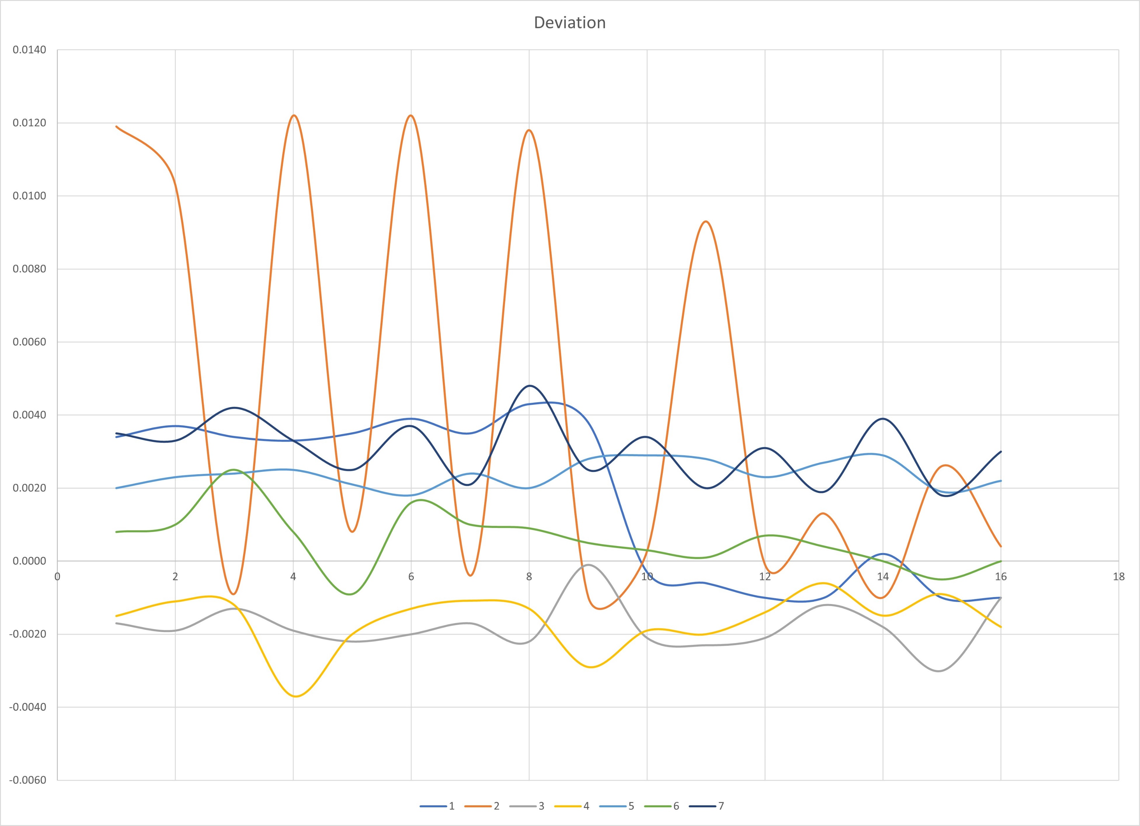
Deviation from design dimensions
Seven dimensions were measured

Slide 4
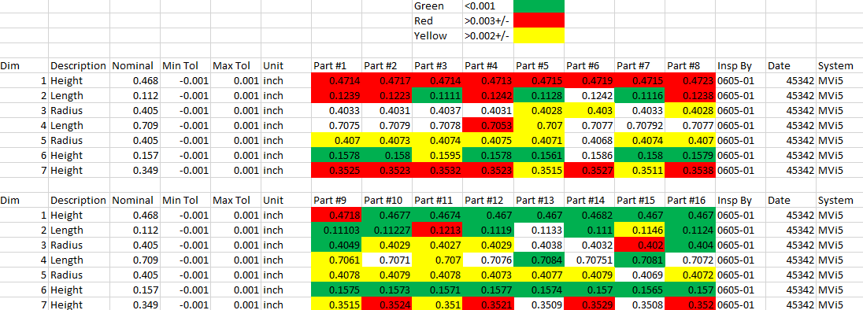
The worst variation is the pump out length, which should not impact performance
We can select the best samples

