Slide 1


HIGHEST collaboration instituto de fisica corpuscular (IFIC), valencia, spain
RF mushroom cavity design for High Temperature Superconductor (HTS) material test
P. Martinez-Reviriego¹, J. Golm³, W. Wuensch³, D. Esperante^{1,2}, B. Gimeno¹,
C. Blanch¹, M. Boronat^{1,} N. Fuster-Martínez¹, D. Gonzalez-Iglesias¹,
P. Martín-Luna¹, E. Martinez¹, L. Pedraza¹, J. Reina¹,
A. Menendez¹ and J. Fuster¹
1 Instituto de Física Corpuscular (IFIC), CSIC-University of Valencia, Parque Científico, C/ Catedrático José Beltrán, 2 46980 Paterna (Valencia)
2 Electronics Engineering Department, University of València, 46100 Burjassot, Spain
3 CERN, 01631 Meyrin, Switzerland

Slide 2
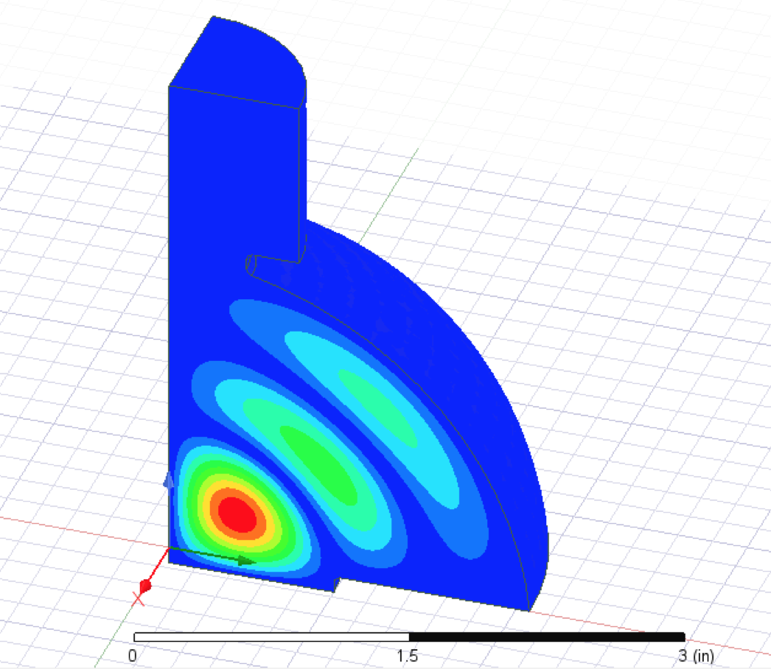
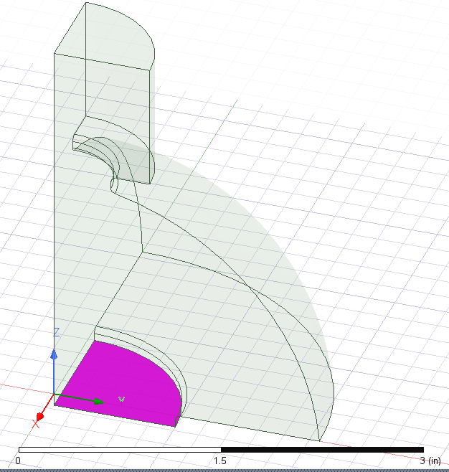
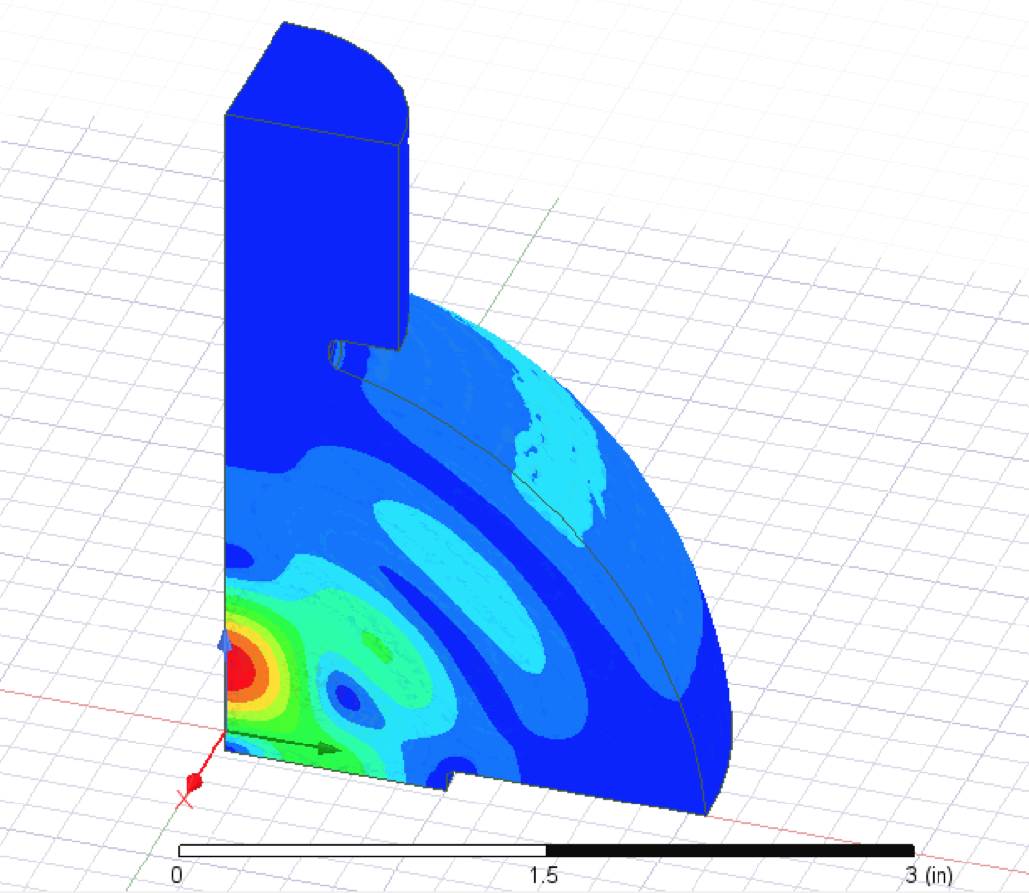
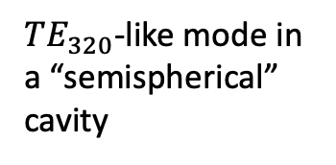



SLAC cavity
Input port
$$\left|\vec{E}\right|$$
$TE_{320}$-like mode in a “semispherical” cavity
Test samples under high magnetic fields:
High-Gradient material
High temperature superconductor
$$\left|\vec{H}\right|$$
Test properties:
No Electric field
High Magnetic field
No electric current on the edge
Sample
$f=11.3995$ GHz

Slide 3
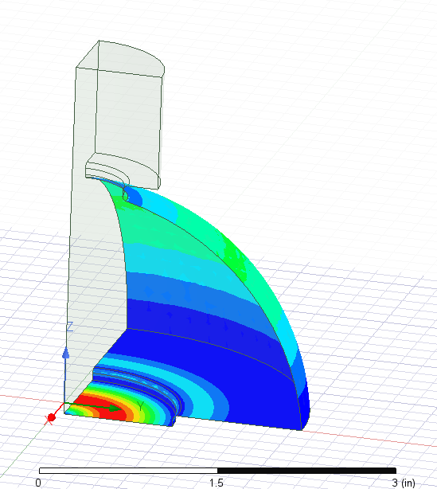

SLAC cavity
$$\left|\vec{E}\right|$$
$$\left|\vec{J}\right|$$
$TE_{320}$-like mode in a “semispherical” cavity
Test samples under high magnetic fields:
High-Gradient material
High temperature superconductor
$$\left|\vec{H}\right|$$
Test properties:
No Electric field
High Magnetic field
No electric current on the edge
$f=11.3995$ GHz

Slide 4
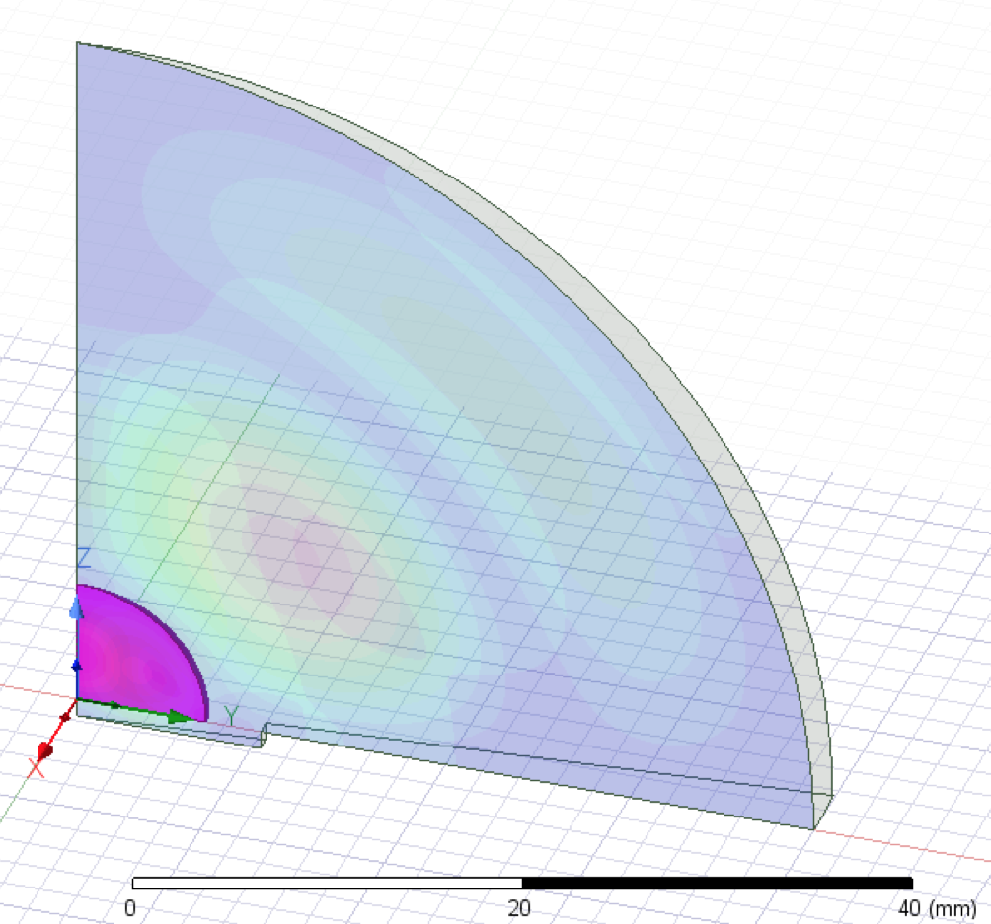
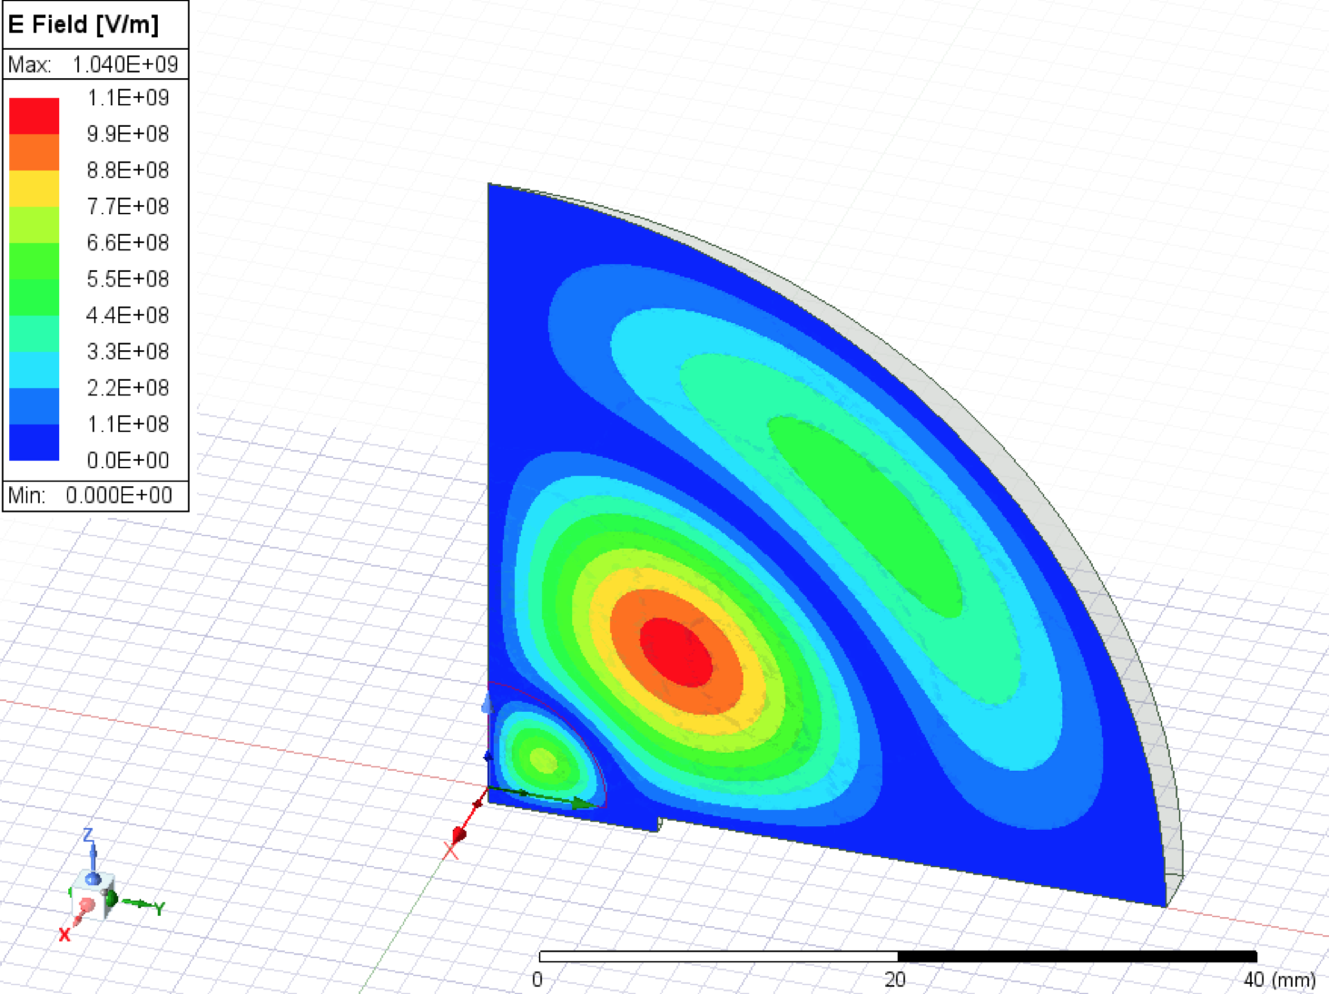
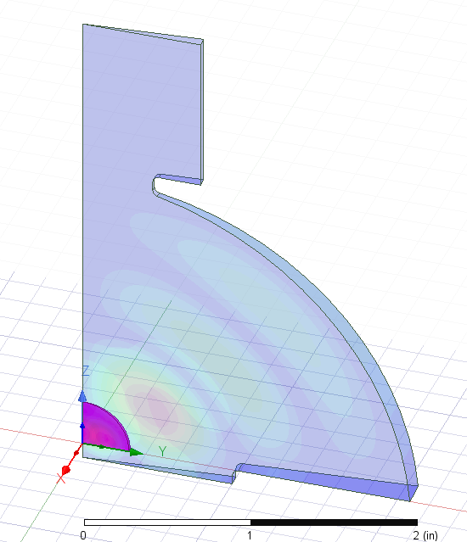
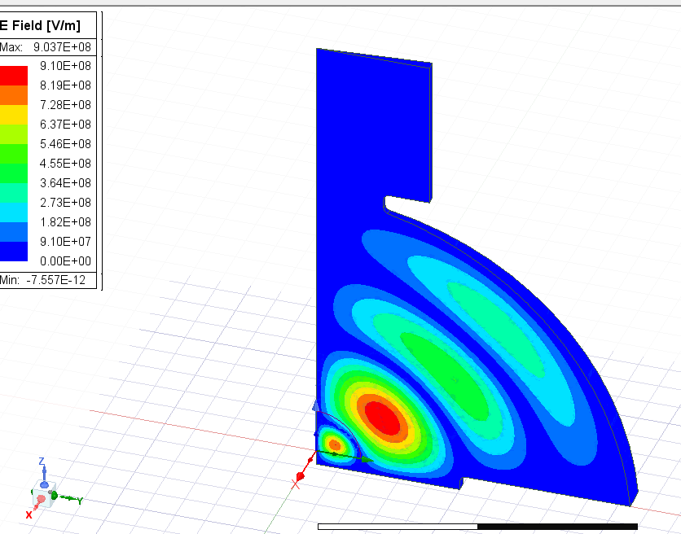
Solution approaches
Challenge:
Radius $=0.95 in \sim$ 24 mm
HTS sample radius $=10$ mm
Same set up -> Same RF frequency
$$\left|\vec{E}\right|$$
$f=11.0397$ GHz
$r_{s}=10$ mm
Solutions:
Design a new cavity using dielectric.
$$Al_{2}O_{3}$$
$$r_{s}$$
HTS
$2r_{s}=20$ mm
$f=11.632$ GHz
$r_{s}=0.95$ in
Next higher order mode with SLAC cavity using dielectric.
HTS
$$2r_{s}$$
$20$ mm
$$Al_{2}O_{3}$$
$$r_{s}$$

Slide 5
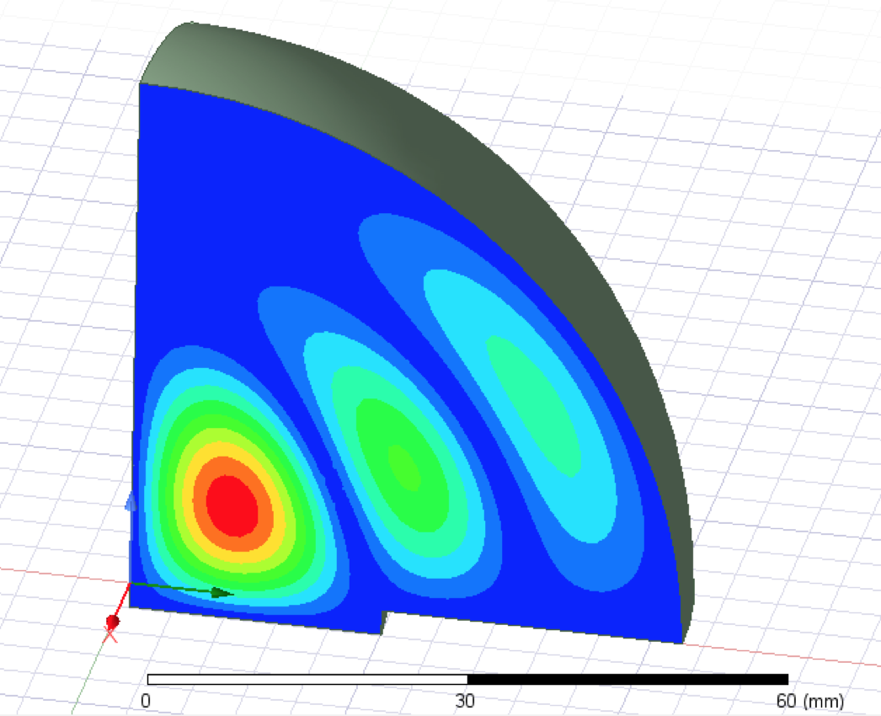
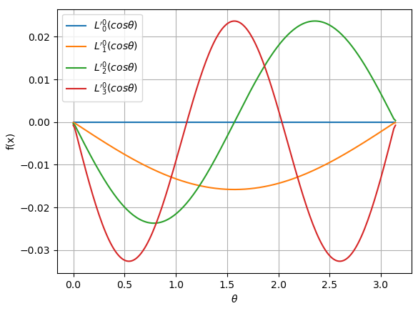
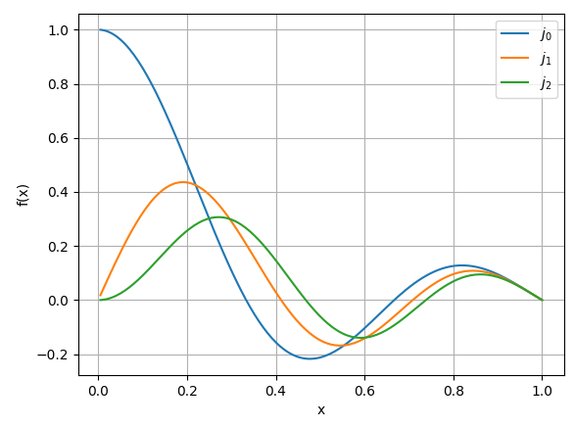





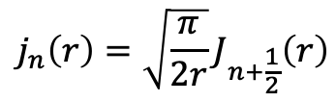






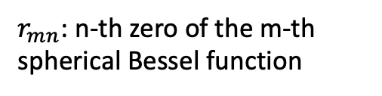
Resonant cavity: analytical study
$TE_{320}$-like mode in a “semispherical” cavity
$$\vec{H}=H_{r}\hat{r}+H_{θ}\hat{θ}$$
$TE, \frac{∂}{∂φ}=0$(axial symmetry)
$$\left|\vec{E}\right|$$
$$\vec{E}=E_{φ}\hat{φ}$$
$$E_{φ}\left(r,θ\right)=E_{0}j_{n}\left(k_{mn}r\right)\frac{d}{dθ}L_{n}^{0}\left(\cos{θ}\right)$$
$L_{n}^{0}\left(x\right)$: Legendre polynomial
$j_{n}\left(r\right)$: spherical Bessel function
$$ω_{m,n}=ck_{mn}=c\left(\frac{r_{mn}}{R}\right)$$
$r_{mn}$: n-th zero of the m-th spherical Bessel function
$$j_{n}\left(r\right)=\sqrt{\frac{π}{2r}}J_{n+\frac{1}{2}}\left(r\right)$$
$$E_{φ}=E_{0}j_{2}\left(k_{32}r\right)L_{2}^{0′}\left(\cos{θ}\right)$$
Zeros of $j_{2}\left(x\right)$
5.76346 | 9.09501 | 12.3229 | 15.5146

Slide 6
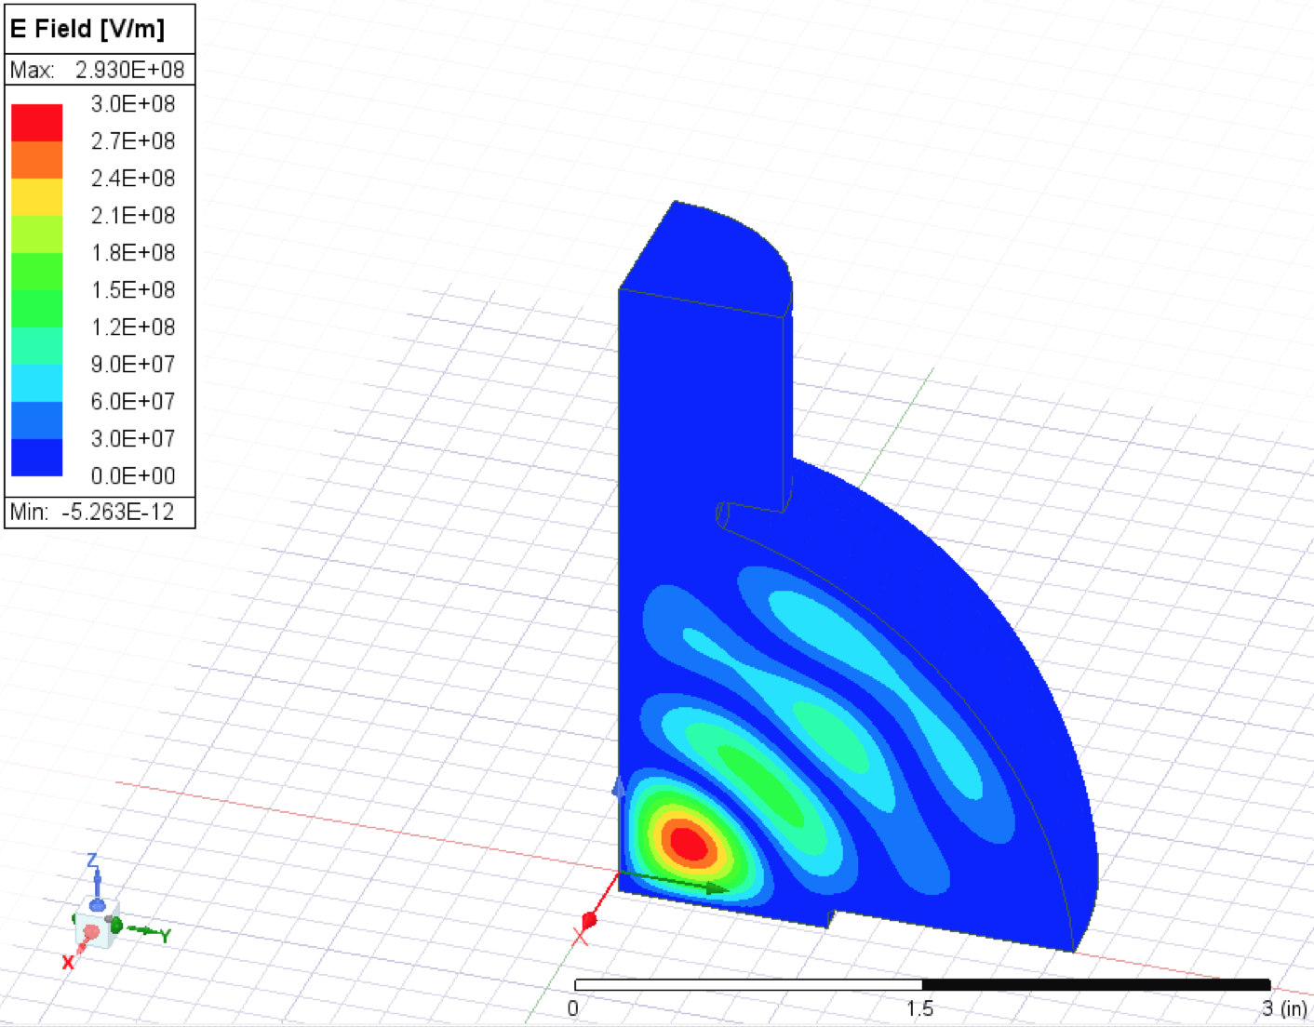
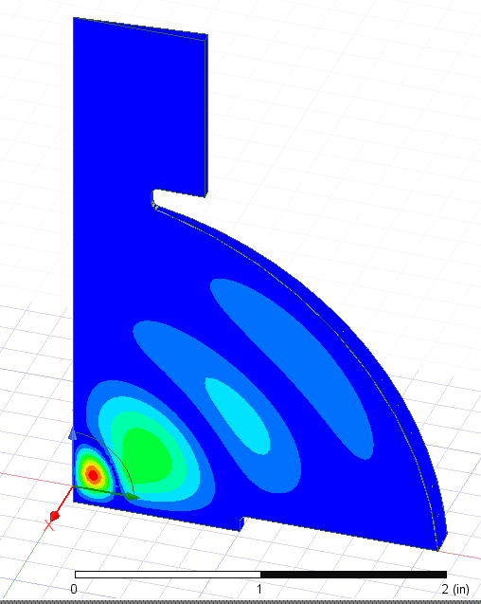
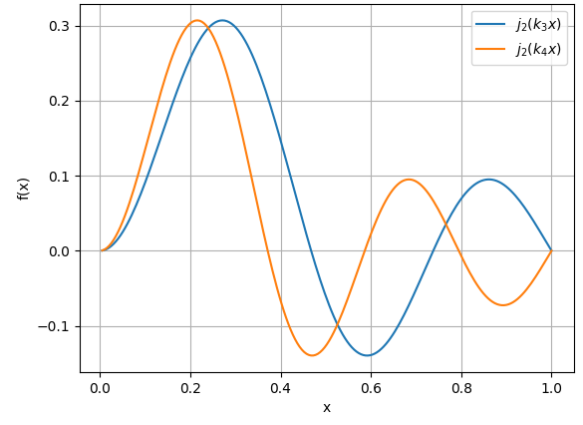
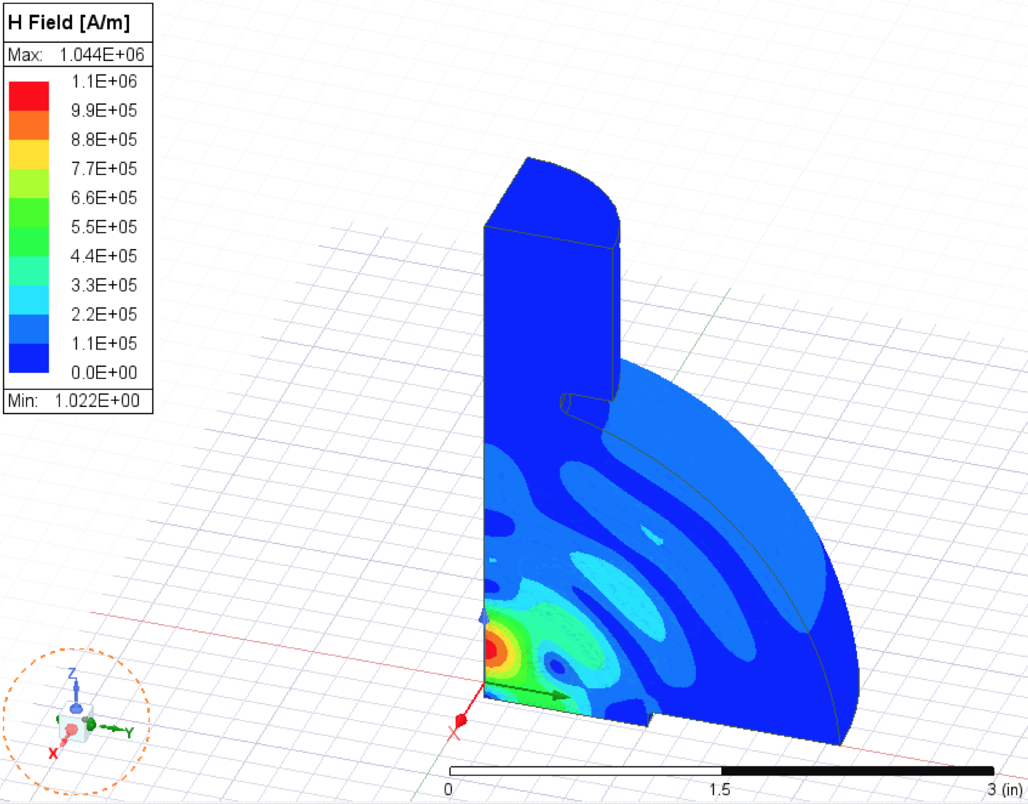
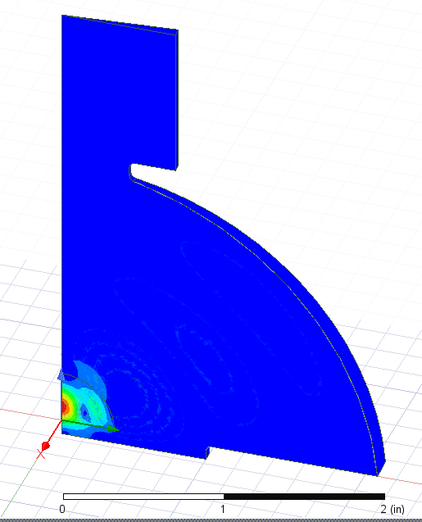


Dielectric resonant cavity
No dielectric
Dielectric $r_{d}=8.79$ mm
$$ω_{m,n}=c\left(\frac{r_{mn}}{R}\right)$$
$$E_{φ}∝j_{2}\left(k_{42}r\right)$$
$f=14.3557$ GHz
$f=11.3996$ GHz
$$λ_{12}$$ | 0.37*R
$$λ_{22}$$ | 0.215*R
$$λ_{32}$$ | 0.208*R
$$λ_{42}$$ | 0.207*R
$$\left|\vec{E}\right|$$
$$\left|\vec{H}\right|$$

Slide 7
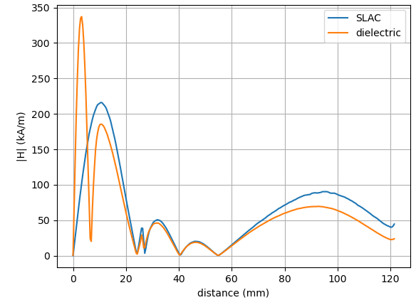
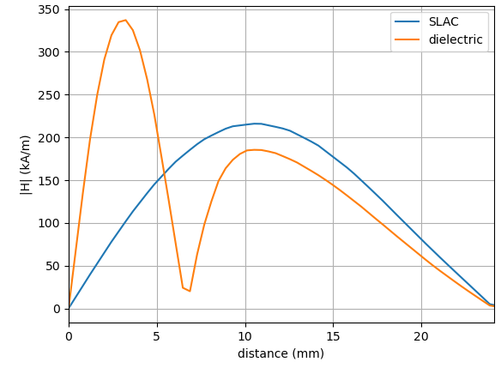
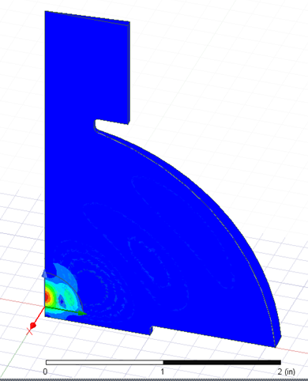




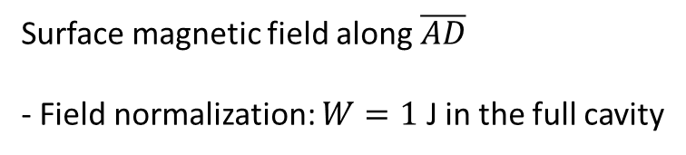
Dielectric resonant cavity
Surface magnetic field along $\overline{AD}$
- Field normalization: $W=1$ J in the full cavity
$$E_{φ}∝j_{2}\left(k_{32}r\right)$$
D
$f=11.3995$ GHz
A
B
C
$$E_{φ}∝j_{2}\left(k_{42}r\right)$$
$f=11.3996$ GHz
A
B
C
D

Slide 8
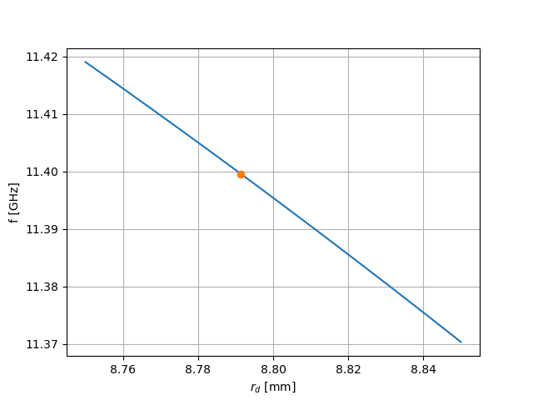
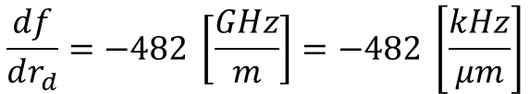
Dielectric resonant cavity
Tolerance study
$$E_{φ}∝j_{2}\left(k_{32}r\right)$$
$f=11.3995$ GHz
$$E_{φ}∝j_{2}\left(k_{42}r\right)$$
$f=11.3996$ GHz
$$\frac{df}{dr_{d}}=−482 \left[\frac{GHz}{m}\right]=−482 \left[\frac{kHz}{μm}\right]$$
How is the cavity tuned?

Slide 9
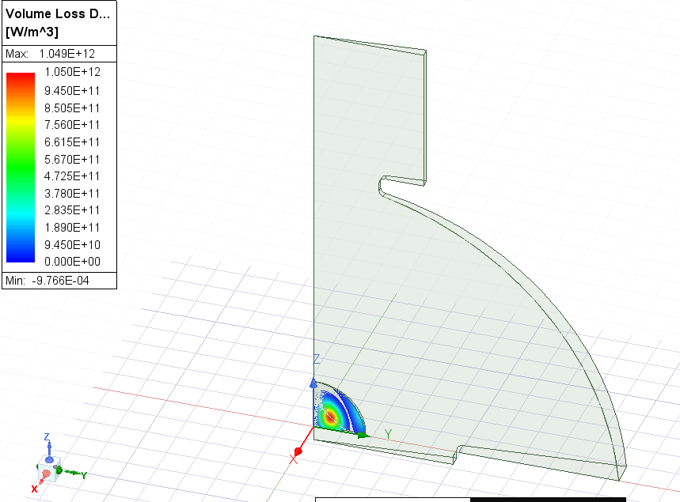
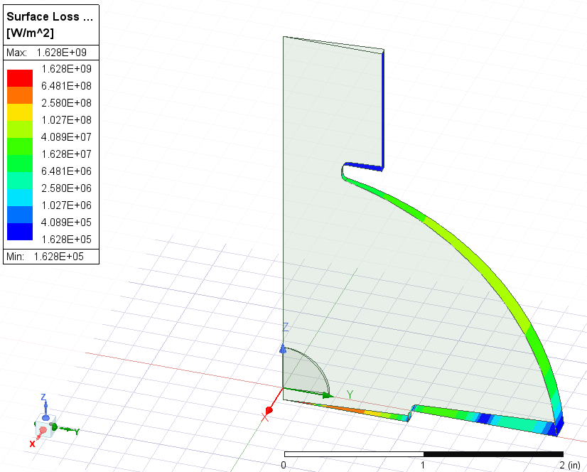
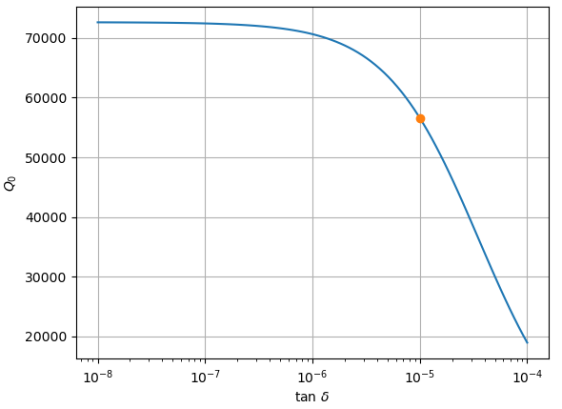

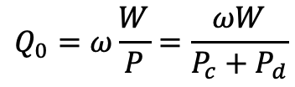
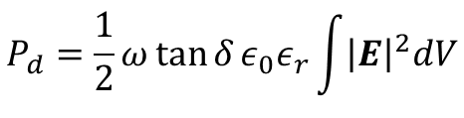
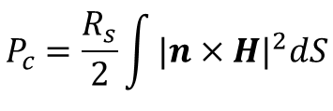
Dielectric resonant cavity
Log scale
$f=11.3996$ GHz
D
$$Q_{0}=ω\frac{W}{P}=\frac{ωW}{P_{c}+P_{d}}$$
Here?
$$P_{d}=\frac{1}{2}ω\tan{δ}ε_{0}ε_{r}\int{{\left|E\right|}^{2}dV}$$
$$P_{c}=\frac{R_{s}}{2}\int{{|n×H|}^{2}dS}$$

Slide 10
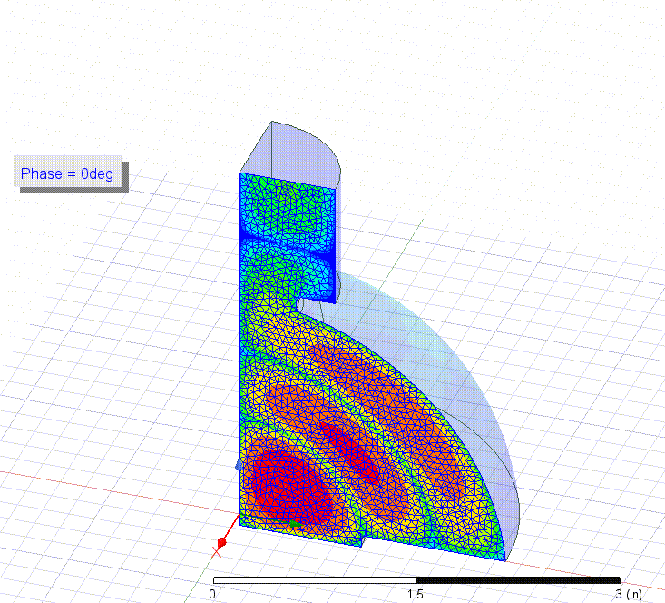
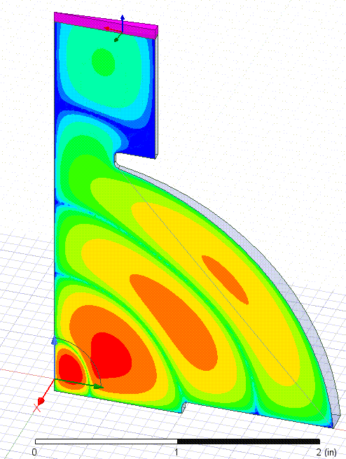
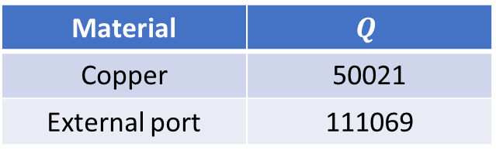
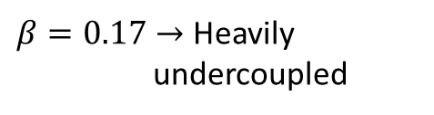


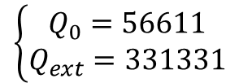
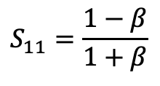


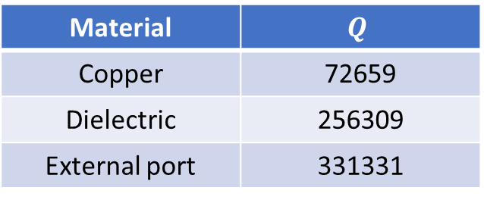
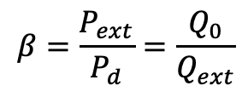
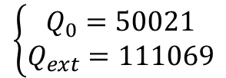



Dielectric resonant cavity
$$E_{φ}∝j_{2}\left(k_{32}r\right)$$
$f=11.3995$ GHz
$$E_{φ}∝j_{2}\left(k_{42}r\right)$$
$f=11.3996$ GHz
Material | $$Q$$
Copper | 50021
External port | 111069
Material | $$Q$$
Copper | 72659
Dielectric | 256309
External port | 331331
$$\tan{δ}={10}^{−5}$$
$$\left\{\begin{aligned}Q_{0}=50021 \\ Q_{ext}=111069\end{aligned}\right.$$
$β=0.45→$ Undercoupled
$$\left\{\begin{aligned}Q_{0}=56611 \\ Q_{ext}=331331\end{aligned}\right.$$
$β=0.17→$ Heavily undercoupled
$$TE_{01}$$
Can we tune the coupling?
$$β=\frac{P_{ext}}{P_{d}}=\frac{Q_{0}}{Q_{ext}}$$
$$S_{11}=\frac{1−β}{1+β}$$

Slide 11
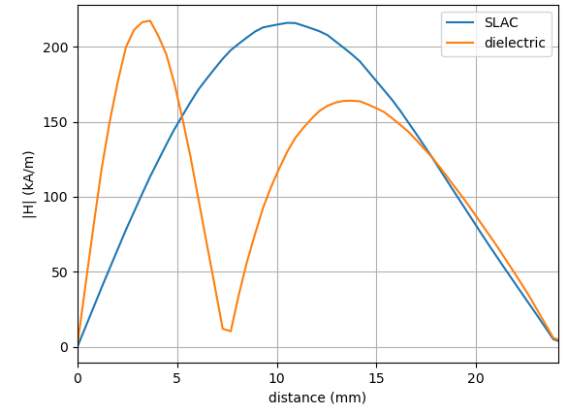
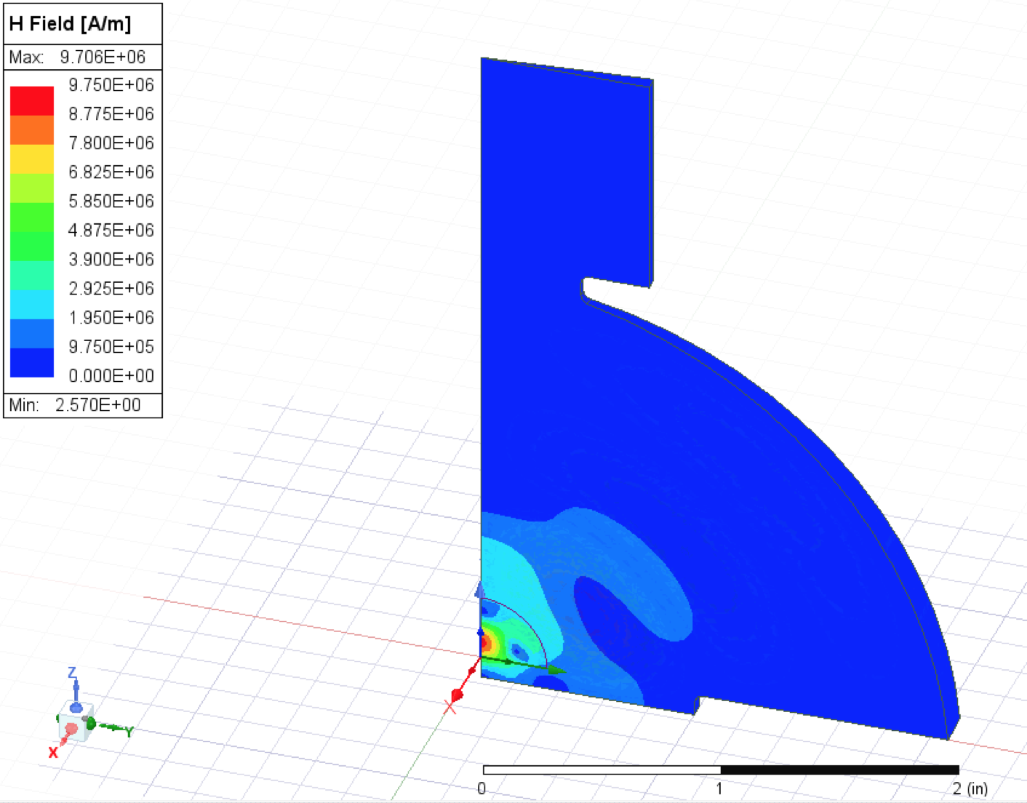
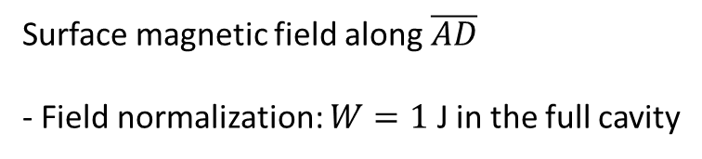




Dielectric resonant cavity
$$\left|\vec{E}\right|$$
Dielectric $r_{d}=7.25$ mm
$f=11.632$ GHz
Surface magnetic field along $\overline{AD}$
- Field normalization: $W=1$ J in the full cavity
$$\left|\vec{H}\right|$$

Slide 12
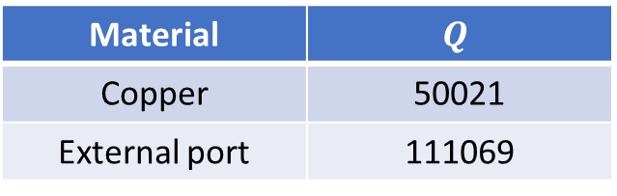

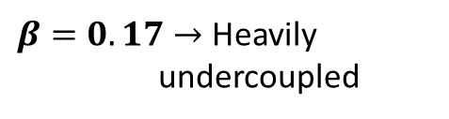

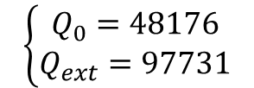
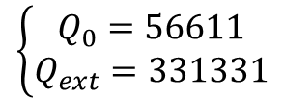



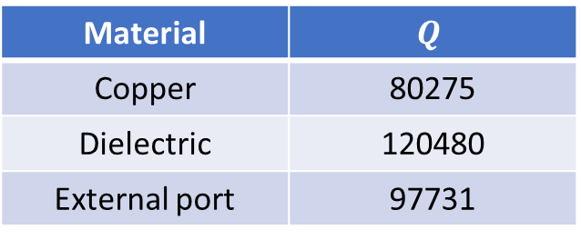
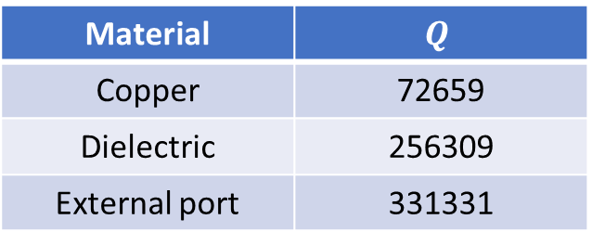
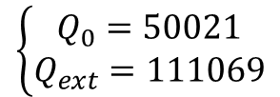


Dielectric resonant cavity
New
$$E_{φ}∝j_{2}\left(k_{42}r\right)$$
$f=11.632$ GHz
Material | $$Q$$
Copper | 80275
Dielectric | 120480
External port | 97731
Without dielectric
$$\tan{δ}={10}^{−5}$$
$$E_{φ}∝j_{2}\left(k_{32}r\right)$$
$f=11.3995$ GHz
Material | $$Q$$
Copper | 50021
External port | 111069
$$\left\{\begin{aligned}Q_{0}=48176 \\ Q_{ext}=97731\end{aligned}\right.$$
$β=0.49→$ Undercoupled
Previous
$f=11.3996$ GHz
$$\left\{\begin{aligned}Q_{0}=50021 \\ Q_{ext}=111069\end{aligned}\right.$$
$β=0.45→$ Undercoupled
Material | $$Q$$
Copper | 72659
Dielectric | 256309
External port | 331331
$$\tan{δ}={10}^{−5}$$
$$\left\{\begin{aligned}Q_{0}=56611 \\ Q_{ext}=331331\end{aligned}\right.$$
$β=0.17→$ Heavily undercoupled

Slide 13
Back up

Slide 14



Dielectric resonant cavity
Anisotropic behaviour:
  Sapphire (crytalline form of $Al_{2}O_{3}$) has anisotropic behaviour in $ε_{r}$ and $\tan{δ}$
  Amorphous alumina is isotropic.
$ε_{r}∥c=11.5$at ${10}^{3}−{10}^{9}$ Hz, $\tan{δ}∥c=8.6×{10}^{−5}$ at ${10}^{10}$ Hz and 25ºC
$ε_{r}⊥c=9.3$at ${10}^{3}−{10}^{9}$ Hz, $\tan{δ}⊥c=3×{10}^{−5}$ at ${10}^{10}$ Hz and 25ºC
https://rayotek.com/PDF/Sapphire-Properties-Data-Sheet.pdf
$$ε_{r}=9.6−10,\tan{δ}={10}^{−4}−{10}^{−5}$$
https://thermalsupport.com/wp-content/uploads/2018/06/Sapphal%C2%AE-U-High-purity-99.9-Translucent-Alumina.pdf
https://www.industrial-ceramicparts.com/sale-13785342-high-purity-99-9-aluminum-oxide-ceramics-260mpa-tensile-strength.html

Slide 15
















Solution I
$$ω_{m,n}=c\left(\frac{r_{mn}}{R}\right)$$
$$E_{φ}∝j_{2}\left(k_{32}r\right)$$
$$λ_{d}=\frac{λ_{0}}{\sqrt{ε_{r}}}$$
$λ_{0}$ must be the same to keep frequency constant
$$λ_{12}$$ | 0.46*R
$$λ_{22}$$ | 0.27*R
$$λ_{32}$$ | 0.27*R
$$\left|\vec{E}\right|$$
$f=11.0397$ GHz
$r=7$ mm
$R=40$ mm
$r_{s}=10$ mm
$$\left|\vec{H}\right|$$
$$r$$
$$Al_{2}O_{3}$$
$$r_{s}$$
$$R$$

Slide 16












Solution I
$f=11.0397$ GHz
$r=7$ mm
$R=40$ mm
$f=11.128$ GHz
$r=9$ mm
$R=40$ mm
$$\left|\vec{E}\right|$$
$$\left|\vec{E}\right|$$
$$\left|\vec{H}\right|$$
$$\left|\vec{H}\right|$$

Slide 17




Resonant cavity
$f=10.8501$ GHz
$TE_{320}$-like mode in a “semispherical” cavity
$$\left|\vec{E}\right|$$
$$\left|\vec{H}\right|$$

Slide 18

Dielectric resonant cavity
No dielectric
Dielectric $r_{d}=7.25$ mm
$$ω_{m,n}=c\left(\frac{r_{mn}}{R}\right)$$
$$E_{φ}∝j_{2}\left(k_{42}r\right)$$
$f=14.3557$ GHz
$f=11.632$ GHz
$$λ_{12}$$ | 0.37*R
$$λ_{22}$$ | 0.215*R
$$λ_{32}$$ | 0.208*R
$$λ_{42}$$ | 0.207*R
$$\left|\vec{E}\right|$$
$$\left|\vec{H}\right|$$

Slide 19






Dielectric resonant cavity
$$ω_{m,n}=c\left(\frac{r_{mn}}{R}\right)$$
$$λ_{d}=\frac{λ_{0}}{\sqrt{ε_{r}}}$$
$λ_{0}$ must be the same to keep frequency constant
$$λ_{12}$$ | 0.46*R
$$λ_{22}$$ | 0.27*R
$$λ_{32}$$ | 0.27*R
Reduce 2nd and 3rd lambda with dielectric
Reduce first lambda with dielectric
$$\left|\vec{E}\right|$$

Slide 20











Dielectric resonant cavity I
$f=11.0397$ GHz
$r=7$ mm
$R=40$ mm
$$\left|\vec{E}\right|$$
$TE_{320}$-like mode in a “semispherical” cavity
$r_{s}=10$ mm
$$\left|\vec{H}\right|$$
$$r$$
$$Al_{2}O_{3}$$
$$r_{s}$$
$$R$$

Slide 21



Dielectric resonant cavity I
$f=11.128$ GHz
$r=9$ mm
$R=40$ mm
$$\left|\vec{E}\right|$$
$TE_{320}$-like mode in a “semispherical” cavity
$r_{s}=10$ mm
$$\left|\vec{H}\right|$$
$$r$$
$$Al_{2}O_{3}$$
$$r_{s}$$
$$R$$

Slide 22










Dielectric resonant cavity I
$R=45$ mm
$r=9$ mm
$f=9.81$ GHz
$R=40$ mm
$r=7$ mm
$f=11.0397$ GHz
$$\left|\vec{H}\right|$$
$$\left|\vec{E}\right|$$

Slide 23





Dielectric resonant cavity I
$R=45$ mm
$f=9.81$ GHz
$f=12.056$ GHz
$r=9$ mm
$$\left|\vec{H}\right|$$
$$\left|\vec{E}\right|$$

Slide 24






Dielectric resonant cavity I
$f=6.26137$ GHz
$$\left|\vec{E}\right|$$
$TE_{320}$-like mode in a “semispherical” cavity
$$Al_{2}O_{3}$$
$$\left|\vec{H}\right|$$

Slide 25




Dielectric resonant cavity II
$f=6.8949$ GHz
$$\left|\vec{E}\right|$$
$TE_{320}$-like mode in a “semispherical” cavity
$$Al_{2}O_{3}$$
vacuum
$$\left|\vec{H}\right|$$

Slide 26






Dielectric resonant cavity
$$ω_{m,n}=c\left(\frac{r_{mn}}{R}\right)$$
$$E_{φ}=E_{0}j_{2}\left(k_{42}r\right)L_{2}^{0}\left(\cos{θ}\right)$$
$f=13.6795$ GHz
$$λ_{12}$$ | 0.37*R
$$λ_{22}$$ | 0.215*R
$$λ_{32}$$ | 0.208*R
$$λ_{42}$$ | 0.207*R

