Slide 1

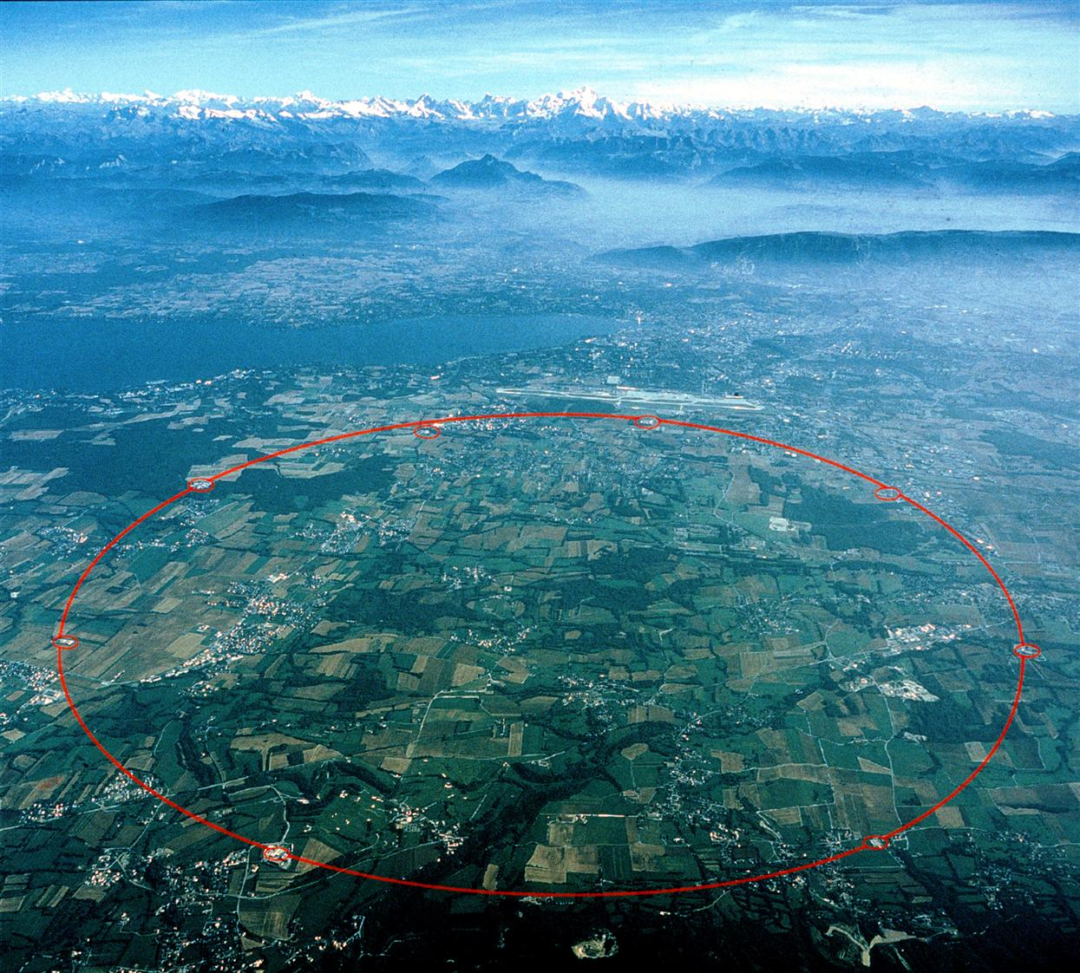
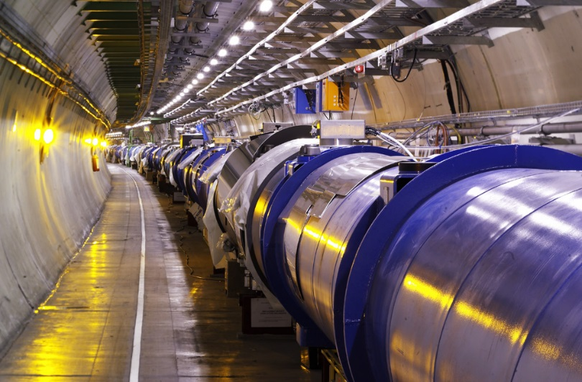

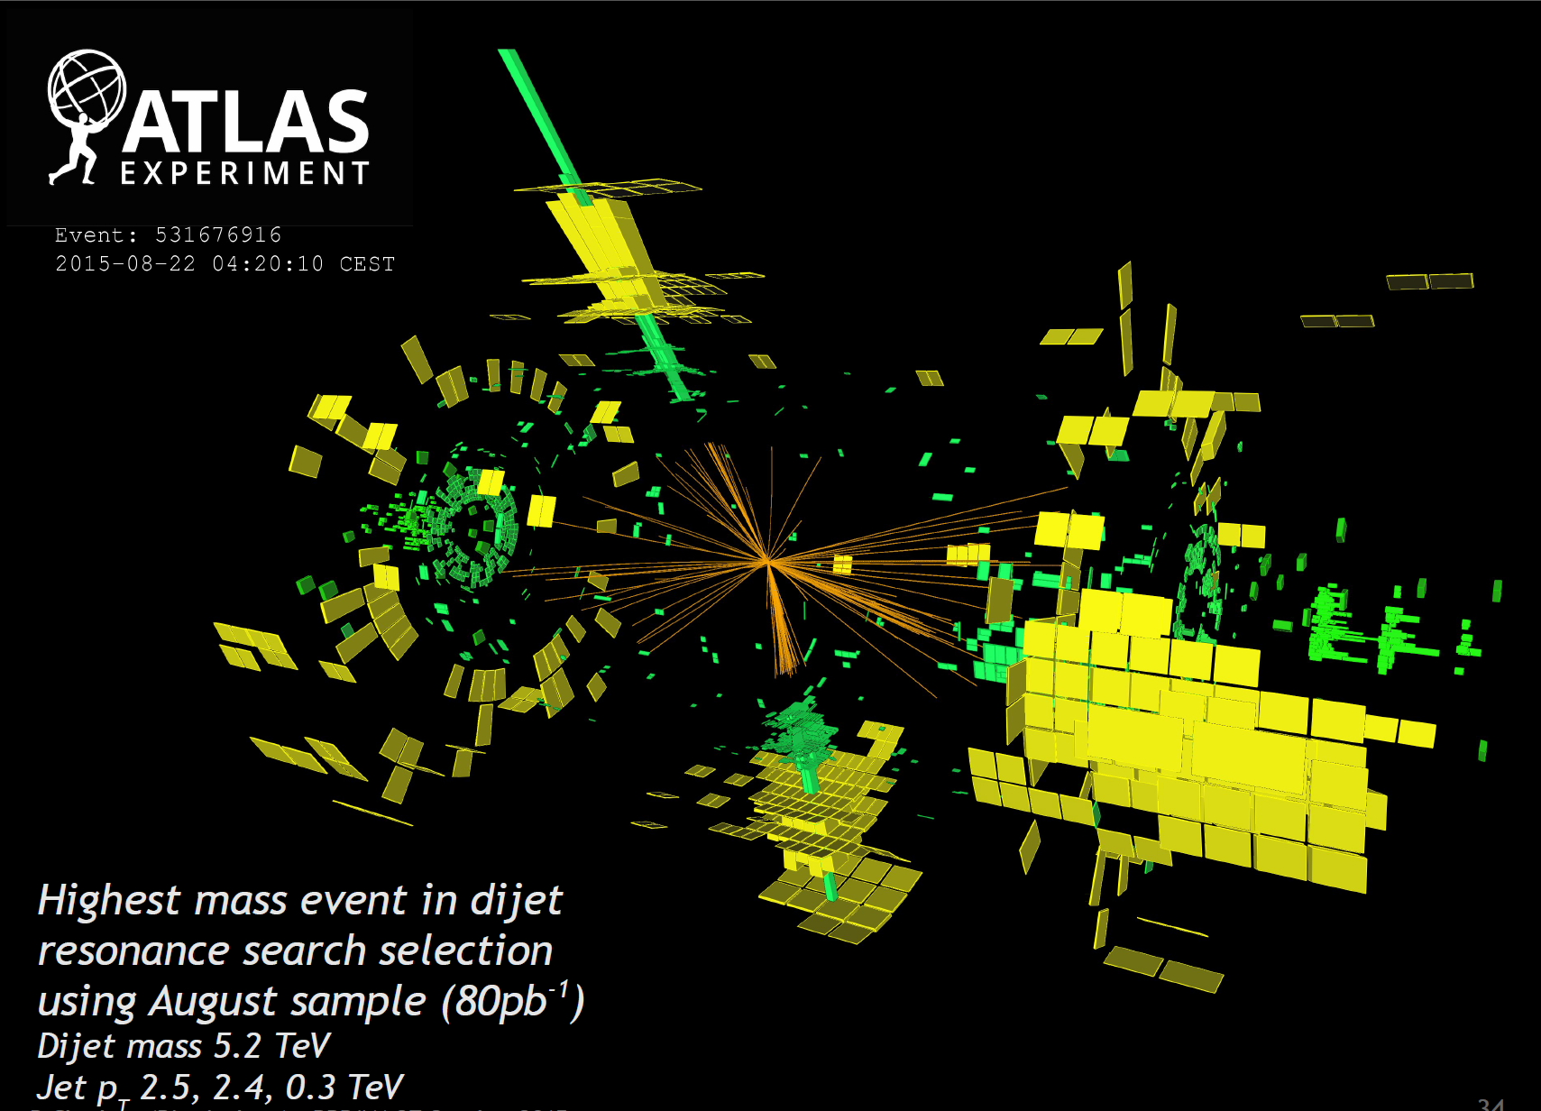
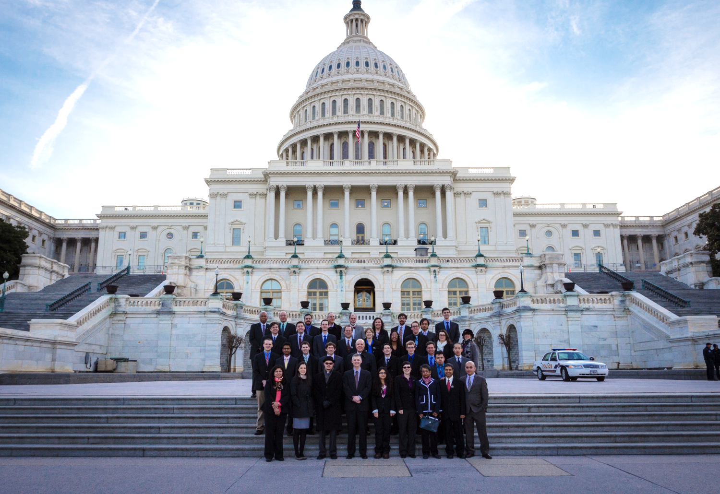
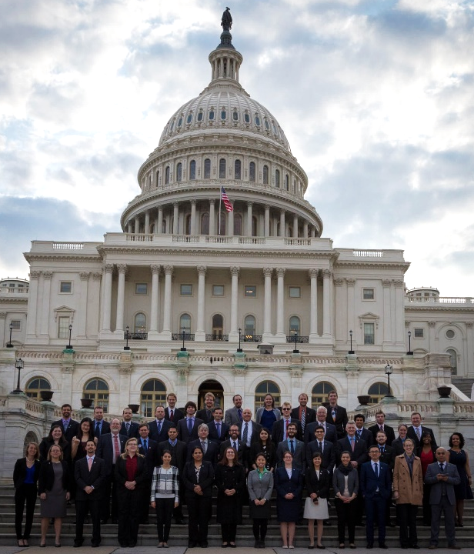
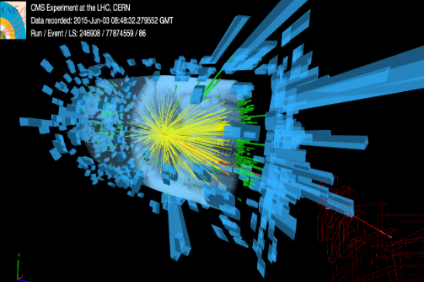



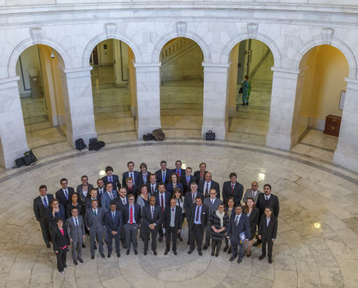
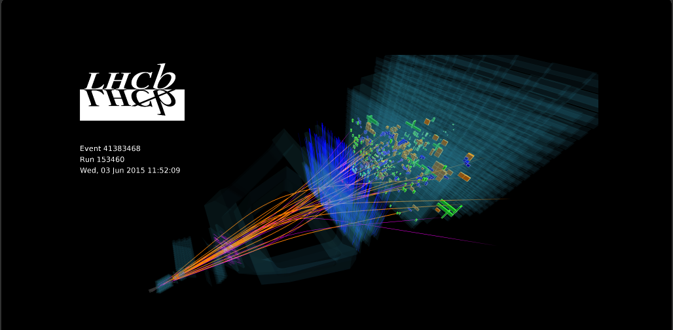
US LHC Users Association
US LUEC Meeting
Harvey Newman
February 26, 2024
Notes:
1

Slide 2
US LUEC Meeting Agenda
February 26, 2024
Welcome and Introduction: HN (20')
Brief Subcommittee Reports (35')
DC trip status and plans: Kiley Kennedy
Finances and Fund raising:
David Saltzberg and John Stupak
Quality of Life: Claire Lee
Outreach/Communications: Julia Gonski
Annual Meeting and Events: Steve Goldfarb
Web Presence and Email Lists: Jannicke Pearkes
Discussion (20’):
New P5 Plan
Issues Related to the Subcommittees
Plans and Goals for the Year
AOB; Action Items
2
Notes:
2

Slide 3
US LHC Users Association (US LUA) http://www.uslua.org
Represents the entire community: Universities and Labs
  The LHC experiments, theory and LARP (Accelerator R&D)
  Forum for information and concerns; special “international” needs
Established as a non-profit tax exempt association, headquartered
in DC, collocated & hosted by URA since May 2013
In our 16th year; 10th as US LUA: Successor to the US LHC Users Organization, approved by the LHC experiments & LARP in April 2007
Mission Statement:
“The purpose of USLUA is to provide a forum for discussions of the US
participation in the LHC research program, with a focus on how best to enhance scientific participation in the discoveries expected from this research. In particular, USLUA aims to help the US LHC community work effectively with their colleagues at CERN while in the US, and to adapt to work at CERN and to living in the environs of the CERN laboratory. USLUA also provides communication channels between scientists working on the LHC experiments, the US agencies supporting this research and the US Congress and Executive branch.”
Working in close cooperation: UEC, SLUO, US LHC Ops Program, ACCU
Notes:
3

Slide 4
US LHC Users Executive Committee
Welcome to Our New and Continuing Members
Maria Baldini - FNAL - Accelerator R&D (2024-2025)
Julia Gonski - SLAC - ATLAS (2024-2025)
Matt LeBlanc - Brown - CMS (2024-2025)
Lawrence Lee - Tennessee - CMS (2024-2025)
Harvey Newman - Caltech - CMS (2024-2025)
Karri Di Petrillo - Chicago - ATLAS (2024-2025)
Deepa Thomas - UT Austin - ALICE (2024-2025)
Caterina Vernieri - SLAC - ATLAS (2024-2025)
Michael Wilkinson - Syracuse - LHCb (2024-2025)
Special thanks to Steve Goldfarb and John Stupak
for conducting our election
Special thanks to Indara Suarez, Phil Ilten, Lesya Horyn and Daniel Takaki for their excellent service and work throughout the 2022-23 term, and to all the continuing members and observers who continue to support our community and support the cause so well.
Notes:
4

Slide 5
US LUA Executive Committee: 18 Members
2024 Membership (2 Year Terms)
Name Institution Collaboration Term Expires
Maria Baldini Fermilab Accelerator R&D 2025
Karri DiPetrillo Chicago ATLAS 2025
Julia Gonski (APS Liaison;Sec’y) SLAC ATLAS 2025
Matt LeBlanc Brown CMS 2025
Lawrence Lee Tennessee CMS 2025
Harvey Newman (Chair) Caltech CMS 2025
Deepa Thomas Texas Austin ALICE 2025
Caterina Vernieri (Co-Chair) SLAC ATLAS 2025
Michael Wilkins Syracuse LHCb 2025
Steve Goldfarb Melbourne ATLAS 2024
Kiley Elizabeth Kennedy Princeton CMS 2024
Elise Le Boulicaut Duke ATLAS 2024
Claire Lee Fermilab CMS 2024
Kaori Maeshima Fermilab CMS 2024
Jannicke Pearkes Colorado (Boulder) CMS 2024
David Saltzberg (Treasurer) UCLA CMS 2024
John Stupak Oklahoma ATLAS 2024
Anyes Taffard UC Irvine ATLAS 2024
Observers: David W. Miller, Joe Haley, Sergei Gleyzer
Totals: CMS 8 (+1), ATLAS 7 (+2), LHCb 1, ALICE 1, AR&D 1; 3 Observers; APS Liaison
Ex-Officio: US ATLAS and CMS PMs, Deputies, CB Chairs, IB Chairs
5
Notes:
5

Slide 6
US LUEC EX Officio Members
Giorgio Apollinari (LARP Director)
Lothar Bauerdick (US CMS Program Manager)
Ken Bloom (US CMS NSF PI)
Andre de Gouvea (DPF Executive Committee Chair)
Sekhar Chivukula (Past DPF Executive Committee Chair)
Sridhara Dasu (US ICFA Member)
Robin Erbacher (US CMS Collaboration Board Chair)
JoAnne Hewett (BNL Director)
Hassan Jawahery (US LHCb Program Manager)
Sudhir Malik (US CMS Deputy Collaboration Board Chair)
Patricia McBride (CMS Spokesperson)
Jane Nachtman (Fermilab UEC Chair)
Jason Nielsen (US ATLAS Institutional Board Chair)
Srini Rajagopalan (US ATLAS Program Manager)
Heidi Schellman (DPF Executive Committee Chair Elect)
Sally Seidel (Interim HEPAP Chair)
Daniel Tapia Takaki (US ALICE Council Chair)
Anthony Timmins (US ALICE Coordinator)
6
Notes:
6

Slide 7
US LUEC Officers & Subcommittees 2023-24
Officers: Chair: HN, Vice-Chair: Caterina Vernieri
Treasurer: David Saltzberg. Secretary: Julia Gonski
Quality of Life: Daniel Tapia Takaki (Chair), Claire Lee (Co-Chair), Jannicke Pearkes, Kaori Maeshima, Elise Le Boulicaut, Steve Goldfarb, Lesya Horyn, David Miller, HN
Gov’t Relations: Kiley Kennedy (Chair), Caterina Vernieri, John Stupak,
David Saltzberg, Joe Haley, HN
Outreach/Communications, Social Presence: Julia Gonski (Chair),
Caterina Vernieri, Kiley Kennedy, Kaori Maeshima, Daniel Tapia Takaki, Elise
Le Boulicaut, Claire Lee, Indara Suarez, Lawrence Lee, Steve Goldfarb, HN
Annual Meeting and Events: Daniel Tapia Takaki (Co-Chair),
Steve Goldfarb (Co-Chair), John Stupak, Kaori Maeshima, Phil Ilten, HN
Web Presence and Email Lists: Jannicke Pearkes (Chair), Daniel Takaki (Co-Chair),
Joe Haley, Lawrence Lee, Maria Baldini, Elise Le Boulicaut, Lesya Horyn,
Anyes Taffard, Claire Lee
Fund Raising and Finance: John Stupak (Chair), David Saltzberg (Co-Chair),
Kiley Kennedy, Caterina Vernieri, Indara Suarez, Anyes Taffard, HN
Rules & Elections Taskforce: John Stupak, Maria Baldini, Phil Ilten, HN
APS Liaison: Julia Gonski, Indara Suarez
New members: committee signups
Present members: Volunteers for new Chair or Co-Chair; Any preferred changes
7
Notes:
7

Slide 8
US LUO Activities (1)
US LHC Users Association (US LUA)
Activities (1)
  Annual Fall Meetings
    Thanks to Fermilab for Hosting our Annual Meeting in 2023 !
    And in 2018, 2017, 2015, 2012, 2010, and 2008.
    Rice University and the HEP Group in 2019; Wisconsin HEP in 2013
    LBNL in 2016, 2009; Argonne HEP in 2014, 2011
    Focus: Young Physicists’ Work ! Our Lightning Round Tradition: CL, KK, SG, CM;
    thanks to Verena Martinez, Corrinne Mills, Anthony Timmins, Kevin Black,
    Sridhara Dasu; Julia Thom, Gordon Watts, Darin Acosta, et al
    Review the LHC experimental & accelerator program, view from
    Washington. Early career perspectives. Lab tours and/or Careers Session.
    Discussion of current issues that affect US LHC users at home & abroad
    Special Events: None greater than P5 ! And the Early Career Perspective.
  Annual HEP Visits to Washington DC: 2024 will be our 16th Annual Trip
  Coordinated with FNAL UEC, SLUO, BNL, DPF; URA as host in DC
    Great occasions to highlight our science, the impact and need
    Looking forward to coordinating our advocacy, messaging, strategy in the new
    context with the P5 report and close collaboration and engagement
    with the lab directorates and agencies
    Excellent start with Fermilab UEC, SLUO, LBL and BNL
Notes:
8

Slide 9
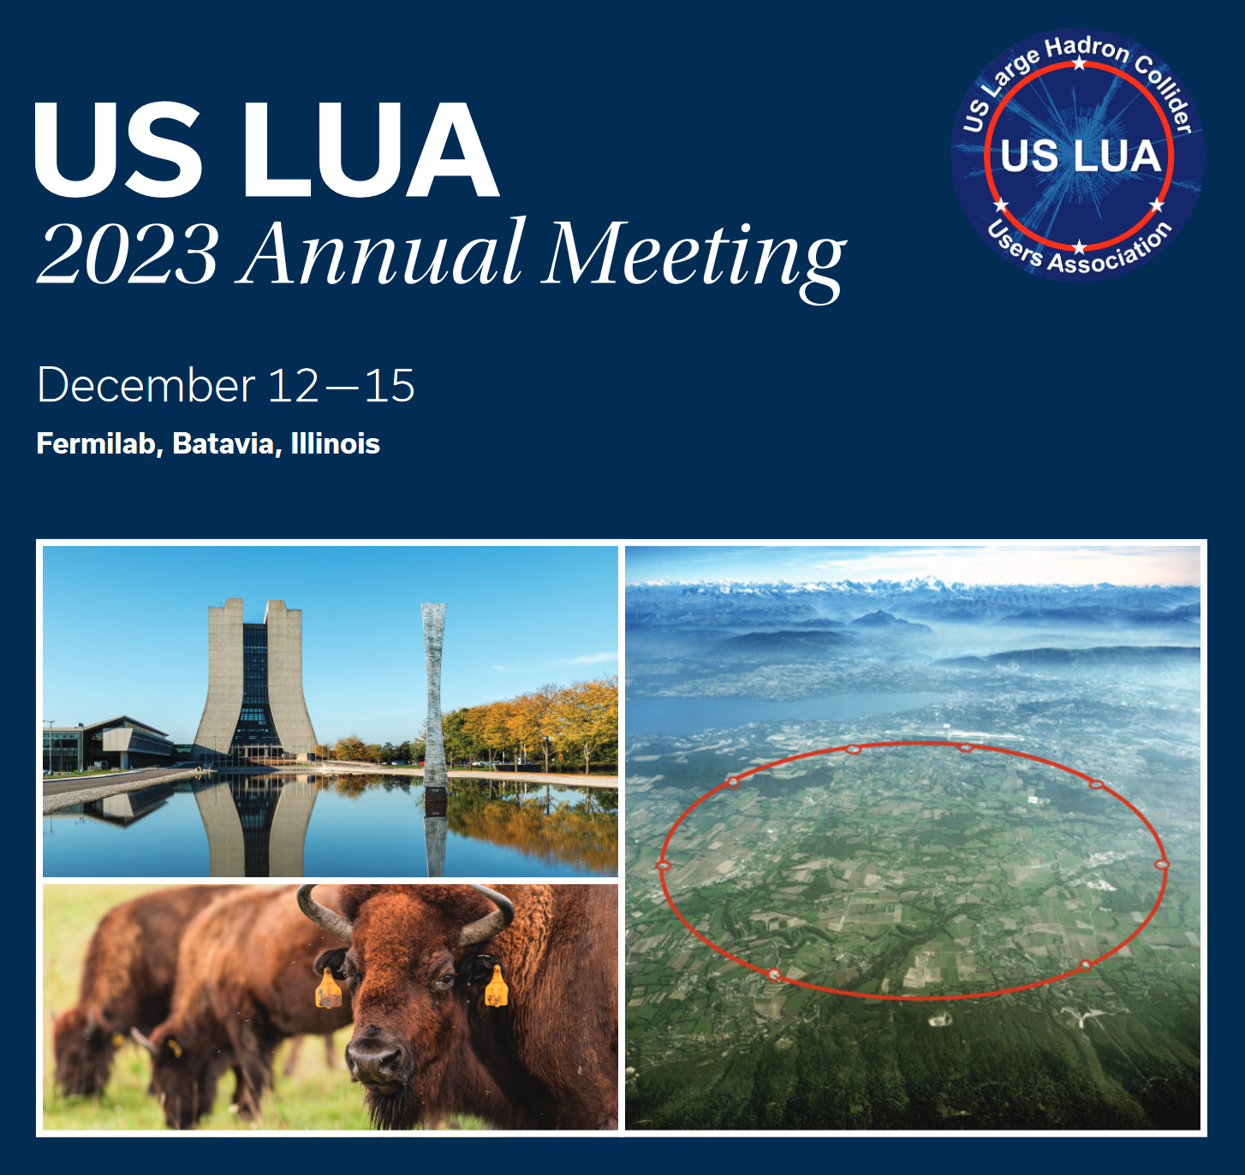
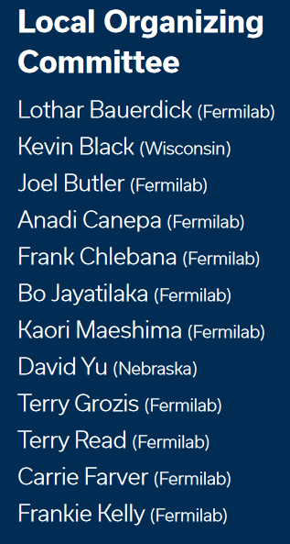

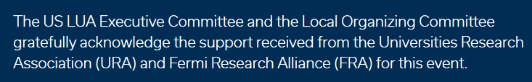
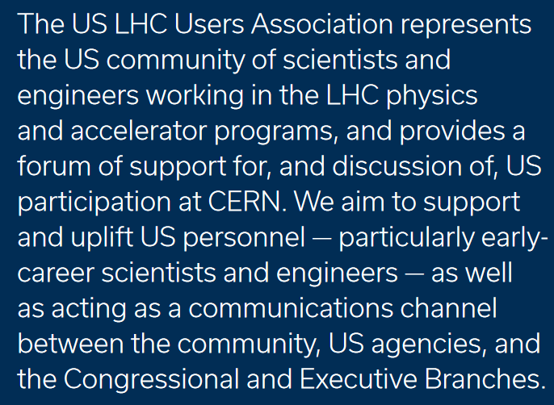
Thank You Fermilab, FRA, URA !
US LUA Annual Meeting
December 13, 2023
Notes:
9

Slide 10
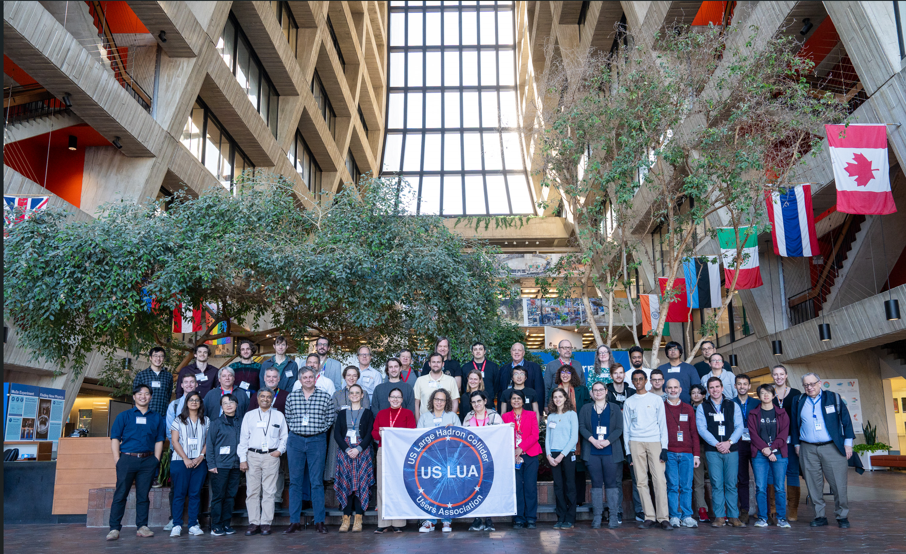
Our 2023 Annual US LHC Meeting at Fermilab
Congratulations: Our Lightning Round
Winners !
Brendon Bullard
Kevin Greif
Ryan Kim
Oz Amram
Thomas Boettcher
Gillian Kopp
Nate Grieser
Gwen Gardner
Gabriel Matos
Abhisek Datta
Notes:
10

Slide 11
Our 2023 Annual US LHC Meeting at Fermilab
Post P5 & Town Hall Discussion; roundtable ! Looking back and forward
Early Career: Perspective and Visions Going Forward; Future Leaders !
P5 Community Support Campaign: A great success, thanks to DPF
Accelerator R&D, ATLAS, ALICE, CMS, LHCb Status & Outlook
APS DPF, NSF EPP Views
NSAC and DOE NP Views: Perspectives relative to P5
DEI, Outreach and Undergrad REU Perspectives
Subcommittee Reports: Crystallizing and expanding upon
what we are doing for our Community; our oals going forward
Our 2024-25 US LUEC Election: Thanks Steve and John !
Beautiful Lightning Round talks:
Talented physicists, speakers, and potential spokespersons
for the US LHC Community. Looking forward to our DC Trip
Funding Drive to maximize our Trip contingent;
and enhance our activities for the community from now on
Notes:
11

Slide 12

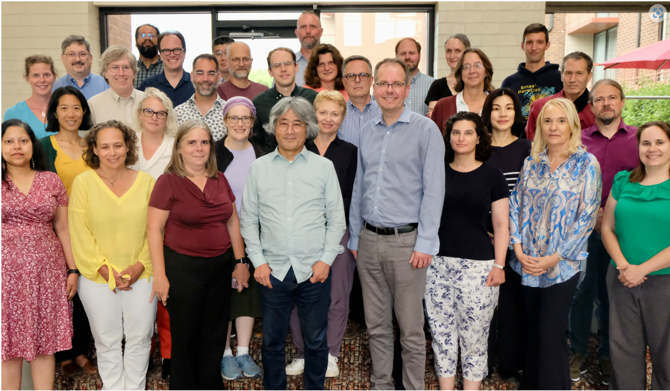
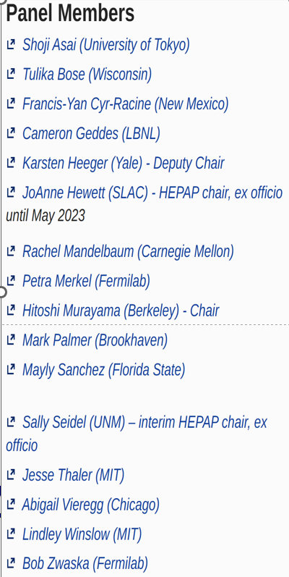
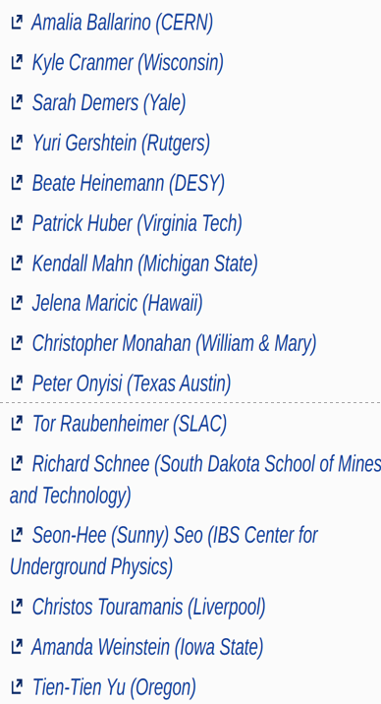
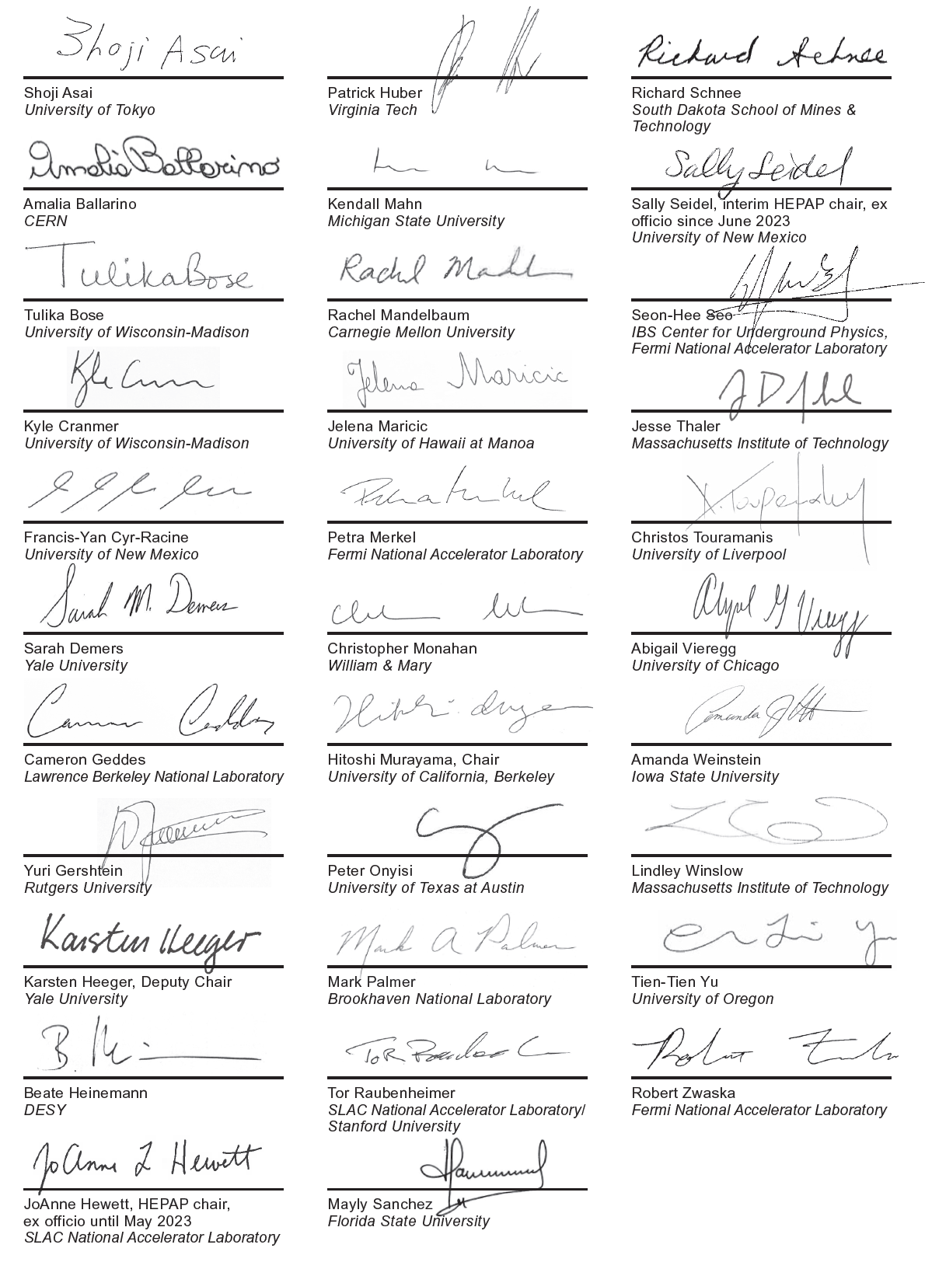
P5 Report and Plan: The Path to Our Future
A Great Report: Dawn of A New Era
See usparticlephysics.org
Exploring the Quantum Universe:
A vast inspiring, feasible vision of exploration, discovery, innovation, and leadership.
An agile program balanced across space
and time, physics and project scales
Inspiring the EC future leaders and the young; building a technologically adept workforce.
Tremendous Community Support:
Letter Signed by 3200 Physicists from 49 states
Notes:
12

Slide 13
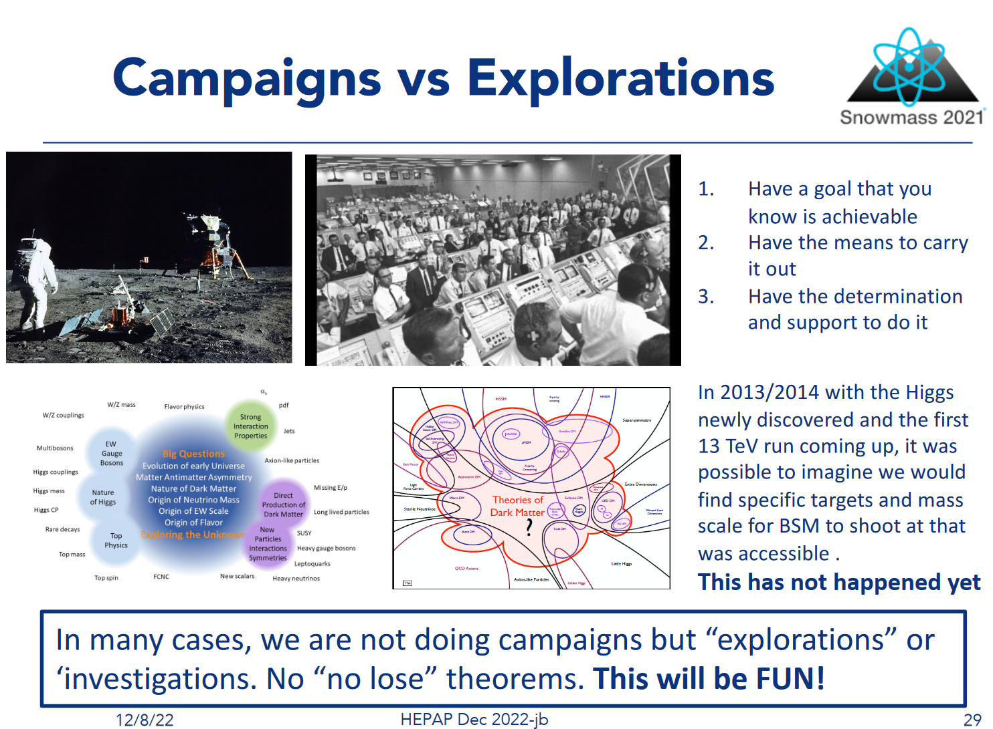

Joel Butler Talk on Snowmass at HEPAP 12/2022
13
Notes:
13

Slide 14
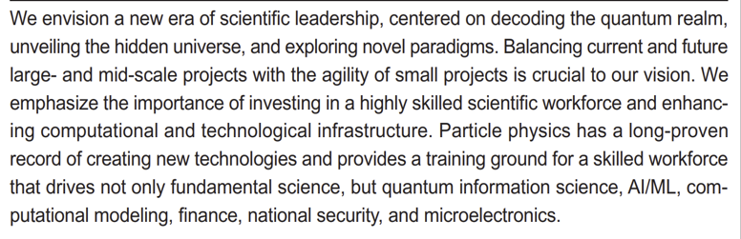
Vision: Exploring the Quantum Universe
Pathways to Innovation and Discovery in Particle Physics
  See usparticlephysics.org
  2023 P5 Report: Exploring the Quantum Universe | Pathways to Innovation and Discovery in Particle Physics. (usparticlephysics.org)
Notes:
14

Slide 15
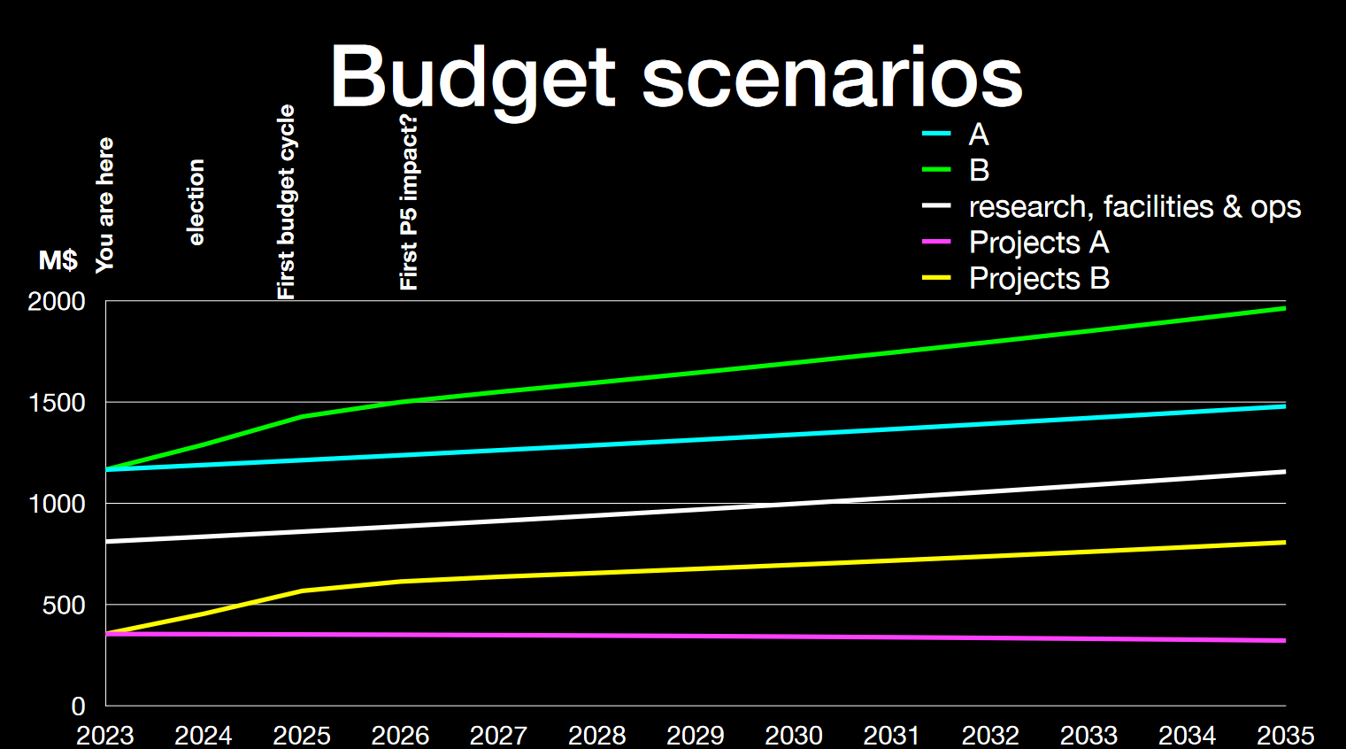
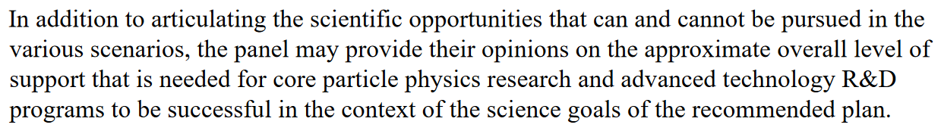
P5 Charge: Budget Scenarios for FY 2024 – 2033 Making the Hard Choices
B. Baseline: Budget levels for HEP in FY 2024 - 2027 as specified in the
Chips and Science Act, followed by increases of 3.0 percent from FY 2028 - 2033
A. Less Favorable: Increases of 2.0 percent per year in fiscal 2024-33 starting
with the FY2024 level for HEP in the President’s Budget Request
A springboard to our strategy going forward;
Additional factors: Research priority; Fair wages
Notes:
15

Slide 16

US LUA Government Relations
Kiley Kennedy
  Purpose and Motivation
    Forge a stronger connection between the
    US LHC scientific community and policymakers
    Advocate for the interests and priorities of the US
    HEP community, such as those in the latest P5 Plan
    Make information on science policy issues and the
    federal funding process more easily accessible
  Successful Activities in 2023-4
    DC Trip in March: first in-person HEP advocacy trip since 2019
    Inreach campaign to expand awareness of advocacy activities
      Held several dedicated talks and workshops: five total,
      including at both the US CMS & US ATLAS Annual Meetings
      Added Government Relations page to the USLUA website:
      uslua.org/government-relations
  Goals and Challenges in 2024
    Increase DC Trip participation: Well on the way:
    to a team of 65-70 members (20+ USLUA)
    Adapt and refine advocacy trip to the new P5 Report Materials, messaging, strategy
  More information on Government Relations and the DC Trip from Kiley
Notes:
16

Slide 17
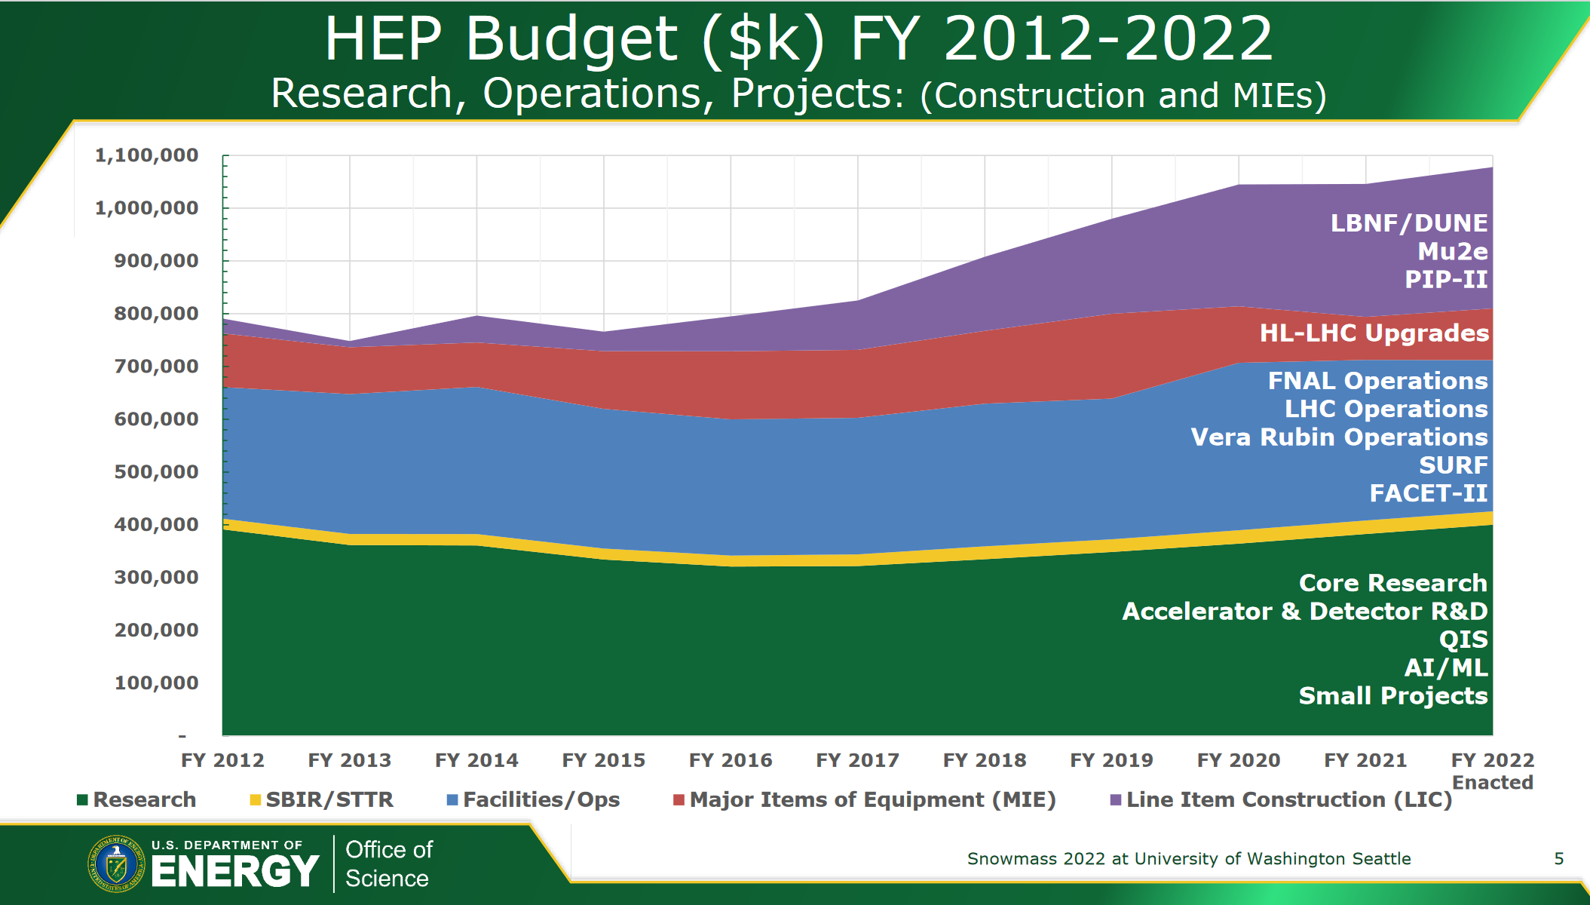
Continued Pressure on Core Research
FY22: Aided by the Inflation Reduction Act
Notes:
17

Slide 18
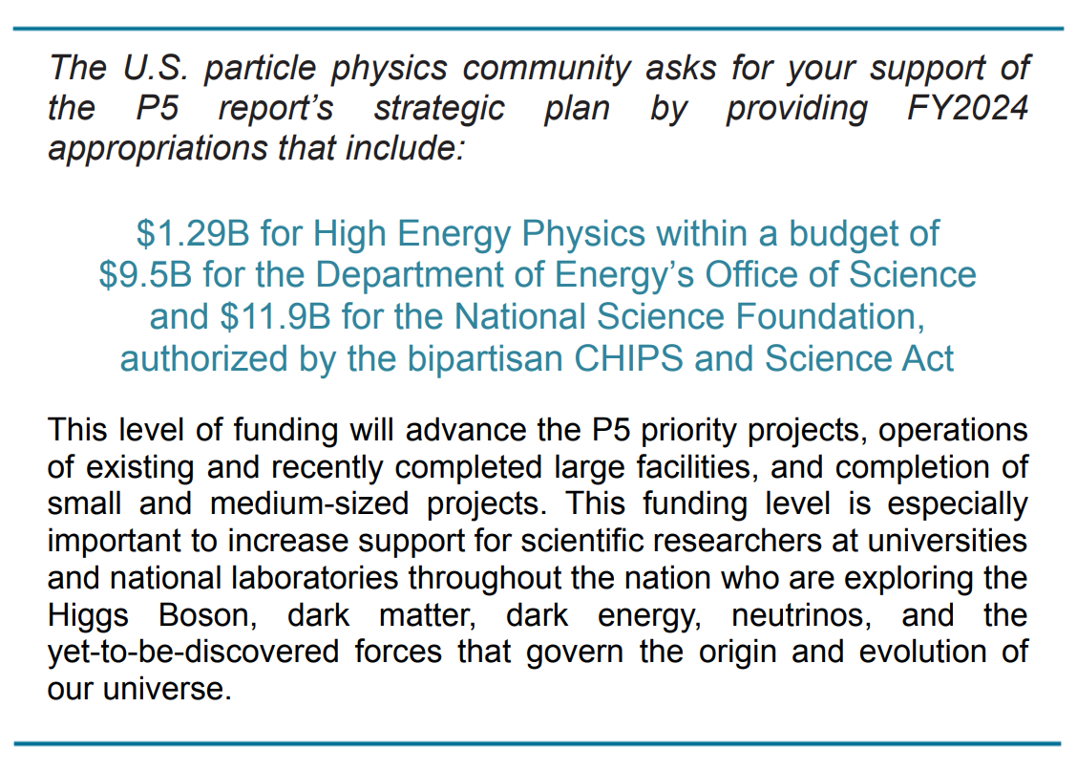
DC Trip FY2024 Ask from HEP
Priority for Core Research; LHC; LBNF/DUNE
Advocating for the Funding Needed for HEP
to Realize Its Goals and Vision, within Feasible Bounds
Notes:
18

Slide 19
DC Trip FY2025 Ask Numbers for HEP, Office of Science, NSF
Office of Science Ask for FY 2025: $9.5 billion
This has already been approved by consensus from the science community
The likely outcome for Office of Science in FY 2024 is $8.4 billion.
This means a 13% increase for Office of Science in FY 2025.
NSF top line $ 11.9B
FY 2024 likely to be $ 9.6B (Senate Mark); hence +24% for FY 2025
HEP Ask: $ 1.385 billion
This is in line with the CHIPS and Science Act, and
other community asks across the Office of Science
Final FY 2024 for HEP is likely to be $1.226 billion (Senate mark).
This means about a $159 million increase for FY 2025.
Of this amount, $50 million is for LBNF/DUNE to stay
with the current project profile.
The remaining $109 million could be for other projects:
CMB-S4 up to $25 million depending on status
Any additional funding needed for HL-LHC projects
and smaller dark matter projects.
A significant chunk would be to grow research
And a smaller chunk to maintain operations of
the accelerator complex and existing experiments.
Notes:
19

Slide 20
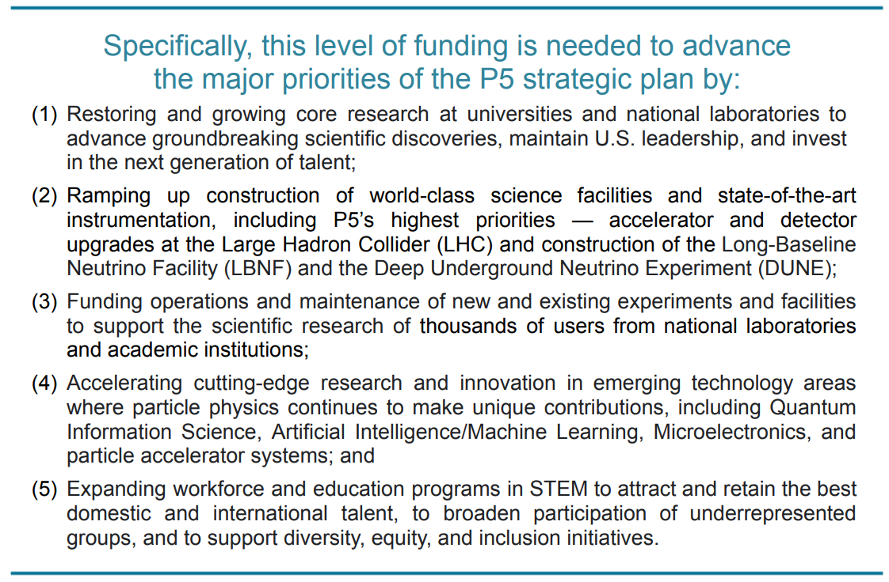
DC Trip FY2024 Ask from HEP
Priority for Core Research; LHC; LBNF/DUNE
Finalizing Justification Text for FY 2025
Should be done by ~next week
Notes:
20

Slide 21
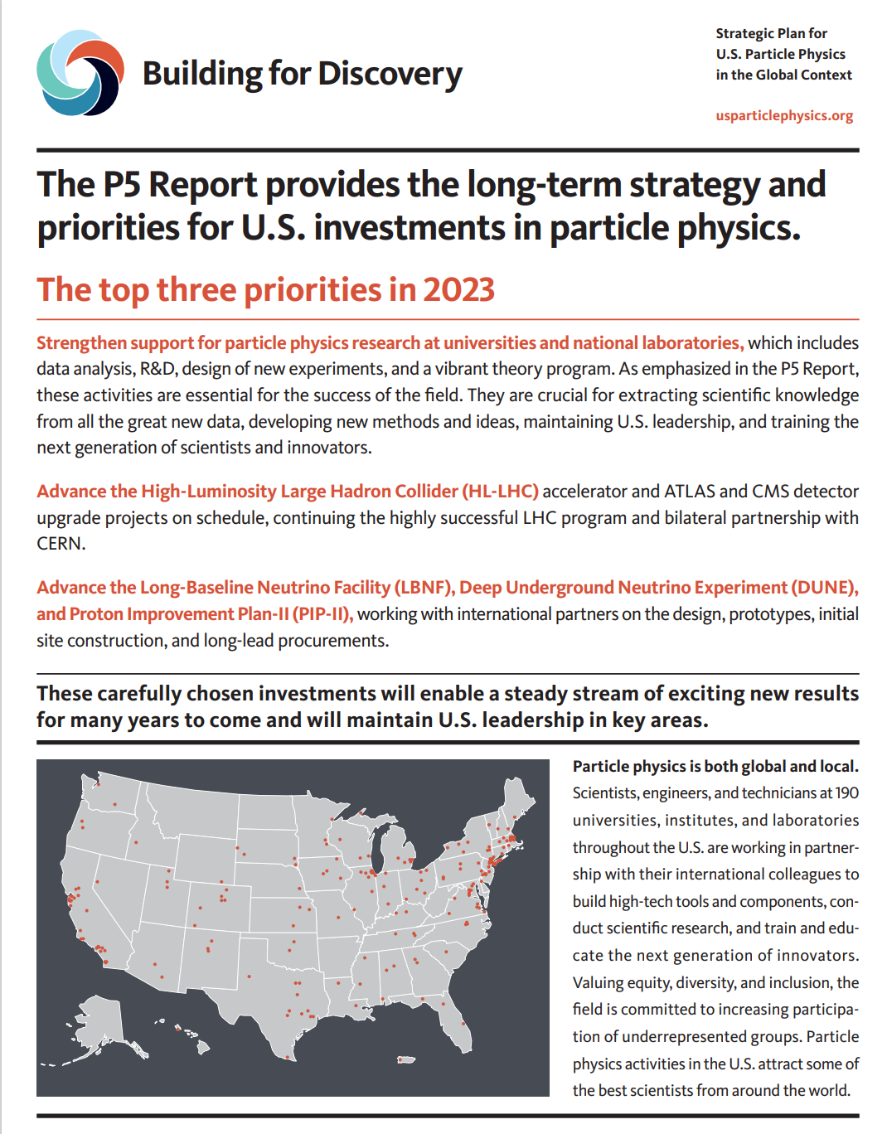
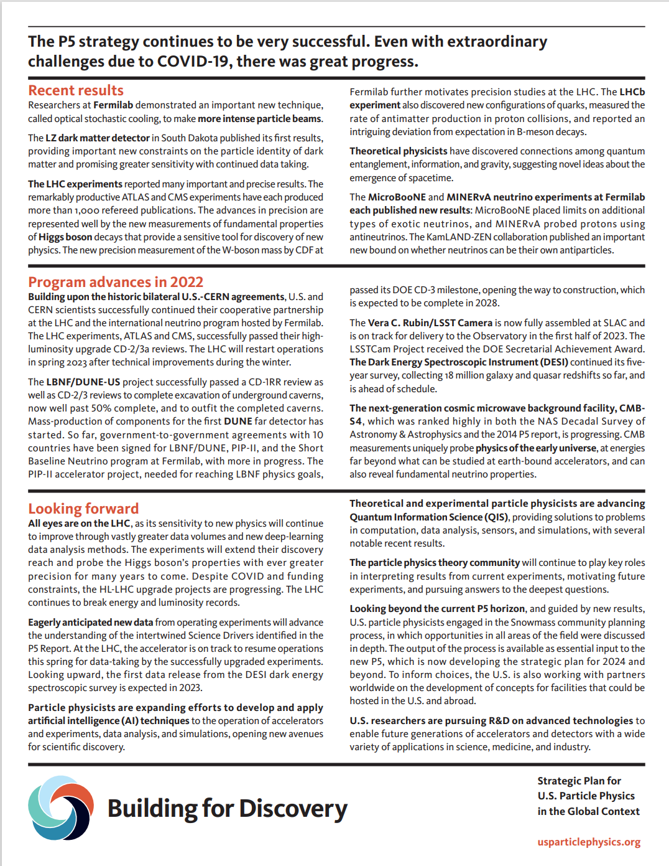
The P5 Two Pager 2023: Strategy and Priorities for US Investments

Slide 22
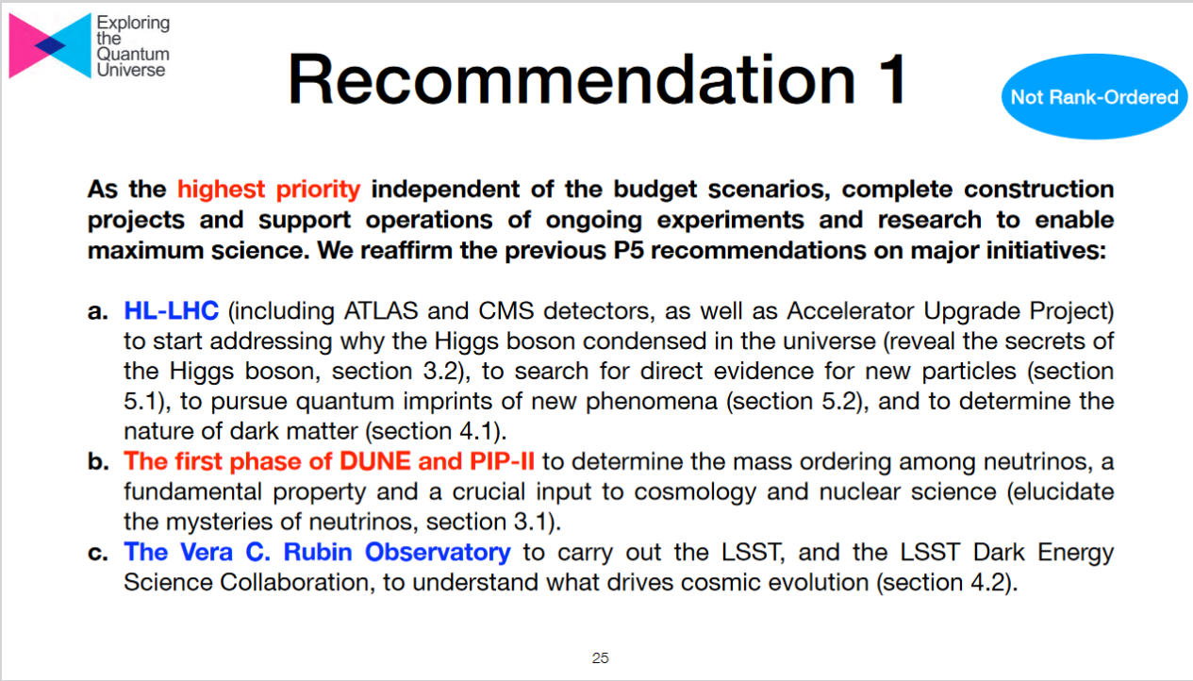
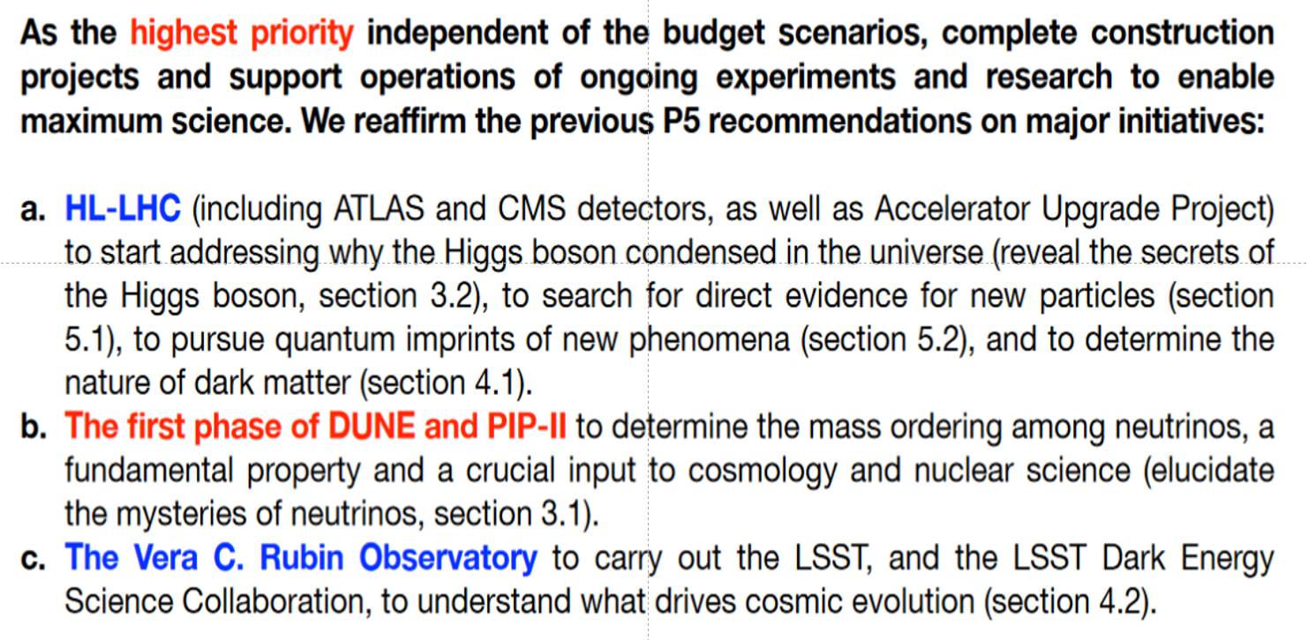
Notes:
22

Slide 23
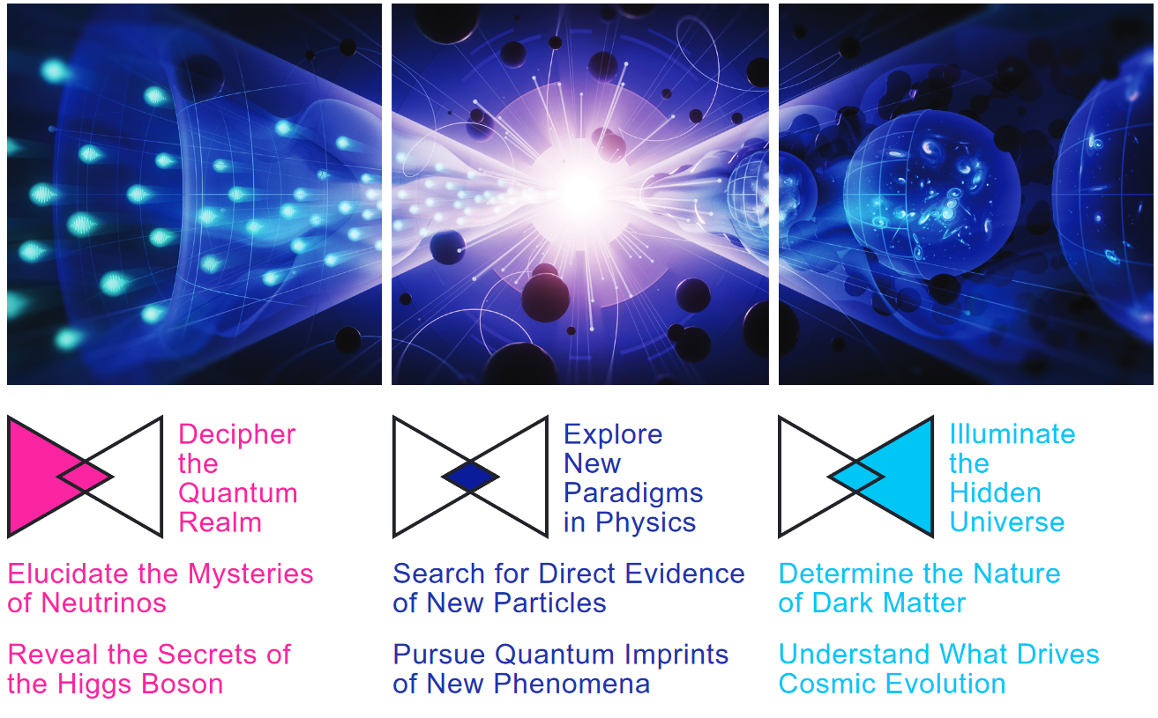
Exploring the Quantum Universe
Pathways to Innovation and Discovery in Particle Physics
  Six Science Drivers: a Profound New Perspective
    Elucidate the Mysteries of Neutrinos
    Reveal the Nature (Secrets) of the Higgs Boson
    Search for Direct Evidence of New Particles
    Pursue the Quantum Imprints of New Phenomena
    Determine the Nature of Dark Matter
    Understand What Drives Cosmic Evolution
Notes:
23

Slide 24
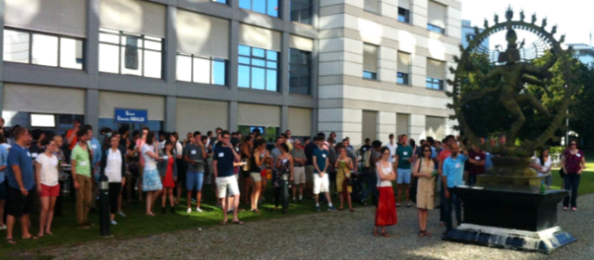
US LUA Activities (2): Helping the US Community Adapt to Work at CERN and Life in the Region
  Quality of Life Committee:
  We provide Information on everyday important
  issues: starting work at the lab, hostels; taxes,
  time management, careers, health insurance,
  visas, etc.
    See Darin Acosta’s New Student Orientation Guide: https://github.com/acostad/acostad.github.io/blob/main/NewStudentOrientationAtCERN.pdf
        We have had successful, lively get-togethers of students
        and young postdocs at CERN. 200+ at these parties.
        Speakers: Spokespeople, DG, Ombuds, key staff
        Thanks to Steve Goldfarb and Claire Lee
        for our 2022 and 2023 parties
        Also monthly coffees at R1
        We plan more in 2024
        – Volunteer to help !
Notes:
24

Slide 25
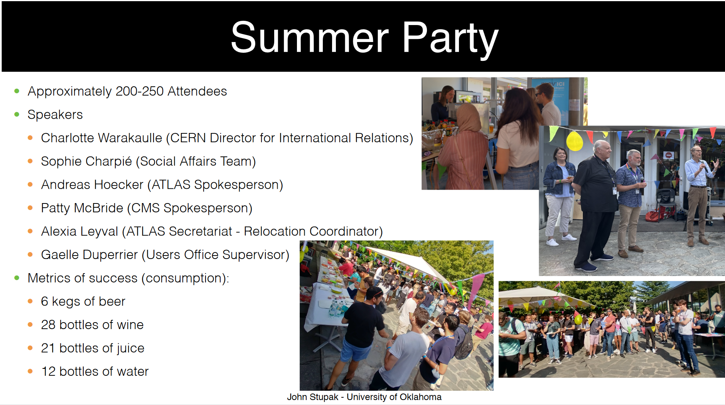
Notes:
25

Slide 26
US LUA Activities (2): Helping the US Community Adapt to Work at CERN and Life in the Region
    We help community members when and where needed to solve problems, and/or refer them to appropriate people to get help while respecting their privacy.
    Recent issues:
      Visa C requirements for > 8 day stays; even just for shifts
      Geneva hospitals not recognizing some US medical insurances
      Allianz policy terms
      We have helped some graduate students first hand who were having problems, and have worked with ACCU to improve the handling of such cases at CERN
    We met with the US Mission in Geneva. They are eager to help the US community at CERN across many fronts: policy issues, int’l relations, emergency personal help
    A Young Volunteers' Group founded by Usha Malik met periodically with newcomers + other young people to answer their questions.
    We aim to revitalize it in 2024.
Notes:
26

Slide 27
US LUA Activities (3)
  In 2015 we Launched Our Website www.uslua.org:
    Thanks to Tulika Bose, Gordon Watts; Jane Nachtman, Darin Acosta; David Miller, Toyoko Orimoto; Jannicke Pearkes, Daniel Takaki
    Links to Useful Information: New Student Orientation Guide,
    Newcomers Guides, US ATLAS and US CMS Wikis
  Outreach about the LHC Program
    At National Events (more follows); During VIP Visits to CERN
    Working actively with the US LHC Ops Program,
    US LHC Communications (Sarah Charley)
  Media Training: how to talk to Congress, the public, media
  Thanks to Sarah Charley: Sessions are available on request;
  typically at CERN in Fall and Winter;
  These are useful for the Annual DC Trip, and on other occasions
  Plan: Partial support for young people going to conferences,
  including in other fields – on a pilot basis in 2024
Notes:
27

Slide 28
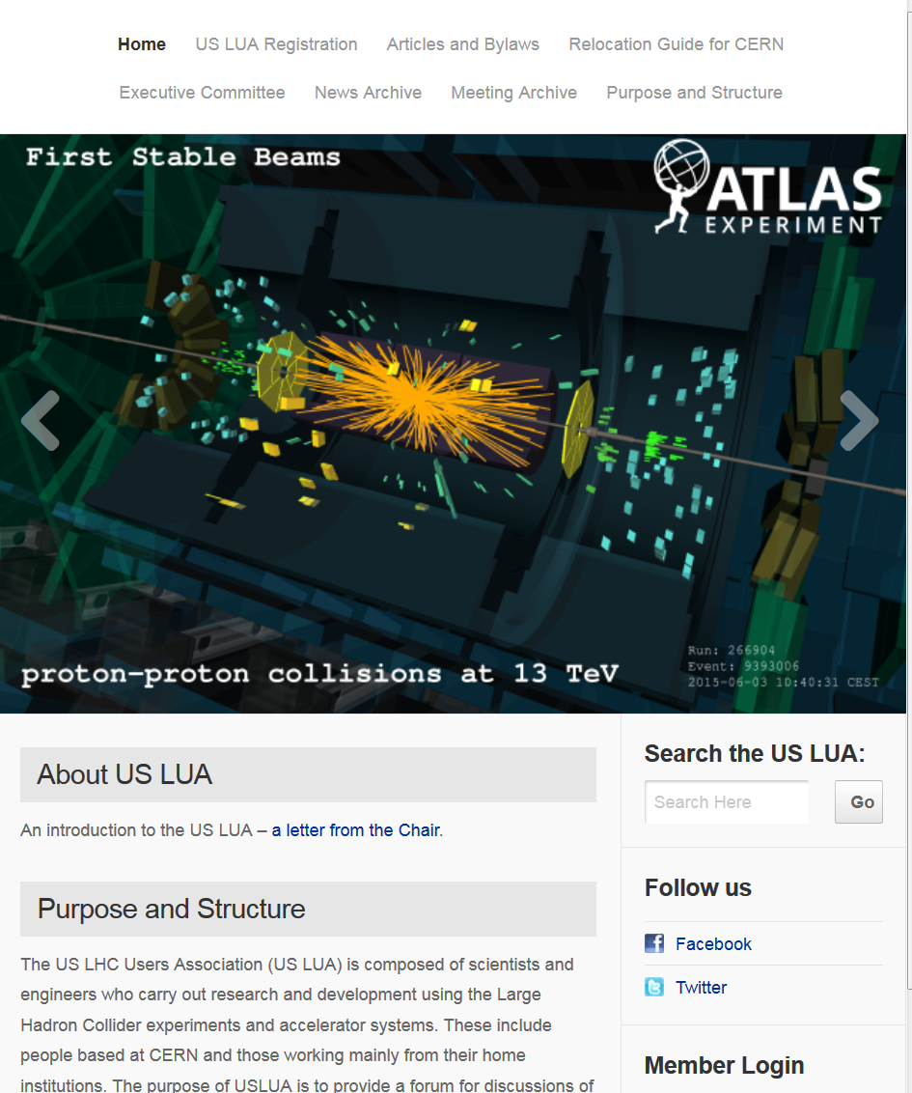
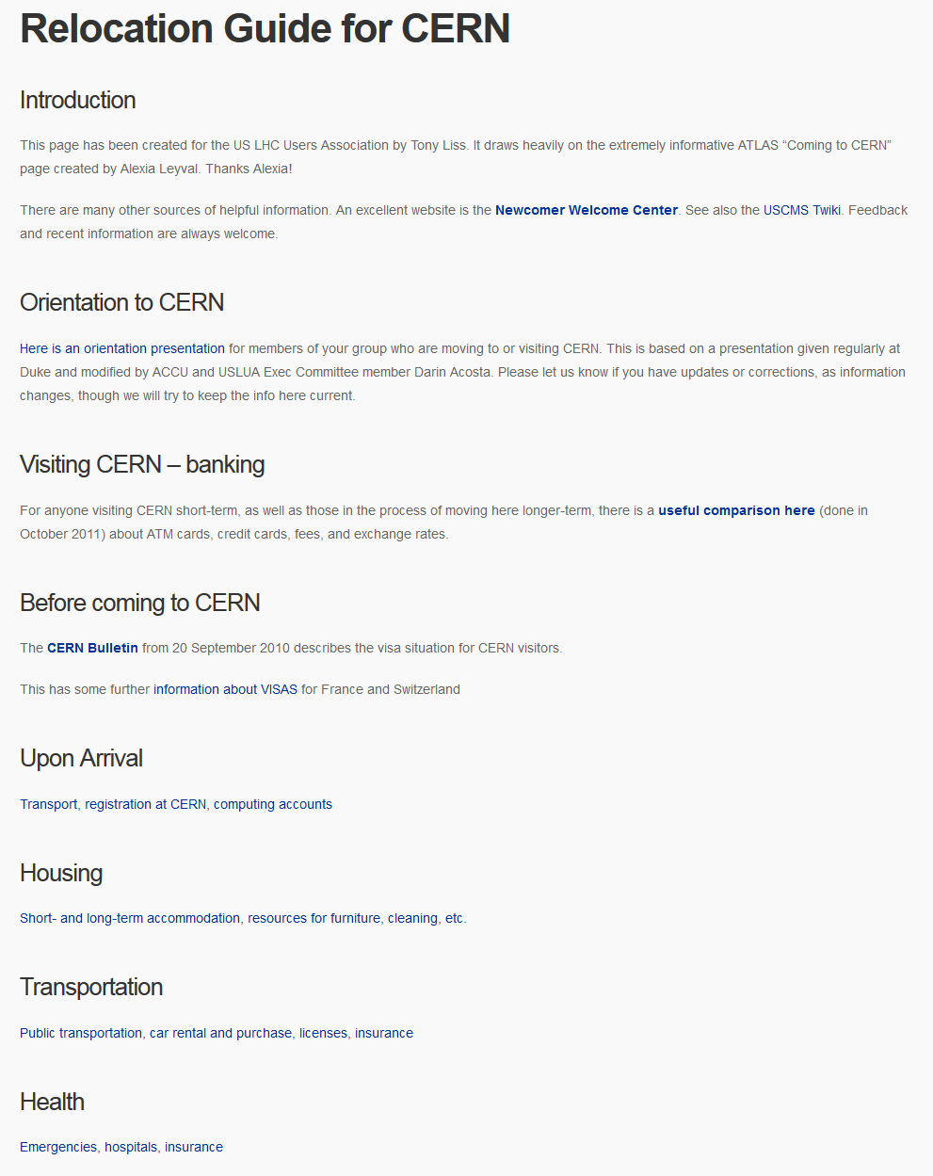
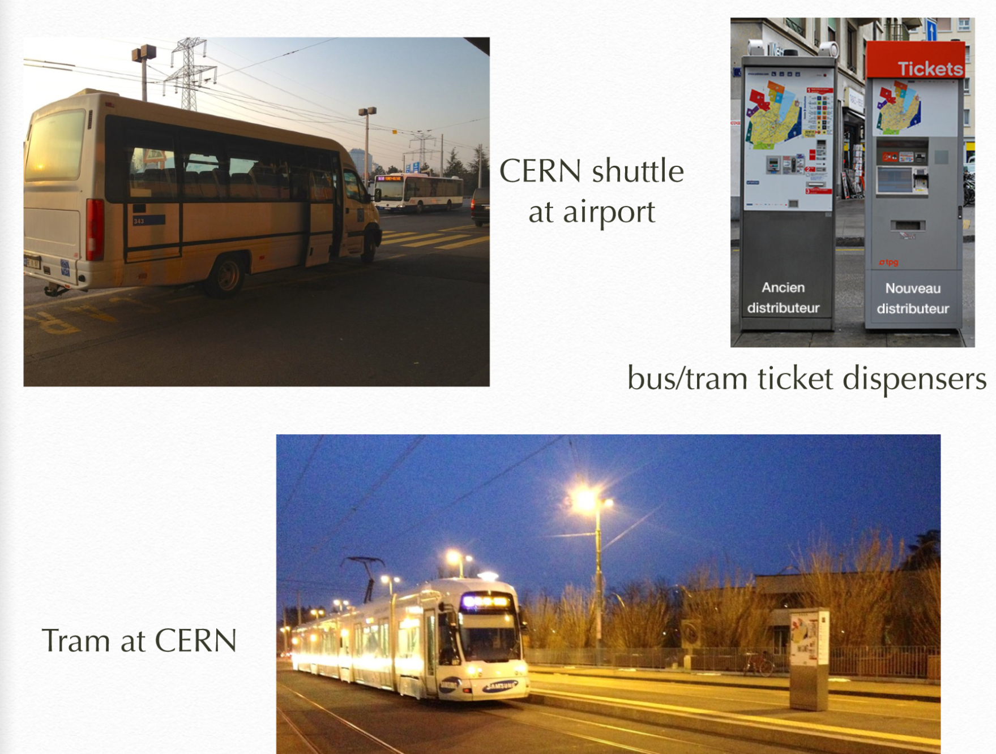
Visit www.uslua.org
Darin Acosta
    Clear and comprehensive, with photos
https://github.com/acostad/acostad.github.io/blob/main/NewStudentOrientationAtCERN.pdf
Notes:
28

Slide 29

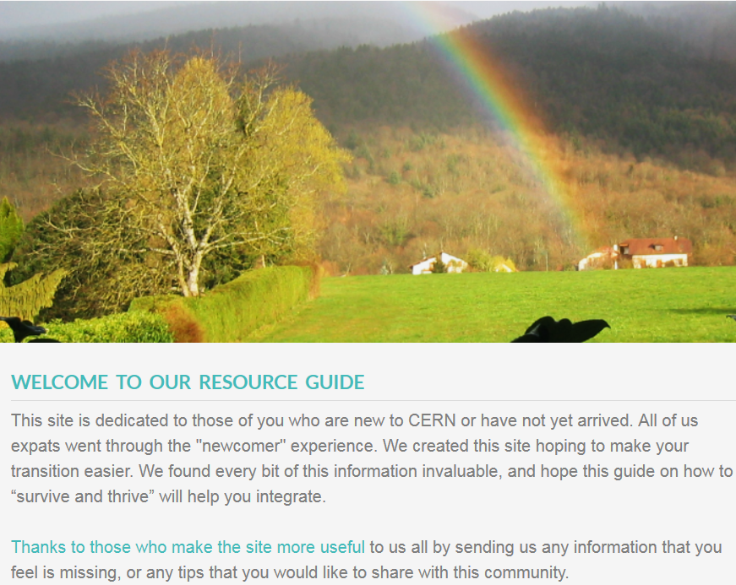

Newcomers Guides
Newcomers Guide
How to Survive
and Thrive
At CERN
In Switzerland
In France
Visas, permits
Health (Insurance,
Emergency Contacts)
Getting a Bank Acct.
Exchange Rates
Finances & Jobs
Taxes
Childcare
Finding Housing
Internet, Telephone
Schools
Buying a Car
Shopping
Transport, Mobility
Learning French
Culture, Dining
Current Events
For Kids
The Whole Experience
http://newcomerwelcomecenter.weebly.com/
Other Valuable Resources
from the US CMS and US ATLAS Program Offices
https://twiki.cern.ch/twiki/bin/view/Main/USCMSProjectOfficeCERN
http://www.usatlas.bnl.gov/twiki/bin/view/Support/CERNVisitorInfo
Notes:
29
29

Slide 30
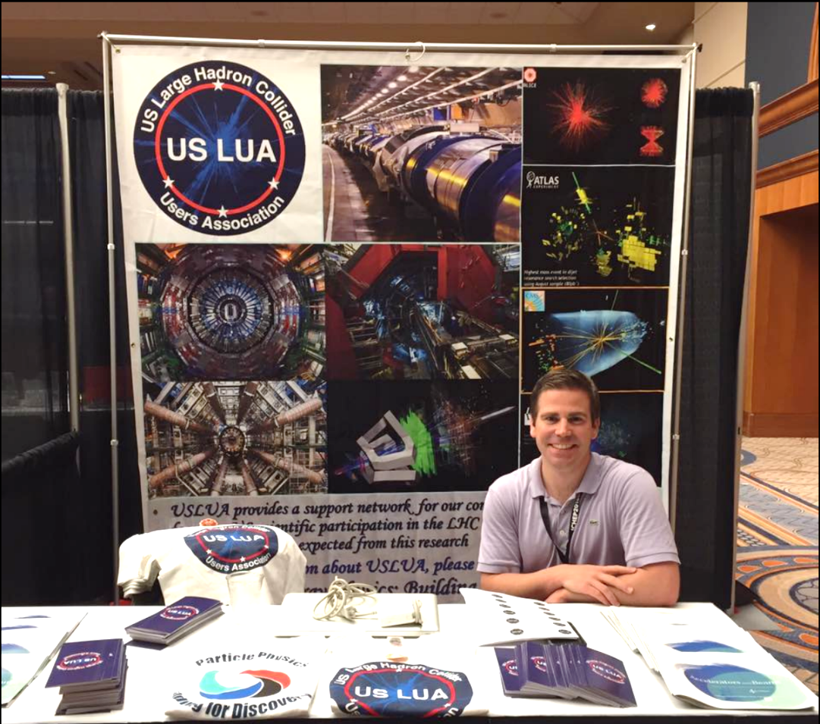
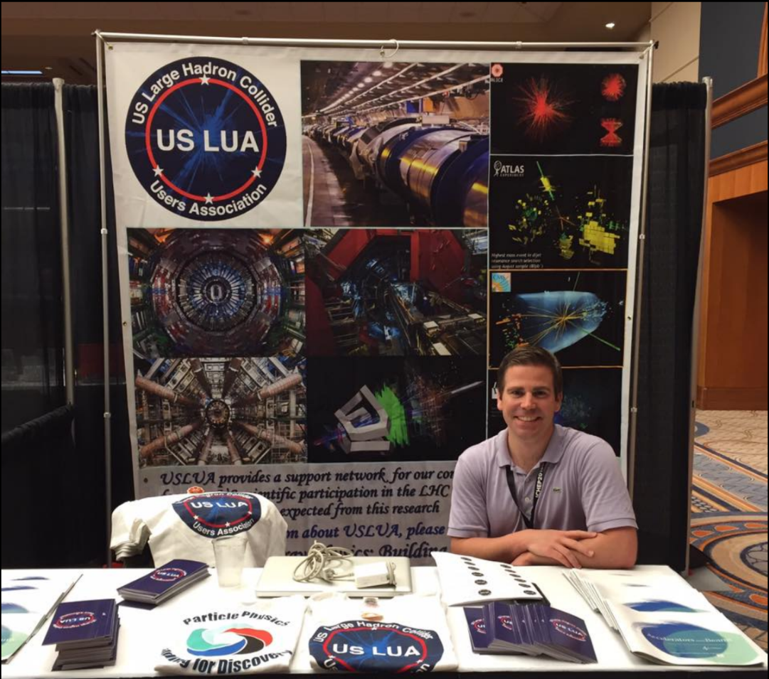

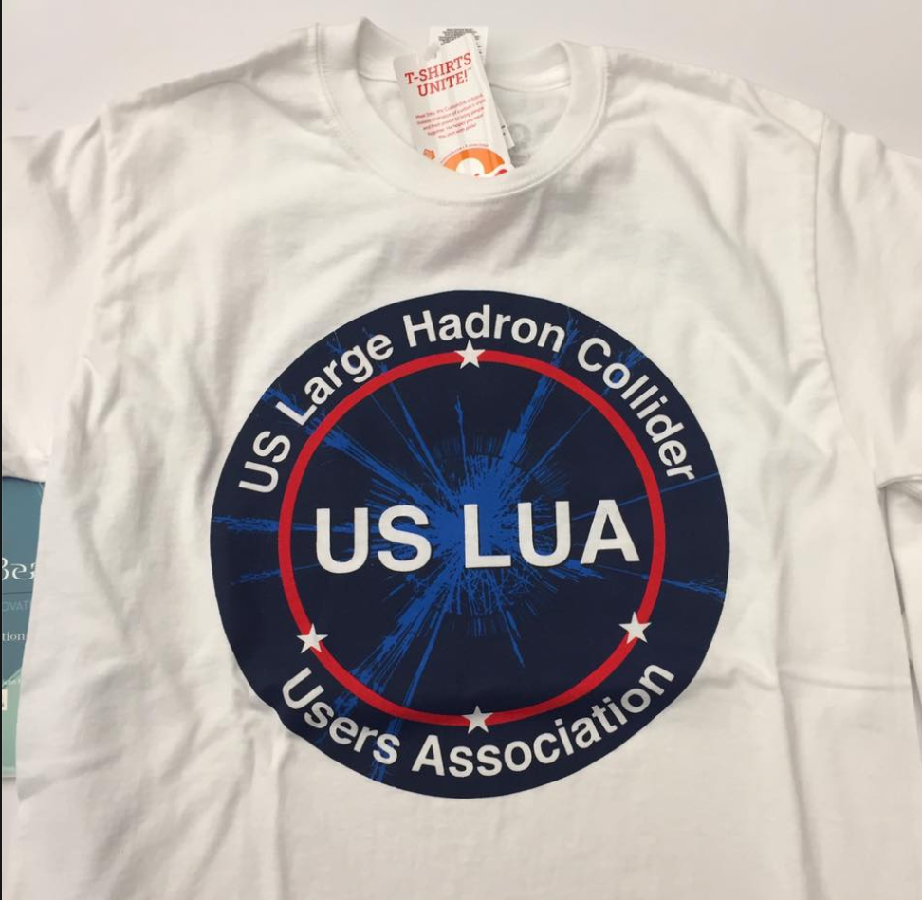
US LUA Activities (4):
National Events, Virtual Visits, Outreach
  Our US LUA Booth at ICHEP 2016
    Visited by hundreds of attendees
    Tee Shirts (Raffle), Brochures,
    Postcards and Buttons
    Thanks to David Miller, Toyoko Orimoto,
    Verena Martinez, Corrinne Mills
  Virtual Visits:
  ATLAS: Steve Goldfarb, Julia Gonski
  and “youtube atlas virtual visit”
  Virtual Visits (atlas.cern)
  CMS: “youtube cms virtual visit”
  Outreach: Consider the extensive
  ATLAS resources page as a model: https://atlas.cern/Resources
  Consider a booth in 2024 or 2025 at a major conference in the US !
    For example: APS April Meeting
Notes:
30

Slide 31
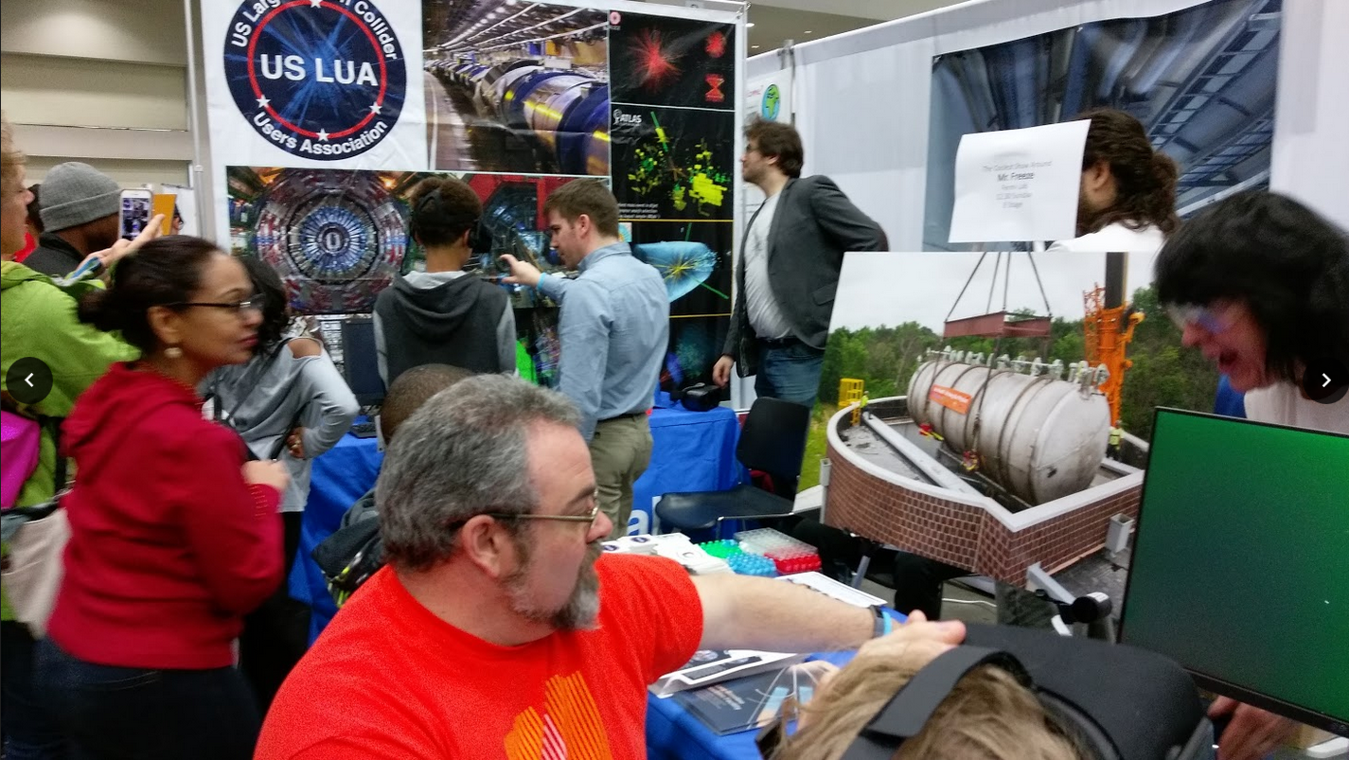
USA Science and Engineering Festival
April 2018
+ Mr. Freeze

Slide 32
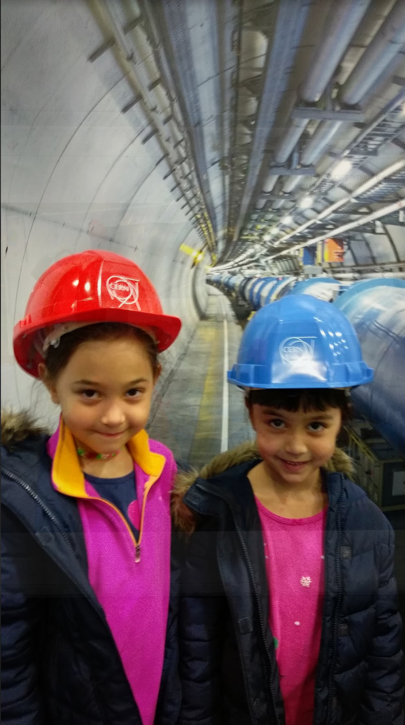
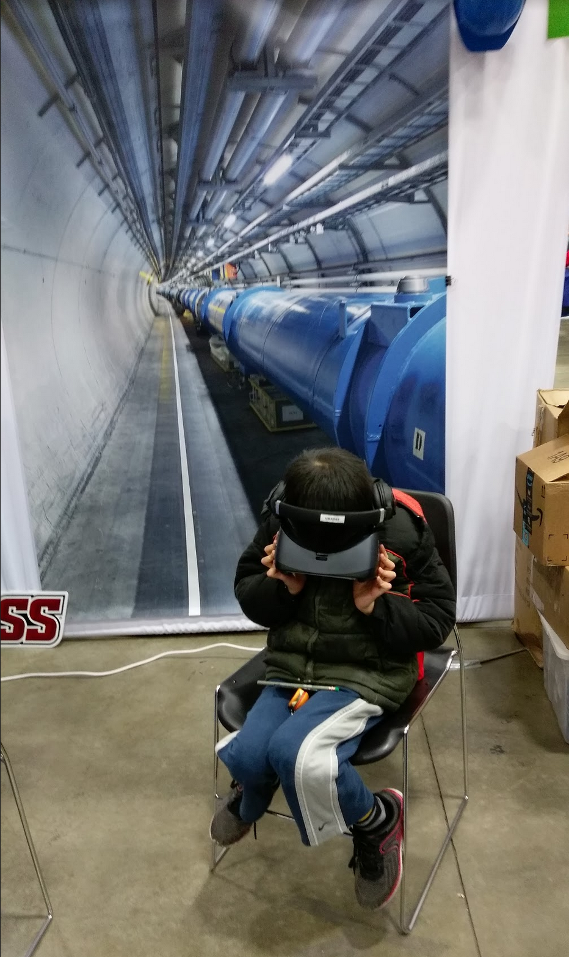
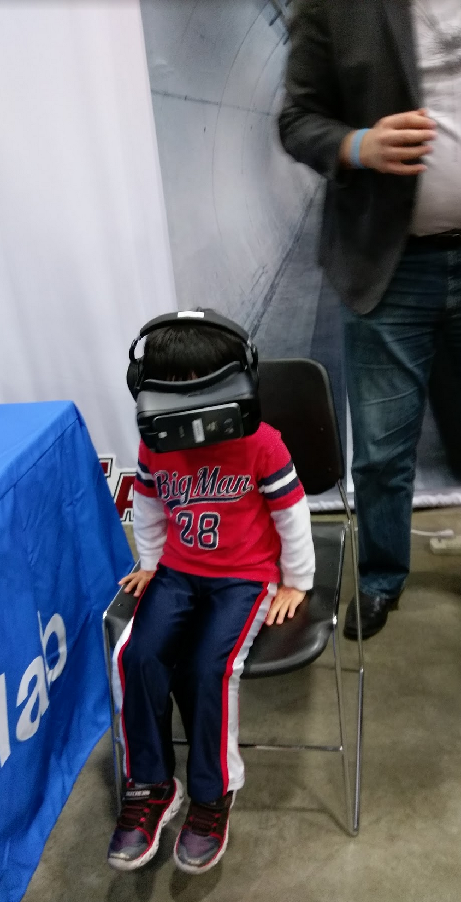
USA Science and Engineering Festival
April 2018

Slide 33
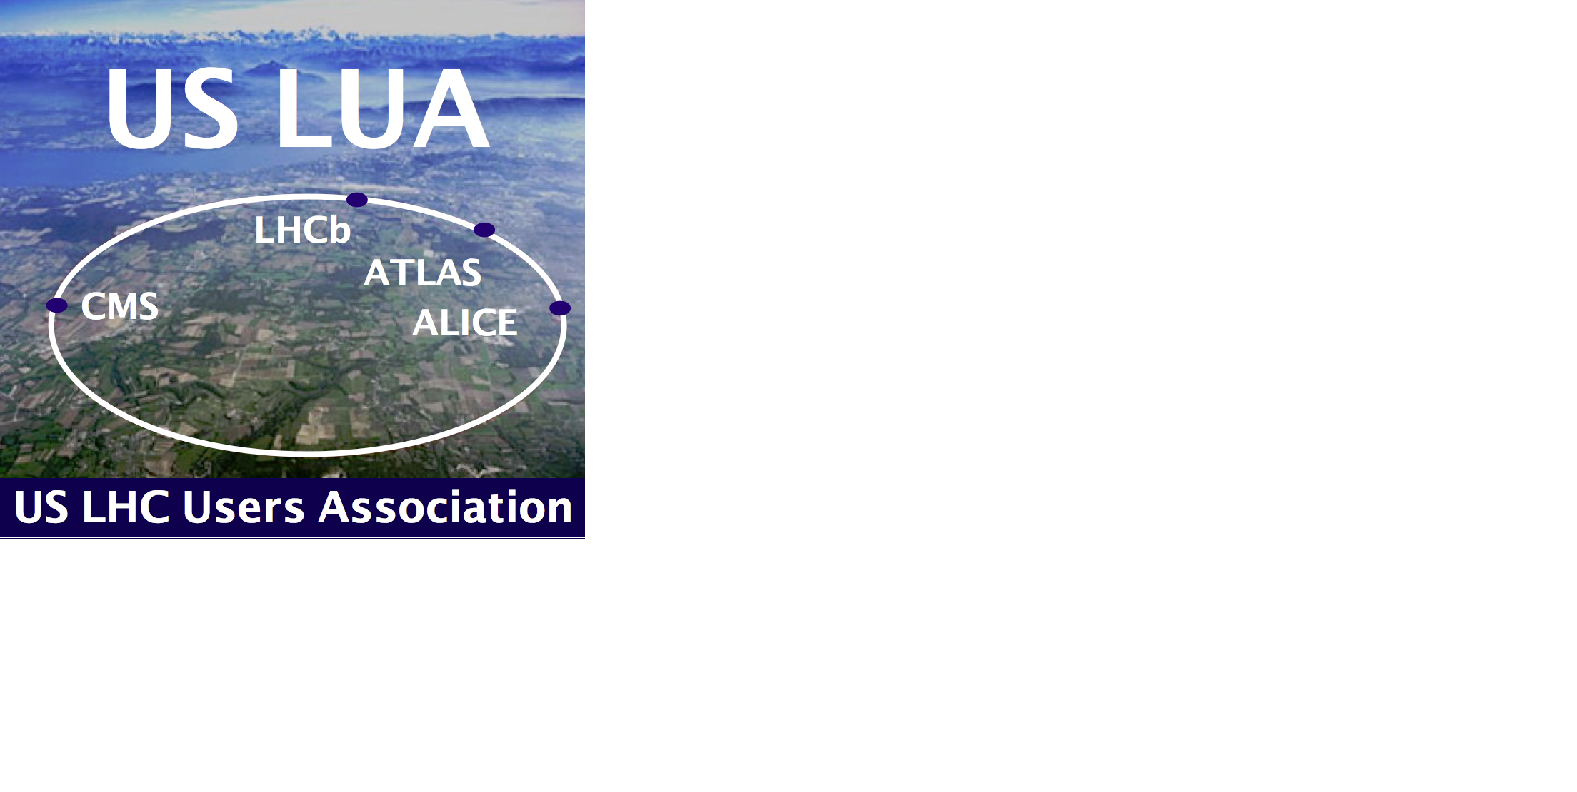

We have come a long way;
we have a long way to go.
We will need your support.
If your group members or colleagues involved in the LHC Program are not already US LUA Members, ask them to please sign up at
www.uslua.org
Many thanks to Fermilab, SLAC, LBNL, BNL, URA/FRA
and our Members for your generous support
Notes:
33

Slide 34
Backup Slides Follow
Notes:
34

Slide 35
US LUA Finance and Fund Raising
  Committee Members: John Stupak (Chair), David Saltzberg (Co-Chair),
  Kiley Kennedy, HN, Indara Suarez, Anyes Taffard, Caterina Vernieri
  USLUA is a 501(c)3 tax-exempt non-profit the needs funding from the community to support its mission
    Travel support for the annual HEP DC advocacy trip
    Summer parties at CERN
    Monthly get togethers at R1
    Early career support to attend conferences, networking events
    Outreach events
    Student webmaster
  This year we raised over $ 55k (through December 2023) through 3 efforts:
    Lab Funding drive ($ 33k): thanks to Fermilab, SLAC, LBL, BNL
    URA Visiting Scholars Program: funding EC members to attend
    our meeting
    Community funding drive ($ 2.3k)
      These funds are unrestricted and extremely valuable to US LUA
    Update from John Stupak
Notes:
35

Slide 36
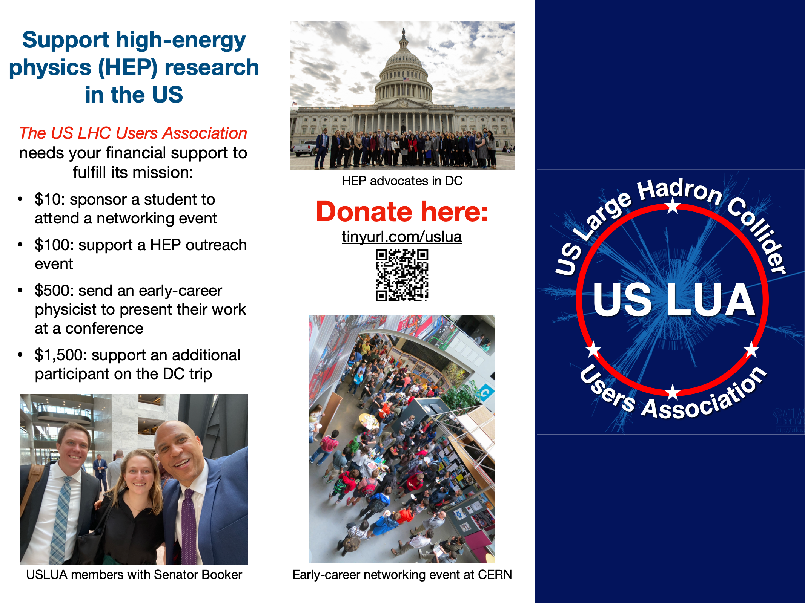
Finance and Fund Raising
Support USLUA
Our request for community support is available here
To help ensure the continued success of US participation in the LHC program, please consider donating: tinyurl.com/uslua
Notes:
36

Slide 37
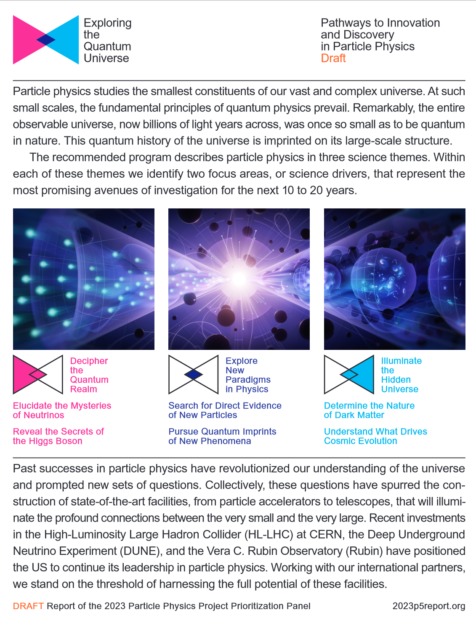
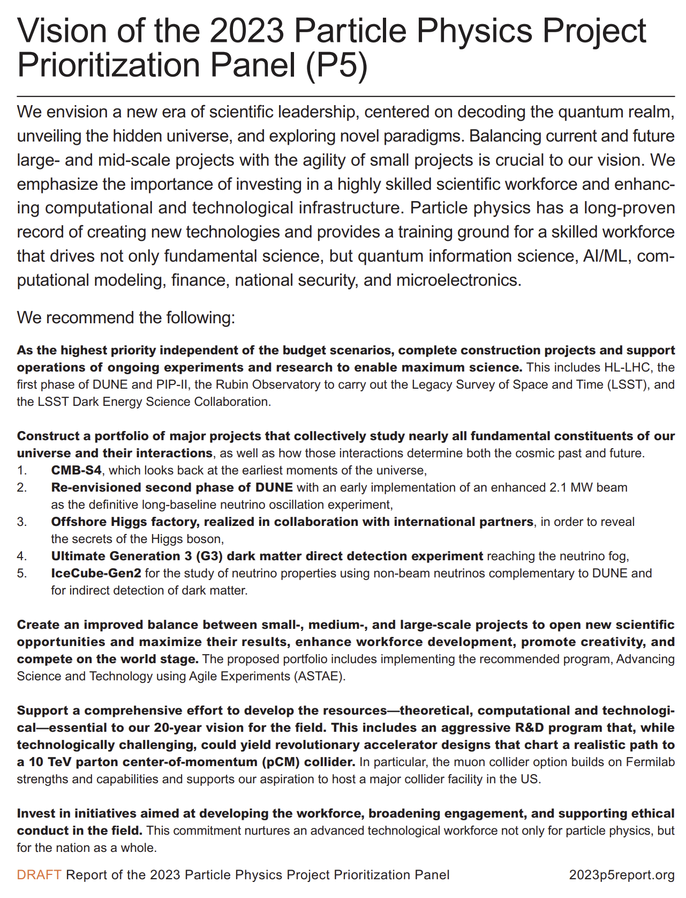
Notes:
37

Slide 38

Notes:
38

Slide 39
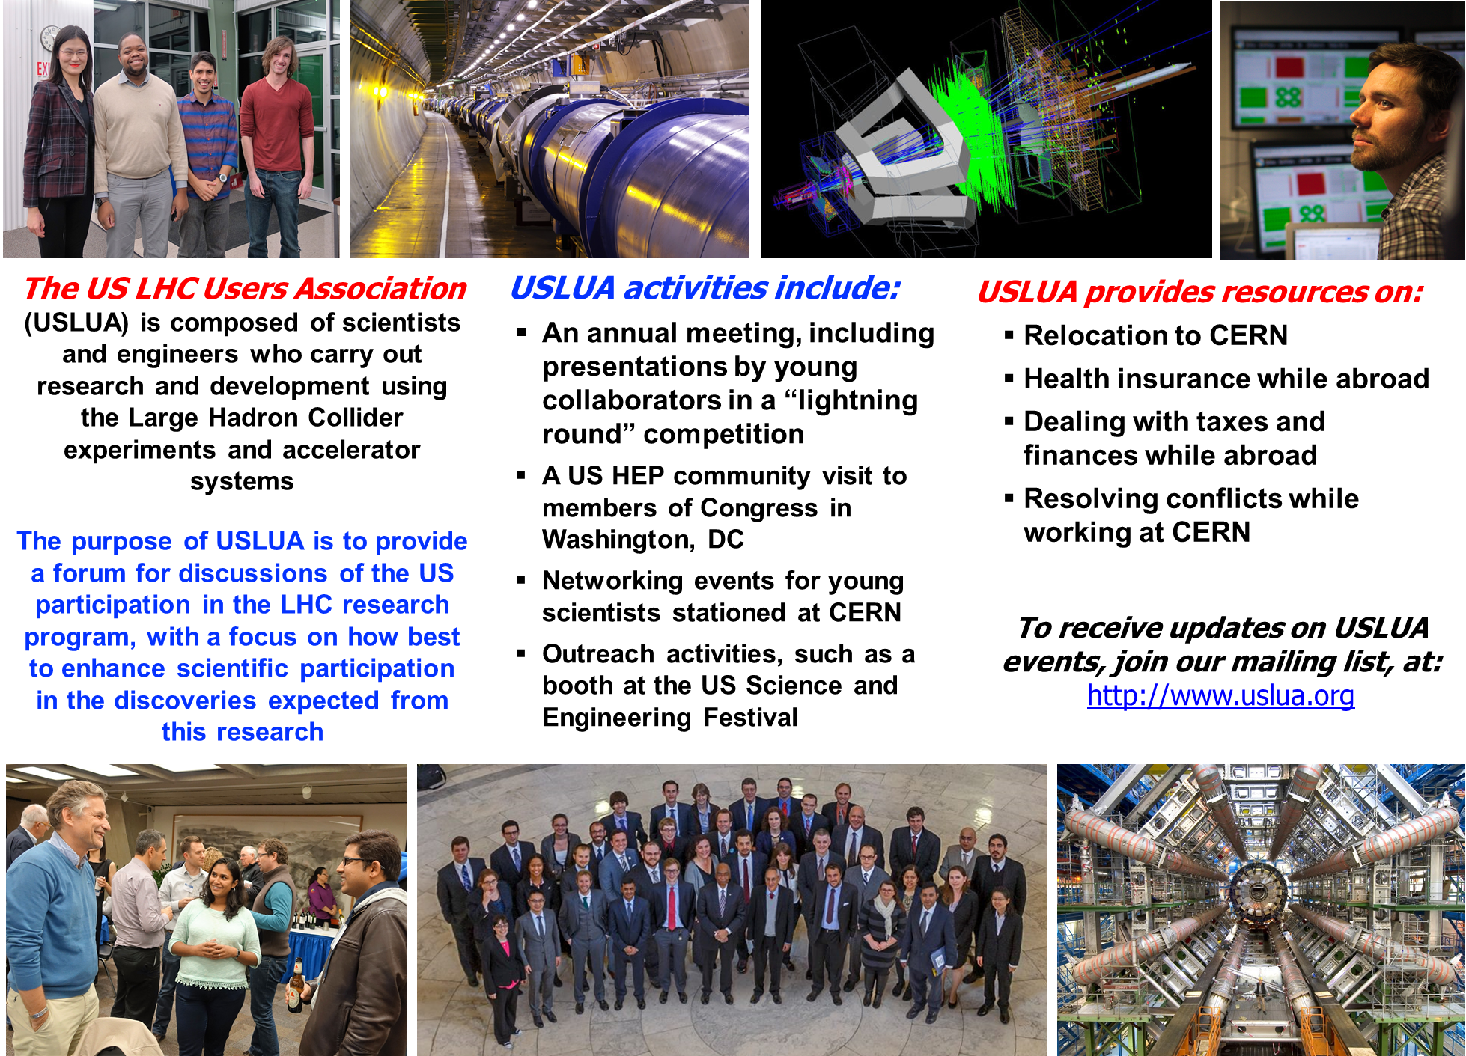
Notes:
39

Slide 40
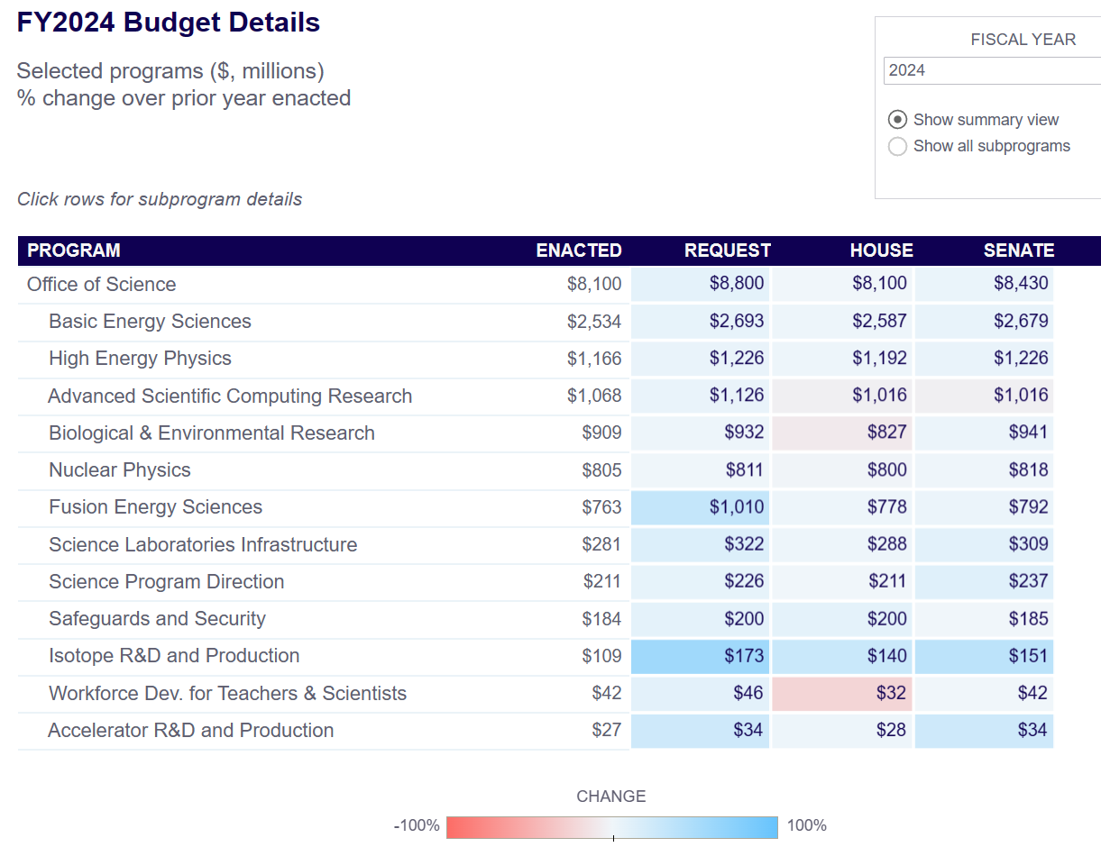
DOE Office of Science FY24 Budget Summary
NB: Bottom Up Needs Estimate for US HEP was ~$ 1.25B in FY21
Notes:
40

Slide 41
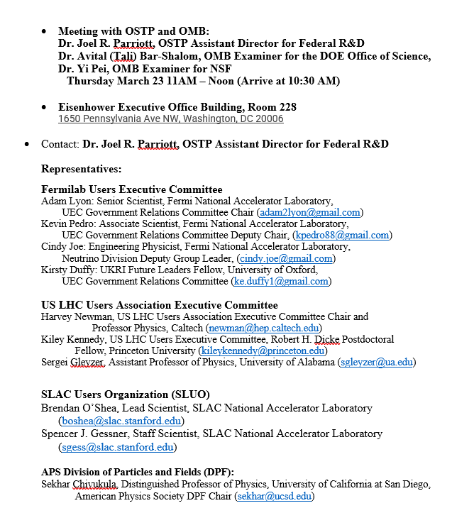
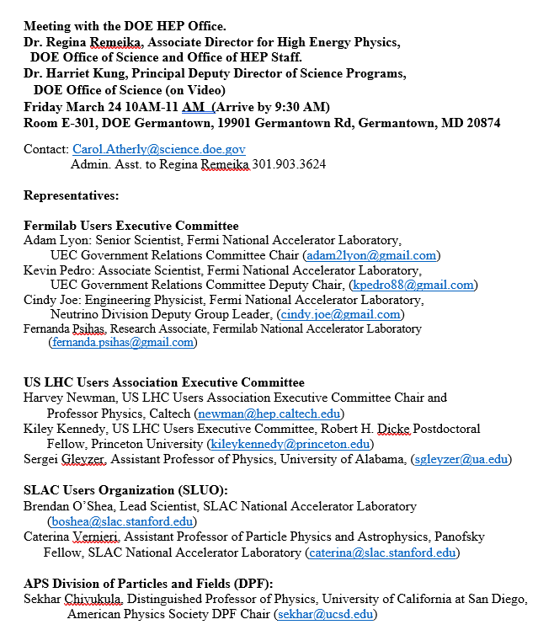
Executive Meetings: DOE SC HQ, OMB + OSTP, DOE OHEP
Notes:
41

Slide 42

P5 Priorities (I)
Notes:
42

Slide 43

P5 Priorities (II)
Notes:
43

Slide 44

Notes:
44

Slide 45


The P5 Two Pager 2023: Strategy and Priorities for US Investments

Slide 46

✴
✴
Notes:
46

Slide 47

Gina Ramieka at HEPAP December 7: Energy Frontier Program – the LHC and Higgs Science Driver
Notes:
47

Slide 48


HEPAP: Report of the Committee of Visitors
Consistency with P5 https://science.osti.gov/-/media/hep/hepap/pdf/202012/HEP_COV_202012-HEPAP_meeting_Patterson.pdf
Notes:
48

