Slide 1

CIRCUS: an autonomous control system for complex experiments
Marco Volponi, Jakub Zielinski (the AEgIS Collaboration)

Slide 2
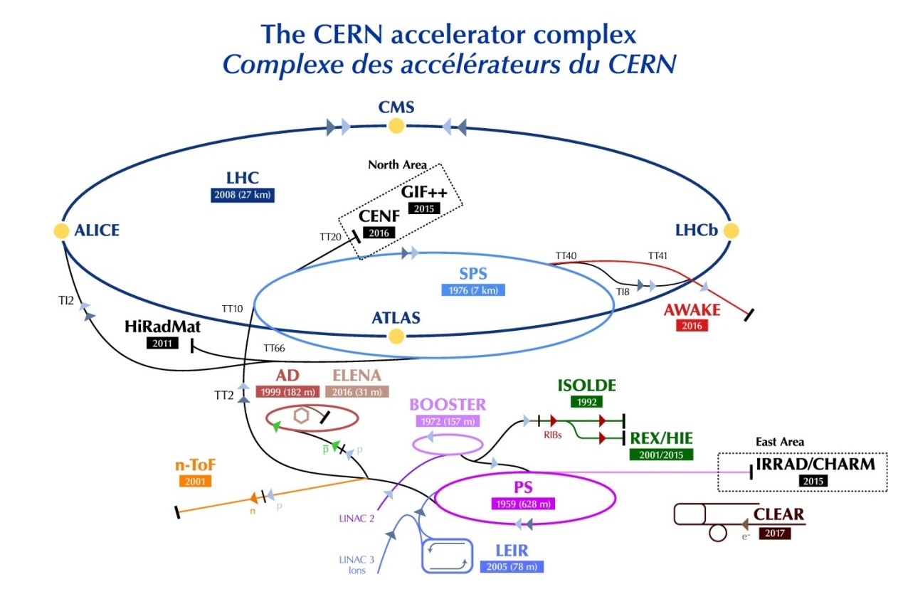
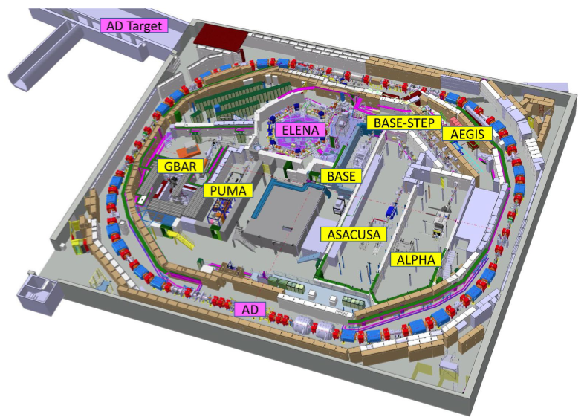

The Aegis experiment
The Antimatter Experiment: Gravity, Interferometry, Spectroscopy (AEgIS) collaboration aims at performing spectroscopic studies and direct experimental tests of the Weak Equivalence Principle (WEP) using antimatter-containing neutral systems (anti-hydrogen, positronium atom, antiprotonic ions).

Slide 3
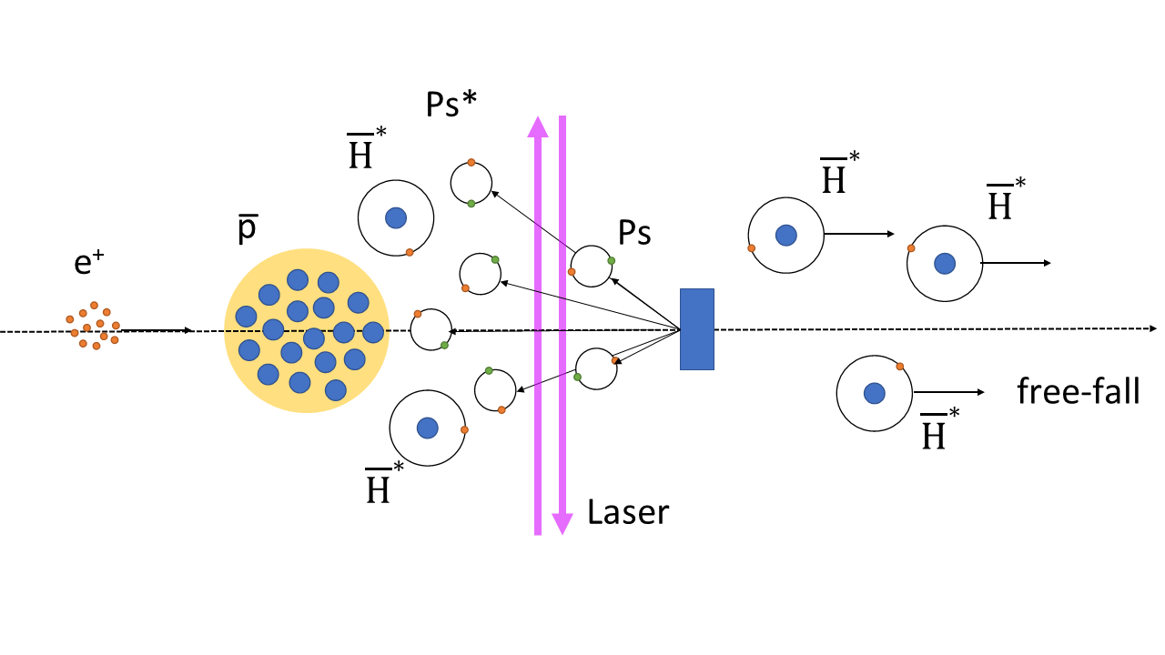
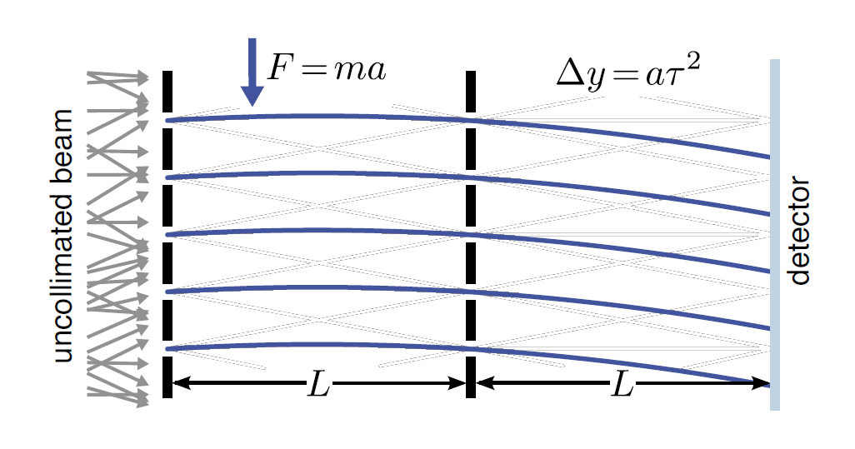
Gravity on antihydrogen
Beam of antihydrogen
via charge-exchange
Gravity detector:
measure free-fall

Slide 4
Why autonomous?
ELENA works 24/7 😱
More beamtime
Unmanned system
Less shifters workload
More time for data analyses & physics 🚀

Slide 5

The CIRCUS:
Computer Interface for Reliably Controlling, in an Unsupervised manner, Scientific experiments

Slide 6
Two Founding Pillars
Distributed System
  Unifies all the single machines in a coordinated system
  Enhance reproducibility, stability and safety
  Enable possibility of smart automation
“Everything is a MicroService”
  Defined, clear scope and tasks
  Modularity
  Asynchronicity
  Code uniformation and standardisation

Slide 7
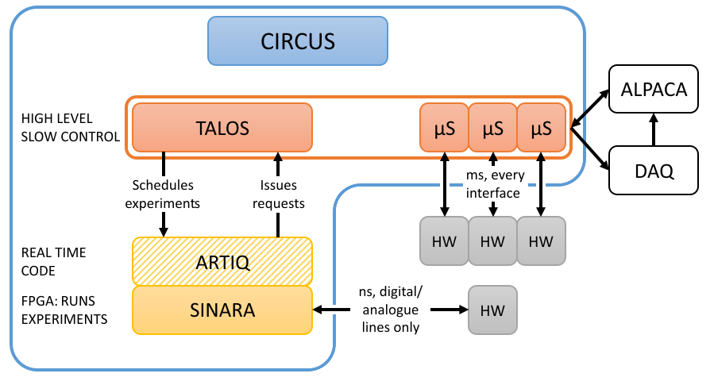
CIRCUS Structure
ANALYSIS
ENGINE

Slide 8
A Boat with two captains
TALOS does overall coordination, but it’s “slow” (~ms)
Sinara is used to control the fast operations (~ns)
High integration:
  TALOS controls Sinara, so no humans need to feed it experiments scripts
  Sinara can ask TALOS to perform operations on hardware
  In case of any error, TALOS guarantees their handling
The helm is periodically switched between the two!

Slide 9

Talos: total automation of labview operations for science
Coded in LabVIEW™, using the Actor Framework
On each PC a Guardian is executed, serving as Root Actor
Flat Hierarchy: Each µService is a Nested Actor of the Guardian
Guardians unify PCs in a single entity (TCP, watchdogs)
Power of class inheritance: all uServices are children of FOAM (Father Of All MicroServices)

Slide 10
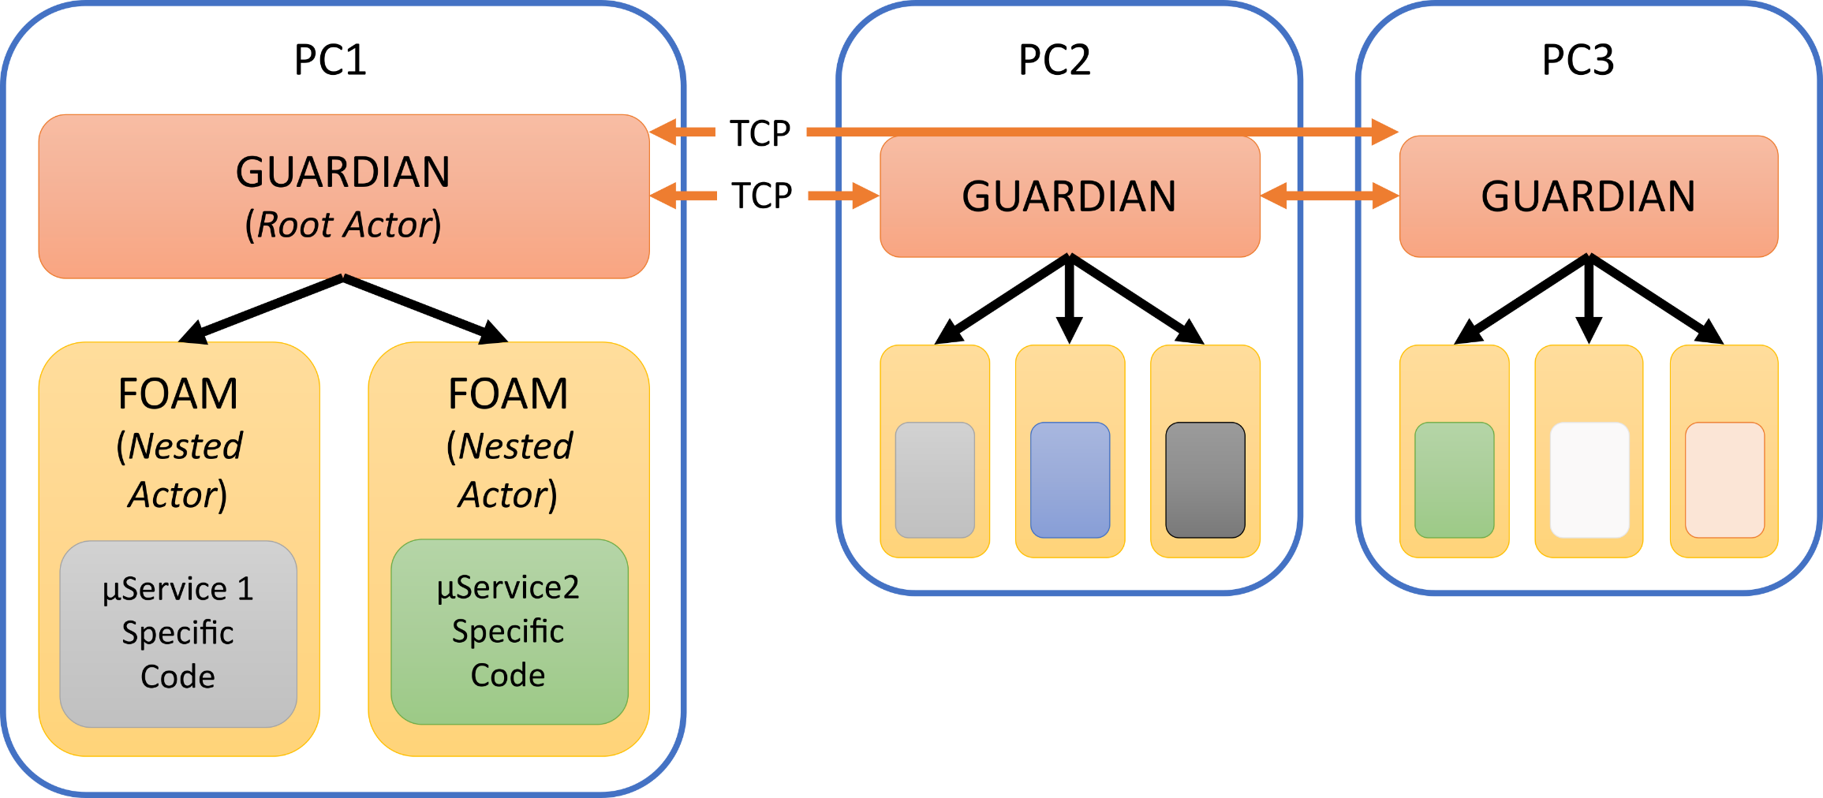
Talos structure

Slide 11
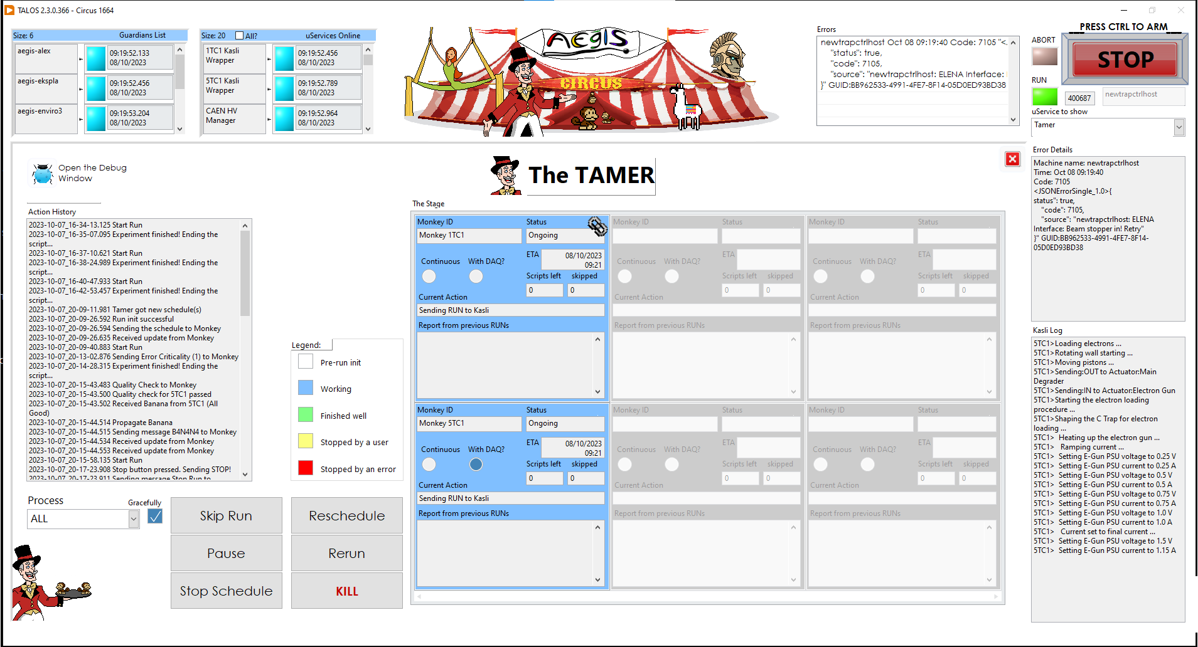

Slide 12
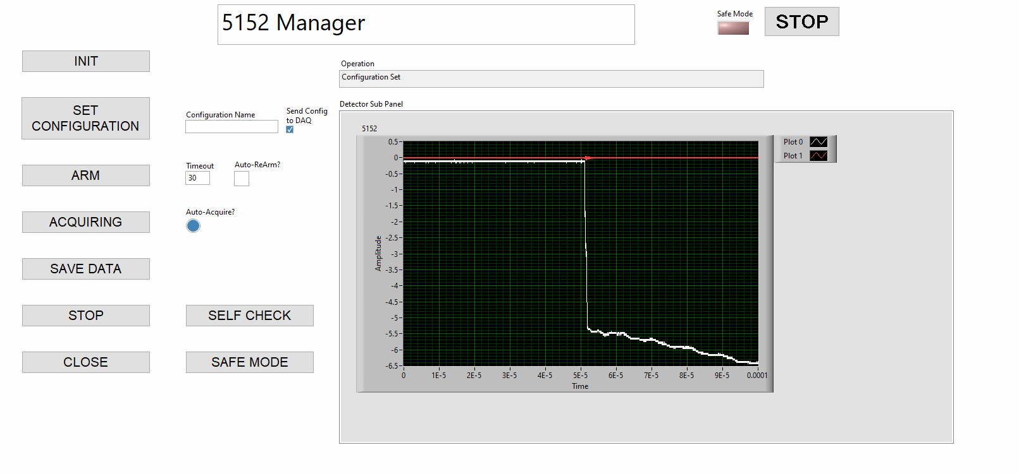
Single uService testing

Slide 13
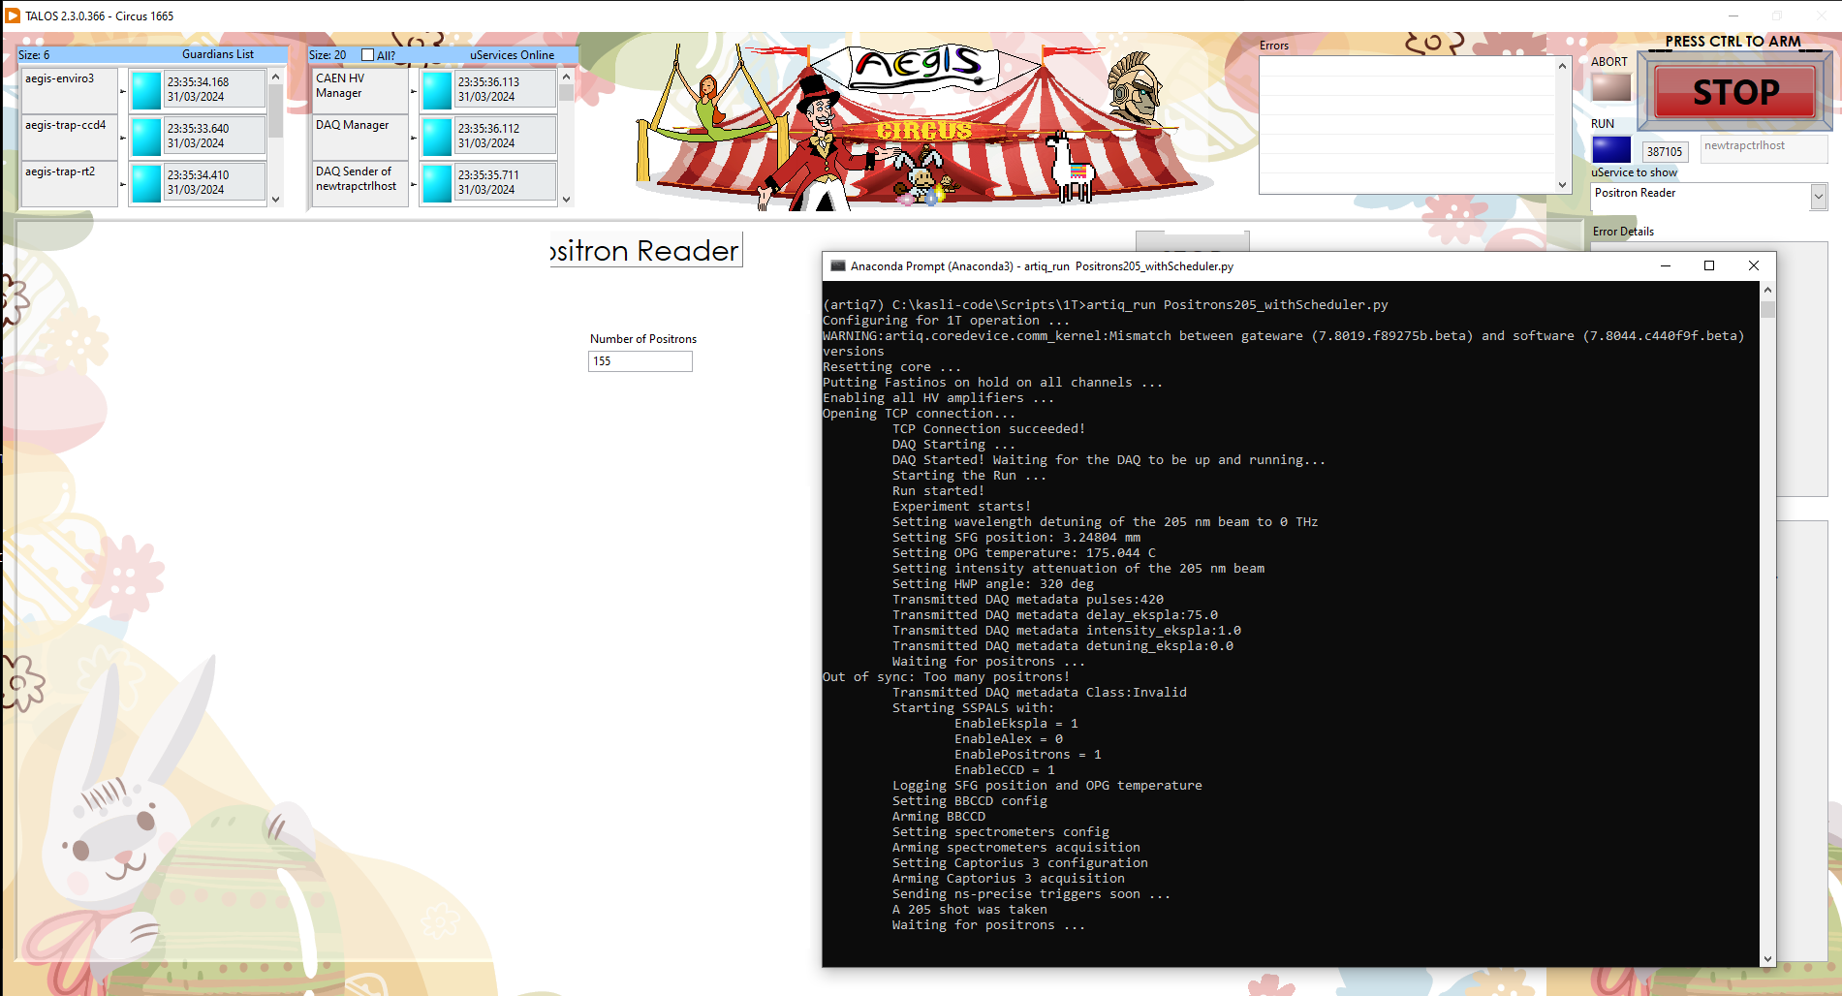
Running in Hybrid (Debug) mode
Picture of TALOS with an anaconda shell opened with a script running?

Slide 14



Running in autonomous mode: main $μ$services
Error Manager: distributed system error concentrator
Scheduler: to create schedules of experiments (i.e. scripts + parameters)
Kasli Wrapper: encapsulate shell interaction with Kasli (FPGA)
Monkey: core of automation, execute experiments
Tamer: for multi-Kasli operation

Slide 15
Running in autonomous mode: operations
Via the Scheduler, a list of scripts to be executed can be prepared (each with different parameters)
Then the Monkey takes over and executes the scripts one by one
In case an error is generated by a µService or the Kasli, the Monkey can:
  Continue
  Retry – run again the same script
  Skip – go to the next script in the schedule
  Stop – stop the execution of the scripts and idle
  Abort – stop the execution and put the entire system in Safe Mode

Slide 16
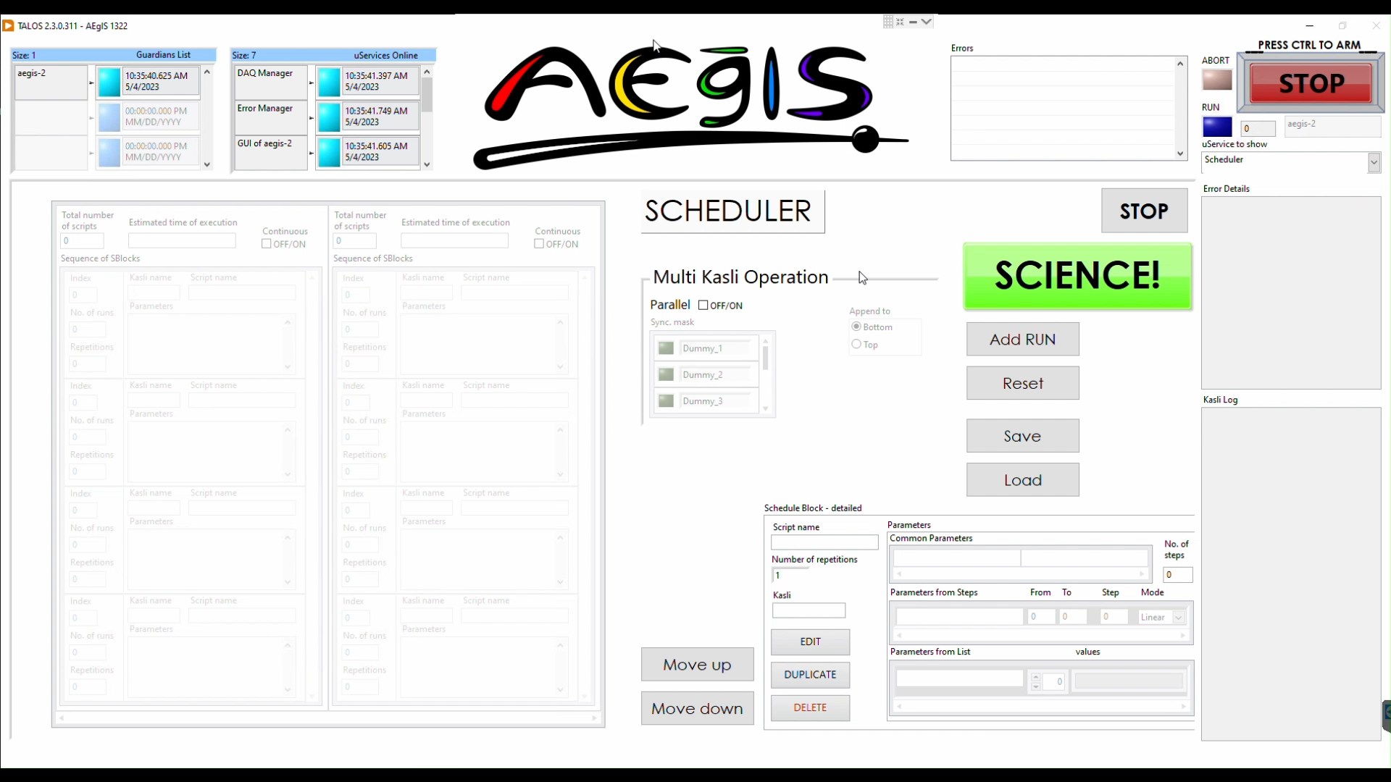

Add sblock - demo
Notes:
Add sblock - demo

Slide 17
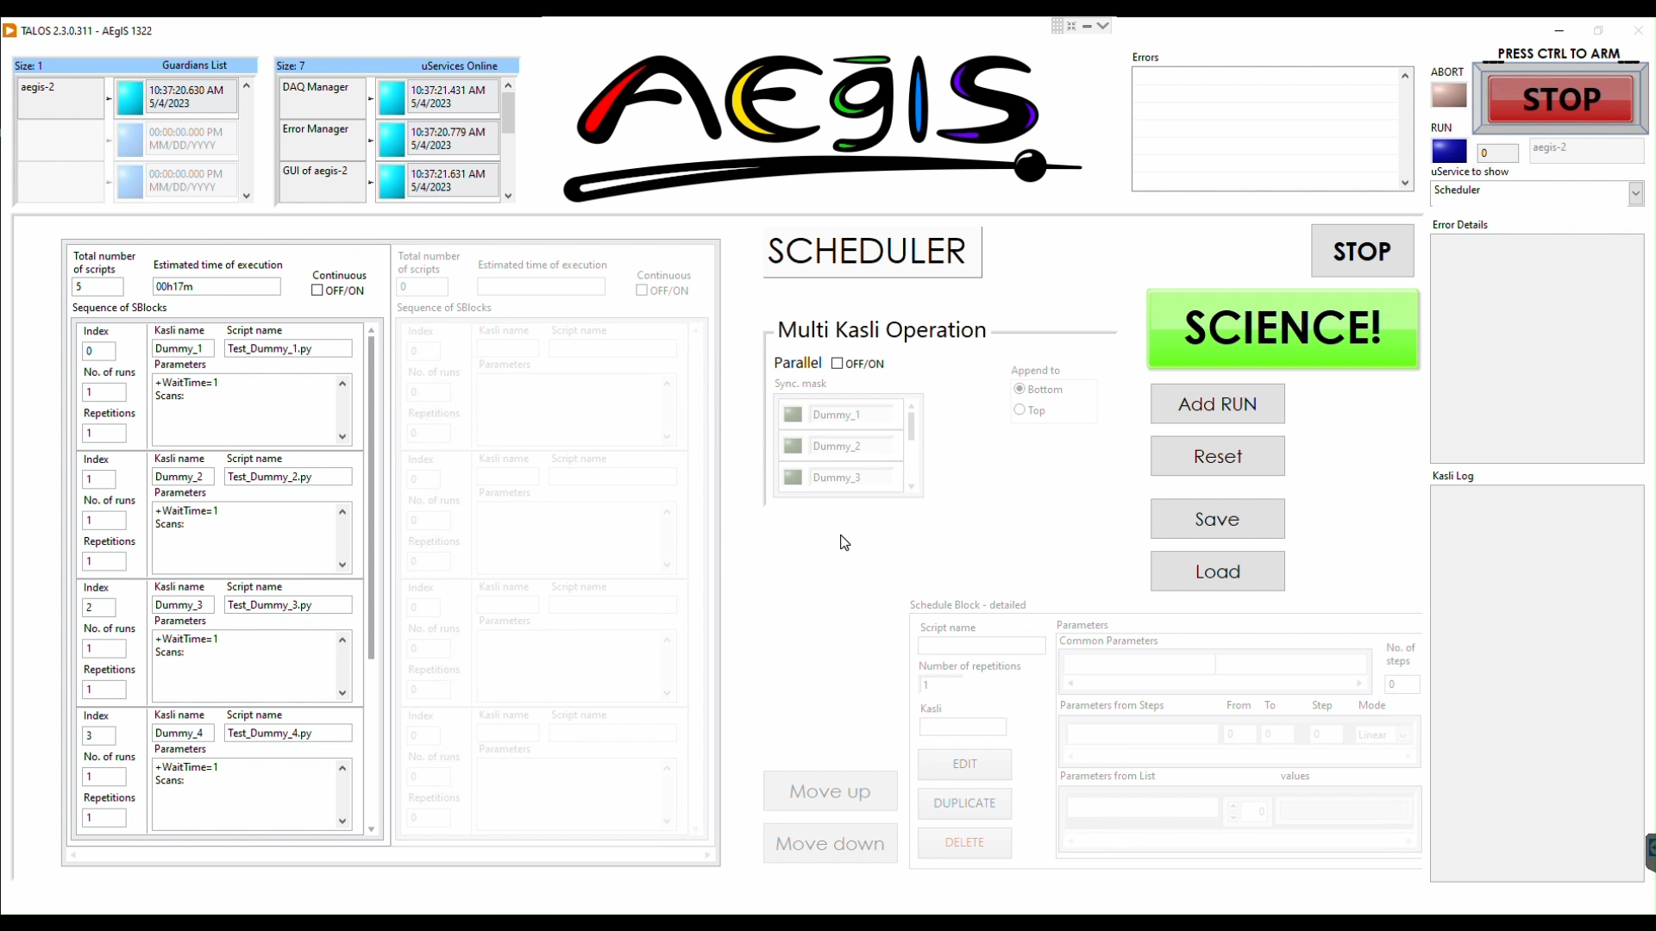
Standard operation – demo
Notes:
Standard operation - demo

Slide 18
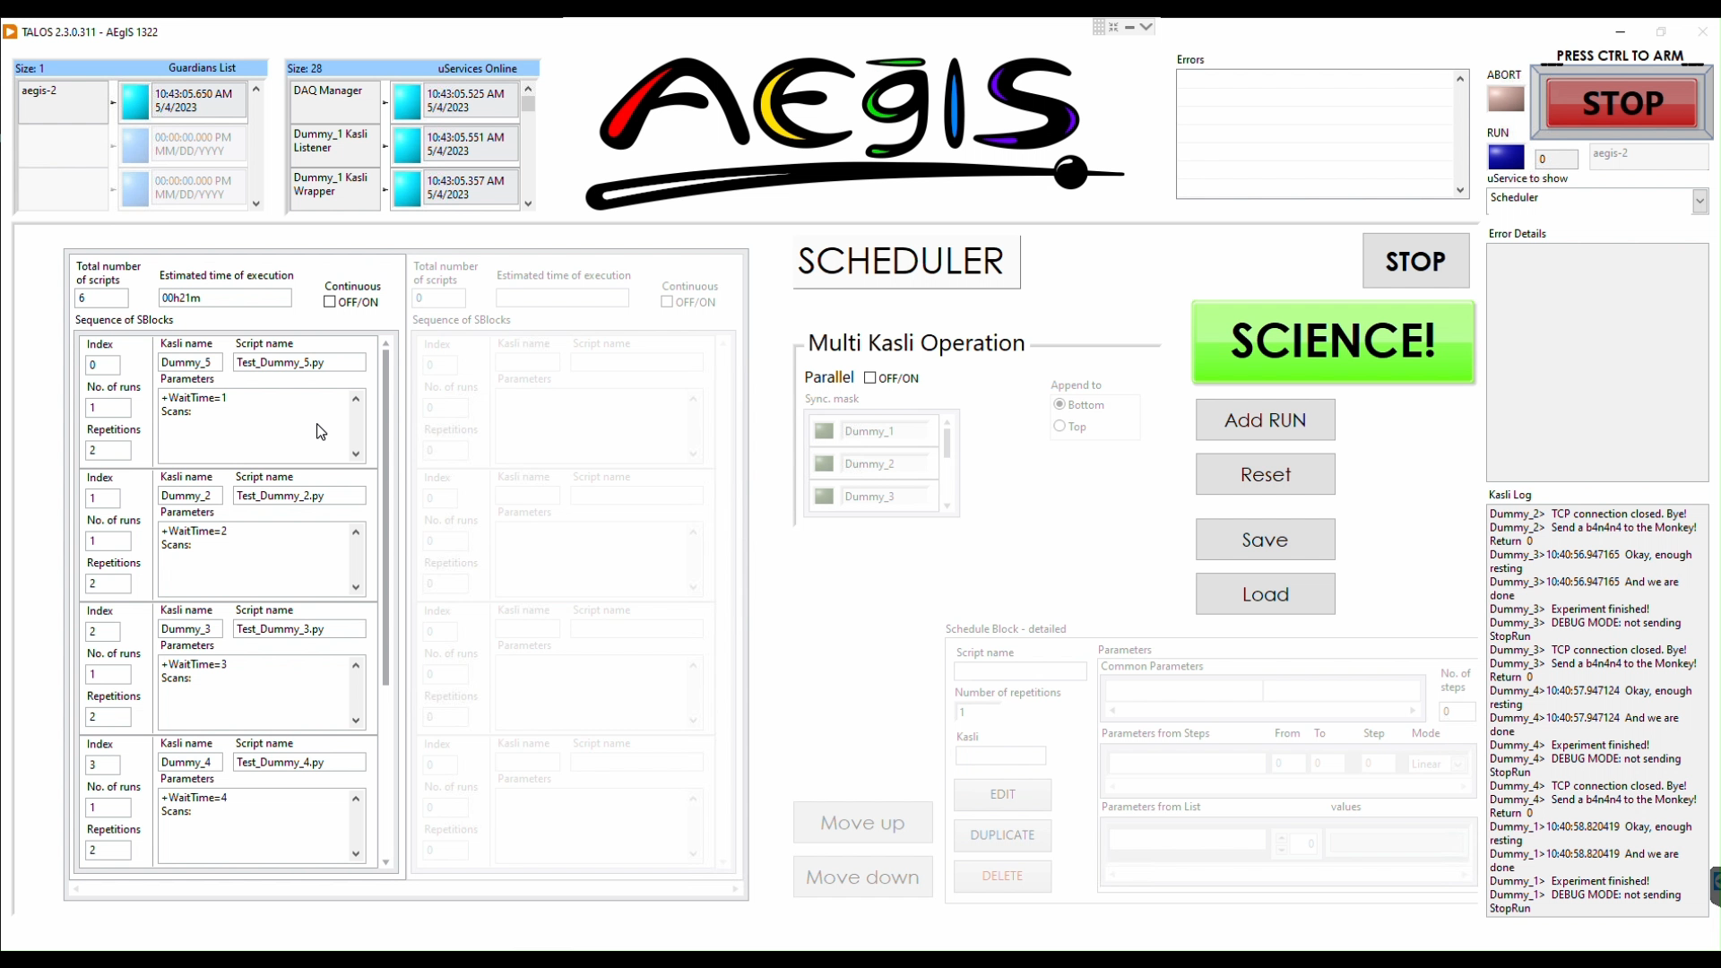
Parallel mode – demo
Notes:
Parallel mode - demo

Slide 19
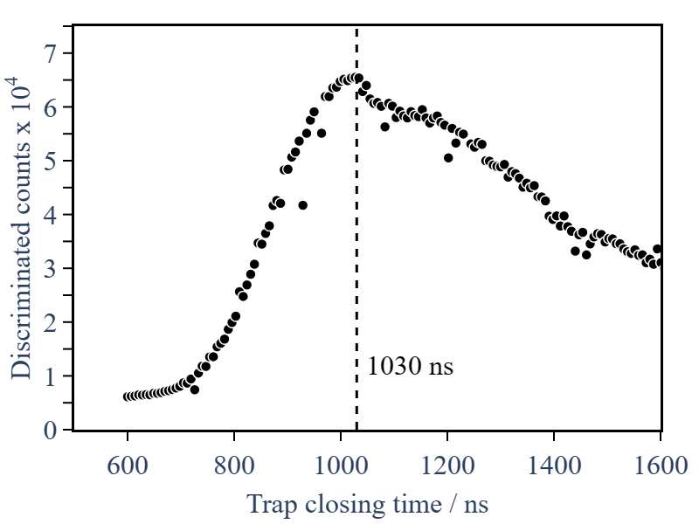
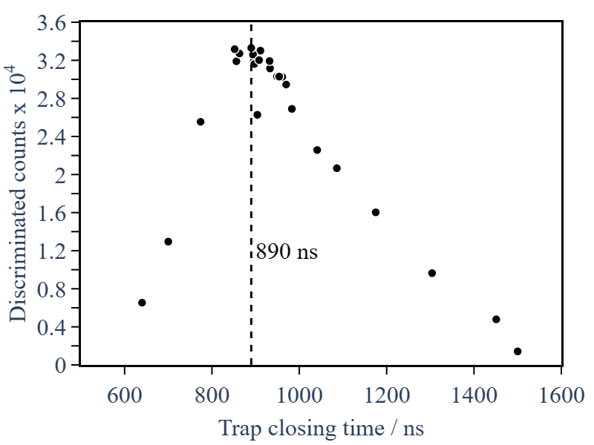
Autonomous parameter optimisation via live data feedback
Interface of Monkey with ALPACA (Data Analysis Engine) enabled autonomous parameter exploration to optimise pre-defined observable

Slide 20
results

Slide 21
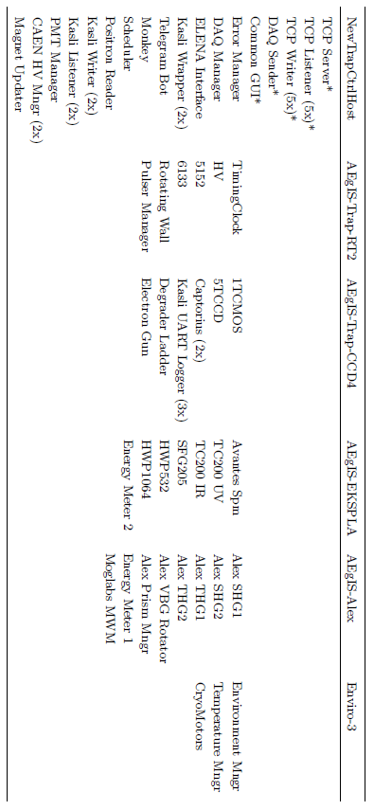
Machines Topology

Slide 22
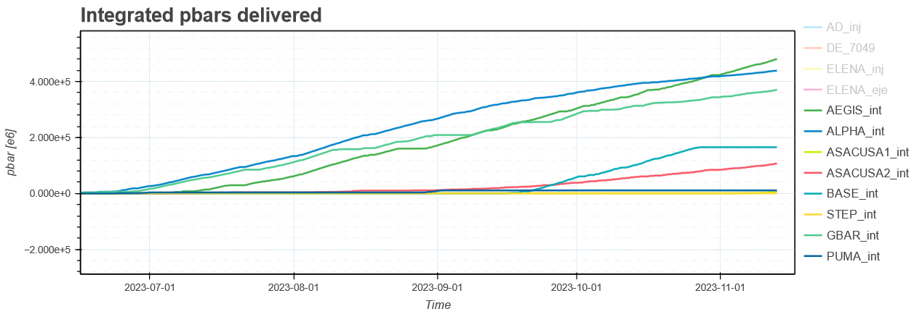
Steady performances

Slide 23
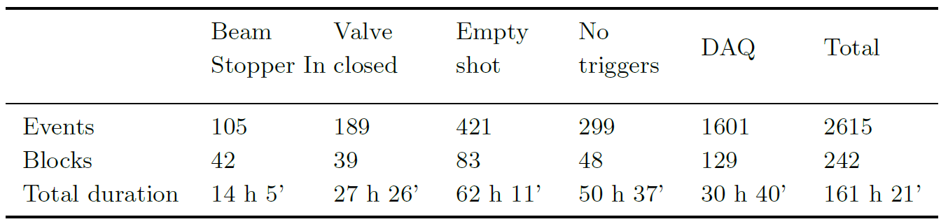
Error handling
Data from 4/09/2023 to 11/11/2023
Total time of data taking: 894.2 h (≃37 days) ≃ 54 % of 69 days of campaign
TALOS saved 18 % of data taking time

Slide 24
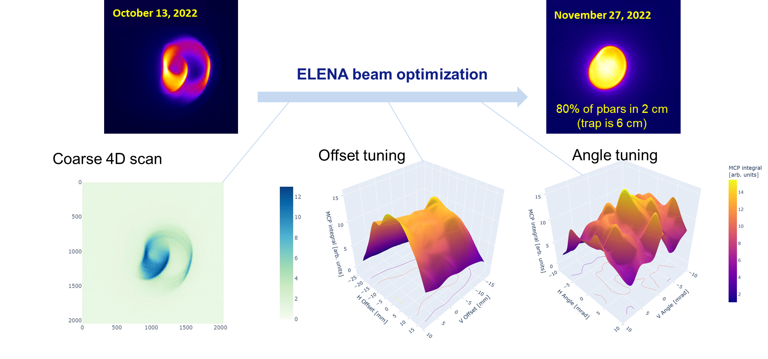
ELENA automated beam Steering

Slide 25
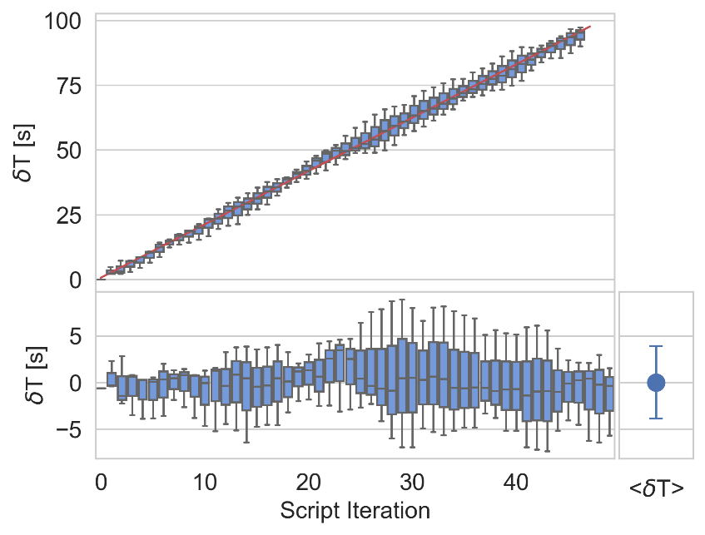
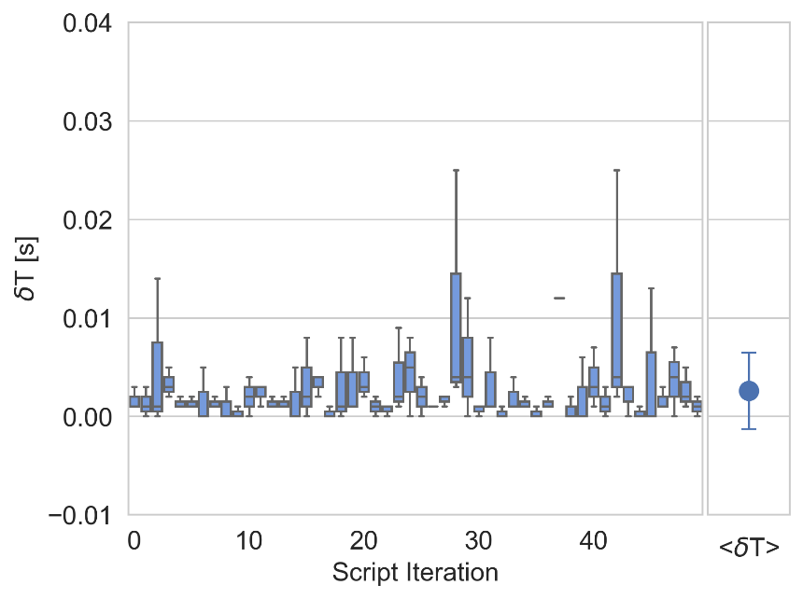
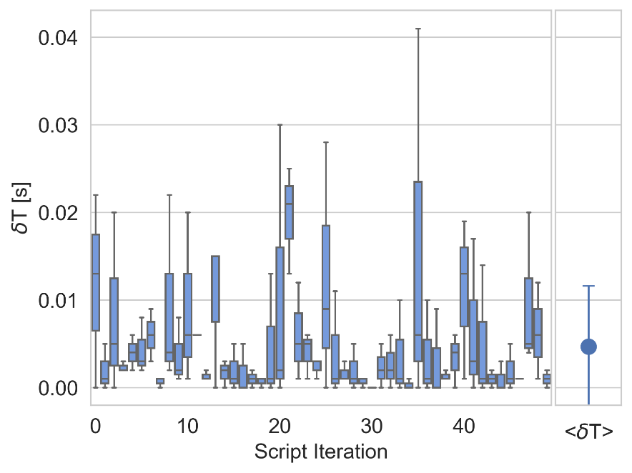
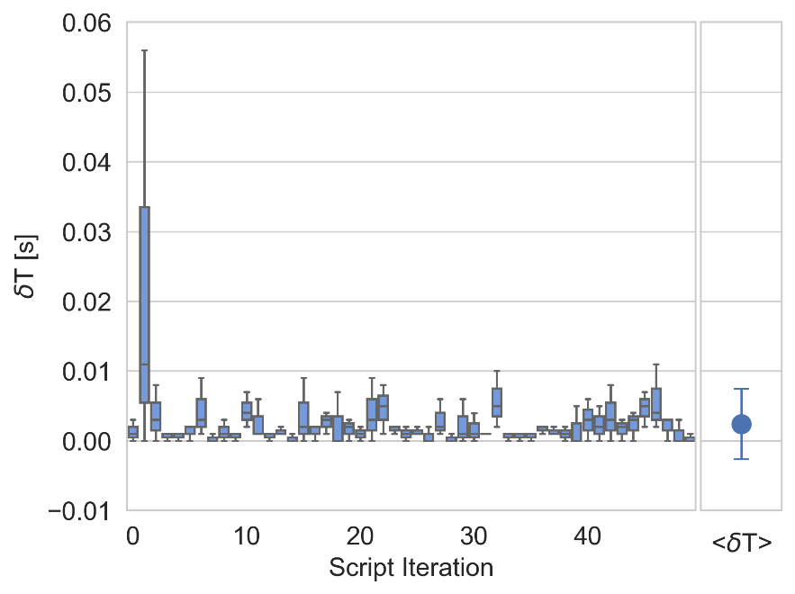
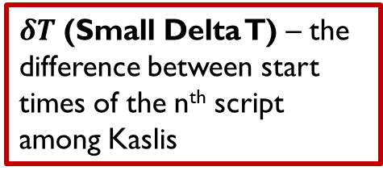
Performance tests
Different duration - async
Different duration - sync
Same duration - async
Same duration - sync
$δT$ (Small Delta T) – the difference between start times of the n^{th} script among Kaslis
25

Slide 26
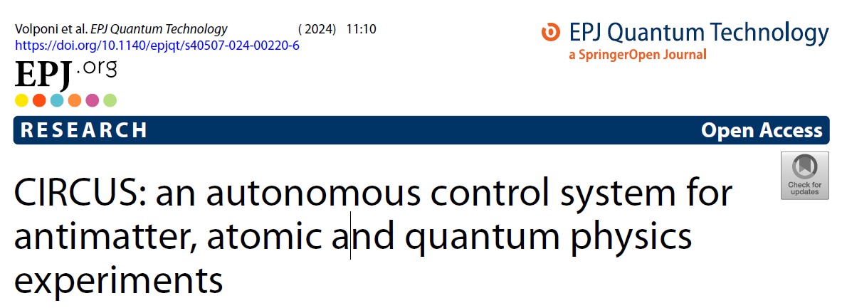
1&1/2 publications
TALOS (Total Automation of LabVIEW Operations for Science): a framework for autonomous control systems for complex experiments
Volponi, M. , Zielinski, J. , et al.
SUBMITTED

Slide 27
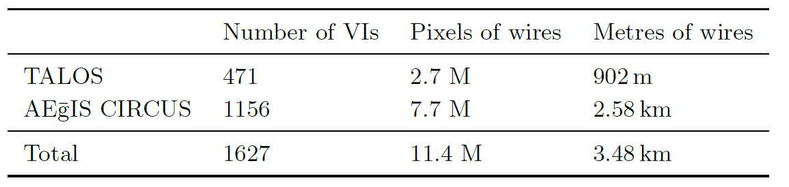
The most important metric
Using a corrected version of Piotr Demski’s Wirelength Calculator and a 24” screen with full HD resolution.

Slide 28
Conclusions
The system is already mature, last year with the antihydrogen production it reached full production level
Automation level is very high, system is running unsupervised (especially overnight or during the weekends)
Open source release
  CIRCUS: 10.5281/zenodo.10371799
  TALOS: 10.5281/zenodo.10371404
Deployment in other experiments (PSICO, Univ. Of Trento)

Slide 29







Thank you!
Disclaimer: no animals have been mistreated for the creation of this project.
Just some scientists.

Slide 30
Backup slides

Slide 31
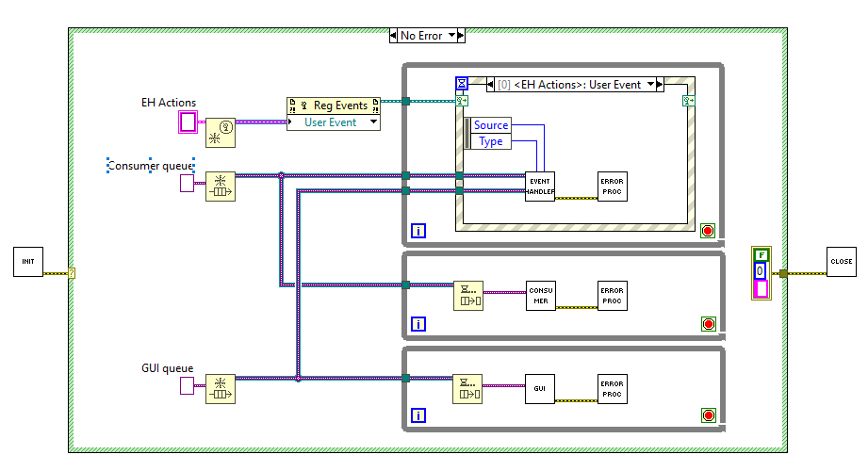
uService = QMH

Slide 32
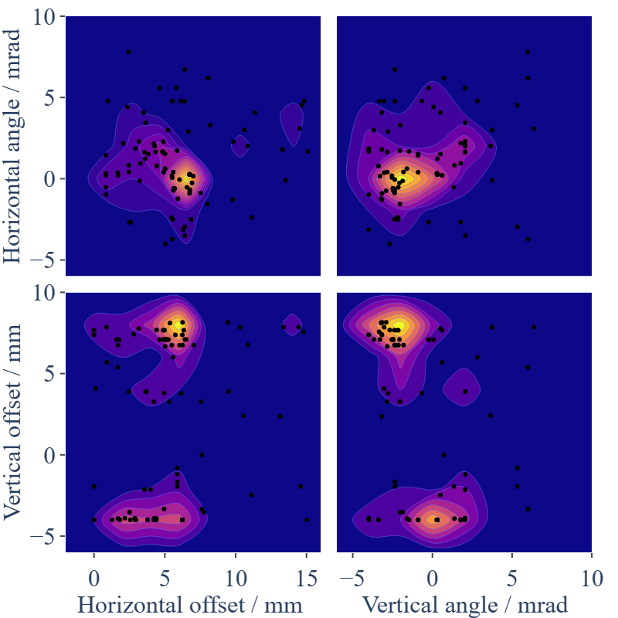
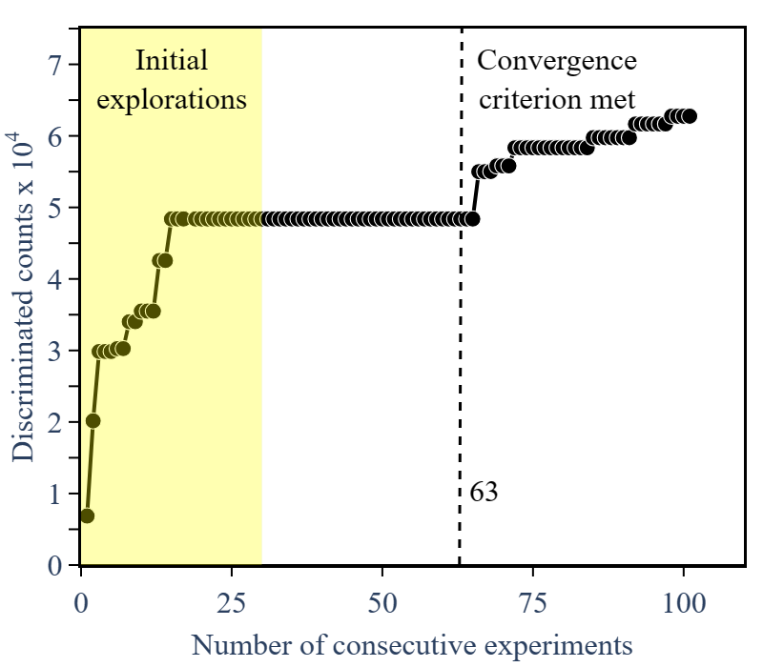
ELENA automated beam Steering

Slide 33
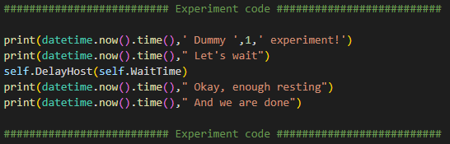
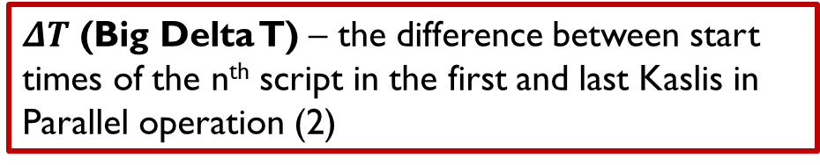
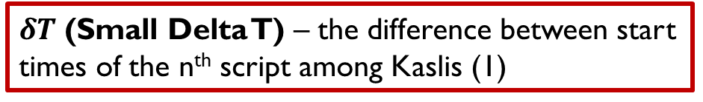
Performance tests
Different number of Parallel Kaslis (2-5):
Run 50 scripts with:
  Asynchronous and same time
  Synchronous and same time
  Asynchronous and varying time
  Synchronous and varying time
$δT$ (Small Delta T) – the difference between start times of the n^{th} script among Kaslis (1)
Kasli 1
Kasli 2
Kasli 3
Kasli 4
Kasli 5
1
1
2
1
$ΔT$ (Big Delta T) – the difference between start times of the n^{th} script in the first and last Kaslis in Parallel operation (2)
1

Slide 34
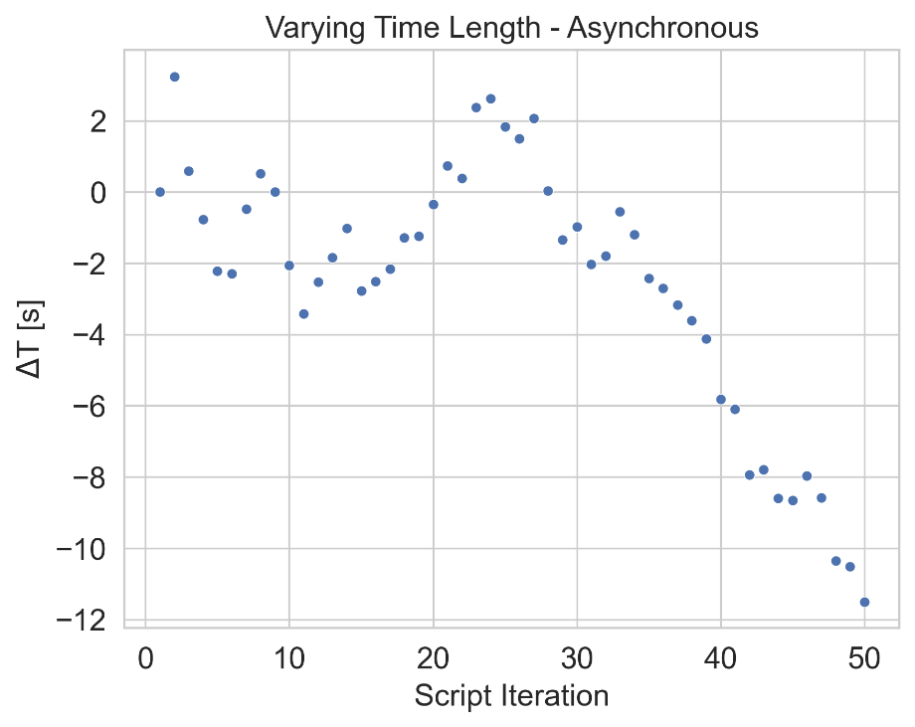
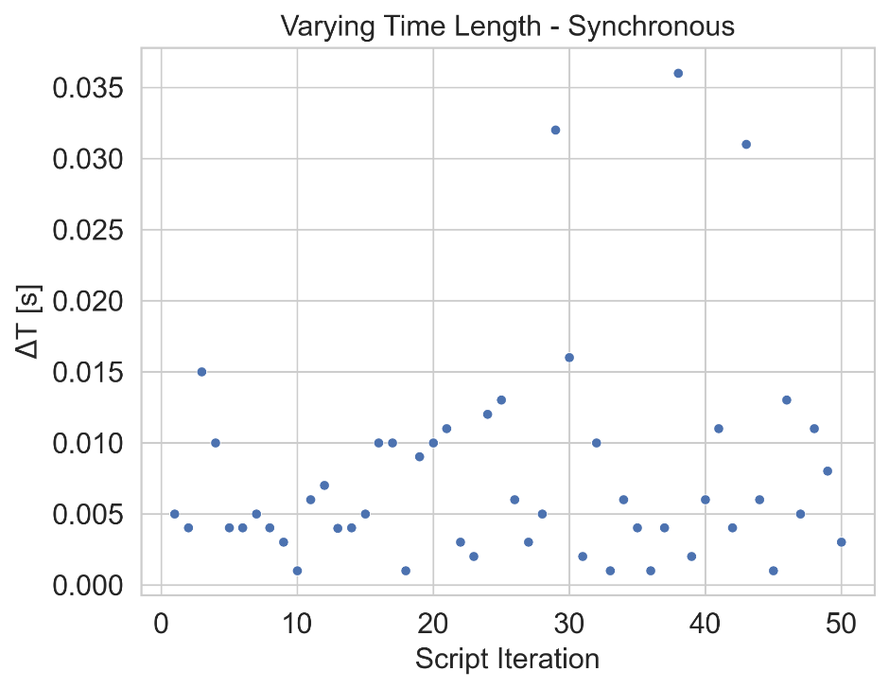
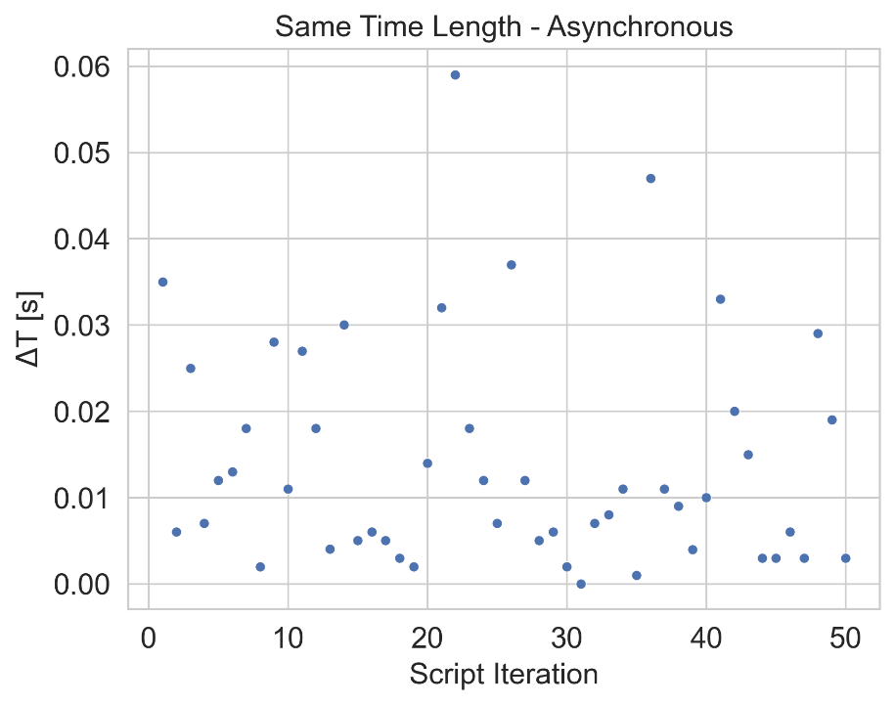
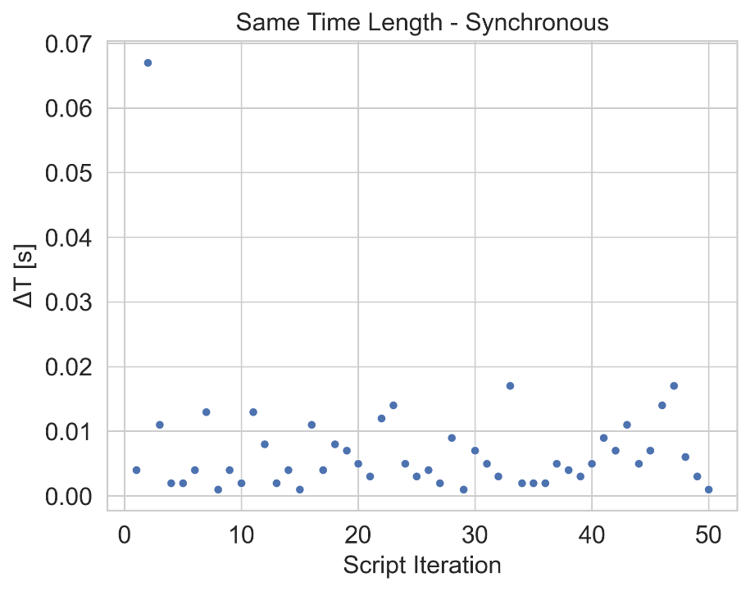
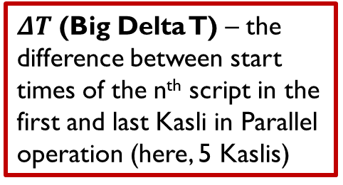
Performance tests
Different duration - async
Different duration - sync
Same duration - async
Same duration - sync
$ΔT$ (Big Delta T) – the difference between start times of the n^{th} script in the first and last Kasli in Parallel operation (here, 5 Kaslis)

Slide 35
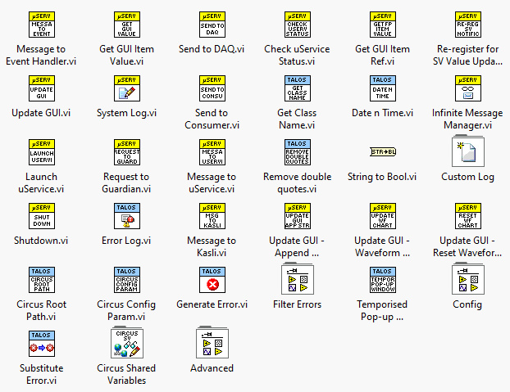
... With dedicated palette!

Slide 36
future development
Consolidation and extension of the Parallel Mode (periodic self-check barrier)
Extension of the system to include additional parts of the experiment
Deployment in other experiments (PSICO, Univ. Of Trento)

Slide 37
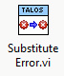
Criticality code
Each error is substituted with a custom defined error with associated criticality code:
0: Continue
1: Retry
2: Skip
3: Stop
4: ABORT

Slide 38
Parallel Schedules operation

Slide 39
Problem: how to run two kaslis at once?
Scheduler
Monkey
HW
Monkey communication with a single Kasli is complicated
Adding more complexity to the Monkey may slow down the system (need for speed)
Kasli 1 Wrapper
Kasli 1
Kasli 2 Wrapper
Kasli 2
Kasli 3 Wrapper
Kasli 3
Dynamically spawned as schedule requires

Slide 40

SOLUTION – Introducing the tamer
Scheduler
Tamer
HW
Standard operation
Monkey
Kasli 1 Wrapper
Kasli 1
Kasli 2 Wrapper
Kasli 2
NOTE: only ONE Kasli at a time is operated!
Kasli 3 Wrapper
Kasli 3
Dynamically spawned as schedule requires

Slide 41
SOLUTION – Introducing the tamer
Scheduler
Tamer
HW
Parallel operation
Monkey Kasli 1
Kasli 1 Wrapper
Kasli 1
Monkey Kasli 2
Kasli 2 Wrapper
Kasli 2
Monkey Kasli 3
Kasli 3 Wrapper
Kasli 3
Dynamically spawned as schedule requires

Slide 42
operation
Scheduler
Tamer
Monkey
Monkey
Prepare schedule(s)
Init Run
(Spawn Monkeys, Check Guardians,
Check uServices)
Failed
Passed

Slide 43
operation
Standard operation
Tamer
Monkey
Monkey Kasli 2
Send schedule
Check script
Script execution
Submit script
Kasli 1
Banana arrived
Kasli
Kasli
Finish script
Update
Report to Tamer

Slide 44
operation
Parallel operation - asynchronous
Tamer
Monkey Kasli 1
Monkey Kasli 2
Send schedules
Check script
Check script
Script execution
Submit script
Submit script
Kasli 1
Banana arrived
Kasli
Kasli
Finish script
Finish script
Update
Report to Tamer
Report to Tamer

Slide 45
operation
Parallel operation - synchronous
Tamer
Monkey Kasli 1
Monkey Kasli 2
Send schedule
Check script
Check script
Collect checks
Script execution
Submit script
Submit script
Kasli 1
Banana arrived
Kasli
Kasli
Collect bananas
Finish script
Finish script
Update
Report to Tamer
Report to Tamer

Slide 46
Kasli Wrapper
Dedicated uService that substitutes human input via shell
Dynamically spawnable (as many copies as Kaslis in the system)
Intercepts StdIn/StdOut/StdErr to guarantee low level communication

Slide 47
Double TCP Tunnel
Communication via shell breaks realtime operation
Solution: two monodirectional TCP tunnels between Kasli and TALOS
  No realtime breaking
  Faster than shell processing for TALOS (~ ms), immediate* for Kasli
  Being each tunnel monodirectional, no message delay
  Kasli can reach all uServices, with no wire drawn!
(*) The communication takes place between TALOS and the Kasli Host, so if Kasli schedules it well it literally takes no time

Slide 48
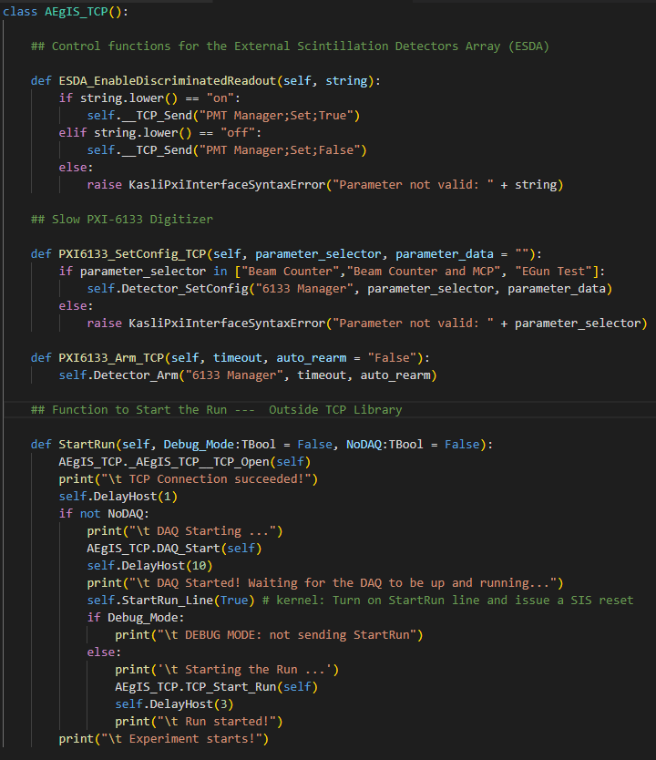
TCP Library
All communication functions are immediately available by importing this library
Each function triggers a specific action from a specific uService
The entire bridge is created by simply encasing the experiment code inside two function, StartRun() and StopRun()

Slide 49
What about the daq?
Operation mode | DAQ operator
Standard | Monkey (in the script, as before)
Parallel (Asynchronous) | Only dedicated ports supported (no run-specific DAQ)
Parallel (Synchronous) | Tamer (starts when the script checker is passed, stops when all bananas arrive)

Slide 50
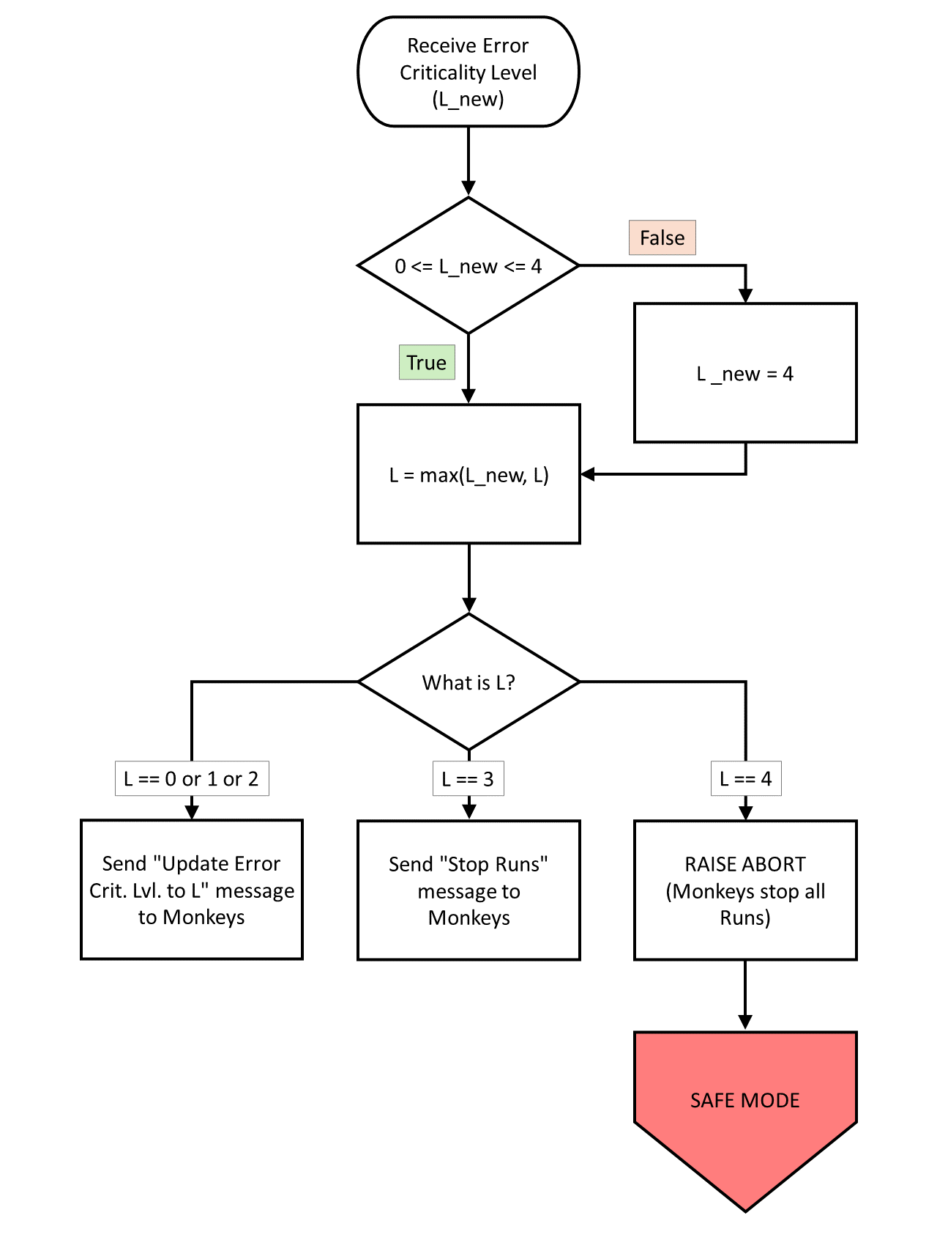
Tamer Flowchart

Slide 51
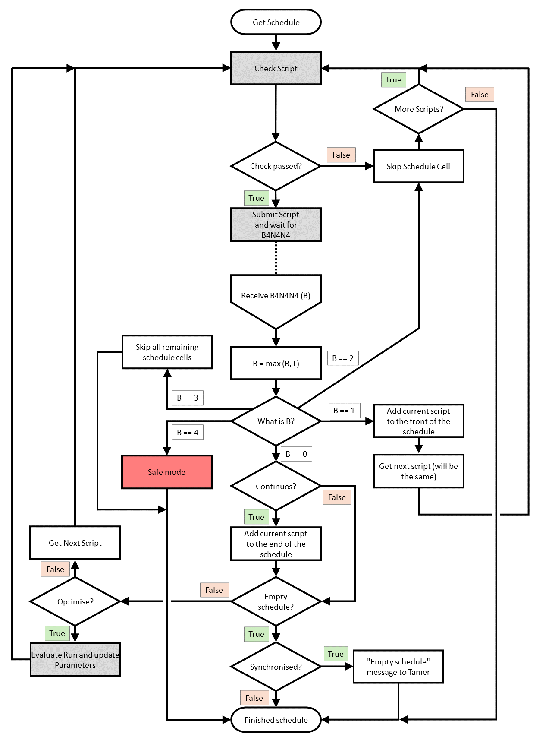
Monkey Flowchart

Slide 52
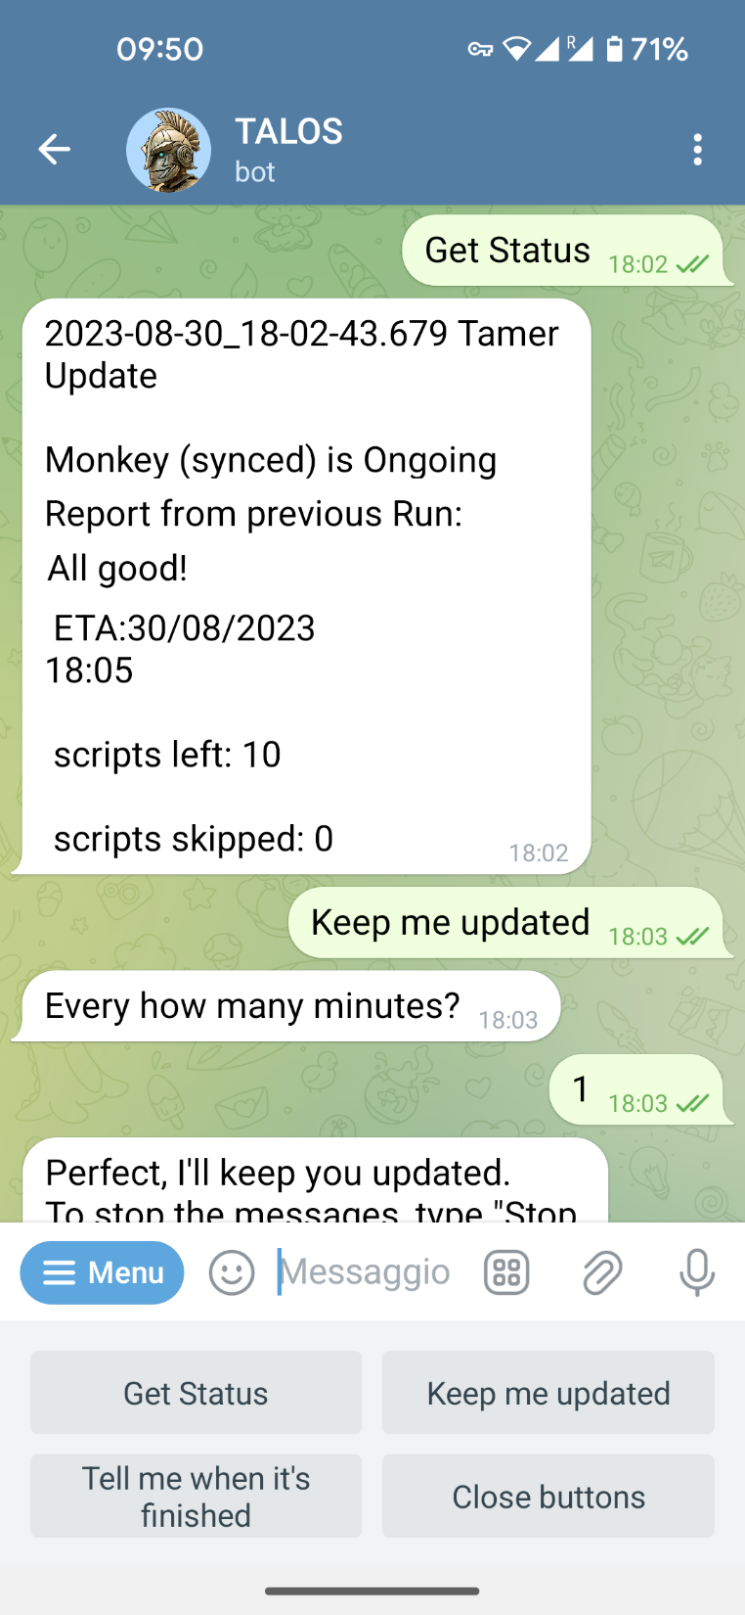

Slide 53
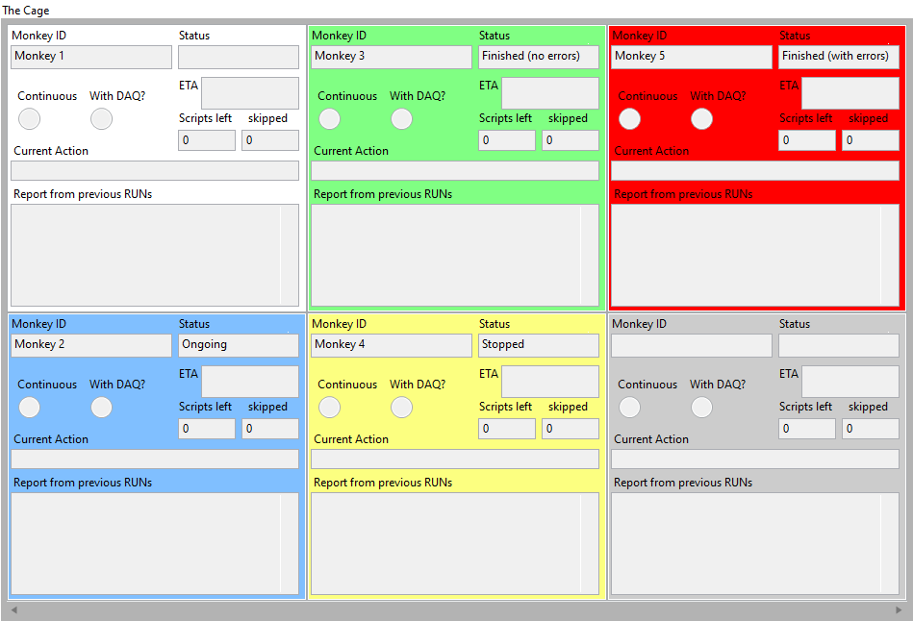

Slide 54
ABORT: Singleton in the network
The problem of the ABORT SV is that is a single point of failure: i.e. what happens when the hosting pc goes down? -> Singleton in the network
The logic is that, when a Launcher (on a pc) starts, it checks the network for the existence of a SV called ABORT: if it doesn’t find it, it deploys the variable locally [implemented]. If, later in the execution, the variable ABORT is not found (from whichever pc: basically it means that the hosting pc is down), an error is generated, the variable is redeployed locally, and it is set to True.
What if two variables are present at the same time in the network? (original host got disconnected from the network and then reconnected, or the original host goes down and two other PCs simultaneously redeploy locally) -> Alphabet always wins: who is later in the alphabet (computer’s name) has to undeploy its variable (and set the other(s) as True, just in case). Need a periodic checking inside the usual check for ABORT
Complex to keep the variable as a singleton across the network, but at least one copy should always be present and the marking as True is univocal.

Slide 55

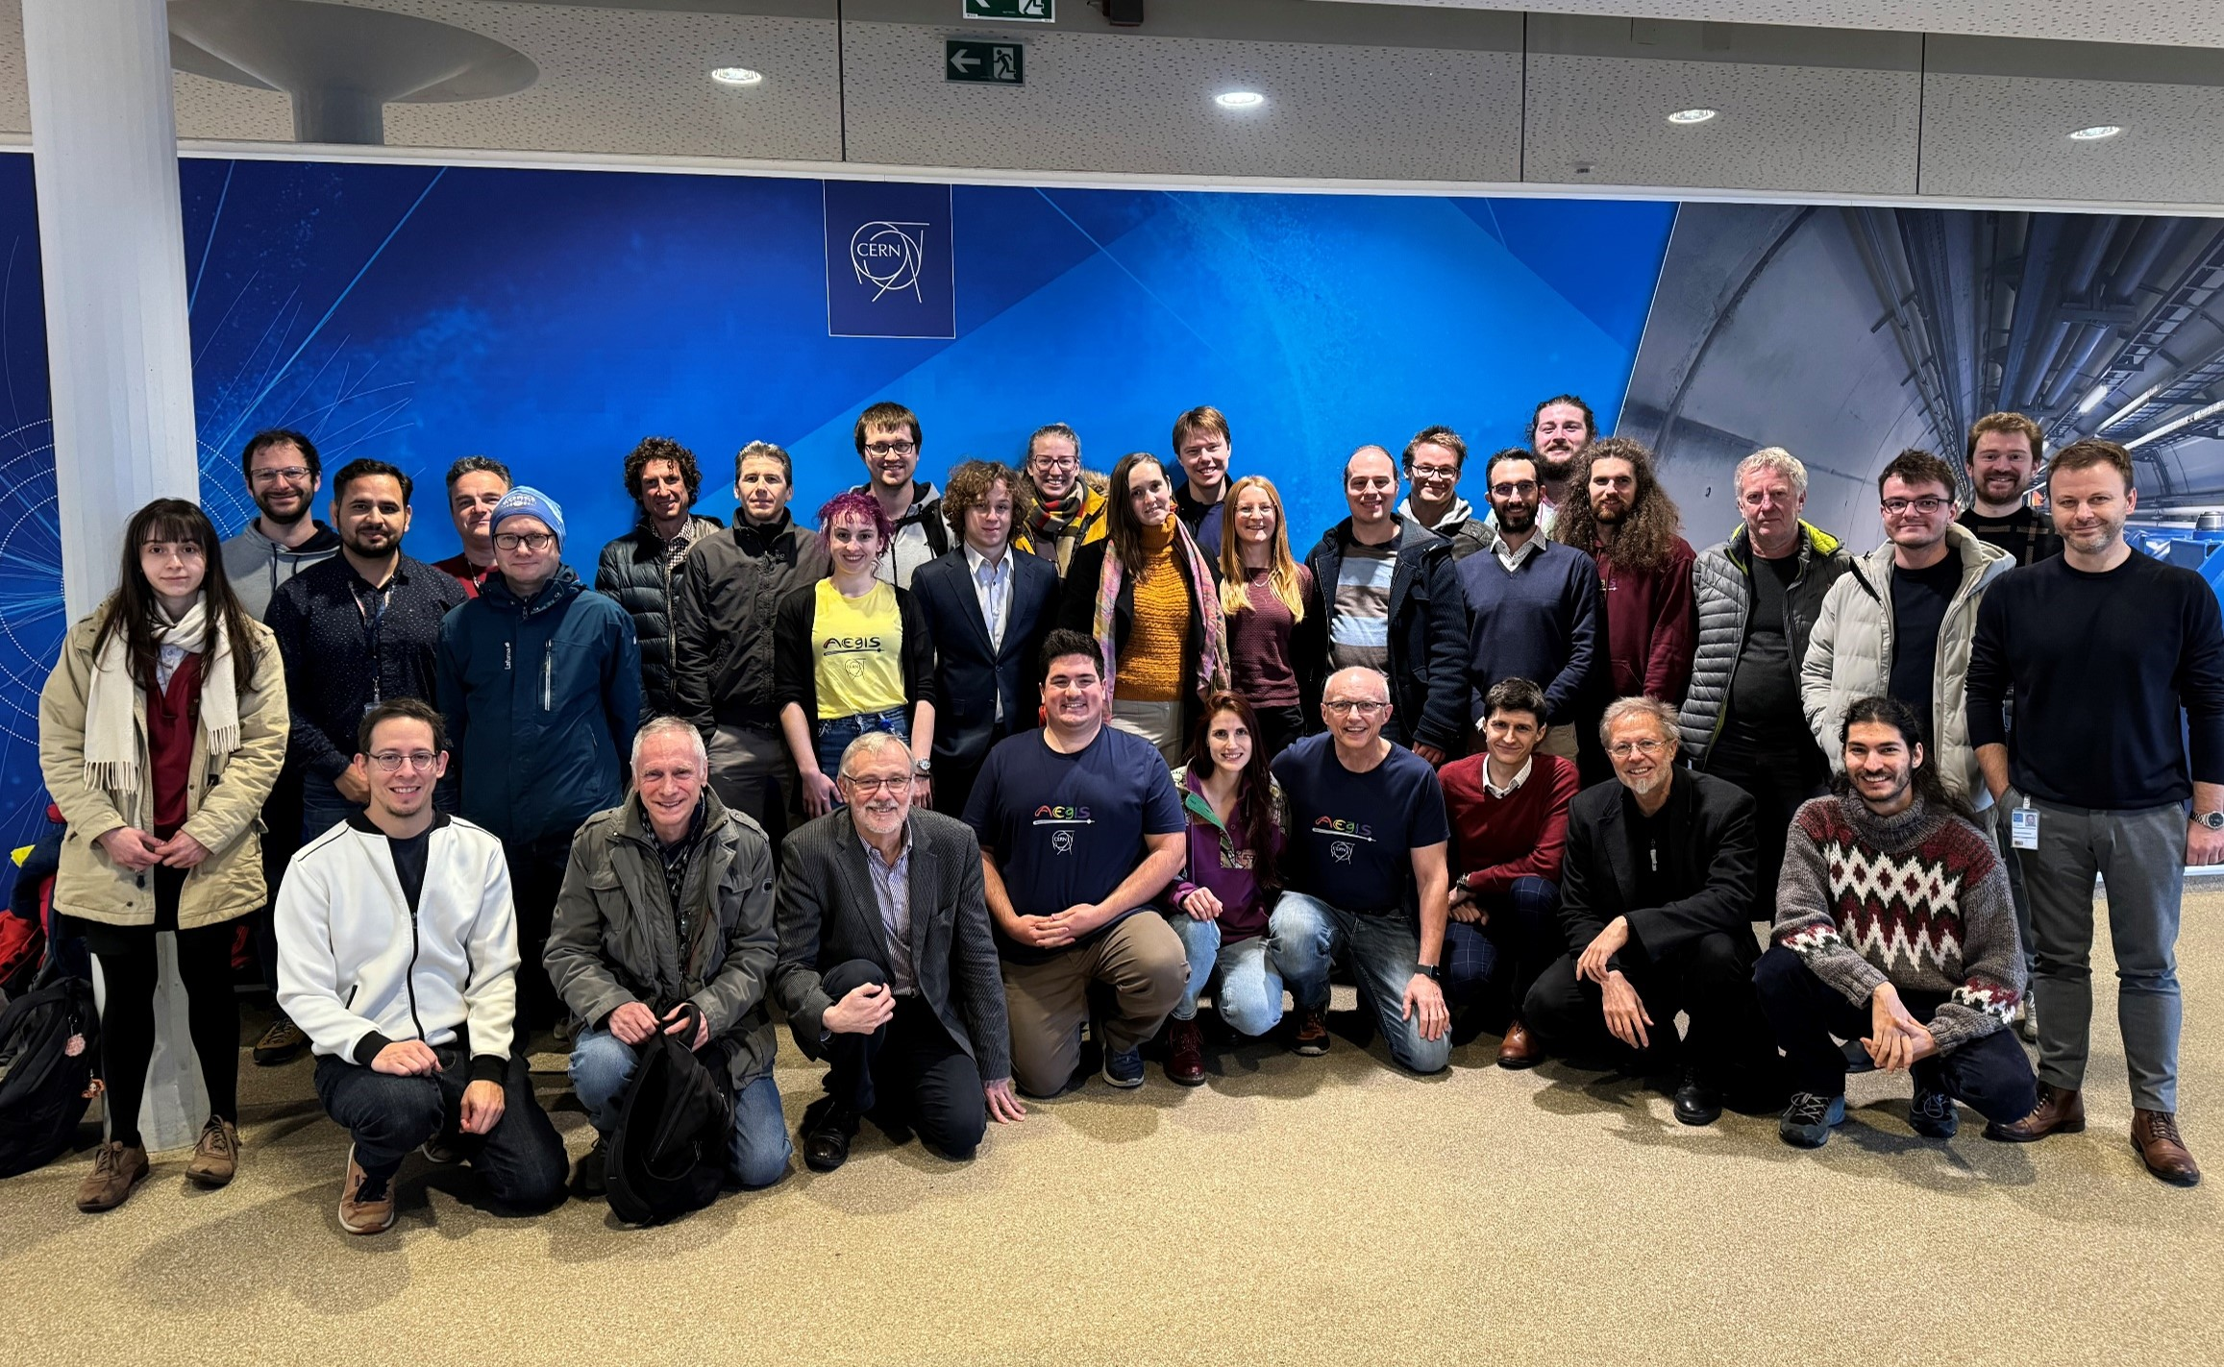
AEgIS Collaboration

