Slide 1
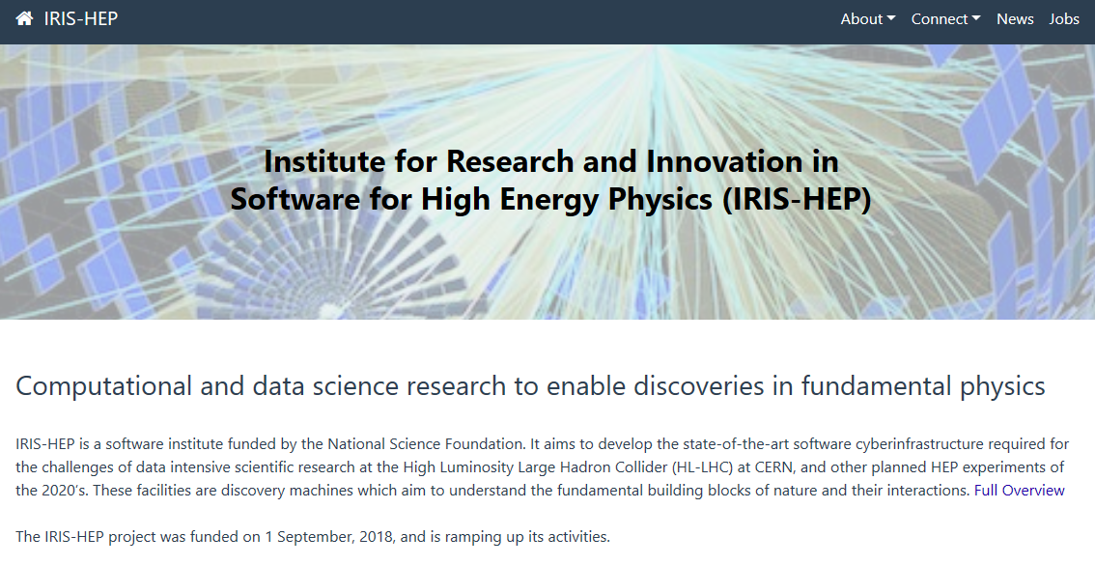

Slide 2


IRIS-HEP Steering Board
Meeting #20
G. Watts
For the IRIS-HEP Executive Board
2024-01-16
“The IRIS-HEP Steering Board represents the Institute’s stakeholders to provide, to the Executive Board, the stakeholder’s input on the priorities, execution, and strategy of the Institute.”

Slide 3
Thank You
Liz Sexton-Kennedy (CERN)
CMS
Tulika Bose (U Wisconsin)
US CMS Ops Program
Paolo Calafiura (LBL)
US ATLAS Ops Program
Patrick Koppenburg (NIKHEF)
LHCb
Simone Campana (CERN)
WLCG
Graeme Stewart (CERN)
HSF
David South (DESY)
ATLAS
Ken Herner (FNAL)
The OSG Council

Slide 4
Welcome
steering-board@iris-hep.org
(you)
exec-board@iris-hep.org
(us)

Slide 5
Next Meeting Dates
July 2, 2024
Oct 1, 2024
Jan 14, 2025

Slide 6
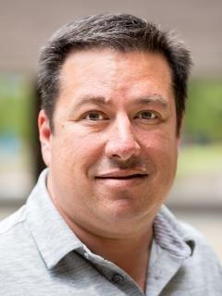
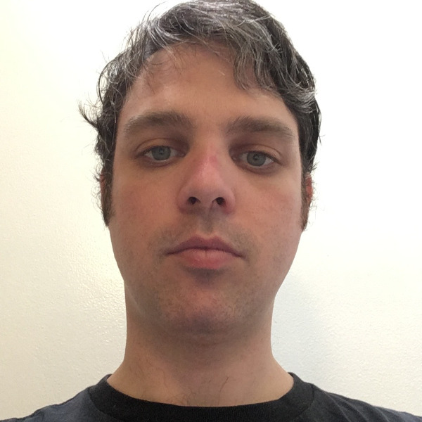
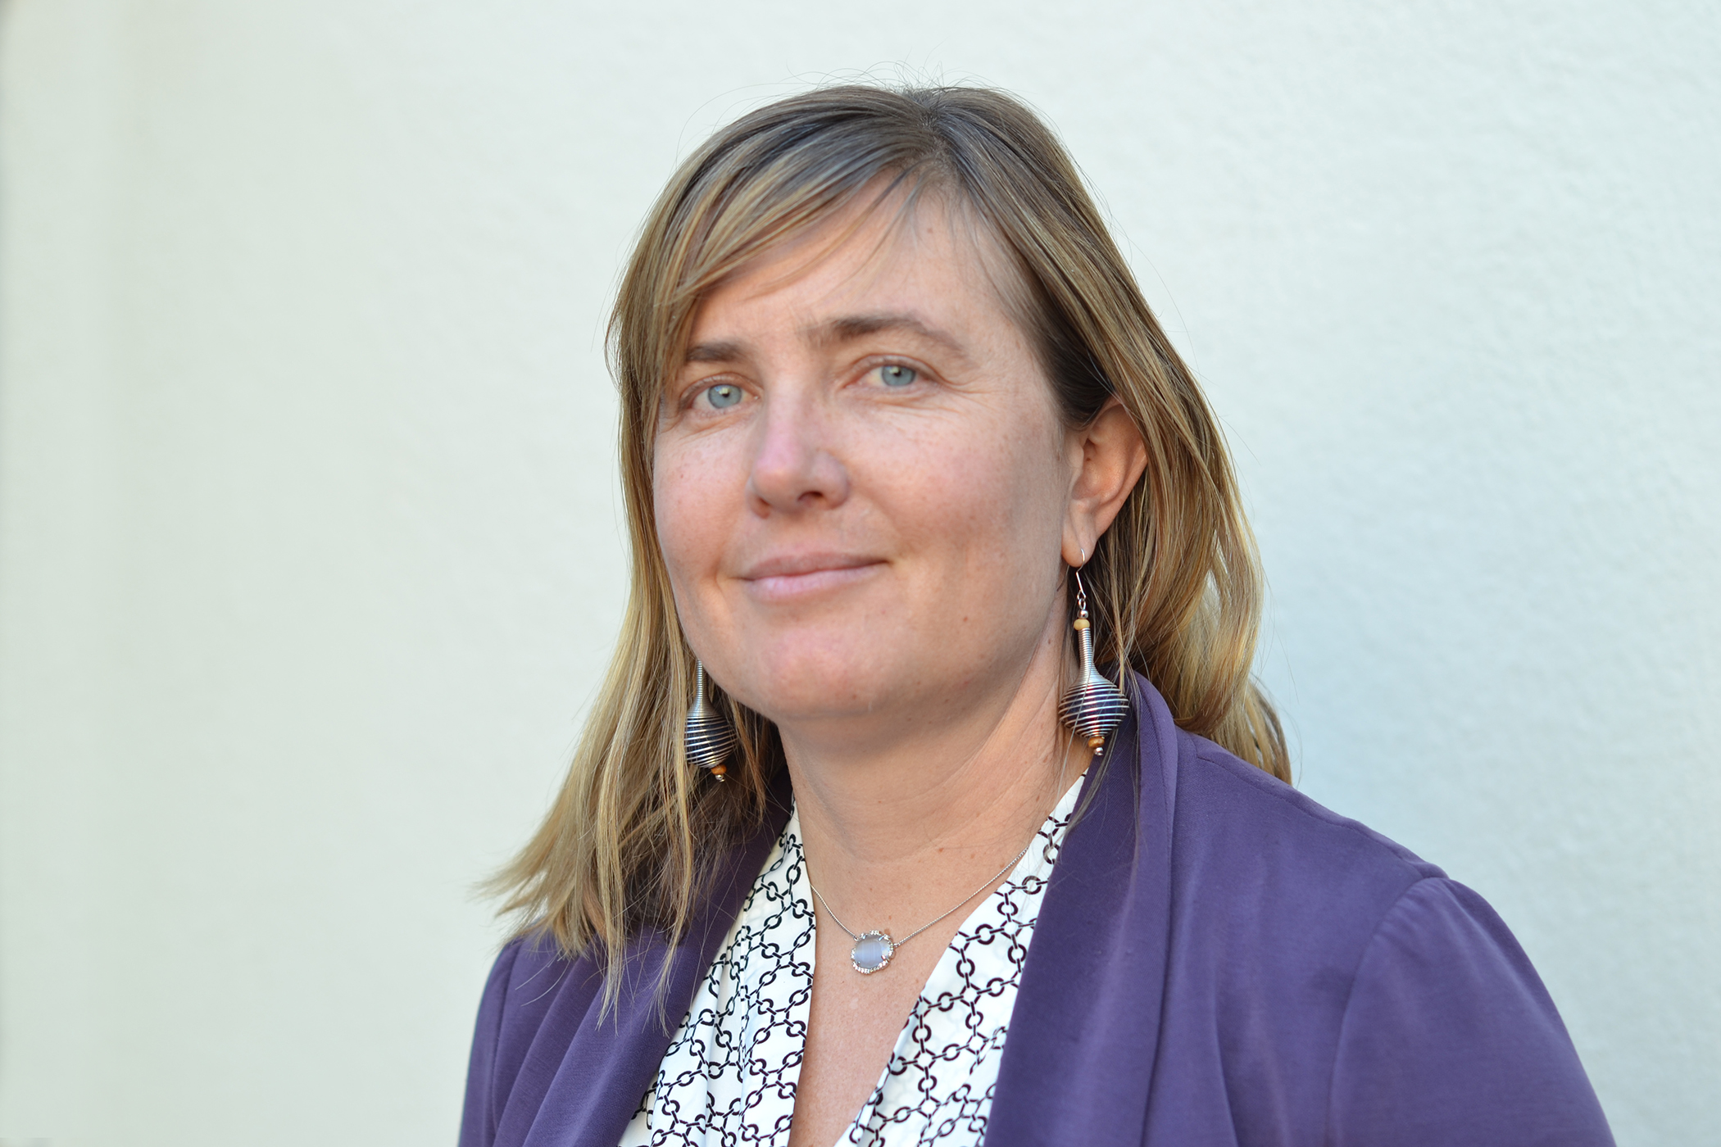
Innovative Algorithm Leadership
Heather Gray (UC Berkeley)
Many thanks for the last 6 years!
David Lange (Princeton)
(continuing)
Louis-Guillaume Gagnon (Berkeley)
Welcome!!

Slide 7
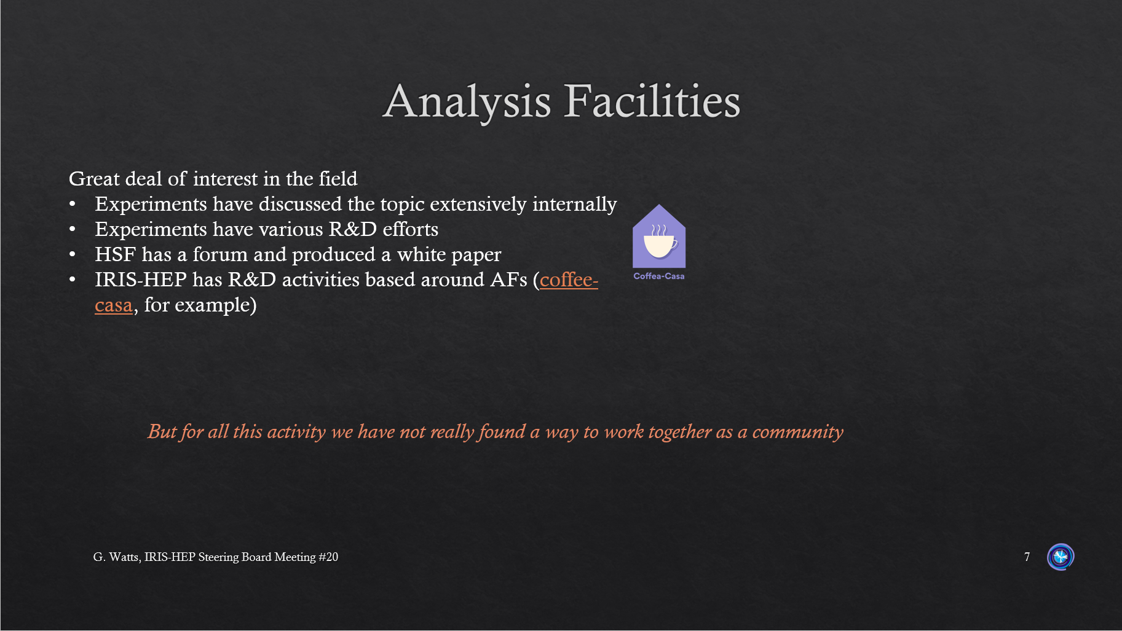
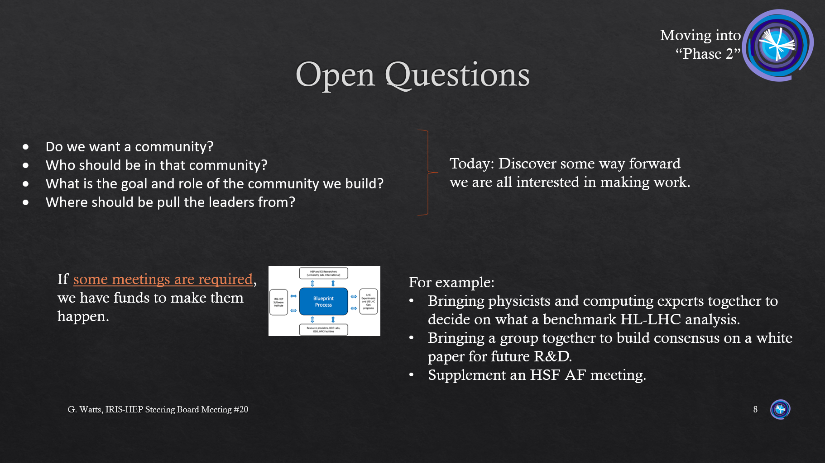
The Analysis Facilities Conversation
Since last time we met…
The HSF White Paper on Analysis Facilities has been released
  Archive: 2404.02100
LHCC has asked the LHC experiments to help it build a blueprint for Analysis Facilities
  Step 1: Build a list of questions, to be curated by the WLCG/LHCC
  Step 2: Answer the questions
The WLCG/HSF workshop May 13-24
  Question input for LHCC due
  Thursday afternoon is devoted to Analysis Facility Discussion
From SB#19

Slide 8
Community Involvement
We are running…
We are co-sponsoring…
Recent Highlights…
Full Team Retreat
Seattle
September 4-6
All SB members are invited
US LHC/IRIS-HEP Summer Meeting Training
US CMS/IRIS-HEP, Princeton, 21-22 June
US ATLAS/IRIS-HEP, Seattle, 18-19 July
CODAS-HEP Training Event
Application period closed
Princeton, July 22-26
Had 77 applicants this year!
PyHEP.dev
Aachen
Aug 26-30
MODE Workshop
Valencia
Sept 23-25
Joint k8s hackathon
Chicago
April 24-26
Workflow languages for HEP
CERN
Apr 3-5
Also
ACAT 2024
Training on Analysis Pipelines
pyhf Workshop
AGC Demo Day 1, 2, 3

Slide 9
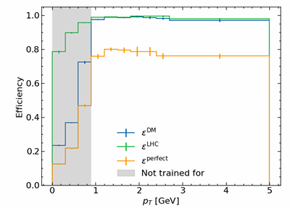
A few other things
GNN Tracking: High Pileup Particle Tracking
Awkward Array and Uproot are now part of the Scientific Python’s Package Index
Recognition outside of HEP
Several talks and tutorials will be given on tools from IRIS-HEP at the SciPy (Scientific Python) conference in Tacoma in July.
From ACAT talk
Fellows and More:
We now have a small post-bac program running at CERN (5 students)
We are matching Summer 2024 fellows to projects
HSF-India is another source of fellows, post-bacs, and sponsorship of s1-3 month research visits
(tracks emerge as clusters in latent space)
IMPRESS-U Funding
Collaboration/funding for Ukraine, Lithuania, Poland
Continuing with QuarkNet collaboration to offer additional training

Slide 10
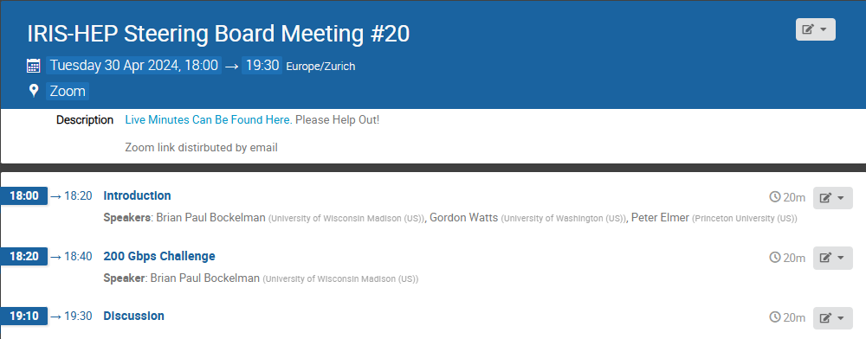
Today
DOMA
Recent News
200 Gbps Challenge
Please use the google doc linked to the agenda to add comments or make any notes you want us to track!

Slide 11
Questions & Comments?

