Slide 1
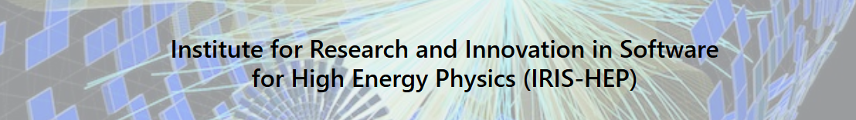
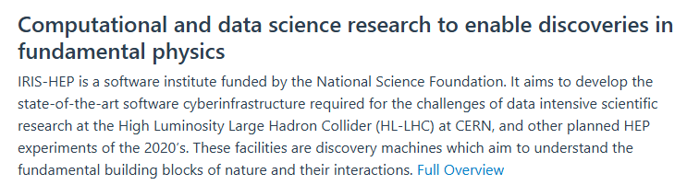

Slide 2



IRIS-HEP Steering Board
Meeting #23
G. Watts
For the IRIS-HEP Executive Board
2025-01-14
Happy New Year!
“The IRIS-HEP Steering Board represents the Institute’s stakeholders to provide, to the Executive Board, the stakeholder’s input on the priorities, execution, and strategy of the Institute.”

Slide 3
Thank You
Liz Sexton-Kennedy (FNAL)
CMS
Tulika Bose (U Wisconsin)
US CMS Ops Program
Paolo Calafiura (LBL)
US ATLAS Ops Program
Patrick Koppenburg (NIKHEF)
LHCb
Simone Campana (CERN)
WLCG
Graeme Stewart (CERN)
HSF
David South (DESY)
ATLAS
Ken Herner (FNAL)
The OSG Council

Slide 4
Welcome
steering-board@iris-hep.org
(you)
exec-board@iris-hep.org
(us)

Slide 5
Next Meeting Dates
Proposed Meeting Dates
May 20, 2025
July 15, 2025
October 7, 2025
January 13, 2026
We will send around an email shortly so everyone can check!

Slide 6
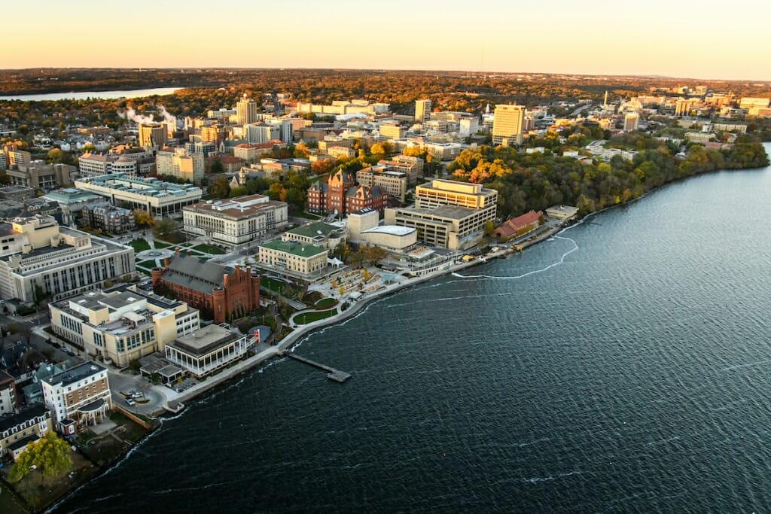
18-Month IRIS-HEP v2 Review
This is one of the major reviews for IRIS-HEP by the National Science Foundation.
April 24-25, Madison Wisconsin
Full scope of the IRIS-HEP program is covered
Besides “us” managers giving talks, we will have presentations by post-docs, and posters by students.
We will use some of the comments from the ATLAS/CMS talks today and LHCb and HSF talks next time in this review
  Helps tune up are strategic vision for the next several years.
  Thank you very much for taking the time.

Slide 7
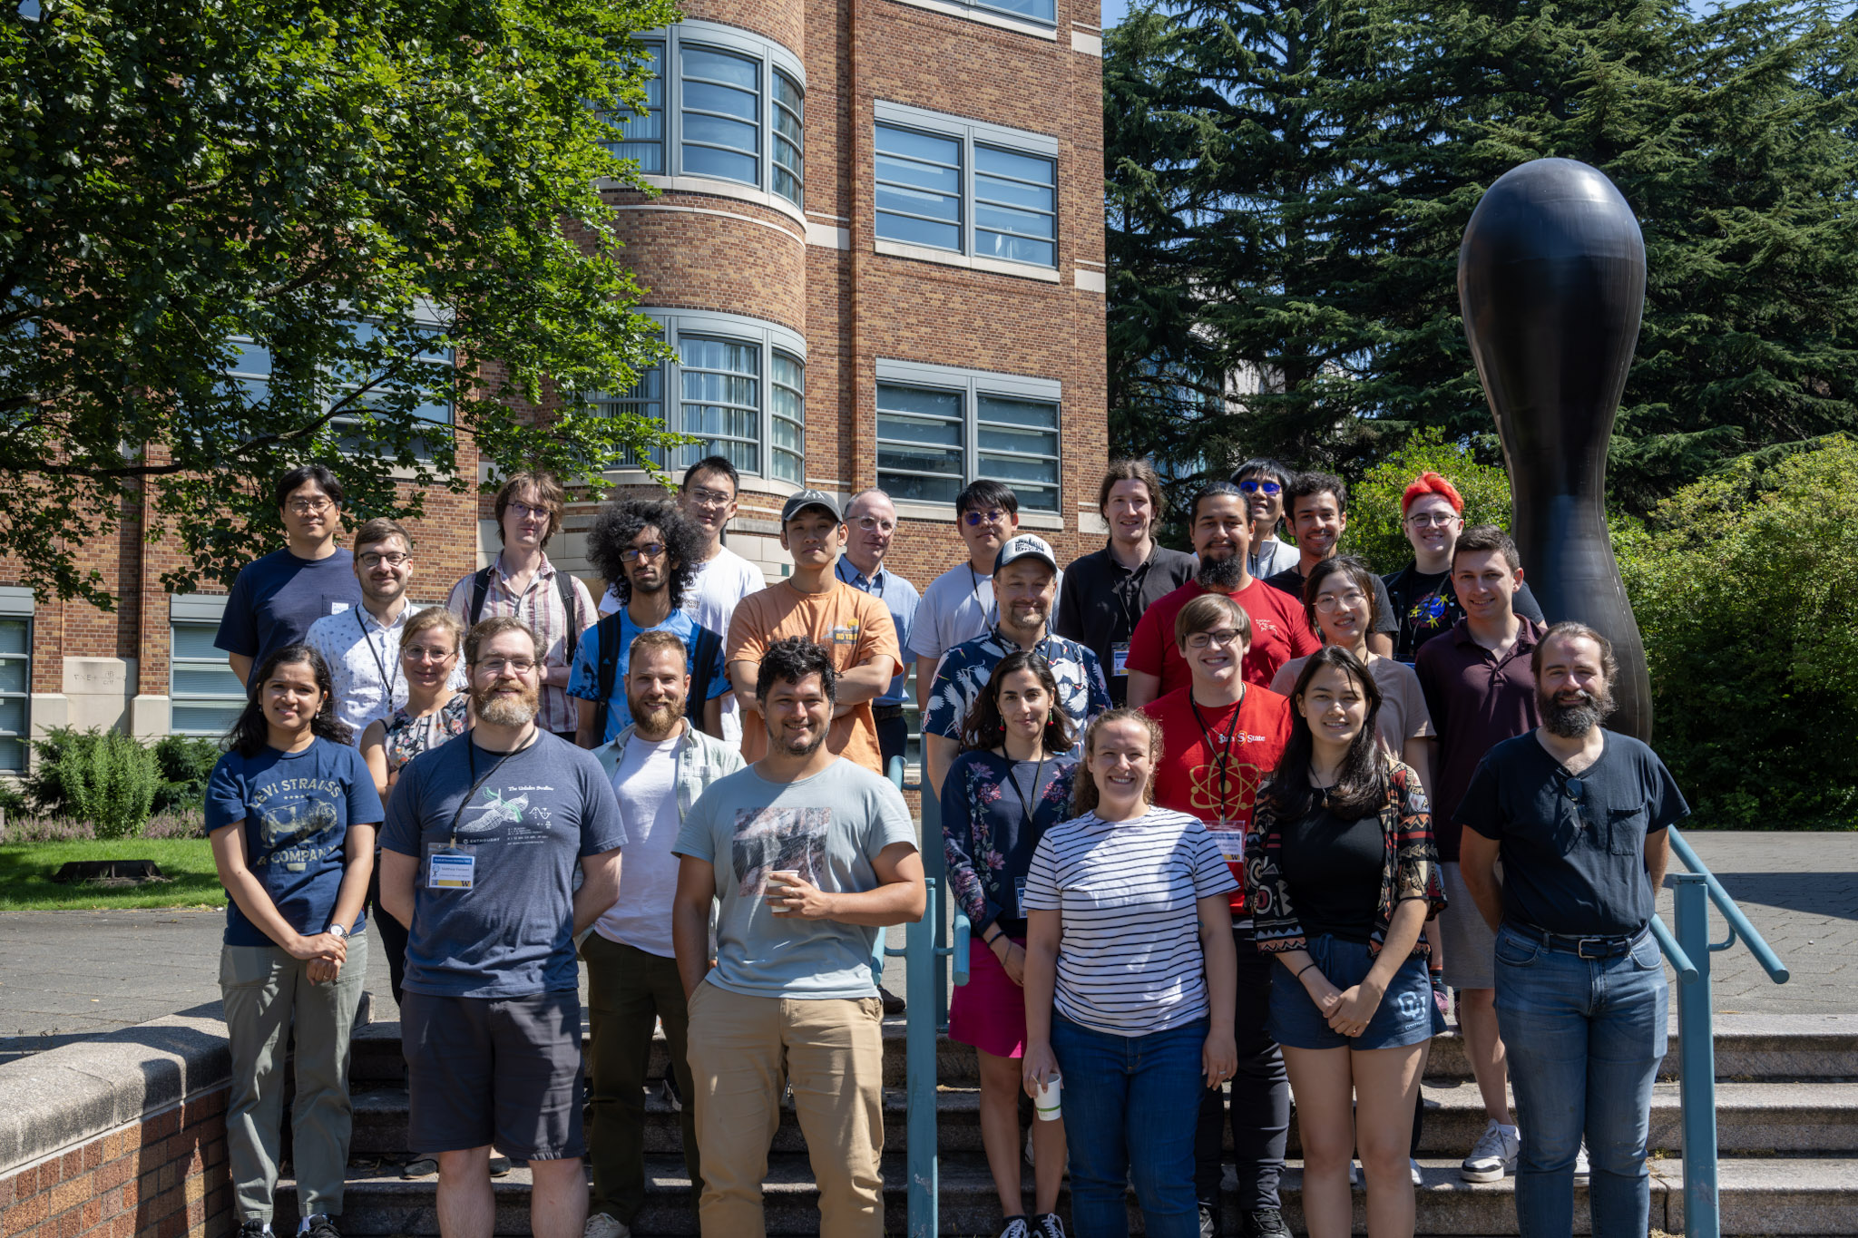
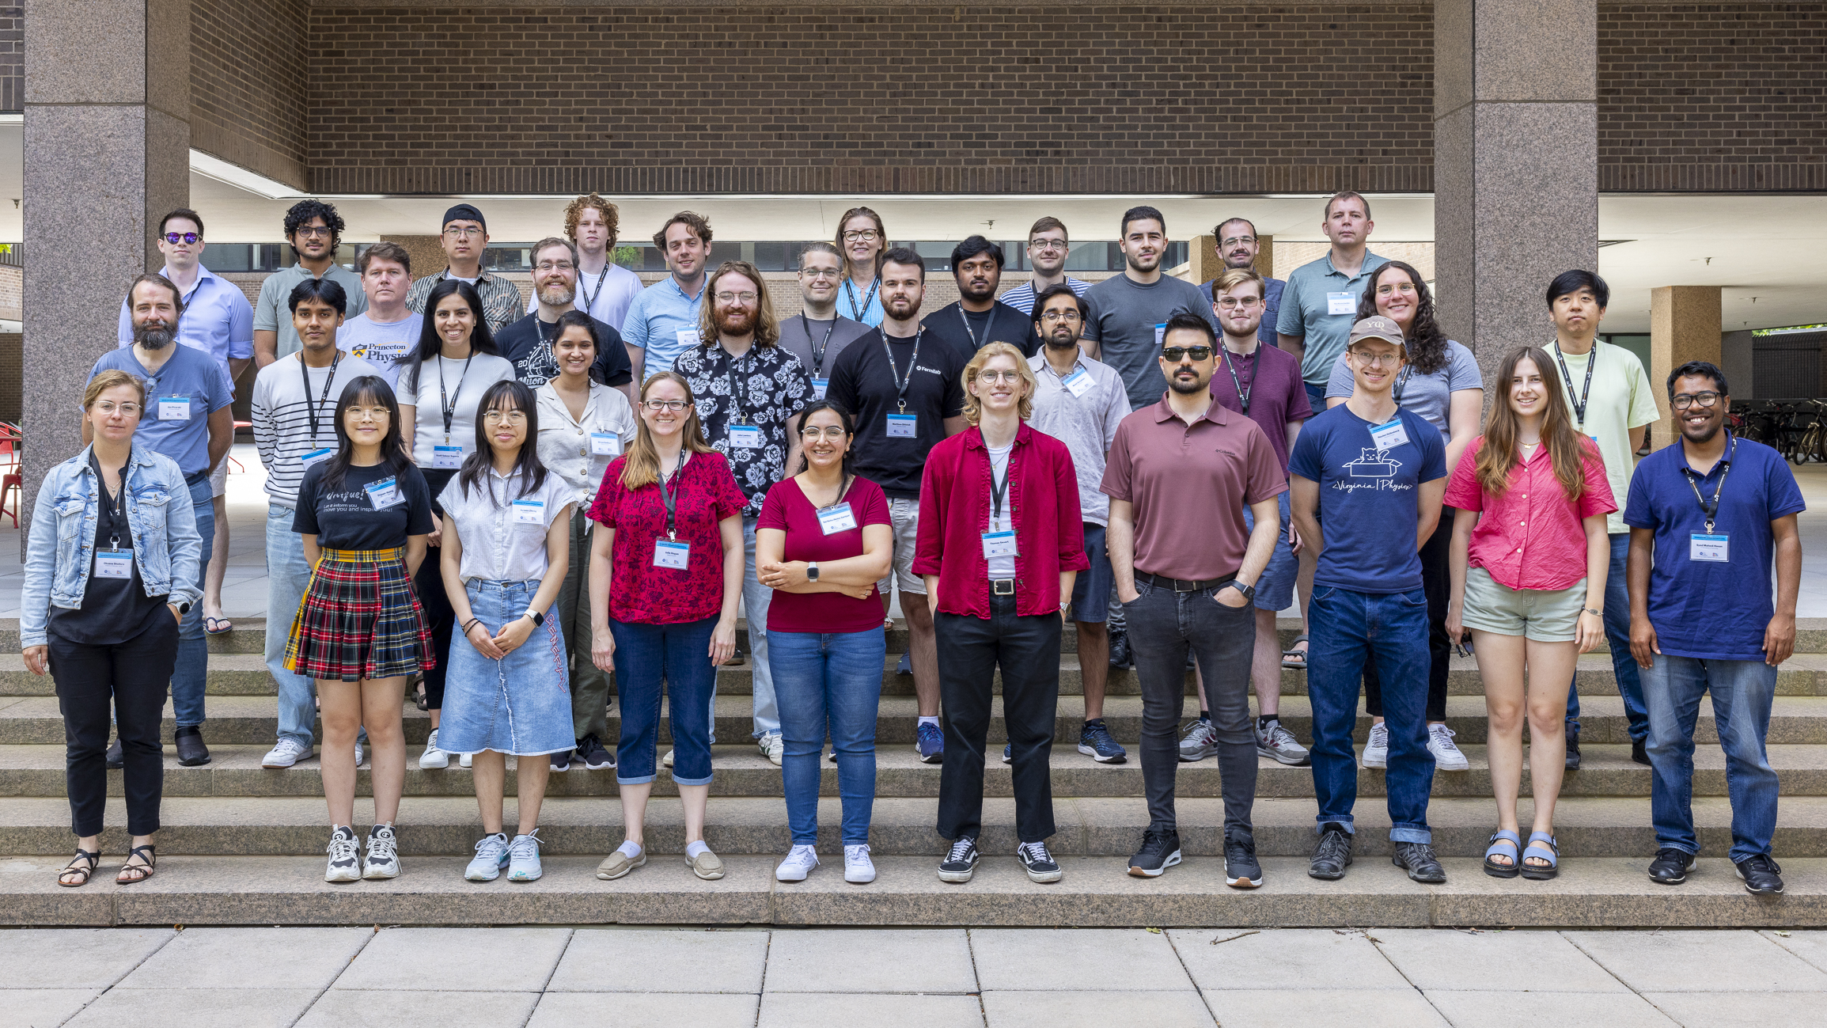
US OPS Training
Last Time!
US-ATLAS (Seattle)
US-CMS (Princeton)
2 Days of training post-summer meeting agenda.
30 at US ATLAS, 37 at US CMS
Topics included Columnar analysis, Distributed analysis, Data Visualization, Coffea, Analysis Facilities, and Statistical Tools.
Students did not have to pay for the flight for the summer meetings on their grant’s dime.
IRIS-HEP paid for graduate students (and some undergrads) attending: $750 for flights, lodging for the training, meals.

Slide 8
US OPS Training
Both OPS programs would like us to repeat this year.
 | Dates | Training Dates
US ATLAS, UMichigan | July 21-23 | July 24-25
US CMS, Rice University | May 21-23 | May 19-20
Working with local organizers to finalize training events organization
  Rooms for students, room for training, catering, dinner, etc.
We will do the same travel deal as we did previously
  Up to $750 for flights to attend from the USA
  Accommodation for the training days
Will give graduate students training on tools and analysis and reduce per-grant costs for summer meeting attendance.

Slide 9
IRIS-HEP Sponsorship
Software/Computing: “LHC to Future Colliders” Ecosystem workshop
  spring 2025 TBD, probably at Princeton
USCMS/IRIS-HEP 2025
  19-20 May 2025 (at RiceU, USCMS itself is 21-23 May 2025)
MODE Workshop (differentiable programming)
  9-13 June 2025 (Crete)
HSF-India Bangalore (16-22 Jun 2025)
USATLAS/IRIS-HEP 2025
  24-25 July 2025 (at U.Michigan)
CoDaS-HEP 2025
  21-25 July 2025, at Princeton
JuliaHEP 2025
  28-31 July, 2025, at Princeton
IRIS-HEP Retreat Sep or Oct 2025 TBD, at or near CERN likely
Connecting the Dots 2025
  will be in Fall 2025, at UTokyo (dates still TBD, soon)
We are quite active in both running and sponsoring various workshops
“Intellectual Hub” effort
Some of these we organize
Some of them we provide significant help
Some we sponsor directly
Some we organize to send non-IRIS-HEP US participants to

Slide 10
HL-LHC analysis blueprint
Benchmark analyses to demonstrate our workflows
Benefits both facilities and tool developers in the community (and IRIS-HEP)
Get away from “simplified” demos into something that is truly relevant to analyzers
  We already are a long way down this road – but – we’d like to do better!
February Software & Computing Week(s)
ALICE, ATLAS, CMS, LHCb are all meeting the first week of February at CERN.
Joint meetings between ATLAS and CMS already planned
  e.g. One session motivated by the LHCC Analysis Facilities questions (3c/3a).
Can we carry this conversation further?
Input from the LHCC drafts
Survey circulated inside the experiments
Meeting/2-day workshop in early March (Hybrid Zoom/CERN room)
  Artifact: Report with Run 4+ Analysis assumptions, and some benchmark analyses, and some idea of future collaboration possibilities.
  Discussion guided by survey responses (“lightning talks”) and more regular experiment contributors.

Slide 11
Questions & Comments?

