Slide 1

CMS Recovery systems
M. C. Arena, A. D’Auria, R. Guida, B. Mandelli
CMS Gas System Status meeting, 21/03/2024

Slide 2
Overview - CMS Gas Recuperation
CMS CSC CF₄ Recovery System →
recuperate CSC exhaust mixture (Ar/CO₂/CF₄) and separate good quality CF₄
CMS RPC R134a Recovery System →
recuperate RPC exhaust mixture (R134a/iC₄H₁₀/SF₆) and separate good quality R134a
Storage system for both plants to inject the recovered gas in variable proportion into the mixer along with the fresh gas

Slide 3
CSC CF₄ Recovery system

Slide 4
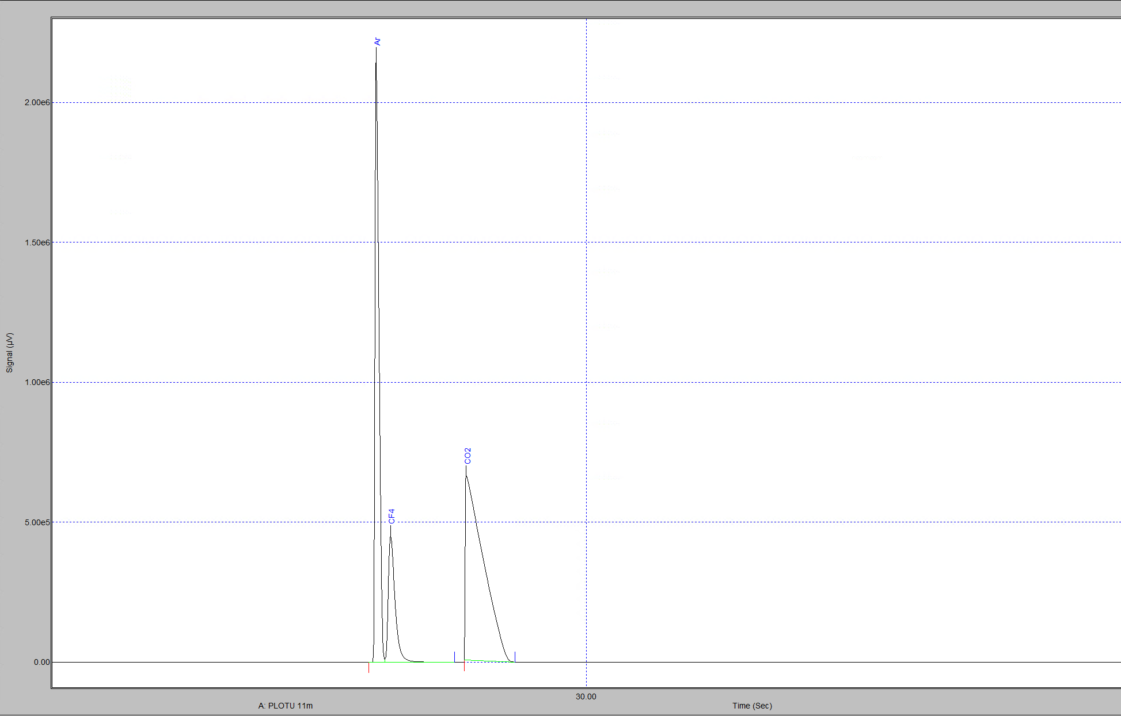
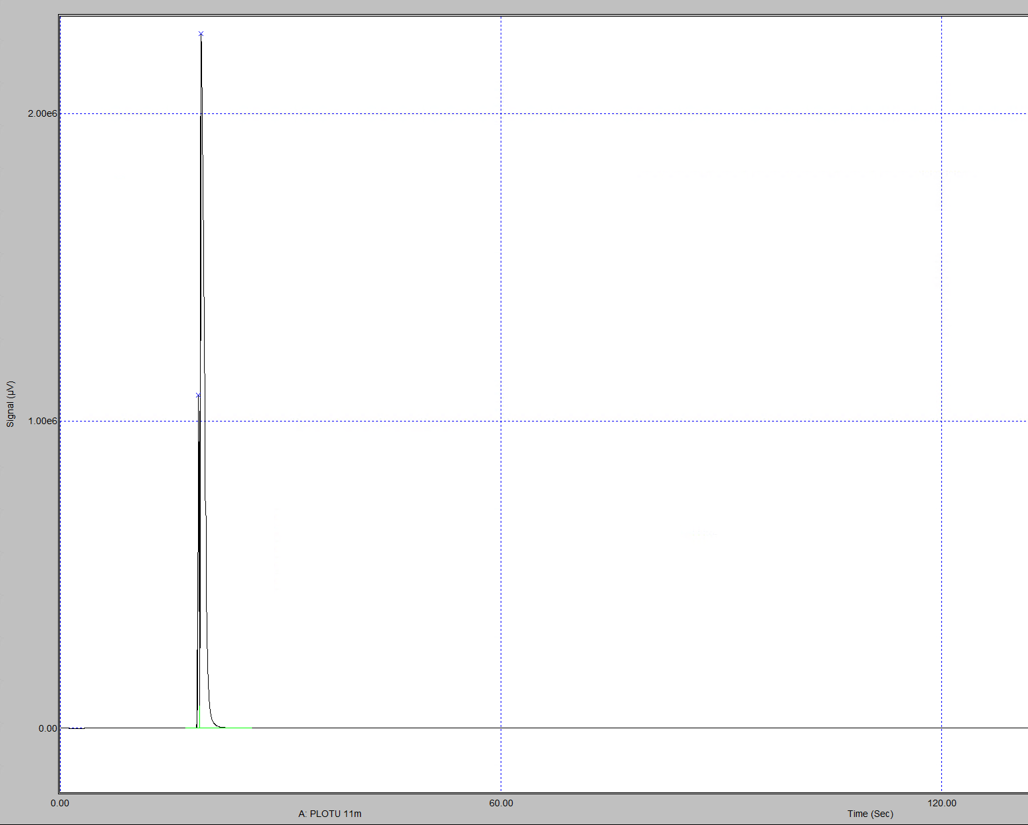
CSC CF₄ RECUPERATION
Monitoring
CSC mixture
Daily monitoring of the status of the recovery system (efficiency, pressures, status of absorbers)
Weekly analyses of the gas recovered and stored in the batteries → 30-50 analyses, 4 hours (necessary to reach the stability of gas composition)
Monitoring of the batteries to schedule the swap for the CF4 recuperated injection in the mixer→
  analyses of CSC mixer before and after the battery swap
  analyses of the battery used for the injection to calculate the right ratio in the final gas mixture
  100-150 analyses, 1-2 days for the procedure
  Calibration and monitoring of SWPC system in parallel
Recovery Battery

Slide 5
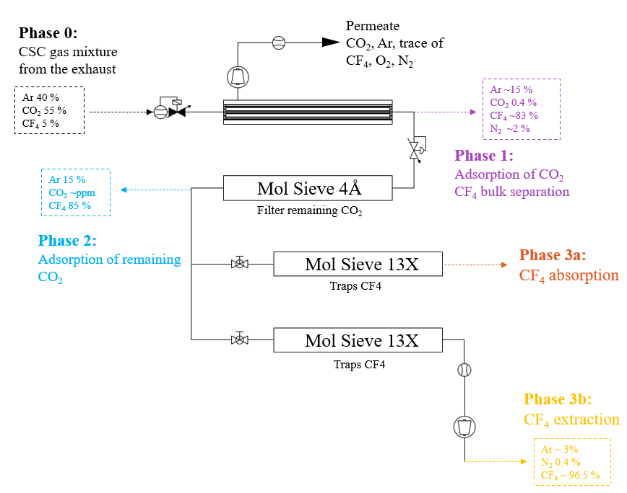
CF₄ recovery plant
Recuperation process
Phase 0 → CSC gas mixture is injected in the first module of the recovery system from the Exhaust module
Phase 1 → the gas passes through the membrane module optimized for the CO2 separation; CF4 is recovered at the retentate side with 15% of Ar, 0.4% of CO2 and 2% of N2
Phase 2 → All the remained CO2 is absorbed in the MS 4Å
Phase 3 → CF4 is absorbed in the MS 13X, N2 and Ar are vented and the CF4 is then recovered through pressure swing adsorption
Phase 4 (3b) → CF4 is extracted and stored in the battery, ready to be reinjected in the mixer
Plant operational since 2012,
a lot of tuning and upgrades realized
Ar ~ 10%
CF4 ~ 89.6%
N2 ~ 0.4%

Slide 6
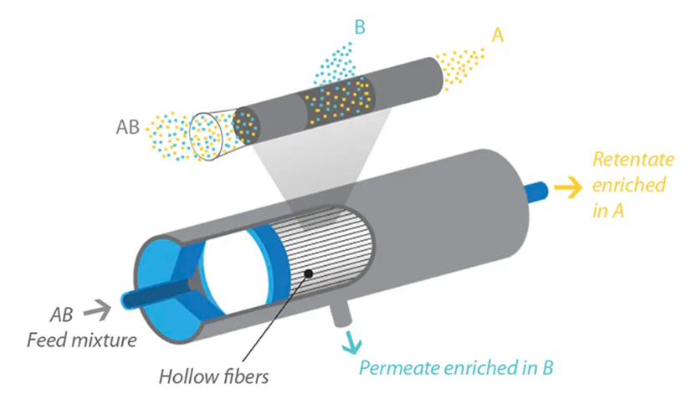

Gas separation techniques
Membrane separation
Separation process is driven by →
  Partial pressure gradient
  Nature of membrane (chemical structure)
  Permeability → capability of a membrane to permeate gas molecules
  Solubility →thermodynamic parameter given the amount of penetrant absorbed by membrane
  Diffusivity → dependent on geometry of penetrant: if molecular size increases the coefficient decreases
$$P=Diffusivity \left(D\right) ×Solubility (S)$$
$$α=\frac{P_{A}}{P_{B}}$$
Permeability A
selectivity
Permeability B
Ability of a membrane to separate two molecules
Notes:
Aggiungere absorber

Slide 7
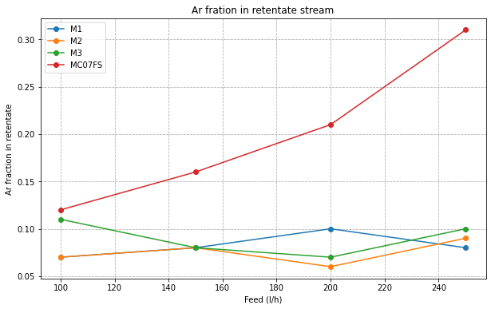

CF₄ recovery plant
R&D Membrane module
 | Model | Working flow | Specifications
Membrane 1 | CO-C10 | Up to 300 l/h | High thickness and density gradient
Membrane 2 | CO-C10A | Up to 300 l/h | High thickness and density gradient
Membrane 3 | CO-C10A | Up to 300 l/h | High thickness and density gradient
Membrane 4 | CO-410A | More than 600 l/h | High thickness and density gradient
Memb. Highly sensitive | CO-C07FS | Up to 300 l/h | Reduced thickness and density gradient
Ar fraction in retentate stream is a contamination of our recuperate gas → C07FS not good for our purpose
$ε$= $\frac{{\text{Φ}CF}_{4 retentate side }}{\text{Φ}{CF}_{4 feed}}$

Slide 8
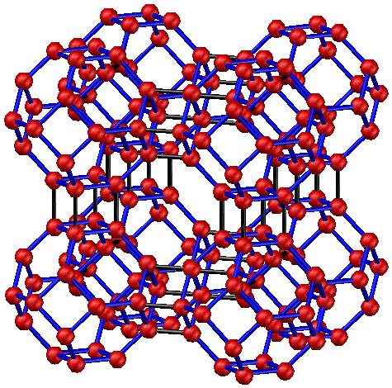
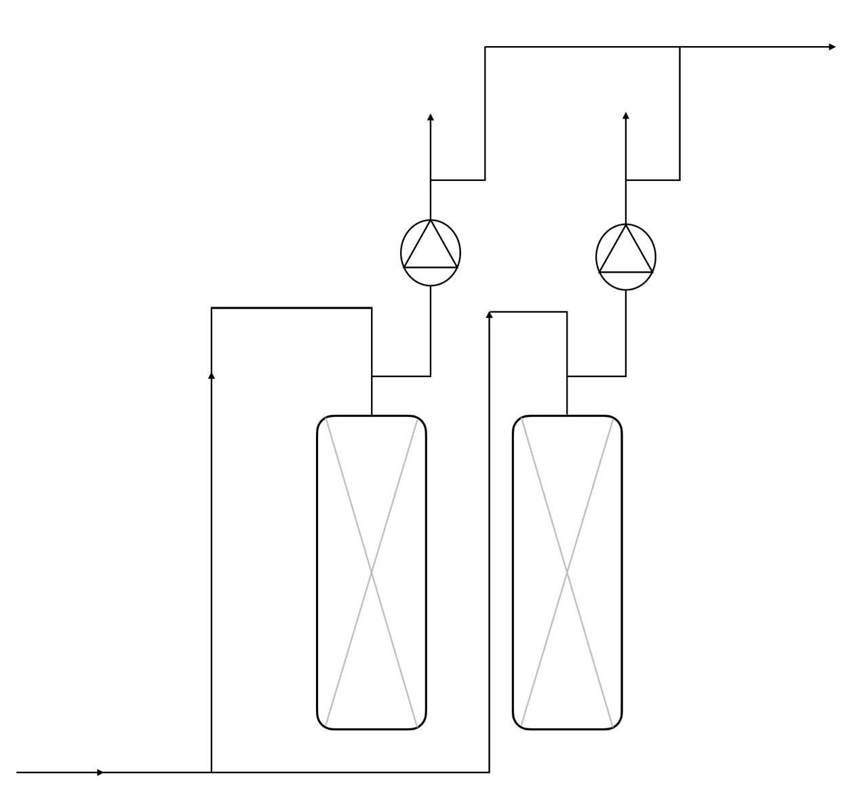
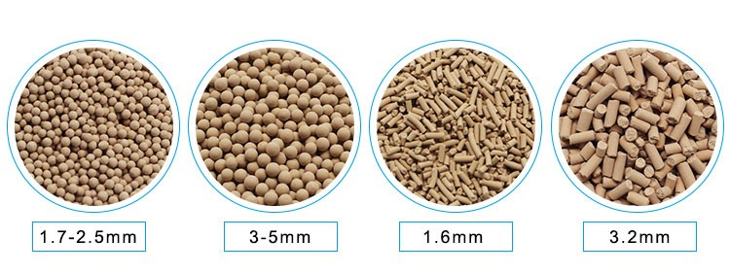
Gas separation techniques
Thermal Swing Adsorption & Pressure Swing Adsorption
PRESSURE SWING ADSORPTION (PSA) → contaminated feed stream is fed to the sieve beds at high pressure and then the sieve bed pressure is reduced to regenerate the MS and remove adsorbent contaminants. Vacuum regeneration has the advantage of not overheating the material, avoiding break down processes.
Structure model of 4Å molecular sieve
MS 3A
MS 4A
MS 5A
MS 13X
ABSORPTION
DESORPTION
Schematic view of an absorber module of gas system
Notes:
Aggiungere absorber

Slide 9
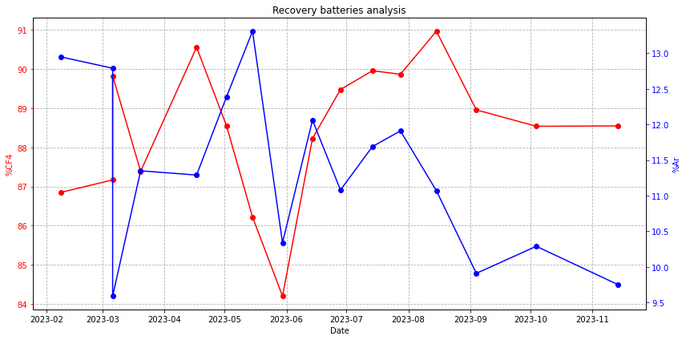
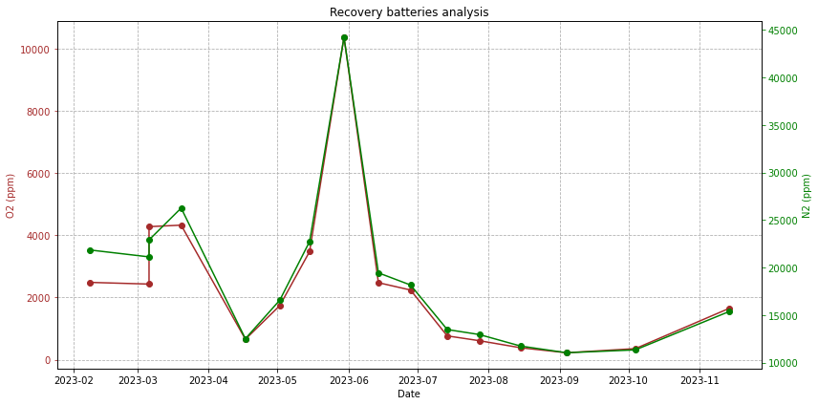
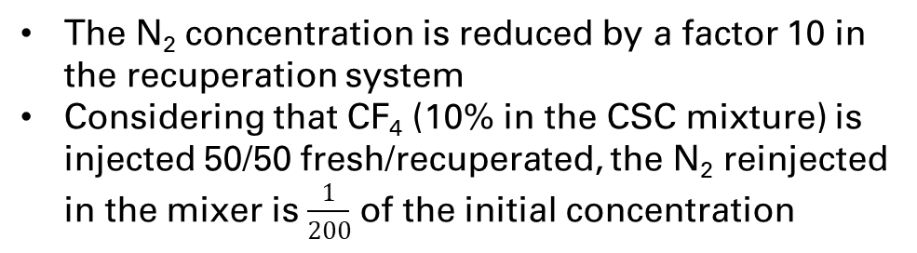
CF₄ recovery plant
Recuperation batteries
Problem with pump module
Problem with pump module
2023-2024 average
composition of the battery
Ar 11%
CF₄ 88%
N₂ 1.9%
O₂ 0.2%
The N₂ concentration is reduced by a factor 10 in the recuperation system
Considering that CF₄ (10% in the CSC mixture) is injected 50/50 fresh/recuperated, the N₂ reinjected in the mixer is $\frac{1}{200}$ of the initial concentration

Slide 10
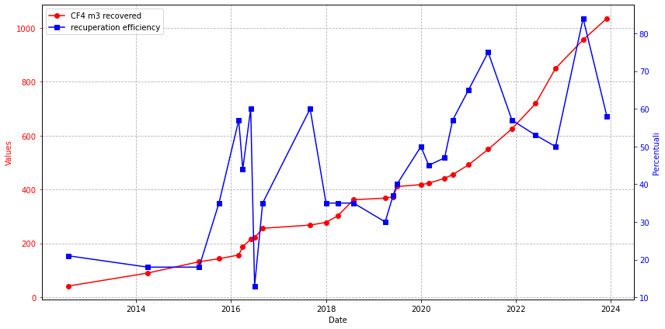
CF₄ recovery plant
Recuperation summary
Efficiency mean value: 70% in the period January-November 2023, (higher than 2021 and 2022, 65% and 51% respectively)
In 2023, out of 358 m³ of CF₄ injected into the mixer, 242 m³ were recovered CF₄ (70%)
2023 → 300m³ and 60kCHF saved
2012 → 42m³
The CF₄ recuperation system is also important to overcome possible CF₄ shortage → in 2023 no fresh CF₄ available

Slide 11
CSC CF4 RECUPERATION
Status & Plans
Smoothing of input flow from Exhaust module to improve the membrane separation
New membranes to test for the CF₄ separation:
1. new polyimide membrane
2. carbon nanotube membrane
3. zeolite membrane
Code upgrading for the CF₄ Absorber module (now Col 1 does more cycles than Col 2)
New compressor for Battery module

Slide 12
RPc R134a Recovery system

Slide 13
RPC R134a RECUPERATION
Monitoring
Daily monitoring of the status of the recovery system (efficiency and status of the 4 columns)
uGC analyses of the gas recovered and stored in the bottle perfomed twice per week → 30-50 analyses, 3 hours (necessary to reach the stability of gas composition)
Monitoring of the quality of the gas extracted by each column through uGC analysis→ check of the efficiency for the single column(30-50 analyses)
R&D
Lot of parameters still need to be tuned →
  New Huber installed changed the equilibrium of the system
  Daily tests to find the new best configuration (since beginning of February 2024)

Slide 14
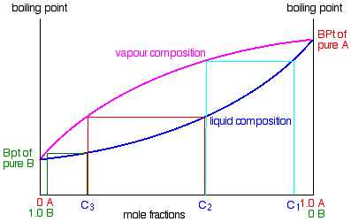
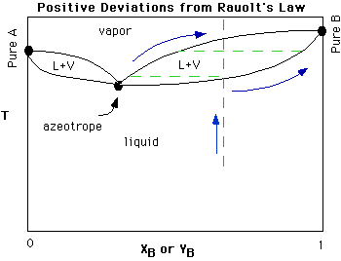
Gas separation techniques
Distillation
The composition of vapor phase depend on the initial one of the liquid phase →
lighter (lower-boiling) component tend to concentrate in vapor phase
heavier (higher-boiling) component tend toward the liquid phase
Simple distillation → Can be used when the components have widely different boiling points (>100˚C)
Typical liquid-vapor plot
Fractional distillation → Fractionating column allows for many successive distillations to take place at once. It contains packing material with lots of surface area. The vapours temporarily condense on these surfaces and the heat of the distillation allows those pools of liquid to vaporize again. Every vaporization-condensation event (called a "theoretical plate") is like a simple distillation, and each event enriches the distillate in the lower boiling component.
Purification method to separate 2 or more compounds based on differences in boiling points or volatility
Minimum boiling point azeotrope
Notes:
Aggiungere absorber

Slide 15
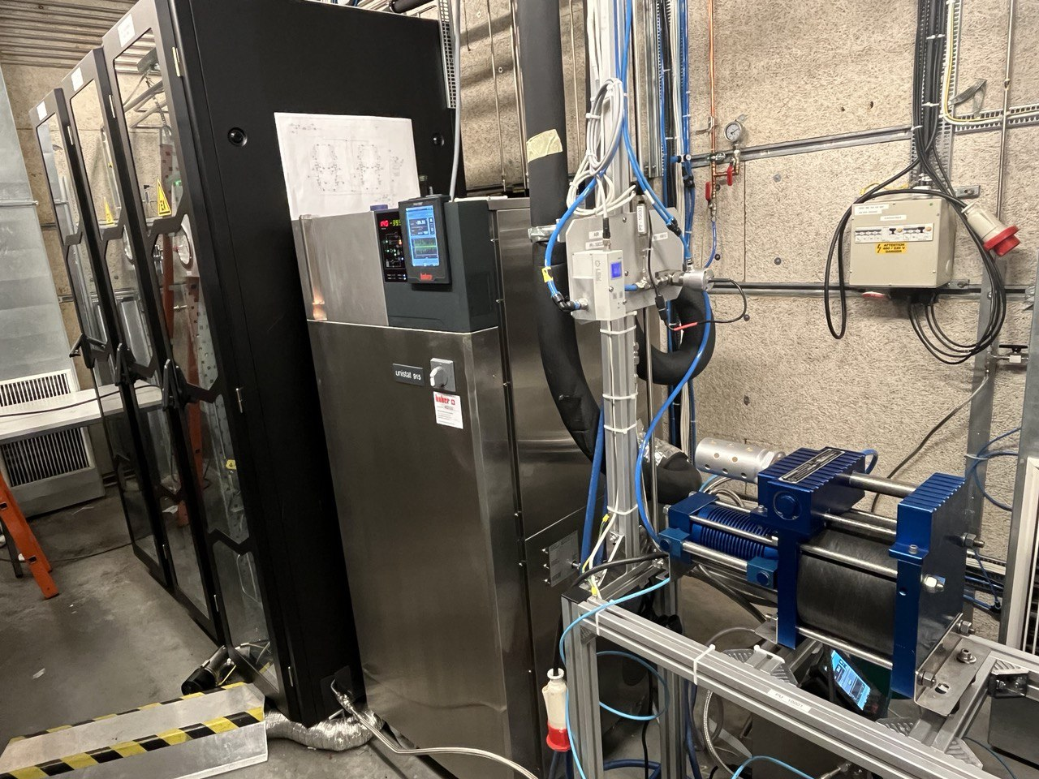
RPC R134a RECUPERATION
Plant Overview
New system installed in April 2023 and tests started in May 2023
Goal: to recover the R134a from the mixture R134a/SF₆/iC₄H₁₀
Problem: R134a forms an azeotrope with iC₄H₁₀
2 racks for the separation columns, 2 columns each
The system was designed to work both in series and in parallel
The plant was designed following the tests done between 2020 and 2022
SEPARATION MODULES
COMPRESSOR
CHILLER
ELECTRICAL RACK

Slide 16
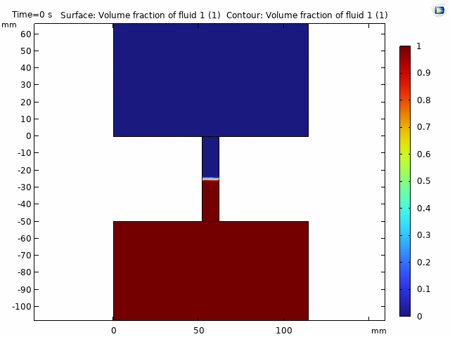
RPC R134a RECUPERATION
Separation process
Azeotrope → mixture that exhibits the same concentration in the vapor phase and the liquid phase. This contrasts with ideal solutions with one component typically more volatile than the other
Vapor&liquid
Vapor&liquid
Slow heating of liquified azeotrope (blue curve) allows to enrich the liquid of R134a and the vapor phase of iC₄H₁₀
Thermodynamic simulation done by M. Bruno (PoliTO)

Slide 17
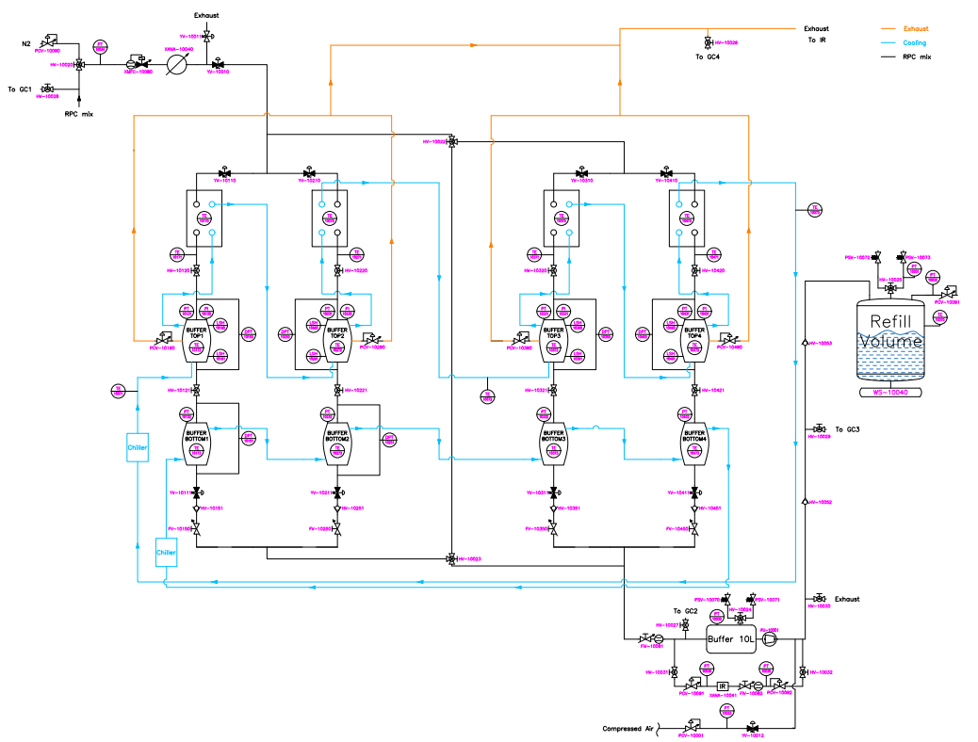
RPC R134a RECUPERATION
Plant Overview
Optimal conditions:
  Filling rate → 200 l/h up to 600 l/h
  Chiller Temp. → -36.2°C
  Top buffer P → 10 mbar (C1&C2), 35 mbar (C3)
  Bottom buffer T → 20°C
  Emptying rate → 600 l/h (air)
FLAMMABLE EXHAUST
Heat exchangers
Top Buffers
Bottom Buffers
Compressor module
80% of Recuperation Efficiency

Slide 18
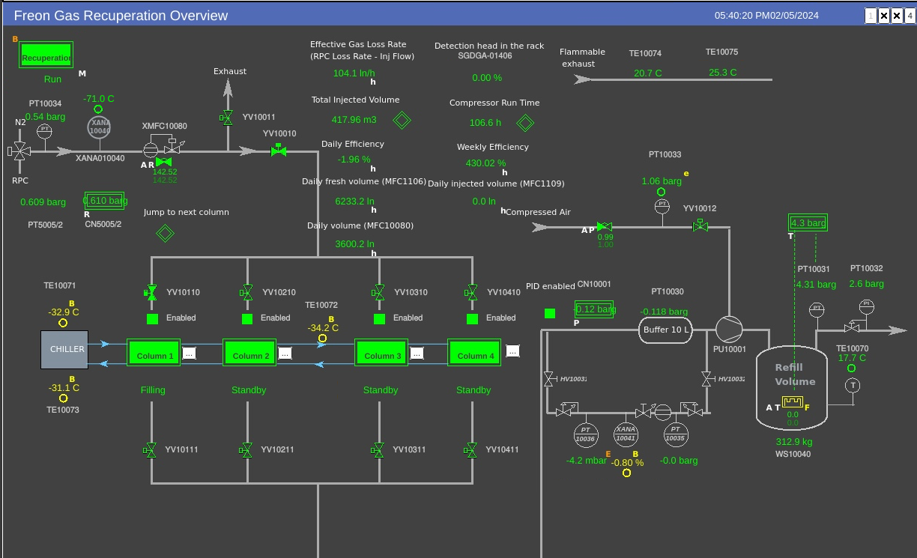
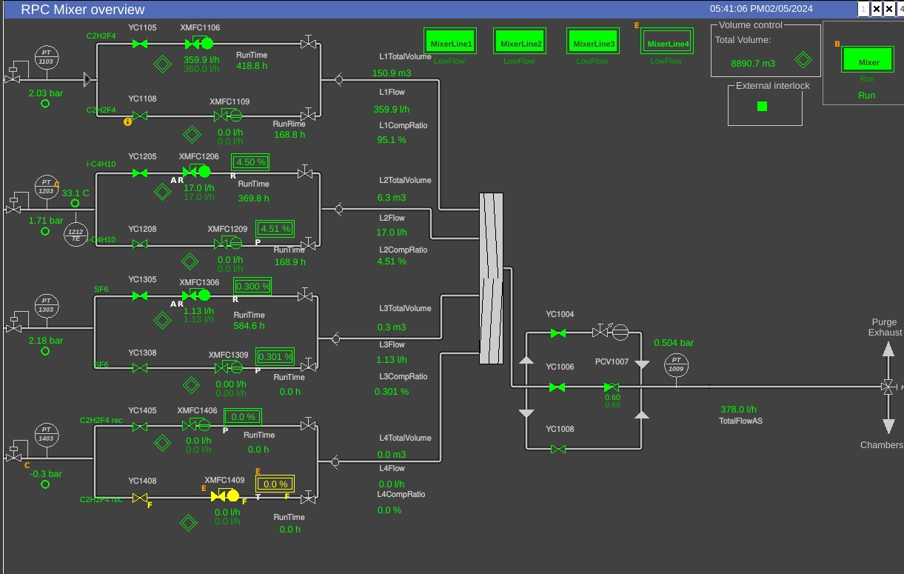
RPC R134a RECUPERATION
Software
Dedicated mixer line for R134a recuperated

Slide 19
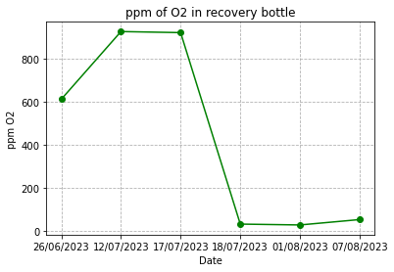
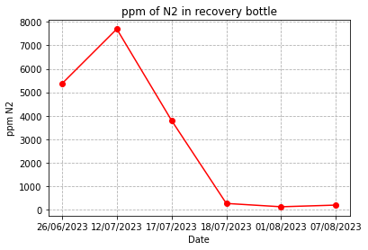
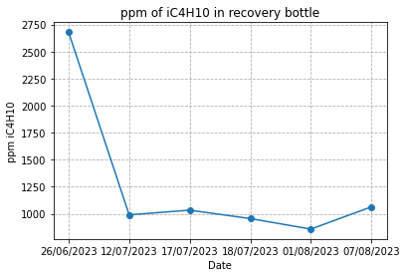
RPC R134a RECUPERATION
Recuperated R134a Quality
More than 70 tests were performed to find the best parameters for the plant
Now new tests required to obtain the same conditions with new chiller
Now we are injecting 15% of recuperated R134a in the RPC gas mixture → 40 ppm iC₄H₁₀

Slide 20
RPC R134a RECUPERATION
Status & Plans
DONE →
New cooling unit Huber installed
Recuperation system works with an input flow up to 500 l/h
NEXT→
Tests ongoing to find the best temperature with the new chiller
Evaluation of parallel vs series cooling on the next plant
Buy spare chiller

Slide 21
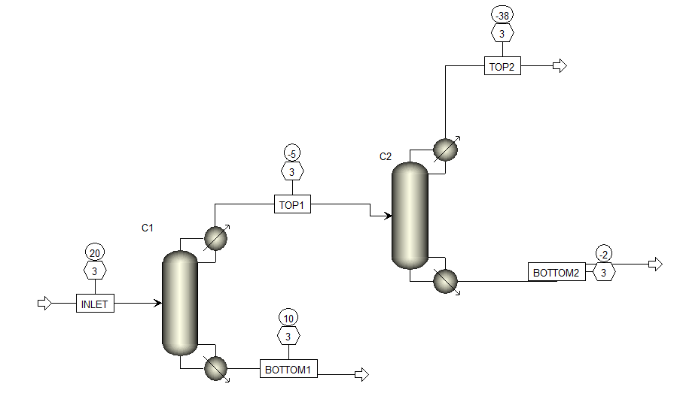
RPC R134a RECUPERATION
New SF₆ recuperation plant
Studies on SF₆ solubility in R134a ongoing
SF6: 0,126
ISOBUTANE: 0,22
FREON: 0,62
N2: 0,04
SF6 : 0,591
ISOBUTANE : 1,27 E-10
R134A : 0,00022
N2: 0,408
Two distillation columns for reasonable reflux ratio (from 140 to 20/20)
output mixture composition:
59% SF₆ , 40% N₂, 1% freon + residue of isobutane
→ Easier to separate in the second stage with a membrane or a MS that are more selective for SF₆ → test ongoing
SF6: 0,013
ISOBUTANE: 0,7934
R134A : 0,19
N2 : 0,0036
SF6: 0,075
ISOBUTANE: 0,240
R134a: 0,684
N2: 1,23 E-13
SF6: 0,00189
ISOBUTANE: 0,85
FREON: 0,148
N2: 8,32-09

Slide 22
Conclusions
CSC - CF₄ Recuperation Plant
  Recuperation efficiency ~ 70% reached in the last year
  (after completion of intense R&D activity done in 2020-2021)
  Plant operational at design condition
  recuperation + injection of recuperated CF₄
  in few occasions recuperated CF₄ allowed to
  overcome problems with standard CF₄ fresh supply
  RPC - R134a Recuperation plant
  Recuperation efficiency ~ 80%
  Recuperated R134a of good quality
Improvements still necessary to reach operation requirements

