Slide 1
Site and Civil Engineering Department
CERN Workspaces / ERGON @CERN
Araceli Alvarez Escobar, Pieter Mattelaer
CERN, 6 Month 2024

Slide 2
Agenda
CERN WORKSPACE OFFER
Healthy workspaces
Current regulations
CERN population
New vision
NEW OFFICE BUILDINGS (777 & 140)
Location and scope
Procurement & contract strategy
Timelines
Current progress

Slide 3






CERN WORKSPACE OFFER – Healthy Workspaces
WORKSPACE
- Place in which you work, such as your desk in an office.
- The architectural typology of office buildings encompasses more functions and expands the program’s spectrum; The contemporary configuration integrates numerous “third places”.
- The workspace has different scales, especially at CERN. Our workspace starts already from the moment we cross the CERN gate and ends with the dimension of our table or the transparency of our office’s door.
HEALTHY
- Physiologically healthy (ergonomics, air quality, natural and artificial light….)
- Psychologically healthy (motivation, collaboration, interaction, exchange, integration, equality…)
- Healthy habits and wellness (walking, moving, spending time outside …)
offices, meeting rooms, cafeteria, classrooms, break corners, print corners…
Shared bike/car, shuttle…
clubs, areas, gym, changing rooms…
hotels, restaurant, library…
CERN WORKSPACE OFFER
restaurants, picnic areas, coffee corners…
clubs,changing rooms, gym restaurant, events, conferences, library…
Free time
Offices, meeting rooms, cafeteria, classrooms, break corners, print corners…
restaurant
Shared bike/car, shuttle…
~8h
~4h
~1h

Slide 4
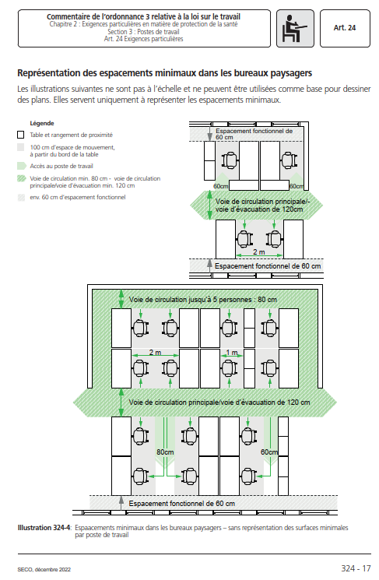
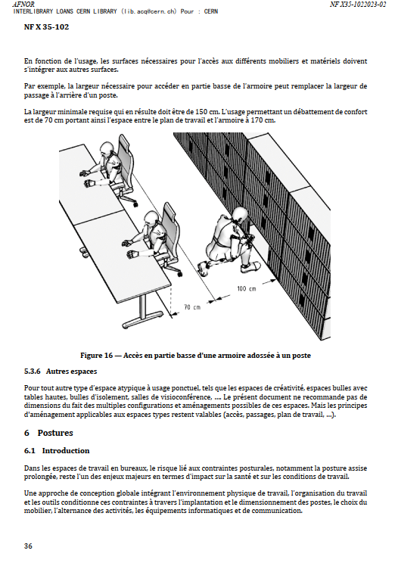
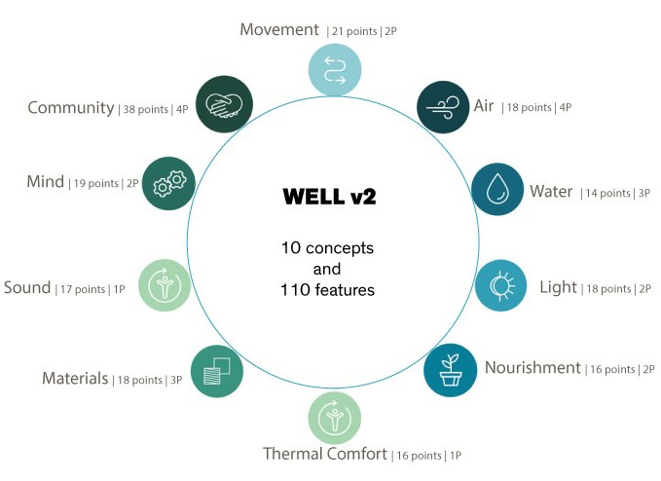
CURRENT REGULATIONS
___________________________________
CERN Space Management Policy
The process to produce a Space Strategy will engage with all Departments and Units at CERN. Profiting of the existing Space Management Forum (SMF), SCE proposed a work plan that:
Defines space regulatory framework for offices and common space management (HSE)
Working group “Official guidelines for offices and common space allocation”
Working group ”Space processes, tools and operational procedures”
Working group ”Space management data and KPIs”
___________________________________
The WELL Building Standard (V2)
Vehicle for buildings and organizations to deliver more thoughtful and intentional spaces that enhance human health and well-being.
Set of strategies that aim to advance human health through design interventions and operational protocols and policies and foster a culture of health and well-being.
Swiss code (since 12/2022): Commentaire de l’ordonnance 3 relative à la loi sur le travail
NF X 35-102 (since 02/2023): Ergonomie — Conception ergonomique des espaces de travail en bureaux
CERN SPACE MANAGEMENT POLICY (on going)
WELL Building Standard (international certificates being used as an inspiration for CERN)

Slide 5
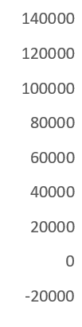



CERN POPULATION
TERTIARY INFRASTRUCTURES AT CERN (m2)
POPULATION
Diversity of contract durations and ages
Potential change in the Organization’s structure every 5 years
Diversity of activities, services and professional profiles
International environnement
General interest in innovating, learning and collaborating
Knowledge based organisation
Human beings (perception of colours, proportions, forms…)
ARCHITECTURE
Science-driven architecture (priorities, requirements, budget…)
Diversity of building typologies
High number of existing infrastructures and furniture
Fixed location
Uncertainty on the future spatial needs
Variable density (urban vs countryside)
SITE DENSITY (Km2)
27%
35%
39%
14%
64%
22%
SITE DAILY OCCUPATION (people)
IMPACT ON SURFACE (m2)

Slide 6
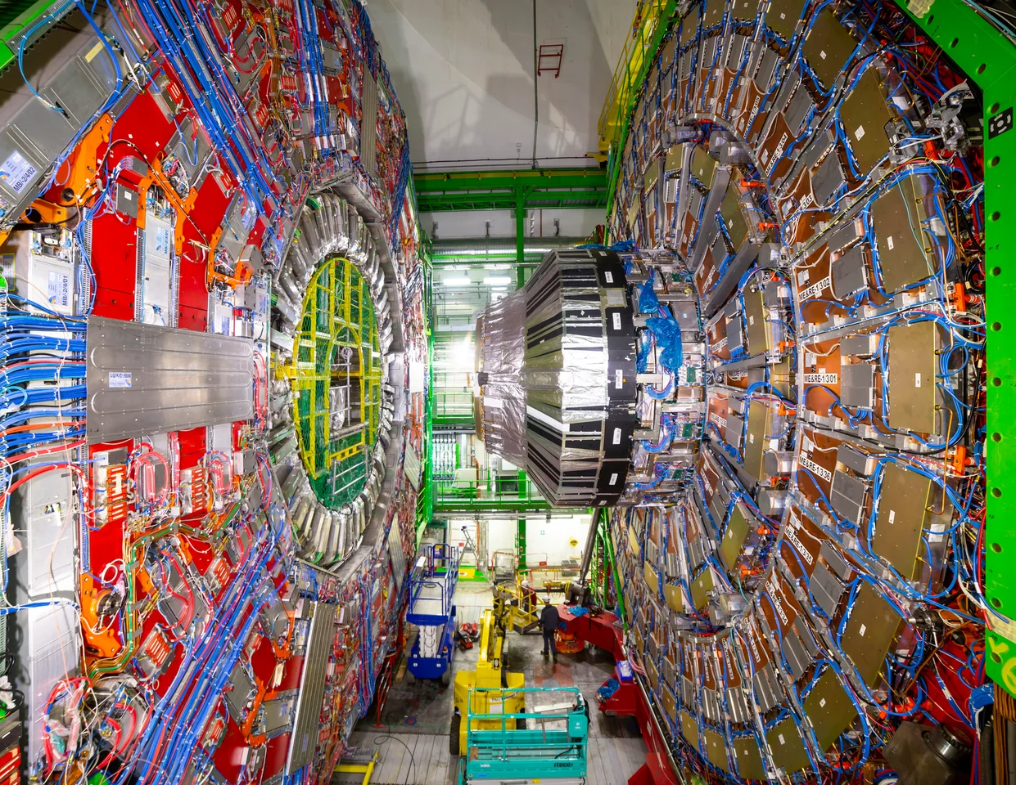
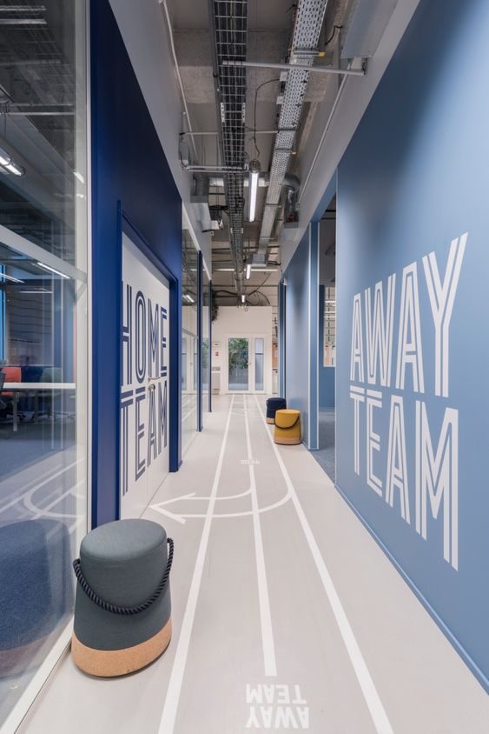
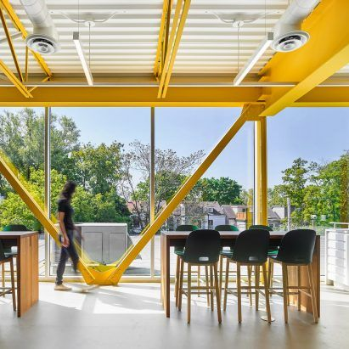
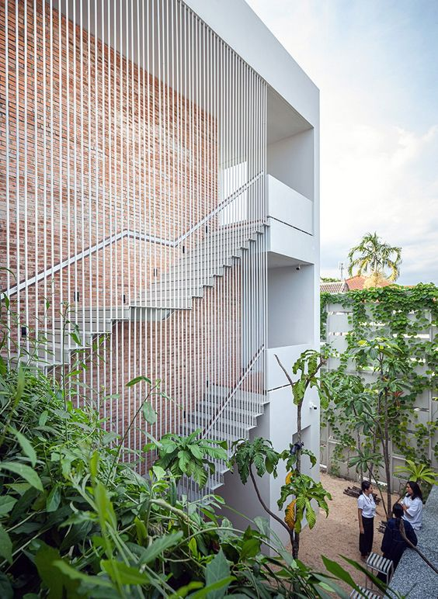
NEW VISION: Interior spaces
Combine different kinds of spaces in a “multi-space office” > answer to different types of activity and professional profiles
Façade, structure and finishings modularity > give flexibility
Increase shared areas > promote exchange and common services
Design efficient distributions > giving various uses to a space
Communicate > direct discussions with future users to guide and publish what is being done to give a sense of evolution
Use reversible construction systems
Use easy maintenance construction systems and materials > Visible installations, openable windows, …
Work with the existing > every existing building has its own schema and particular elements that must be put into value
Use visual effects and signage > colour contrast is an easy low-cost way to make spaces more understandable and user-friendly
Increase energy efficiency > space management, updated technical installations
Increase safety > upgrade in terms of safety regulations
Inspirational images

Slide 7
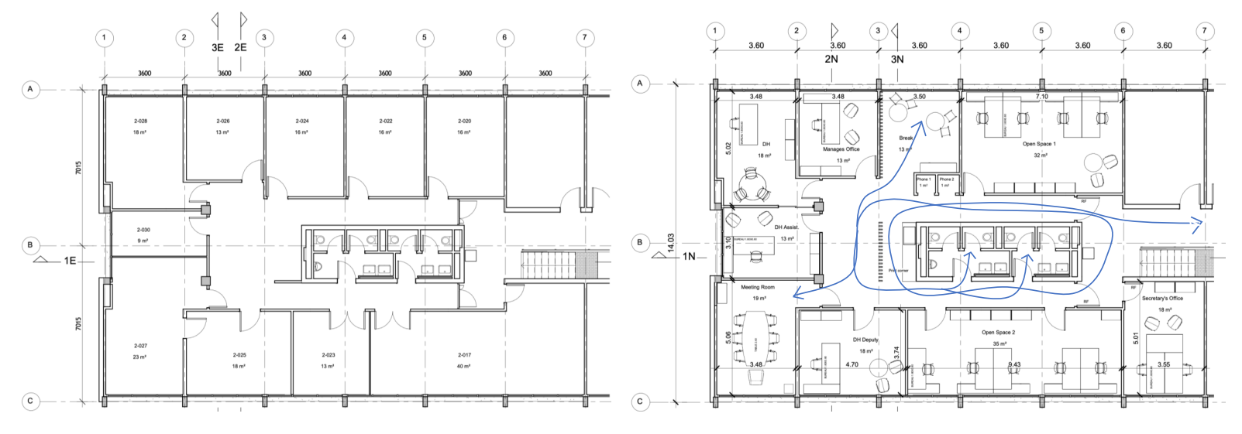
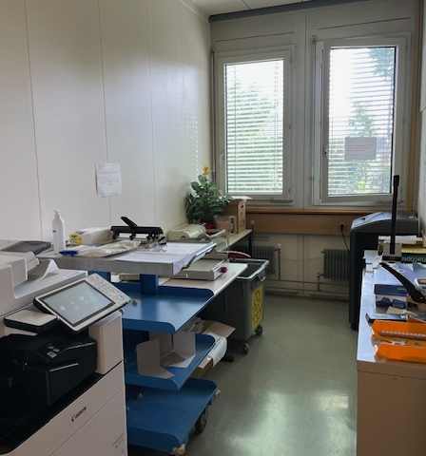
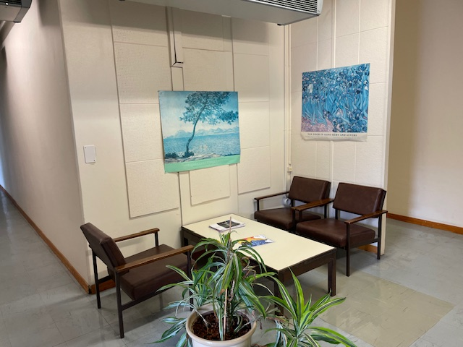
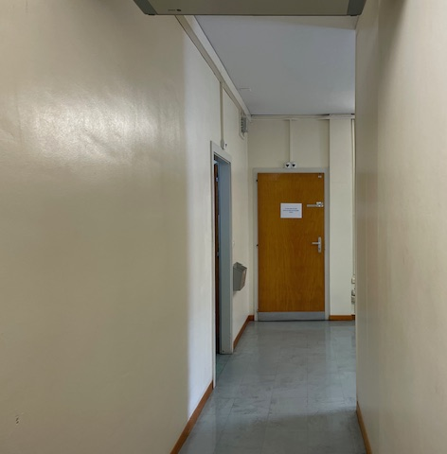
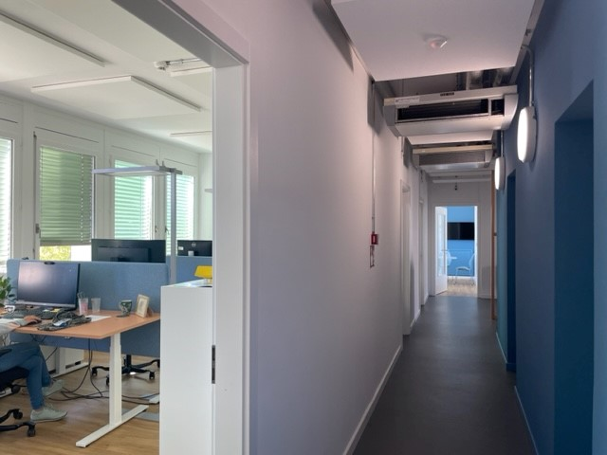
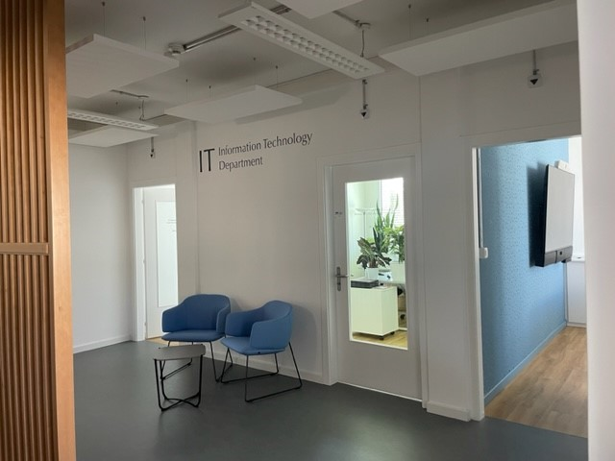
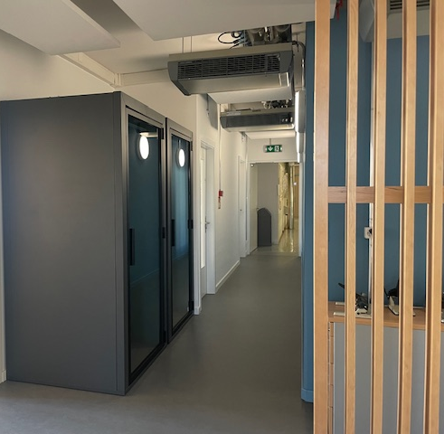
REFERENCES: CERN projects
BUILDING 31 2nd floor (IT Department)
Before
After
Gained 5 new workstations, 1 new meeting room, 1 new collaborative room (with 2 floating workstations) and 2 phone booths

Slide 8
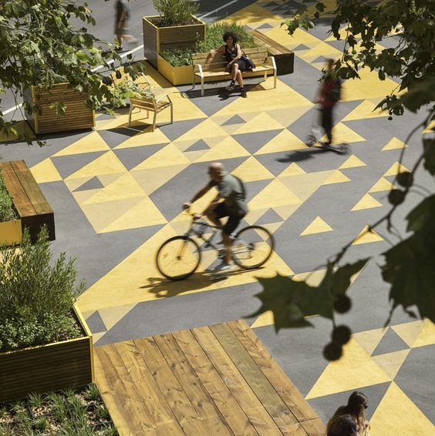
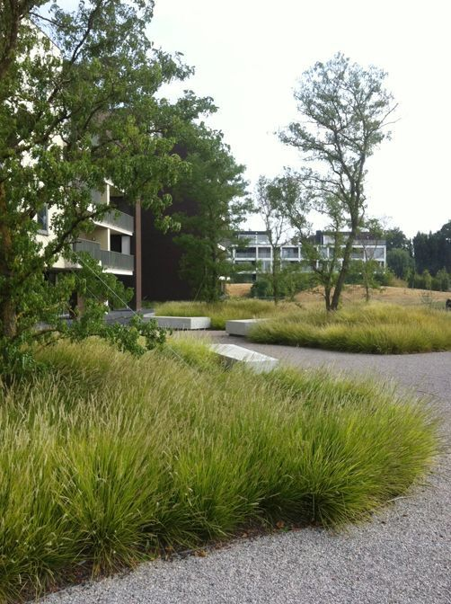
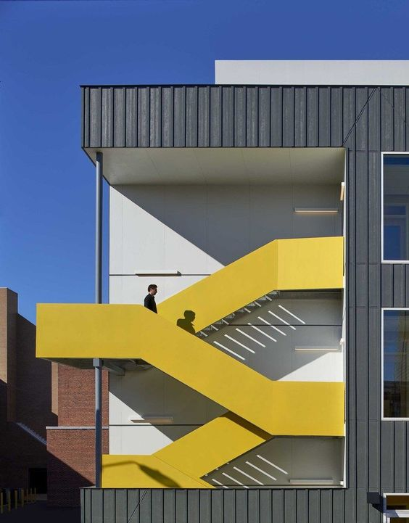
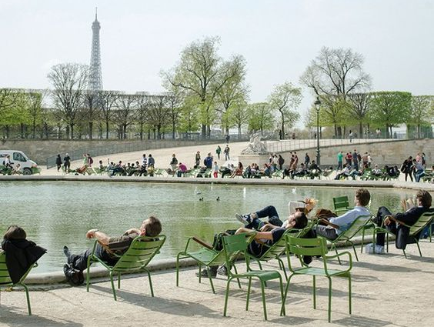
NEW VERSION: Exterior space
Increase shared areas > promote exchange
Combine different kind of spaces > answer to different types of activities
Communicate > direct discussions with users working nearby, totems with information about the project and the location, publications announcing these new areas…
Create a module and a system that can be repeated around the site in different locations
Use easy maintenance elements and materials
Work with the existing
Use visual effects and signage
Increase safety > revision of the walking and cycling circulations and
Foster soft mobility
Inspirational images

Slide 9
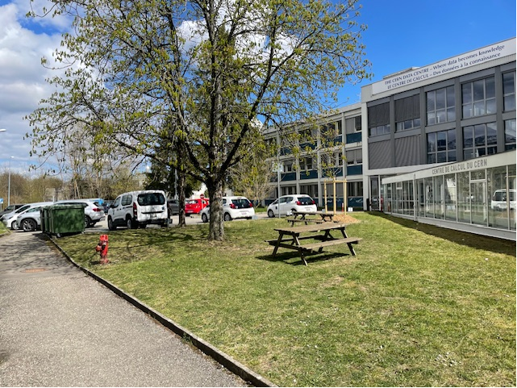
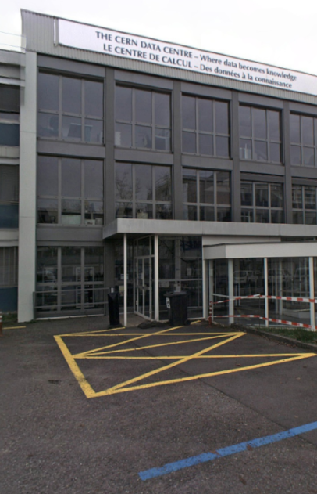
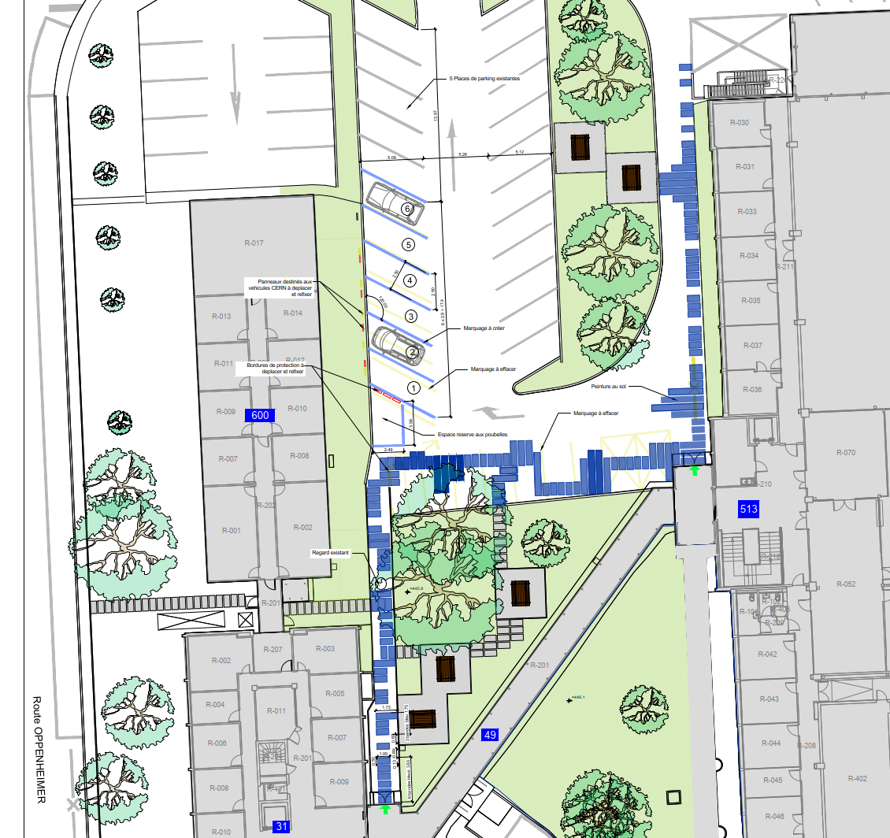
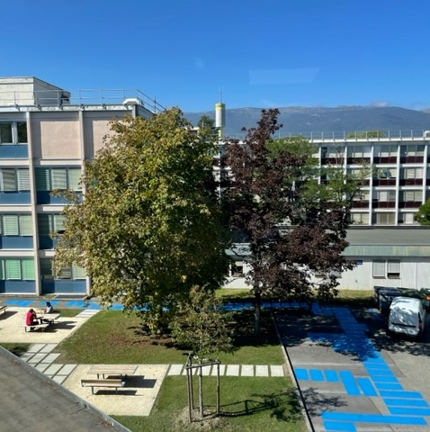
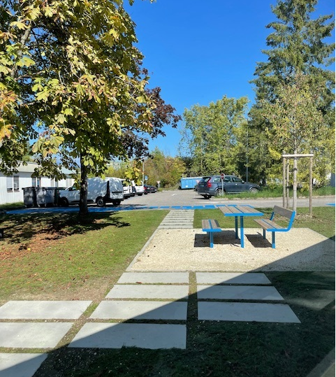
REFERENCES: CERN projects
Before
Outdoor Spot 6 (IT area)
After

Slide 10
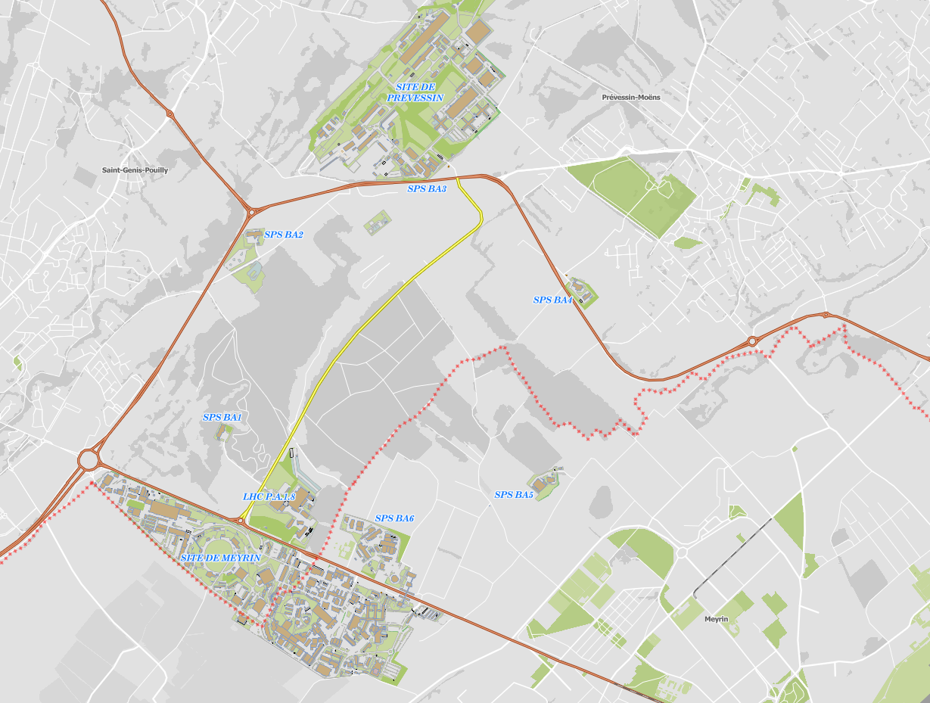
NEW OFFICE BUILDINGS (777 & 140)
B777
Create an inspiring and welcoming environment for
CERN’s scientific community now and in the future.
Strategic objectives
Develop a building with an architectural quality that surpasses the existing feel of an industrial and laboratory site;
Construct an environmentally friendly and state-of-the-art building; aiming towards net zero carbon, considering operational and embodied carbon;
Create a building in which CERN staff and users truly feel at home and happy to work;
Obtain appropriate levels of energy efficiency and sustainability certification.
B140

Slide 11
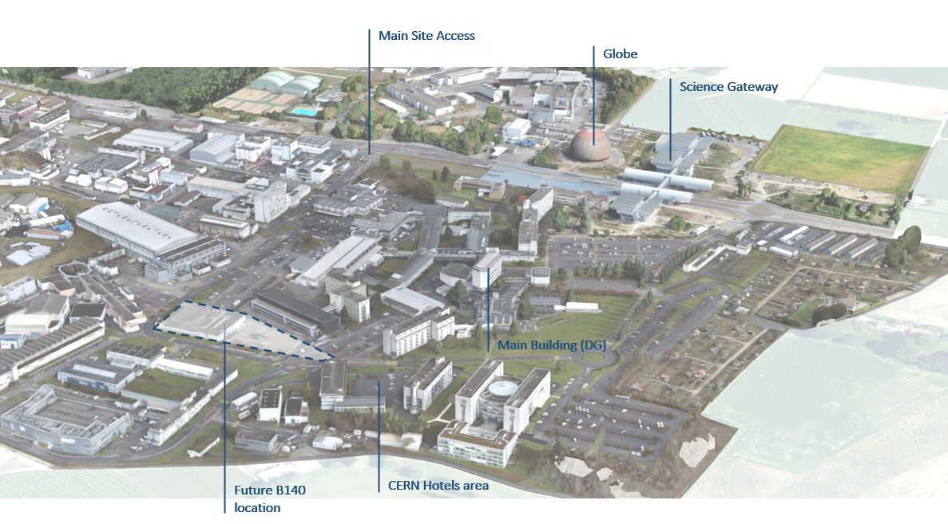
Location and scope – B140 (Meyrin Site)

Slide 12
Location and scope – B140 (Meyrin Site)
Offices for ~ 315 people
Open plan spaces with ~ 160 workstations
Meeting rooms for ~ 150 people
Laboratories for ~ 5 different activities
Workshops for ~ 5 different activities
approximately PA 5,350 m2
EP (Experimental Physics Department)
Improve the working environment for the EP community.
Accommodate laboratories, workshop spaces and offices for the EP-DT group.
PHASE 1
Learning Center (HR, HSE, IR)
Centralise the training activity to foster synergies and lead to a considerable reduction of operational costs.
IR (International Relations Sector)
Co-locate most of the IR sector services, currently spread in several locations, facilitating synergies and addressing the lack of IR offices and technical spaces.
DG (CERN Directorate)
New Plenary Room and several meeting rooms for Council meetings during the Council weeks, which will also be available for use by CERN population outside those time slots.
Offices for ~140 people
Meeting rooms for ~ 150 people
Laboratories for ~ 3 different activities
Workshops for ~ 5 different activities
Classrooms for ~ 300 people
A Plenary room for ~ 150 people
A cafeteria for ~ 150 people
Conference rooms for ~ 150 people
approximately PA 4,350 m2
PHASE 2

Slide 13
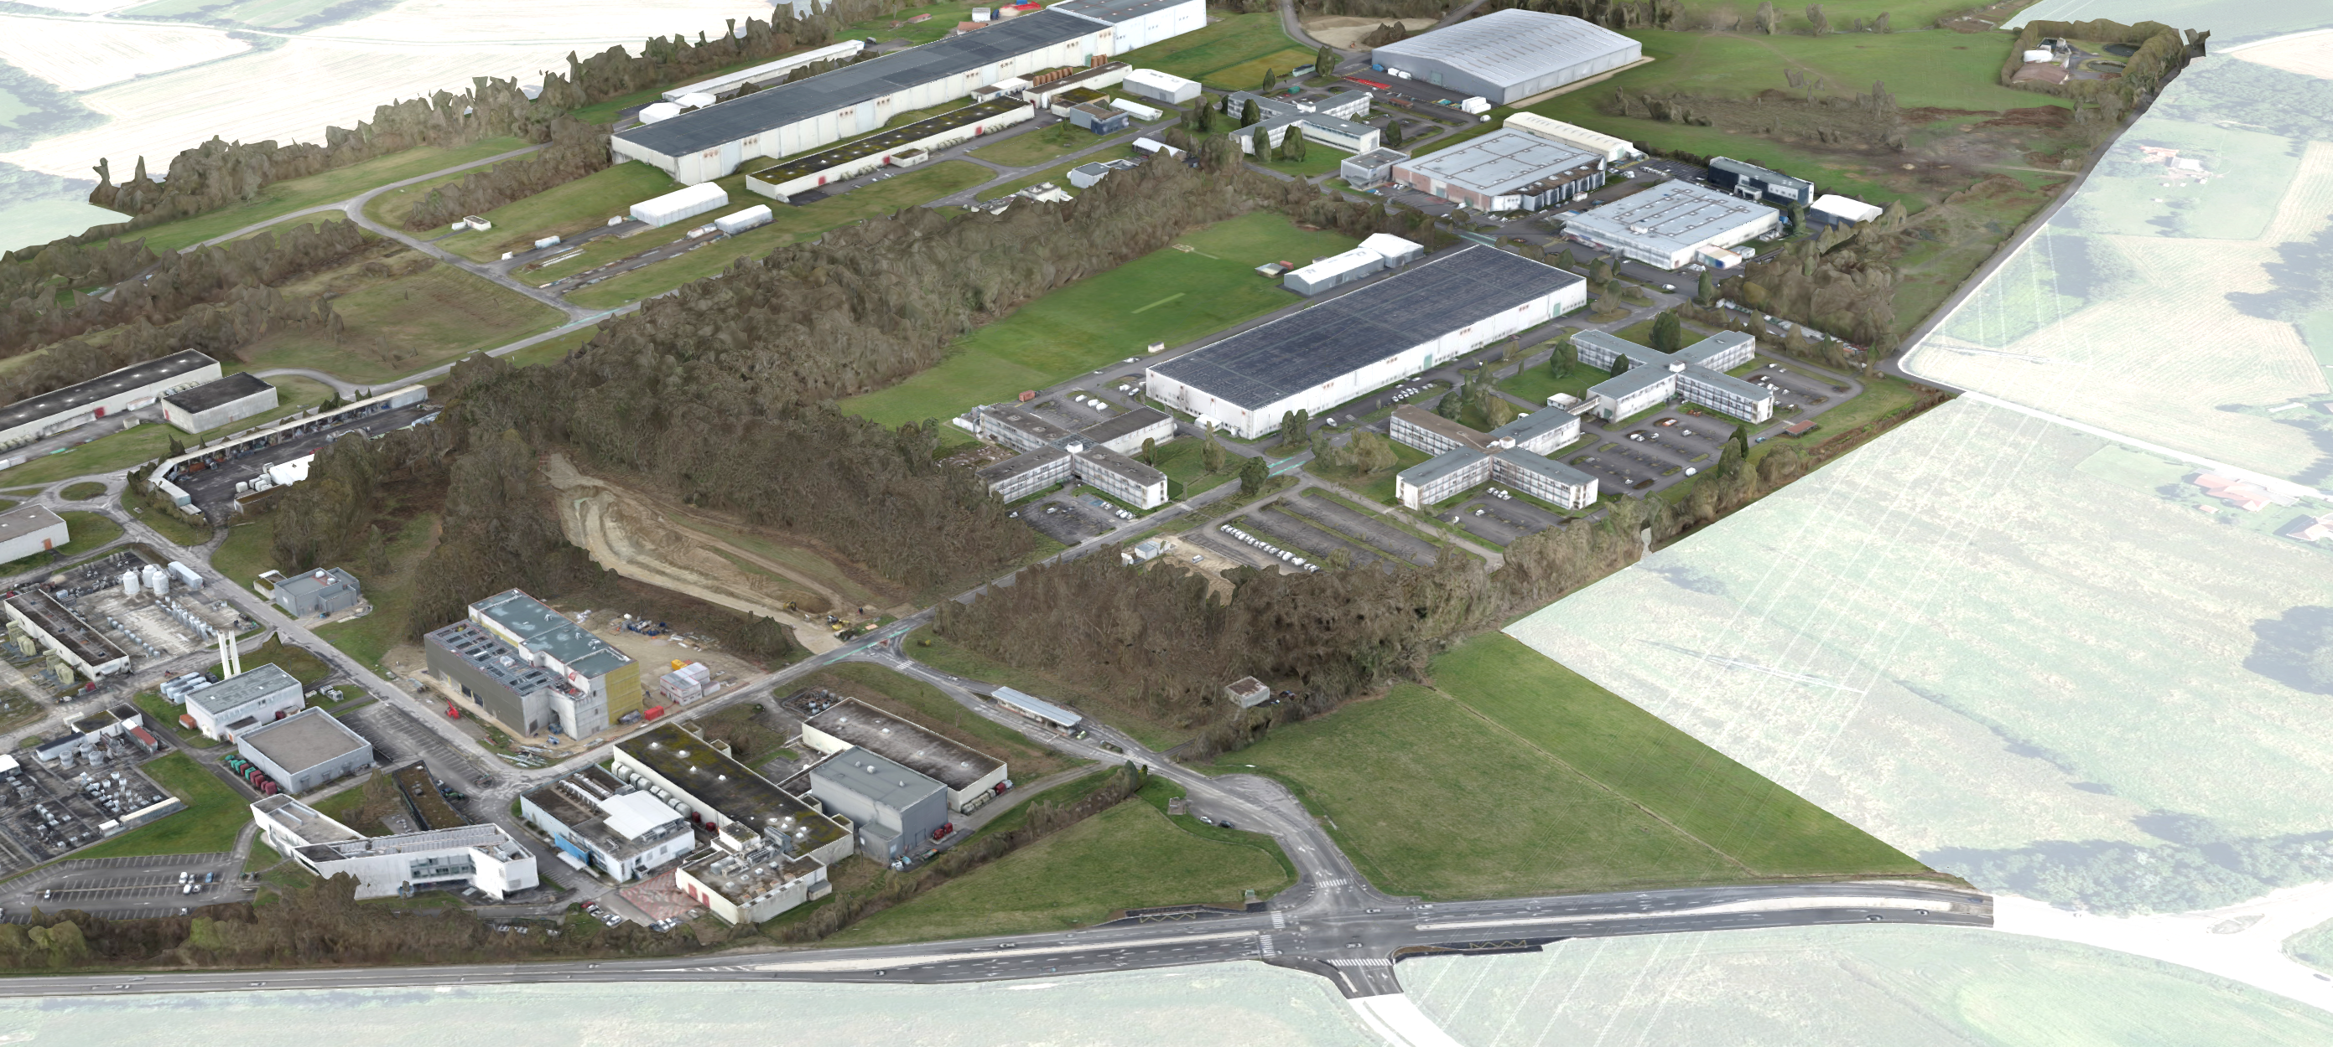
Location and scope – B777 (Prévessin Site)
PCC (B775)
Future B777 location
Main Site Access

Slide 14
Location and scope – B140 (Meyrin Site)
Offices for ~528 people
Meeting rooms for ~300 people
New Restaurant 3 (500 daily servings)
Laboratories for 3 different activities
approximately PA 6,886 m2
ATS Sector
Answer to ATS Sector need of new spaces (TE and BE departments)
Reflect the importance of the Prevessin Site, connecting inside & outside and creating a social & service hub for the site

Slide 15


Procurement & contract strategy
CONSULTANT
Market Survey & Invitation to Tender; based on BVFM adjudication;
Agreement based on FIDIC White Book (2017 Ed.), incl. CERN amendments;
Scope: design (up to tender) & construction administration;
CONTRACTOR
Market Survey & Invitation to Tender; based on lowest cost or BVFM adjudication;
Agreement based on FIDIC Yellow Book (2017 Ed.), incl. CERN amendments;
Scope: construction documents & build.
For further information: https://fidic.org/

Slide 16








Procurement & contract strategy – Consultant
IRP & Reference Design
Publication of the Market Survey
MS publication
Publication of the Market Survey
MS replies
MS replies including Qualification Questionnaire and reference projects
Evaluation & selection
Maximum of 8 qualified bidders based on the ranking of responses
Evaluation & adjudication
Bidders with the highest ranked total weighted score (from the 2nd to the 6th) will receive a bid indemnity
IT replies
IT replies including
bid design, evaluation questionnaire and financial bid
Bidders conference
Bidders conference at CERN including a visit to the project site
IT Dispatch
Dispatch of the Invitation to Tender to selected firms, including a reference design

Slide 17
Procurement & contract strategy – Time line
2022
2023
2024
2025
2026
2027
2028
2029
2030
2031
2032
2033
MS/IT for Consultant | Consultant Design, Building Permit and MS/IT for Contractor | Execution Design and Construction
MS/IT for Consultant | Consultant Design, Building Permit and MS/IT for Contractor Phase 1 | Phase 1 Execution Design and Construction | Demolition works for Phase 2 | Design Update & MS/IT for Contractor Phase 2 | Phase 2 Execution Design and Construction

Slide 18
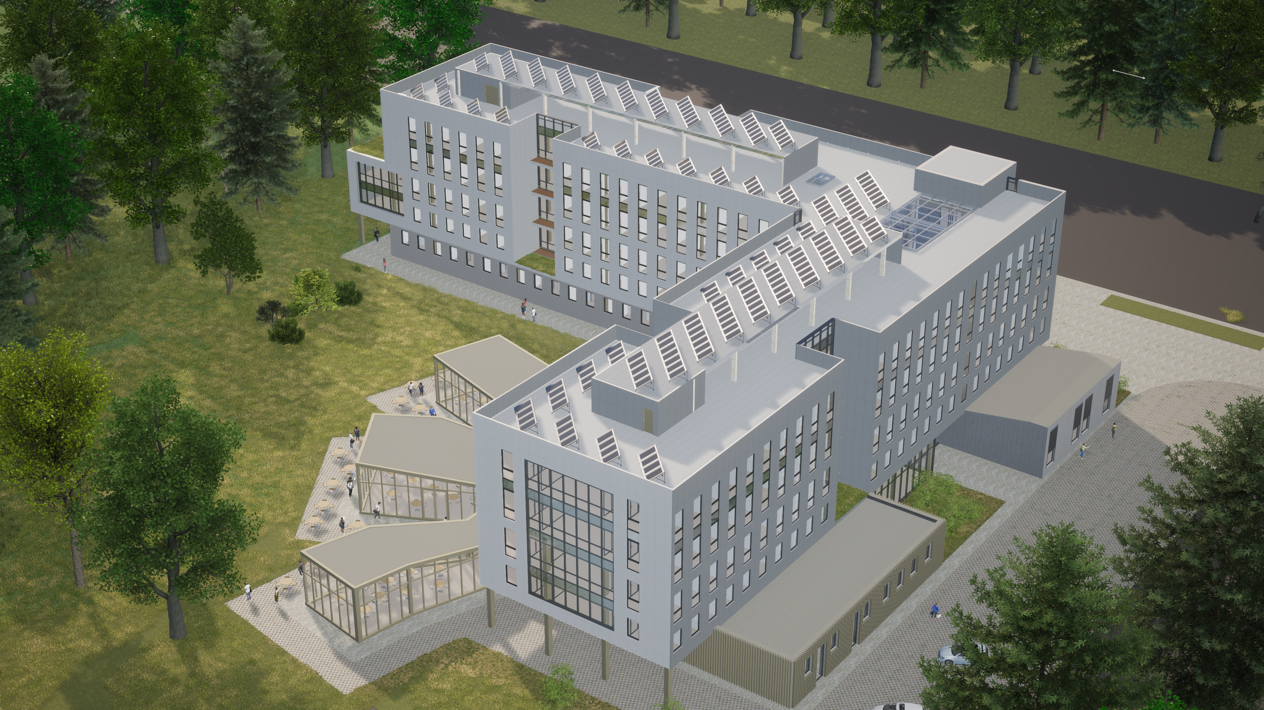
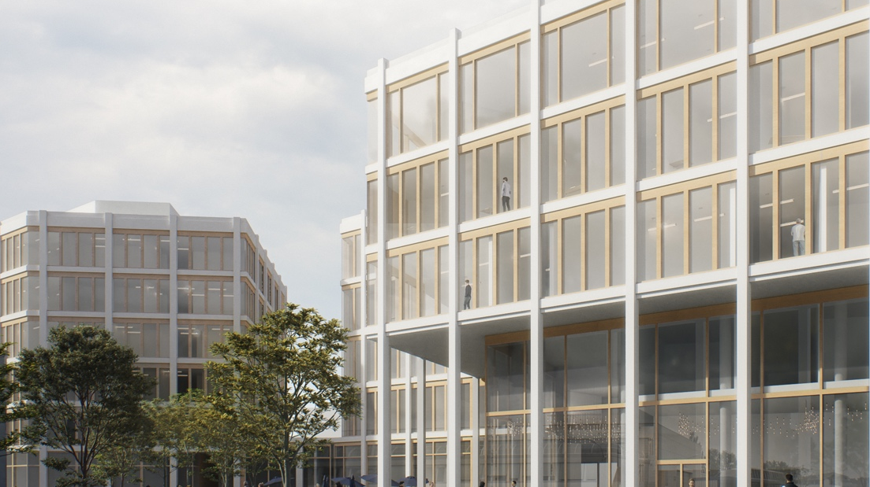
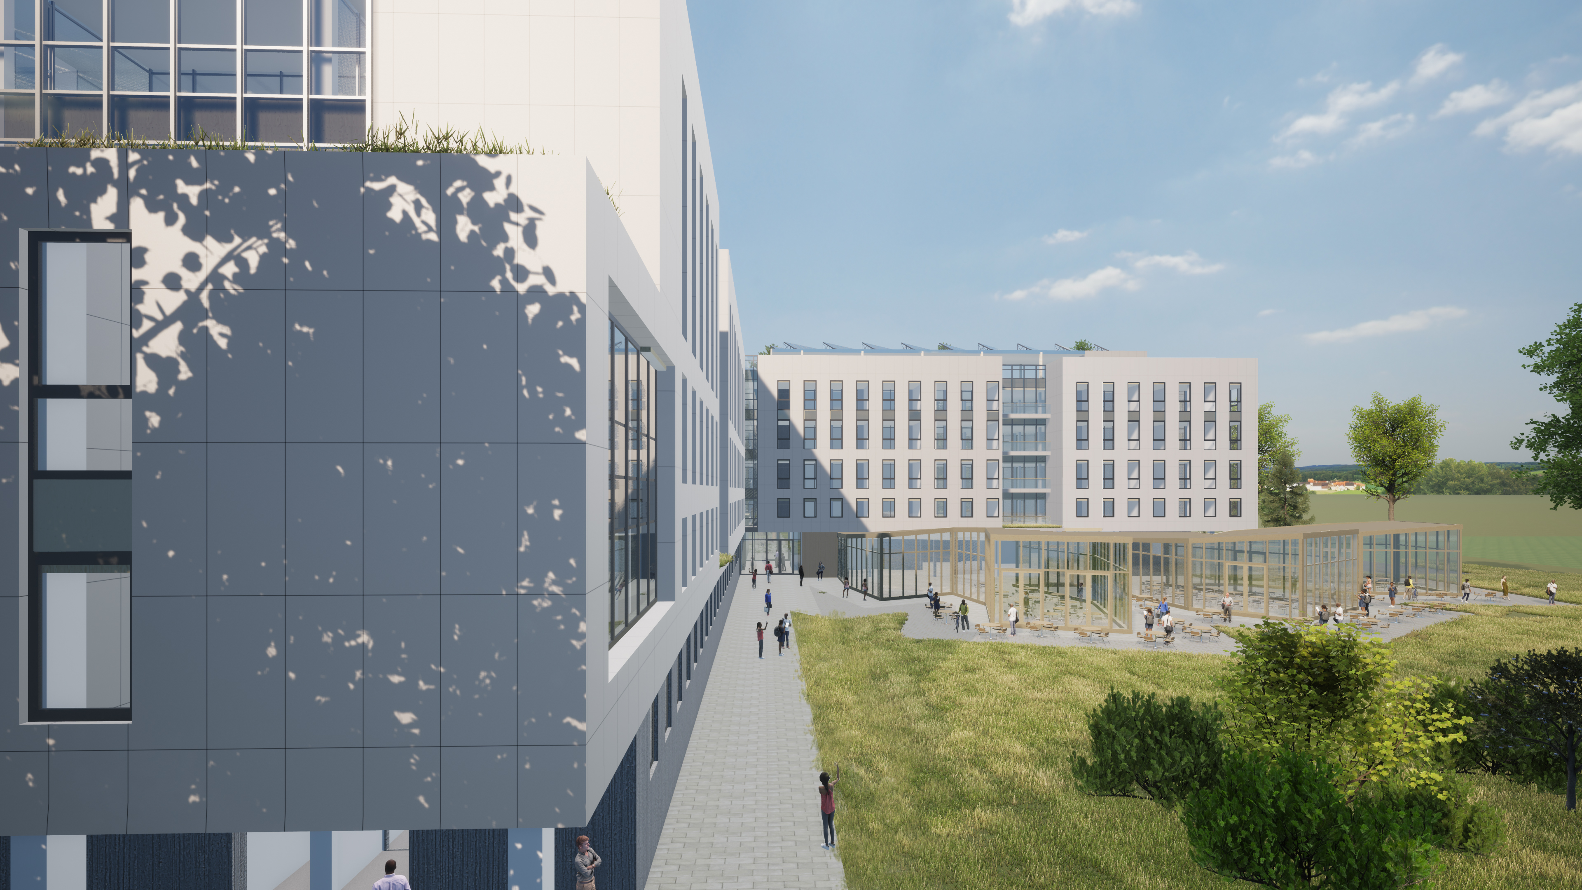


Location and scope – Reference Designs
Outcome of a feasibility study (avant-projet) for the Project, based on the design brief defined in the IRP and included in the IT for the Consultant:
  A descriptive report;
  Drawings/Images
  Room schedule.
“The Reference Design is a conceptual design study, provided for information only, and graphically illustrates CERN’s requirements in terms of the proposed space programme for Building 777.”

Slide 19
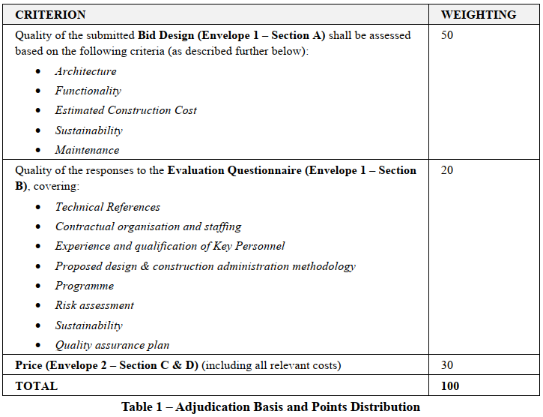
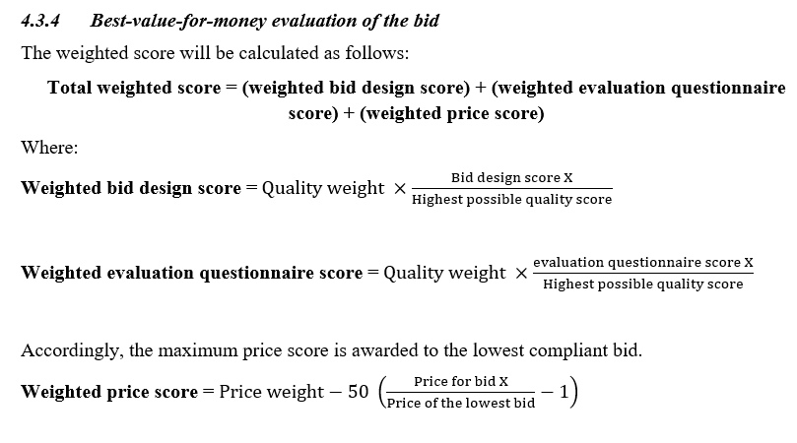
Procurement & contract strategy - Consultant
EVALUATION QUESTIONNAIRE
BID DESIGN
FINANCIAL BID
Notes:
The aim of building 140 is to meet the space needs of different CERN services, grouped together in a single new building on the main CERN site in Switzerland. It responds to CERN wider masterplan strategy to dnsify the site and group together various CERN services for improved complementarity. The project will be developed in two phases.

Slide 20
Procurement & contract strategy - Consultant
BID DESIGN
Ranking of 1 to 8 by consensus between jury members based on five criteria:
User Group Panel Representatives
2 external senior architects
1 representative from AMO
4 CERN representatives from the Site and Civil Engineering Department (SCE)
A technical support panel will review the bid designs and provide guidance to the Bid Design Evaluation Panel in an advisory role, covering subjects such as architectural compliance with the program, structure, MEP, sustainability, estimated construction cost and ease of maintenance.
Functionality
Architecture
Estimated Construction Cost
Sustainability
Maintenance
Notes:
The aim of building 140 is to meet the space needs of different CERN services, grouped together in a single new building on the main CERN site in Switzerland. It responds to CERN wider masterplan strategy to dnsify the site and group together various CERN services for improved complementarity. The project will be developed in two phases.

Slide 21
Procurement & contract strategy - Consultant
EVALUATION QUESTION
References (Annex 1 & Annex 2);
Contractual Organisation and Staffing (Annex 3);
Experience and Qualifications of the Key Personnel (Annex 4); Proposed Design & Construction Administration Methodology (Annex 5);
Programme (Annex 6); includes design & construction phases
Risk assessment (Annex 7);
Sustainability (Annex 8);
Quality Assurance (Annex 9);
Compliance with Tender Documents (Annex 10);
FINANCIAL BID
Lump sum fee for Stages 1 to 5, with fee breakdown in deliverables per Stage;
Stage 6 – Construction Administration: (split in Stage 6.1 and 6.2 – per Phase)
Stage 7 - Defects Notification Period: (split in Stage 7.1 and 7.2 – per Phase)
Additional Services: hourly rates based on rates used to calculate Stage 1-7 Services.
Notes:
The aim of building 140 is to meet the space needs of different CERN services, grouped together in a single new building on the main CERN site in Switzerland. It responds to CERN wider masterplan strategy to dnsify the site and group together various CERN services for improved complementarity. The project will be developed in two phases.

Slide 22
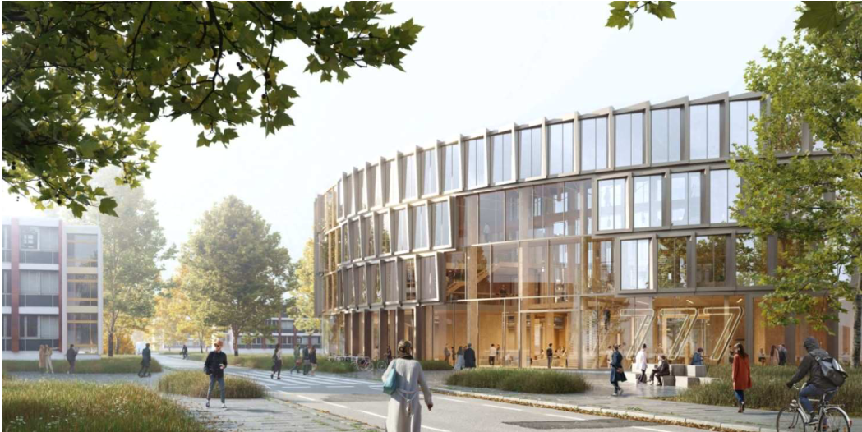
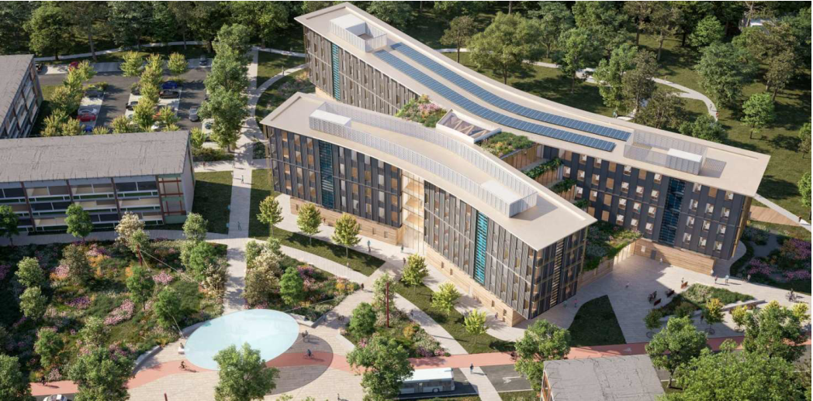
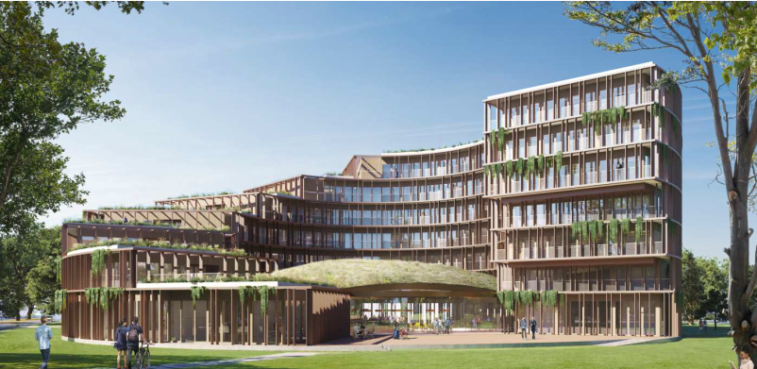
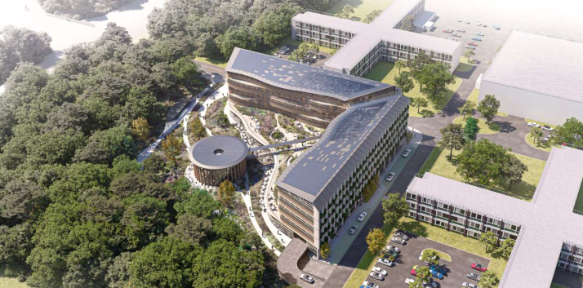
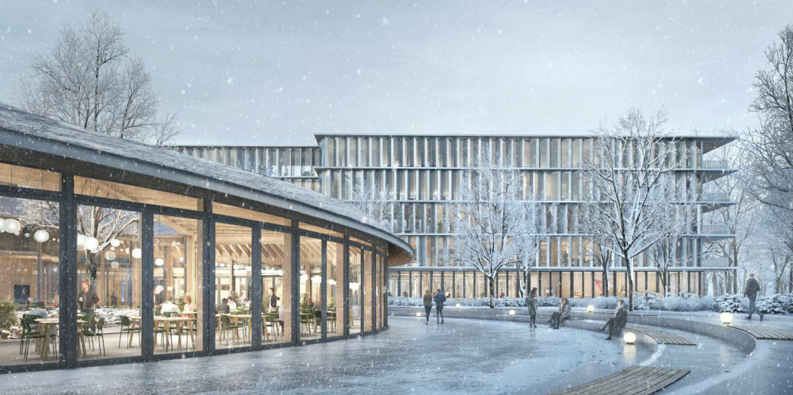
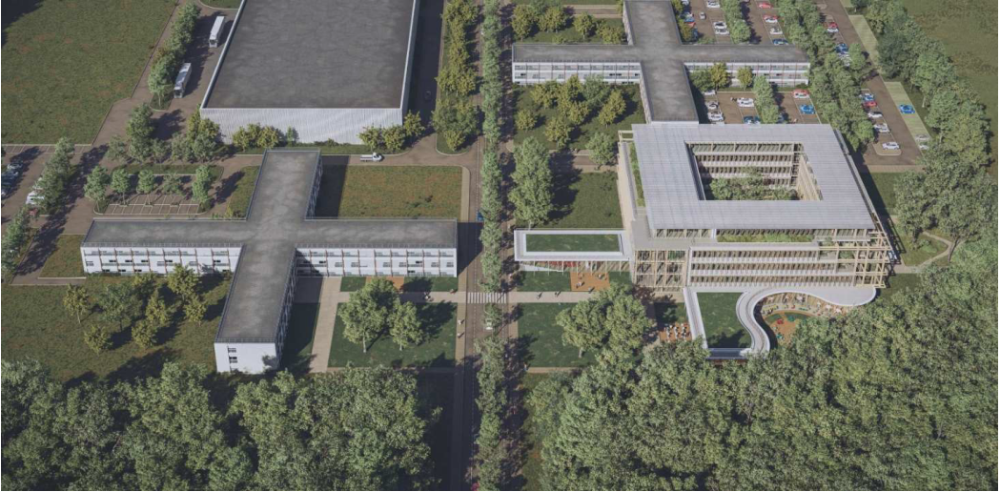
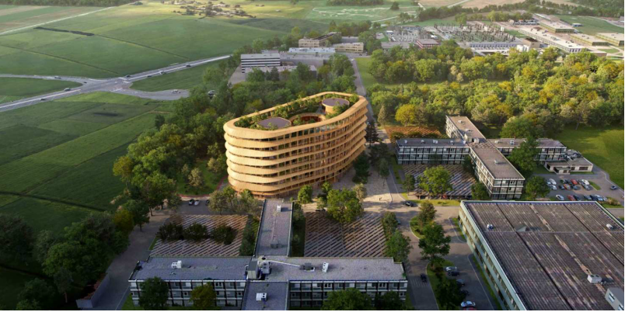
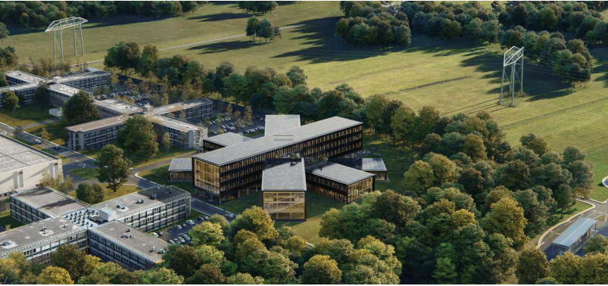
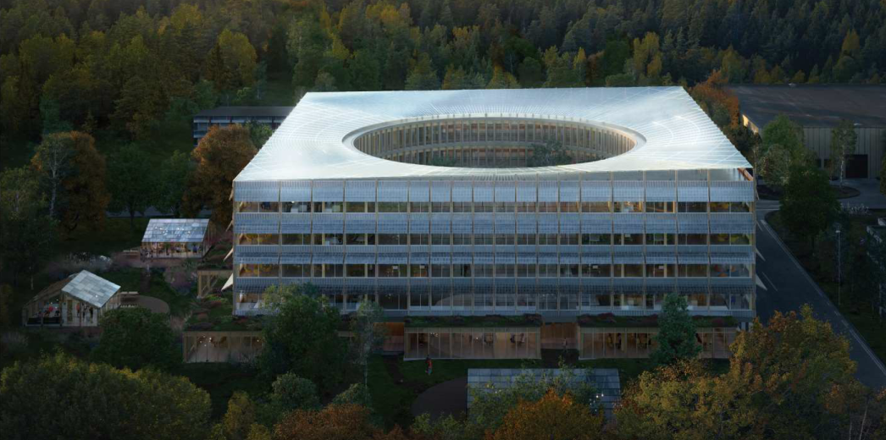
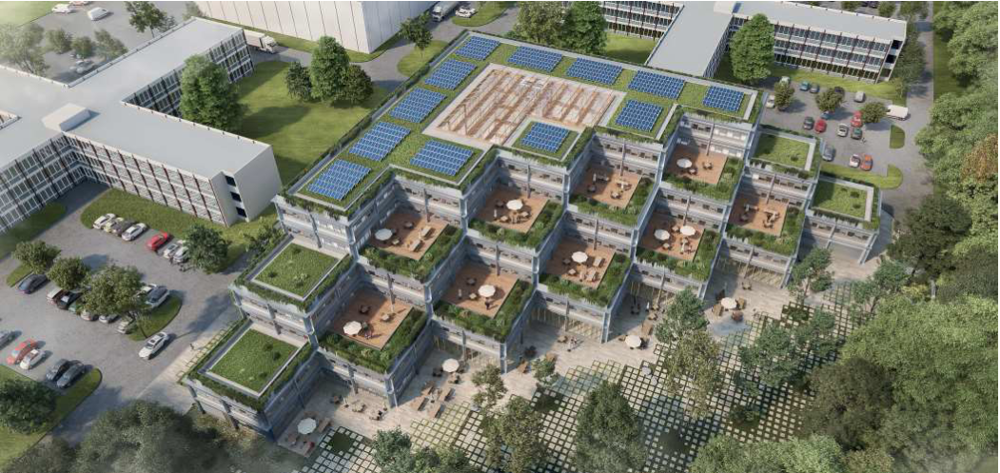
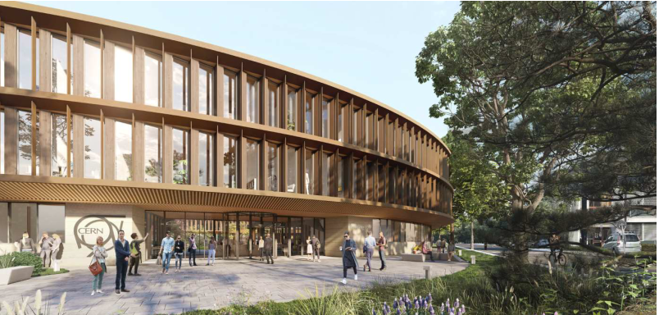
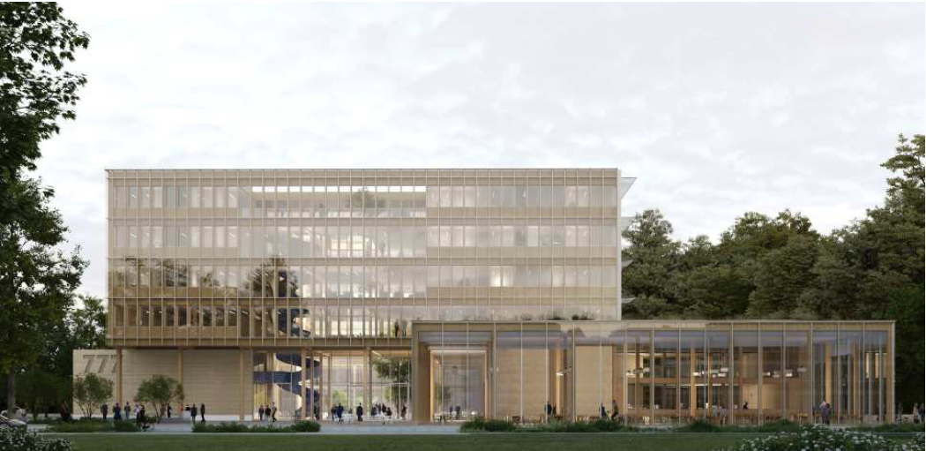
Procurement & contract strategy – B777
Henning Larsen
Grimshaw
Neutelings Riedijk Architecten BV
Wilkinson Eyre Archiects
Snohetta
Belvedere Architecture
Adjaye Associates Limited
BIG Partners Ltd
Schmidt Hammer Lassen Architects
EGIS Bâtiments Rhone Alpe
Dietrich Untertrifaller Architekten
Unanime Architectes

Slide 23
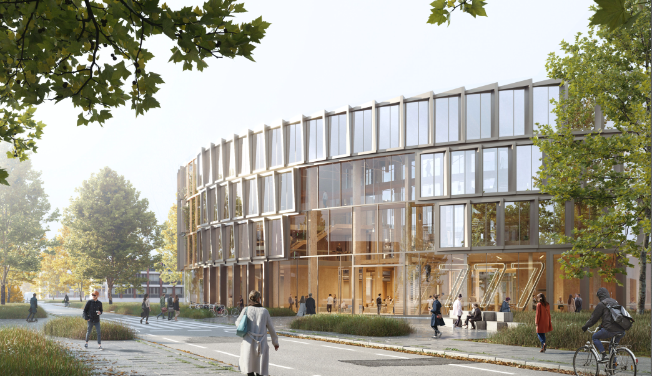
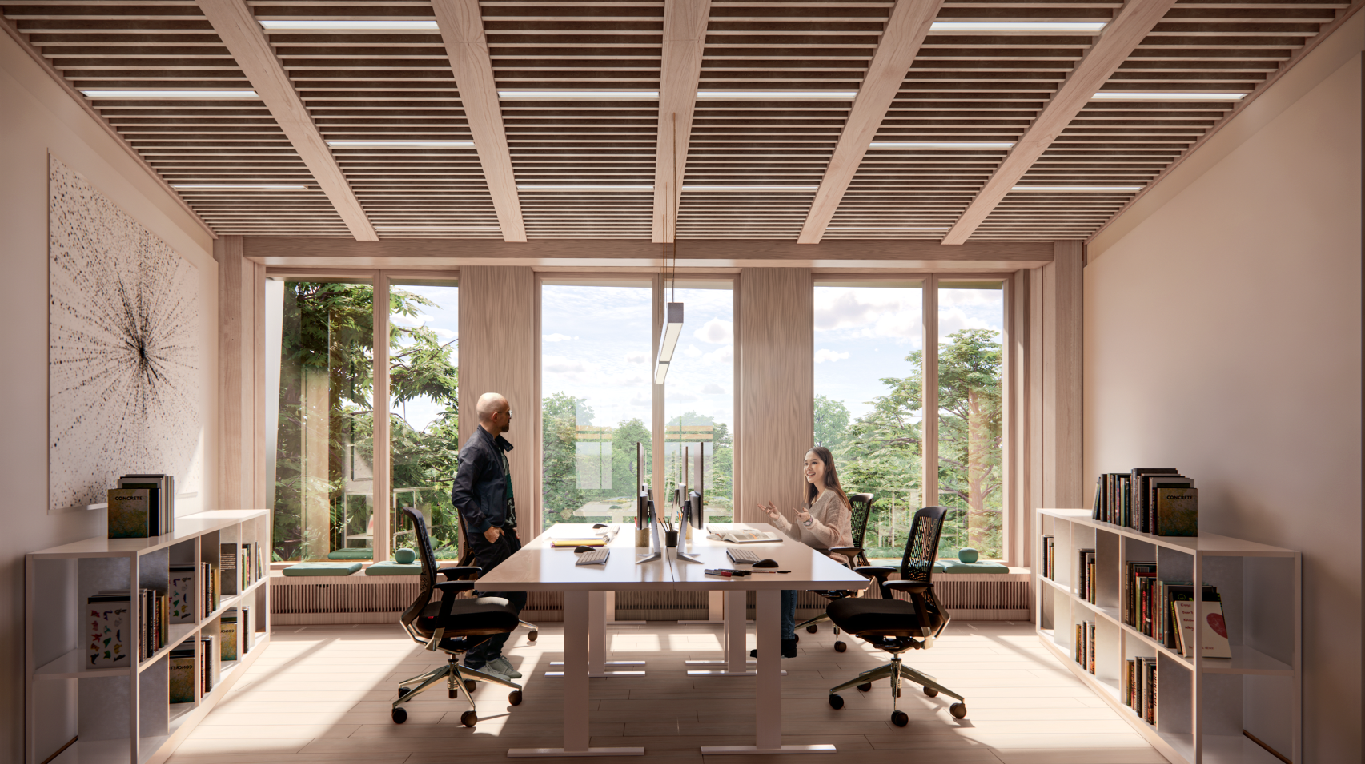
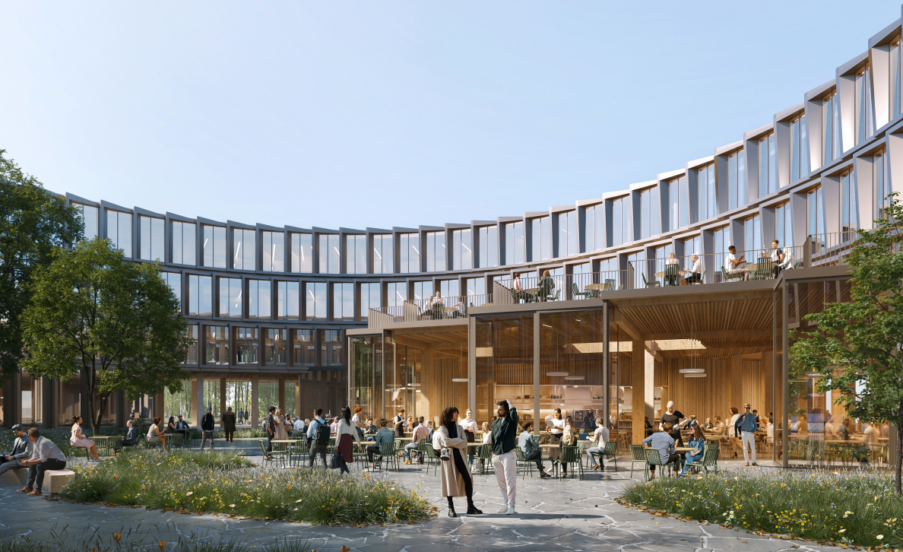
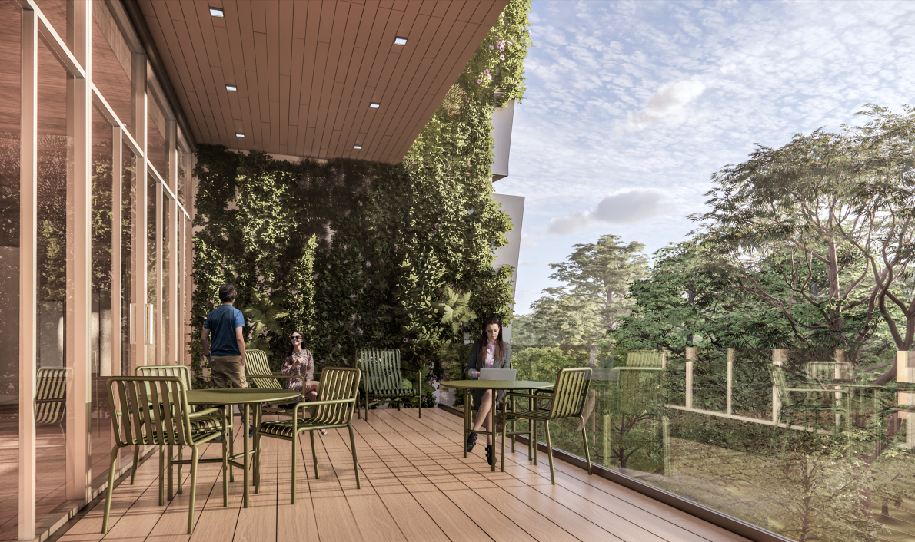
Current progress – B777
For further information: https://fidic.org/

Slide 24
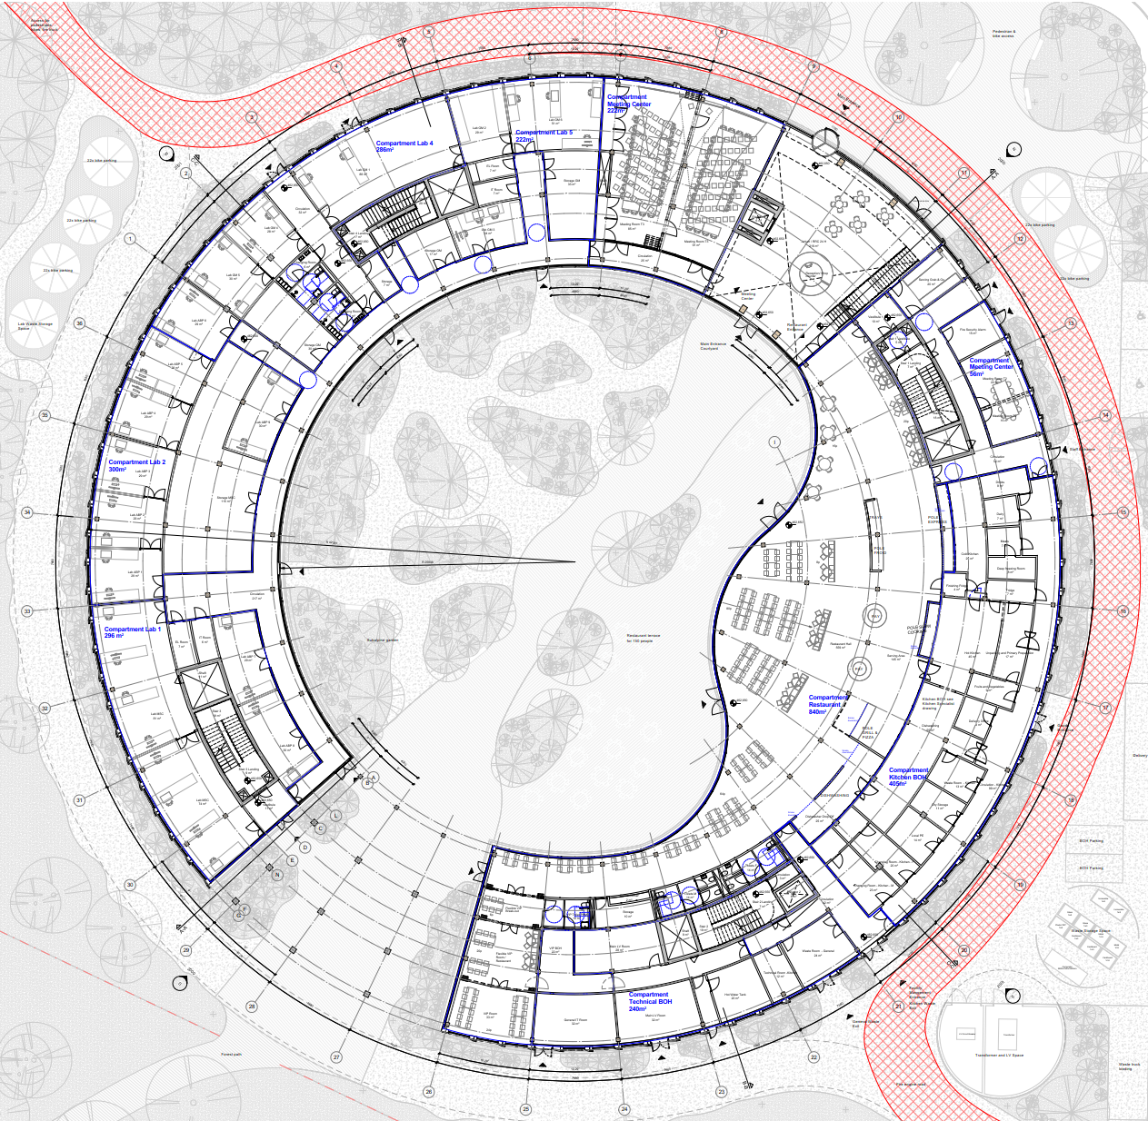
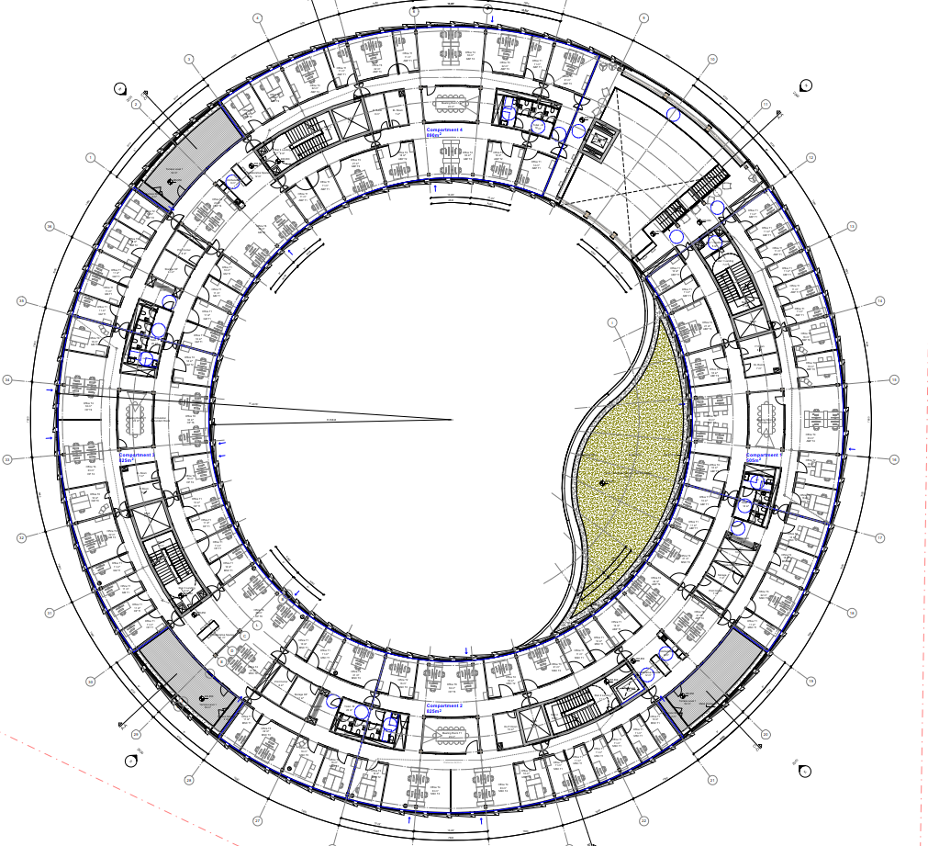
Current progress – B777
Ground floor
Typical floor

Slide 25




