Slide 1
X-Box Summary
20.03.2024

Slide 2
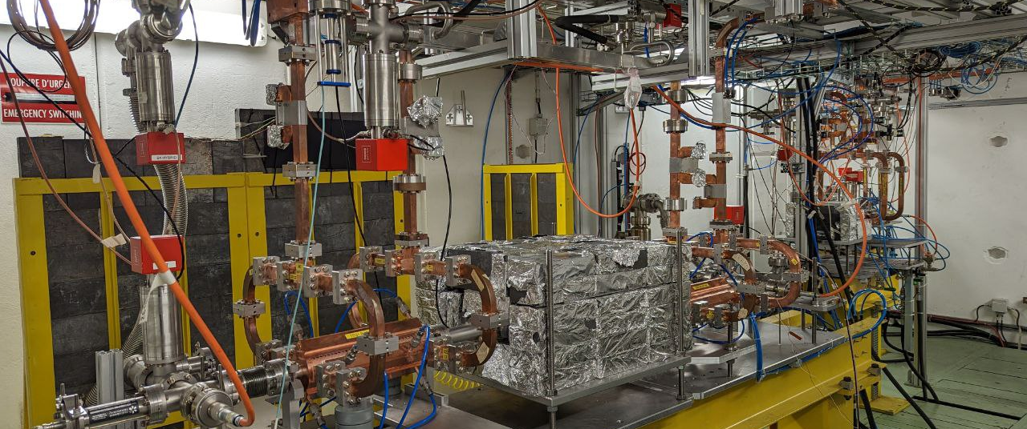
X-Box 2: TD31 N3 N4

Slide 3
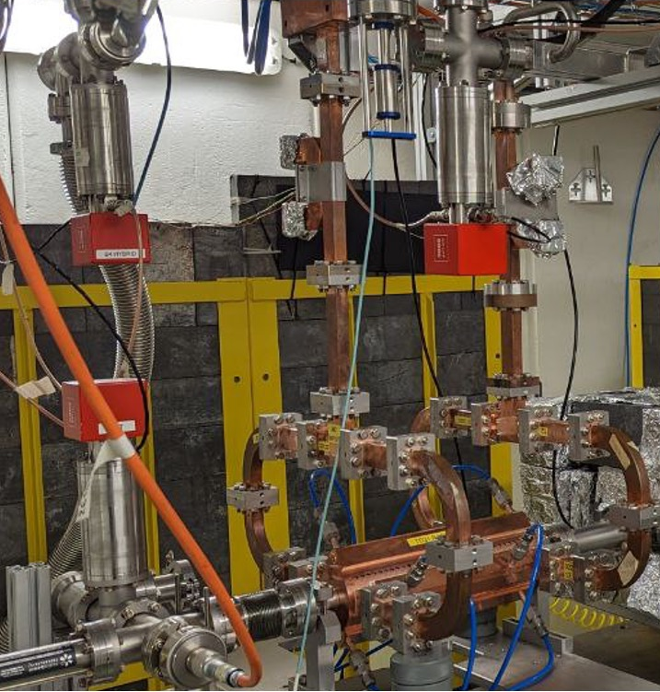
X-Box 2: TD31 N3 N4
X-Box 2 TD31 N3 N4: Structure A
Restarted 05.06.2023
100:1 ratio, all power to Structure A
Max. power ~45 MW
Pulse width 200ns
Breakdowns w/o breakdown current

Slide 4
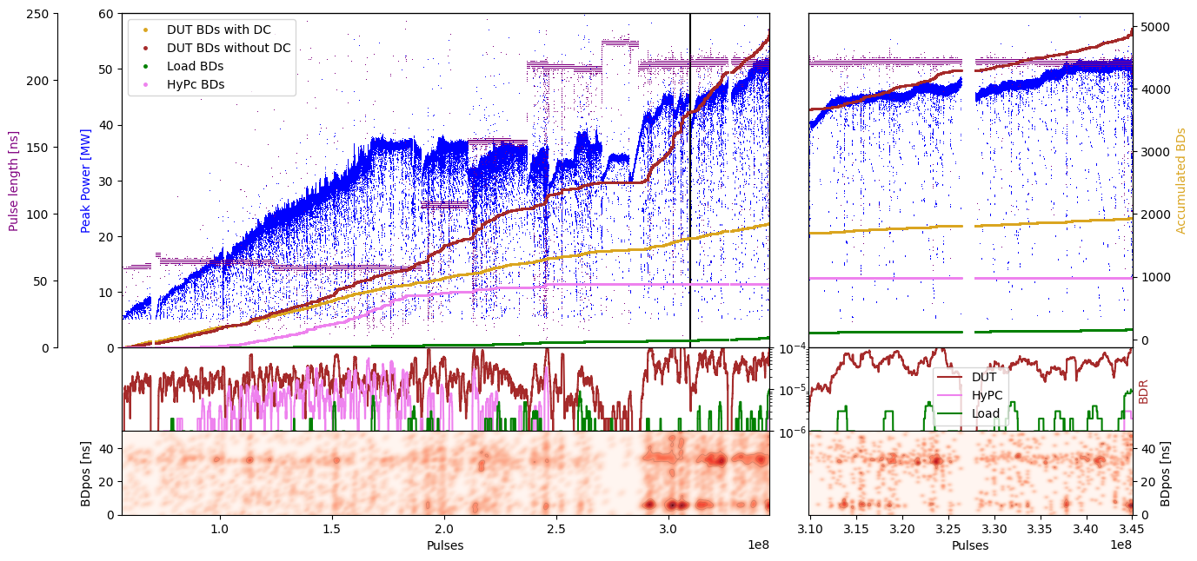
X-Box 2: TD31 N3 N4 Structure A – Peak Power

Slide 5
X-Box 2: TD31 N3 N4 Structure A – Gradient

Slide 6
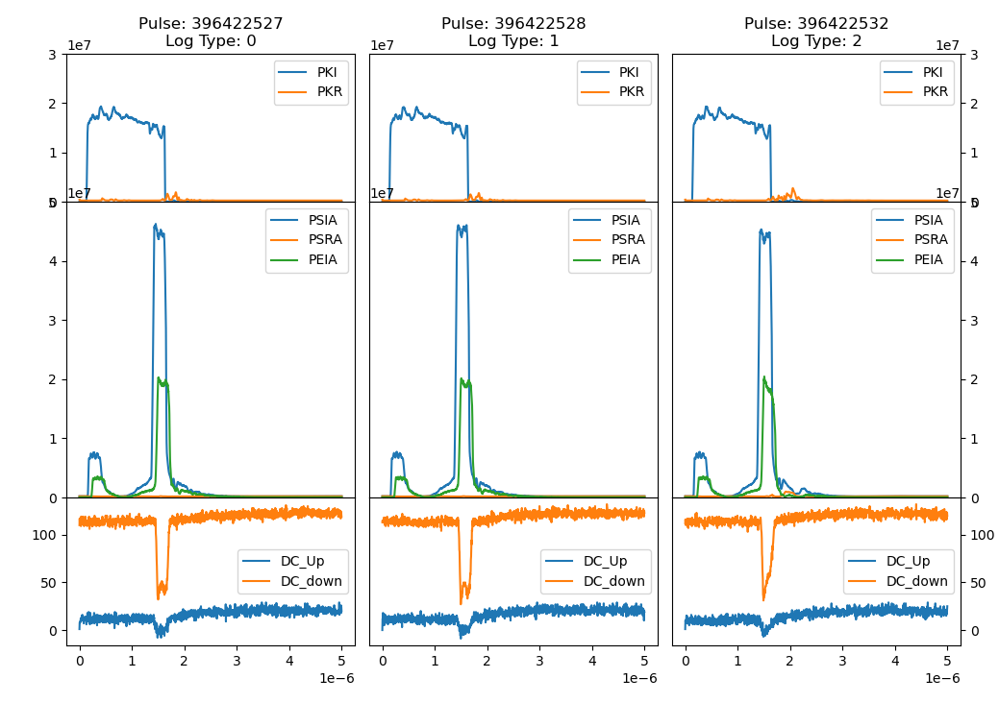
X-Box 2: 08 July 2023 Pulse 396422527

Slide 7
X-Box 2: TD31 N3 N4
X-Box 2 TD31 N3 N4: Structure B
Restarted 26.01.2024
100:1 ratio, all power to Structure B
Starting power ~25 MW
Pulse width 50ns
No operation until before Easter
  Scandinova modulators yearly maintenance
  Switch unit broken – solved
  Chiller connected to Structure B broken - solved
Last week stopped
  Water station maintenance

Slide 8
X-Box 2: Reminder on BD classification
BD_Flag_PER_log
BD Load
TRUE
BD_Flag_DC_DOWN
DC Up >=140
DC Down>=100
BD DUT w. BDC
BD_Flag_DC_UP
FALSE
BD_Flag_PSR_log
BD DUT wo. BDC
BD_Flag_PKR_log
BD HyPC
No BD

Slide 9
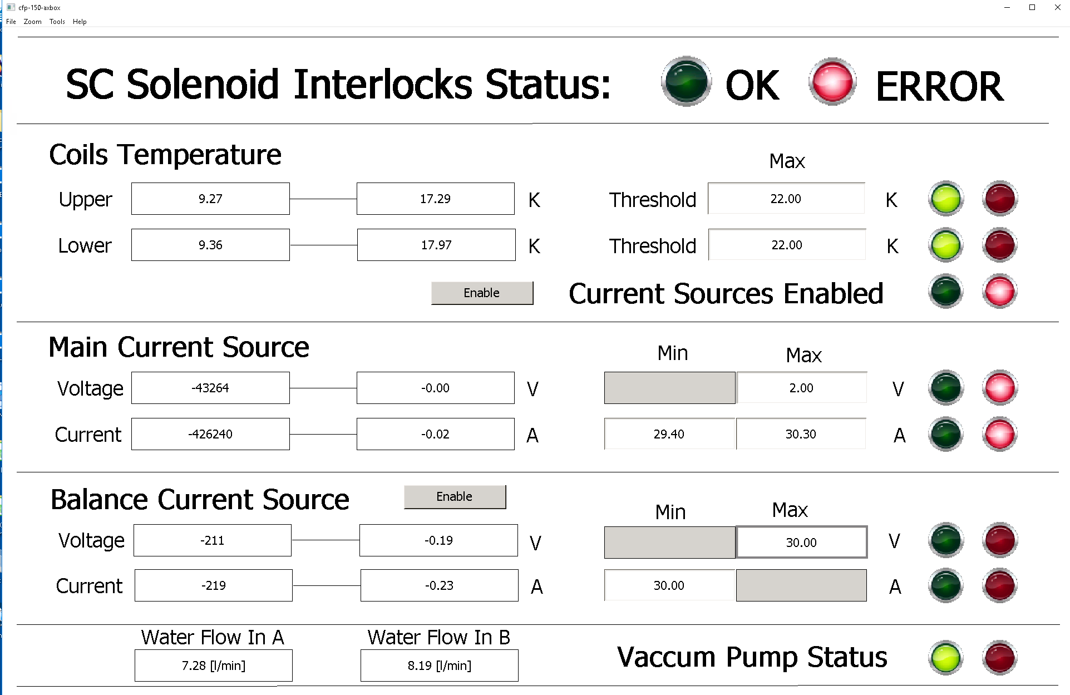
X-Box 2 - improvements
Done:
  Readout of water flow
  Addition of extra temperature channels
To do:
  Duplication of channel DC_DOWN_B, with and without attenuation

Slide 10
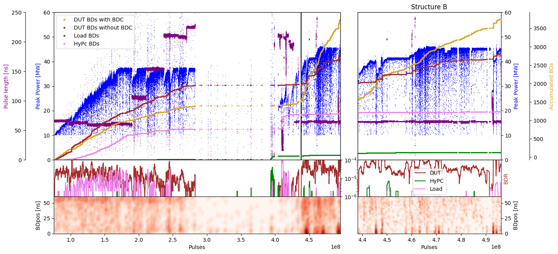
X-Box 2: TD31 N3 N4 Structure B – Peak Power
100:1 to structure A

Slide 11
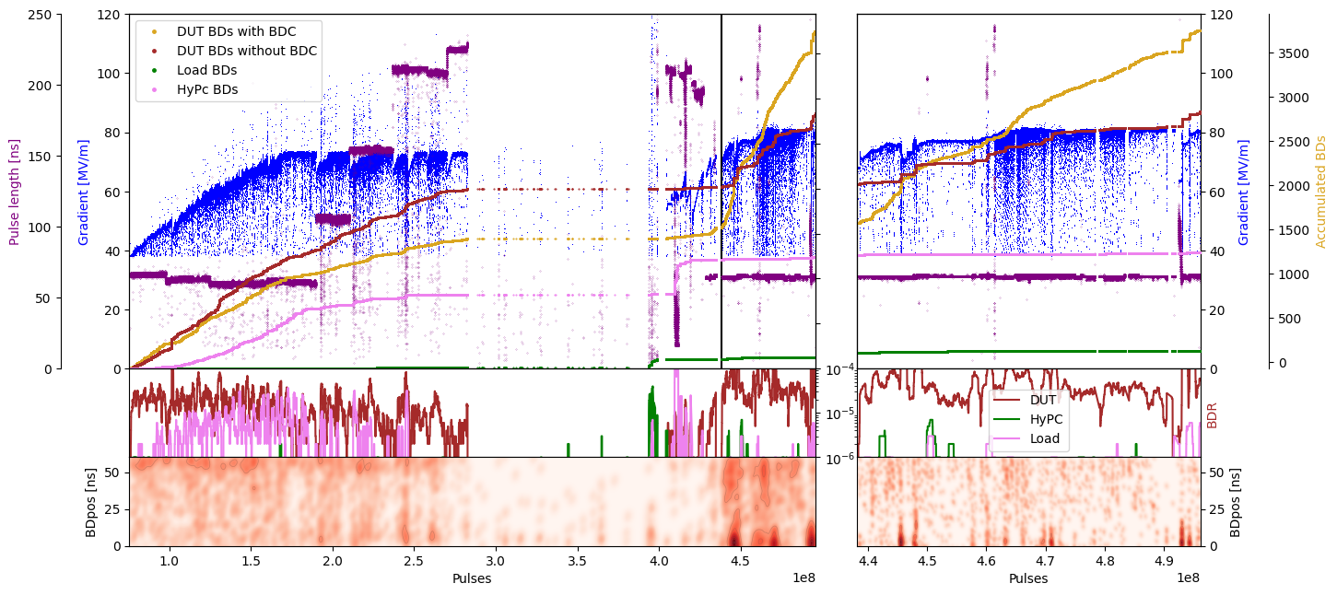
X-Box 2: TD31 N3 N4 Structure B – Gradient
100:1 to structure A

Slide 12
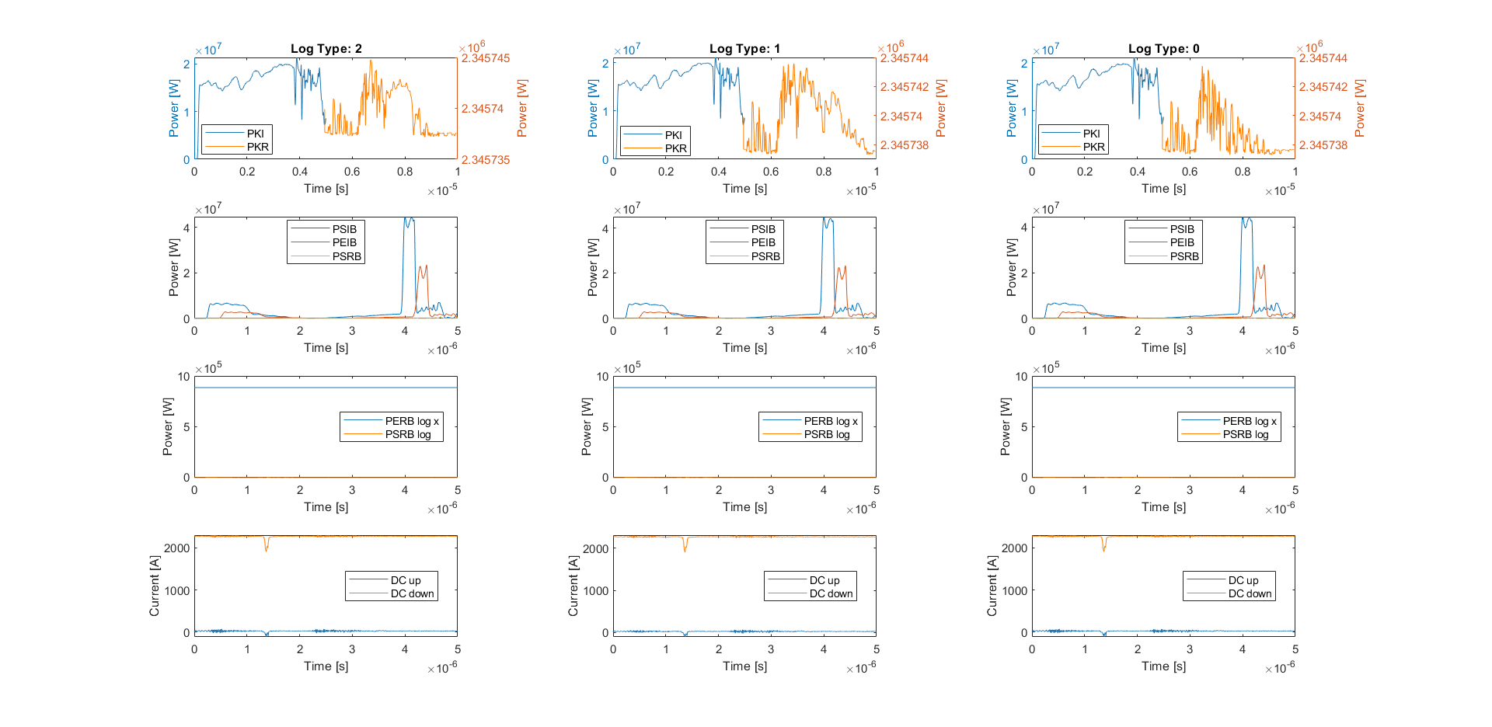
X-Box 2: 5 Apr 2024 Pulse 496283877

Slide 13
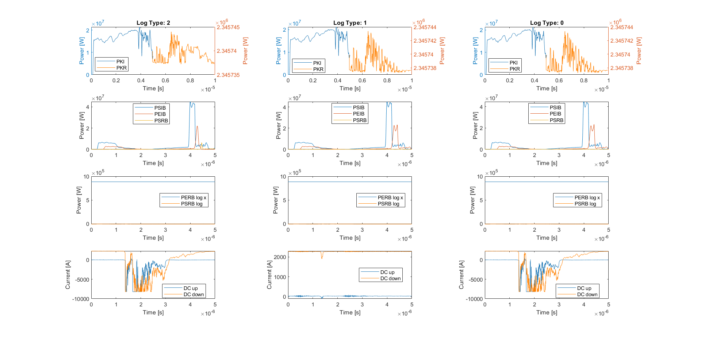
X-Box 2: 5 Apr 2024 Pulse 496484173

Slide 14
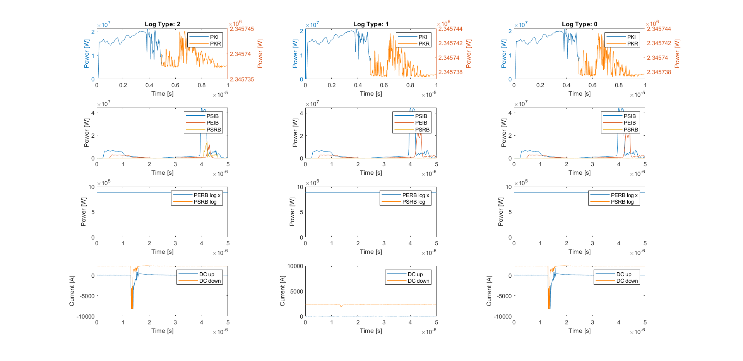
X-Box 2: 6 Apr 2024 Pulse 497123120

Slide 15
X-Box 2: 7 Apr 2024 Pulse 498194338

Slide 16
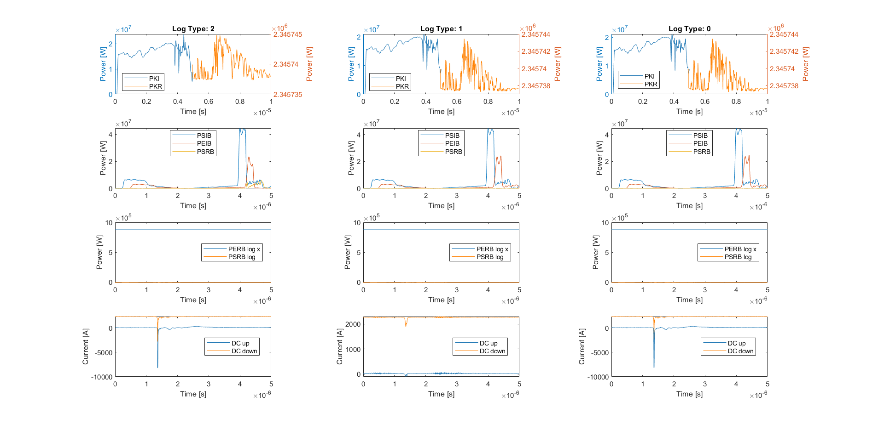
X-Box 2: 7 Apr 2024 Pulse 498204269

Slide 17
X-Box 2: Planning week 08-12 April 2024
Experiment at Xbox2
  Demonstration of operation mode using leading edge of modulator to amplify RF pulse (Ping simulations)
  Study on the dependency of the pulse ripple versus phase rising time

Slide 18
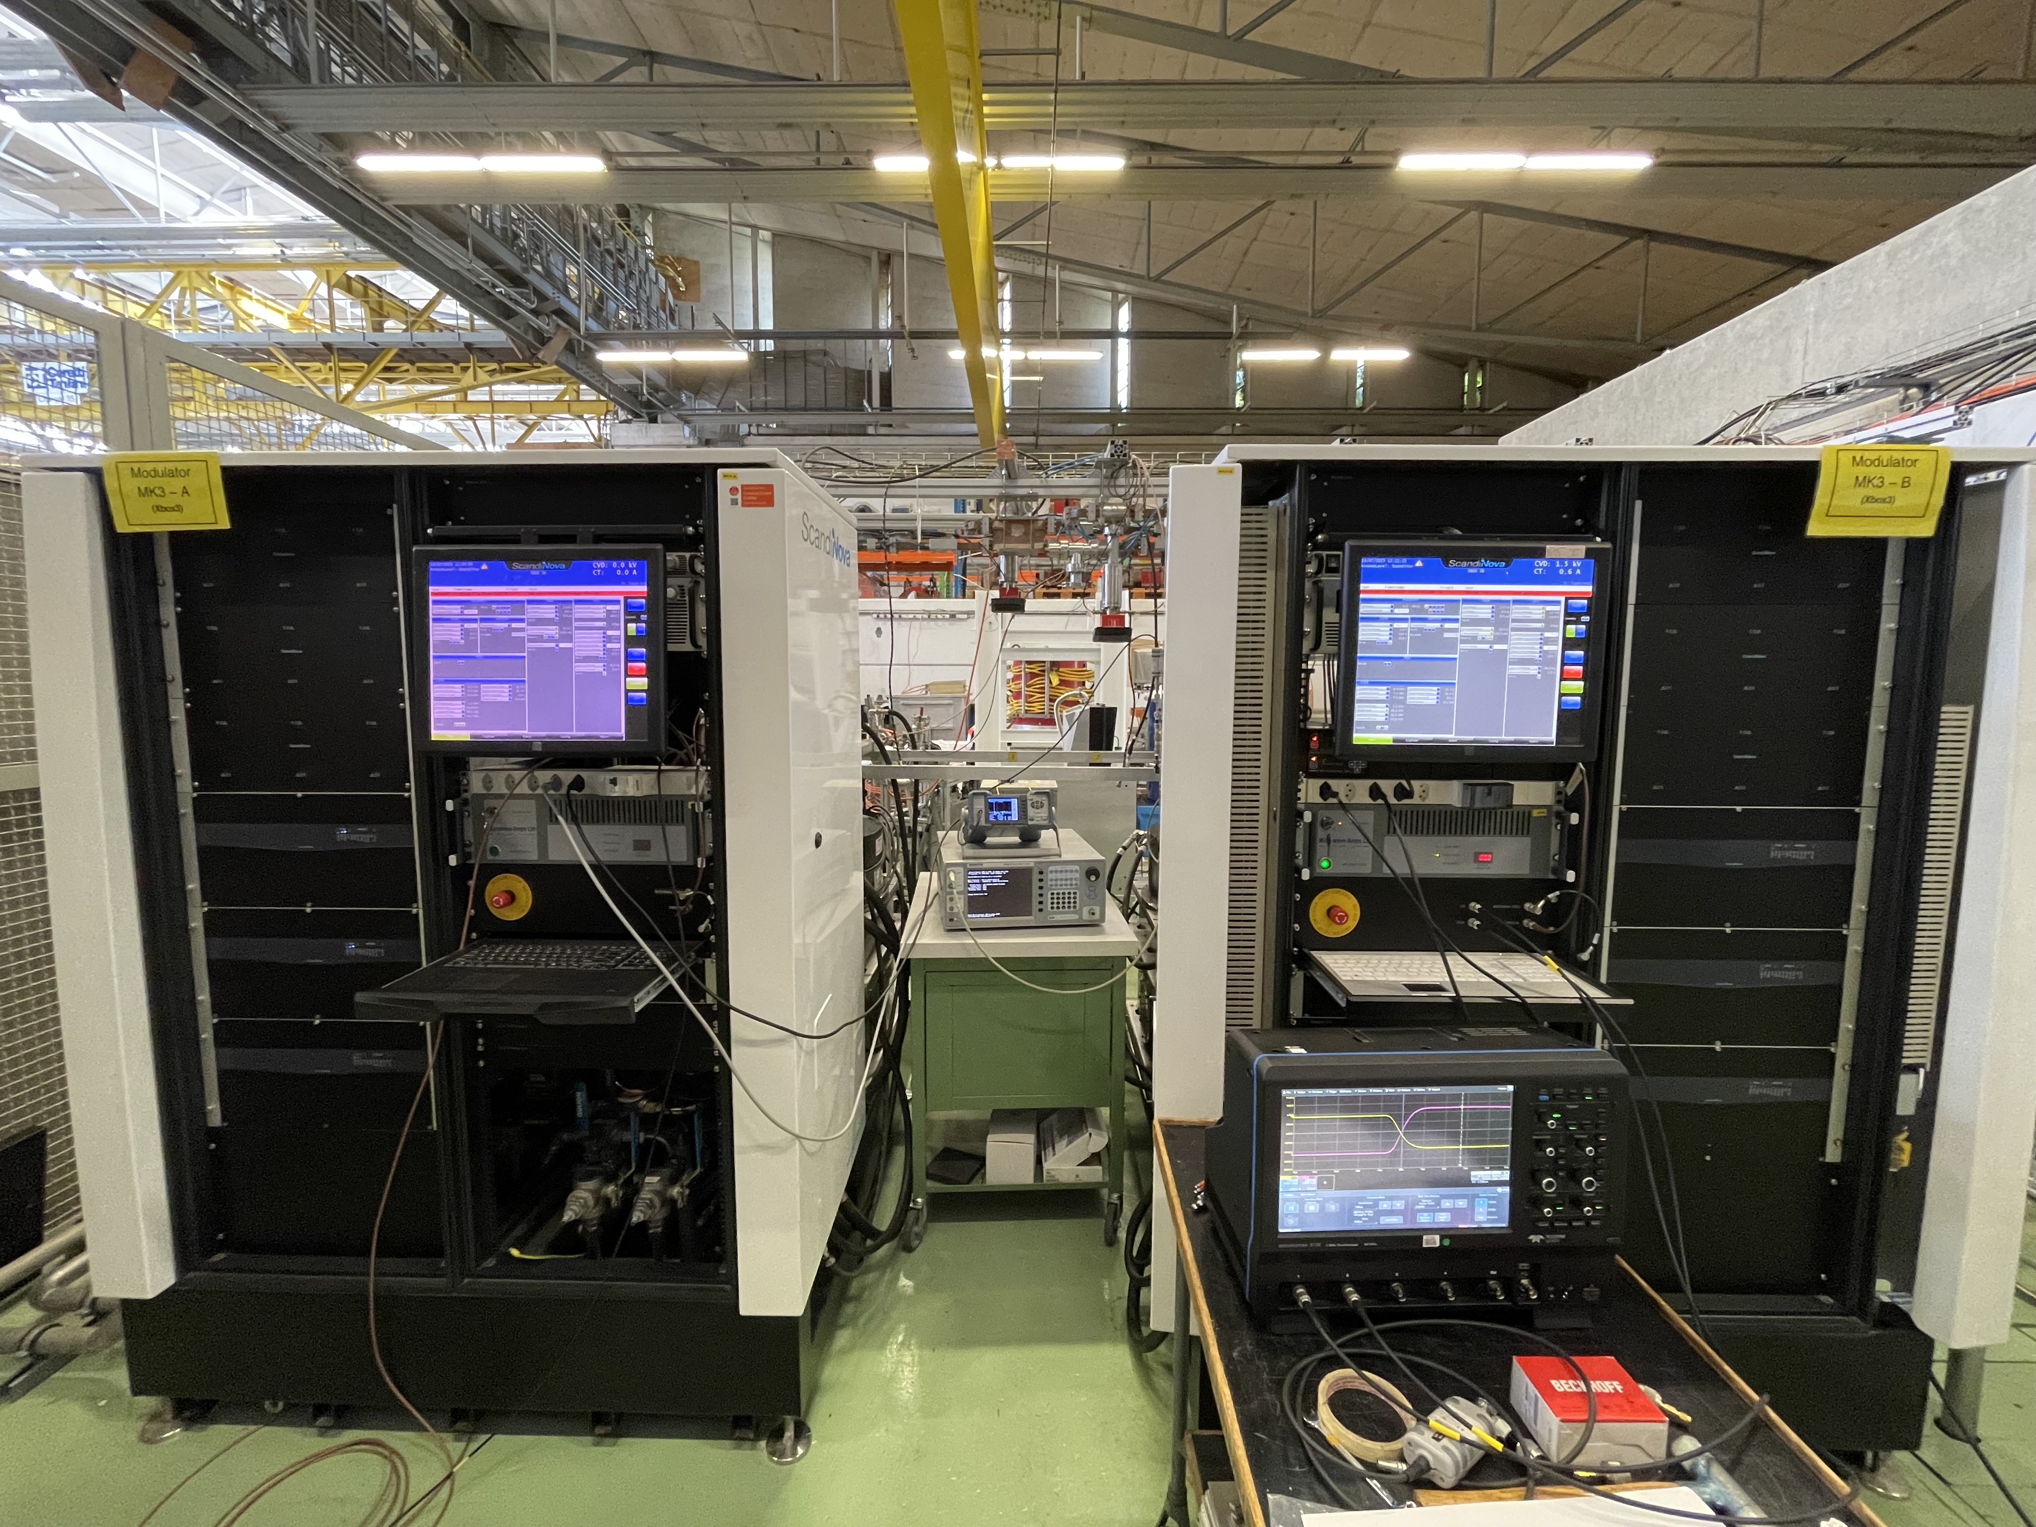
X-Box 3: High Efficiency Tubes Characterisation
New campaign based on calorimetry
  Temperature sensors and flow meters installed
  Channels integrated in Labview code
Uncertainty sources in collector calorimetry
  Variations in temperature due to slow response of water station
  Variations in water flow
TUBE1 22M001
CAV 22G002

Slide 19
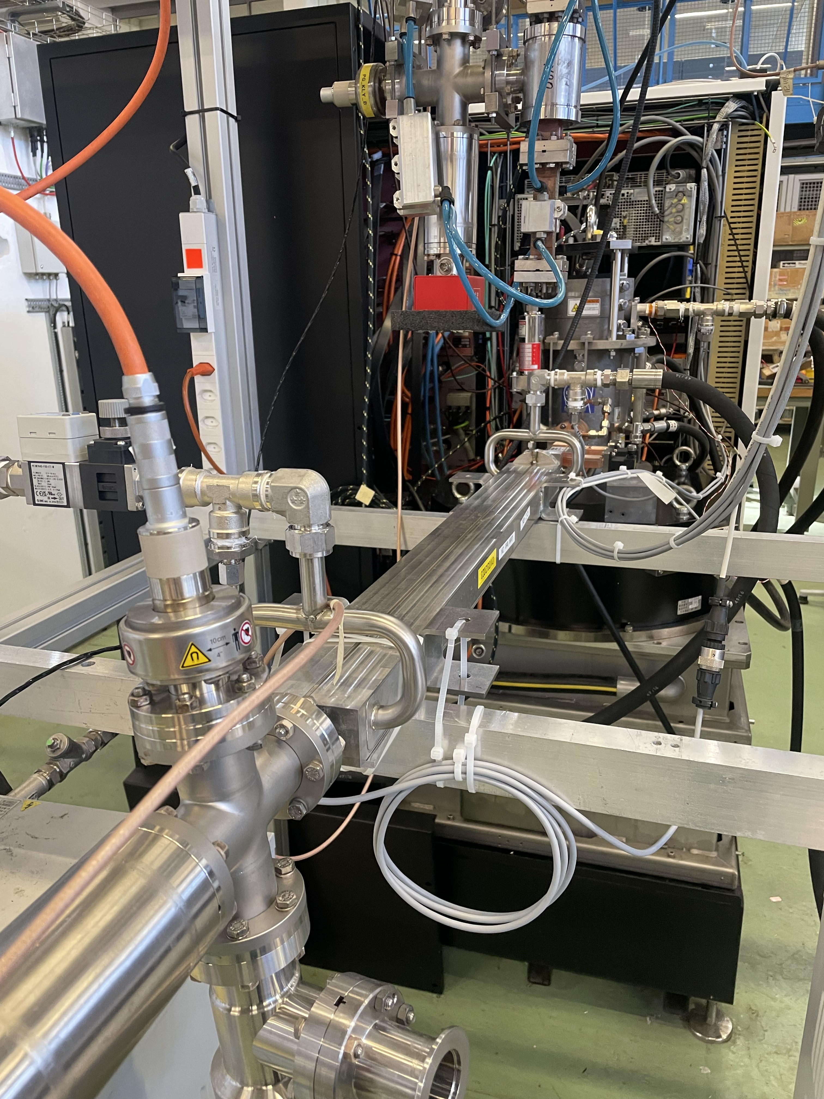
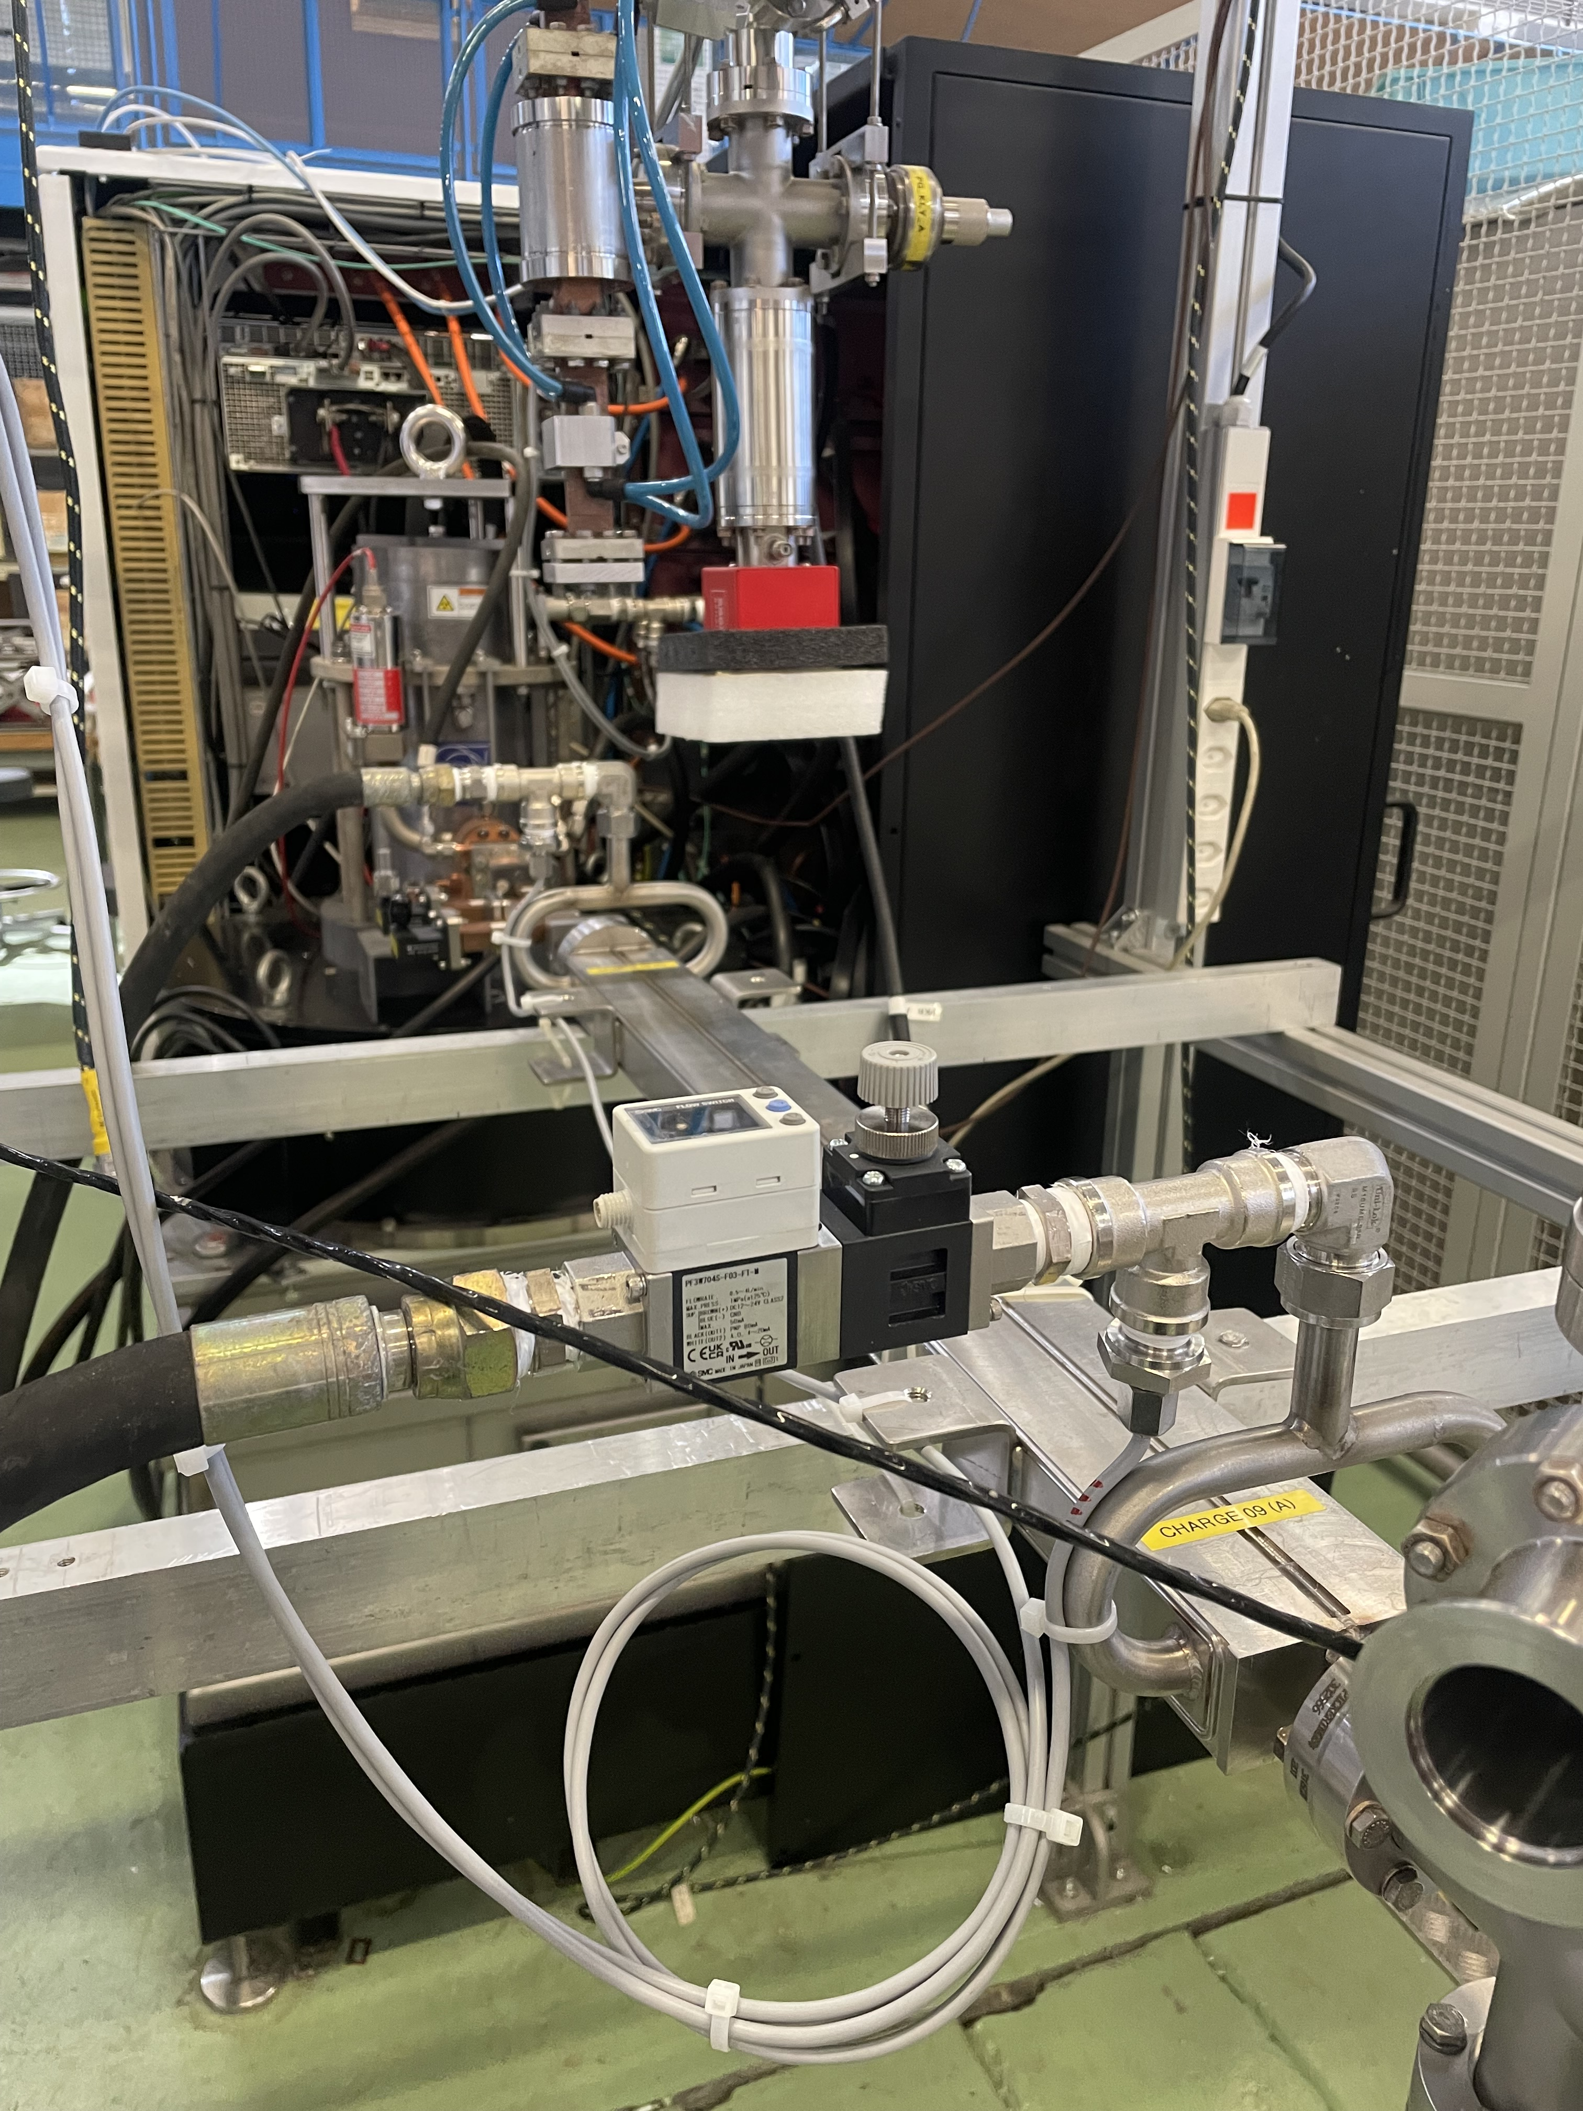
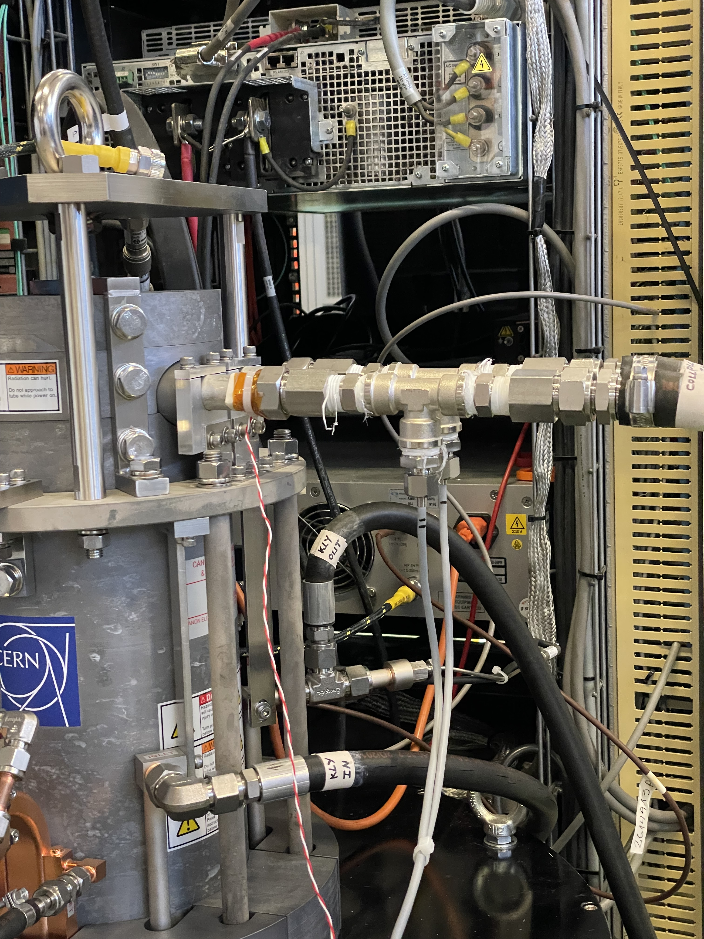
X-Box 3 HEK: New setup

Slide 20
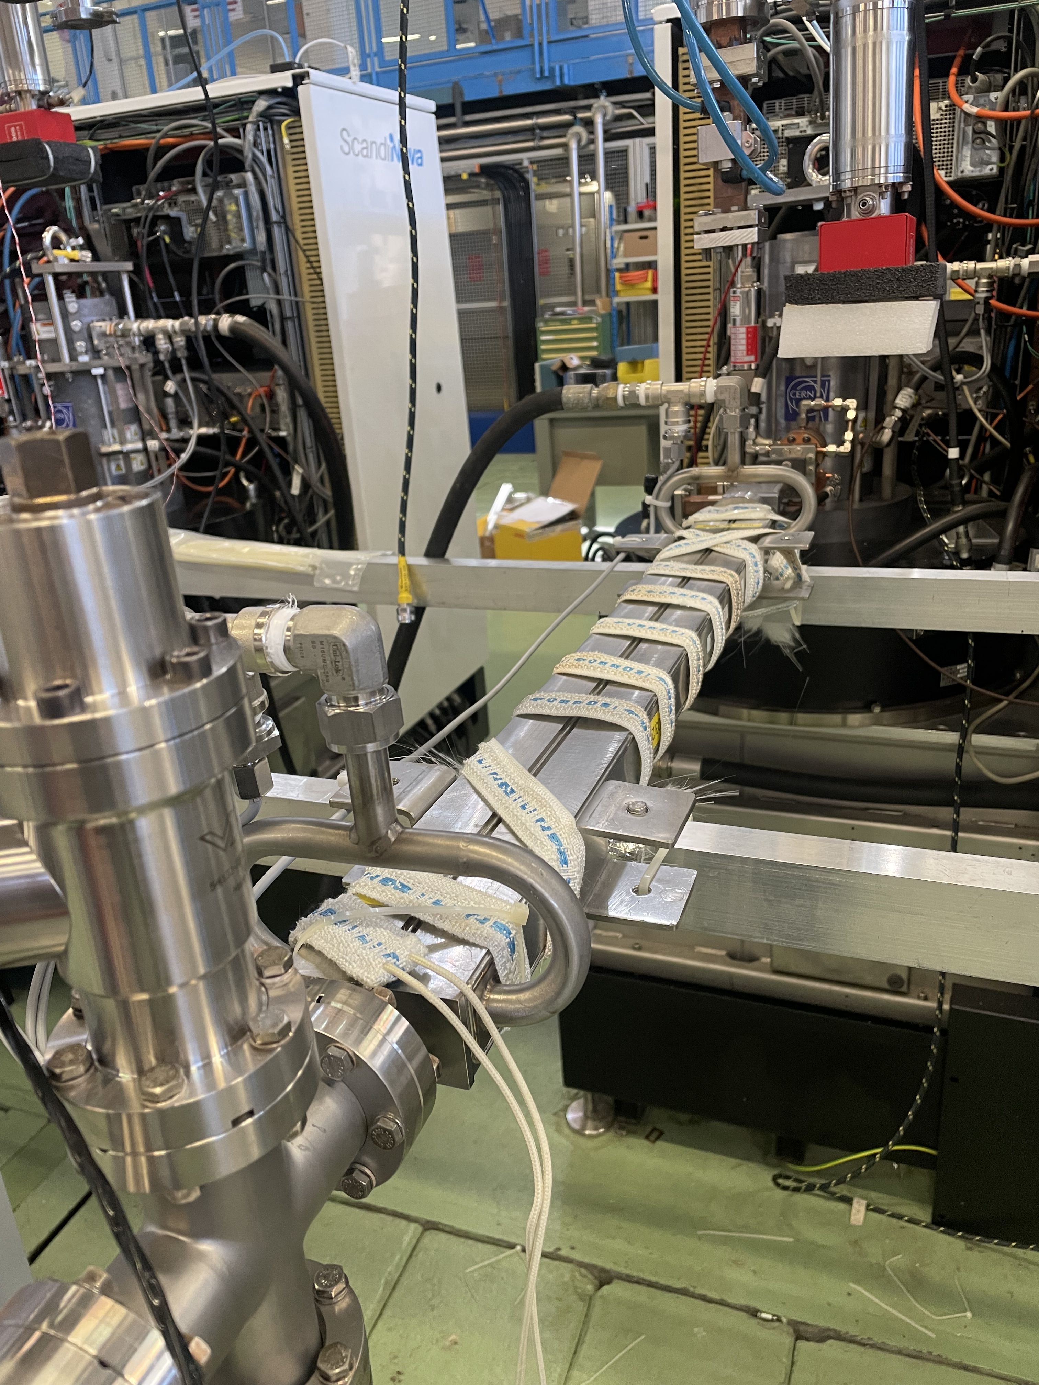
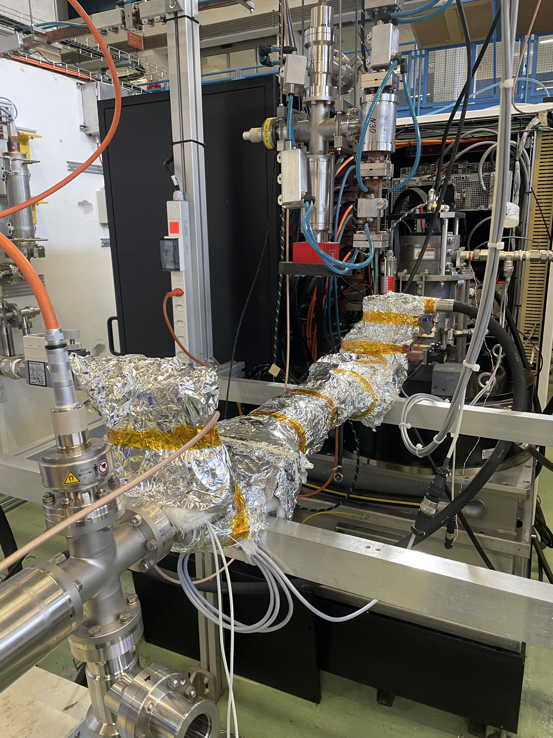
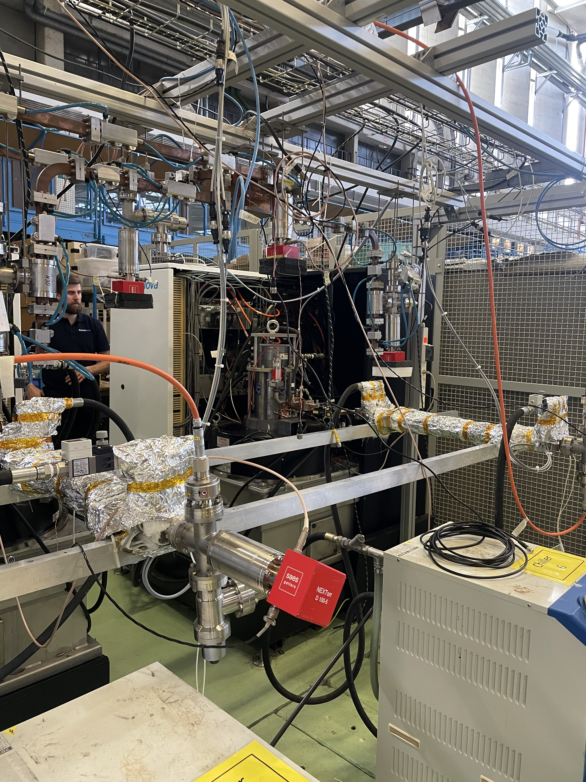
X-Box 3 HEK: New setup

Slide 21
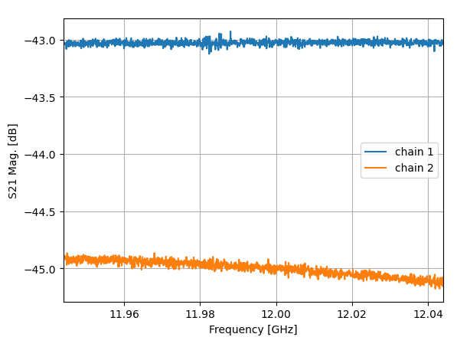
High Efficiency Tubes Characterisation
Measurement setup
Klystron
RF Gen
SSA
HP DC
Load
DC
Attenuation
Isolation + Transition + Attenuation
Power Meter 1 - PKI
Power Meter 2 - PKI

Slide 22
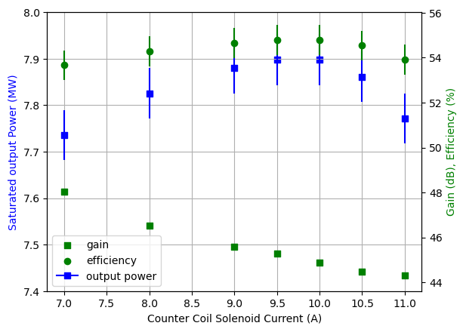
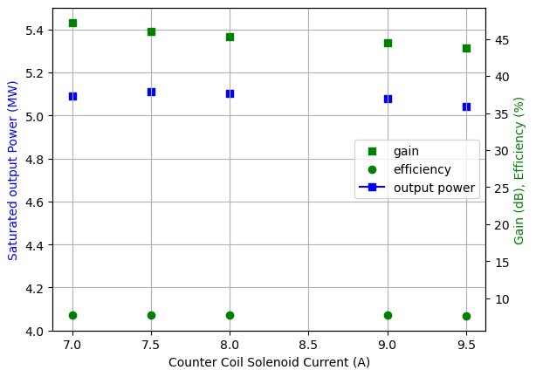
High Efficiency Tubes Characterisation
Gain curves vs Counter Coil Current
22M001 TUBE
22G002 CAV

Slide 23
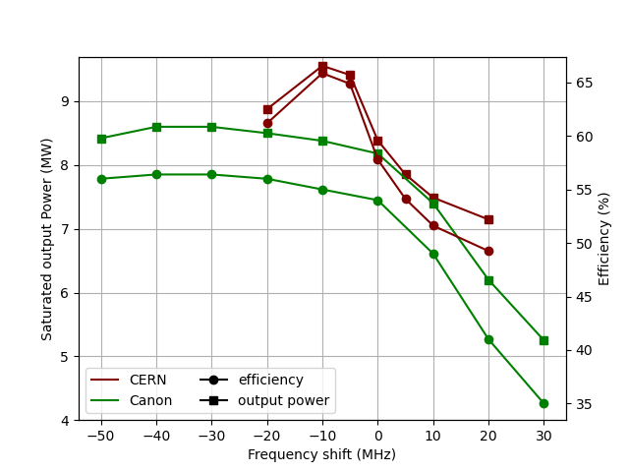
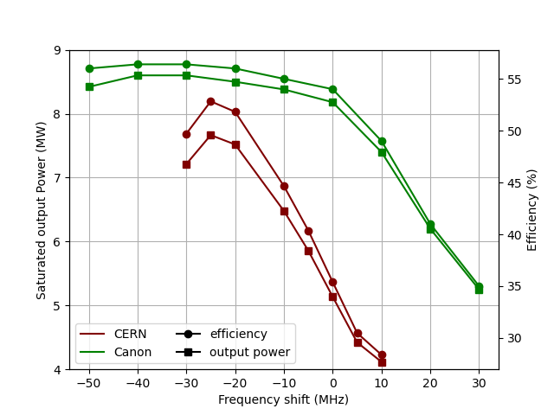
High Efficiency Tubes Characterisation
Frequency Behaviour
22M001 TUBE
22G002 CAV

Slide 24
High Efficiency Tubes Characterisation
Some problems with vacuum
  Last week before Christmas break this was solved
  Now both lines <1e-9 mbar
New measurement campaign, based on calorimetry
  Still waiting for flow meters and temperature sensors

Slide 25
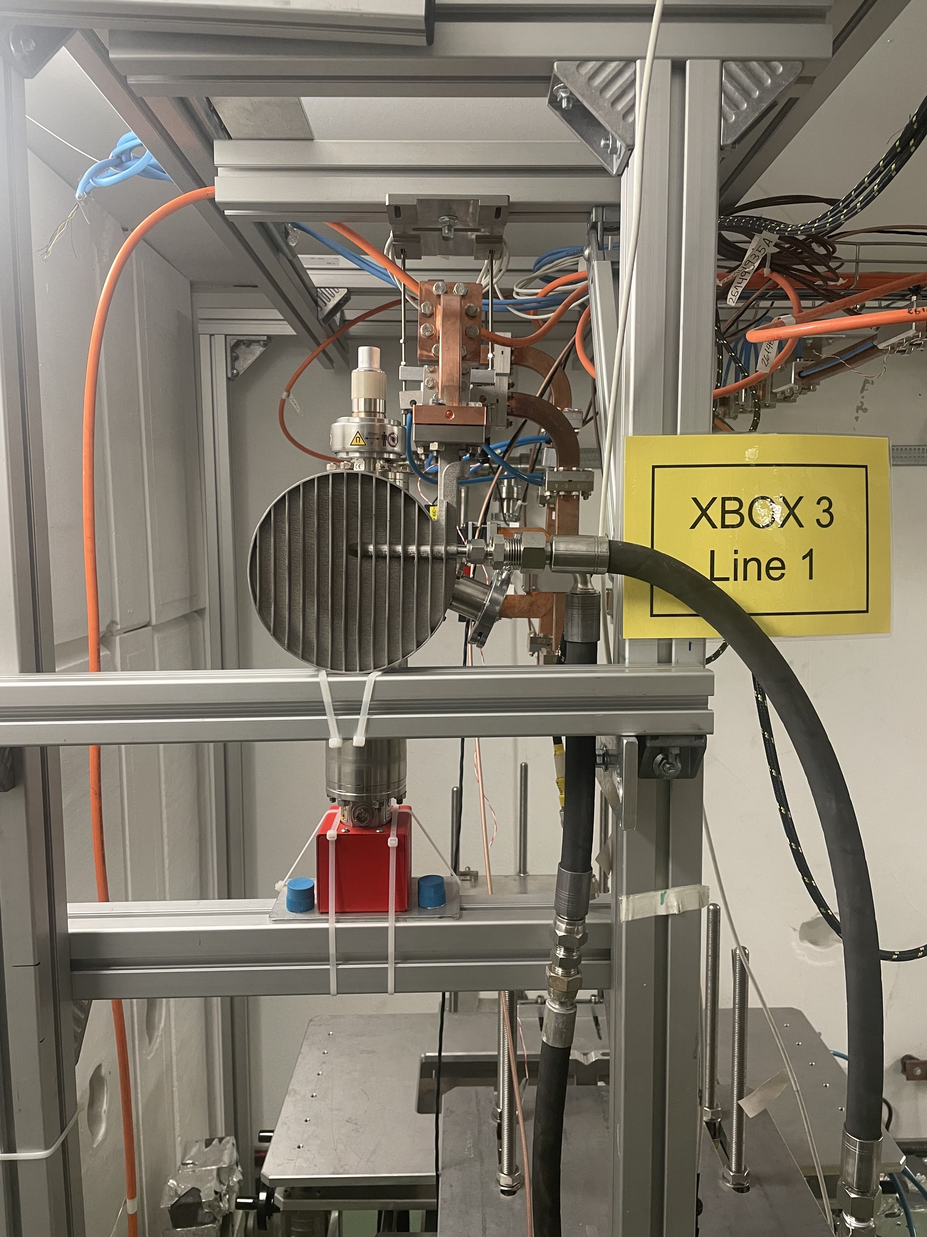
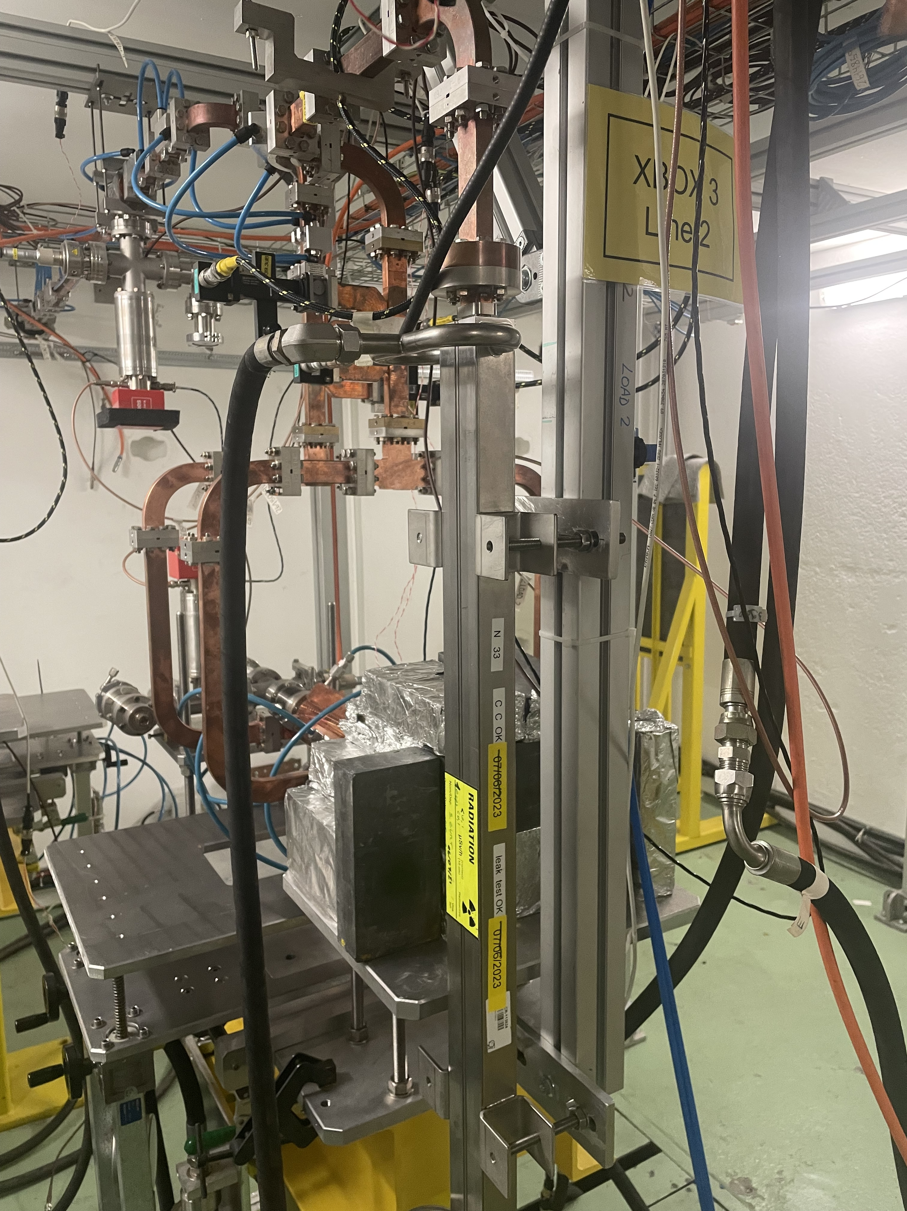
X-Box 3
Installation of loads
  Line 1- spiral load
  Line 2- long load
Installation of new chillers
  Planned for next week

