Slide 1
MCBXFB Coils assignation
Jesús A. García Matos, Fernando Toral
6th February 2024

Slide 2
Outline
Inner coils: ICBS 09 / 15 / 16 / 17 / 18
Outer coils: OCBS 05 / 08 / 14 / 15 / 16 / 17

Slide 3
Outline
Inner coils: ICBS 09 / 15 / 16 / 17 / 18
Outer coils: OCBS 05 / 08 / 14 / 15 / 16 / 17

Slide 4
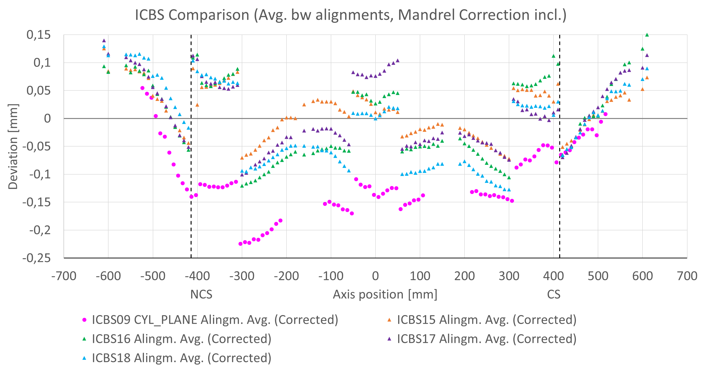
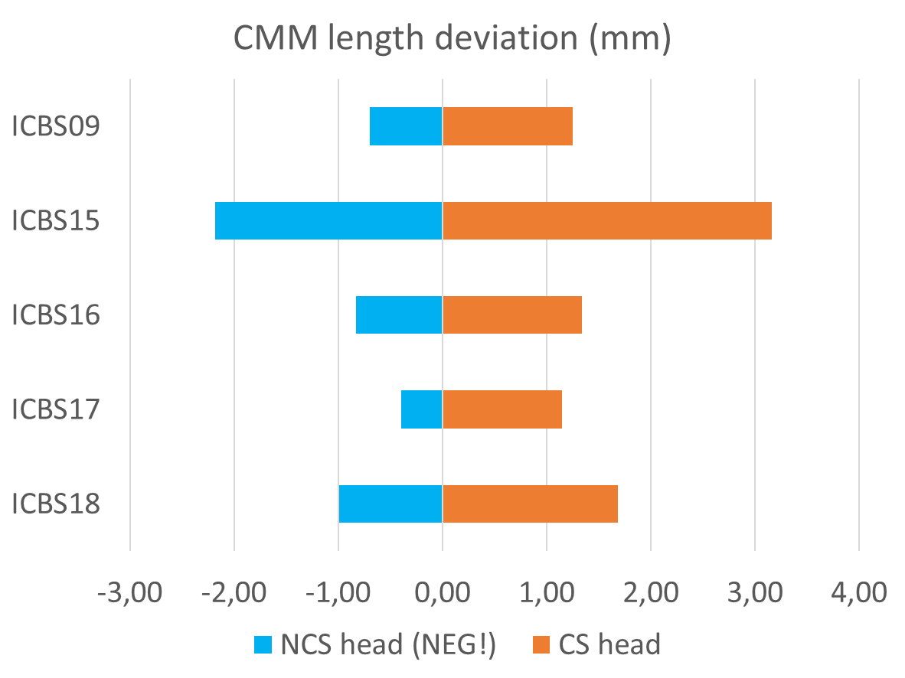

Inner coils: ICBS 09 / 15 / 16 / 17 / 18
ICBS09 should wait for another coil with a similar azimuthal profile
All profiles in 0,25 mm range aprox.
NCS overdimension is showed in negative values only for better visualization

Slide 5
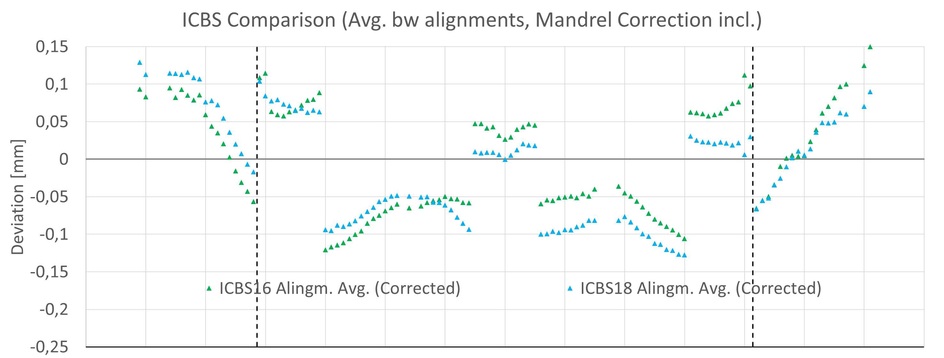
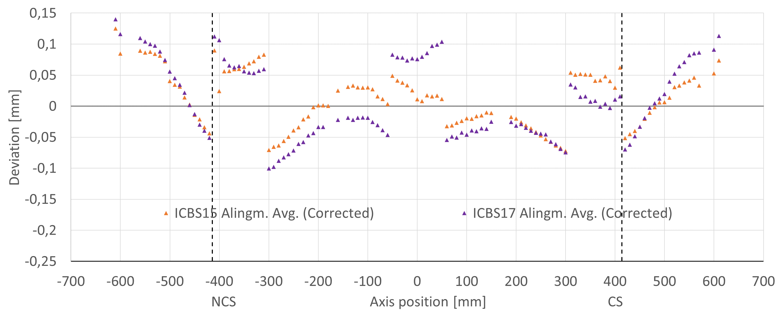
First proposal: 16+18 / 15+17
Best azimuthal match

Slide 6
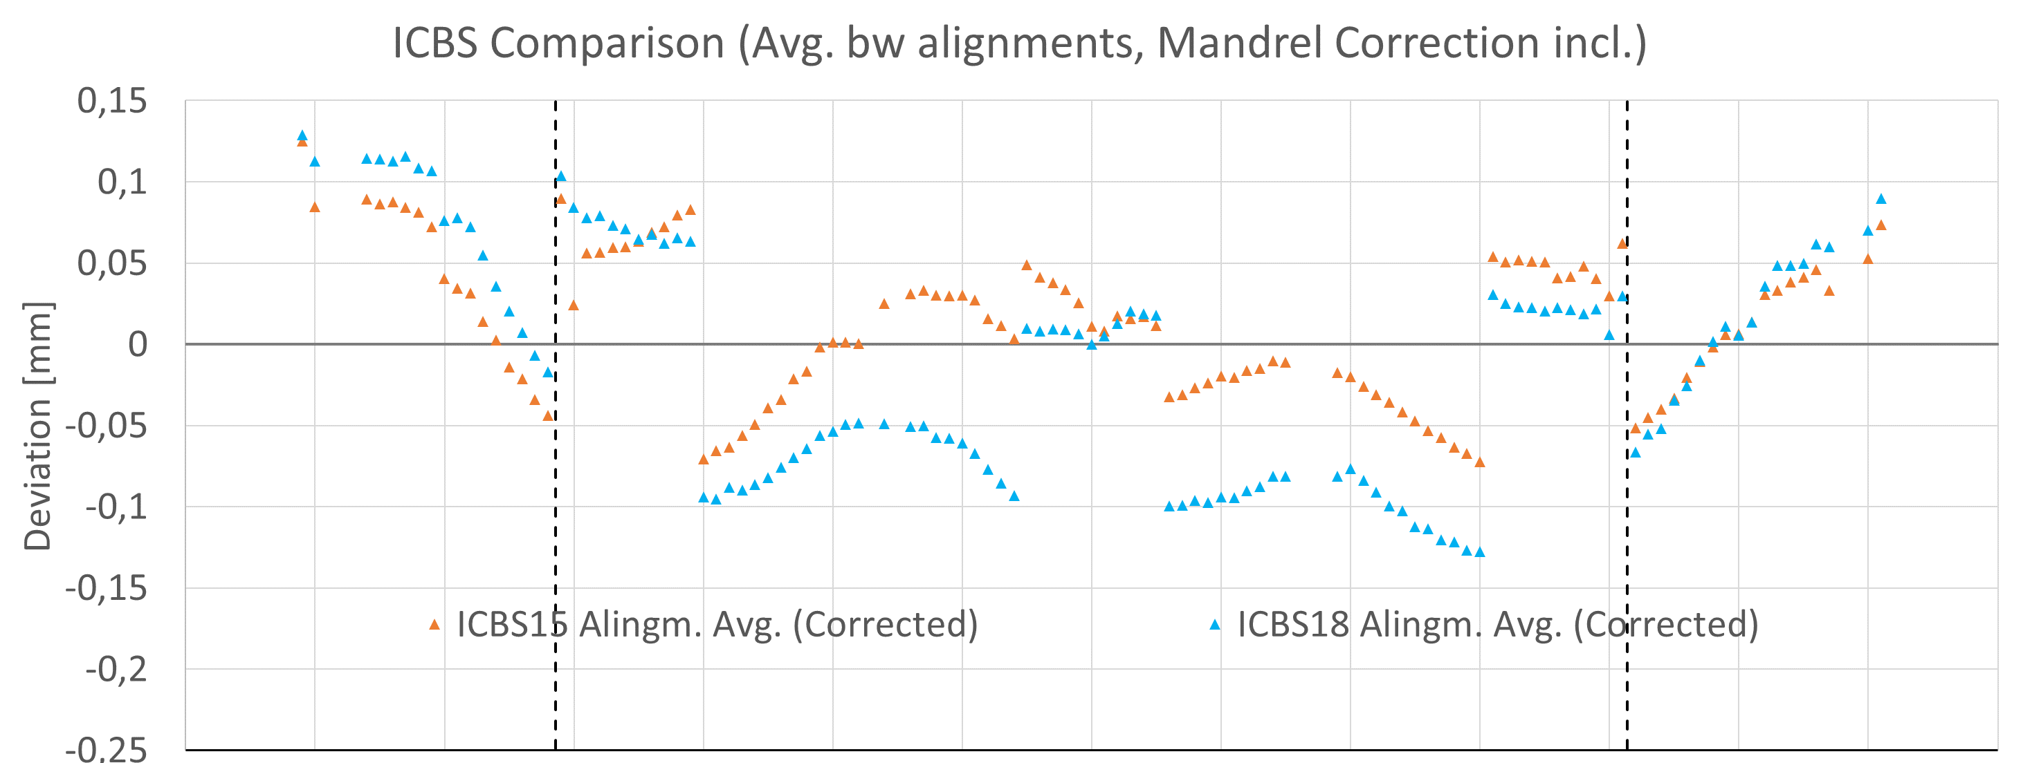
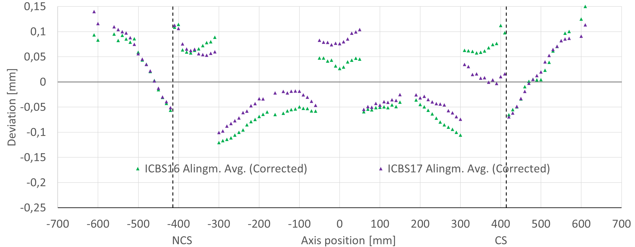
Second proposal: 15+18 / 16+17
Better longitudinal match

Slide 7
Outline
Inner coils: ICBS 09 / 15 / 16 / 17 / 18
Outer coils: OCBS 05 / 08 / 14 / 15 / 16 / 17

Slide 8
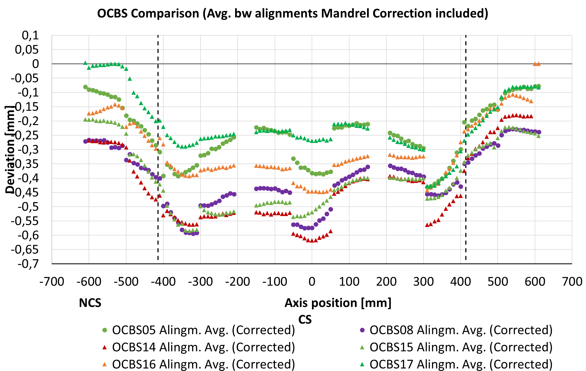
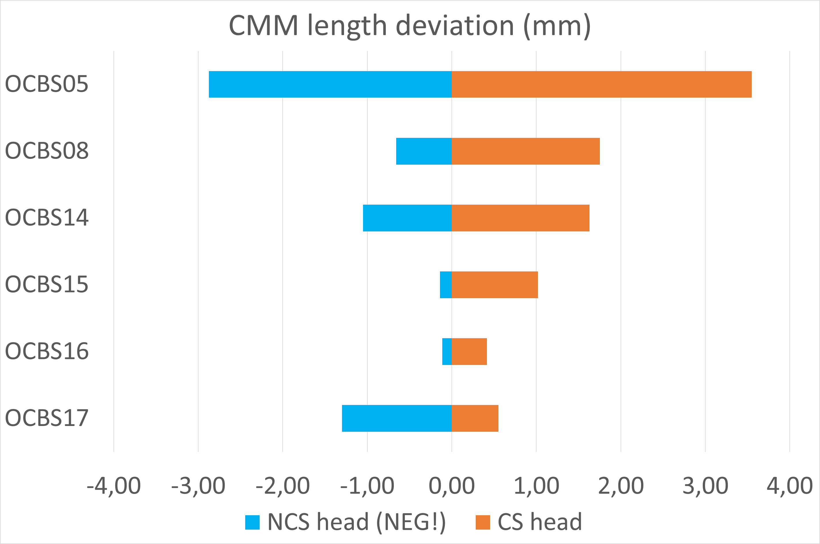
Outer coils: OCBS 05 / 08 / 14 / 15 / 16 / 17
OCBS05 is particularly long
Wide range: 0.45 mm aprox.

Slide 9
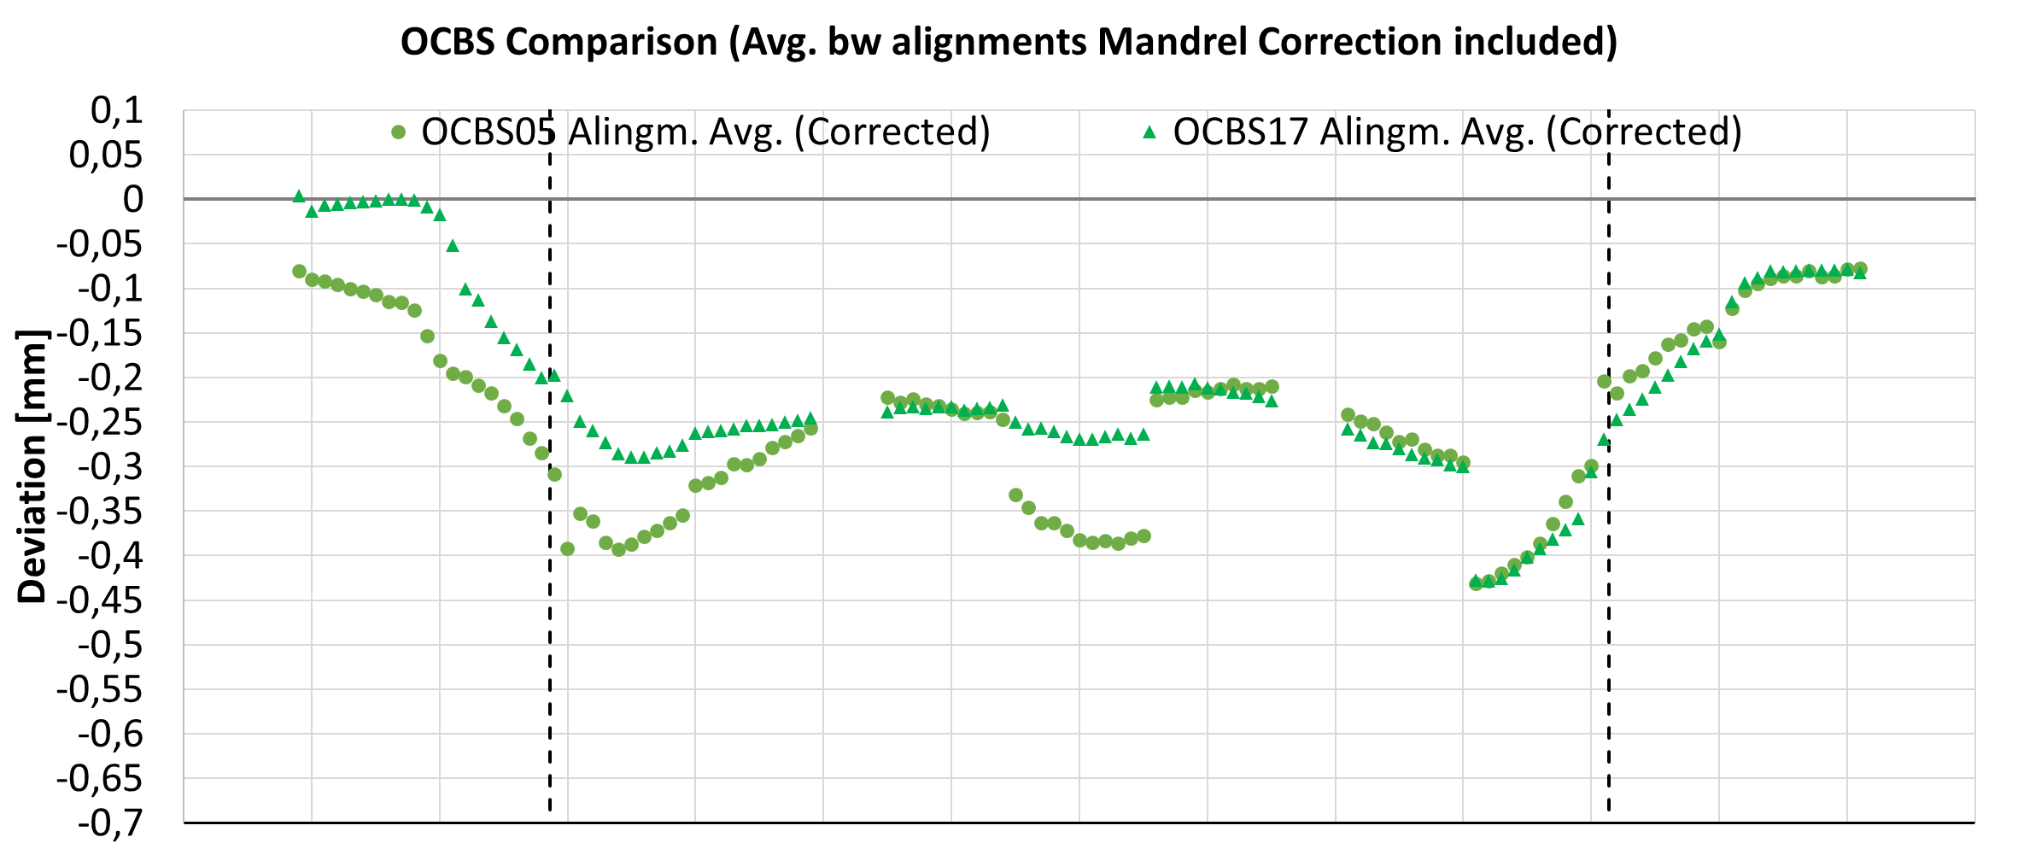
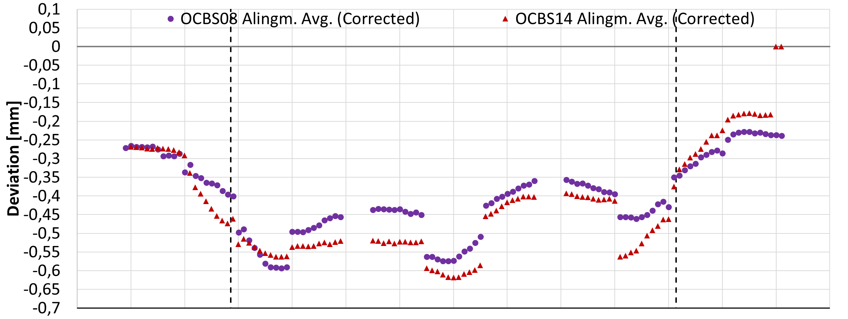
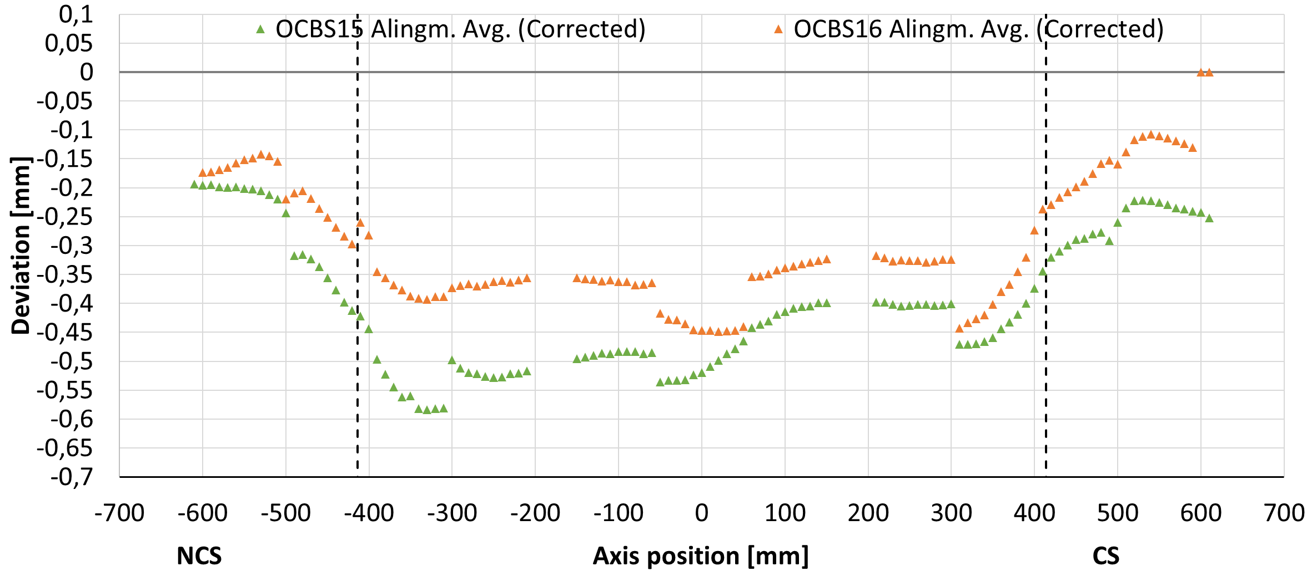
Proposal: 05+17 / 08+14 / 15+16

Slide 10
Conclusions
Inner coils: ICBS 15+18 / 16+17 (2nd proposal)
Outer coils: OCBS 05+17 / 08+14 / 15+16

