Slide 1
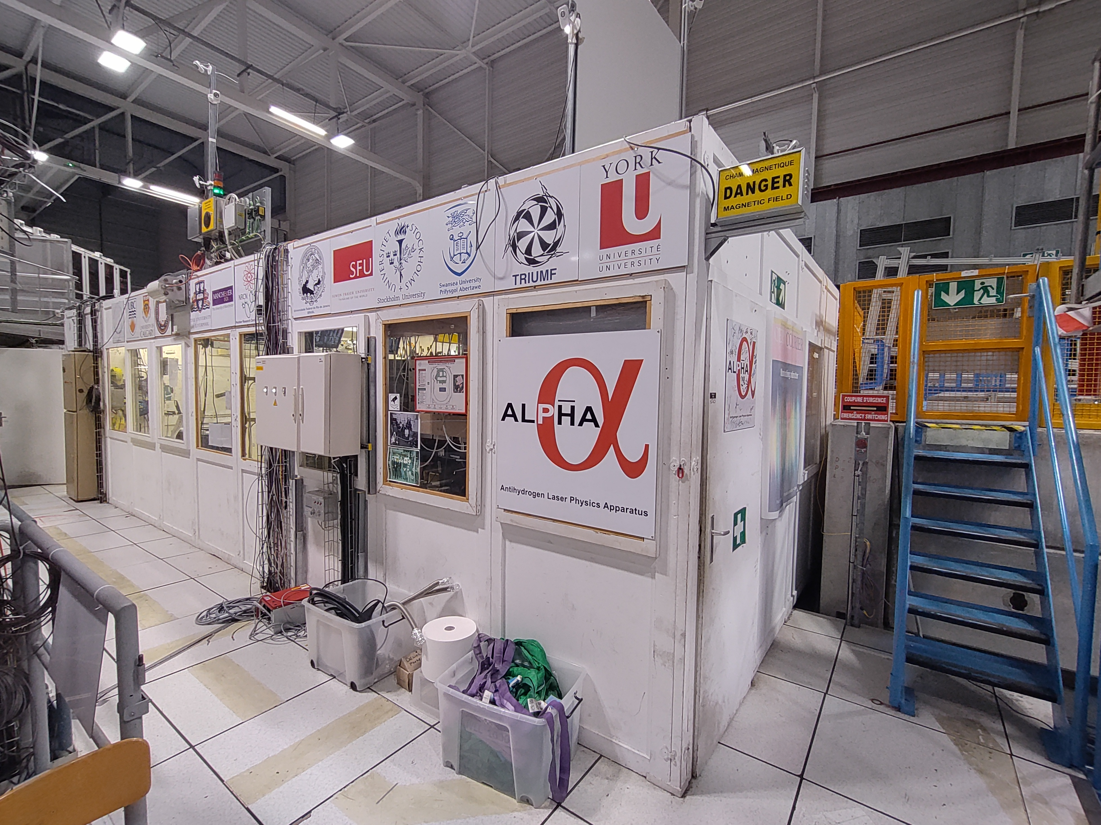
ALPHA control room refurbishment
YETS 23-24
Maud Wehrle
29/02/2024

Slide 2
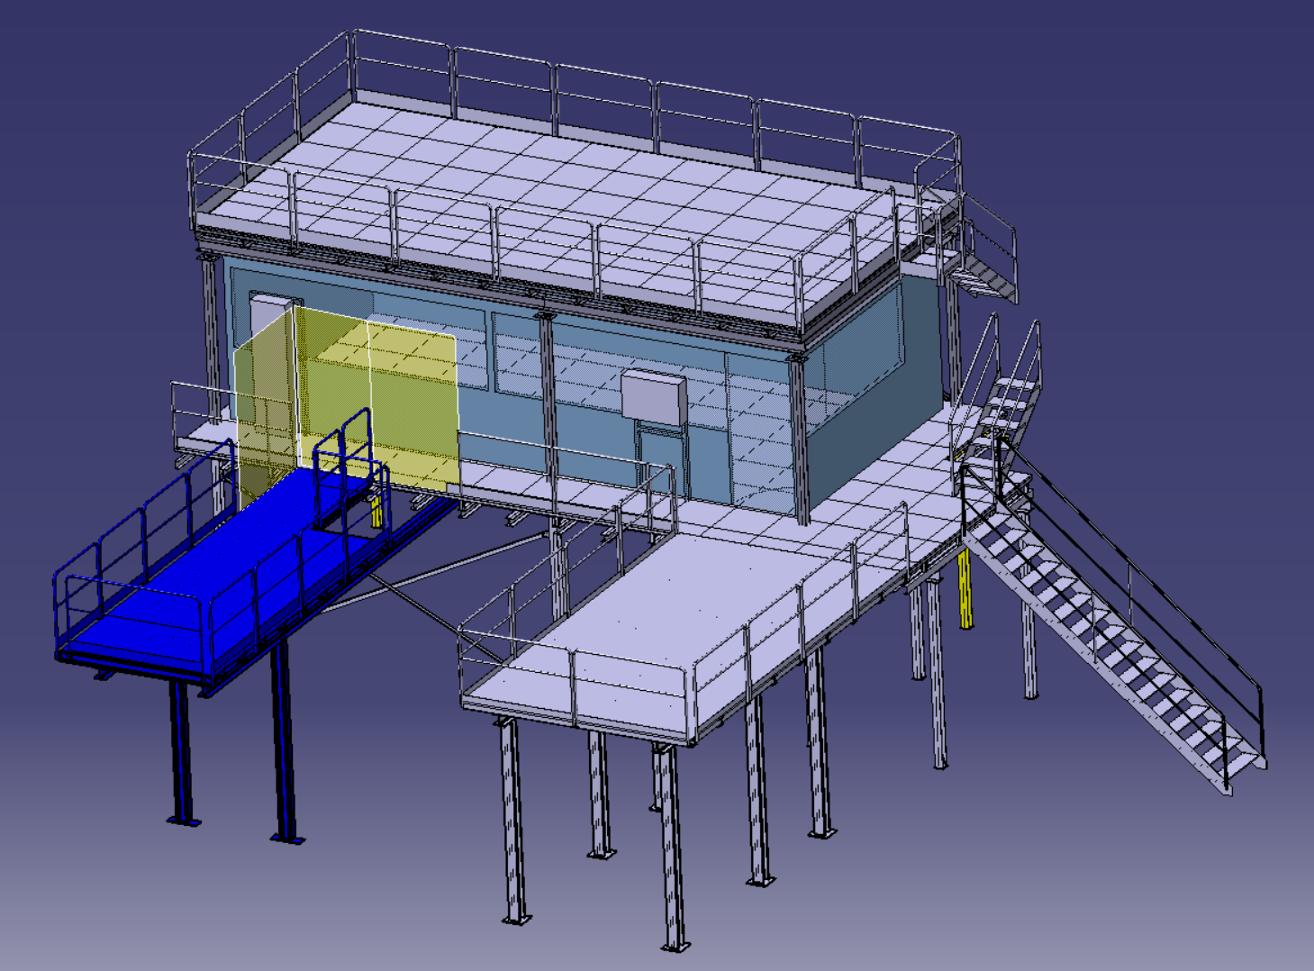
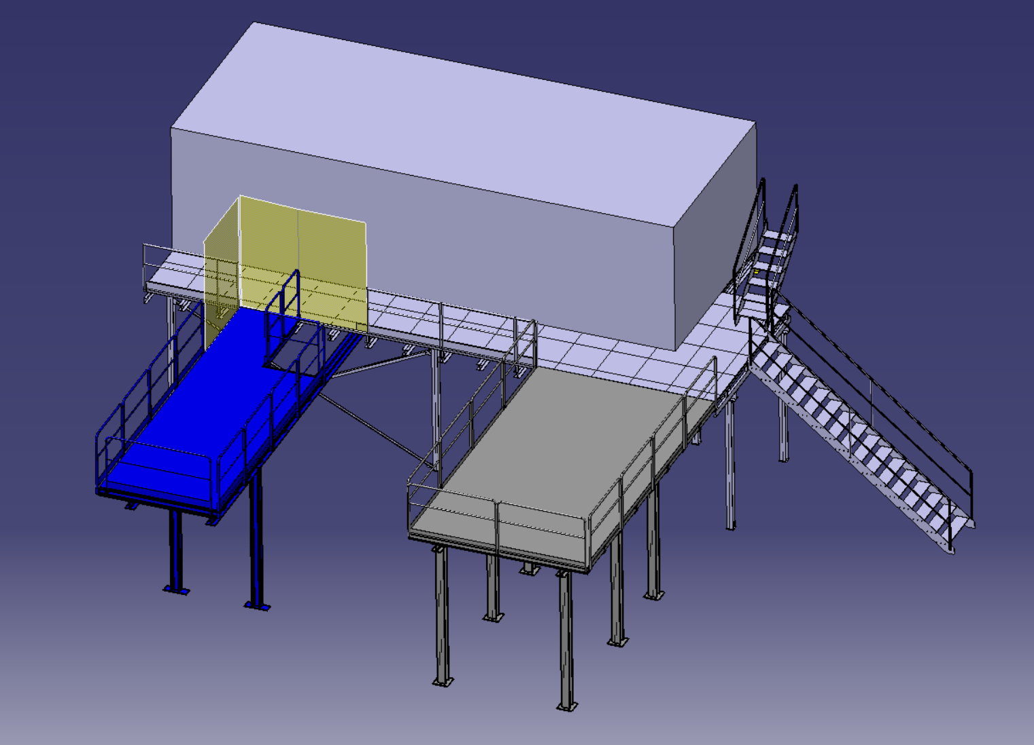
Refurbishment project : YETS 23-24
  Barrack replacement to get the control room up to standards :
    Better acoustic and thermic insulation
    New electrical installation
  Possible addition of storage platform (YETS 24-25?)
  Consequently slightly smaller dimensions

Slide 3
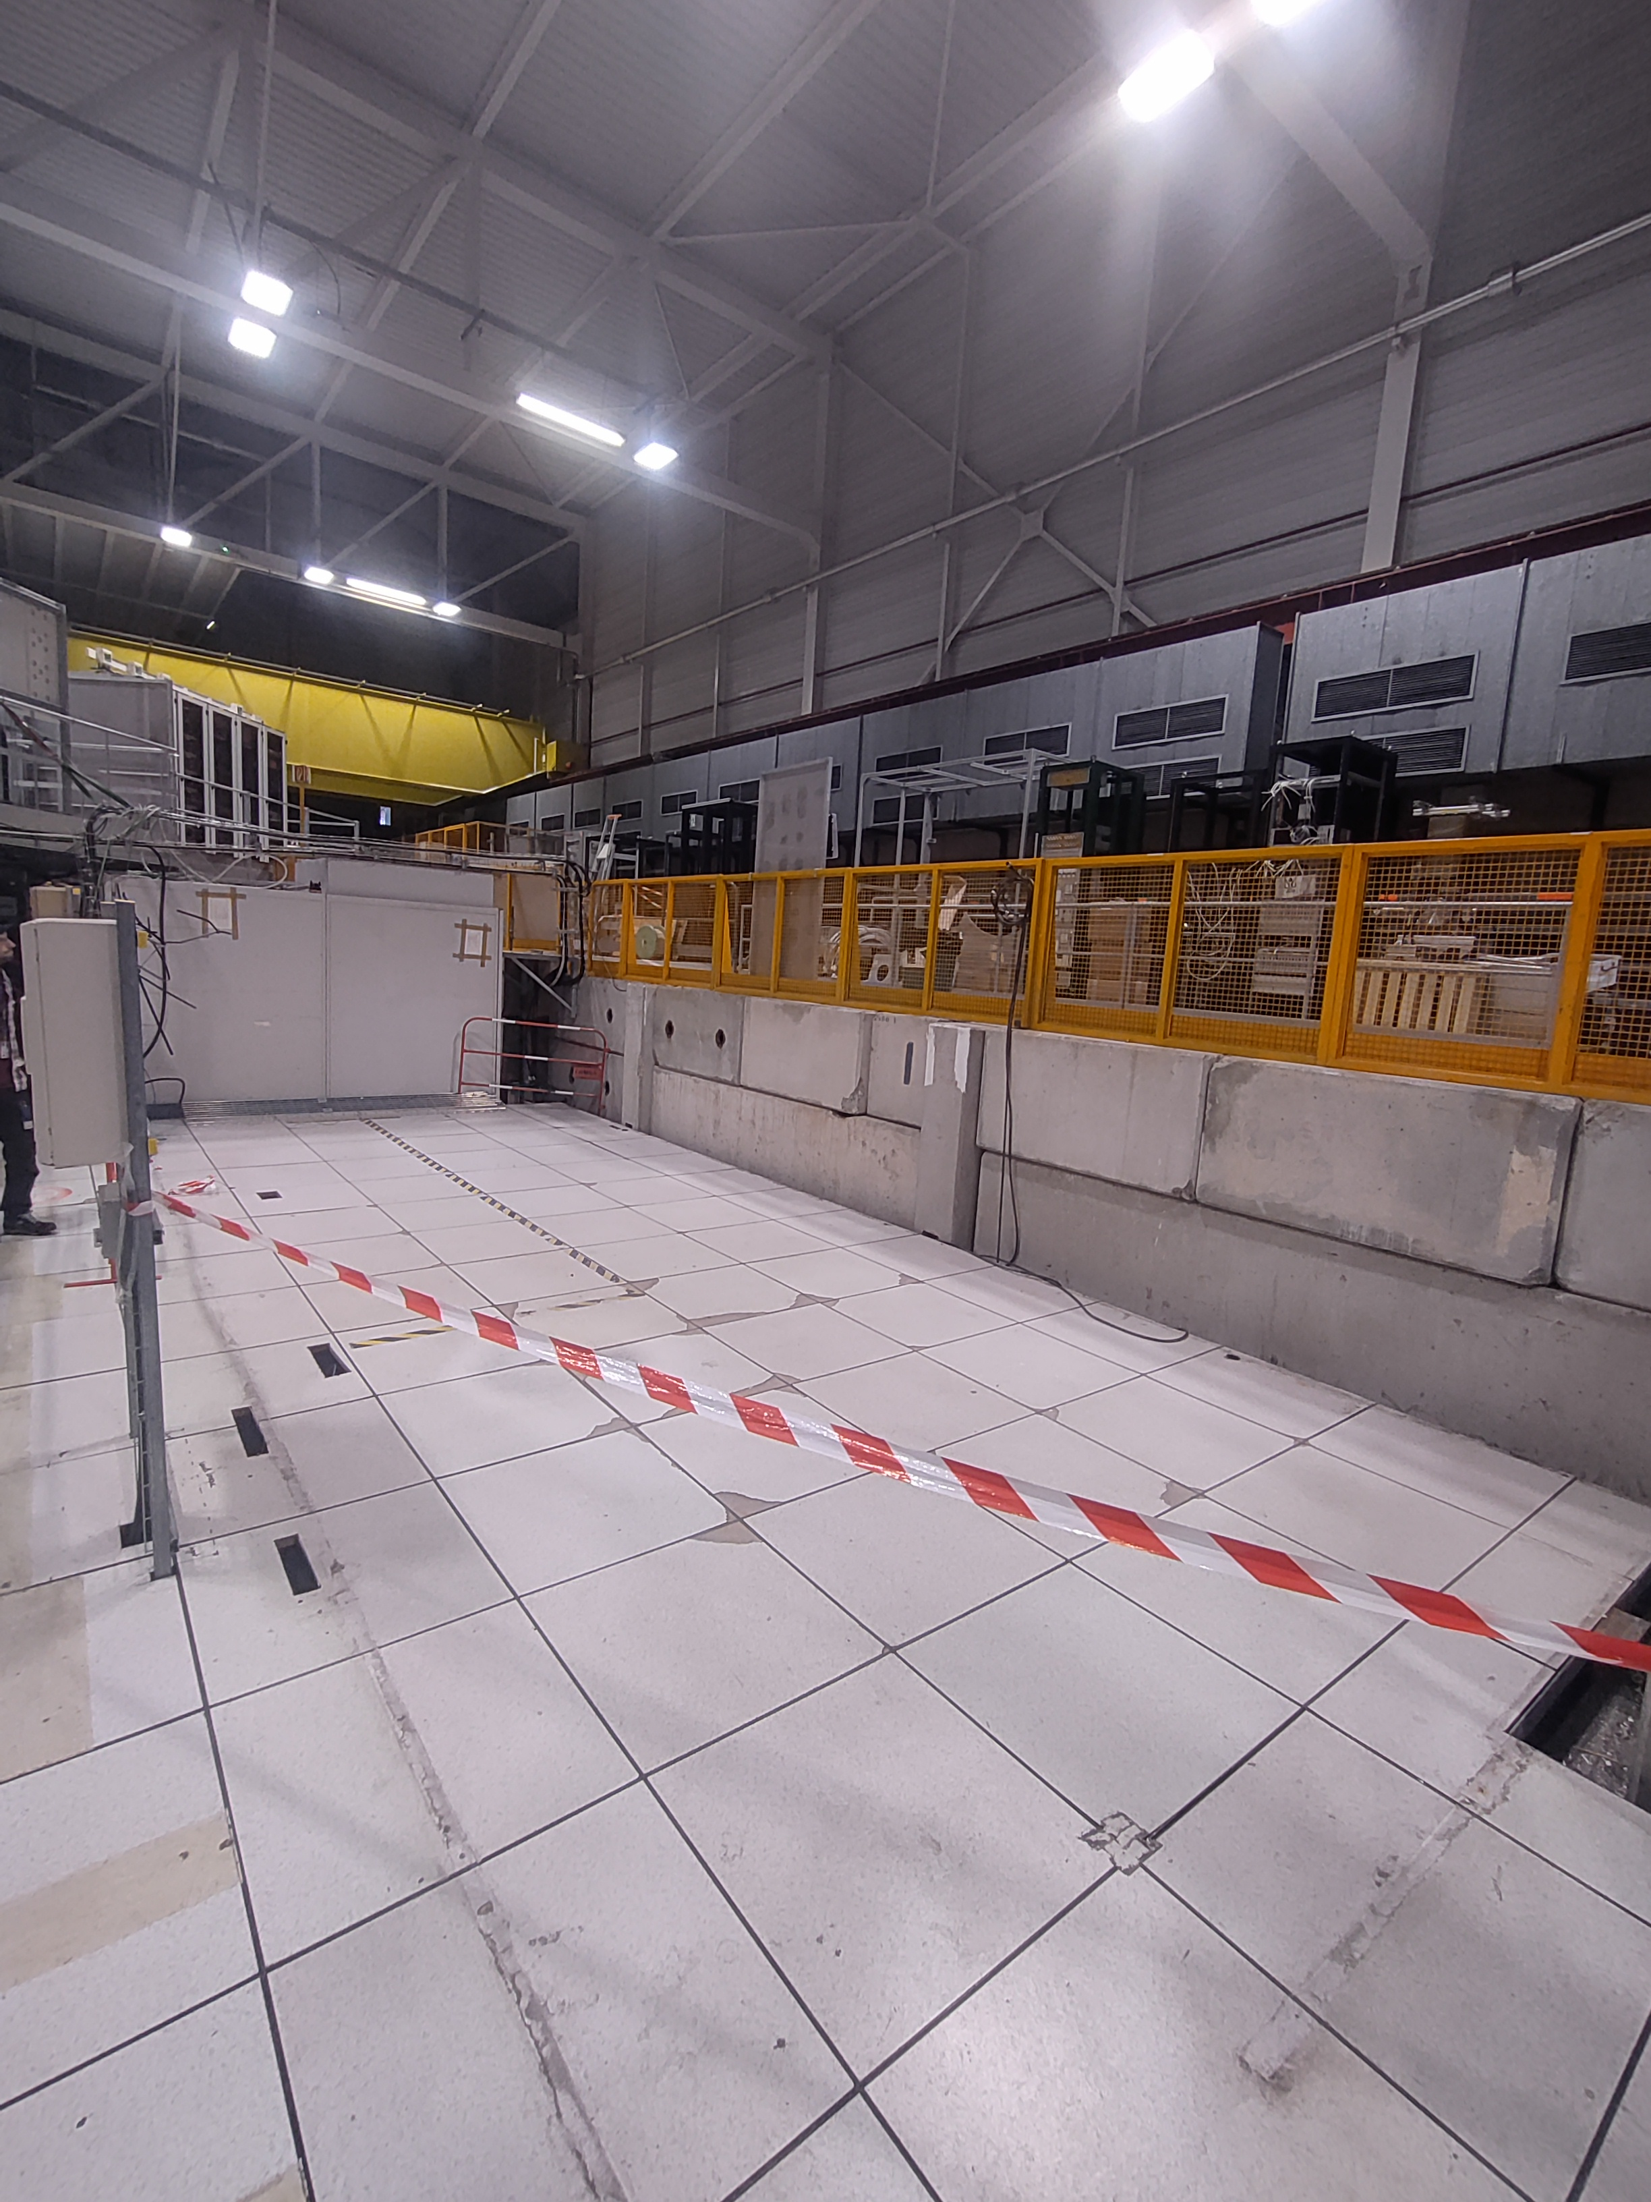
What has been done ?
  Decabling (Power + RP+ AC)
  Displacement of 2 electrical cabinets
  Dismantling of the panels
  Pathway under the false flooring for power cables
  We’re now waiting for the crane to be back in service !

Slide 4
What’s next ?
  Installation of poles + bracing for the potential future platform. → Installed at the moment !
  STIC company is arriving on Monday 04/03 to install the new control room.
    The crane will be used to unload the packages and when the STIC workers will need to access the roof.
  EN-EL is cabling from 11/03 until 20/03
  Installation of Fire detection, RP equipment and AC will then follow straight after.
  Control room to be accessible between the 25th and 28th of March !

Slide 5
Safety reminders
  Activities taking place around the ALPHA barrack should be notified.
  The crane will be on lockout when used as an anchor for STIC workers lifeline.

Slide 6
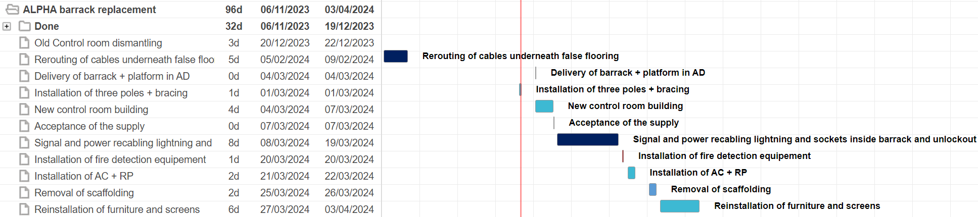
Schedule YETS 23-24

