Slide 1

AD/ELENA FACILITY
ADTC Meeting
29th February 2024
2023-2024 YETS follow-up

Slide 2
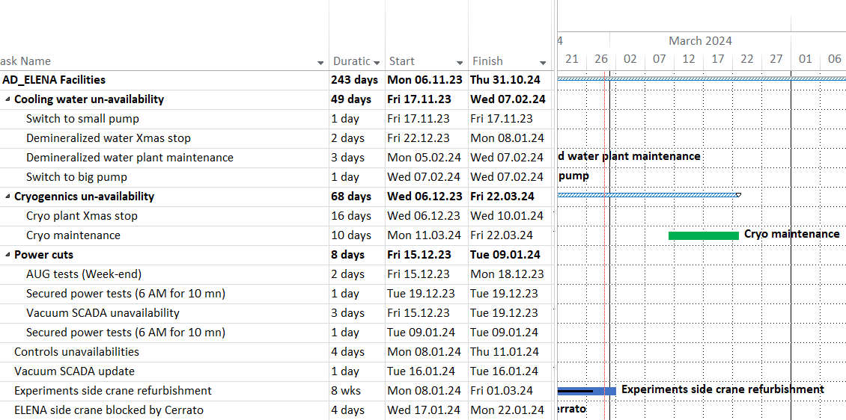
Planned services disruptions
09/03 – 24/03
Load tests planned
Planning available at
https://oss-coordination.web.cern.ch/gantt/latest?facilities=AD/ELENA&scale=week&worktypeproject=

Slide 3
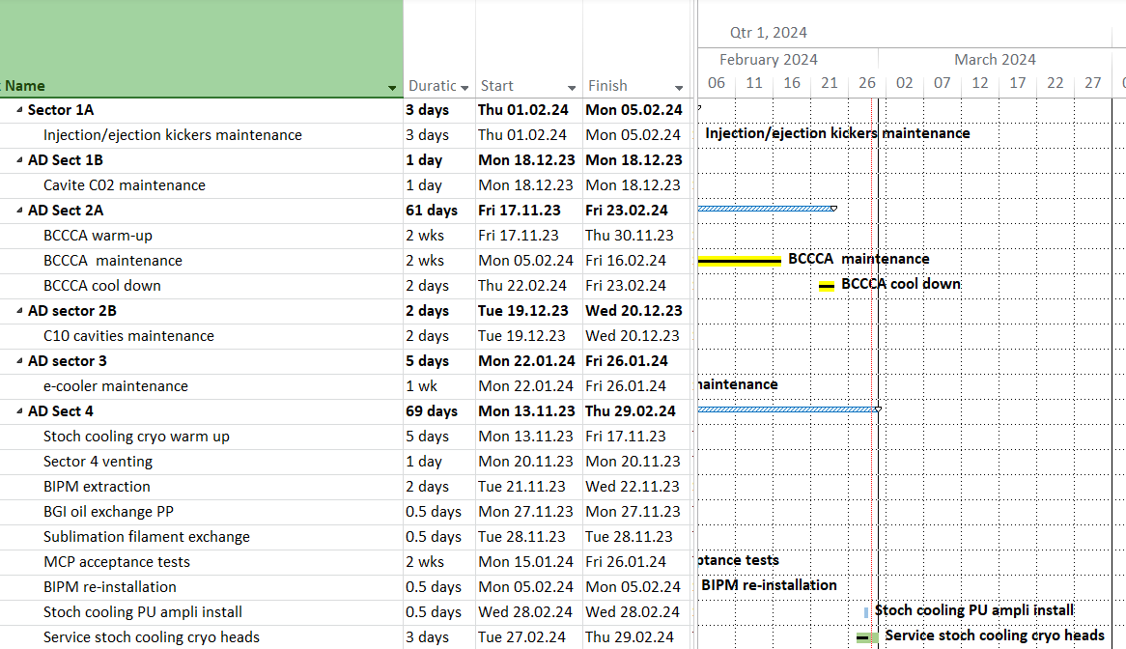
AD sectors 1A-1B-2A-2B-3-4

Slide 4
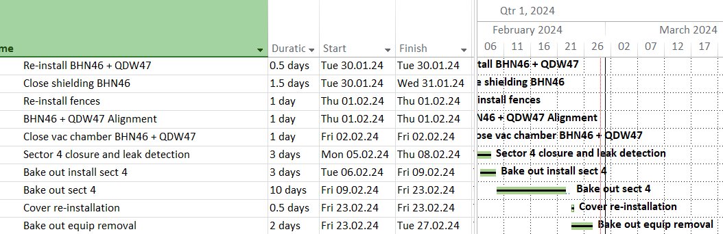
AD ring sector 4

Slide 5
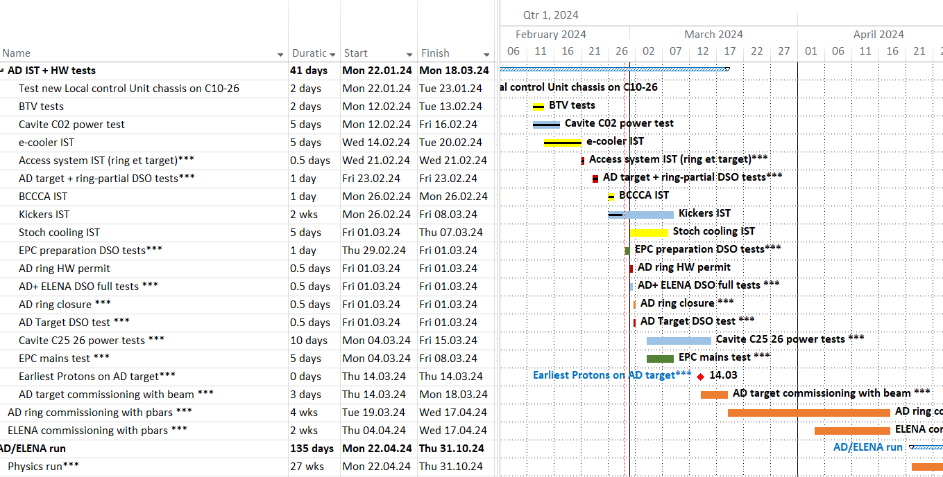
AD re-commissioning

Slide 6
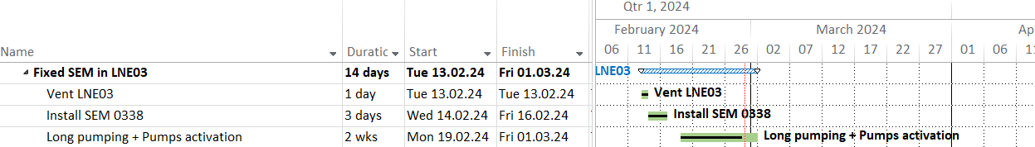
ELENA

