Slide 1


Preliminary tracking results
L. Soubirou, A. Chance – CEA Saclay
MuCol workshop on RCS, pulsed magnets & powering (15 May 2024, CERN)

Slide 2
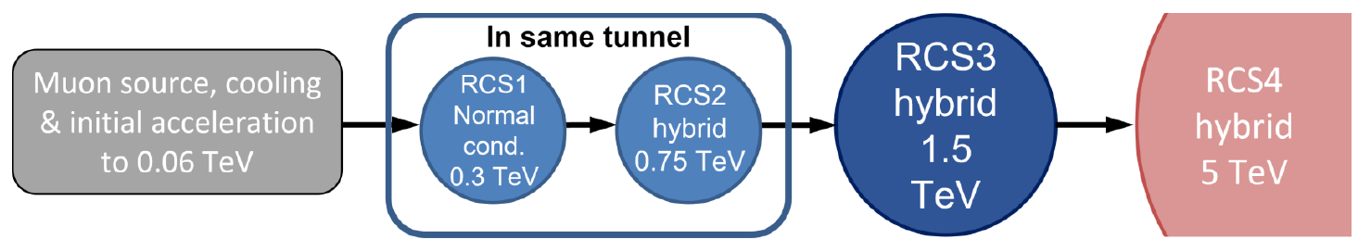
Structure of a RCS
Chain of RCS
Study focused on RCS2: hybrid synchrotron
Structure of RCS: FODO cells with phase advance: µ=90°
RCS2 geometric parameters:
  C=5990m
  n_{arc}=26
  n_{RF}=26
  n_{c}=8 cells per arc
QP_{f}
QP_{d}
SC
NC
SC
L_{SC}
L_{NC}
L_{SC}
Half-cell L_{c}/2

Slide 3
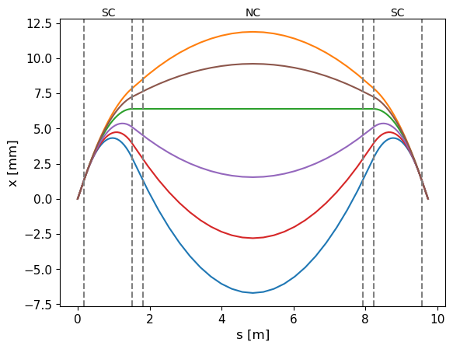
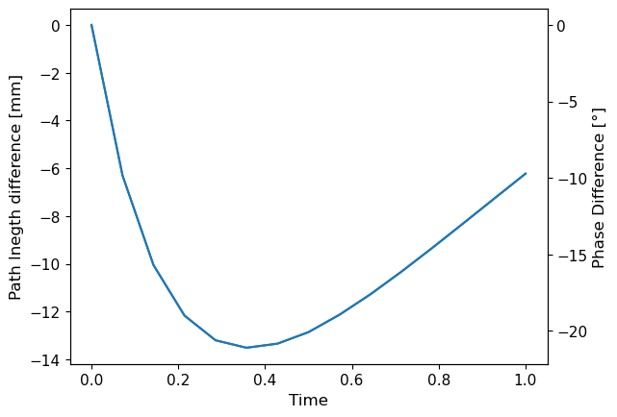
Difference of trajectory during ramping
Results from Xsuite
Trajectories from injection to extraction
Path length difference from injection
ext
inj
RF tuning ?

Slide 4
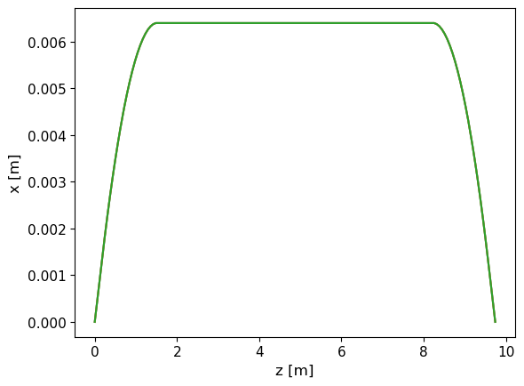
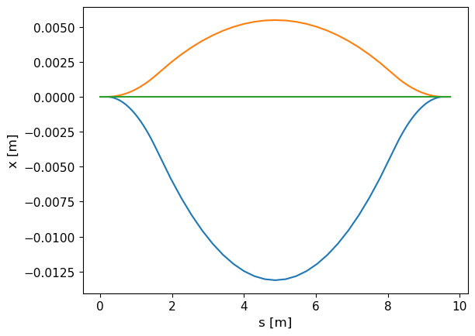
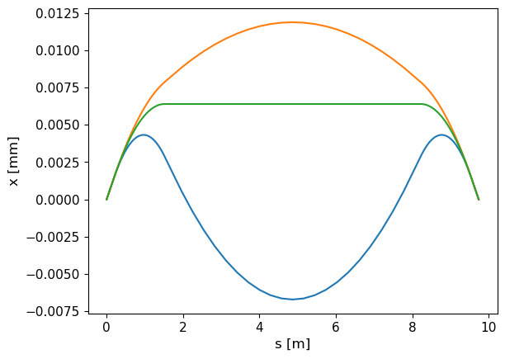
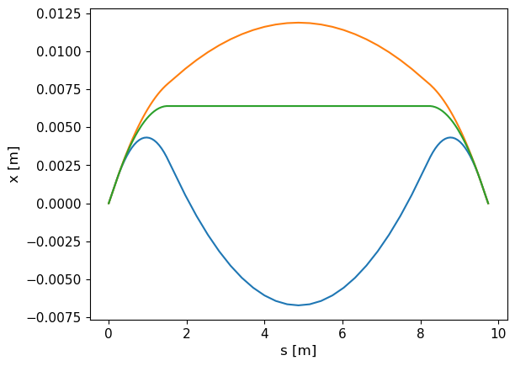
Defining a reference trajectory during ramping
② Reference trajectory is constant
Only normalized strength of dipole varies and bending of reference trajectory is constant: k_{0,i}(t) and h_{i}=h*
Reference trajectory is not constant.
Normalized strength and bending of reference trajectory varies together: k_{0,i}(t) = h_{i}(t)
Ref traj: B_{NC}=0
Tracking
Survey
Same trajectories

Slide 5
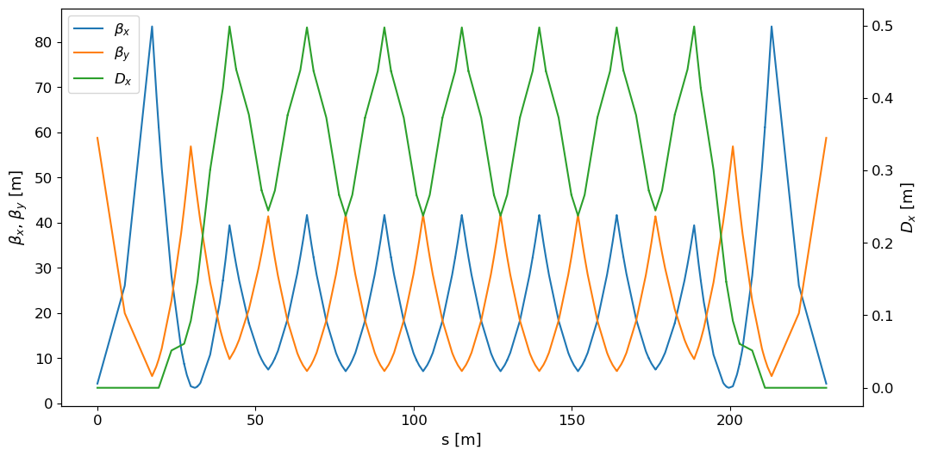
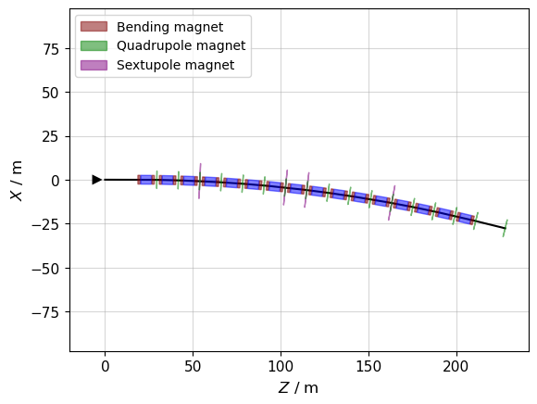
Structure of an arc and optics
FODO structure, base of µ=90°
Dispersion suppressor for RF insertion (cavity + energy kick)
Quad and Sextupoles: thin multipole approximation
Dipoles: thick bend, sliced before tracking

Slide 6
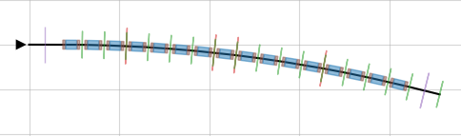


Ramping in Xsuite
How is ramping done in RCS ?
→ Magnets can include time $τ$-varying attributes like the normalized strength $k_{0}$
→ Time variable $τ$is updated only at the beginning of the lattice (each arc here): the magnet fields are updated only at the beginning of each arc.
NC magnets with same field in an arc
Time $τ$ is updated
1 arc:
RF cavity: 1st kick in energy
RF cavity: 2nd kick in energy

Slide 7
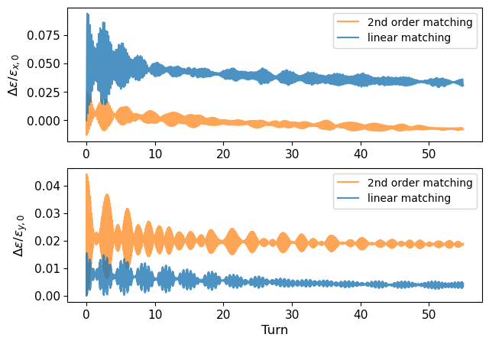
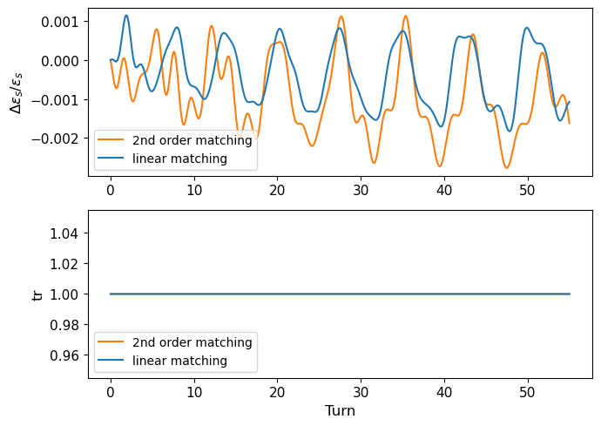
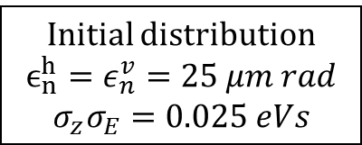
Impact of Montague functions
Initial distribution
$$ϵ_{n}^{h}=ε_{n}^{v}=25 μm rad$$
$$σ_{z}σ_{E}=0.025 eVs$$
Dependence of Twiss parameters on relative energy difference δ: β_{x}(δ), β_{y}(δ), α_{x}(δ), α _{y}(δ)
Beam is linearly adapted but not perfectly adapted (higher order) → emittance growth. We superficially get rid of the problem by initially matching the beam to the optics depending on δ → Work on optics to be done !
Relative transverse emittance growth
Relative longitudinal emittance growth and transmission

Slide 8
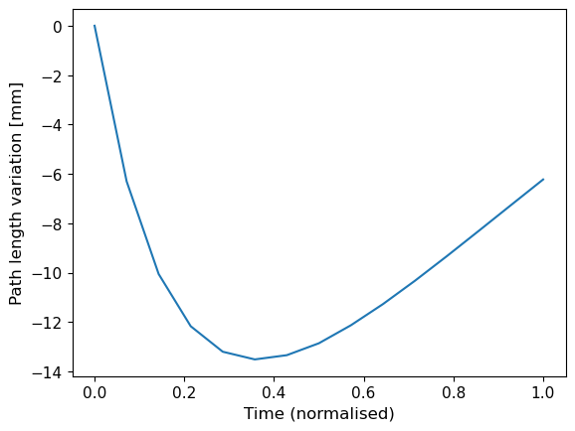
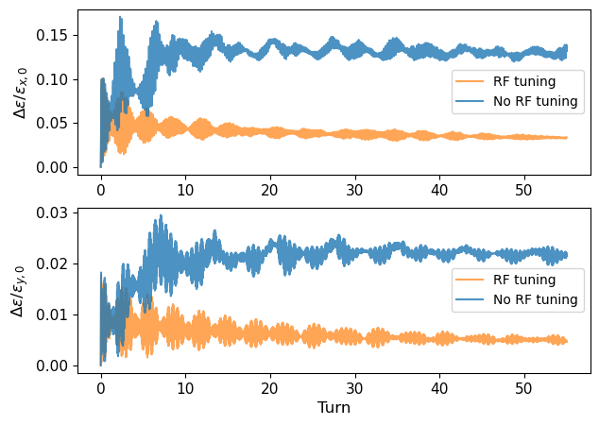
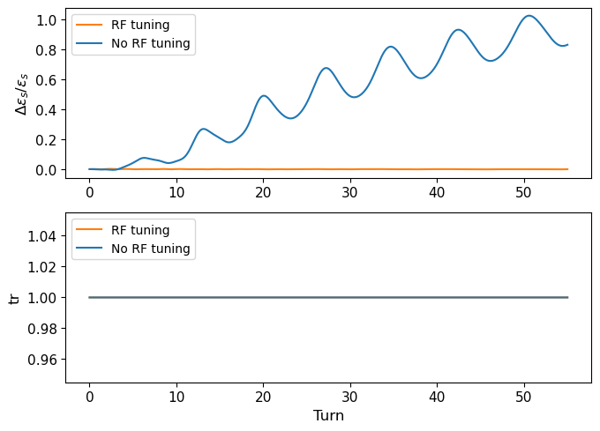
Effect of path length difference and RF tuning
RF tuning ↔ Applies a time shift to the particle when going through the RF cavity equal to the time of flight difference with the reference trajectory.
Relative transverse emittance growth
Relative longitudinal emittance growth and transmission

Slide 9
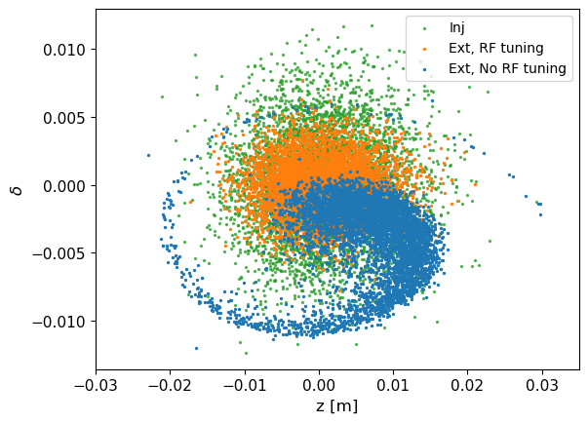
Effect of path length difference and RF tuning
RF tuning ↔ Virtually give a ∆z shift to the reference trajectory when going through the RF cavity :
Relative transverse emittance growth
Longitudinal phase-space

Slide 10
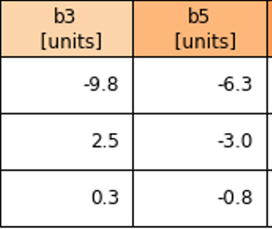
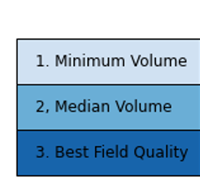
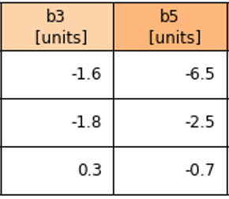
Adding higher multipolar component to the dipoles
So far, dipoles only had b1 component = dipolar component
No alignment errors, no rolls, no fringe field: « perfect vertical field »
Include b3 and b5 => systematic errors added to all the SC dipoles
Different dipole designs: different b3/b5 to be tested
Correct chromaticity after introducing b3: dqx=5, dqy=5
2 RTs *
Additional coils (AD) *
(Min V)
(Med V)
(Best B)
* Initial Magnetic Design of Superconducting Dipoles in Acceleration Stage - Siara Fabbri, Luca Bottura (IMCC-MuCol annual meeting 2024)

Slide 11
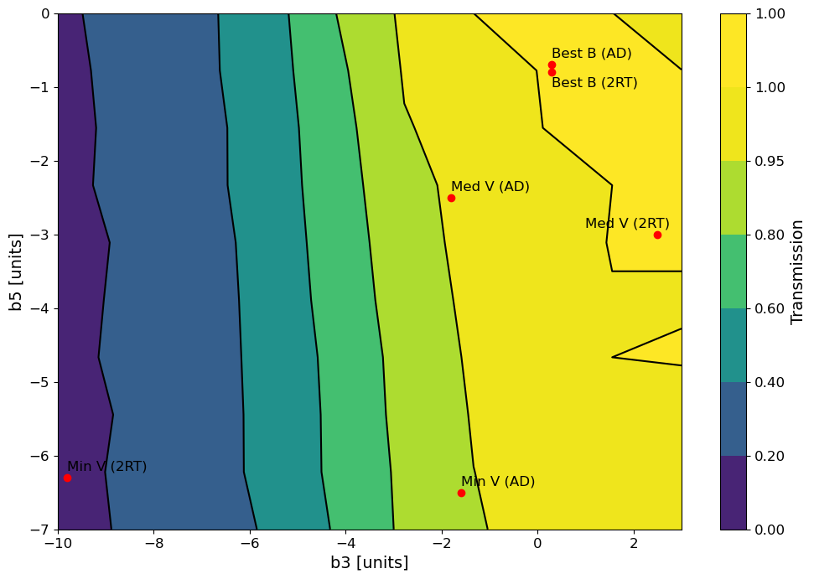
Transmission map
Rough scan of b3/b5 component
Transmission
Rough scan : 10 * 10 points
  → get an idea of the good/bad regions
Minimum volume (2RT) : not good enough
Best field + MedV designs are the best
Optics not yet optimised : could improve those results

Slide 12
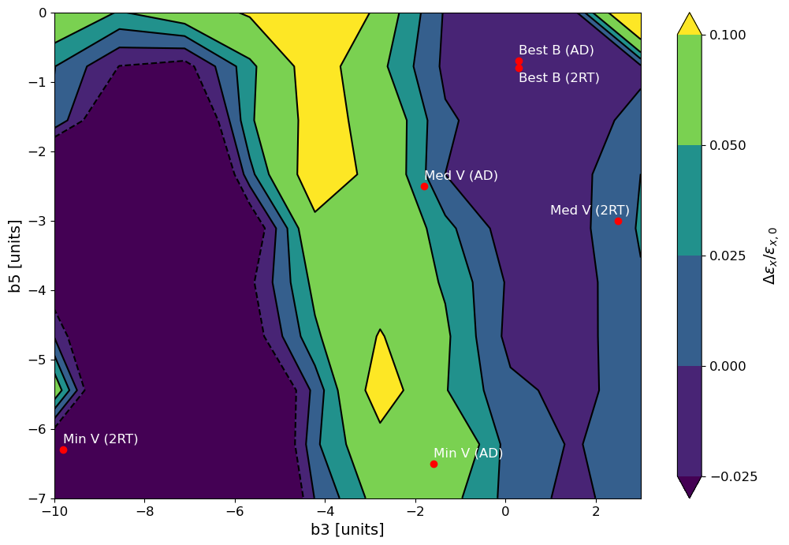
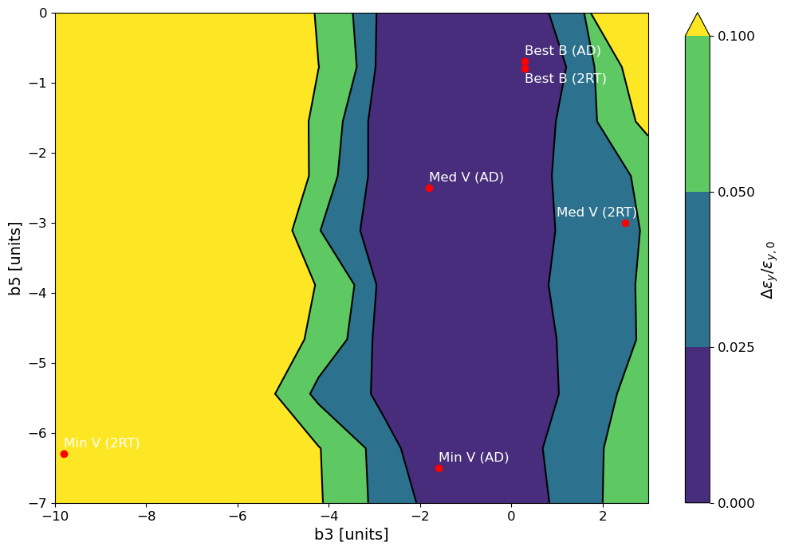
Rough scan of b3/b5 component
Emittance growth
Same order of magnitude as without errors : good!
Same order of magnitude as without errors : good!
ε_{x}
ε_{y}
Lose a lot of particles

Slide 13
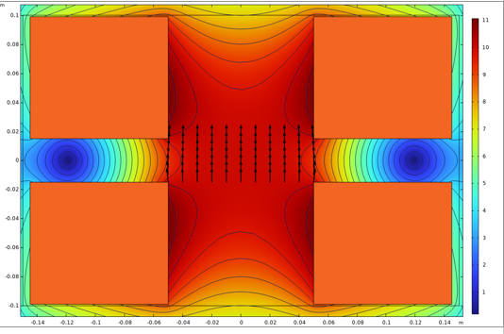
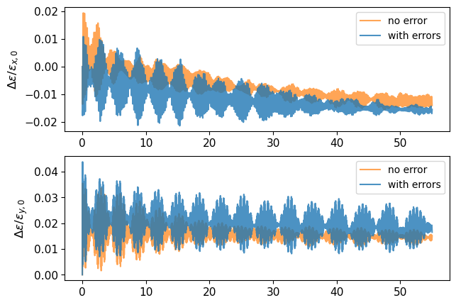
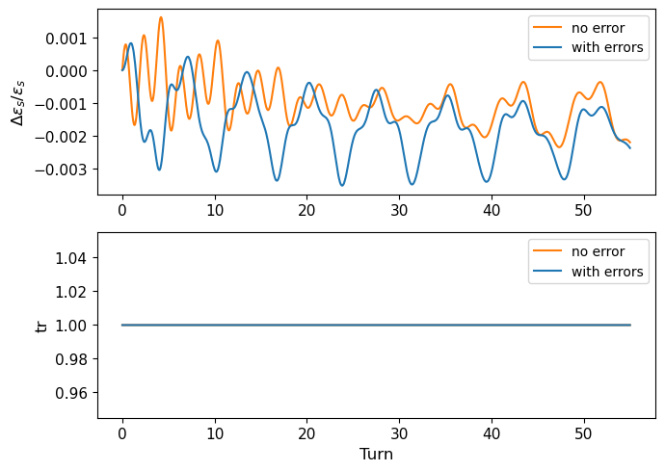
Best Field Quality (2RT)
*
Relative transverse emittance growth
Relative longitudinal emittance growth and transmission
* Initial Magnetic Design of Superconducting Dipoles in Acceleration Stage - Siara Fabbri, Luca Bottura (IMCC-MuCol annual meeting 2024)

Slide 14
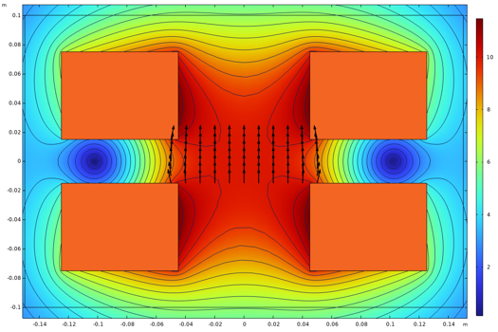
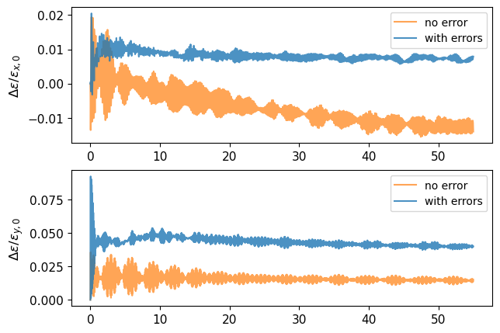
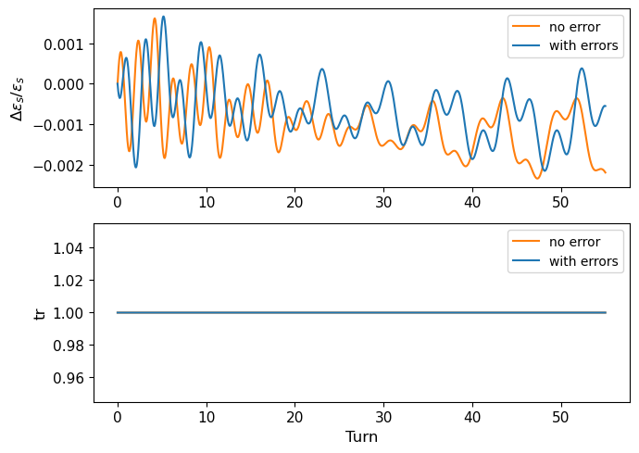

Median Volume (2RT)
*
Relative transverse emittance growth
Relative longitudinal emittance growth and transmission
* Initial Magnetic Design of Superconducting Dipoles in Acceleration Stage - Siara Fabbri, Luca Bottura (IMCC-MuCol annual meeting 2024)

Slide 15
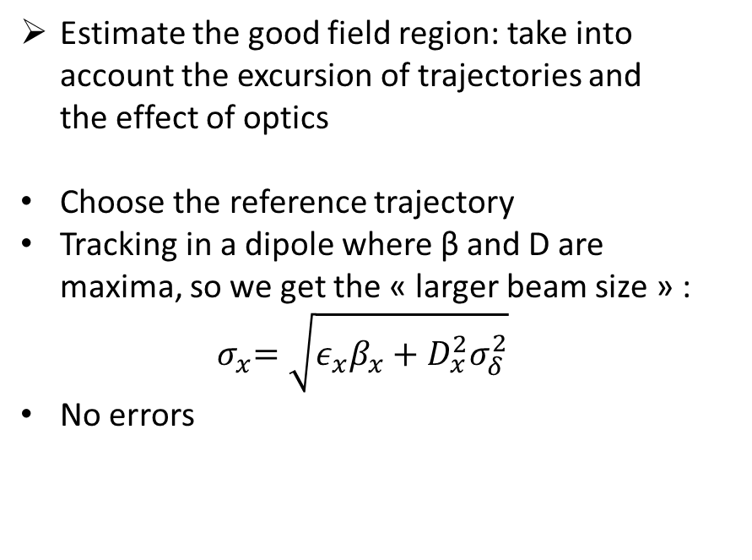
Good field region of SC dipoles
Estimate the good field region: take into account the excursion of trajectories and the effect of optics
Choose the reference trajectory
Tracking in a dipole where β and D are maxima, so we get the « larger beam size » :
$${ σ}_{x}=\sqrt{ε_{x}β_{x}+D_{x}^{2}σ_{δ}^{2}}$$
No errors
Reference traj B_{NC}=0

Slide 16
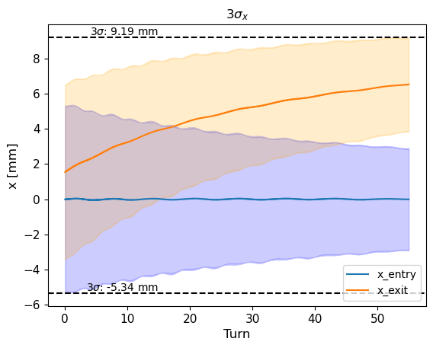
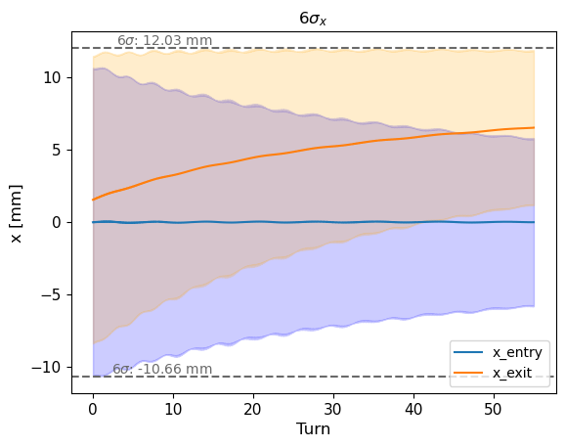
GFR: Horizontal plane x
Horizontal plane σ_{x}
3σ : ~ 15 mm width
6σ : ~ 23 mm width
About 20 mm horizontal width for the good field region should be enough → not a lot of travelling in the outer side of GFR

Slide 17
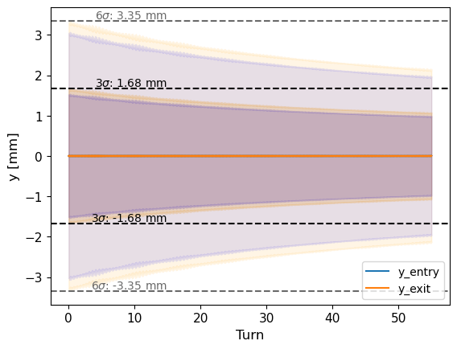
GFR: Vertical plane y
Vertical plane σ_{y}
3σ : ~ 3 mm width
6σ : ~ 7 mm width
No excursion of the trajectory in the vertical plane : much smaller region
GFR x : ~ 20 mm
GFR y: much less needed

Slide 18
Conclusions and perspectives
First tracking studies conducted
Impact of preliminary optics and RF tuning
Tracking integrating systematic errors b3/b5 from dipole designs
  Have an idea of which designs could be used
Get a rough idea of the width of the GFR with tracking studies
What’s next ?
  Work on optics
  Add misalignment/roll errors and random errors (jitters) on dipoles
  Include passive correction schemes

