Slide 1
Pulsed magnet and powering system design and optimization
MuCol Mini-Workshop on Rapid Cycled Synchrotrons, pulsed magnets and powering
CERN, 15/05/2024
Fulvio Boattini (CERN), Marco Gast (CERN)

Slide 2
Outline of the presentation
Presentation of the Python classes and the new cost model;
New optimizations and cost computation (pu values)
Conclusions

Slide 3
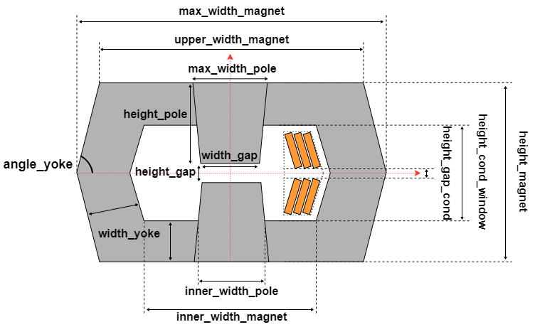
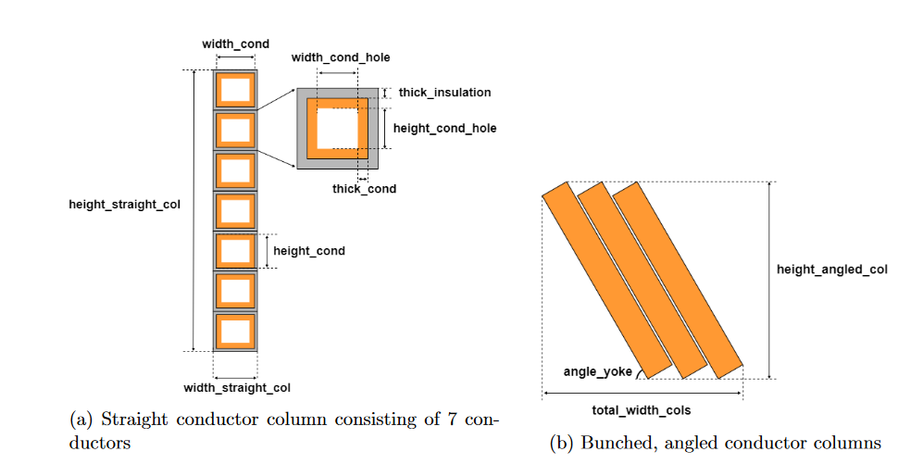
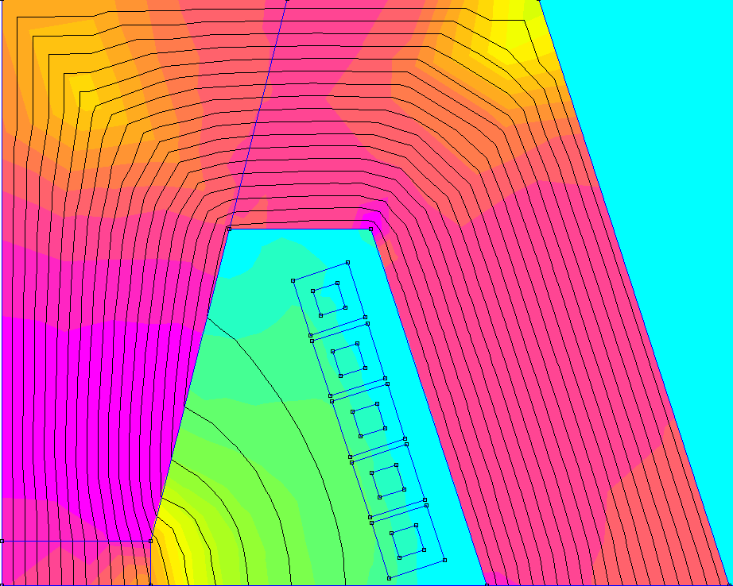
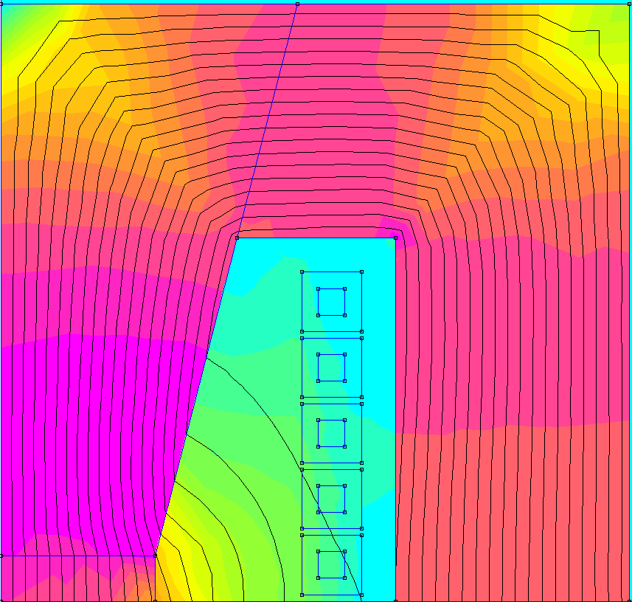
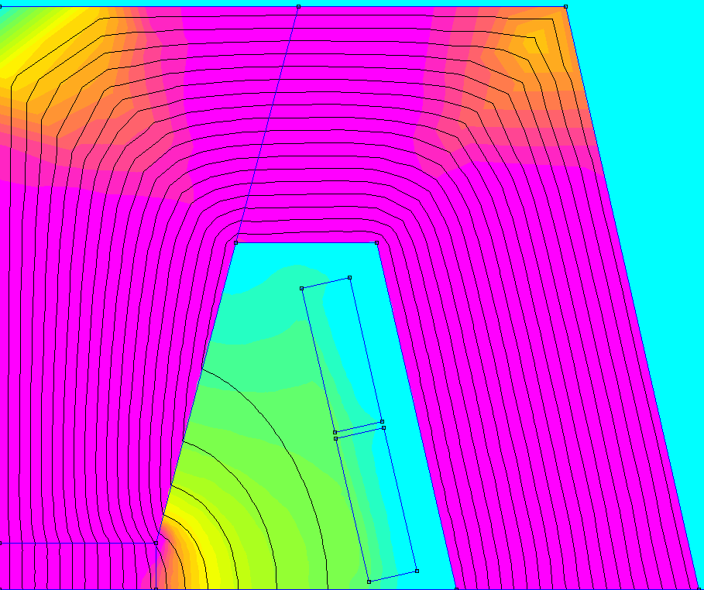
Introduction – Dipole class
Unified dipole class to treat both “Hourglass” and “H-type” magnets with hollow or flat conductors
Hourglass and H-type magnet
Hollow Water-cooled and flat coils
Magnet joke and pole made of possibly different steel M235-35A
Each parallel coil is connected to a separate parallel power electronics circuit to keep the maximum current of each power electronic cell low

Slide 4
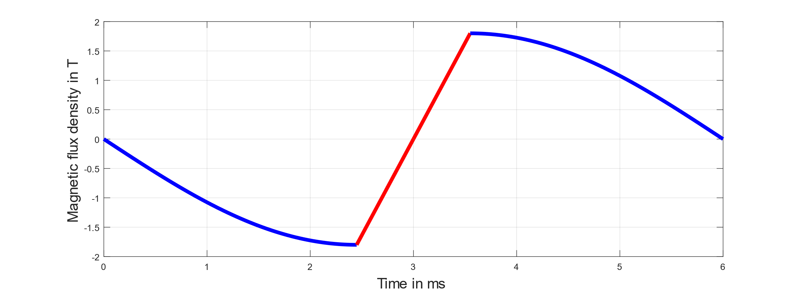
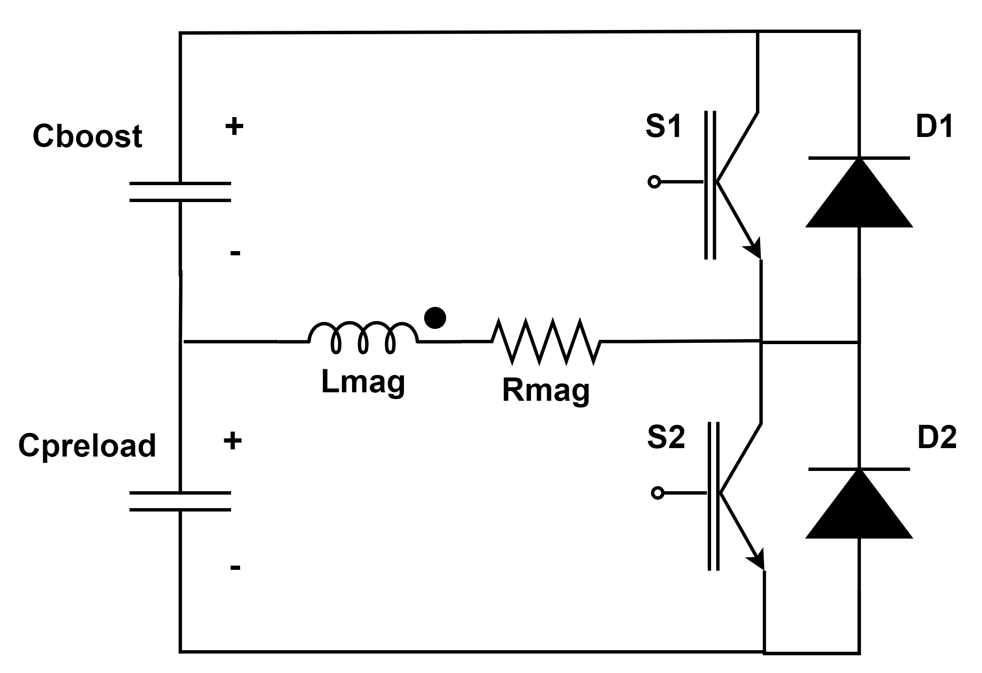
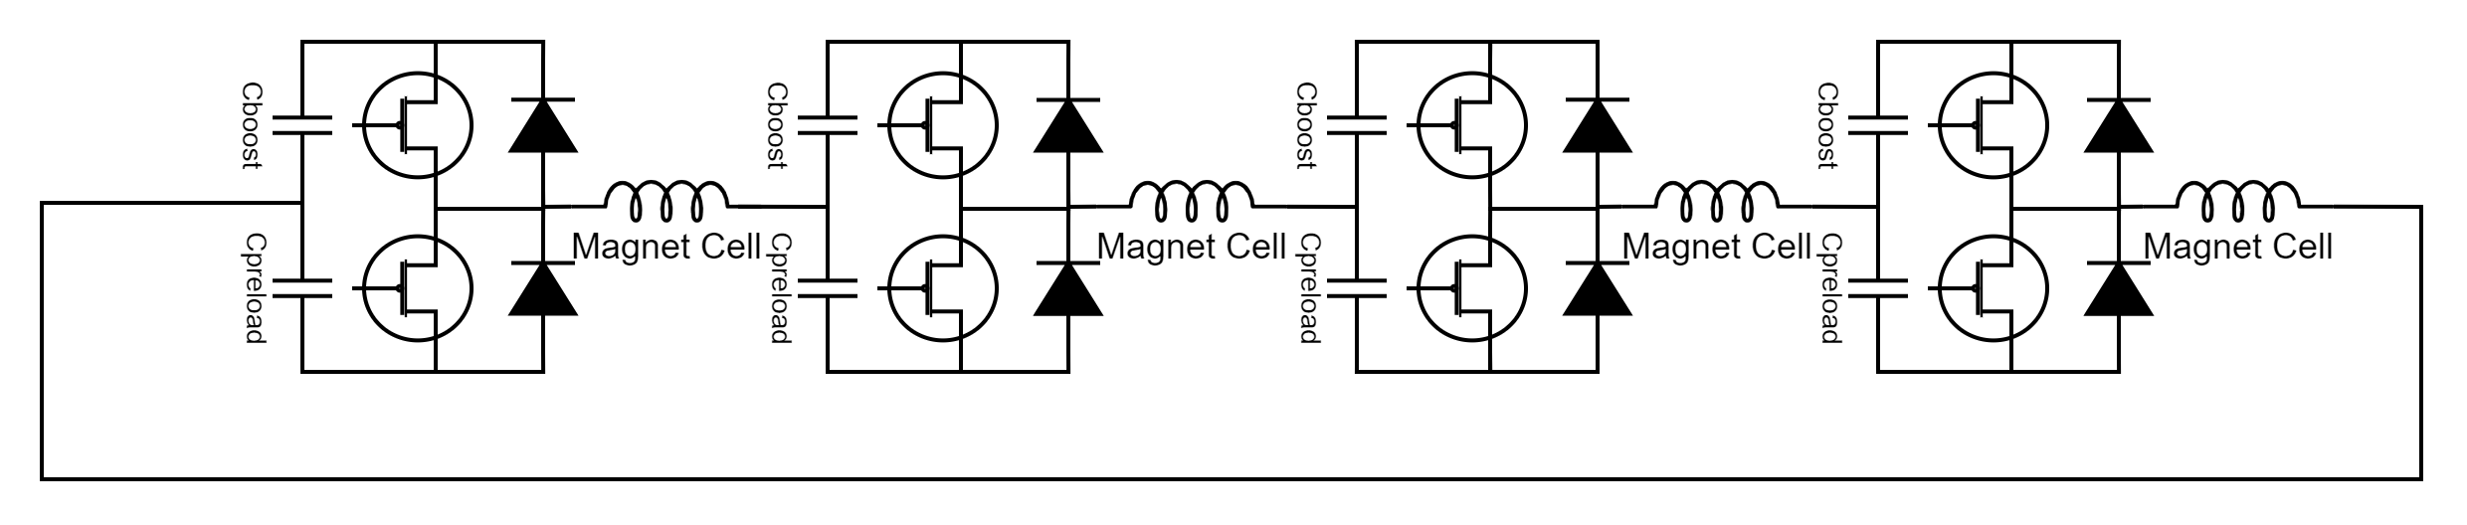
Introduction – Power Converters Class
Power converter cell
“One” IGBT/diode shown in the circuit diagram can hold several IGBTs/diodes connected in parallel and series.
Magnetic field reference
Preload
Boost
Magnet
T_{pulse}
Preload
Connection of the magnets and the power cells
The preload capacitor pre-charges the magnet to the injection field Binj.
The boost capacitor generates the desired magnetic field ramp for the muons.
Splitting the cell into two circuits allows more degrees of freedom, so that, for example, the pulse time Tpulse and the maximum magnetic field gradient Bdot,max can be varied.

Slide 5
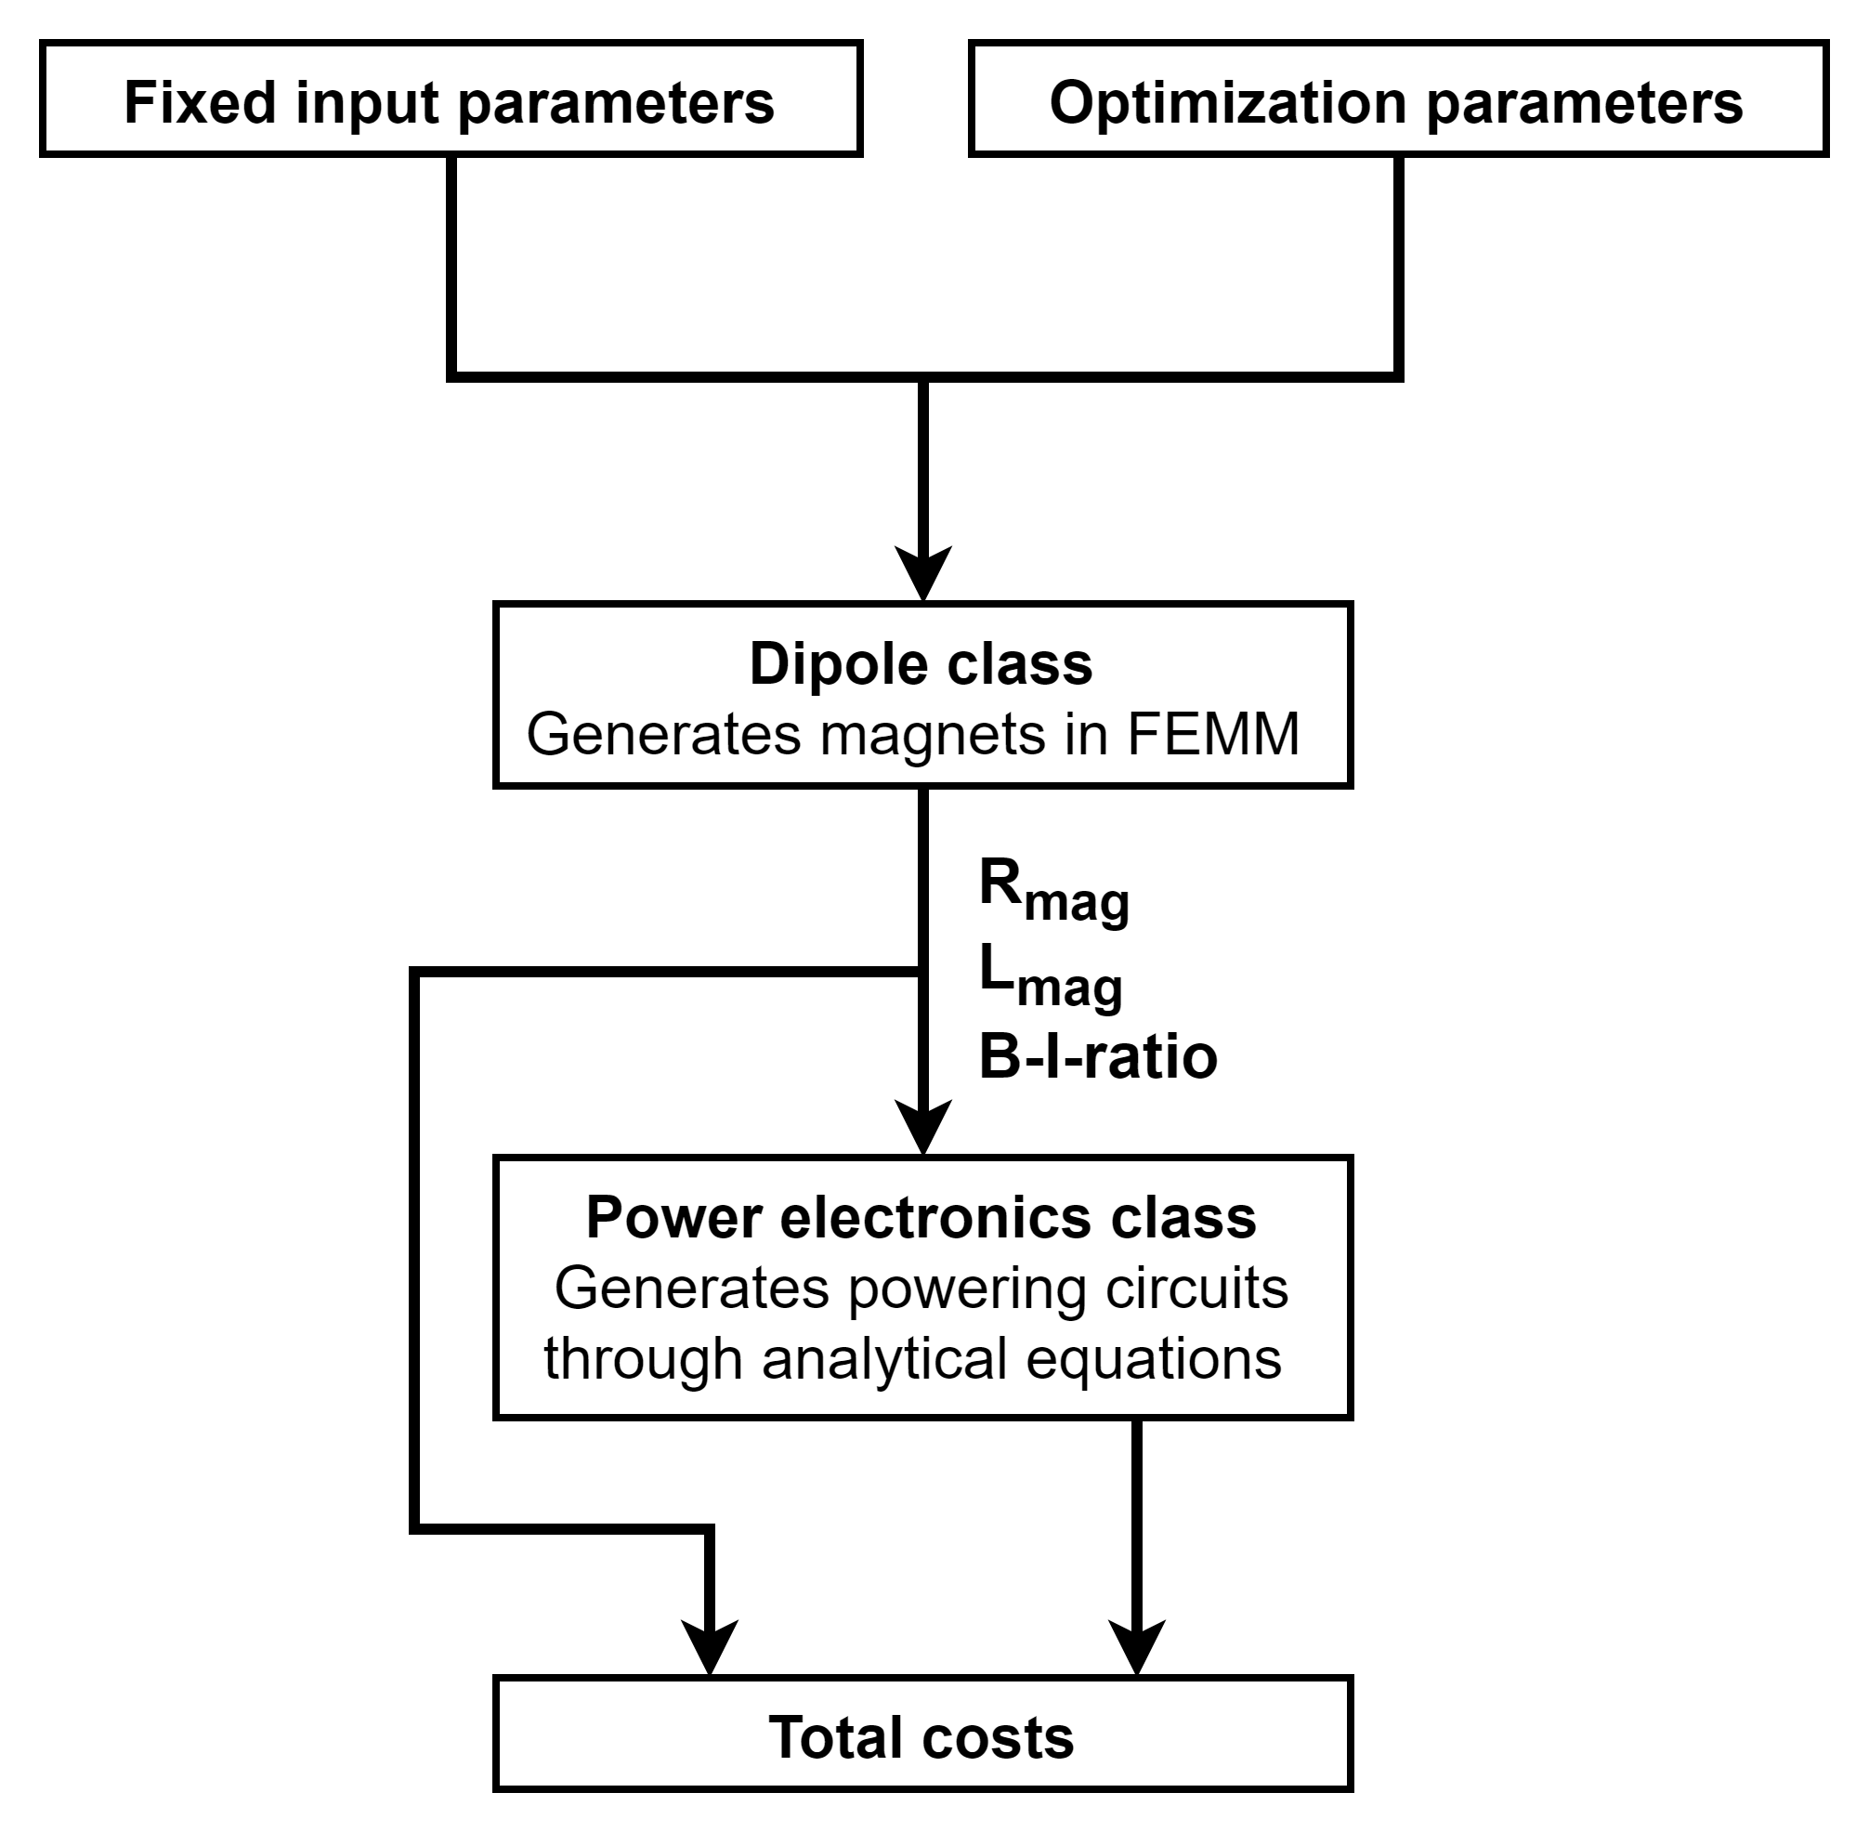
Optimization Process in Python
Some inputs of the Dipole and power converter classes are used as optimization variables. EX: B_max_yoke, B_ratio, pulse_time, height_gap_cond, angle_yoke, sigma_RMS_cycle
Some input parameters are fixed because they come from different systems or the overall accelerator design. To ensure a flexible optimization for varying accelerator designs, these input parameters come from the Python classes of the other systems.
The detailed explanation of the setup can be found in the presentation “Software tools” by David Amorim.
The goal of the optimization is minimizing the overall costs. The following costs are included:
  Magnet costs (material + manufacturing)
  Capacitor costs including containers
  Power electronics costs
  Operational costs (Losses in magnets and IGBTs, and energy needed for cooling of the coils) for 20 years of operation with 6000h per year
The detailed overview of the cost models is described in the presentation “Magnet and power systems plan – accelerators” by Fulvio Boattini.
COST MODEL

Slide 6
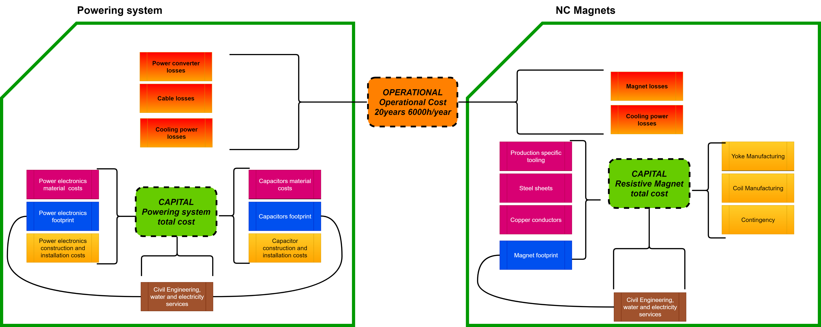
Cost model layout – Both classes
The cost model is based on the computation of capital and operational cost.
Capital costs includes:
Material
Construction
Infrastructures.
Infrastructure costs are strongly dependent upon the location of the power converters (surface or tunnel). In the following computations we will consider installation on surface
Several components of the cost model still to be implemented
Several components of the cost model still to be implemented

Slide 7
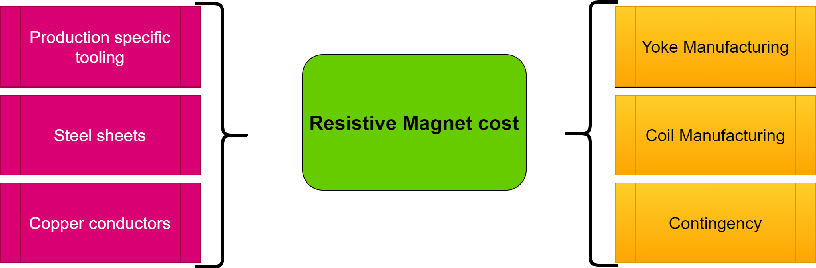
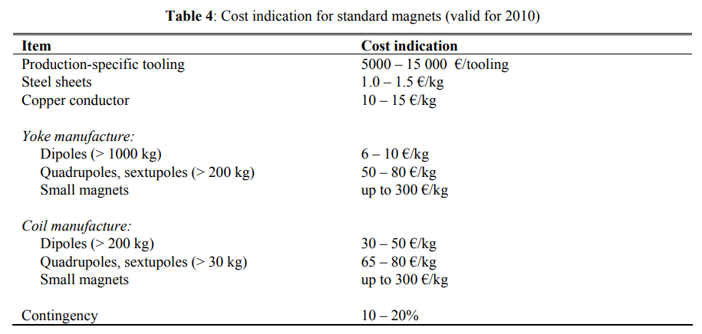
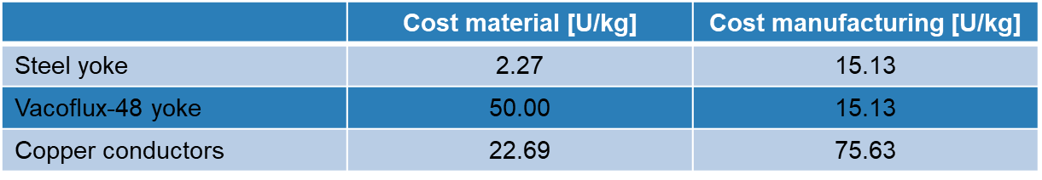
Cost Models: NC Magnets. Bottom-up model
Capital costs
Much simpler model because of lack of expertise in magnet construction. Briefly discussed with magnet expert but requires verification.
The simplified cost approach is taken from “Basic design and engineering of normal-conducting, iron-dominated electromagnets” by Th. Zickler.
Cost figures are adapted for 3% of inflation over the last 14 years and the highest value of the range is taken.
The material costs for Vacoflux 48 are estimated values in consultation with magnet experts.

Slide 8
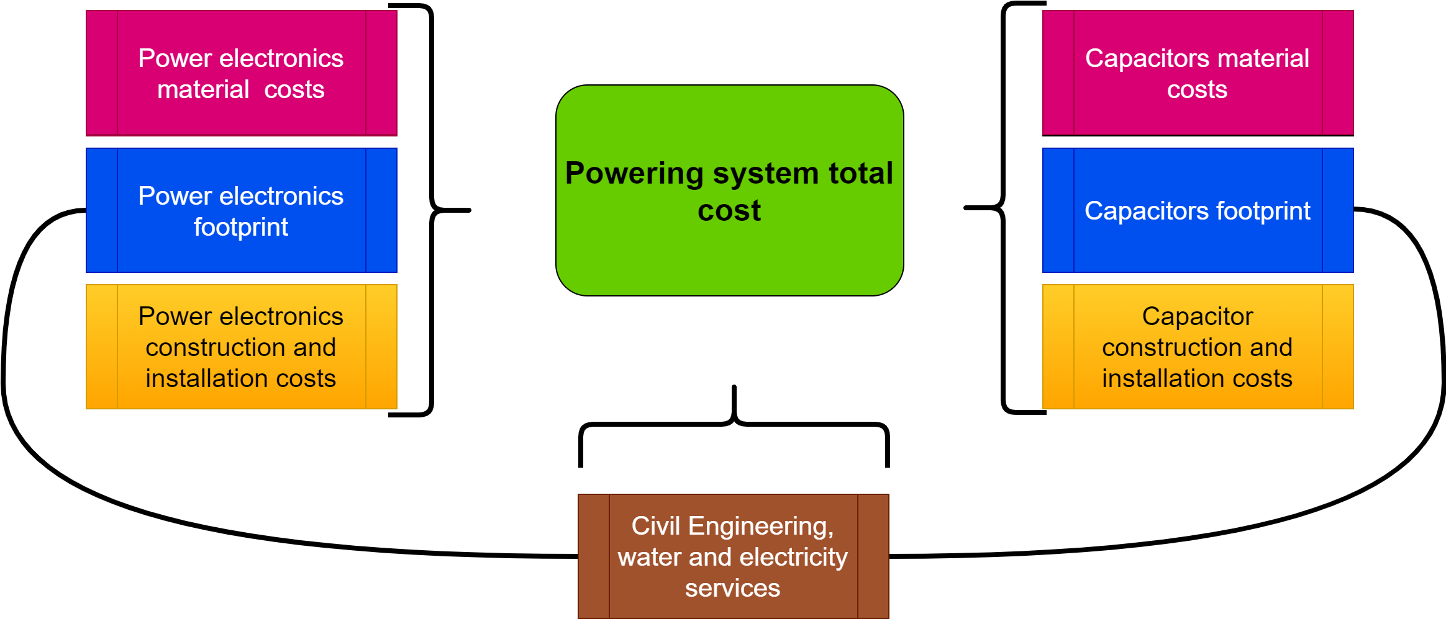
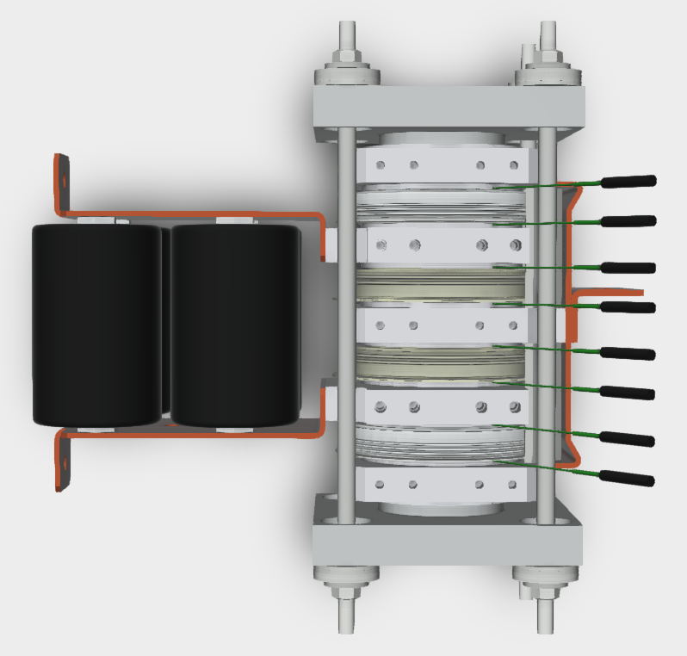
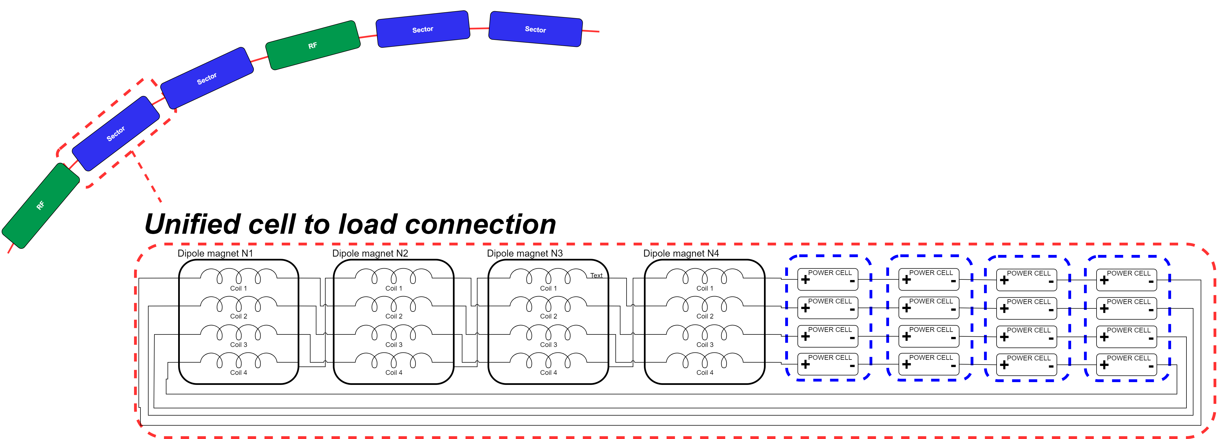
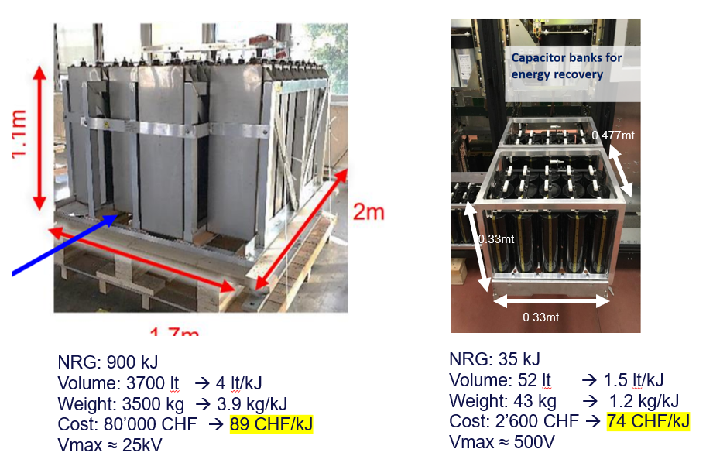
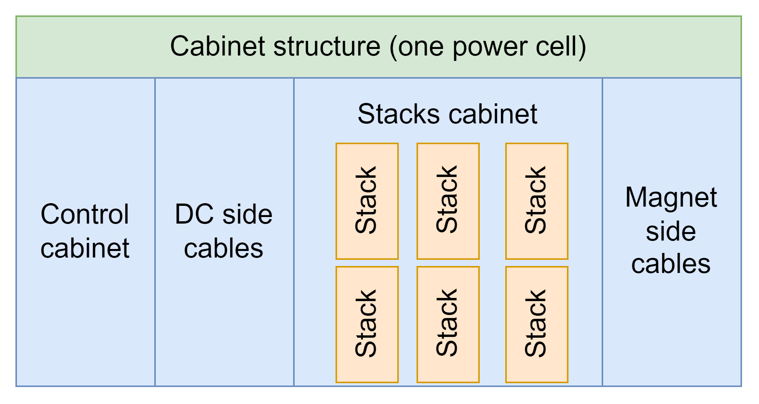
Cost Models: Power converters. Bottom-up model
Capital costs
HP: installation on surface. Unified cell to load connection. One powering system per sector.
Identify Nseries/Nparallel power cells.
Compute the size and cost of IGBTs/Diodes and stacks.
1
2
5
Identify size and cost of the technical building and capacitor containers
Compute the size and cost of Boost (left) and preload(right) capacitors.
4
3
Identify size and cost of the power cell cabinet. Included fabrication costs

Slide 9
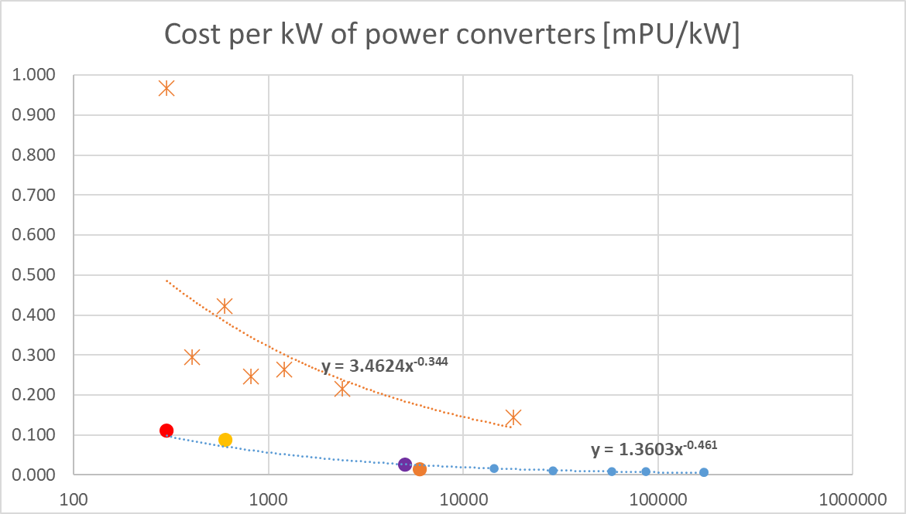
Cost Models: Power converters. Bottom-up model
Capital costs… let’s check them
Cost per kW seems quite low with respect to existing fast pulse converters→ let’s compare with existing power converters of different power
 | V [V] | I [A] | P [kW] | Cost [mPU/kW]
Cycled Polaris 4P | 188 | 1600 | 300.8 | 0.967
Cycled Sirius 2S | 900 | 450 | 405 | 0.295
Cycled Saturn 2P | 350 | 1700 | 595 | 0.422
Cycled Sirius 4P | 450 | 1800 | 810 | 0.246
Cycled Boreal 2P | 400 | 3000 | 1200 | 0.263
Cycled Boreal 2S2P | 800 | 3000 | 2400 | 0.215
Standard power converters
 | V [V] | I [A] | P [kW] | Cost [nPU/kW]
Pulsed Maxiplus Single | 600 | 500 | 300 | 0.111
Pulsed Maxiplus Double | 600 | 1000 | 600 | 0.089
MegaDiscap | 2500 | 2000 | 5000 | 0.027
FP 2P2S | 2000 | 3000 | 6000 | 0.014
Resonance based power converters
Cost computed with cost model is low but two effects are active:
Peak power: the higher the peak power the lower is the cost per kW (must consider same power converter category)
High numbers: Mucol will require high number of power cells

Slide 10
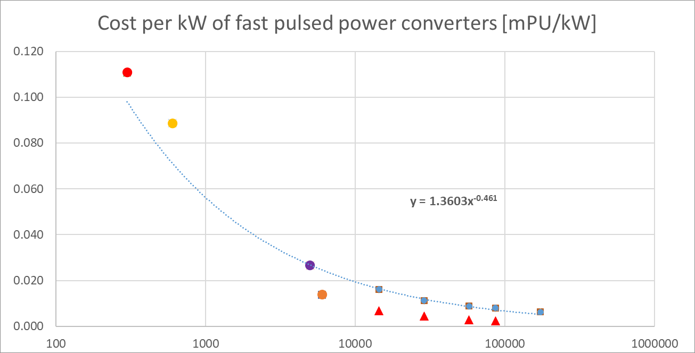
Cost Models: Power converters. Bottom-up model
Capital costs… let’s check them
 | Standard POPS |  | low duty cycle LC discharge POPS
Peak Power | 18 MW |  | 172 MW
 | Cost [pu] |  | Cost [pu]
Total | 2.1971 |  | 1.0543
Cabinets POPSplus | 0.2932 |  | 0.146587073
Copper busbars | 0.0251 |  | 0.012564606
DC filtering capacitors | 0.0439 |  | 0
DC commutation caps | 0.0209 |  | 0.013960674
Precharge transformer | 0.0249 |  | 0
Precharge resistors | 0.0083 |  | 0
Precharge contactors LV | 0.0033 |  | 0
Precharge Contactors MV | 0.0083 |  | 0
Precharge lems | 0.0017 |  | 0
Afe Line inductor | 0.0299 |  | 0
RC snubber | 0.0083 |  | 0
AFE/DCDC line LEMs | 0.0108 |  | 0.007179775
IGBTstacks | 0.5983 |  | 0.418820208
Diode stacks | 0.2493 |  | 0.161544937
DCDC inductance | 0.1496 |  | 0
AFE DC output switch (Motor) | 0.0166 |  | 0
AFE DC output Switch (Manual) | 0.0100 |  | 0
Ground Switch 3 poles (Manual) | 0.0133 |  | 0.01329588
Hydraulic pipes, cable ladders… | 0.0758 |  | 0.038697658
Assembly activities FSU | 0.1609 |  | 0.102378273
Testing activities FSU | 0.0293 |  | 0.014625468
Control | 0.2493 |  | 0.124648871
Cooling unit | 0.1662 |  | 0
Consider the DCDC part of POPS as a set of power stacks with an equivalent LC discharge power.

Slide 11
Cost Models: Power converters. Bottom-up model
Capital costs… let’s check them
From POPS estimation, we derive a new set of cost figures.
 | V [V] | I [A] | P [kW] | Cost [mPU/kW]
Pulsed Maxiplus Single | 600 | 500 | 300 | 0.111
Pulsed Maxiplus Double | 600 | 1000 | 600 | 0.089
MegaDiscap | 2500 | 2000 | 5000 | 0.027
FP 2P2S | 2000 | 3000 | 6000 | 0.014
MUcol new Model Ex1 | 3000 | 4800 | 14400 | 0.016
MUcol new Model Ex2 | 3000 | 9600 | 28800 | 0.011
MUcol new Model Ex3 | 6000 | 9600 | 57600 | 0.009
MUcol new Model Ex4 | 6000 | 14400 | 86400 | 0.008
POPS as LC discharge | 6000 | 28800 | 172800 | 0.006
MUcol old Model Ex1 | 3000 | 4800 | 14400 | 0.007
MUcol old Model Ex2 | 3000 | 9600 | 28800 | 0.004
MUcol old Model Ex3 | 6000 | 9600 | 57600 | 0.003
MUcol old Model Ex4 | 6000 | 14400 | 86400 | 0.003
A nice power curve seems to fit almost all real and computed vales.
Cost estimation increased by a factor of 2-3.

Slide 12
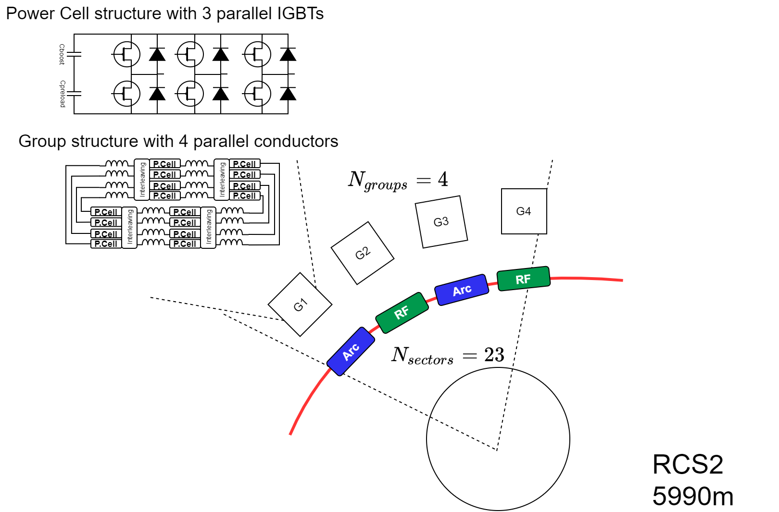
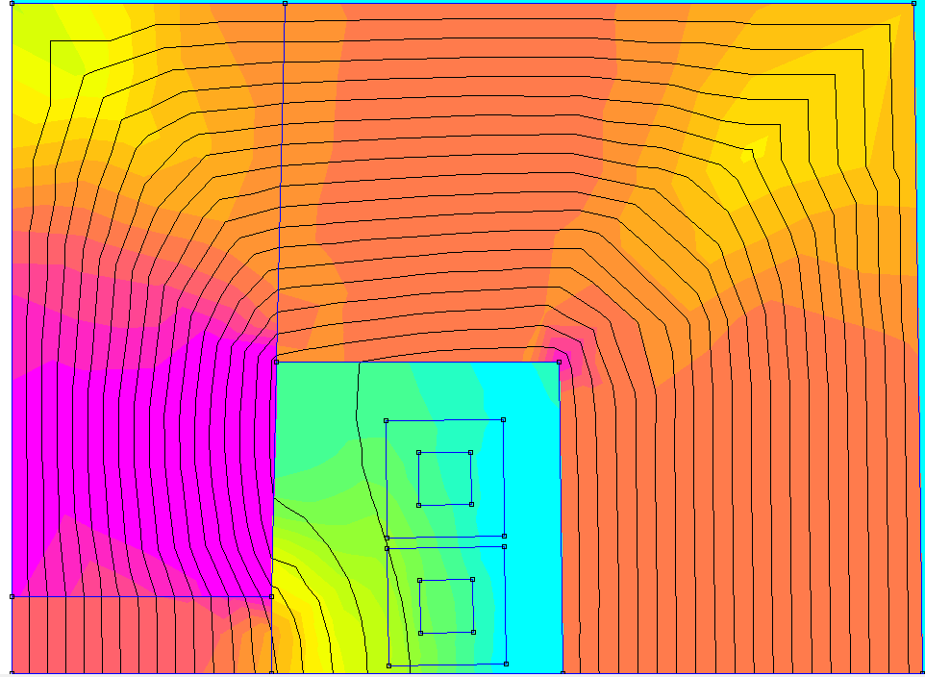
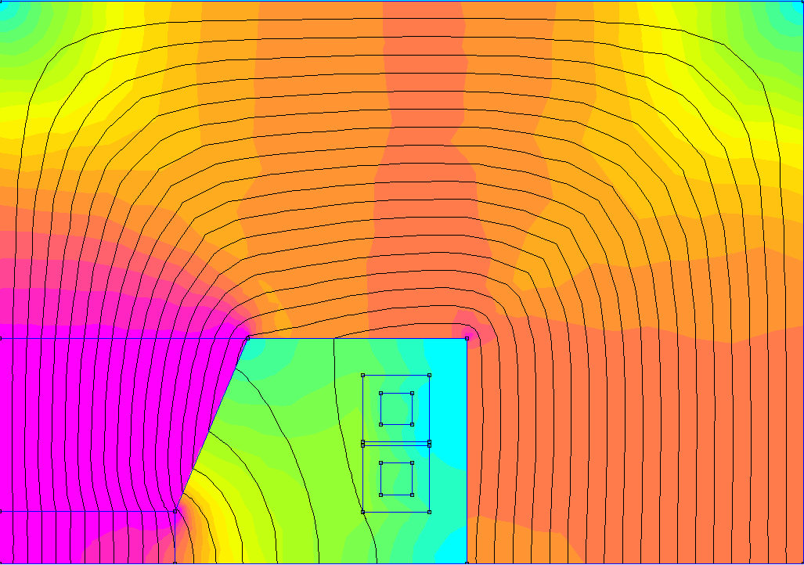
OPTIMIZATION RESULTS: RCS2
175 mm
Optimization with the new cost model and dipole class
Steel M235-35A
T_{pulse}= 6.6 ms
σ_{rms}= 4.4 A/mm2
mmf = 55860 At
E_{lossIron}= 55 J/m/pulse
E_{losscu}= 762 J/m/pulse
NRG_{stored}= 5687 J/m
130 mm
Steel M235-35A
69 mm
10 mm
15 mm
50 mm
22 mm
229 mm
Optimization with the old cost model and class
The Power Cell are more expensive with the new cost model; therefore the optimizer tries to reduce the energy in the magnet at the cost of higher losses
Steel M235-35A
T_{pulse}= 4.5 ms
σ_{rms}= 4.6 A/mm2
mmf= 48374 At
E_{lossIron}= 56.2 J/m/pulse
E_{losscu}= 424.9 J/m/pulse
NRG_{stored}= 6263 J/m
161 mm
Steel M235-35A
Presented here: IMCC Annual 2024
9 mm
15 mm
19 mm
50 mm
96 mm

Slide 13
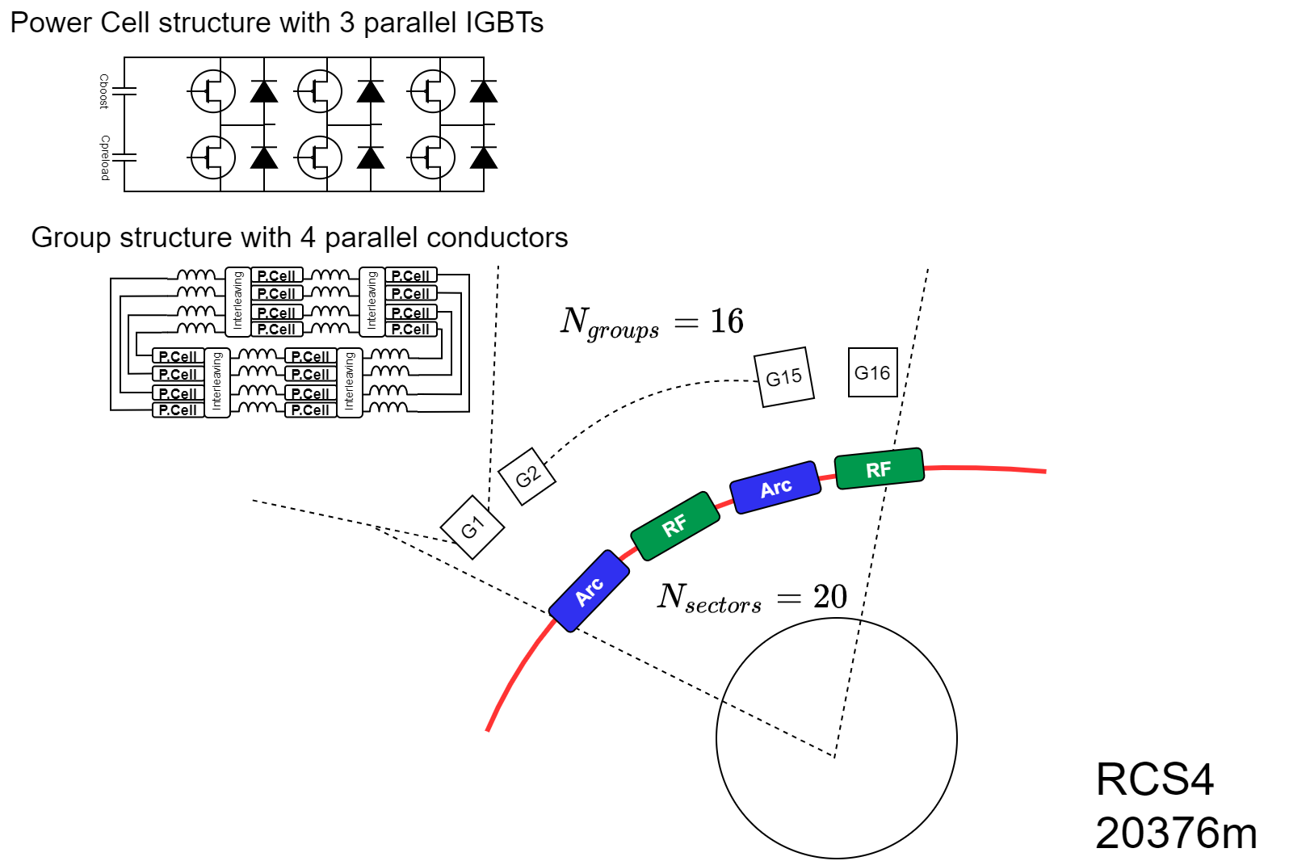
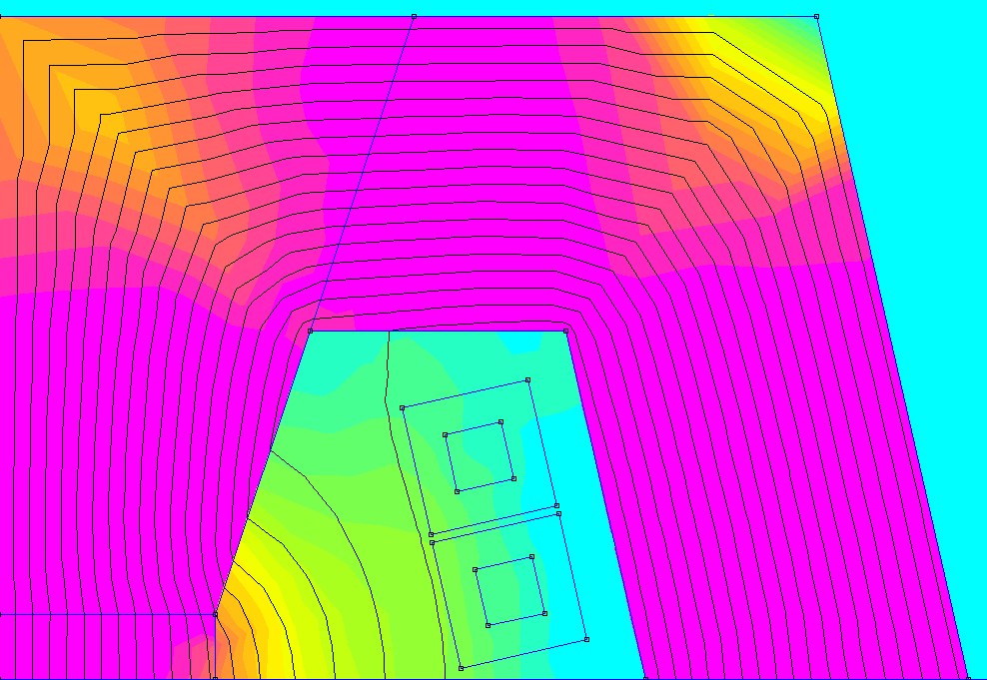
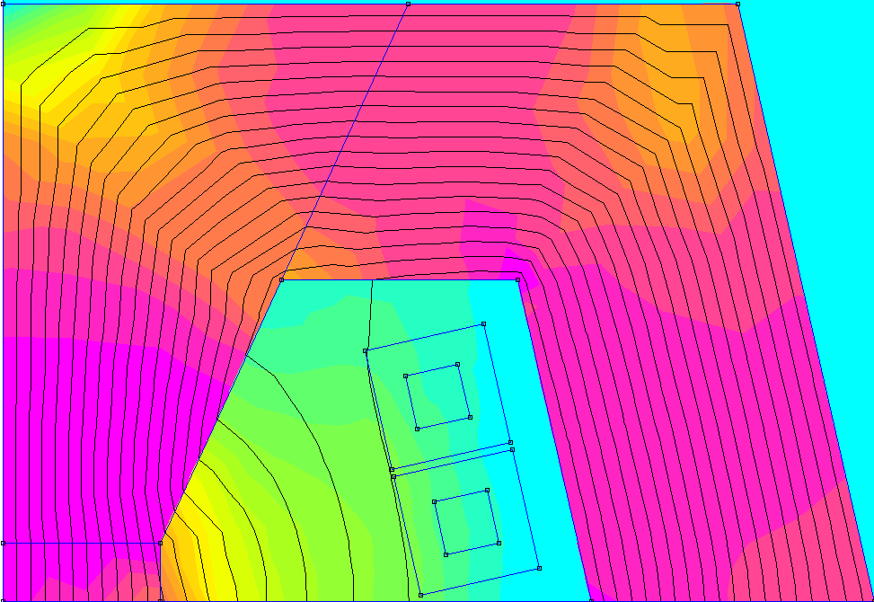

OPTIMIZATION RESULTS: RCS4
224 mm
Optimization with the new cost model and dipole class
Steel M235-35A
T_{pulse}= 11.0 ms
σ_{rms}= 3.3 A/mm2
mmf = 56562 At
E_{lossIron}= 69 J/m/pulse
E_{losscu}= 588 J/m/pulse
NRG_{stored}= 6393 J/m
153 mm
Steel M235-35A
13 mm
E_{lossMag}= 2615 J/cell/pulse
E_{lossIGBTs}= 233 J/cell/pulse
N_{cells}=5120 → E_{lossTot}=14’581’760 J/pulse
15 mm
50 mm
30 mm
72 mm
221 mm
Optimization with the new cost model and class. Shorter gap 80mm x 30mm
54% of the power cells
T_{pulse}= 20.4 ms
σ_{rms}= 3.9 A/mm2
mmf= 52687 At
E_{lossIron}= 56.6 J/m/pulse
E_{losscu}= 736 J/m/pulse
NRG_{stored}= 5738 J/m
Steel M235-35A
152 mm
Steel M235-35A
14 mm
E_{lossMag}= 5903 J/cell/pulse
E_{lossIGBTs}= 347 J/cell/pulse
N_{cells}=2784 → E_{lossTot}=17’400’000 J/pulse
15 mm
40 mm
31 mm
70 mm

Slide 14
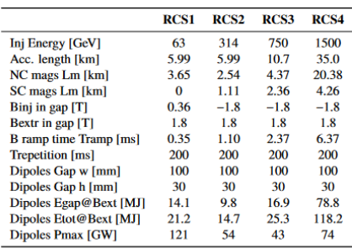
Cost Computation
Using the new cost model for the Power Converters, a new sets of simulations was re-run only for RCS2 and RCS4
 | RCS2(new) | RCS2 (***) | RCS4(new) | RCS4 (***) | RCS4(smaller gap)
NC Magnets cost (*) [pu] | 0.3% | 0.4% | 2.9% | 4.2% | 2.9%
SC Magnets cost [MEu] | 4.0% | 4.0% | 15.5% | 15.5% | < 15.5% (to be updated)
PC cost: power cells [MEu] | 2.5% | 1.3% | 8.8% | 7.4% | 4.8%
PC cost: capacitors [MEu] | 0.1% | 0.1% | 0.8% | 1.3% | 1.0%
Operation cost (losses NC+PC+Cool) (**) [MEu] | 0.8% | 0.5% | 5.3% | 3.4% | 6.3%
Totals | 7.8% | 6.3% | 33.3% | 31.9% | <30.5%
Courtesy of Siara Fabbri and Luca Bottura
With the new cost model, values don’t change much if we can accept more losses
(*) to be verified by magnets’ experts
(**) 20years 6000h/year. Cable losses are not included
(***) Old cost model. Presented here: IMCC Annual 2024
MuCol Mini-Workshop on Rapid Cycled Synchrotrons, pulsed magnets and powering / F. Boattini/ CERN

Slide 15
Cost Computation
Using the new cost model for the Power Converters, a new sets of simulations was re-run only for RCS2 and RCS4
 | RCS2(new) | RCS2 (***) | RCS4(new) | RCS4 (***) | RCS4(smaller gap)
NC Magnets cost (*) [pu] | 0.3% | 0.4% | 2.9% | 4.2% | 2.9%
SC Magnets cost [MEu] | 4.0% | 4.0% | 15.5% | 15.5% | < 15.5% (to be updated)
PC cost: power cells [MEu] | 2.5% | 1.3% | 8.8% | 7.4% | 4.8%
PC cost: capacitors [MEu] | 0.1% | 0.1% | 0.8% | 1.3% | 1.0%
Operation cost (losses NC+PC+Cool) (**) [MEu] | 0.8% | 0.5% | 5.3% | 3.4% | 6.3%
Totals | 7.8% | 6.3% | 33.3% (Ncmag+PC 17.8%) | 31.9% | <30.5% (Ncmag+PC 15%)
Courtesy of Siara Fabbri and Luca Bottura
The effect of reducing gap width by 20% brings a reduction in cost of about 16% of the Ncmag + PC costs.
The reduction of SC magnets’ cost is not included here.
(*) to be verified by magnets’ experts
(**) 20years 6000h/year. Cable losses are not included
(***) Old cost model. Presented here: IMCC Annual 2024
MuCol Mini-Workshop on Rapid Cycled Synchrotrons, pulsed magnets and powering / F. Boattini/ CERN

Slide 16
Conclusions
A more generic Dipole Class has been presented. With this we can extend the optimization to different shapes of magnets.
The NC magnets cost model is a first test based on existing literature. No experts’ eye verified it (carefully).
A new more consolidate cost model for the power converters has been presented. A comprehensive cost comparison with several existing power converters, suggests that we should not use lower figures than the ones highlighted during this new analysis.
We should not focus too much on magnets’ losses. Other components like cables may change the perspective when included in the model.
We shall include the full resonance mode power converter in the power converter class and have a correspondent cost model for this.
A big chunk of the cost of the PE comes from the IGBT and stacks. We have so far considered only Press-pack type. We should probably enrich the cost model with module IGBTs power stacks that are cheaper (but also less reliable).
Civil/ electric/ cooling engineering costs should be included, both for the capital part and for the losses operation costs (cables)
A lot of uncertainty still exist on the “cahier de charge” of the Power Converters, particularly concerning the accuracy that is required to the control. This can greatly influence the topology and cost of the pc. More precise data should be provided.

Slide 17
MuCol Mini-Workshop on Rapid Cycled Synchrotrons, pulsed magnets and powering / F. Boattini/ CERN

