Slide 1
SC steady magnet concept and design studies
T. Maiello^{1,2}, L. Alfonso ¹, A. Bersani¹, L. Bottura³, B. Caiffi¹, S. Fabbri³, S. Farinon¹,
A. Gagno^{1,2} , D. Novelli^{1,4} , A. Pampaloni¹
¹ INFN – Genova, ² Università degli Studi di Genova, ³ CERN, ⁴ Sapienza Università di Roma

Slide 2
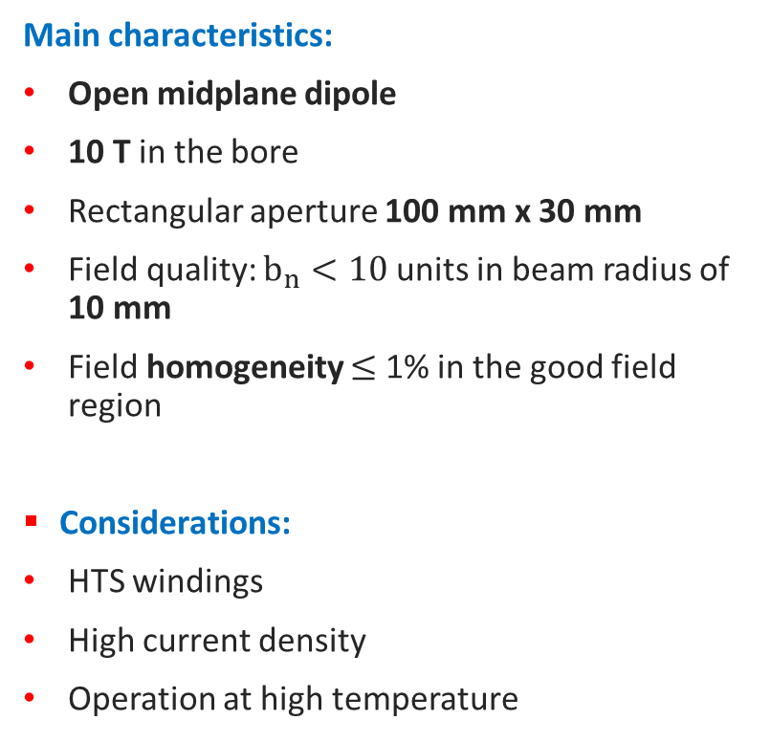
Accelerator Superconducting Magnets
Main characteristics:
Open midplane dipole
10 T in the bore
Rectangular aperture 100 mm x 30 mm
Field quality: $b_{n}<10$ units in beam radius of 10 mm
Field homogeneity $≤$ 1% in the good field region
Considerations:
HTS windings
High current density
Operation at high temperature
Fukjikura cable
HTS cable properties
Bare height [mm] | 12.00
Bare width [mm] | 1.65
Insulation [mm] | 0.10
Number of tapes | 15

Slide 3
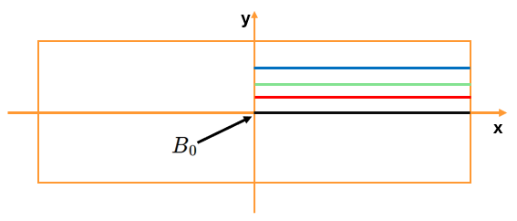
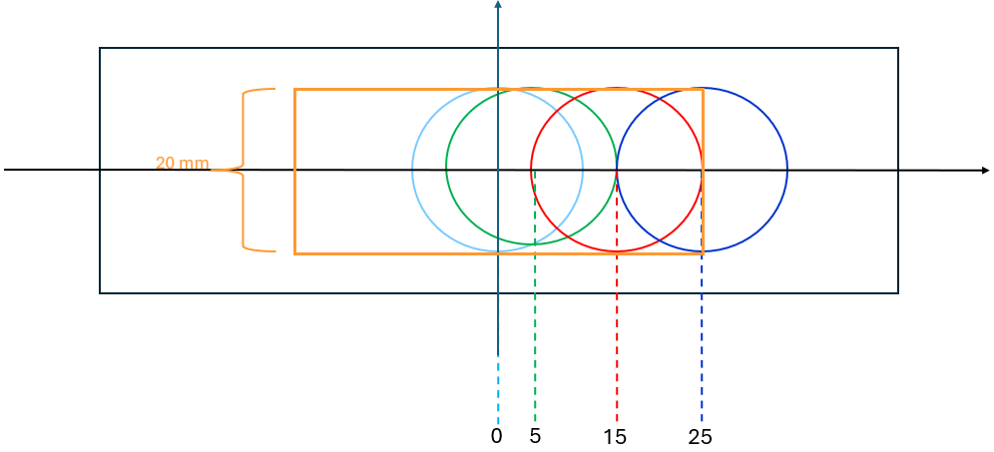
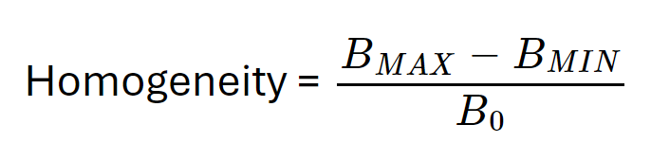
Field Quality and Homogeneity Evaluation
The field quality was evaluated in four harmonic coils with a radius 10mm in order to cover the affected portion of the aperture.
Field homogeneity was calculated in a rectangular area of 10mm height and 50mm width.
100 mm
100 mm
10 mm
30 mm
30 mm
mm
mm
mm

Slide 4
CONFIGURATIONS
We have realized two 10 T configurations:
Configuration 1: the first one has a very good field quality but is more difficult to realize for mechanical reasons because the blocks are not aligned;
Configuration 2: the second one has two aligned racetracks but has a worse field quality.

Slide 5
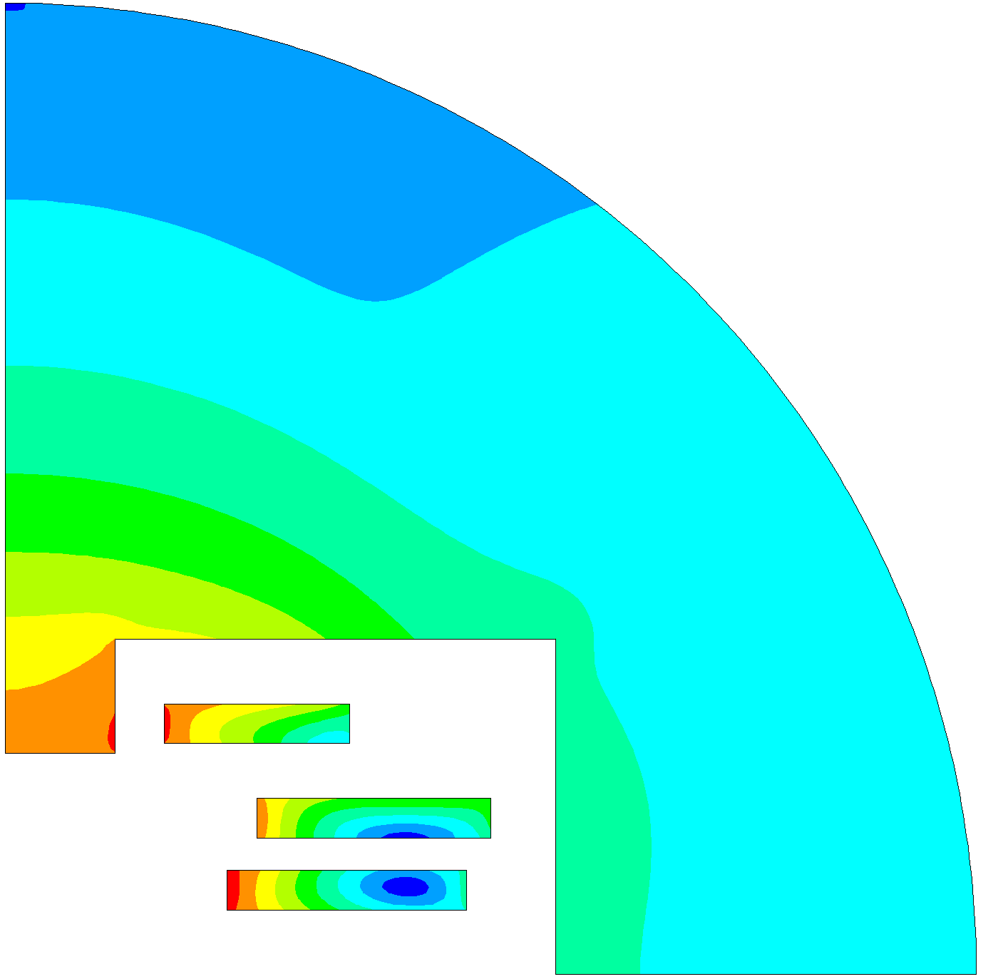
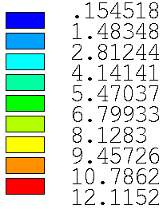

Configuration 1 @ 10 T
Block no. | X [mm] right lower corner | Y [mm] right lower corner | No. of conductors | No. of tapes
1 | 142.6 | 20.0 | 40 | 600
2 | 150.0 | 42.2 | 39 | 585
3 | 106.4 | 71.4 | 31 | 465
B [T]
Iron yoke
Radius [mm] | 300
A [mm] | (170.0; 103.6)
B [mm] | (34.1; 68.4)
A
3
Tot. Structure [k€/m] | 25.9
Tot. Assembly [k€/m] | 20.0
Tot. Conductor [k€/m] | 127.1
Tot. Cost [k€/m] | 173.0
B
100 mm
2
1
30 mm
$$B_{0}=10.0370 T$$

Slide 6
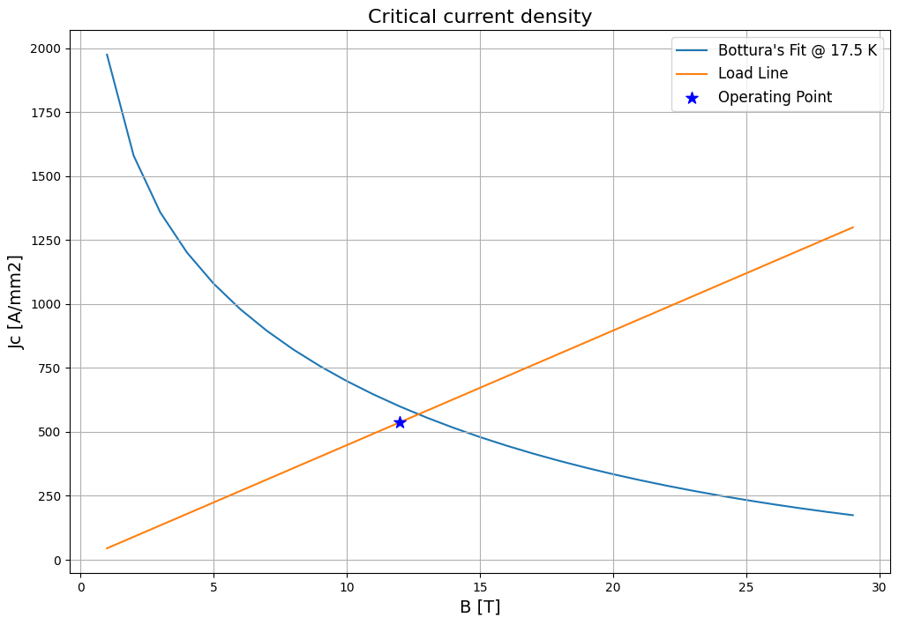
Configuration 1 @ 10 T
Operative temperature [K] | 17.5
Margin [K] | 2.5
Current [A] | 12130
Current density [A/mm²] | 537.44

Slide 7
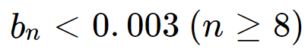
Configuration 1 @ 10 T

Slide 8
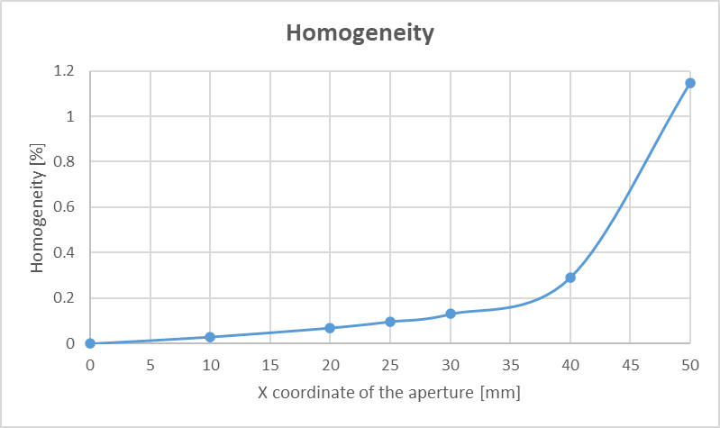
Configuration 1 @ 10 T
Homogeneity (x=25mm) = 0.097%

Slide 9
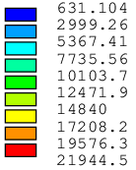
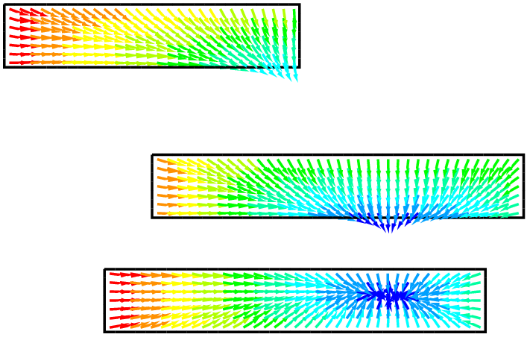
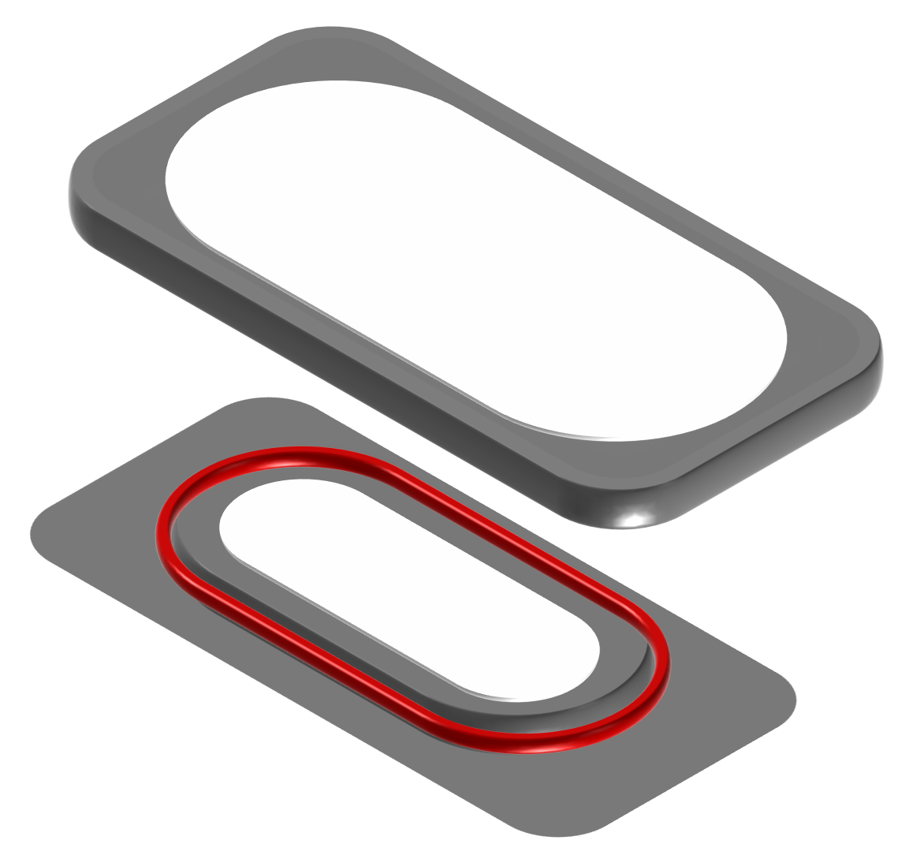
Configuration 1 @ 10 T
Block no. | F_{x} [kN/m] | F_{y} [kN/m]
1 | 1753 | 246
2 | 928 | -1433
3 | 2213 | -1288
TOTAL | 4893 | -2475
F_{L} [N/m]
Preliminary concept: the mechanical structure we want to study consists of stainless steel containers to house racetracks. The sketch on the left is only an indication to understand the concept.
y
x

Slide 10
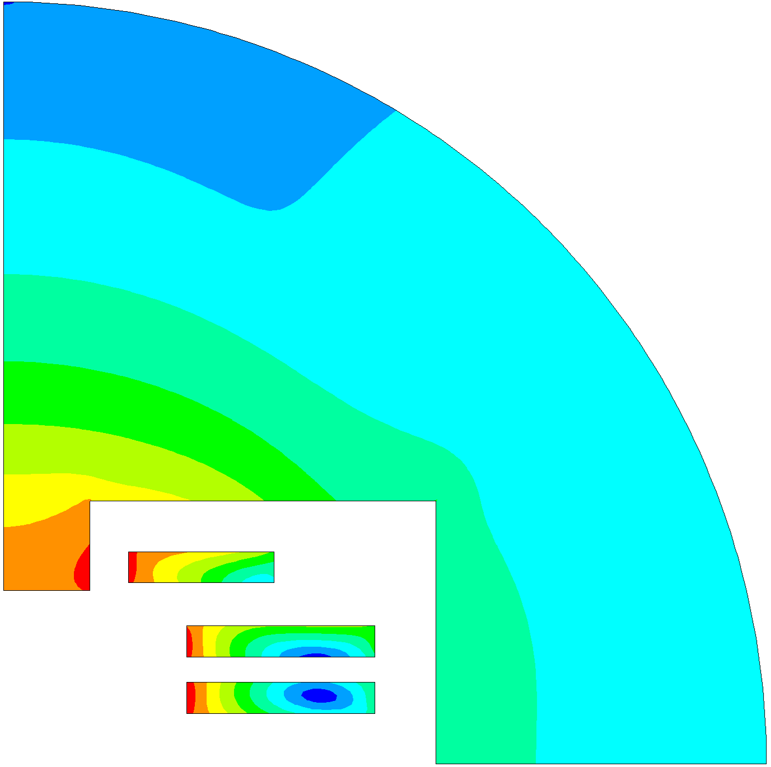
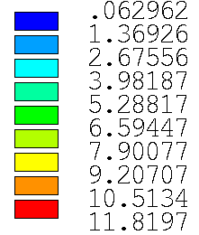

Configuration 2 @ 10 T
Block no. | X [mm] right lower corner | Y [mm] right lower corner | No. of conductors | No. of tapes
1 | 146.0 | 20.0 | 40 | 600
2 | 146.0 | 42.2 | 40 | 600
3 | 106.4 | 71.4 | 31 | 465
B [T]
Iron yoke
Radius [mm] | 300
A [mm] | (170.0; 103.6)
B [mm] | (34.1; 68.4)
A
3
Tot. Structure [k€/m] | 25.9
Tot. Assembly [k€/m] | 20.0
Tot. Conductor [k€/m] | 128.3
Tot. Cost [k€/m] | 174.2
B
100 mm
2
1
30 mm
$$B_{0}=10.0002 T$$

Slide 11
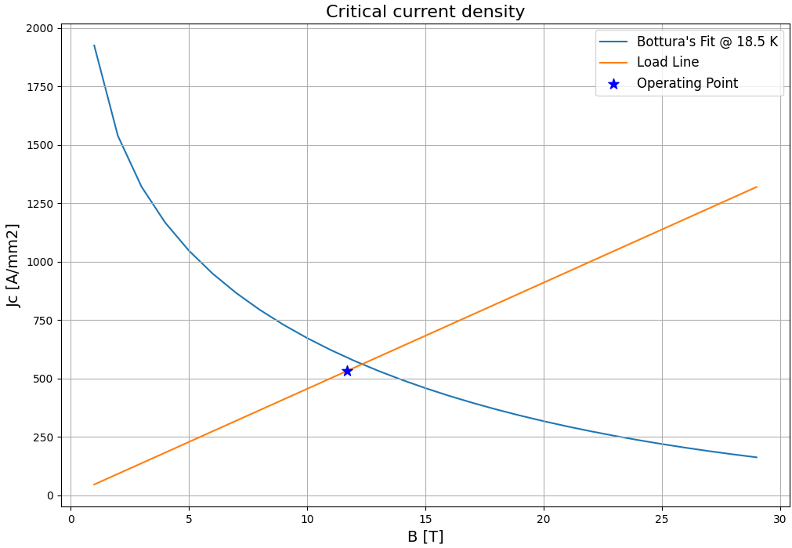
Configuration 2 @ 10 T
Operative temperature [K] | 18.5
Margin [K] | 2.5
Current [A] | 12000
Current density [A/mm²] | 531.68

Slide 12
Configuration 2 @ 10 T

Slide 13
Configuration 2 @ 10 T
Homogeneity (x=25mm) = 0.13%

Slide 14
Conclusions
We were able to find a solution for an open midplane dipole that generates 10T in the center with excellent homogeneity and good field quality.
There are simpler solutions for mechanics with good homogeneity but loosing in terms of field quality.

Slide 15
Thank you for your attention!
T. Maiello^{1,2}, L. Alfonso ¹, A. Bersani¹, L. Bottura³, B. Caiffi¹, S. Fabbri³, S. Farinon¹,
A. Gagno^{1,2} , D. Novelli^{1,4} , A. Pampaloni¹
¹ INFN – Genova, ² Università degli Studi di Genova, ³ CERN, ⁴ Sapienza Università di Roma

