Slide 1
Progress on the Magnetic Design of Superconducting Dipoles in Acceleration Stage
$S. {Fabbri}^{1}$, $L. {Bottura}^{1}$, $T. {Maiello}^{2}$, $A. {Pampaloni}^{2} , et al$
$${}_{}^{1}{CERN}, {}_{}^{2}{INFN −Genova}$$

Slide 2
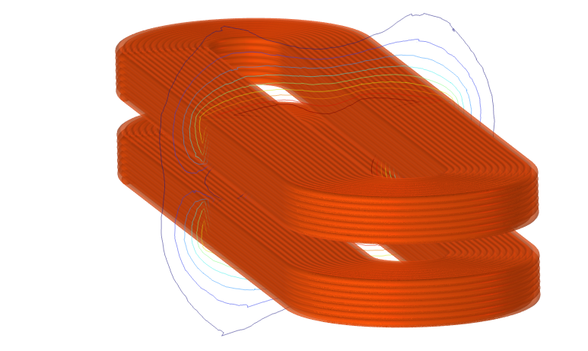
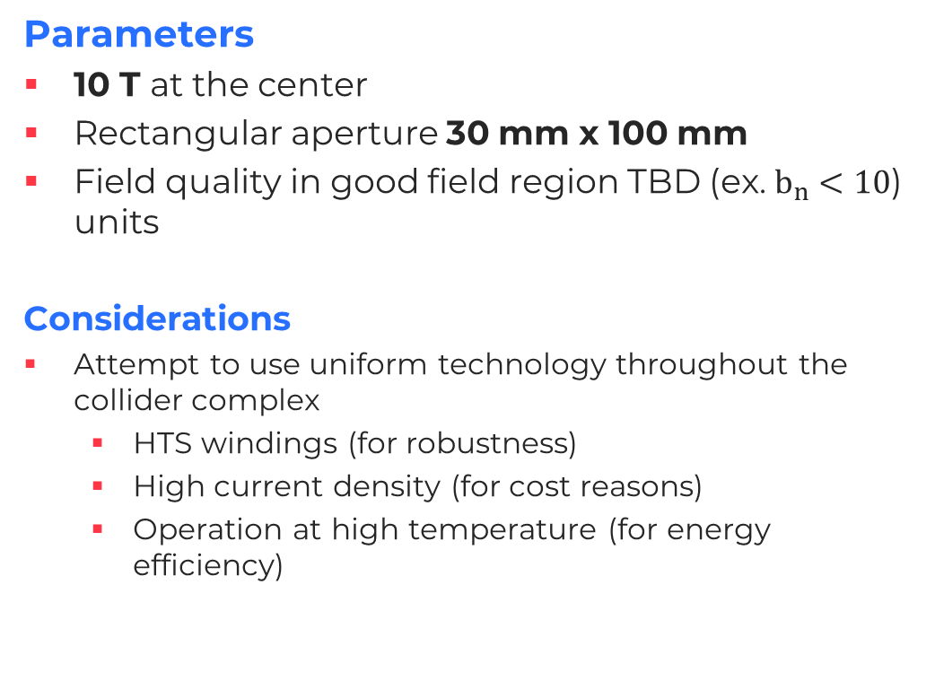
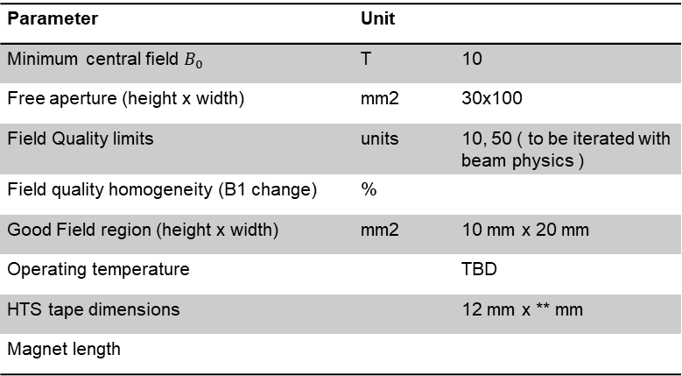
Accelerator Superconducting Magnets
Parameters
10 T at the center
Rectangular aperture 30 mm x 100 mm
Field quality in good field region TBD (ex. $b_{n}<10$) units
Considerations
Attempt to use uniform technology throughout the collider complex
  HTS windings (for robustness)
  High current density (for cost reasons)
  Operation at high temperature (for energy efficiency)
Parameter | Unit
Minimum central field $B_{0}$ | T | 10
Free aperture (height x width) | mm2 | 30x100
Field Quality limits | units | 10, 50 ( to be iterated with beam physics )
Field quality homogeneity (B1 change) | %
Good Field region (height x width) | mm2 | 10 mm x 20 mm
Operating temperature |  | TBD
HTS tape dimensions |  | 12 mm x ** mm
Magnet length

Slide 3

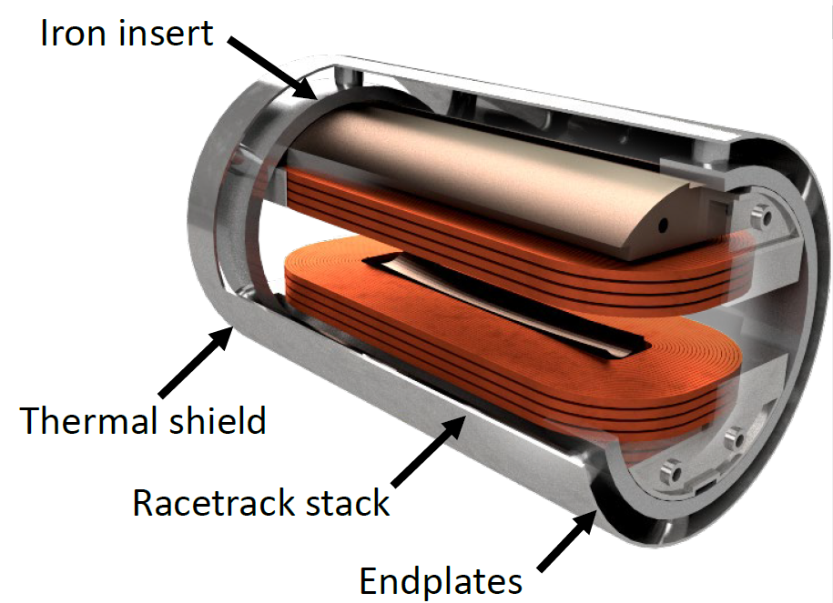

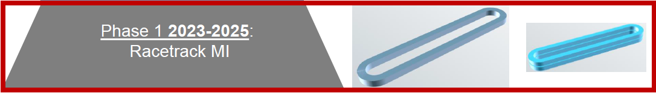
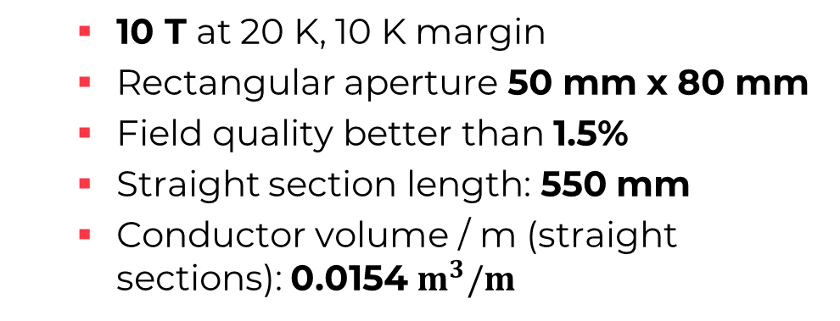
Overlap
  10 T at 20 K, 10 K margin
  Rectangular aperture 50 mm x 80 mm
  Field quality better than 1.5%
  Straight section length: 550 mm
  Conductor volume / m (straight sections): 0.0154 $m^{3}/m$
[1] Design and Plan of a 10 T HTS Energy Saving Dipole Magnet for the Italian Facility IRIS, MT-28
CEA-CERN HFM collaboration
  Demonstrator of metal-insulated ReBCO high field magnet coils

Slide 4
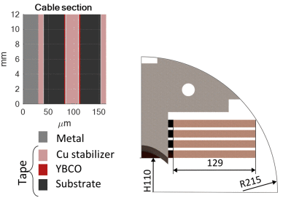
IRIS 10 T energy saving Dipole ESMA
Thank you to discussions with those who designed the dipole magnet ESMA (Lorenzo B., Stefano S., etc.)
6 stacks of 12 mm tape pancakes
9 mm gaps for field quality
Metal insulated (SS) (not NI because of long ramp up time)
1.5 % field quality (150 units)
No Iron because it limits the optimal field quality to one field value – this magnet must be used at range of field values
a
12 mm
9 mm
structural
housing
[1] L. Rossi and others, "Design and Plan of a 10 T HTS Energy Saving Dipole Magnet for the Italian Facility IRIS," in IEEE Transactions on Applied Superconductivity, vol. 34, no. 5, pp. 1-6, Aug. 2024, Art no. 4602406, doi: 10.1109/TASC.2024.3355357
5/15/2024
Initial Magnetic Design of Accelerator SC Dipoles
4

Slide 5
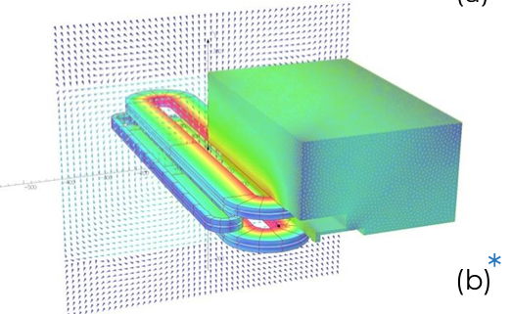
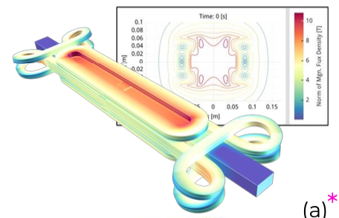
Conceptual Design (Reminder: previously ruled out more complex geometries)
2.1 Flat RT coils in midplane, with return leg on external part
2.2 Cloverleaf winding (novel)
Reference: IRIS - https://indico.cern.ch/event/1220254/contributions/5270734/attachments/2607808/4507319/REBCO%20I.FAST%20CCT%20&%20IRIS%2010%20T%20HTS%20dipole%20at%20INFN.pdf
Add construction complexity
Limited advantages (see [1])

Slide 6
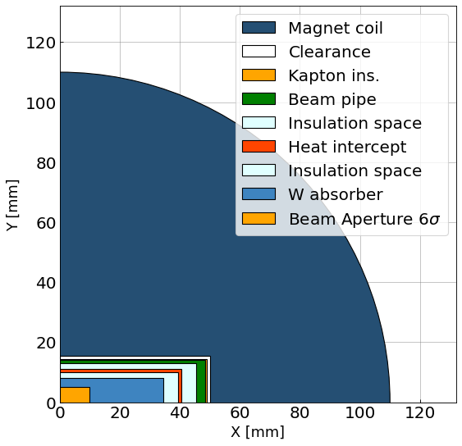
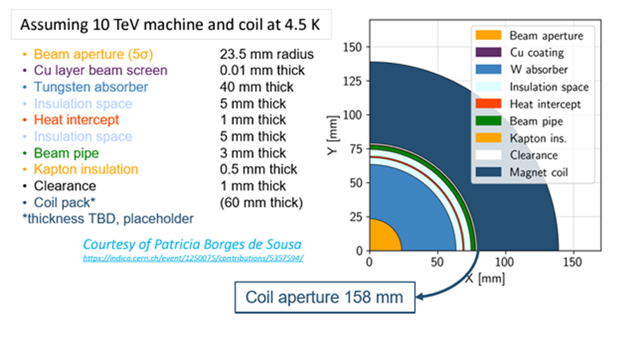
Radial Build
Important for defining space for magnets
Novelli, Daniel, et al.

Slide 7
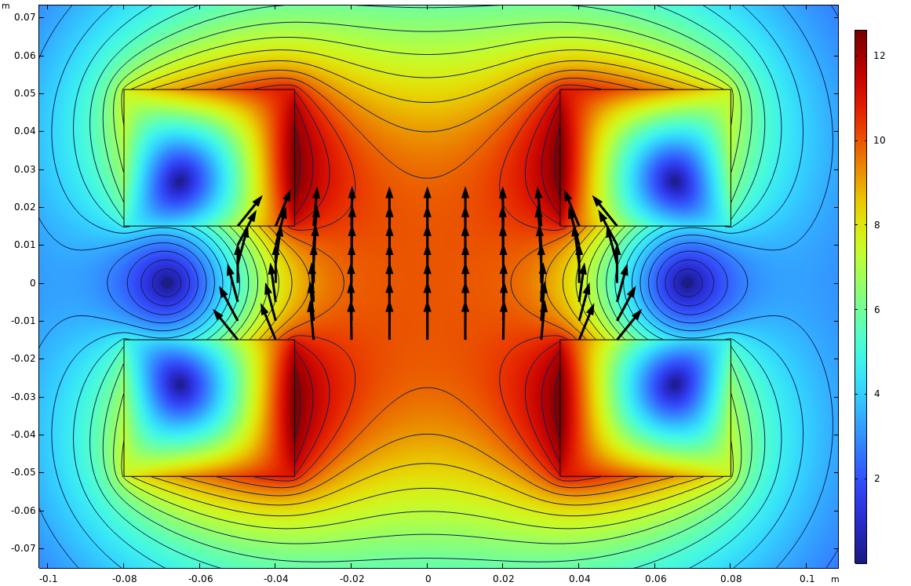
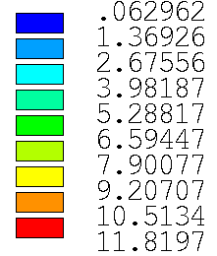
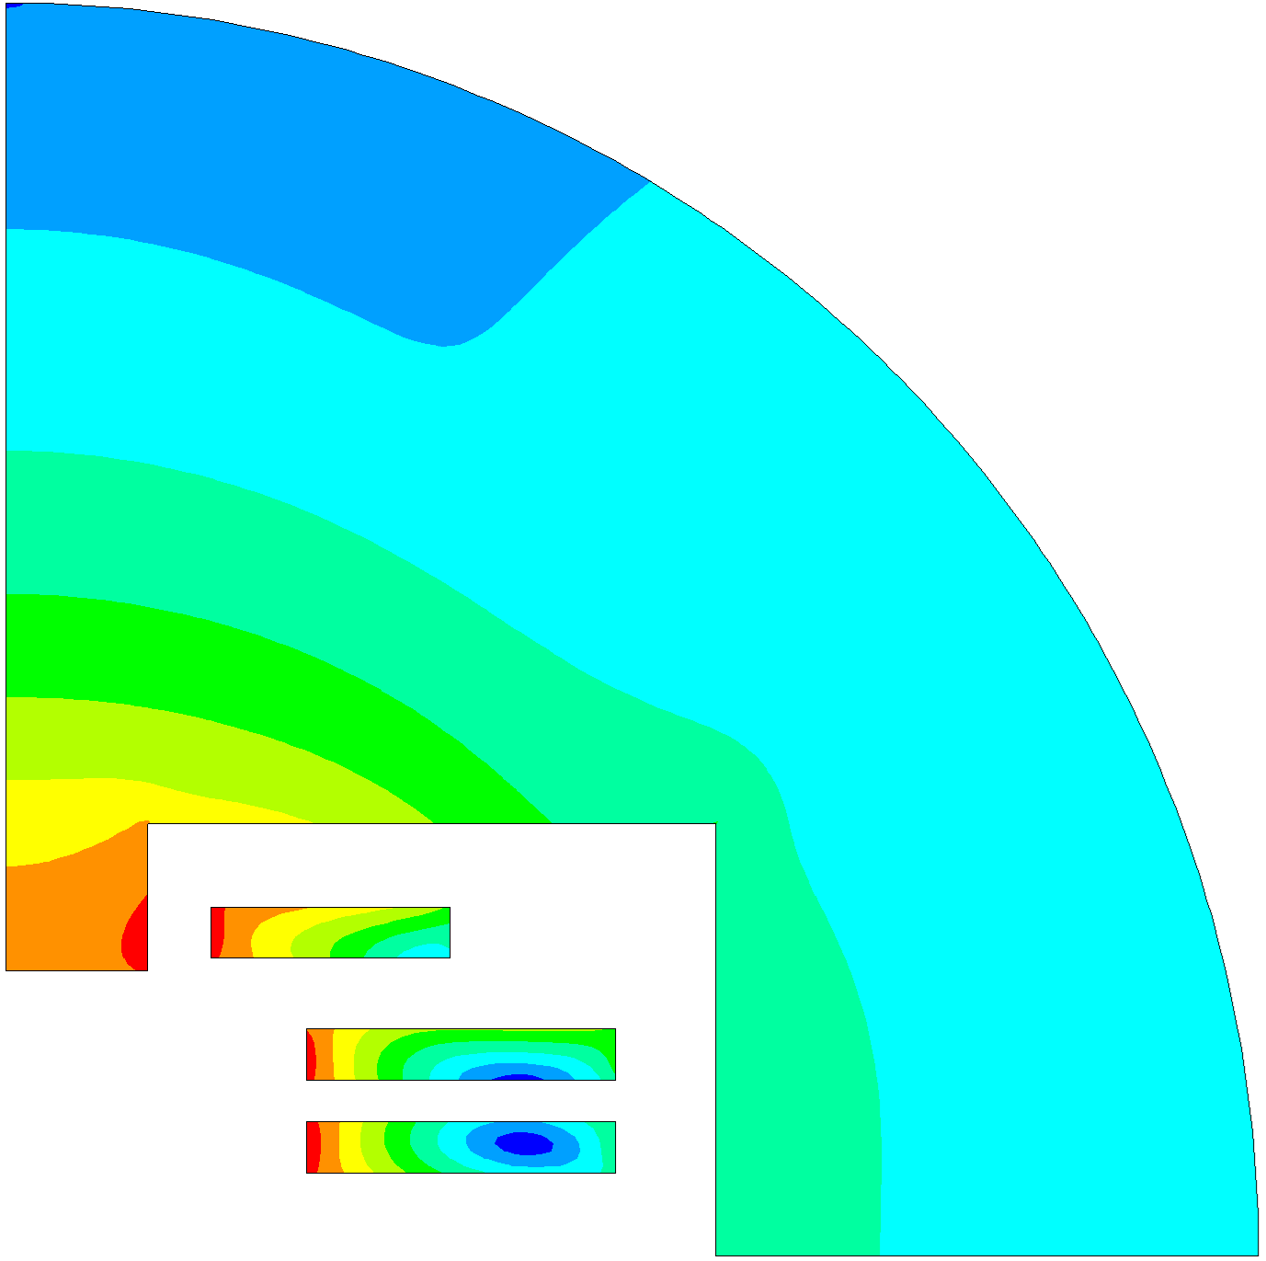
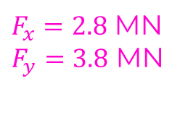



Magnet Design Status
Previously, single stacks of conductor were investigated in terms of cost, with some mechanical analysis (Annual Meeting)
Ongoing conceptual design: two approaches taking place:
  Numerical optimization routine looking at conductor volume, field quality (w/o iron) and critical current density limit
  Optimization in ROXIE including Iron
$$F_{x}$$
$$F_{y}$$
$F_{x}=2.8$ MN
$F_{y}=3.8$ MN
B [T]
First Goals:
Optimization study on possible configurations as a function of cost, field quality, and complexity (number of racetracks, uniformity..)
Mechanical analysis
A
B
3
100 mm
2
1
30 mm
$$B_{0}=10.0002 T$$

Slide 8
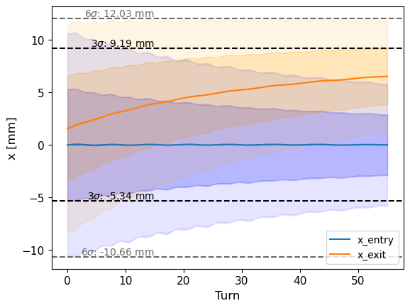
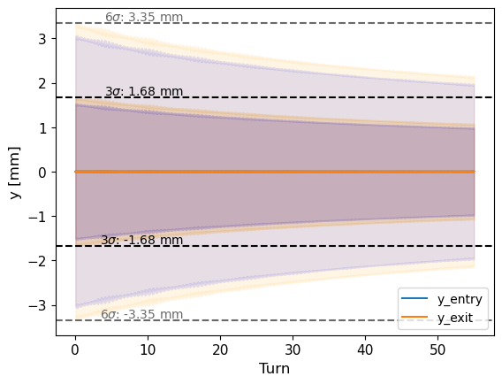
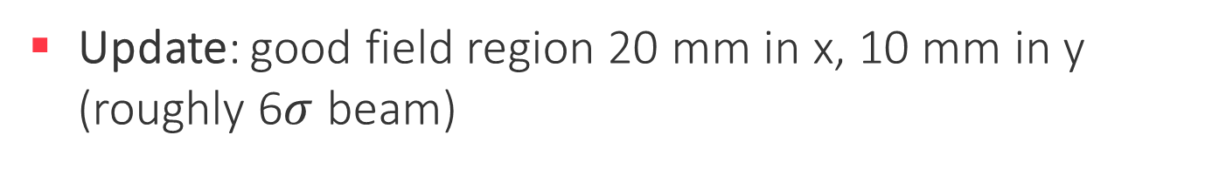
Field Quality Calculation (Updated Values)
Current assumption before update: 50 mm in x, 20 mm in y
Update: good field region 20 mm in x, 10 mm in y (roughly 6$σ$ beam)
-15 mm
-10 mm
-5 mm
+5 mm
+10 mm
+15 mm
Credit and thanks to Lisa Soubirou

Slide 9
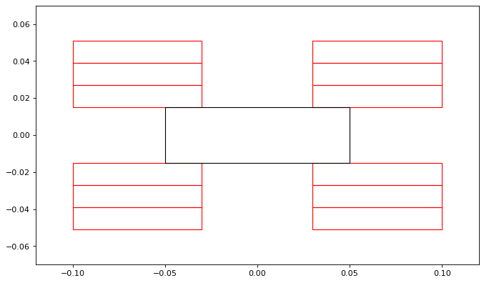
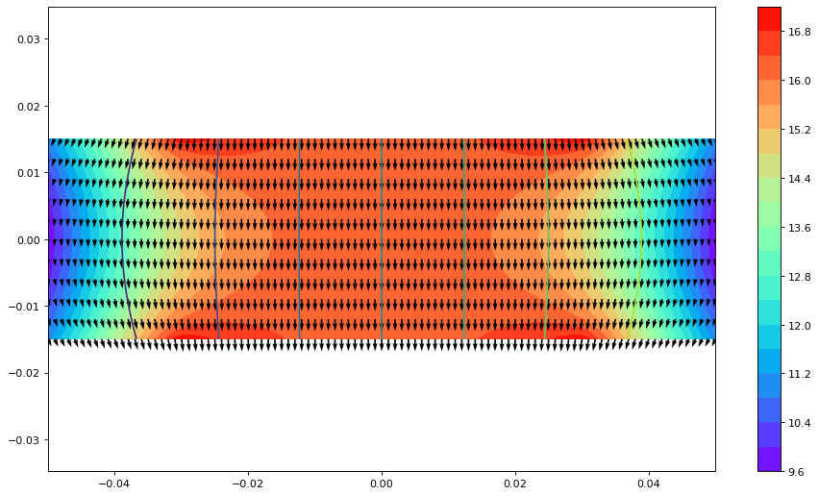
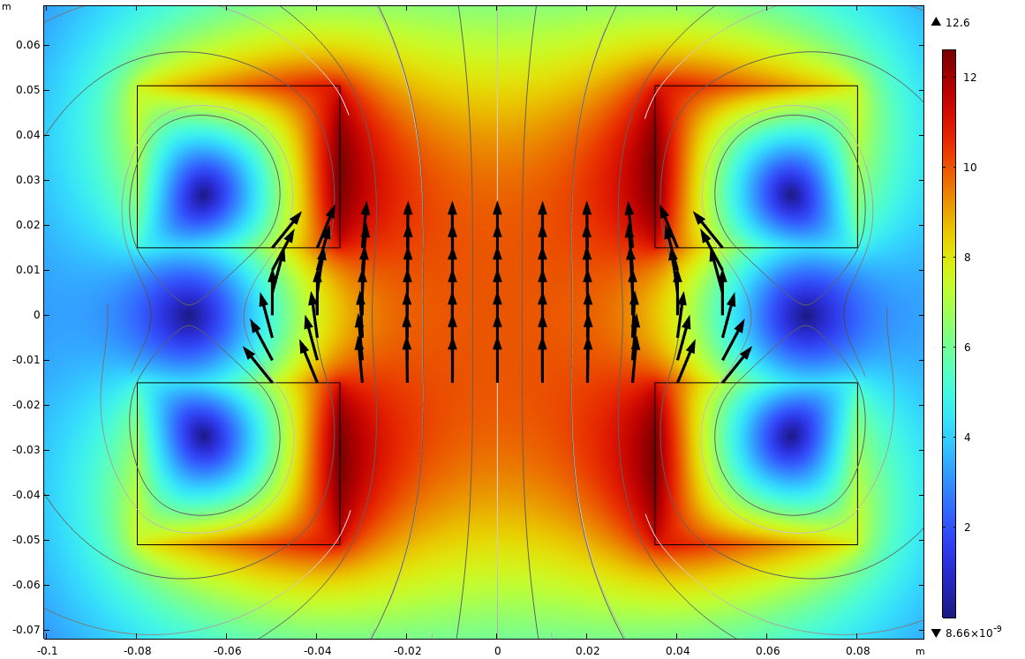
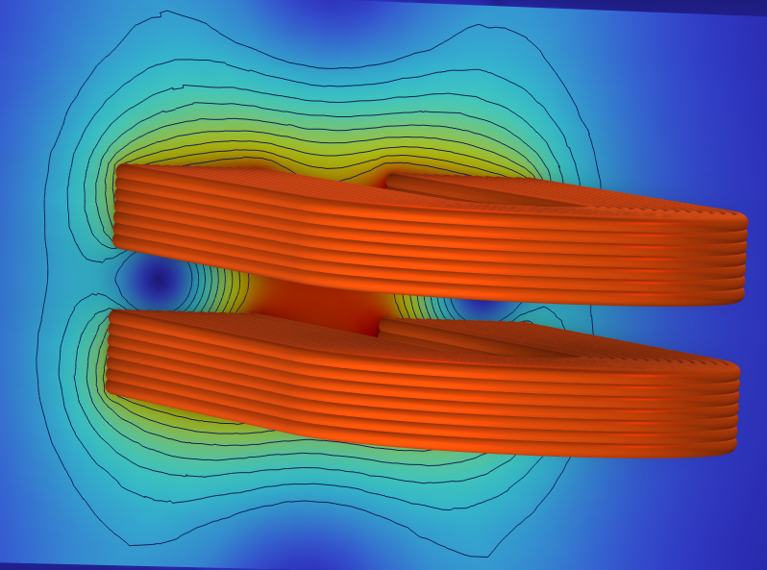
Numerical Optimization Routine
An approach to best optimize field quality and cost
Input constraints:
  Search resolution
  Space the RTs can exist in
  RT constraints (minimum length in x, thickness in y (12 mm))
  Current Density (<700 A/mm2)
Limitations: does not include Iron
30 mm
100 mm
  Racetrack Model 2D and 3D

Slide 10
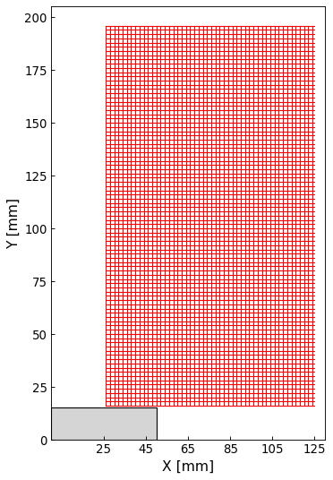
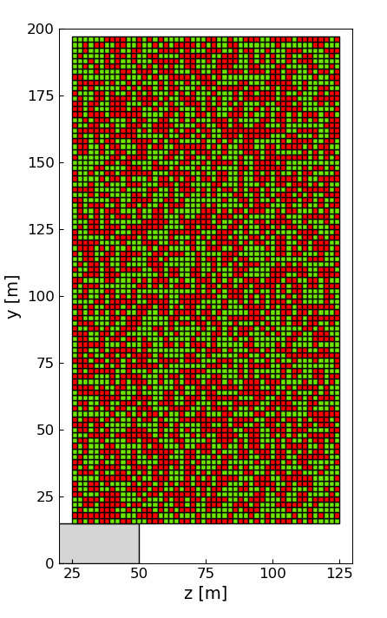
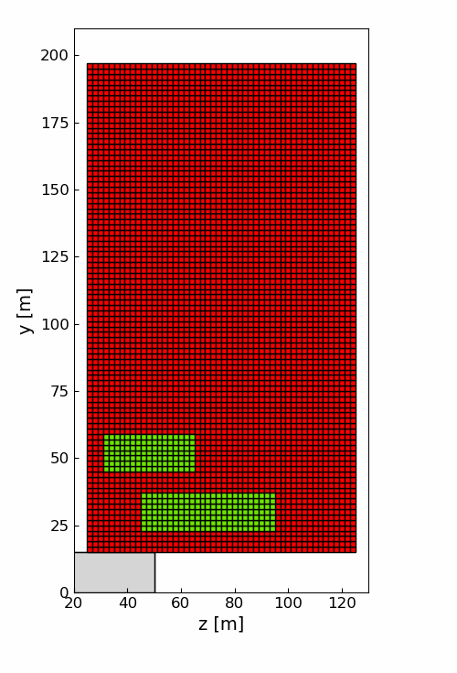
Numerical Optimization Routine - Method
Establish grid where RT pancakes are allowed to exist (Ex. 2 mm dx dy)
Calculate field contribution from all grid elements
Create all unique configurations of 2, 3, 4, 5, and 6 pancakes

Slide 11
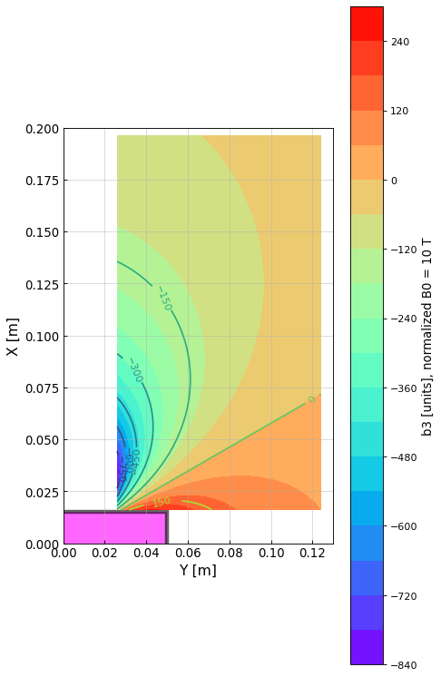
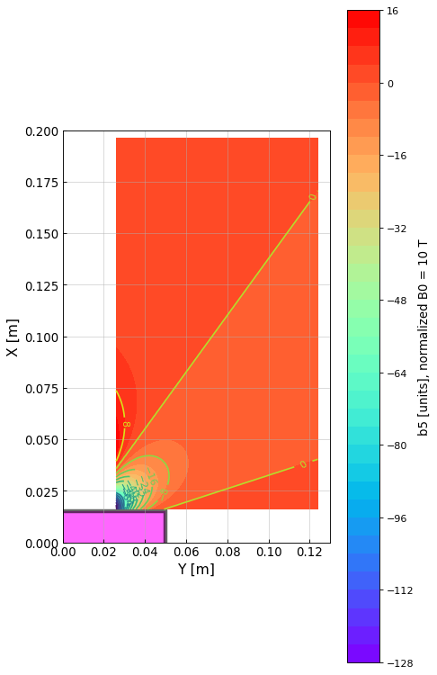
Numerical Optimization Routine - Method
A look at the contributions to higher order terms in this space

Slide 12
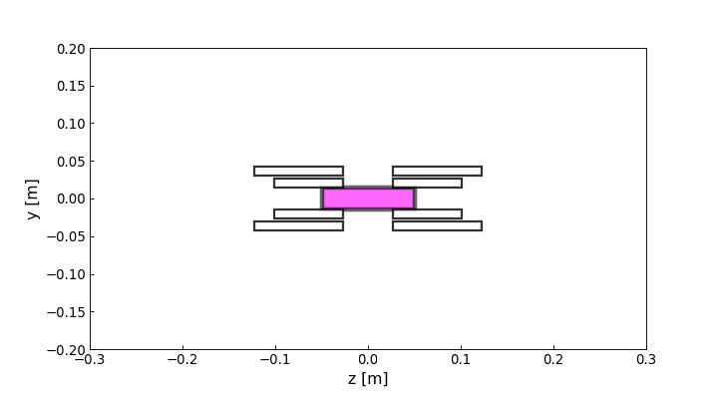
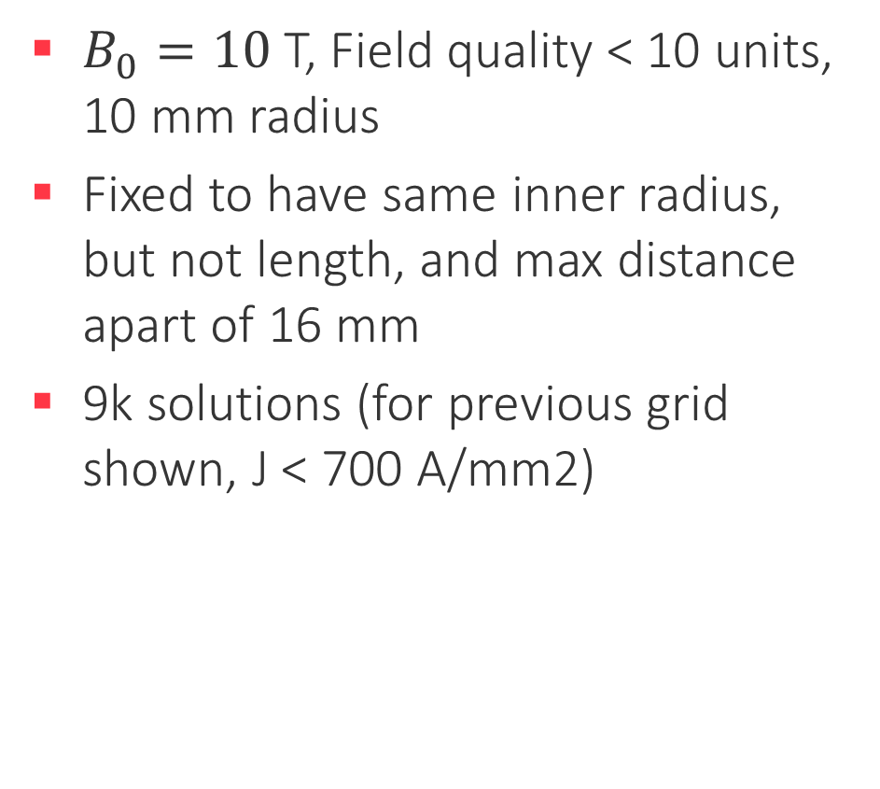
Numerical Optimization Routine – Example: 2 racetracks
$B_{0}=10$T, Field quality < 10 units, 10 mm radius
Fixed to have same inner radius, but not length, and max distance apart of 16 mm
9k solutions (for previous grid shown, J < 700 A/mm2)
x [m]

Slide 13
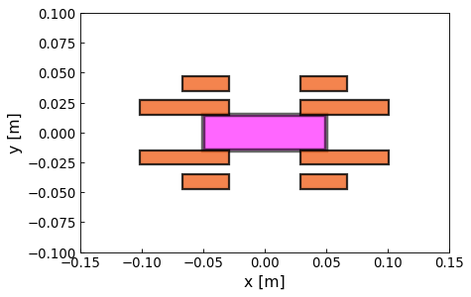
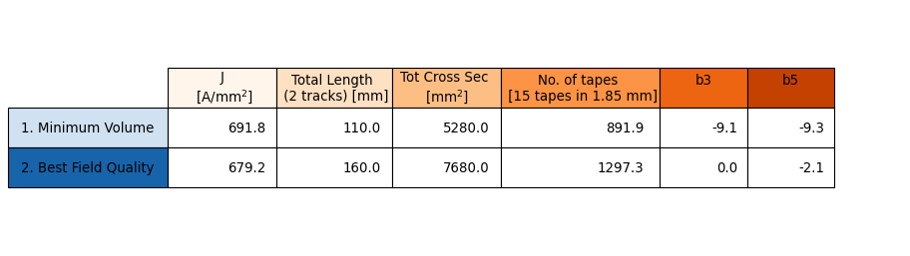
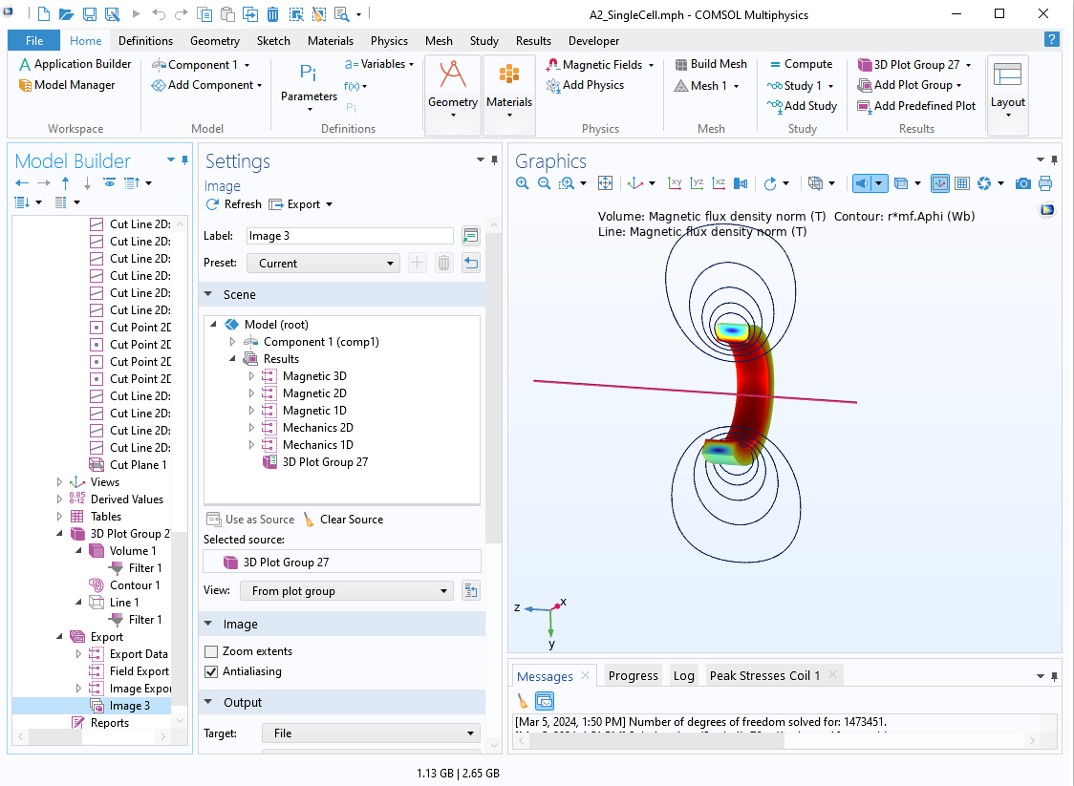
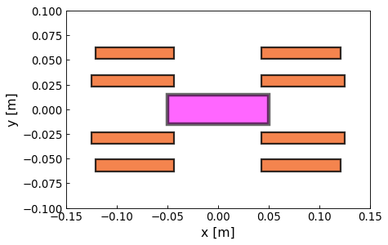
Numerical Optimization Routine – Example: 2 racetracks
1.
COMSOL or ROXIE
2.
Full stress, critical current and field calculations

Slide 14
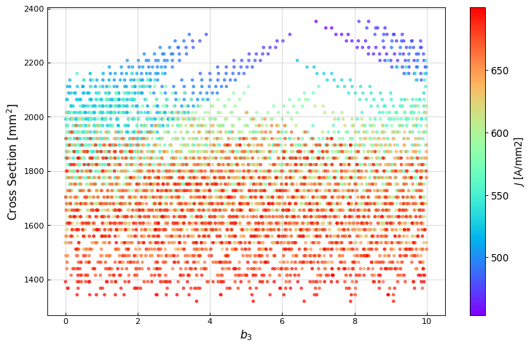
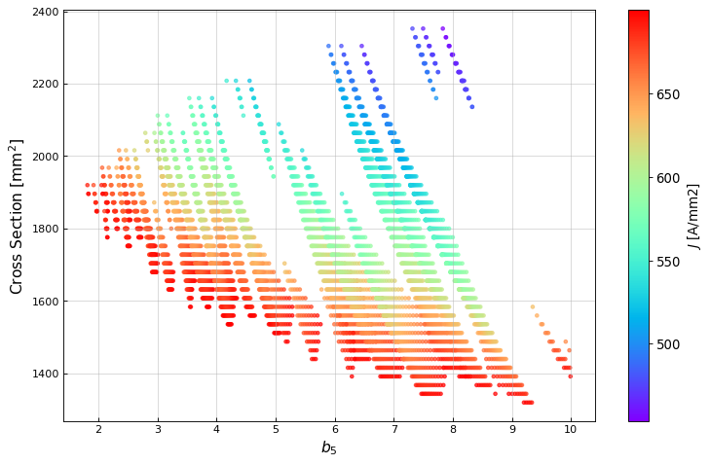
Numerical Optimization Routine – Example: 2 racetracks
Goal

Slide 15
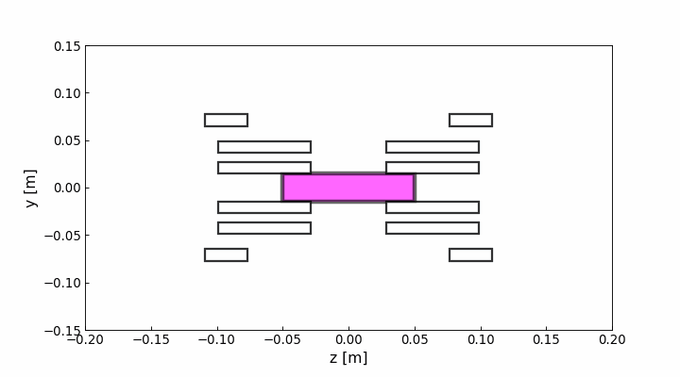
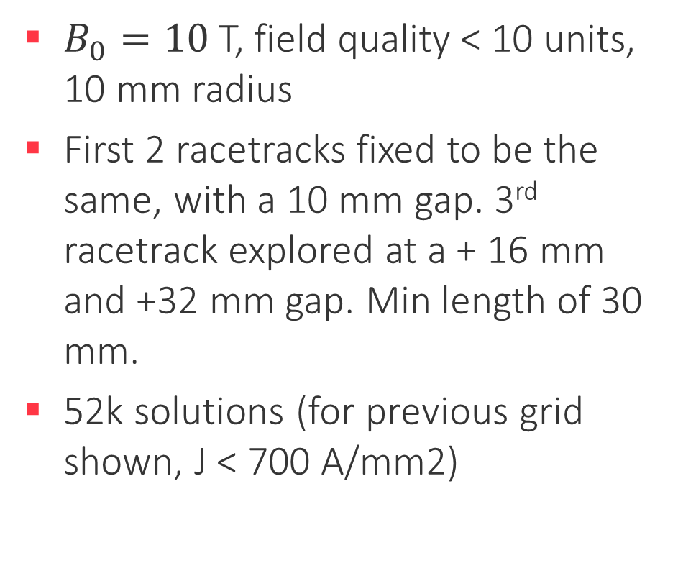
Numerical Optimization Routine – Example: 3 racetracks
$B_{0}=10$T, field quality < 10 units, 10 mm radius
First 2 racetracks fixed to be the same, with a 10 mm gap. 3rd racetrack explored at a + 16 mm and +32 mm gap. Min length of 30 mm.
52k solutions (for previous grid shown, J < 700 A/mm2)

Slide 16
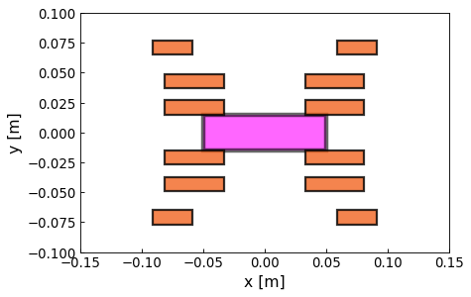

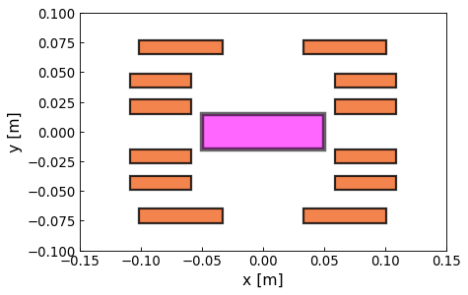
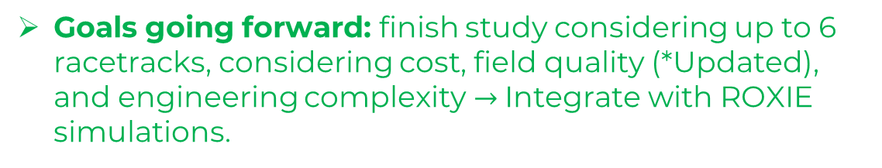
Numerical Optimization Routine – Example: 3 racetracks
1.
To investigate further to understand advantages/disadvantages compared to 2 racetracks, etc.
2.
Goals going forward: finish study considering up to 6 racetracks, considering cost, field quality (*Updated), and engineering complexity $→$Integrate with ROXIE simulations.

