Slide 1

Radiation challenges in the RCS accelerators
S. Marin, A. Lechner, D. Calzolari, C. Ahdida
May 15, 2024

Slide 2
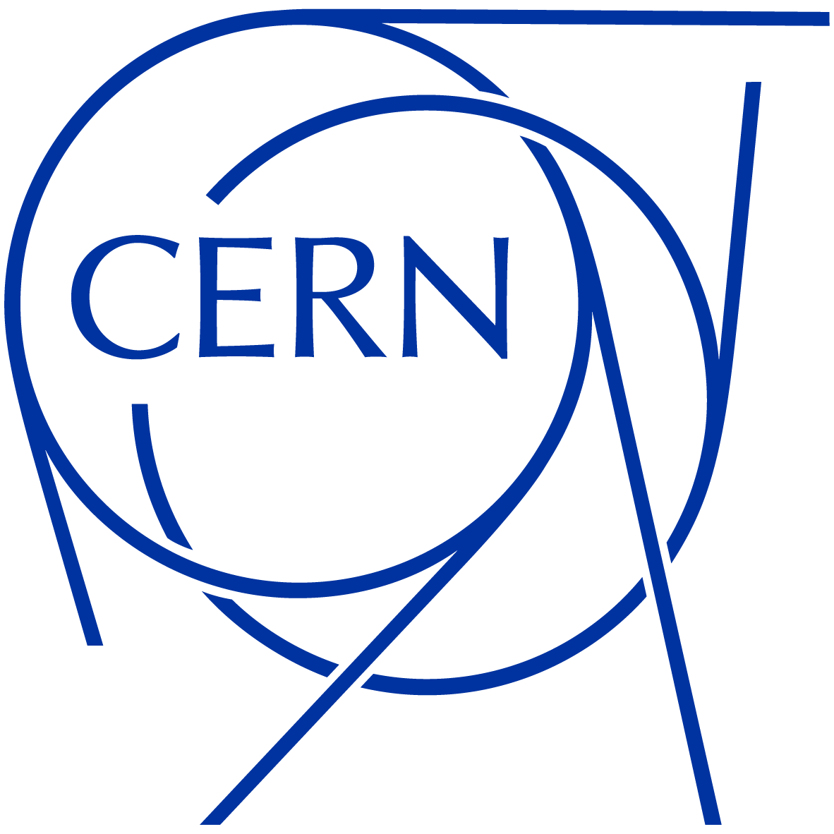
Introduction
Different radiation aspects have to be considered in the RCS design (muon decay):
  Radiation load to magnets:
    Thermal load to SC magnets
    Cumulative radiation damage in SC and NC magnets
  Radiation protection aspects*
    One important aspect is the possible Co content in the NC dipoles
    Neutrino flux
First considerations about the shielding requirements in this presentation
First considerations in this presentation
Not covered here
For the cumulative radiation damage and residual dose rates, we assume 140 days of operation/year
* Radiation protection aspects are under the responsibility of the HSE/RP group (C. Ahdida)

Slide 3
Radiation load on magnets – what to consider
Muon decay, halo losses
Decay rate,
halo loss rate
Integral number of decays, integral halo losses (over collider lifetime)
*Point-like quantity
Instantaneous heat deposition
Power density in coils (mW/cm³)* → must remain safely below quench level of magnets
Total power deposition in cold mass (W/m) → must be compatible with realistic cooling capacity (costs, electricity consumption!), (most of the heat load must be extracted at higher T than the op. temp. of SC magnets)
Long-term radiation damage
Ionizing dose (MGy)* (organic materials for insulation, coil impregnation, etc.) → must remain below critical level for full collider lifetime
Atomic displacements (DPA)* (superconductor, stabilizer) → must remain below critical level, partial mitigation with annual annealing cycles
Concerns SC and NC magnets!
DPA is likely not an issue (like in the collider) – not studied here
Notes:
Muon decay is of course the main source for radiation load to the magnets, but we should of course not forget about beam halo losses on the aperture.
Nevertheless, in the following slides I will focus only on muon decay.
When we study the radiation load to magnets, we have to consider both the instant. Heat deposition and the long-term radiation damage.

Slide 4
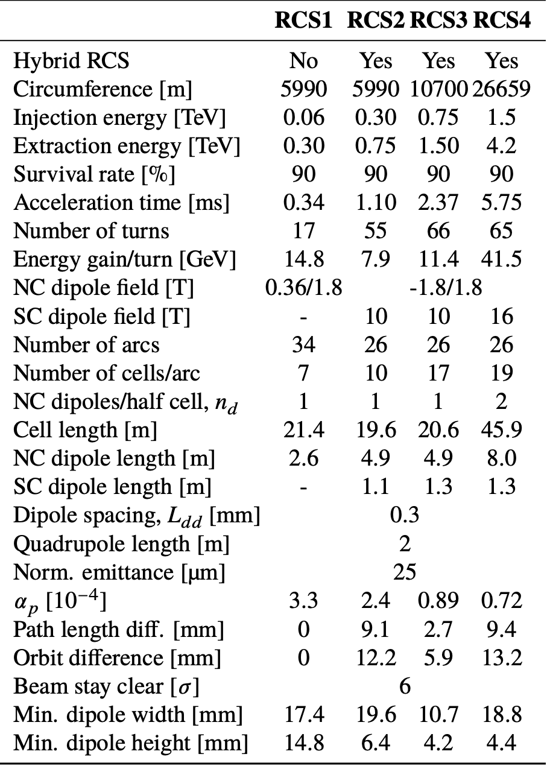
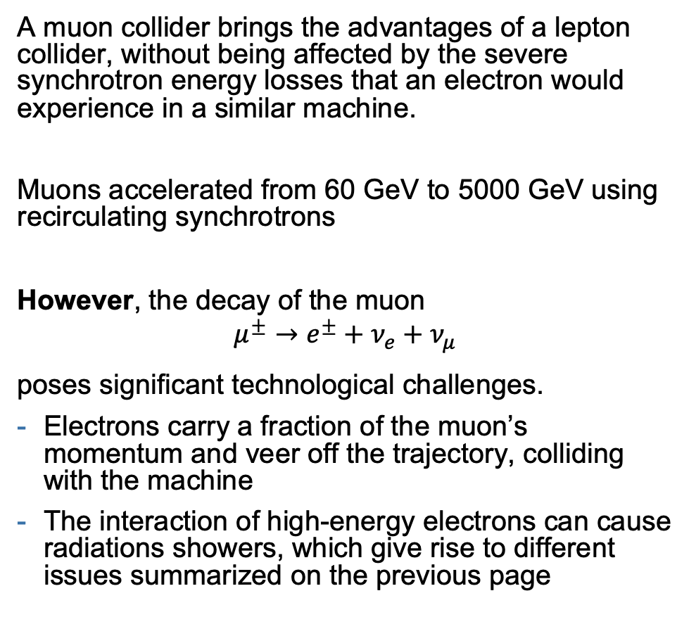
Background
A muon collider brings the advantages of a lepton collider, without being affected by the severe synchrotron energy losses that an electron would experience in a similar machine.
Muons accelerated from 60 GeV to 5000 GeV using recirculating synchrotrons
However, the decay of the muon
$$μ^{±}→e^{±}+ν_{e}+ν_{μ}$$
poses significant technological challenges.
Electrons carry a fraction of the muon’s momentum and veer off the trajectory, colliding with the machine
The interaction of high-energy electrons can cause radiations showers, which give rise to different issues summarized on the previous page

Slide 5
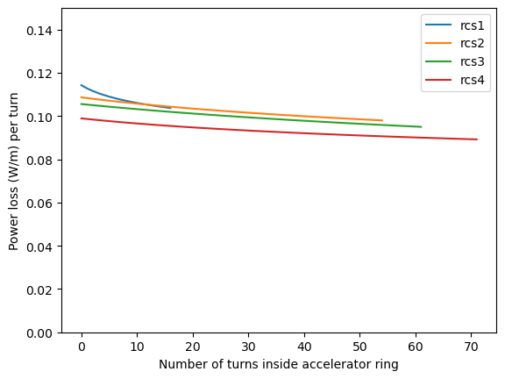
Motivation and Prospect
We perform a preliminary radiation damage study on the RCS accelerator. We pick conservative parameters:
Characterize upper limits on the radiation received by the machine’s equipment
Identify radiation hot spots and design suggestions
Validate shielding design and placement
We simulate a full cell of RCS-3, which is significantly shorter than RCS-4 and with a similar power deposition profile.
Notes:
look if rcs4 with 2 nc is still lower

Slide 6
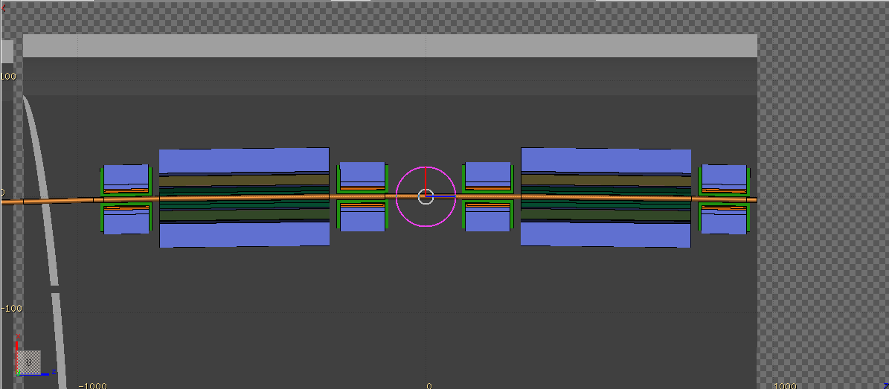
Geometry
We simulate the full cell of a FODO geometry with hybrid SC and NC dipole magnets
To RF
150 m of straight section
All simulation parameters from RCS-3 column from previous slide, and:
Radius of beam pipe: 2.4 cm
NC DIPOLE
-1.8 to 1.8 T
Quadrupole
(no field or magnet material simulated)
SC DIPOLE
10 T
Notes:
No field or magnet simulated

Slide 7
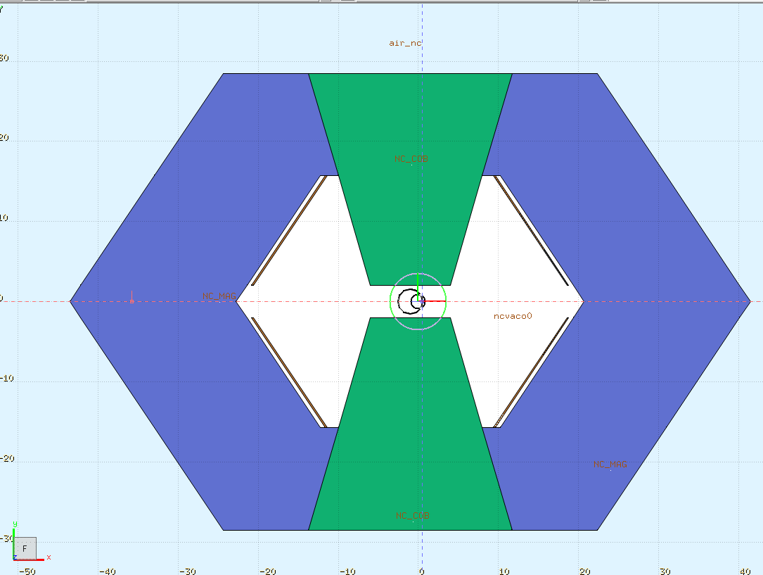
Normal conducting magnet
Normal conducting coils (x4)
We obtained a preliminary NC magnet design from F. Boattini
Coils on the side of the beam pipe generate the dipole magnetic field. Ionizing dose to coil insulation can cause mechanical failures.
Due to the fast ramping of the magnetic field, eddy currents would generate too much power in shielding materials
To increase the magnetic flux through the yoke, cobalt is mixed in the region closest to the beam pipe (assumed 50% ratio). However, neutron reactions on cobalt can generate long-lived ⁶⁰Co
Iron yoke
Cobalt and iron yoke
Notes:
impurities in iron possibly rerun
coals on the side
indicate cobalt ratio on the slide

Slide 8
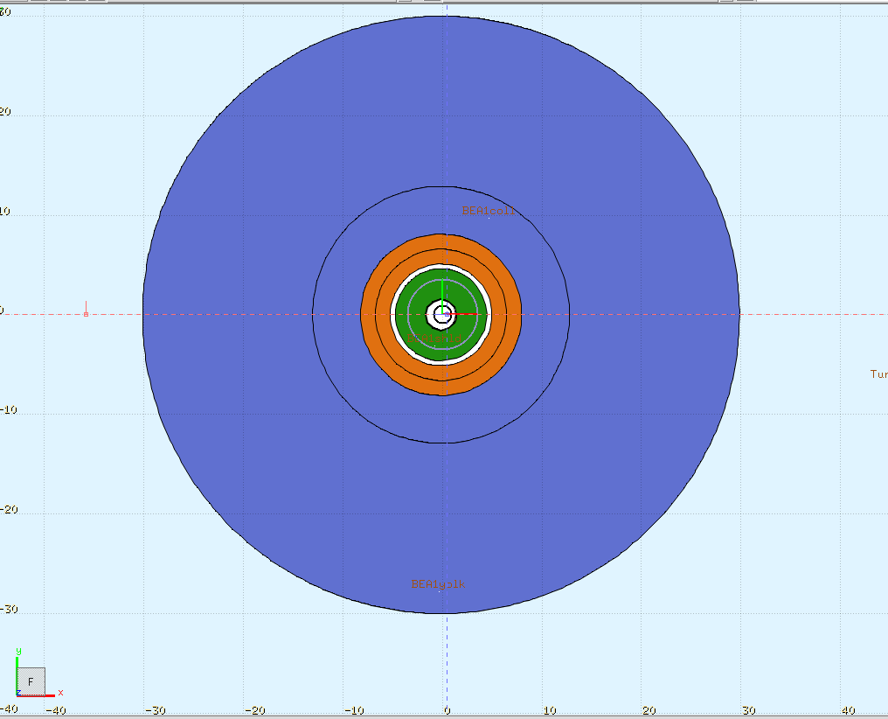
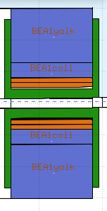
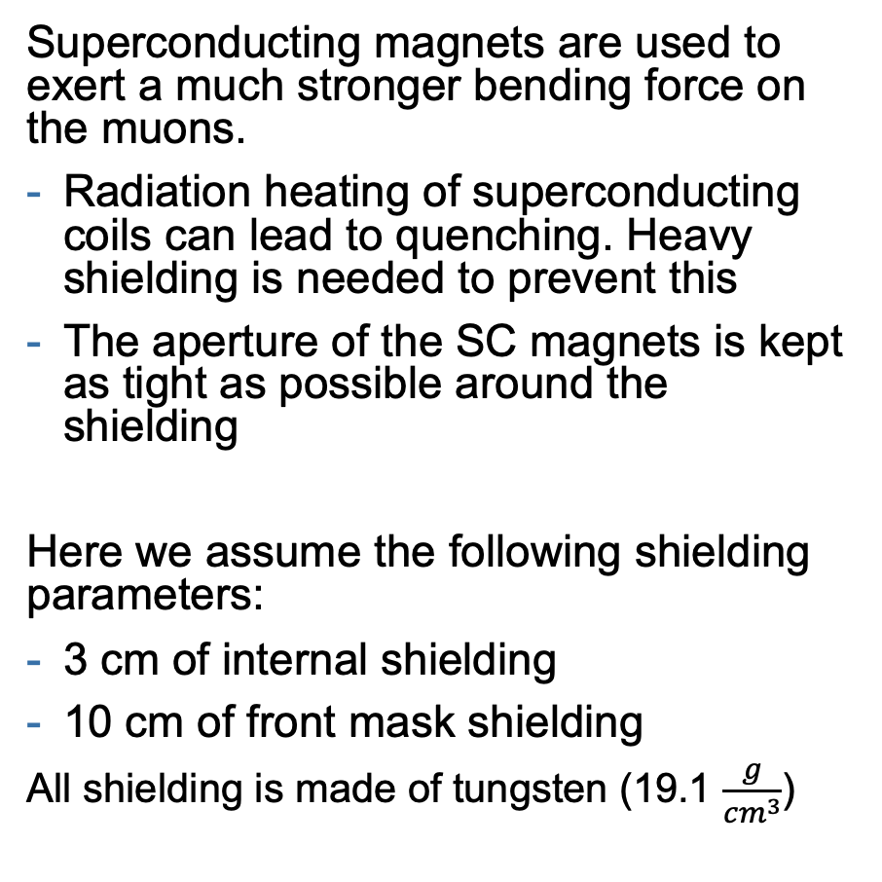
Superconducting magnets
Iron yoke
Superconducting magnets are used to exert a much stronger bending force on the muons.
Radiation heating of superconducting coils can lead to quenching. Heavy shielding is needed to prevent this
The aperture of the SC magnets is kept as tight as possible around the shielding
Here we assume the following shielding parameters:
3 cm of internal shielding
10 cm of front mask shielding
All shielding is made of tungsten (19.1 $\frac{g}{cm^{3}}$)
SC coils
Front mask
Shielding
Beam aperture: 2.4 cm radius
Notes:
State the beam radius

Slide 9
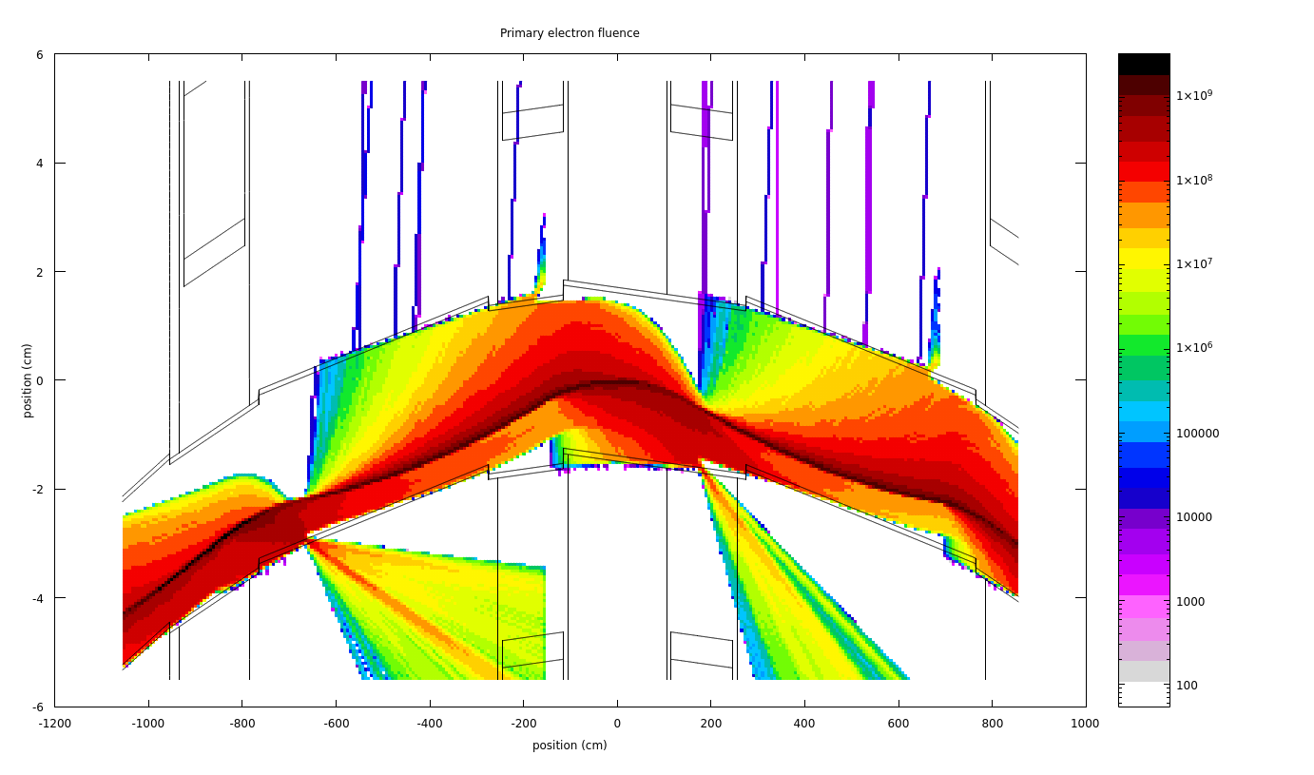
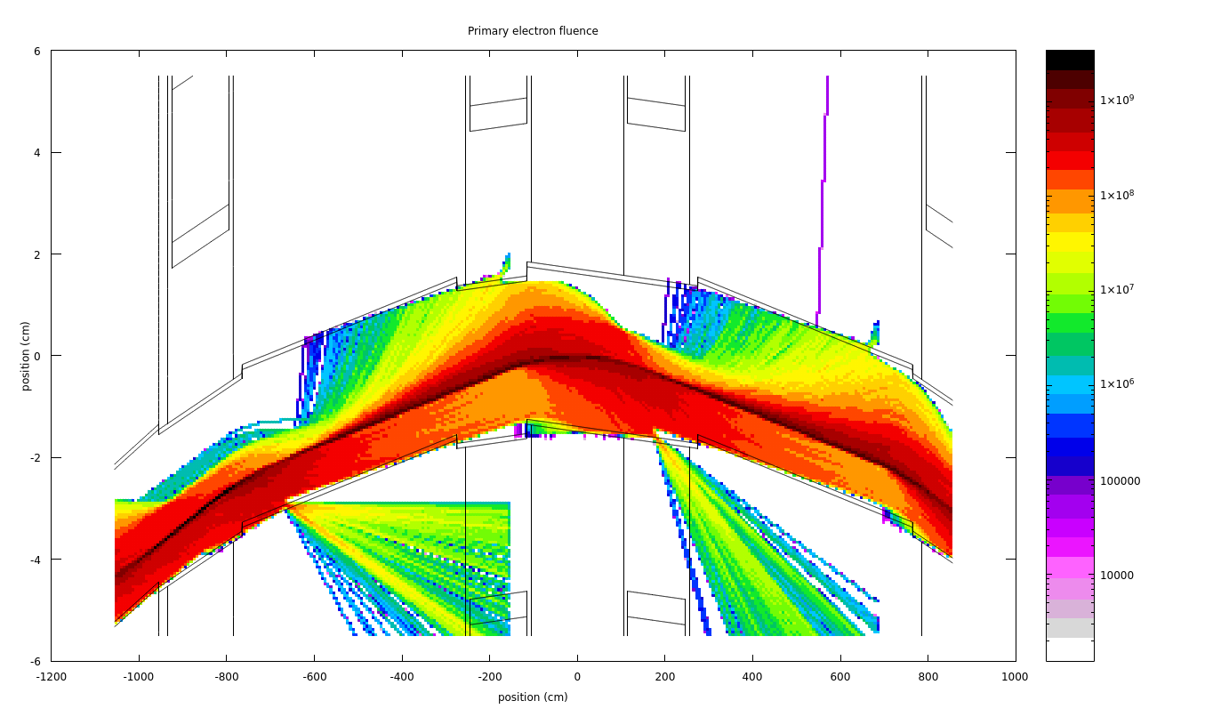
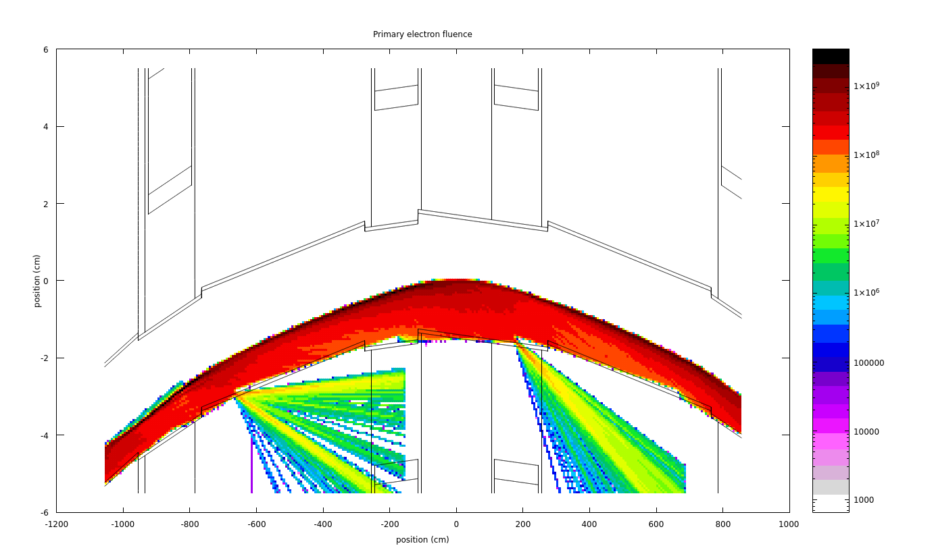
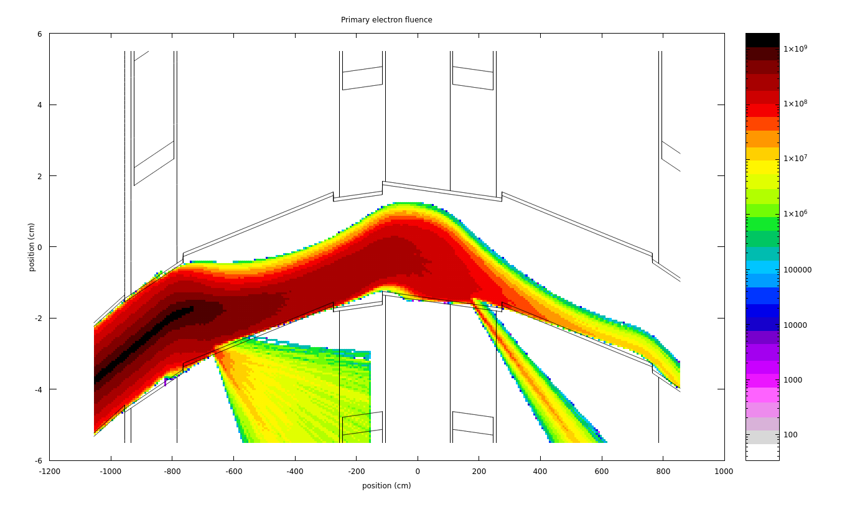
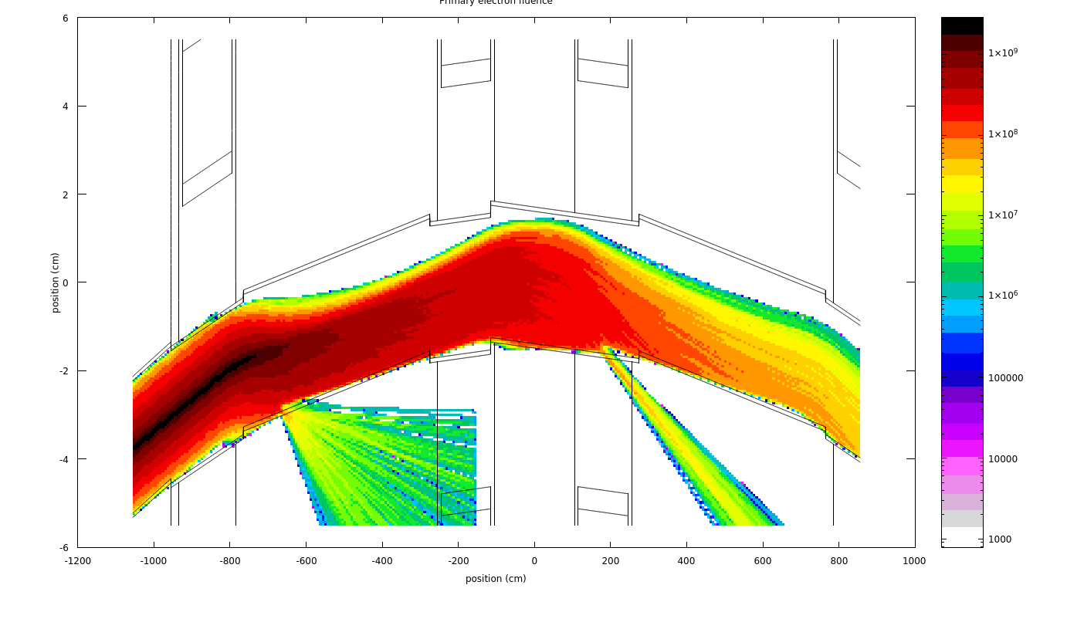
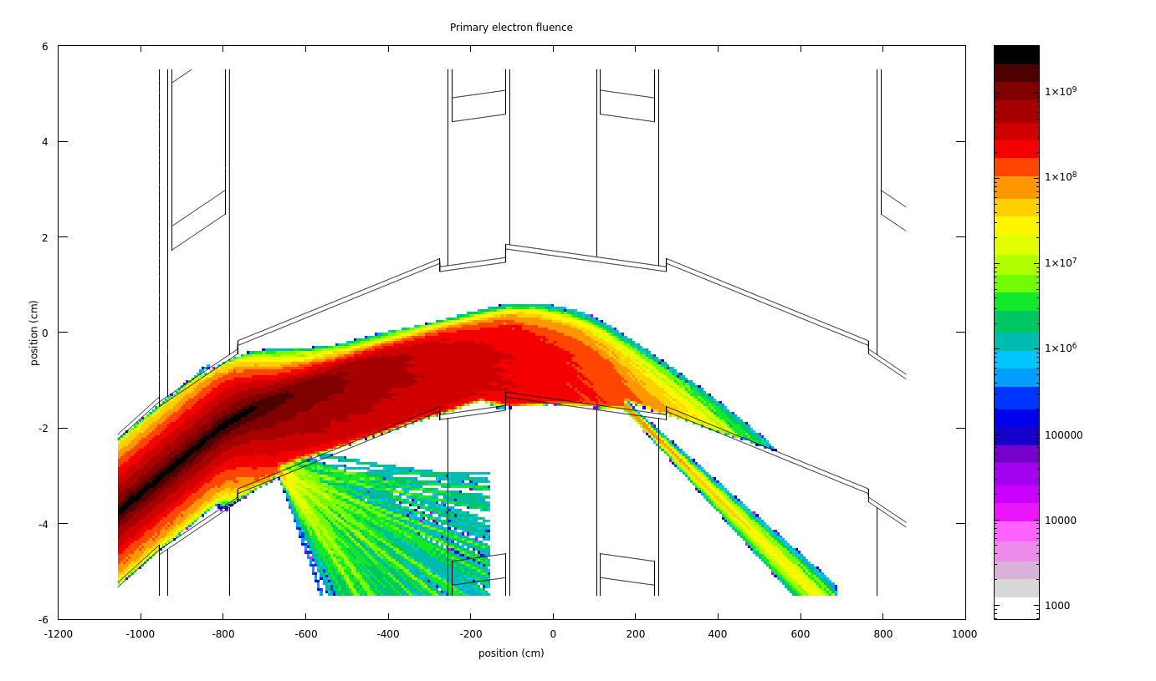

Source
Two separate sets of simulations, for the negative muon beam
Muon decaying inside the arc cell, simulated as a continuous lattice (steady state decay)
Muon decaying inside RF insertion, large power delivered to the first few magnets after the acceleration stage
$$E_{μ}=$$
750 GeV
1150 GeV
1500 GeV
To be conservative, show results for the highest energies and scale as if accelerator operated at those energies throughout.
Deep inside arc
First cell after RF insertion
Notes:
wrong highest energy
only for negative muon beam
put row description
- deep inside arc
- first cell after RF insertion

Slide 10
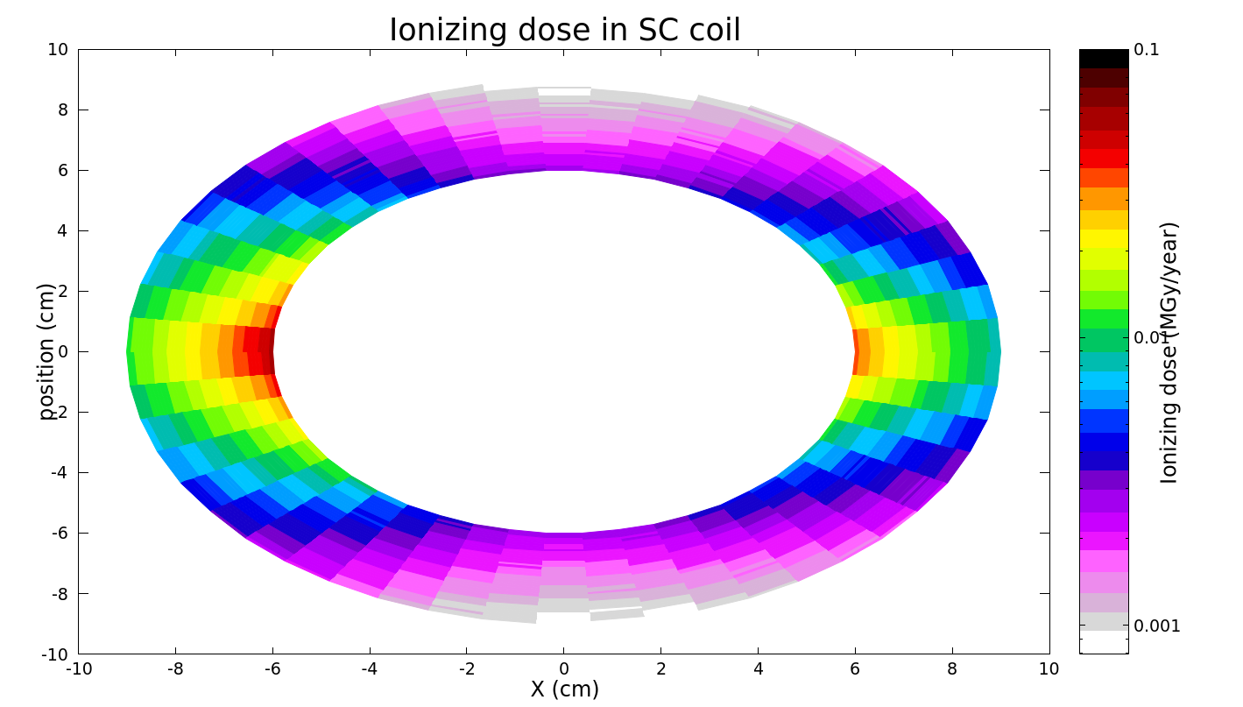
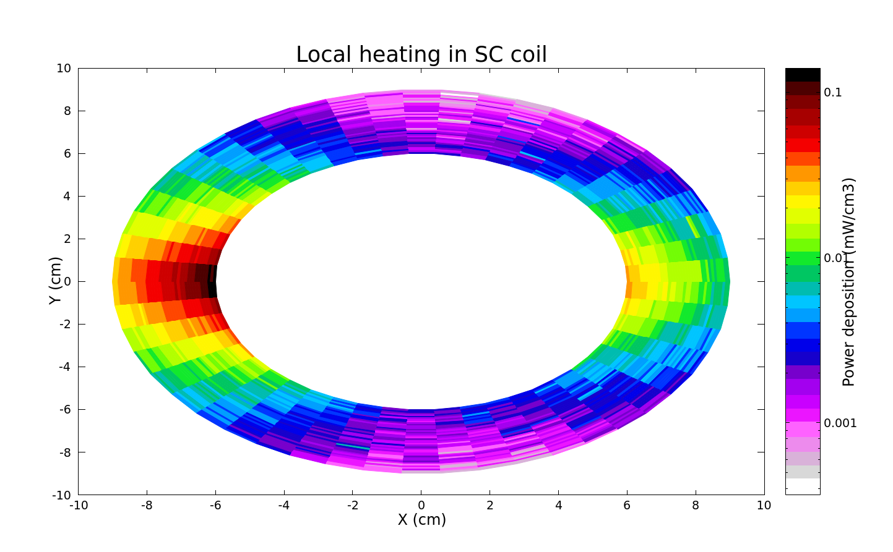


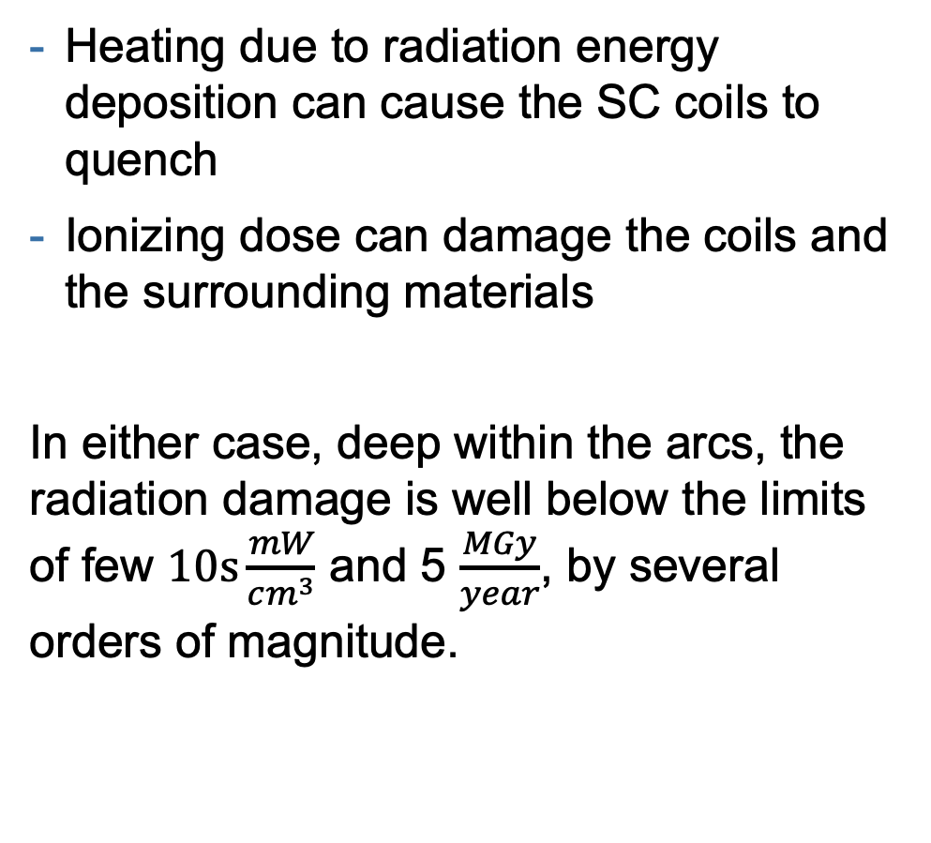
Radiation to SC coils – deep inside arc
Only $μ^{−}$ beam
Heating due to radiation energy deposition can cause the SC coils to quench
Ionizing dose can damage the coils and the surrounding materials
In either case, deep within the arcs, the radiation damage is well below the limits of few $10s\frac{mW}{cm^{3}}$ and 5 $\frac{MGy}{year}$, by several orders of magnitude.
For these conditions/materials:
$$1\frac{kW}{cm^{3}}≈1.4\frac{MGy}{year^{∗}}$$
Notes:
Recall shielding thickness, could be reduced deep within cell

Slide 11
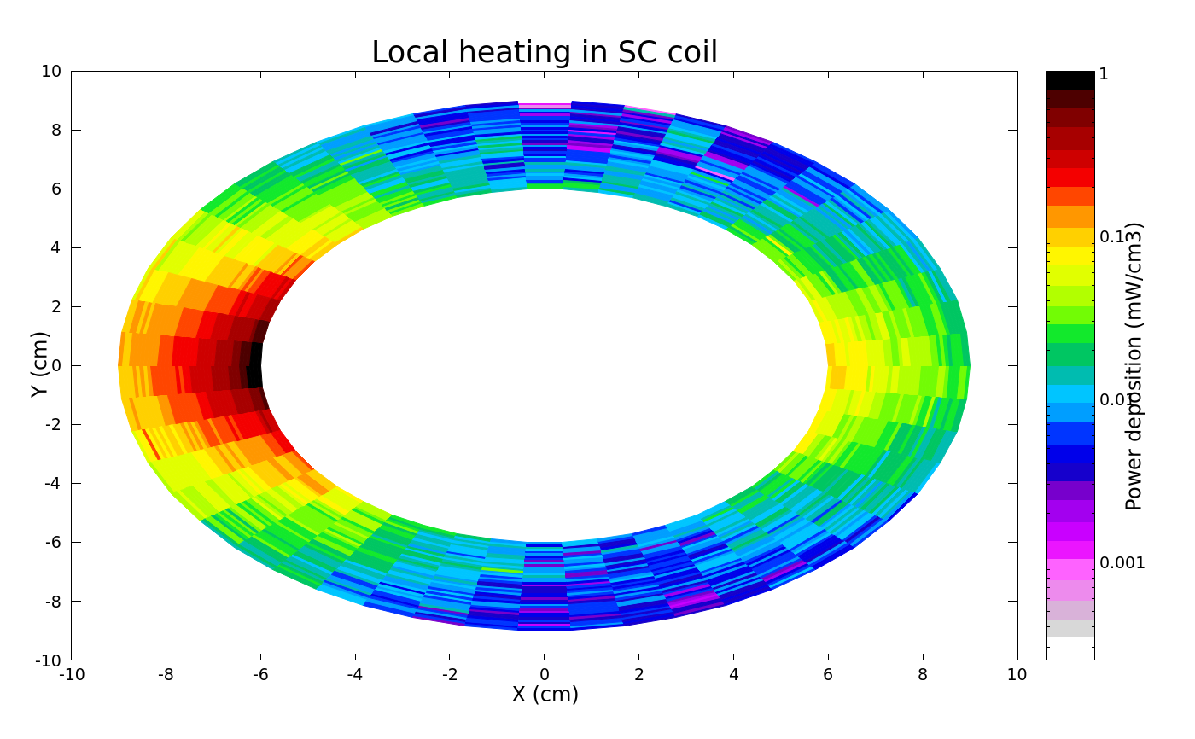
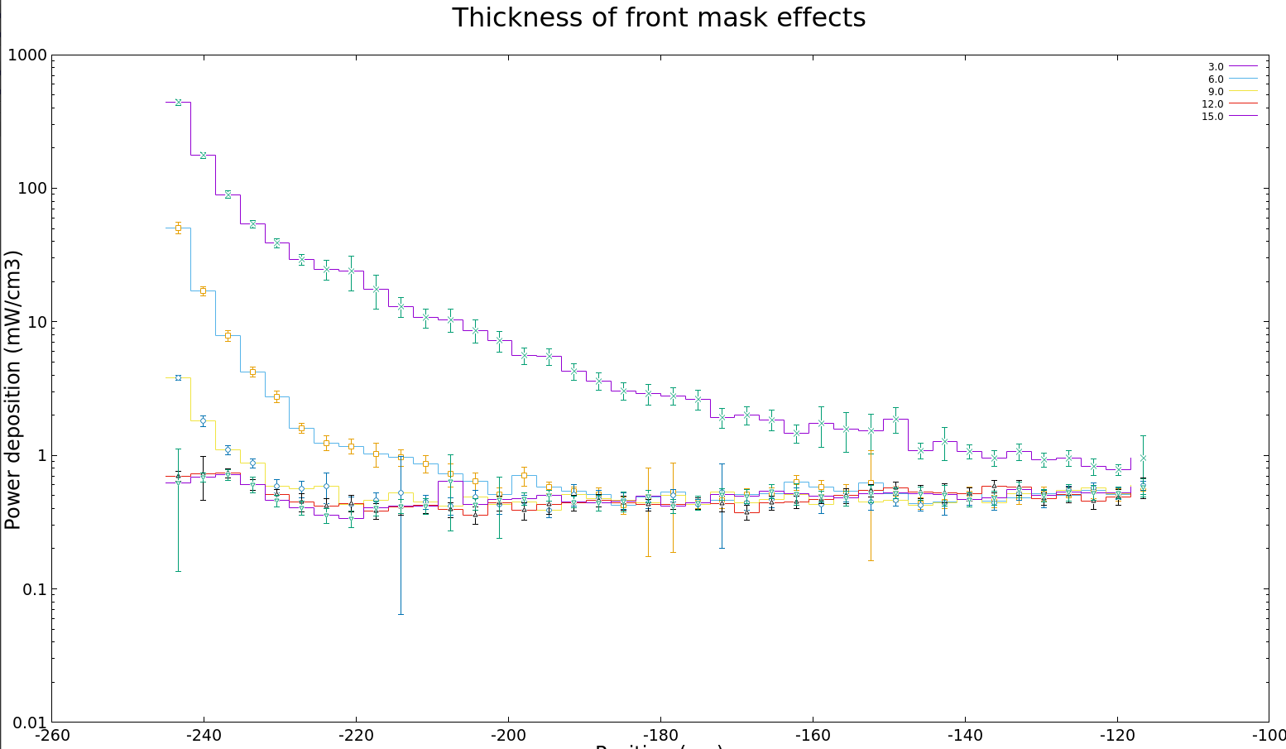
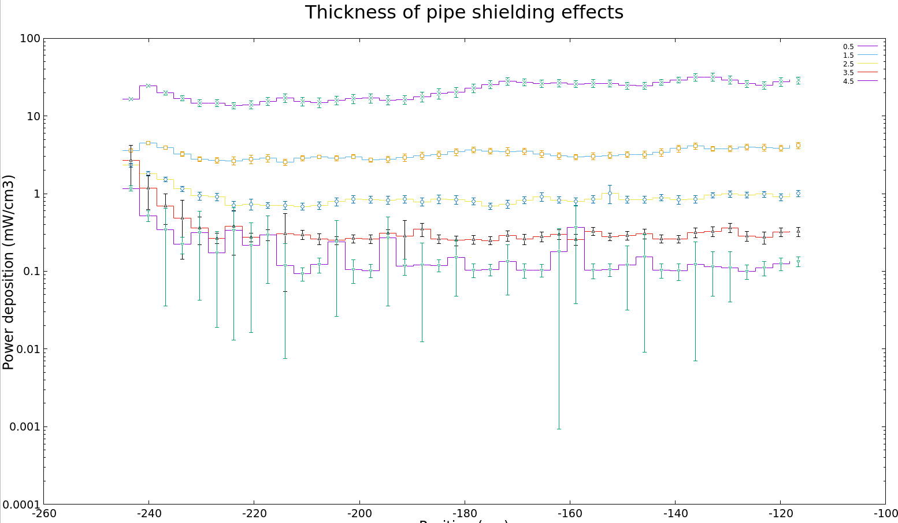
Radiation to SC coils – first cell after RF insertion
Only $μ^{−}$ beam
For the first magnet after the RF insertion, the radiation field is significantly more intense, but still within the limits.
Limited by yearly dose limits, but safe within the prescribed shielding.
Should be feasible as long as the front mask shield is kept deep (~7-10 cm) and the shielding around the beam pipe is at least 2-3 cm.
0.5
1.5
3.0
2.5
3.5
9.0
6.0
4.5
12.0
15.0

Slide 12
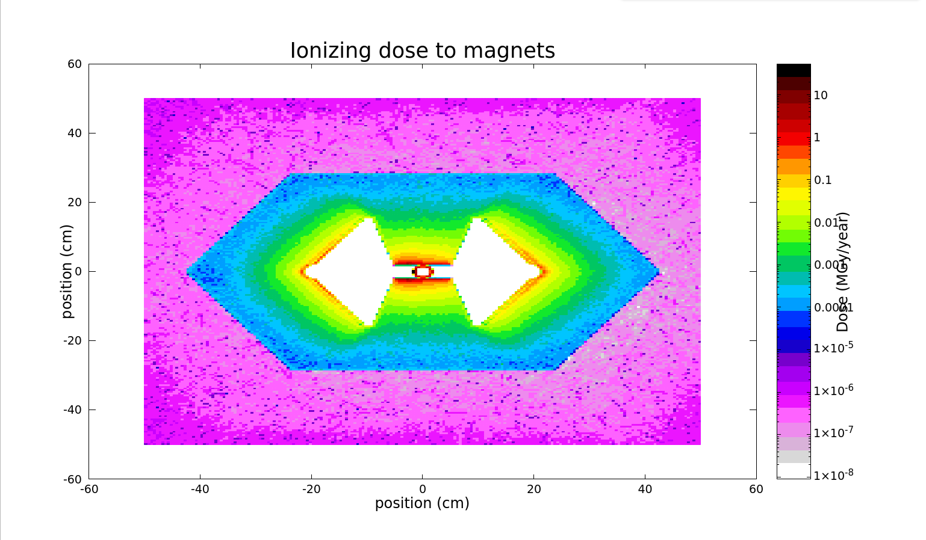
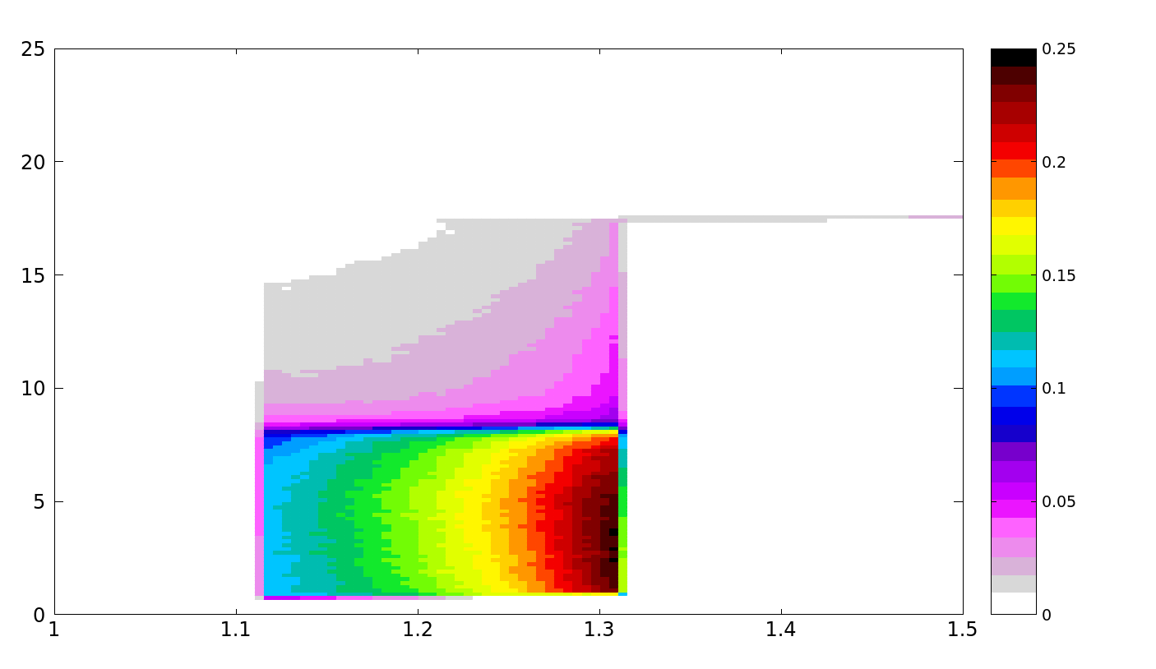
Radiation to NC coils - deep inside arc
Only $μ^{−}$ beam
NC magnets do not suffer from quenching, but high doses of radiation to the coils can degrade their operation.
Even without any shielding, the ionizing dose to the coils remains small (due to the larger distance from coil to beam).
Dose (MGy/year)
Notes:
add an arrow
tilt the plot
Change all scales

Slide 13
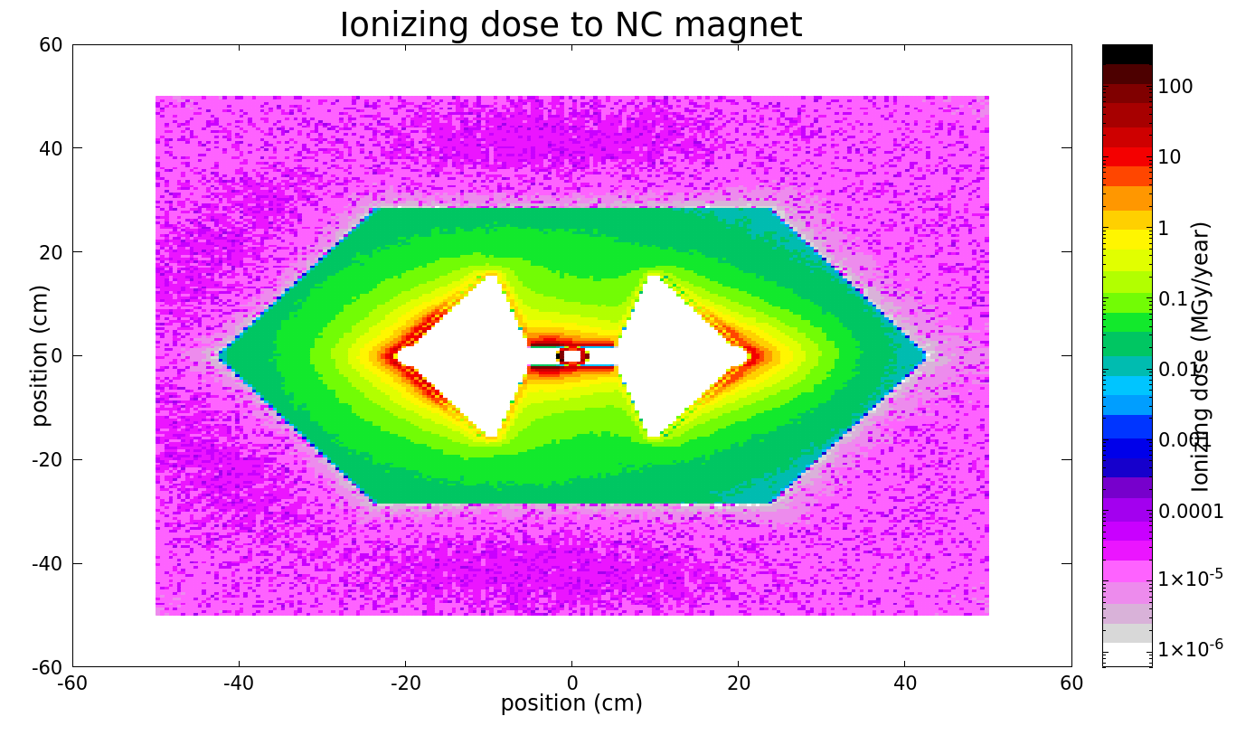
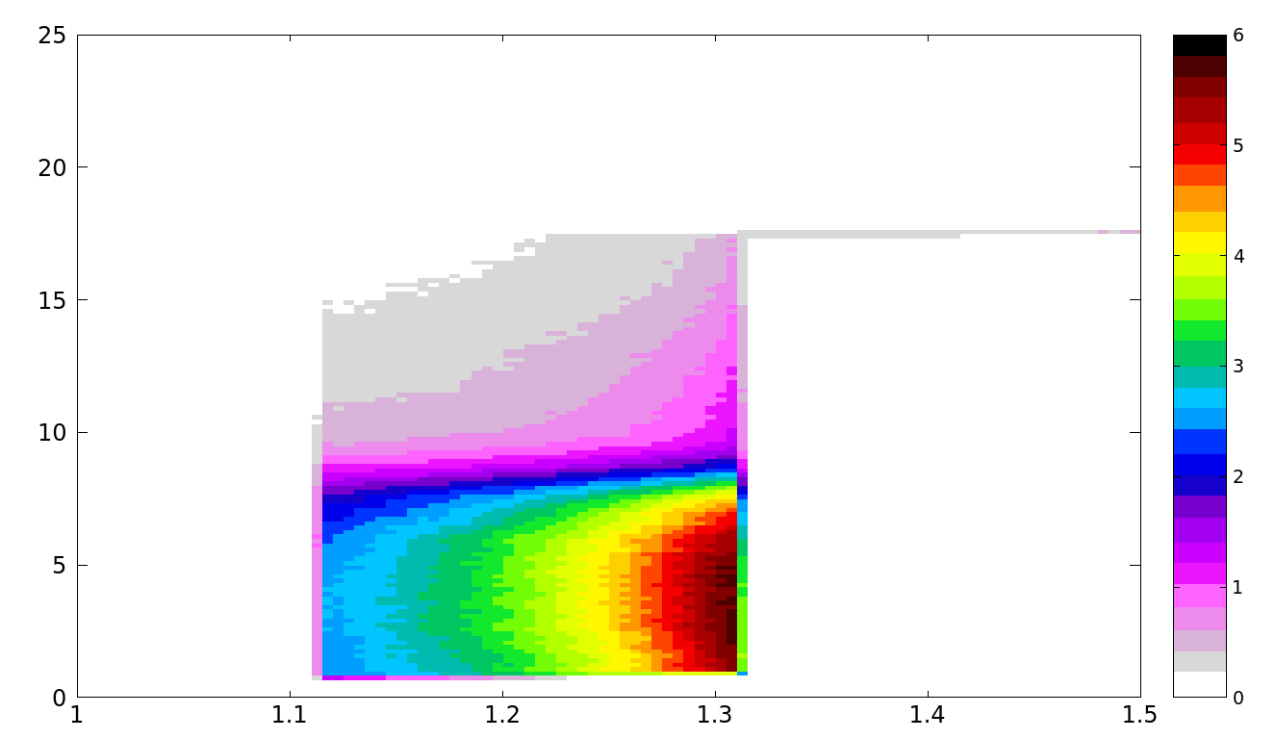
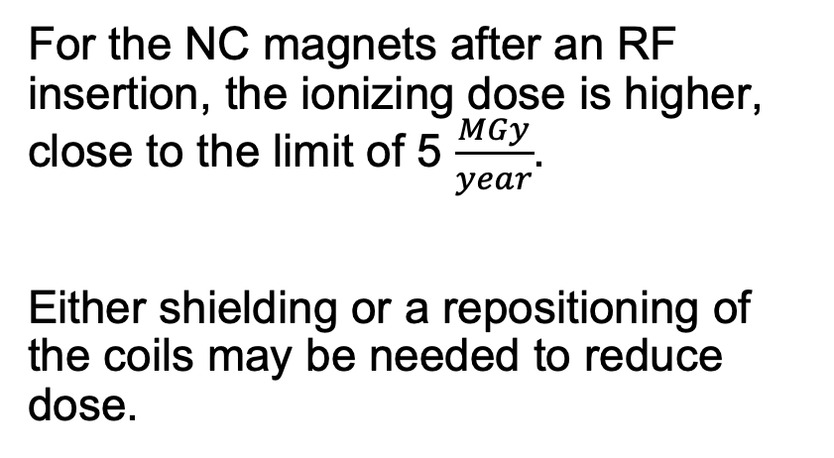
Radiation to NC coils - first cell after RF insertion
Only $μ^{−}$ beam
For the NC magnets after an RF insertion, the ionizing dose is higher, close to the limit of 5 $\frac{MGy}{year}$.
Either shielding or a repositioning of the coils may be needed to reduce dose.
Dose (MGy/year)
Notes:
add an arrow
tilt the plot
Change all scales

Slide 14
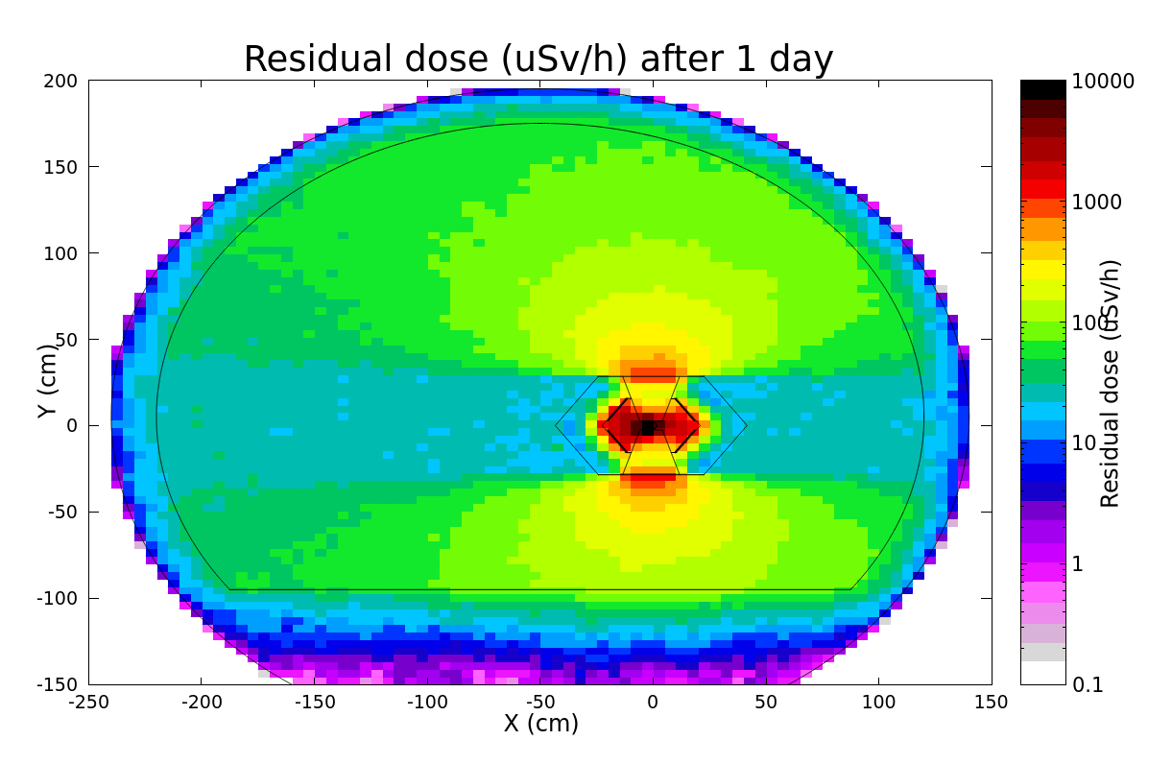
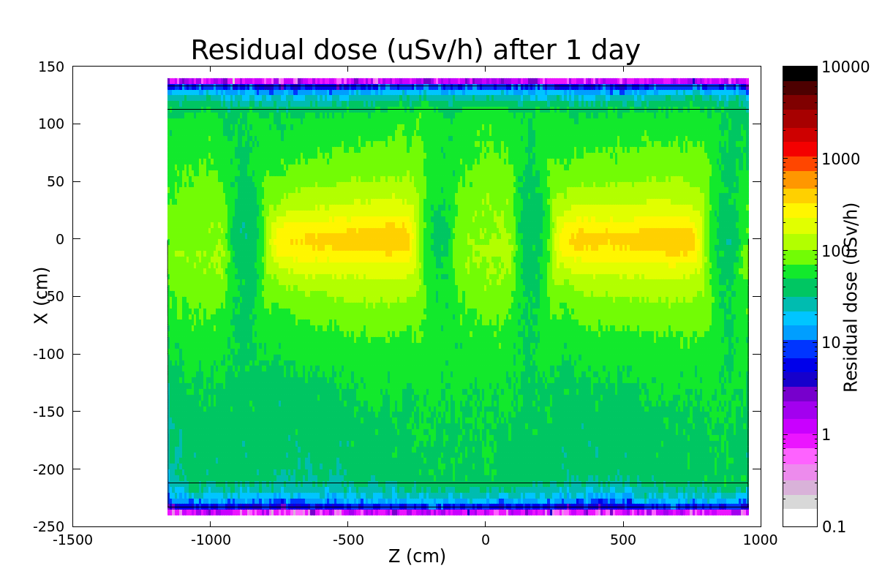
Co60 production
Photonuclear effects can generate an intense neutron radiation field in the cells. These neutrons can interact with the NC magnet yoke, which is composed of up to 50% of cobalt, and produce ⁶⁰Co.
We study an irradiation of 5 years of operations (140 days + 225 days shutdown), with cooldown times of 1 day, 1 month, 6 months, and 1 year
We consider two beams.
The yoke provides considerable self shielding, so the highest dose is received just above the cobalt yoke.
Quadrupole magnet is simulated as vacuum, in reality some shielding would be provided.
Notes:
X profile

Slide 15
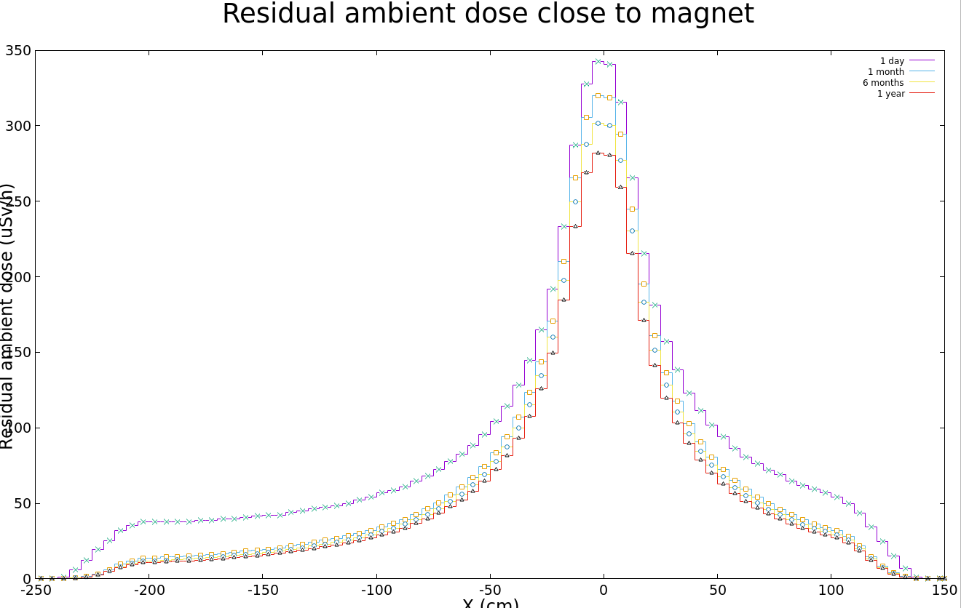
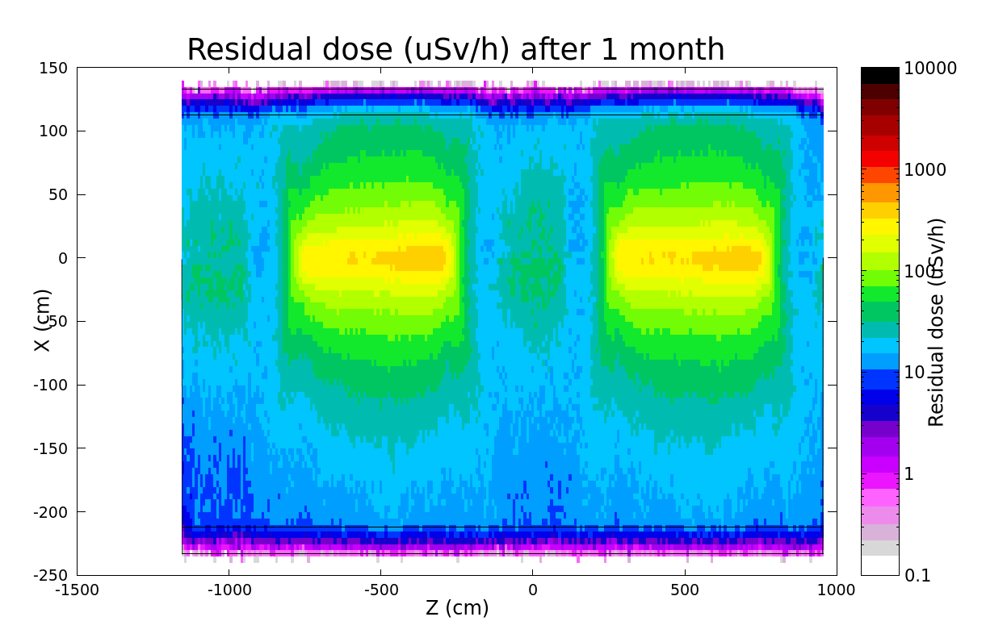
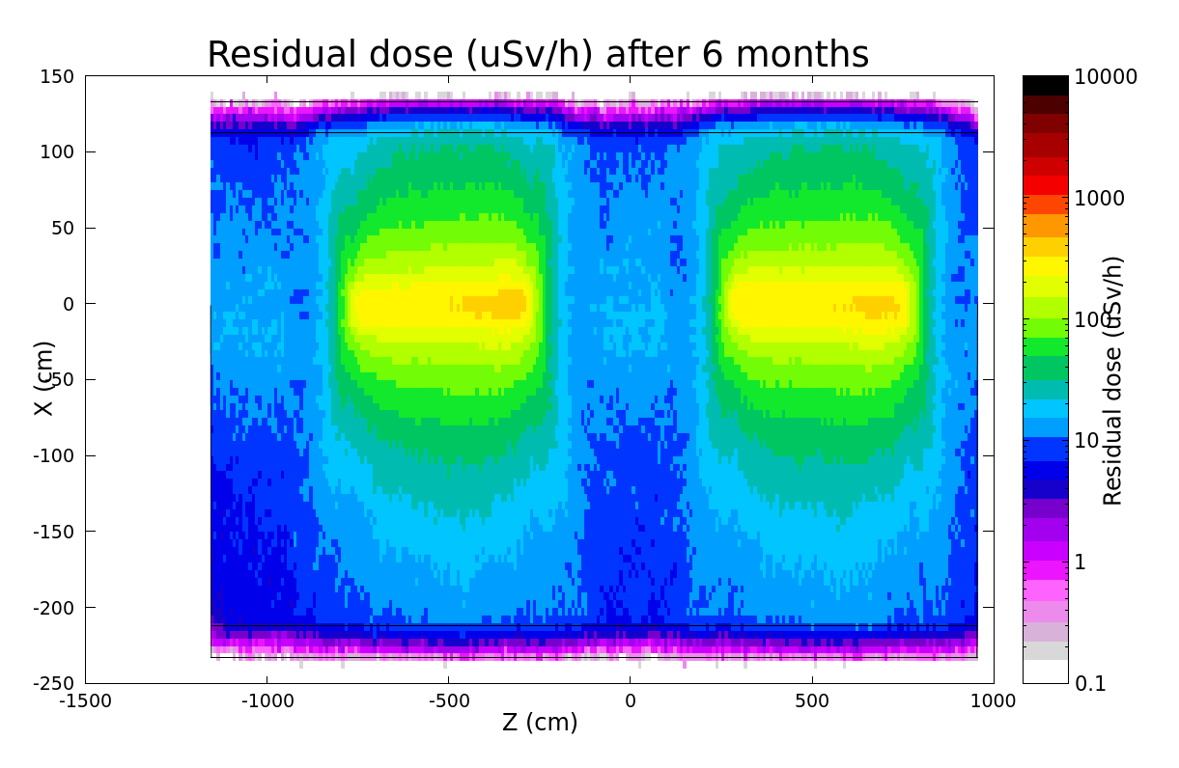
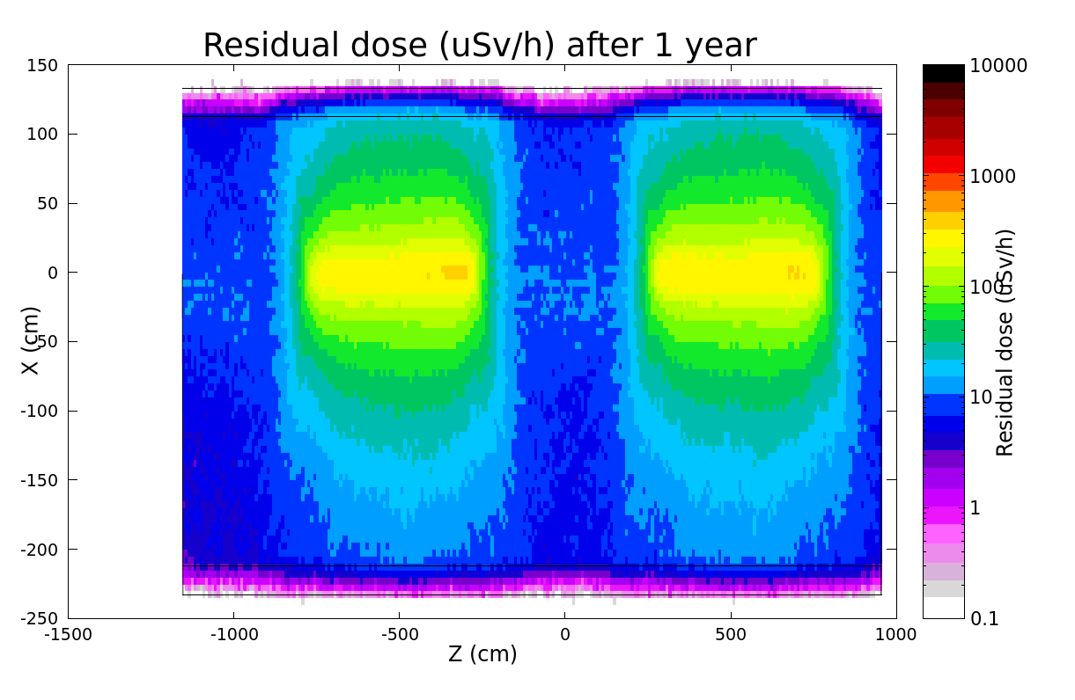
Residual dose rates
After a period of cooling down, the ambient dose of ~30 uSv/h in the vicinity of the NC magnet (40 cm from surface).
These values are comparable to the doses observed in the collider ring.
40 cm from magnet
magnet
Notes:
X profile

Slide 16
Conclusions
Radiation load to the magnets:
The ionizing dose to the normal conducting coils remains acceptable deep in the arcs; shielding might be needed for the first cell after the RF insertion
The ionizing dose to the superconducting coils requires shielding of at least 2 cm around the beam pipe and 10 cm of front shielding.
Radiation protection:
First preliminary studies showed that the residual dose levels of the NC magnets are significant
Nevertheless, at a distance of 40 cm from the magnets they are not significantly higher than in the collider ring
Further aspects need to be studied (e.g. radioactive waste production) in order to give a conclusive answer if such a high cobalt content is acceptable
Notes:
- SC coils power deposition

