Slide 1
HTS pulsed magnet concept & detailed studies
Henryk Piekarz
Accelerator Research Department
Fermilab, Batavia, Illinois 60510, USA
OUTLINE:
Conceptual design of HTS rapid-cycling magnet
Arrangement of HTS power cable
Power test of FNAL fast cycling HTS magnet
Upgraded core design & HTS hysteresis simulation
Upgraded HTS cable design & placement within core
Tentative projections of required cryogenic power
Thermal response of HTS conductor in normal operation and quench
Summary and conclusions

Slide 2
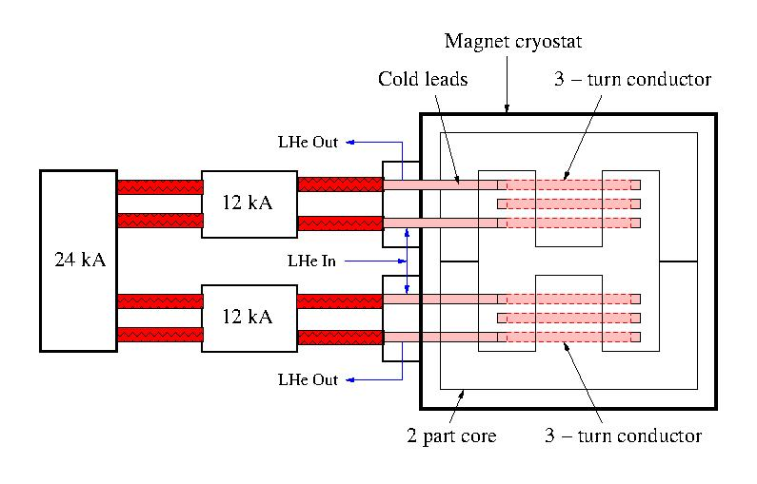
RCS HTS magnet conceptual design
Magnet main characteristics
Magnet core inside the cryostat
Dual 3 – turn HTS coil cooled with
supercritical helium
Current lead ends with spliced HTS tapes cooled through heat conduction from the conductor coil
Magnet core LCW cooling is provided into
interior of magnet cryostat
No vacuum beam pipe:
For oval SS vacuum pipe: 30 mm x 100 mm,
1.65 mm wall (Main Injector, Fermilab)
eddy currents heat is 9.5 kW/m with 1.8 T
@ 5 ms-5 Hz pulse. Temp. rise ~ 7 K/s-m.
Ceramic vacuum pipe option:
Typical wall 5 mm increases gap/current
30 % and power loss 80 %.
12 kA current supplies energize dual 3-turn conductor
to 36 kA generating 1.8 T in the 30 mm beam gap.
With power supply based on 960 µF capacitor bank the discharge voltage is 400 V @ 6000 T/s. Both, conductors and current leads can be made to withstand > 1 kV.

Slide 3
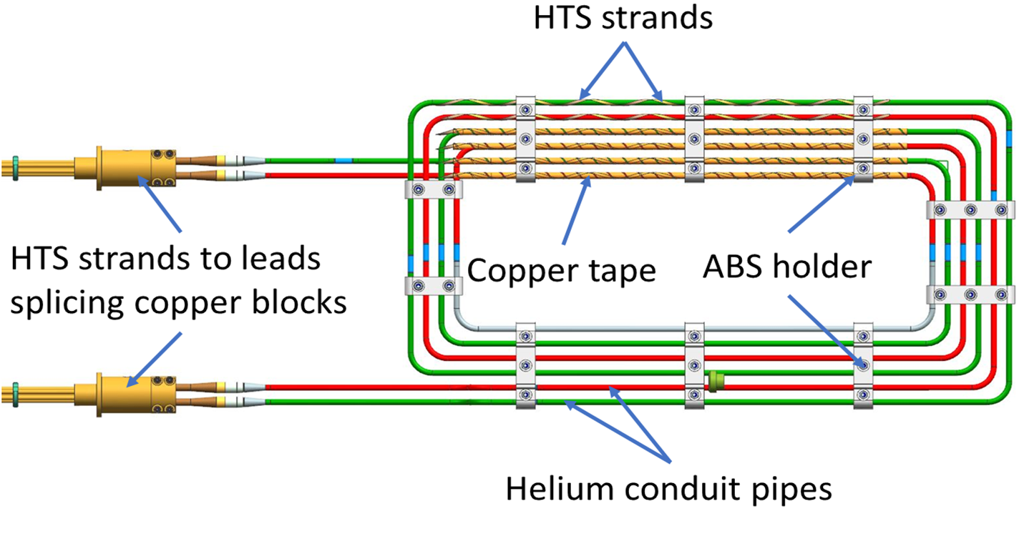
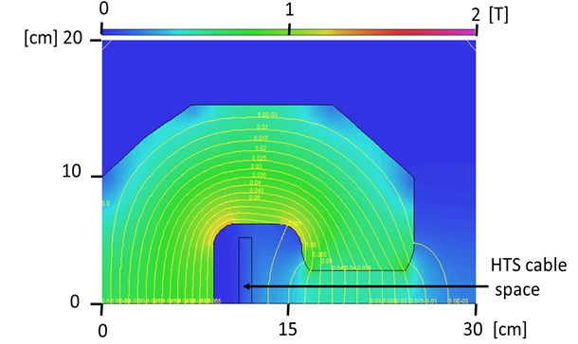
Arrangement of FNAL HTS Fast Cycling Test Magnet
Power cable split to 2 parallel sub-cables, each 0.5 kA
YBCO tapes (2.5 mm x 0.1 mm) wrapped at 10 cm pitch
over helium conduit pipe (316LN, OD 9 mm, wall 0.5 mm).
Copper tape (12.5 mm x 0.1 mm) wrapped @ 5 cm pitch.
ABS holders/spacers hold together cable structure and
secure its position within magnet core cable space.
MLI wrapped over cable assembly between ABS holder.
Conductor coil placed within magnet core cable space of magnetic field less than 5% of that in the beam gap. The 0.4 T beam gap field leads to 0.02 T through cable space.

Slide 4
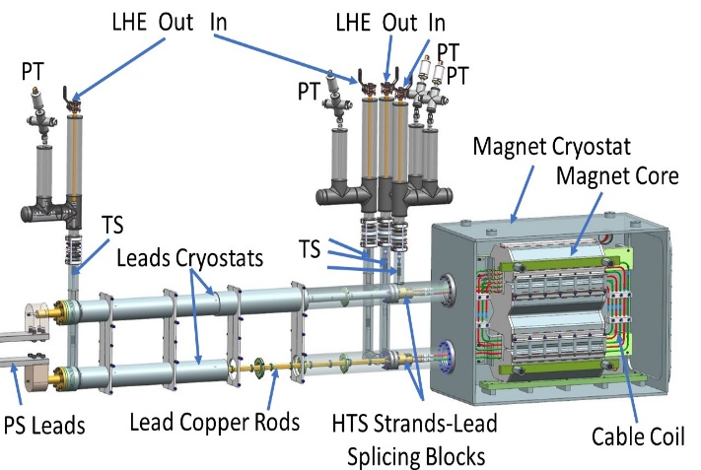
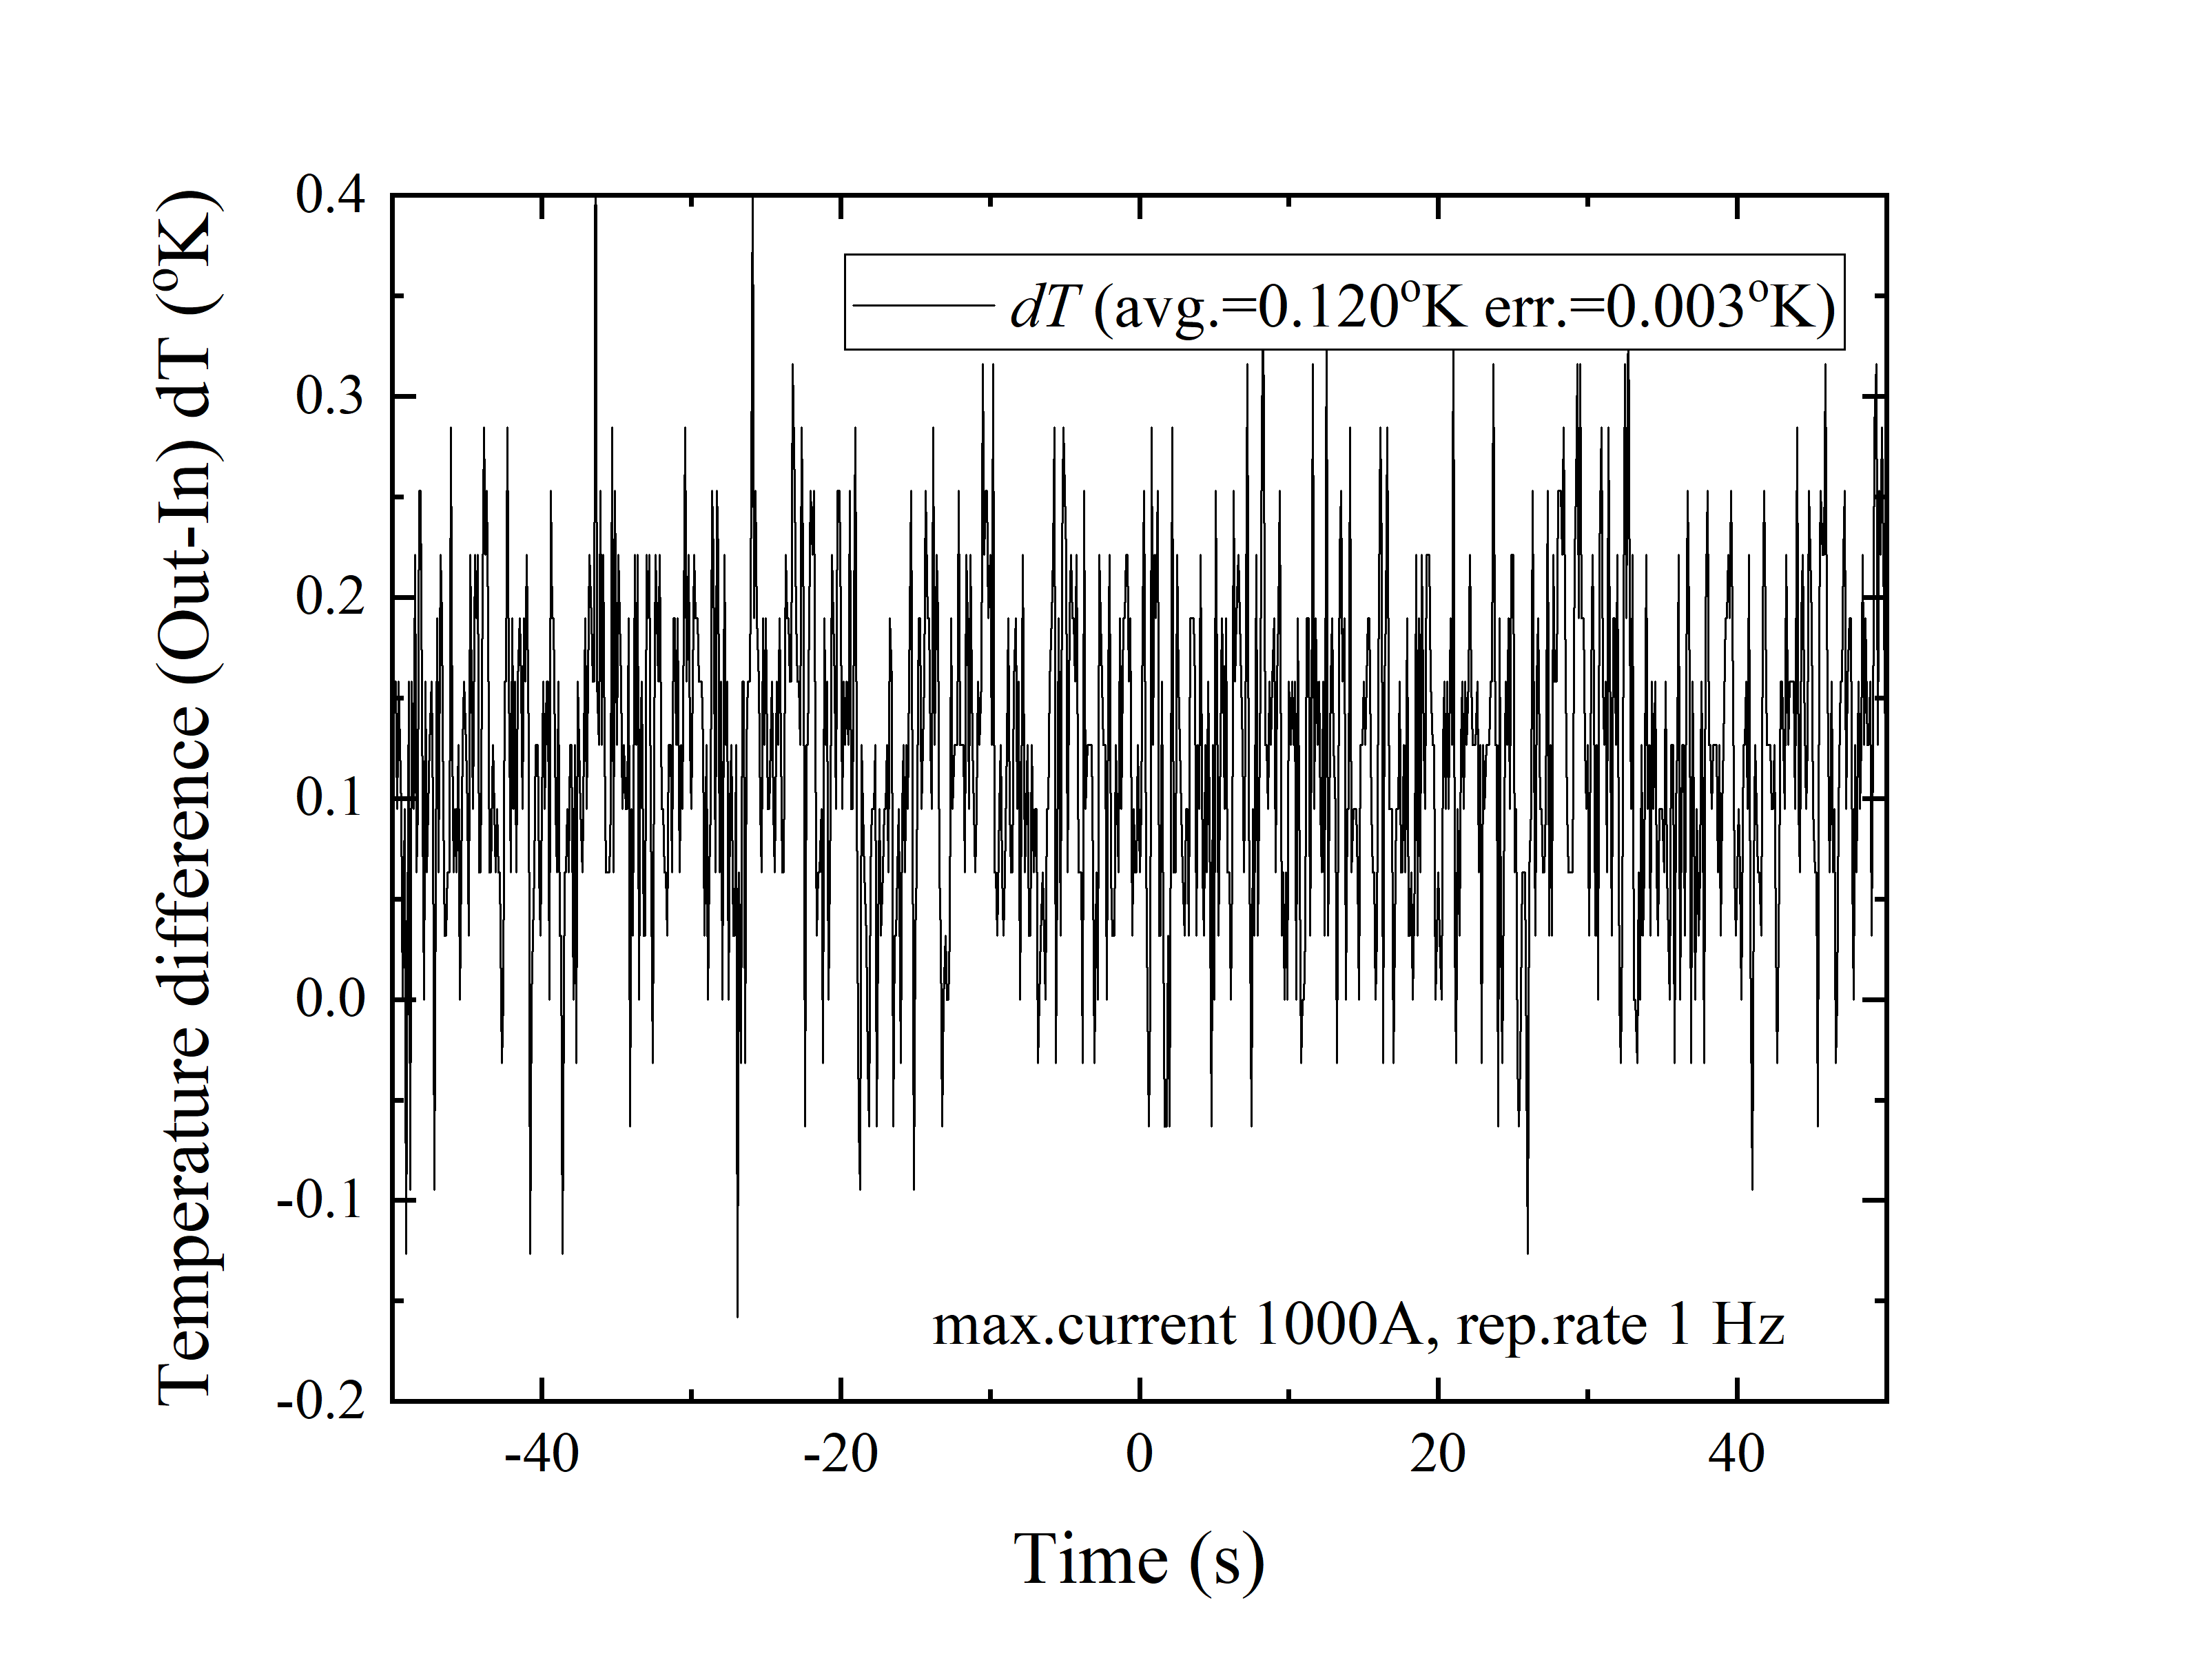
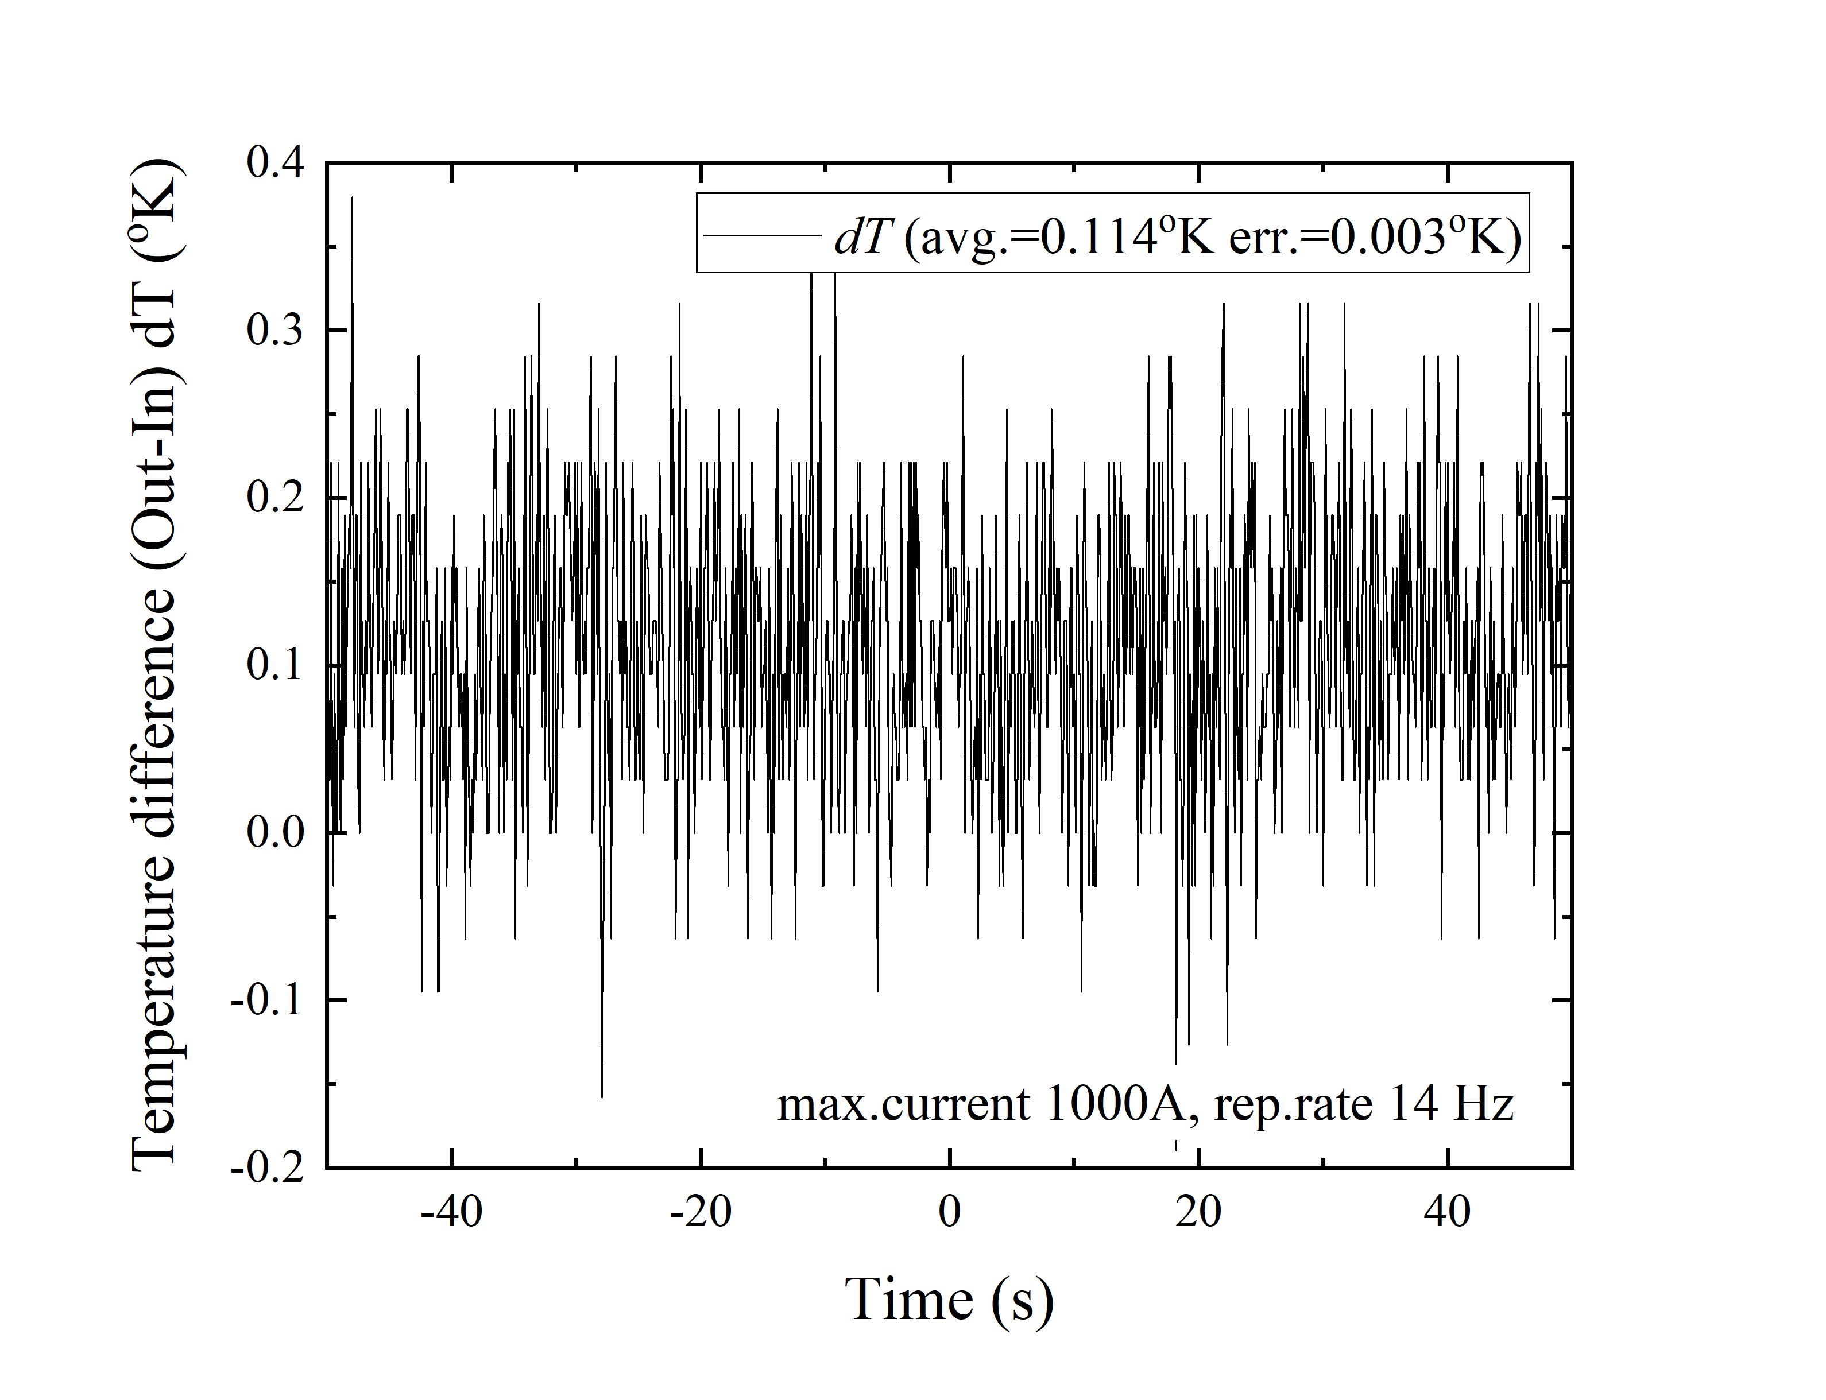
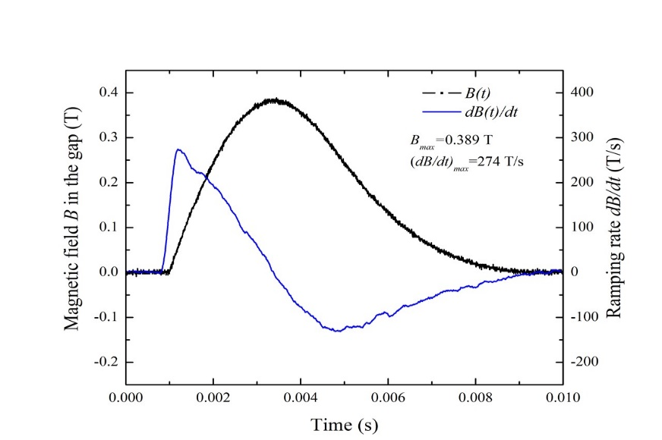
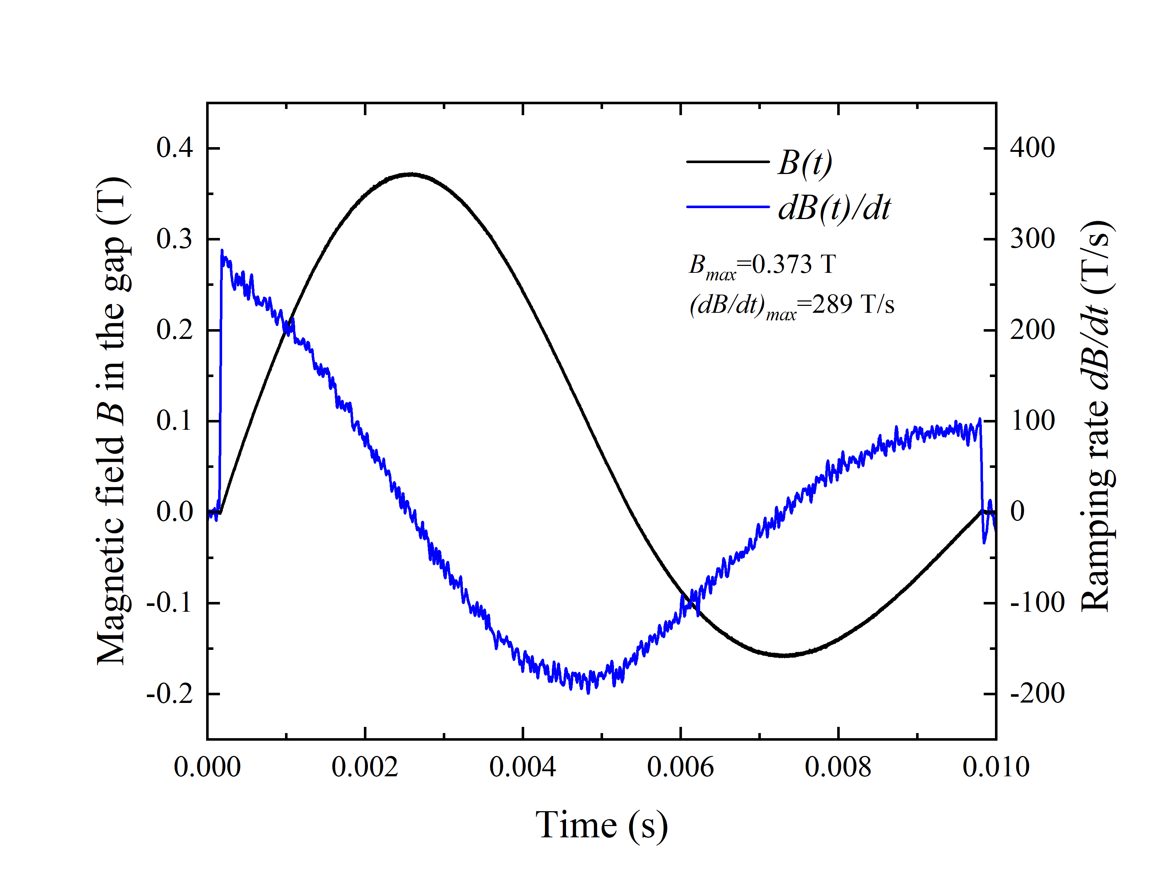
FNAL HTS Fast Cycling Magnet Power Test
Measured: ΔT _{He} (Out – In), P _{He} & F _{He} @ 1 Hz & 10 Hz.
ΔT _{He} (10 Hz – 1 Hz) ) < 0.003 K (measurement error).
Magnet power parameters and loss estimate:
I _{Magnet} : 3 kA (50 % of I_{C} ), t _{Ramp} = 2.6 10⁻³ s.
dB/dt gap 300 T/s, dB/dt cable space 16 T/s.
LHe coolant: 5.5 K, 0.28 MPa, 2.5 g/s.
Power loss, Q, determined using change of
helium enthalpy:
For ΔT _{He} < 0.003 K: Q _{CABLE} < 0.06 W/m *)
Test magnet unipolar & bipolar B-field wave-forms
*) H. Piekarz, B. Claypool, S. Hays, M. Kufer, V. Shiltsev, MT-27 (2022)

Slide 5
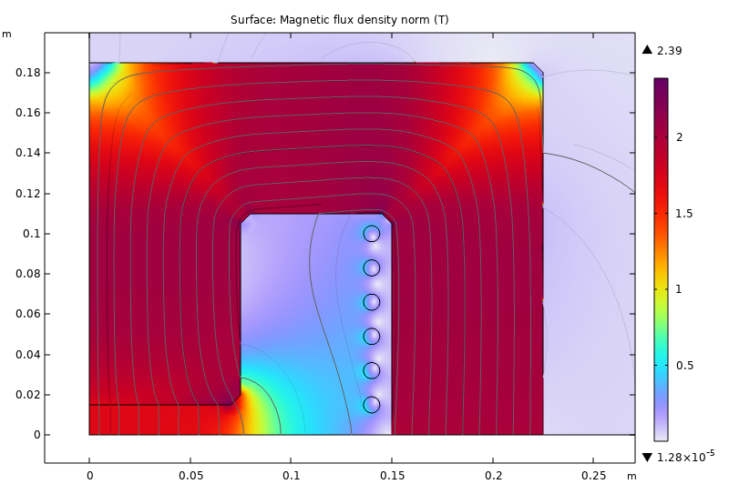
HTS conductor hysteresis loss simulation for Muon RCS magnet *)
+36 kA
+1.71 T
-1.71 T
1 kT/s ramp
-36 kA
B _{max} : 1.7 T, <B _{Cable} > : 0.19 T
t _{rise} : 1.6 10⁻³ s, t _{pulse} = 6 10⁻³ s
<dB/dt> _{Cable} = 119 T/s
Q _{cable} = 30 J/m-pulse
Q _{cable} = 5 kW/m-pulse
DF @ 5 Hz = 5Hz x 3 10⁻³ s = 0.015
Q _{cable} = 75 W/m-cycle
Q _{ELEC-CYCLE} = 5.3 kW/m @ 15 K
Upgraded cable/core arrangement:
Magnet gap: 30 mm x 100 mm
Conductor: 6 sub-cables per ¼ magnet
Sub-cable: 12 x 2 mm HTS tapes
Total HTS tapes/magnet: 288
Cold pipe conduit: 9 mm OD, 0.5 mm wall
*) S. Otten, A. Cario, H. ten Kate, Univ. of Twente

Slide 6
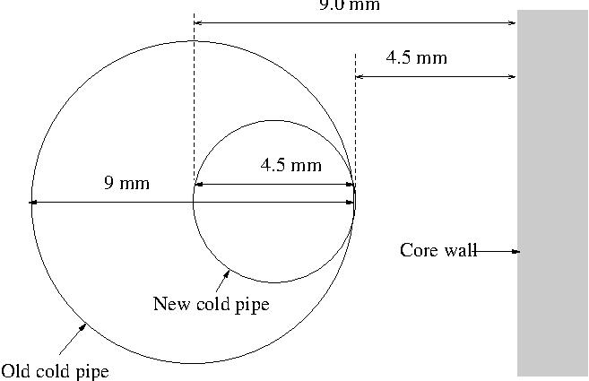
Upgraded Muon RCS magnet cable design & position
BASIC PARAMETRS OF HTS RCS MAGNET
Baseline - 1 m magnet | FNAL Test | UT/CERN | FNAL
HTS Cross-section [mm²] Number of HTS tapes Length [m] Volume [m³] Mass [g] | YBCO 0.25 12 6.6 22.5 10⁻⁷ 20.5 | YBCO 0.20 144 13.2 270 10⁻⁷ 246 | YBCO 0.20 144 13.2 270 10⁻⁷ 246
Cryogenic pipe Diameter x wall [mm x mm] Length [m] Volume [m³] Mass [g] | 316LN 9 x 0.5 6 73 10⁻⁶ 569 | 316LN 9 x 0.5 12 73 10⁻⁶ 1138 | 316LN 4.5 x 0.1 12 14.6 10⁻⁶ 228
Copper tape Cross-section [mm²] Length [m] Volume [m³] Mass [g] | CDA102 1.25 18 15 10⁻⁵ 107 | CDA102 1.25 36 30 10⁻⁵ 214 | CDA102 1.25 36 30 10⁻⁵ 214
Total cable Volume [m³] Mass [g] | 88 10⁻⁶ 676 | 400 10⁻⁶ 1598 | 342 10⁻⁶ 688
Based on field simulations*) we tentatively project that B-field through cable space can be reduced by ½ with cryo-pipe size reduced by ½ and placed much closer to the core, as indicated in figure above.
Such arrangement will likely reduce hysteresis losses by factor 4. In the new cable design HTS tapes are wound in 2 layers at an opposite angle to minimize self-field coupling.
*) F. Boattini et al., MC Magnet Working Group, 2/15/24
S. Otten et al., MC Magnet Working Group, 3/13/24

Slide 7
Projected HTS conductor hysteresis loss & cryogenic power
CABLE PARAMETERS FNAL TEST UT/CERN FNAL RCS I FNAL RCS II
He temperature [K] 5.5 15 15 5.5
He pressure [MPa] 0.28 2.0 2.0 0.28
He specific gravity [kg/m3] ~ 68 ~ 68 ~ 68 ~ 68
He inventory [L/m] 0.95 1.9 1.9 0.95
Magnet gap field [T] 0.4 1.7 1.7 1.7
Ramp rate [T/s] 300 5000 5000 5000
Cable field [% gap] 4 12 6 6
Cable ramp rate [T/s] 12 120 60 60
Pulse frequency [Hz] 10 5 5 5
Cable hysteresis loss/cycle [W/m] < 0.053 302 75 15
Cold pipe eddy loss/cycle [W/m] < 0.007 0.06 0.015 0.003
Cable loss/cycle [W/m] < 0.060 302 75 15
He flow rate [g/s-m] 2.5 13.5 3.375 0.675
COP factor [%] - 5 5 1.9
Minimum cryogenic power [kW/m] - 6 1.5 0.79
Cryogenic plant power *) [MW] - 48 12 3.1
*) Accelerator ring 2000 m, Cryogenic plant efficiency 25 %

Slide 8
Thermal response of HTS conductor in normal operation & quench
Heat exchange parameters | UT/CERN RCS | FNAL RCS
Normal operations, Δ T_{RISE} 1 K
HTS tapes -> copper shield Contact surface area [m²] Thermal conductivity [kW/m-K] Transverse thermal diffusivity [K/s] | 28.3 x 10⁻³ 20 5 10⁵ | 14.2 10⁻³ 10 10⁶
Copper shield <-> cold pipe/helium Contact surface area [m²] Thermal conductivity [W/m-K] Transverse thermal diffusivity [K/s] Return time to normal operation [s] | 28.3 x 10⁻³ 22.6 1.4 0.7 | 14.2 10⁻³ 56.5 7 0.14
Quench, ΔT_{RISE} 10 K
Copper shield <-> cold pipe/helium Transverse thermal diffusivity [K/s] Minimal return time to normal operation [s] | 14 0.2 | 70 0.04

Slide 9
Summary & Conclusions
Upgraded HTS cable design/placement is an encouraging indication for possible further minimization of power loss.
Operation with supercritical helium of 5.5K, 0.28 MPa is best
option for minimization of cryogenic power loss.
Lack of modeling of hysteresis loss in HTS conductor below
15 K is an impediment to a reliable power loss prediction.
A power test of a 1.8 T, dB/dt 5000 T/s short-sample magnet is needed to conclusively prove viability of HTS RCS magnet.

