Slide 1

RF parameter optimization in the high energy muon acceleration chain
Leonard Thiele (University of Rostock, CERN), Fabian Batsch
D. Amorim, R. Calaga, H. Damerau, M. Gast, A. Grudiev, I. Karpov, U. van Rienen, S. Udongwo

Slide 2
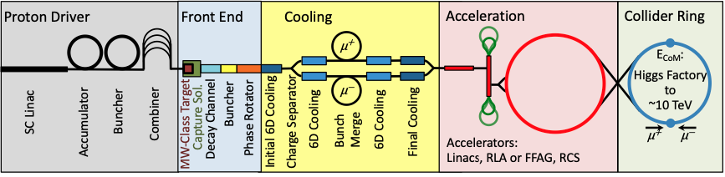
Content
General RF system design criteria
RF system requirements
Beam loading compensation
RF baseline parameters
Integration of RF computations into Python package
Cost estimate

Slide 3
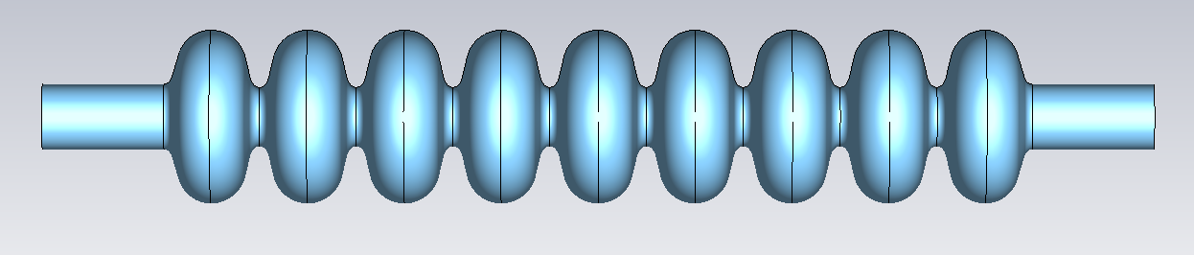
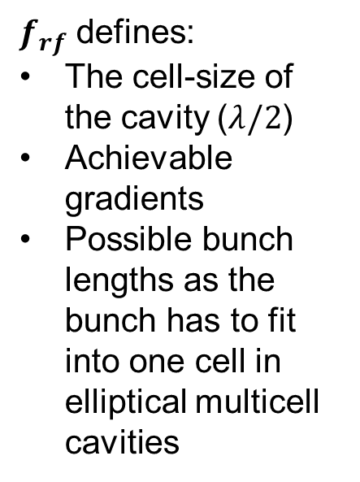
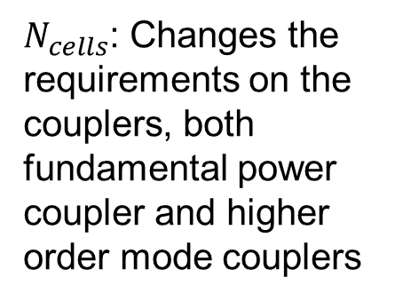
General design criteria for
RF systems I
$f_{rf}$ defines:
The cell-size of the cavity $\text{(}λ/2$)
Achievable gradients
Possible bunch lengths as the bunch has to fit into one cell in elliptical multicell cavities
Baseline 1.3 GHz 9-cell TESLA cavity
R/Q (geometric impedance):
Transverse and longitudinal parameters
Determine the interaction between the cavity fields and the particles.
For fundamental accelerating mode
  high R/Q desired
For higher order modes
  reduction of R/Q desired
Purely dependent on the cavity shape.
$N_{cells}$: Changes the requirements on the couplers, both fundamental power coupler and higher order mode couplers

Slide 4
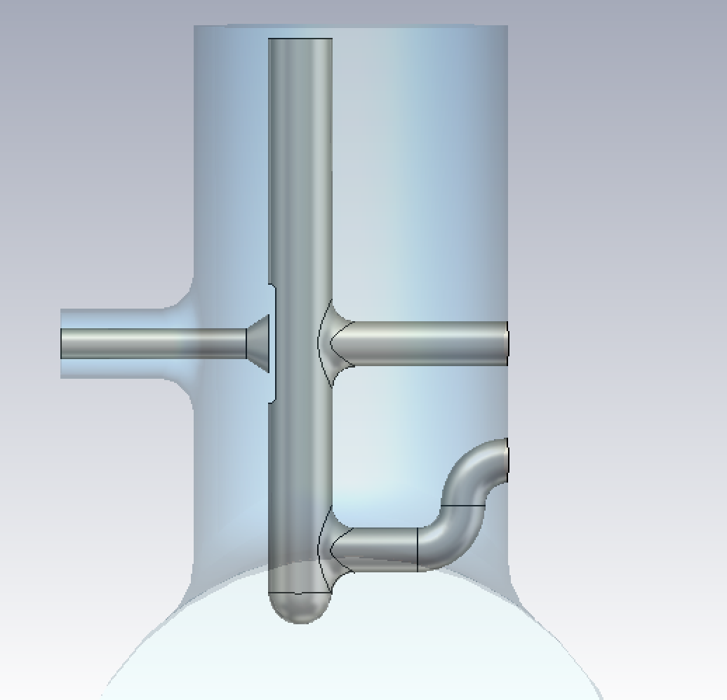
General design criteria for
RF systems II
Higher order modes (HOM) are unwanted resonances at higher frequencies which occur inside the cavity and are induced by the beam passage
Higher order mode quality factors are controlled through the design of (multiple) HOM couplers to reduce the negative impact on the beam (longitudinal and transverse)
Multiplication of R/Q and the quality factor yields the impedance and therefore magnitude with which the beam induces voltage
→ Requirements from transverse and longitudinal beam dynamics necessary as input for the design process of the cavity and couplers

Slide 5
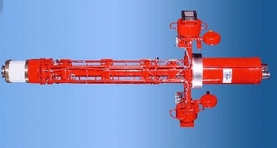
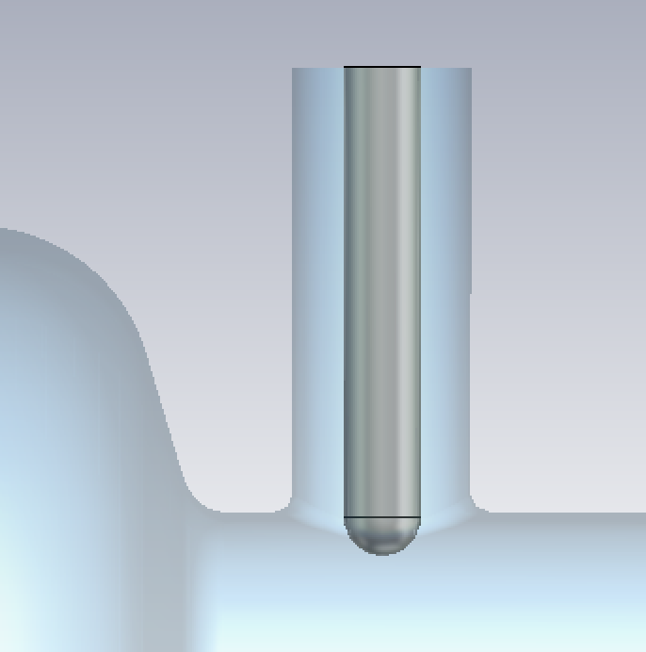
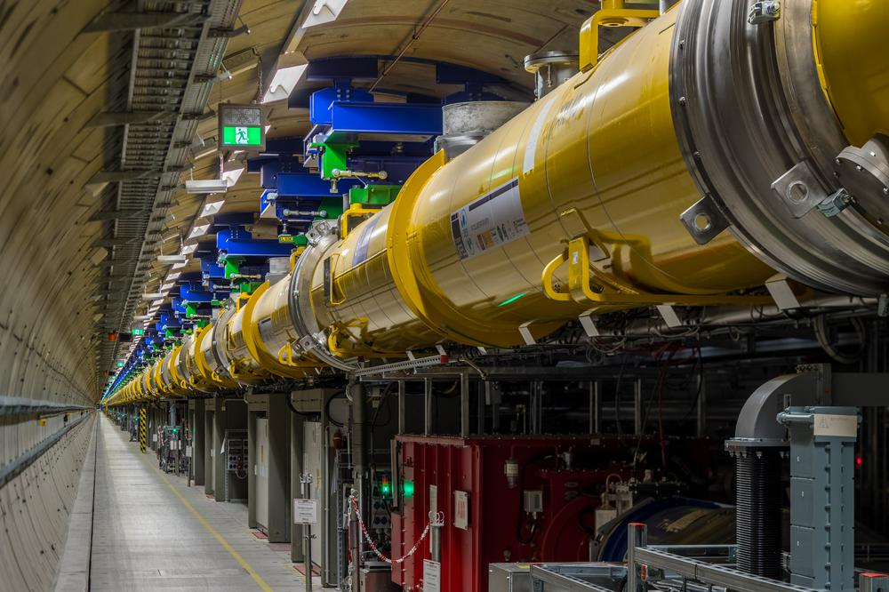
General design criteria for
RF systems III
Fundamental mode quality factor is dominated by the design of the fundamental power coupler (FPC):
Impacts long. beam dynamics via decay time of the beam induced field
Impacts power requirements and filling time of the cavity
MW class pulsed Klystrons and systems of waveguides to drive the cavities;
Klystron efficiency and distribution losses will add to the power consumption
Cryomodules and cryogenic plants to cool the cavities; integration into the tunnel/surface
From [4]

Slide 6
RF system requirements
Two counter-rotating beams with a single high-intensity bunch
  High transient beam loading
High energy gain to preserve muon lifetime
  High voltage per turn → high cavity gradient & large number of cavities
Short acceleration time
  Cavities will be operated in pulsed mode (duty cycle of a few %)
Beams must be kept stable during acceleration despite large synchrotron tune
  Separation of RF system into multiple stations all around the ring
RF-frequency swing will be required to compensate for changing orbit lengths in hybrid RCSs
  Fast reactive tuners necessary
Non-linear energy gain leads to the requirement for additional cavities
  The maximum number of cavities has to be installed but is not required during the full acceleration time.

Slide 7
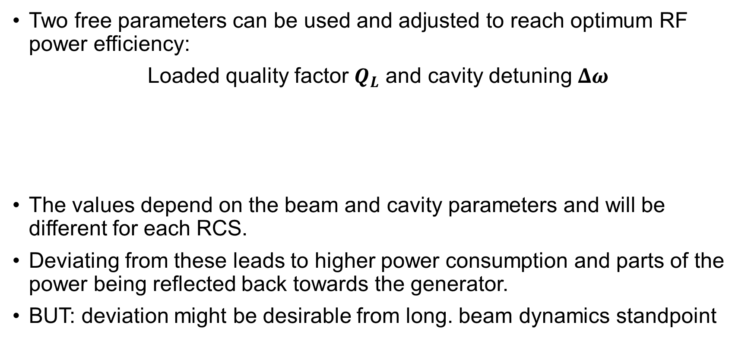
Beam loading compensation I
Two free parameters can be used and adjusted to reach optimum RF power efficiency:
Loaded quality factor $Q_{L}$ and cavity detuning $Δω$
The values depend on the beam and cavity parameters and will be different for each RCS.
Deviating from these leads to higher power consumption and parts of the power being reflected back towards the generator.
BUT: deviation might be desirable from long. beam dynamics standpoint
Reduces imaginary part of reflected and generator power
Reduces real part of reflected and generator power

Slide 8
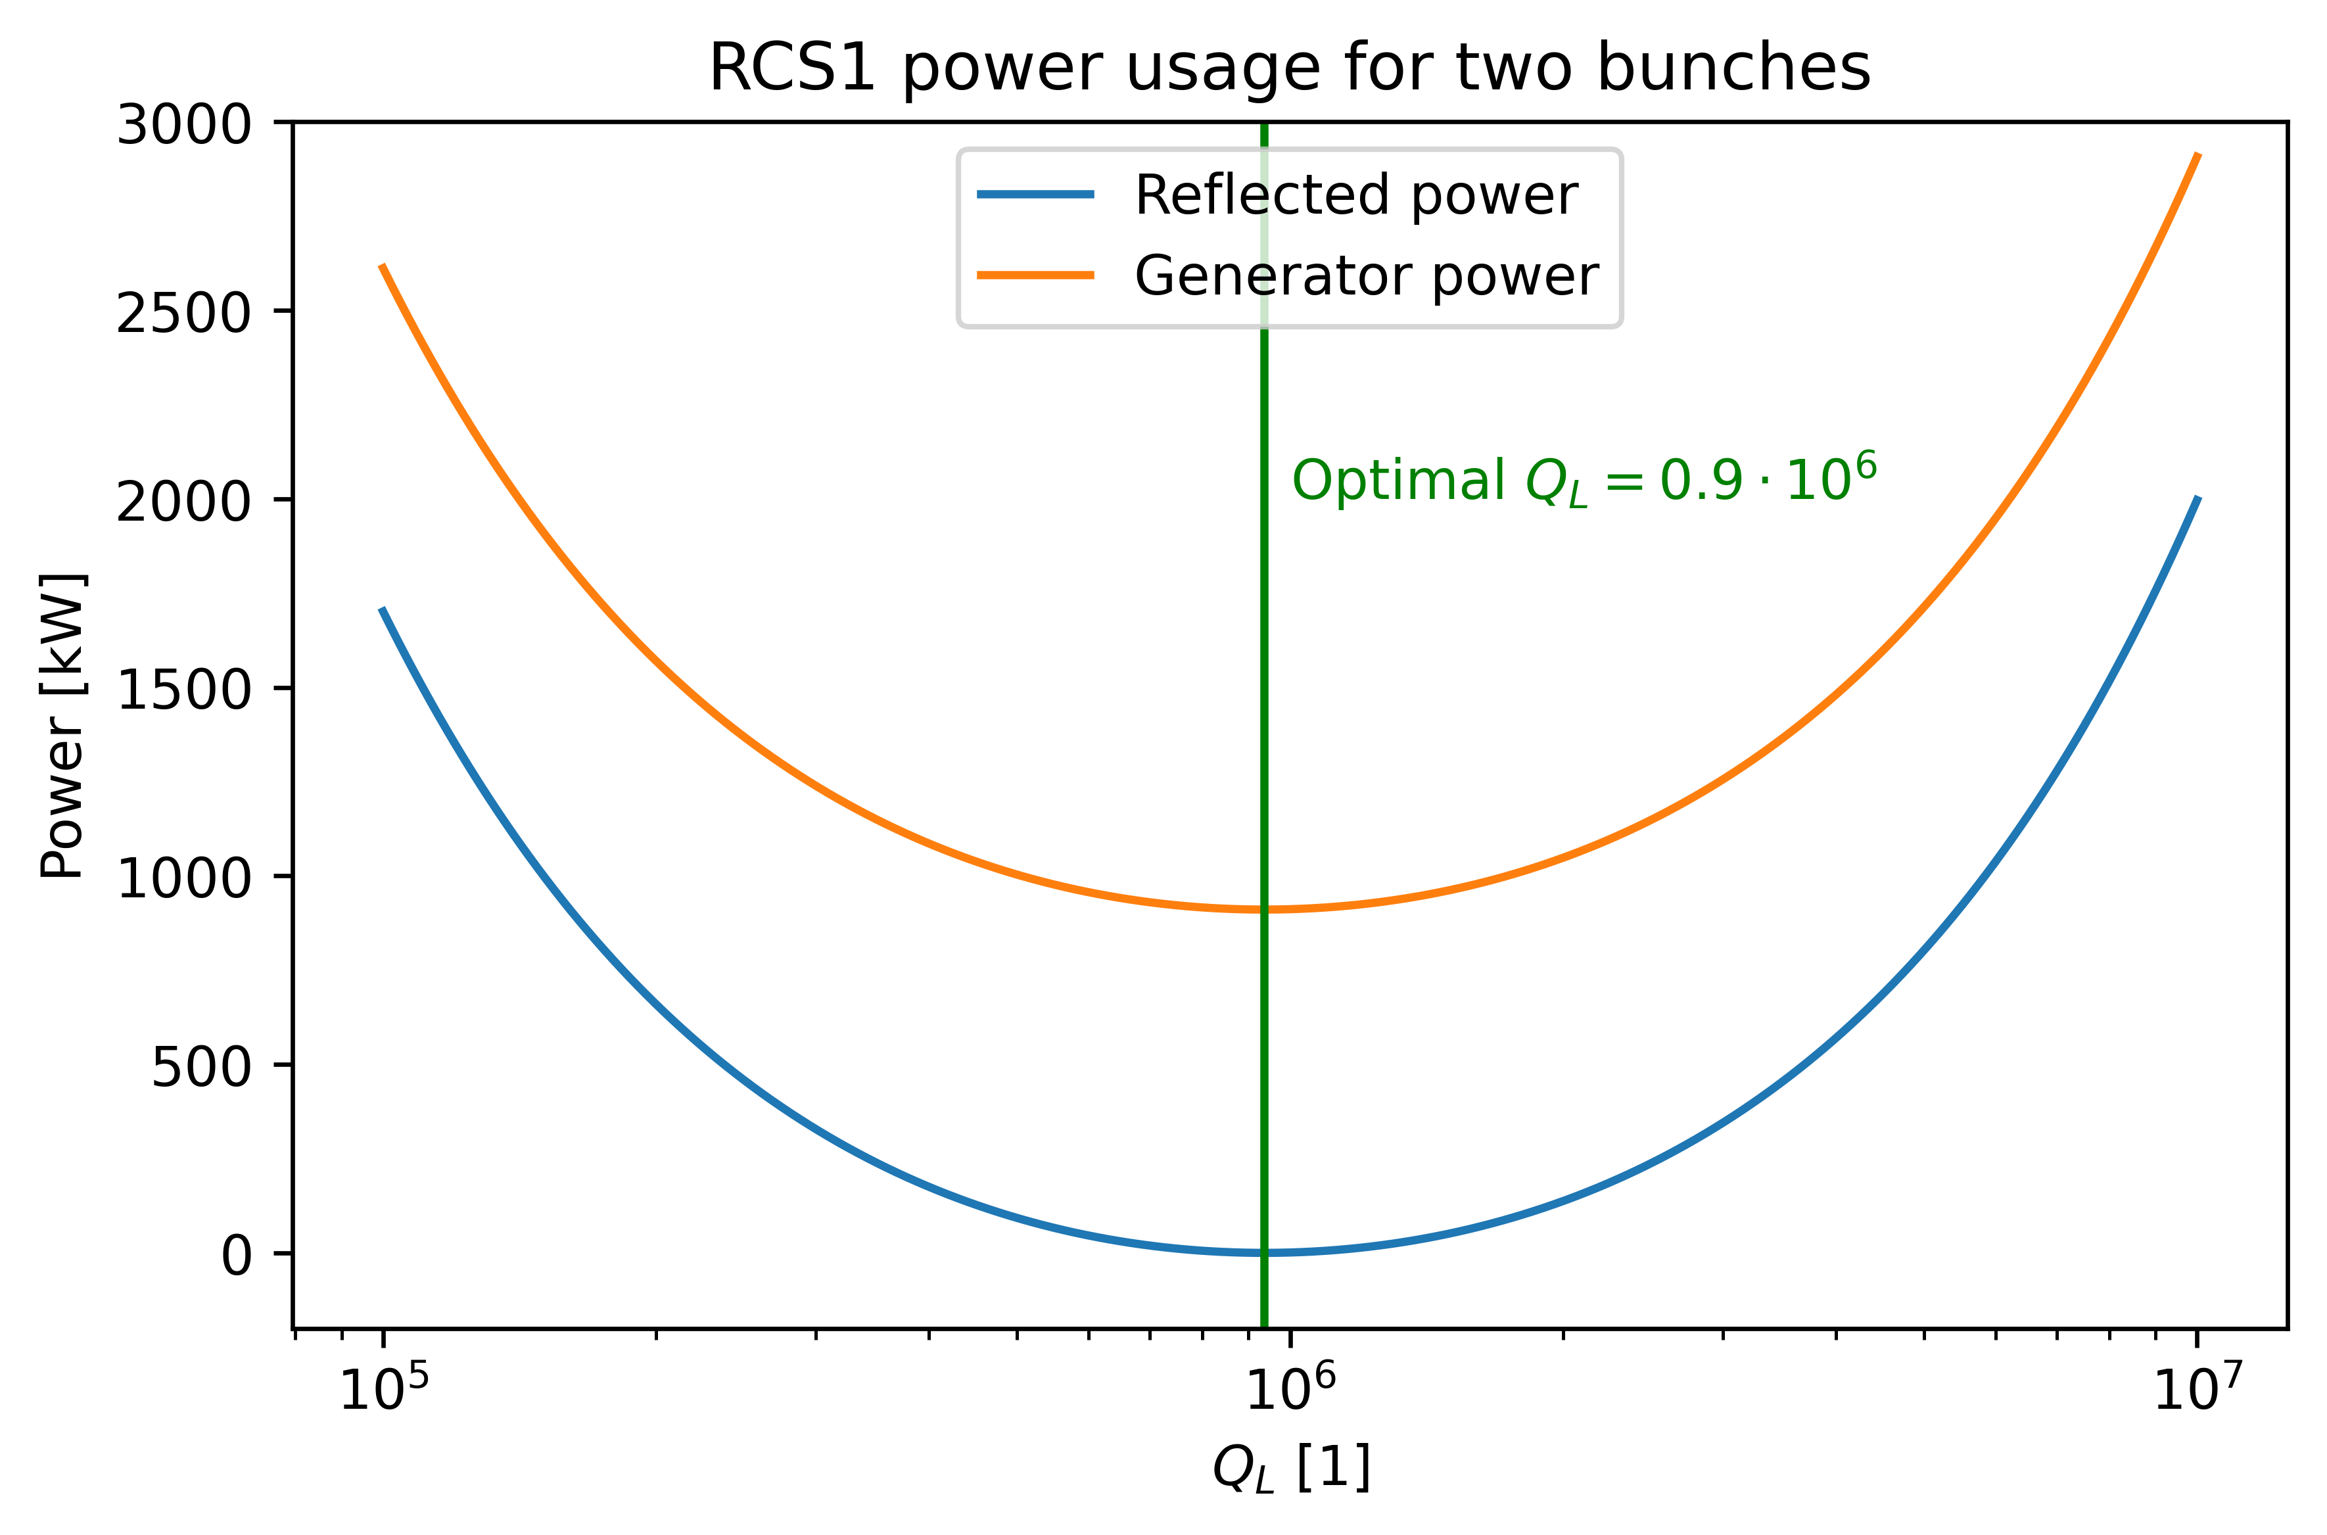
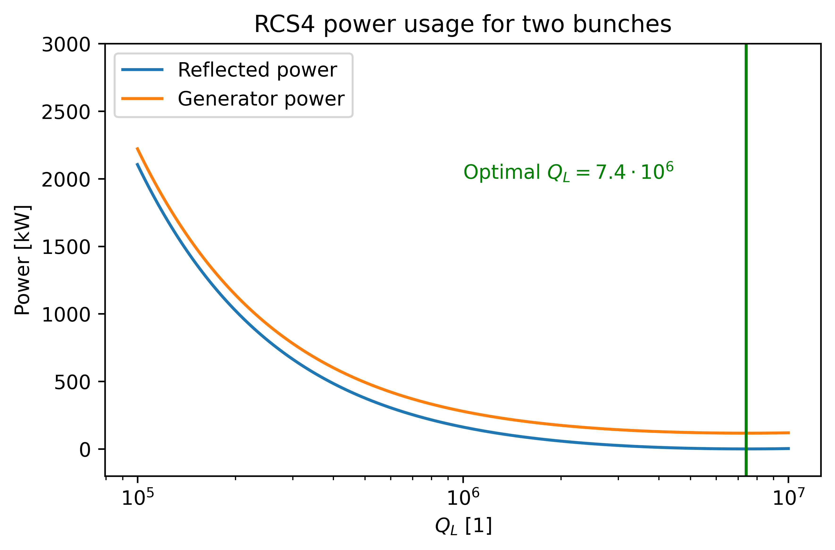
Beam loading compensation II
The power consumption is calculated based on the formulas derived in [1].

Slide 9
RF parameters in the high-energy chain
Cavity powering
Assuming optimal quality factor and frequency detuning of the cavity
Assuming ideal, linear energy ramp (sinusoidal ramp will require additional cavities)
 | Unit | RCS1 | RCS2 | RCS3 | RCS4
Beam acceleration time | [ms] | 0.34 | 1.1 | 2.37 | 6.37
Cavity filling time | [ms] | 0.23 | 0.25 | 0.50 | 1.81
RF pulse length | [ms] | 0.57 | 1.35 | 2.87 | 8.18
FPC peak power | [kW] | 911 | 818 | 416 | 297
Total peak RF power | [MW] | 850 | 410 | 300 | 460
Average wall plug power | [MW] | 3.72 | 4.25 | 6.56 | 29.2
Number of klystrons | - | 88 | 42 | 30 | 47
Cavities per klystron | - | 8 | 9 | 18 | 64
Number of cavities | - | 700 | 380 | 540 | 3000

Slide 10
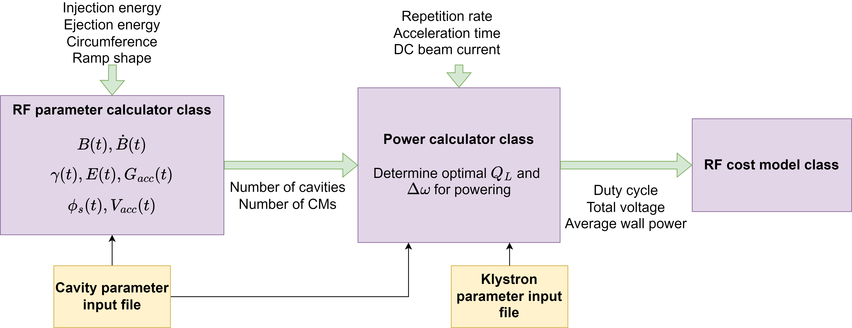
Tools to optimize RF parameters of high-energy acceleration chain
Integrated software package for combined optimization of energy ramp and RF parameters https://gitlab.cern.ch/muon-collider-bd/rcsparameters
The magnet ramp shape defines the voltage shape / RF requirements!
10

Slide 11
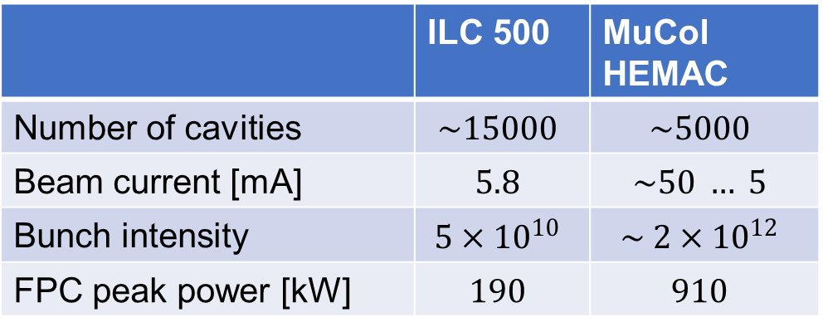
ILC TDR cost distribution
 | ILC 500 | MuCol HEMAC
Number of cavities | $$\sim 15000$$ | $$\sim 5000$$
Beam current [mA] | $$5.8$$ | $$\sim 50 … 5$$
Bunch intensity | $$5×{10}^{10}$$ | $$\sim 2×{10}^{12}$$
FPC peak power [kW] | $$190$$ | $$910$$
RF cost
Increased high level RF cost due to higher beam current
Additional dependance on other parameters like the number of required HOM couplers
→ In RCS chain: Present, preliminary estimates indicate that RF and NC magnet costs are in the same order of magnitude. [5]
Values from [2]

Slide 12
Summary
Muon survival and beam dynamics require a large, distributed RF system on a comparable scale to the ILC
1.3 GHz TESLA cavities are used as a baseline to study beam dynamics
  For the Muon Collider, an improved design is planned to be developed
Preliminary estimates: RF system cost is comparable to NC magnet system
  Optimization is necessary to determine how the most efficient solution looks like
Changes in the ramp shape will require additional cavities, which are not necessary during the entire ramp
High impact on transverse and longitudinal beam dynamics
  Iterations on coupler/cavity design necessary
Cavity powering impacts beam dynamics through fundamental mode quality factor
  Amplitude and decay of induced voltage is changing

Slide 14
RF parameters in the RCSs
Estimates using linear acceleration
 | Unit | RCS1 | RCS2 | RCS3 | RCS4
Synchronous phase | [°] | 135 | 135 | 135 | 135
Bunch population at injection | [1 x 10¹²] | 2.7 | 2.4 | 2.2 | 2.0
Combined avg. beam current (μ⁺ and μ⁻) | [mA] | 43.3 | 39.0 | 19.8 | 5.49
External Q-factor | [1 x 10⁶] | 0.94 | 1.04 | 2.05 | 7.42
Optimal cavity detuning | [kHz] | -0.69 | -0.62 | -0.32 | -0.09

Slide 15
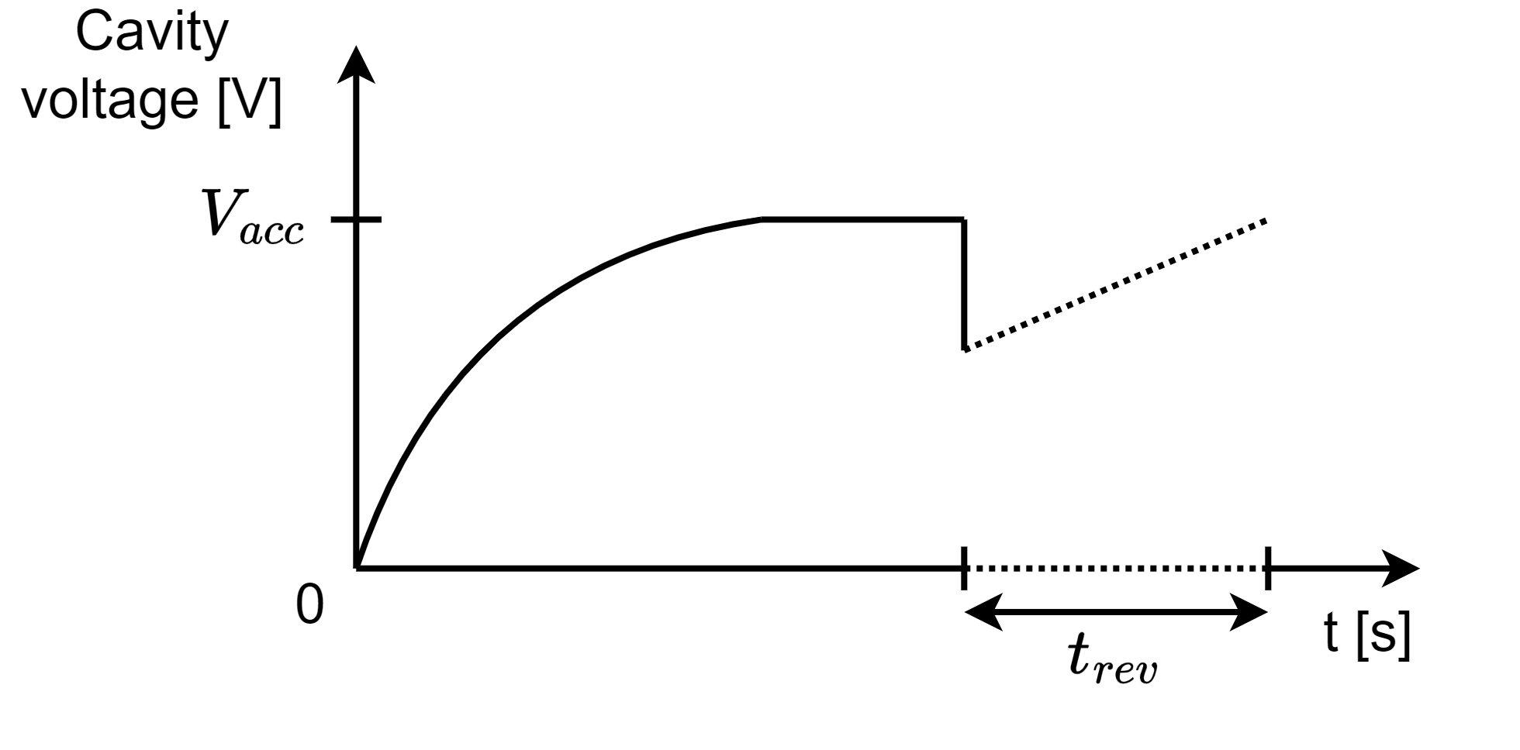
Introduction to beam loading in RF cavities
After filling the cavity with a certain generator current, a voltage will build up.
The bunch passage will then decrease this voltage as parts of the energy are transferred to the bunch.
This effect has to be compensated for, as otherwise, the beam will see less voltage on the next passage → Beam loading compensation
The input power for the ideal compensation can be computed from an equivalent circuit model [1] J. Tückmantel, CERN-ATS-Note-2011-002 TECH

Slide 16
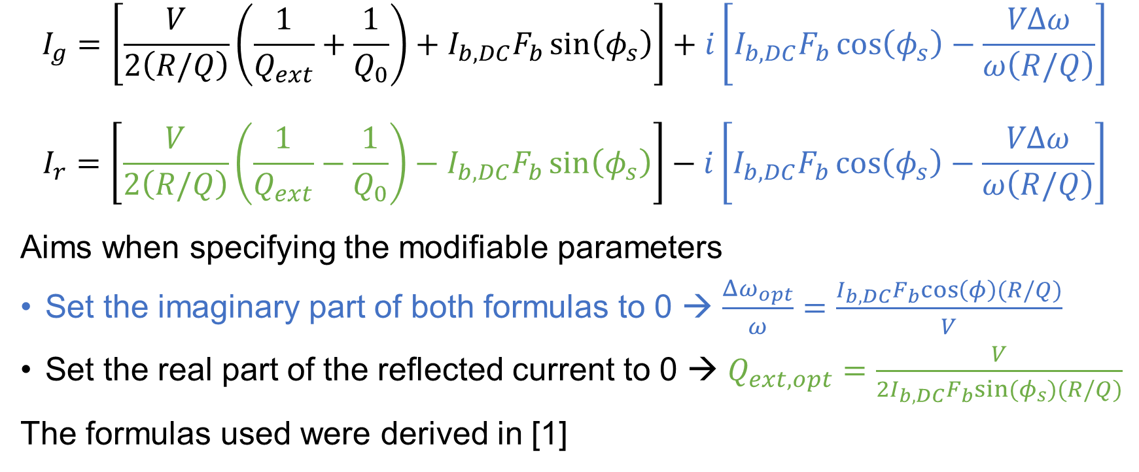
Appendix
Generator and reflected current
$$I_{g}=\left[\frac{V}{2\left(R/Q\right)}\left(\frac{1}{Q_{ext}}+\frac{1}{Q_{0}}\right)+I_{b,DC}F_{b}\sin\left(φ_{s}\right)\right]+i\left[I_{b,DC}F_{b}\cos\left(φ_{s}\right)−\frac{VΔω}{ω\left(R/Q\right)}\right]$$
$$I_{r}=\left[\frac{V}{2\left(R/Q\right)}\left(\frac{1}{Q_{ext}}−\frac{1}{Q_{0}}\right)−I_{b,DC}F_{b}\sin\left(φ_{s}\right)\right]−i\left[I_{b,DC}F_{b}\cos\left(φ_{s}\right)−\frac{VΔω}{ω\left(R/Q\right)}\right]$$
Aims when specifying the modifiable parameters
Set the imaginary part of both formulas to 0 → $\frac{Δω_{opt}}{ω}=\frac{I_{b,DC}F_{b}cos\left(φ\right)(R/Q)}{V}$
Set the real part of the reflected current to 0 → $Q_{ext,opt}=\frac{V}{2I_{b,DC}F_{b}sin⁡(φ_{s})(R/Q)}$
The formulas used were derived in [1]

Slide 17
References
[1]: Cavity-Beam-Transmitter Interaction Formula Collection with Derivation: http://cds.cern.ch/record/1323893/files/CERN-ATS-Note-2011-002%20TECH.pdf
[2]: ILC TDR: https://linearcollider.org/files/images/pdf/Acceleratorpart2.pdf
[3]: https://www.desy.de/xfel-beam/mlin_klyst.html
[4]: https://www.xfel.eu/news_and_events/news/index_eng.html?openDirectAnchor=1772
[5]: https://indico.cern.ch/event/1356899/

