Slide 1
Virtual Visit to LINAC and LEIR
Exclusive online talks for participants of CERN's high-school student programmes
Sarah Zoechling, Guillaume Durey, Angelos Margkas
24/05/2024

Slide 2
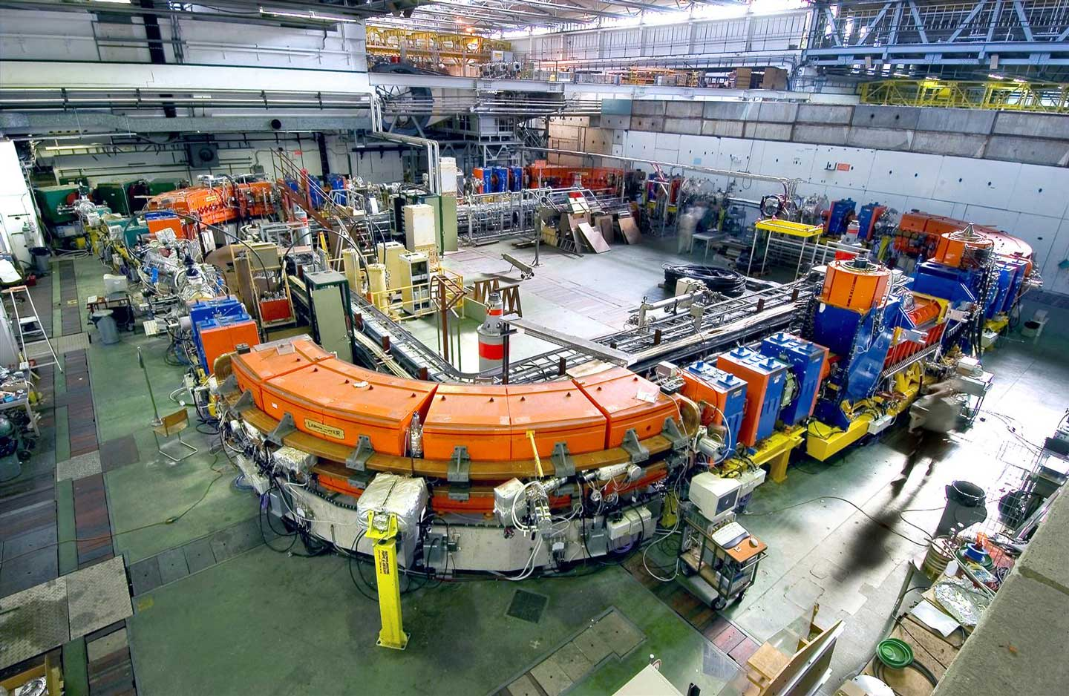
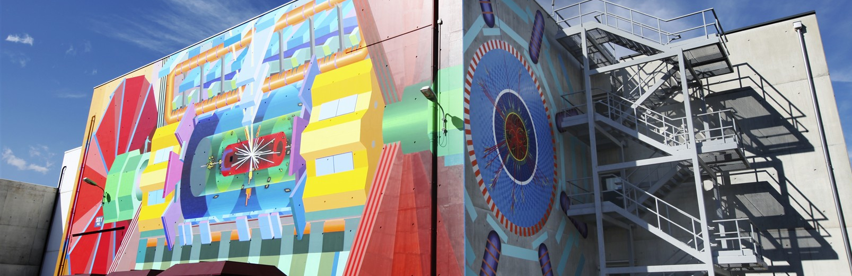
What will we do in the next hour?
LINAC
LEIR
Q&A session
Virtual visit on 24/05/2024

Slide 3
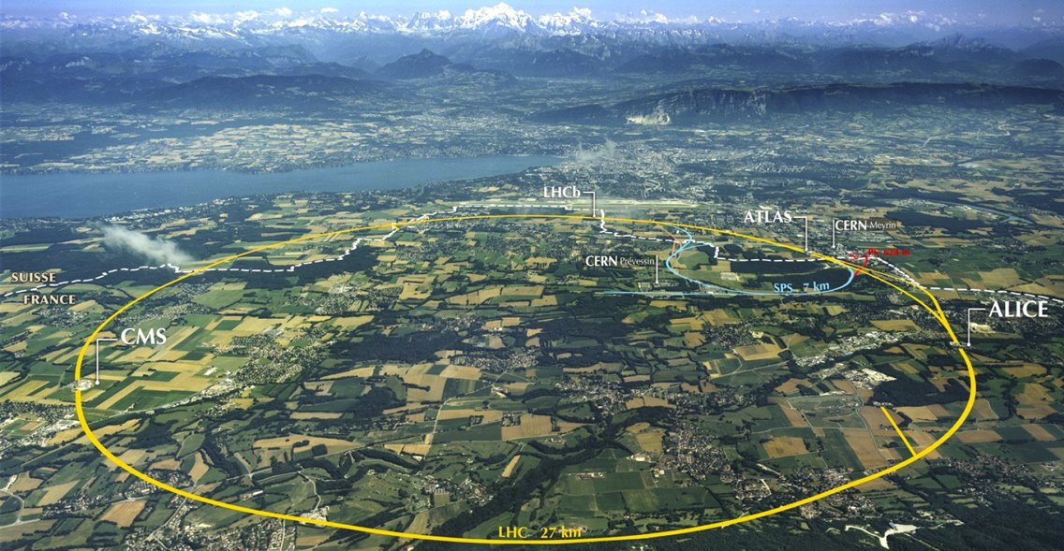
CERN accelerator chain
Virtual visit on 24/05/2024

Slide 4
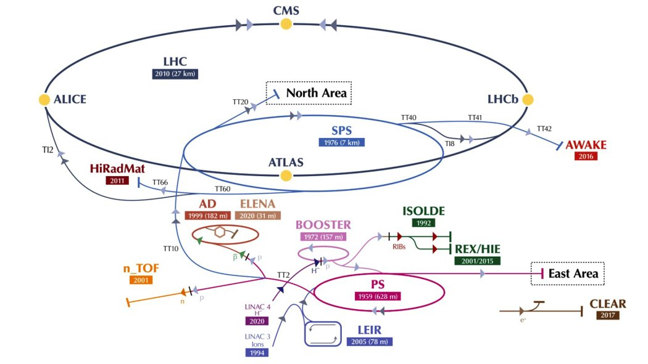
CERN accelerator chain
Virtual visit on 24/05/2024

Slide 5
CERN accelerator chain
Sarah
Virtual visit on 24/05/2024

Slide 6
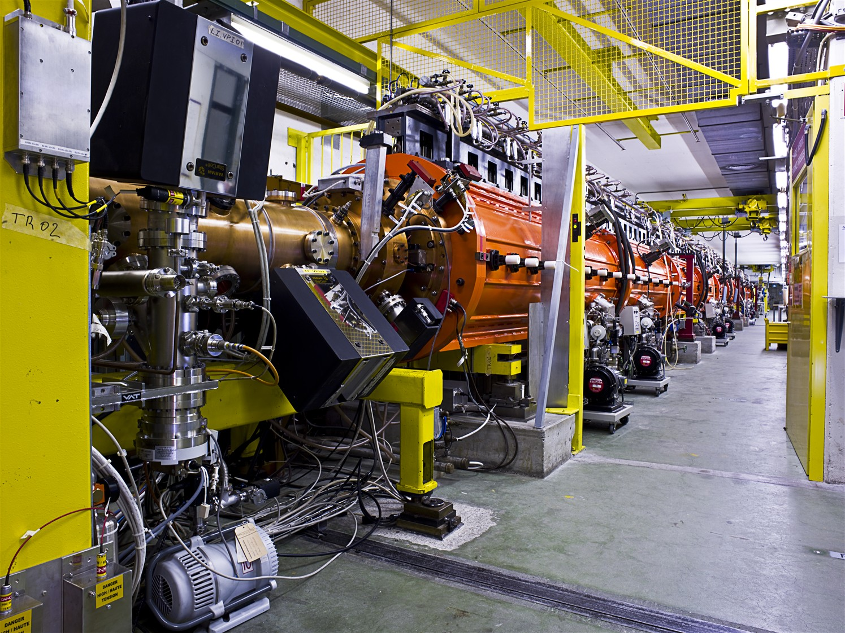
What is LINAC?
LINAC is the first accelerator in CERN’s accelerator chain. There is one LINAC for protons and one for ions.
LINear ACcelerator
⇨ designed to increase the energy of the particles
Beamline for Schools | ATLAS

Slide 7
CERN accelerator chain
Sarah
Virtual visit on 24/05/2024

Slide 8
What is LEIR?
LEIR is the second accelerator in CERN’s accelerator chain for lead ions. It is the first circular accelerator for lead ions in the chain.
Low Energy Ion Ring
⇨ designed to increase the energy of lead ions
Beamline for Schools | ATLAS

Slide 9
Thank you!
Questions?

