Slide 1
BNL Labs
ASP High School Event 2024

Slide 2
BNL Labs for ASP HS Event 2024
BNL will create four (4) hands-on lab activities in support of the ASP HS Event 2024:
  Geiger Counter – To correlate decay events (from over-the-counter thoriated lantern mantles and TIG welding rods) as a function of distance from an inexpensive detector
  Spectrophotometry – To catalog substances by their reflectance spectra and to use this database to identify unlabeled materials
  Ohm’s Law – Empirically determine the relationship between resistance, current, and voltage and to predict the resistance of an unlabeled resistor
  Center of Mass – Mathematically determine the balancing point of 14 and 15-block Jenga cantilevers and physically build those piles

Slide 3
BNL Labs for ASP HS Event 2024
Each lab has these learning objectives/flow:
  A brief introductory lecture about the theoretical physical principles driving the output the students will measure
  Students will use a data capture device to measure signals as they vary experimental conditions
  Students will plot the resulting observations to gain insight into the underlying physical law (mathematical correlation) connecting those data points
  Students will use interpolation/extrapolation to form a hypothesis about an unknown sample and to verify their intuition by measuring/identifying the unlabeled sample
  Gain an appreciation for how low-cost microcontrollers combined with modern sensors can greatly enhance traditional high school benchtop science experiments

Slide 4
BNL Labs for ASP HS Event 2024
48 students will sit at six (6) tables of eight (8) students per table, with each table split into two (2) four-person teams for a total of (12) teams
BNL will provide twelve (12) battery-powered microcontroller data capture devices (one per team, two per table) to conduct the labs
BNL will provide the printed slides, worksheets, graph paper, and calculators for each team to record and analyze the data from each lab

Slide 5
Session 1
Instructor 1
Table 1
Table 2
Table 3
Student
Student
Lab:
Geiger Counter
(50 mins)
Spectrophotometry
(50 Mins)
Student
Student
Team B
Team D
Team F
Team A
Team C
Team E
Student
Student
Student
Student
Instructor 2
Table 4
Table 5
Table 6
Lab:
Ohm’s Law
(50 mins)
Center of Mass
(50 Mins)
Team H
Team J
Team L
Team G
Team I
Team K

Slide 6
Session 2
Instructor 1
Table 1
Table 2
Table 3
Student
Student
Lab:
Geiger Counter
(50 mins)
Spectrophotometry
(50 Mins)
Student
Student
Team B
Team D
Team F
Team A
Team C
Team E
Student
Student
Student
Student
Instructor 2
Table 4
Table 5
Table 6
Lab:
Ohm’s Law
(50 mins)
Center of Mass
(50 Mins)
Team H
Team J
Team L
Team G
Team I
Team K

Slide 7
Session 3
Instructor 1
Table 1
Table 2
Table 3
Student
Student
Lab:
Geiger Counter
(50 mins)
Spectrophotometry
(50 Mins)
Student
Student
Team H
Team J
Team L
Team G
Team I
Team K
Student
Student
Student
Student
Instructor 2
Table 4
Table 5
Table 6
Lab:
Ohm’s Law
(50 mins)
Center of Mass
(50 Mins)
Team B
Team D
Team F
Team A
Team C
Team E

Slide 8
Session 4
Instructor 1
Table 1
Table 2
Table 3
Student
Student
Lab:
Geiger Counter
(50 mins)
Spectrophotometry
(50 Mins)
Student
Student
Team H
Team J
Team L
Team G
Team I
Team K
Student
Student
Student
Student
Instructor 2
Table 4
Table 5
Table 6
Lab:
Ohm’s Law
(50 mins)
Center of Mass
(50 Mins)
Team B
Team D
Team F
Team A
Team C
Team E

Slide 9
BNL Labs for ASP HS Event 2024
Students will not need a computer at their tables, and all lab electronics are powered by rechargeable batteries
There will be four (4) sessions, with each lab taking 50 minutes to complete, with students working in four-person teams
Teams will complete Session 1 and Session 2 labs, then move as a team to another table to finish Session 3 and Session 4 labs
All students will complete all four labs within the allotted 240 minutes

Slide 10
BNL Labs for ASP HS Event 2024
ASP will need to provide the two instructors who must be trained by BNL before the event
  Instructor #1 will demonstrate & monitor the Geiger Counter and Spectrophotometer labs
  Instructor #2 will demonstrate & monitor the Ohm’s Law and Center of Mass labs
BNL will provide an instructor’s guide for each lab that enumerates the learning objectives, step-by-step instructions, and the approved solutions (expected results) to provide students with feedback

Slide 11
The intent is that BNL will temporarily lend this hardware to ASP for the event, and the BNL costs to develop the curriculum will represent an “in-kind” contribution from BNL to ASP – but this is NOT confirmed yet!

Slide 12
BNL Labs for ASP HS Event 2024
Each table has two microcontroller units (MCU), one for each team at that table
All the lab materials are easily transportable between venues, and the instructors are responsible for ensuring all the materials are returned to BNL shortly after the event

Slide 13
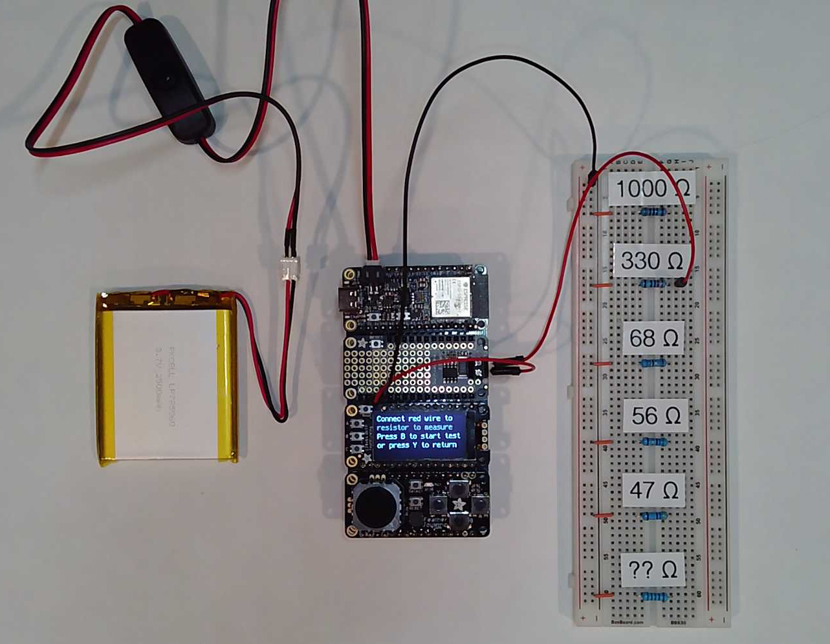
Ohm’s Law Lab

Slide 14
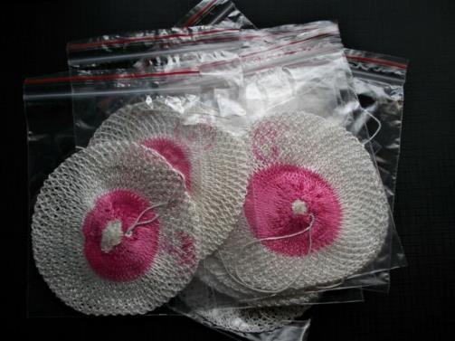
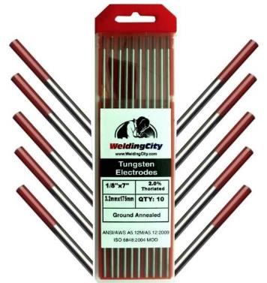
Geiger Counter Lab
The Thorium Mantles and Thoriated Welding Rods are available for public purchase at any Home Depot. The total radioactivity of these samples is so low that they are not regulated by the U.S. Department of Energy.

Slide 15
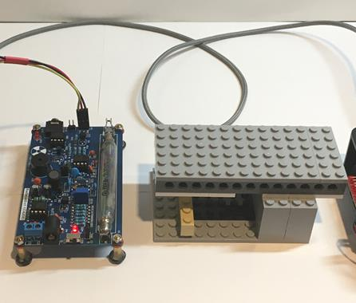
Lab Setup – Thorium Mantle
Do not remove the Thorium Mantle from the carrying cartridge
The Mantle Holder slides underneath the Geiger Counter

Slide 16
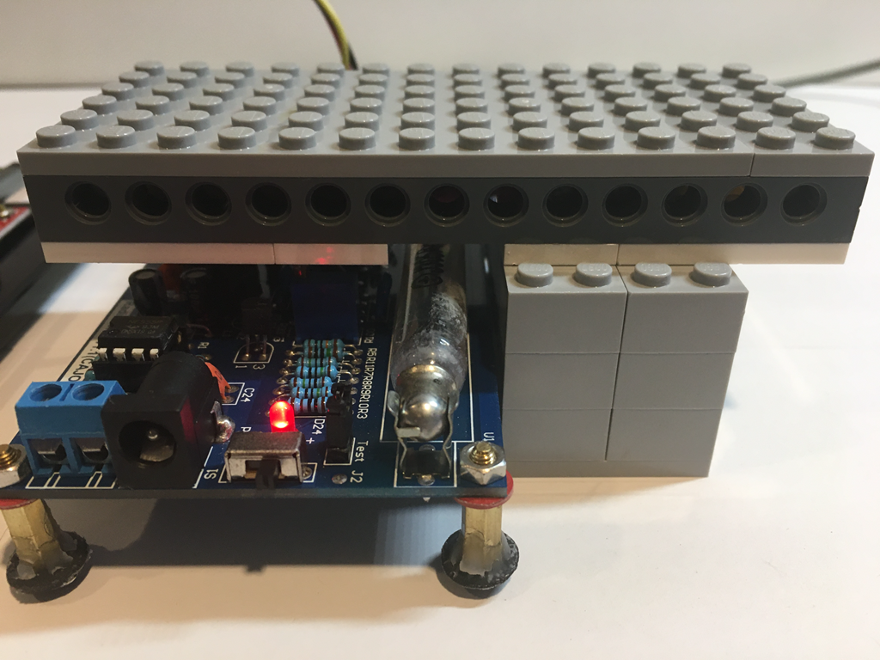
Lab Setup – Before 7th (Final) Run
The Geiger Counter should be flush with the gray bricks supporting the Mantle cartridge
There should be no stopper brick in use during Run #7

Slide 17
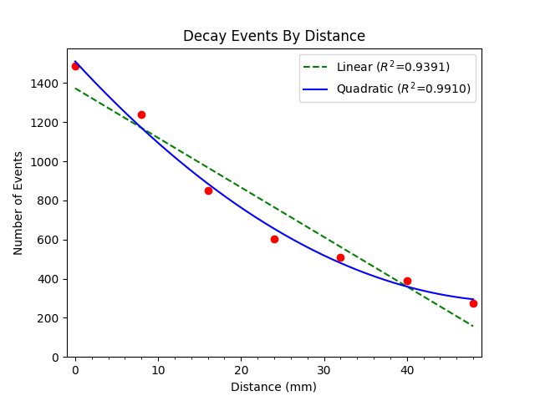
Run plot_distance.py
Radiation intensity obeys the Inverse Square law

Slide 18
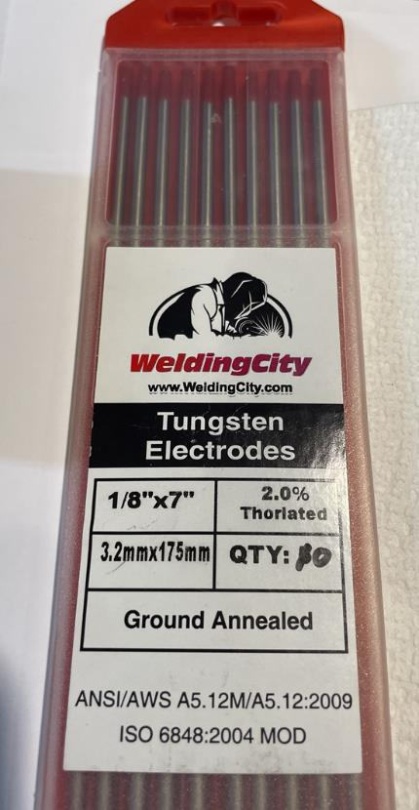
Lab Setup – Thorium Rods
These welding rods have 2% thorium added to the tungsten to improve the heat transfer of the welds

Slide 19
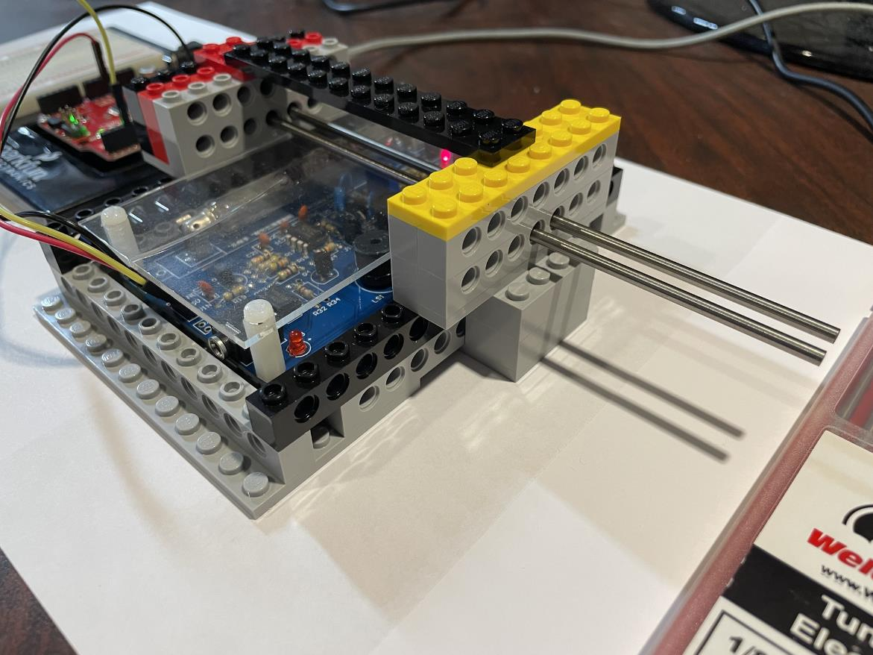
Lab Setup – Before 2nd Run
Ensure the rods are pushed all the way into the frame until the RED tip reaches the left-side barrier

Slide 20
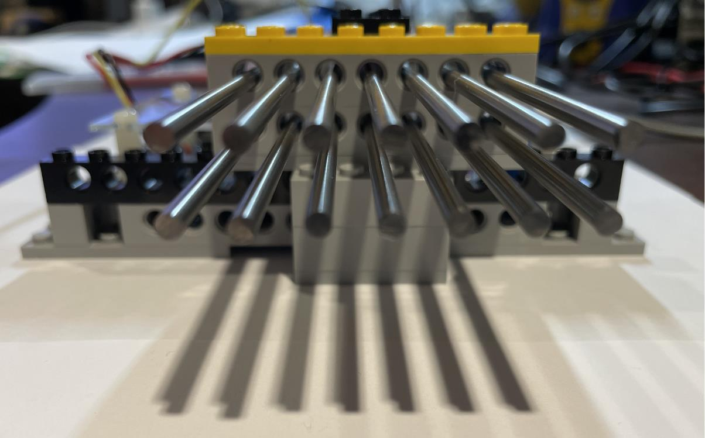
Lab Setup – Before the 14th (Final) Run
The final run will have all 14 thorium rods inserted into the Geiger Counter LEGO frame

Slide 21
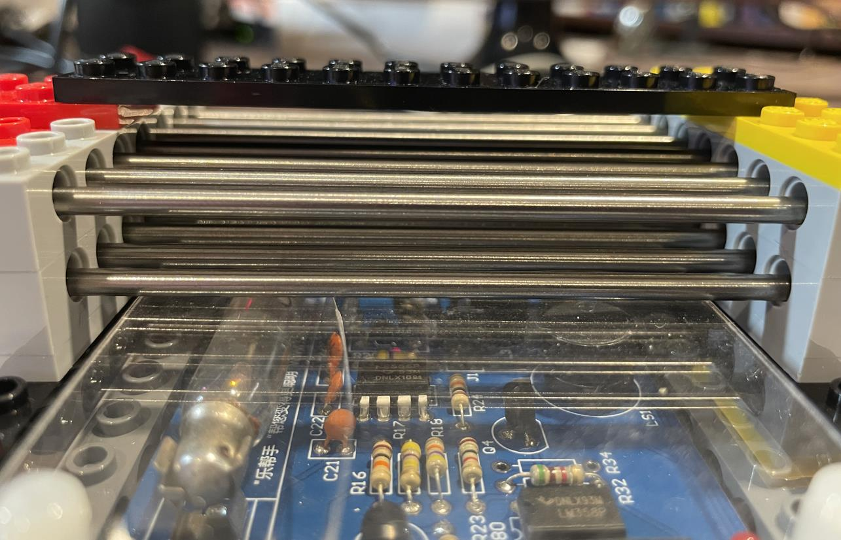
Lab Setup – Thorium Rods
How does the radiation intensity change as we add each additional rod?

Slide 22
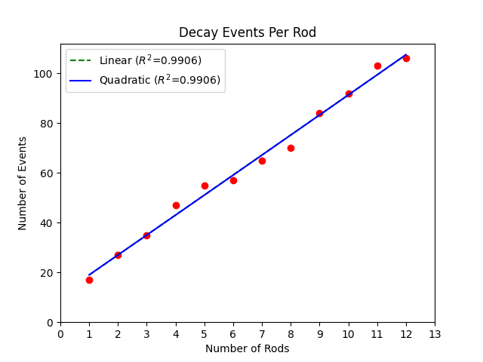
Run plot_rods.py
Do you think the radiation intensity grows linearly as we add more rods?

Slide 23
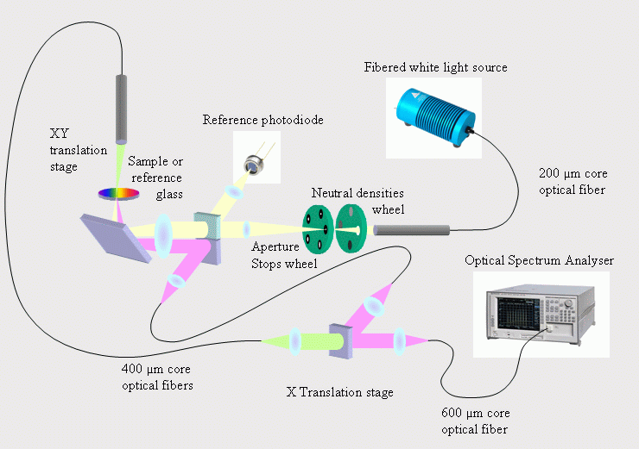
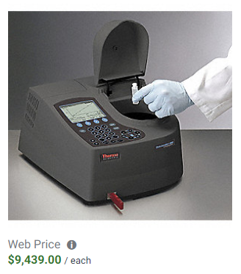
Reflectance Spectrophotometry

Slide 24
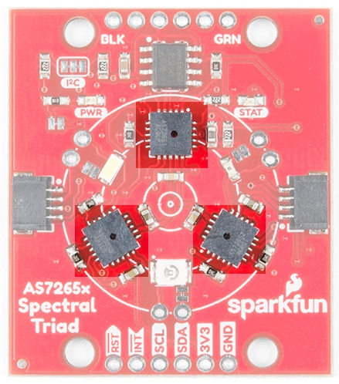
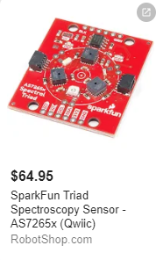
The SparkFun Triad Sensor
The sensor talks to
the computer over a serial (UART) port
Ultraviolet
Near Infrared
Visible Light

Slide 25
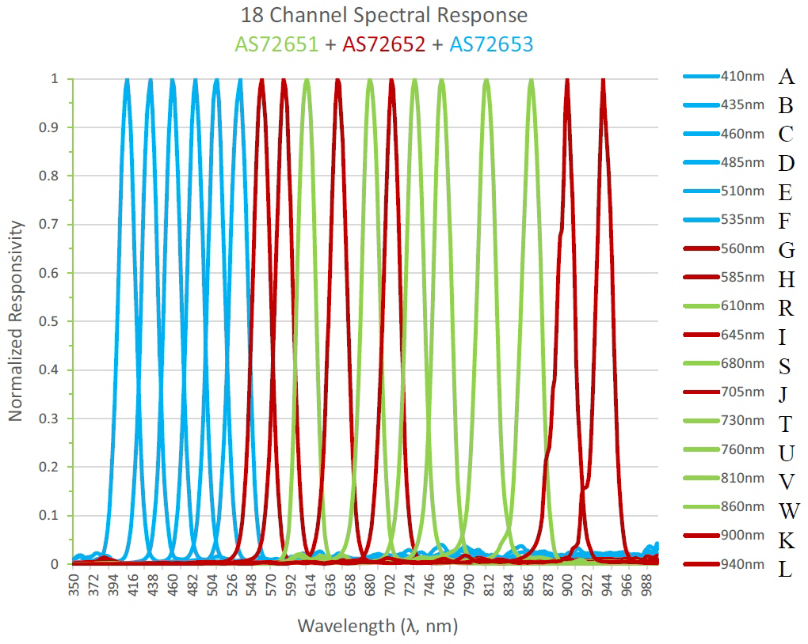

The SparkFun Triad Sensor
$$↓λ=↑E$$
←Increasing Energy
Ultraviolet
Visible Light
Near Infrared

Slide 26
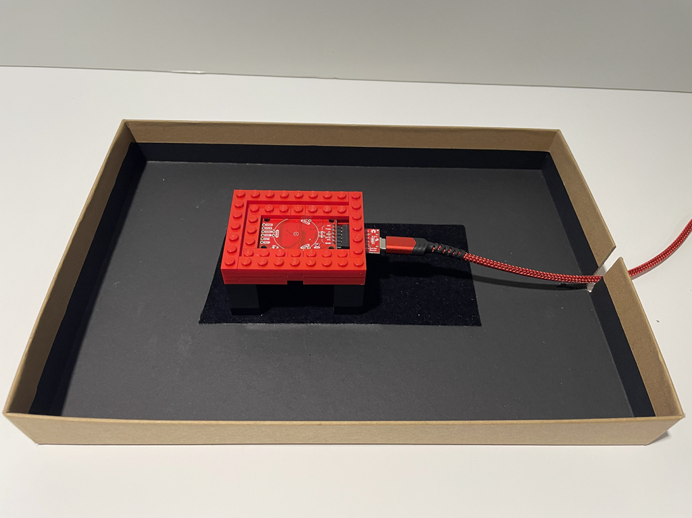
Lab Setup
A black anti-reflective felt strip is centered on the inside of the box top

Slide 27
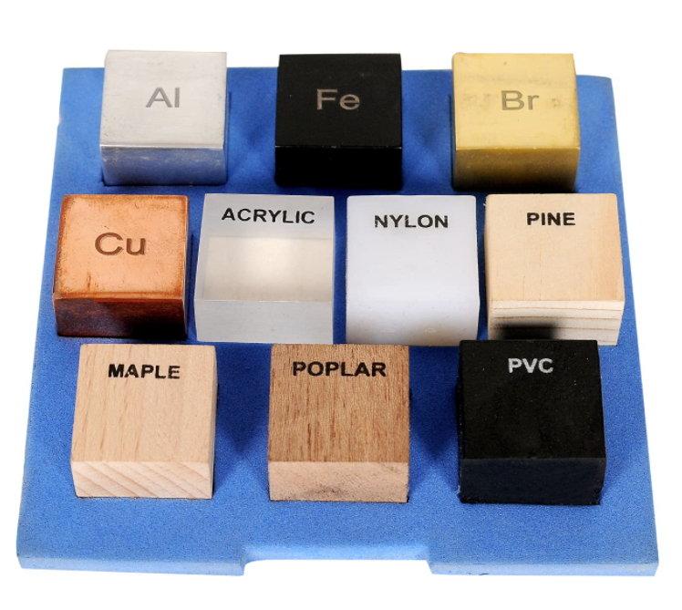
Lab Procedure
Some cubes will contain materials composed from several different types of atoms
You will measure the reflectance of cubes of a single element

Slide 28
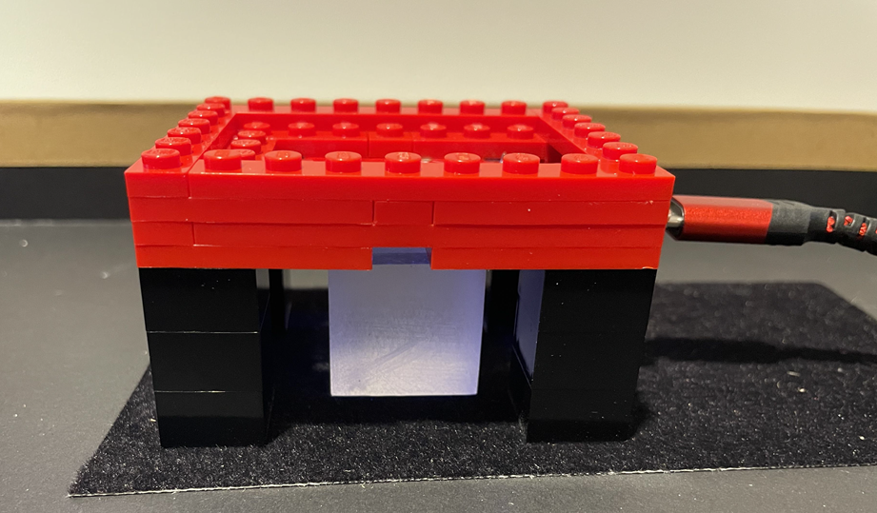
Lab Procedure
Prior to starting a scan, ensure the side of each cube that has writing faces down from the scanner

Slide 29
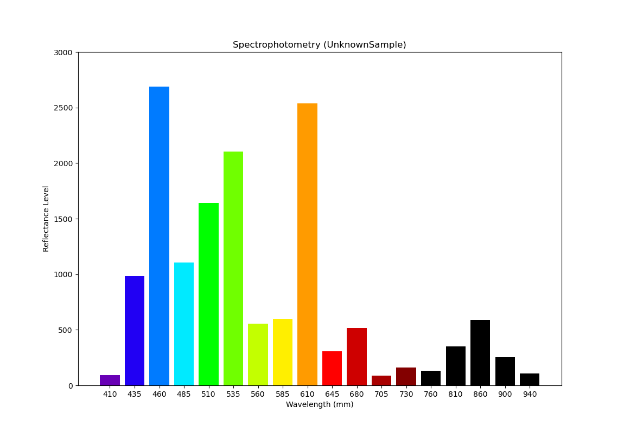
Reflectance Spectra for Nylon
Does Nylon absorb UV light?

Slide 30
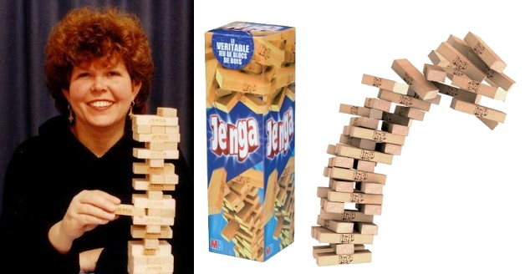
Jenga Block Dimensions
Leslie Scott created Jenga in 1983

Slide 31
1st Ensemble (first two blocks)
y+
Center of Mass = Average of the centers of all blocks
(in each X & Y dimension)
(1.5, 10.5)
15
(4.5, 6.0)
$$C_{x}=\frac{1.5+7.5}{2}=4.5$$
3
(7.5, 1.5)
x+
$$C_{y}=\frac{10.5+1.5}{2}=6.0$$
15
(0,0)

Slide 32
How many 2-block ensembles can be balanced on a single vertical post?
15
The center of mass (of the entire pile) in the x-dimension must remain < 15.0 or else the bottom horizontal block cannot be supported by a vertical post!
This pile would collapse over the vertical post!
Jenga

Slide 33
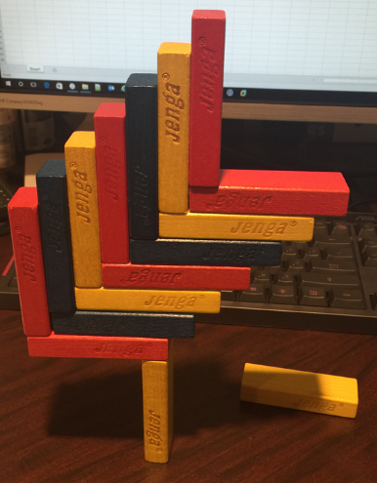
My successful 14-block (7 ensemble) Jenga pile
Can we simulate the construction of a 15-block Jenga cantilever?

Slide 34
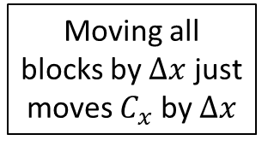
Functional Equation
$${Pile Center of Mass}_{X}=\frac{\sum_{n=1}^{blocks}{{{Center Coordinate}_{x} of Block}_{n}}}{Number of Blocks}$$
$$C_{x}=\frac{1}{4}\left(B_{1x}+B_{2x}+B_{3x}+B_{4x}\right)$$
Assume we have 4 blocks in the pile
$$=\frac{1}{4}\left(\left(B_{1x}+∆x\right)+\left(B_{2x}+∆x\right)+\left(B_{3x}+∆x\right)+\left(B_{4x}+∆x\right)\right)$$
Moving all blocks by $∆x$ just moves $C_{x}$ by $∆x$
$$=\frac{1}{4}\left(4∆x+\left(B_{1x}+B_{2x}+B_{3x}+B_{4x}\right)\right)$$
$$C_{x}^{′}=∆x+\frac{1}{4}\left(B_{1x}+B_{2x}+B_{3x}+B_{4x}\right)$$

Slide 35
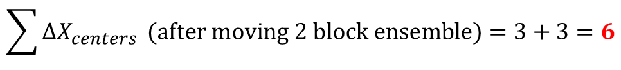
Functional Equation – 14 Block Cantilever
$$\sum{X_{centers}}(of a 2 block ensemble)=7.5+1.5=9$$
$$\sum{∆X_{centers}} (after moving 2 block ensemble)=3+3=6$$
2 Blocks
$$9$$
4 Blocks
$$\left(9+6\right)+9$$
6 Blocks
$$\left(9+6+6\right)+\left(9+6\right)+9$$
8 Blocks
$$\left(9+6+6+6\right)+\left(9+6+6\right)+\left(9+6\right)+9$$
10 Blocks
$$\left(9+6+6+6+6\right)+\left(9+6+6+6\right)+\left(9+6+6\right)+\left(9+6\right)+9$$

Slide 36
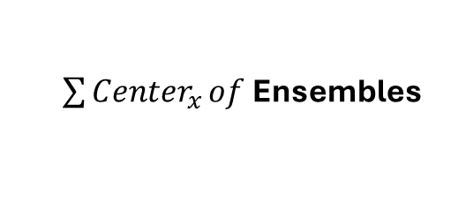
Functional Equation – 14 Block Cantilever
# of 9’s
# of 6’s
$\sum{{Center}_{x}}of$Ensembles
1
0
$$9$$
2
1
$$\left(9+6\right)+9$$
3
3
$$\left(9+6+6\right)+\left(9+6\right)+9$$
4
6
$$\left(9+6+6+6\right)+\left(9+6+6\right)+\left(9+6\right)+9$$
5
10
$$\left(9+6+6+6+6\right)+\left(9+6+6+6\right)+\left(9+6+6\right)+\left(9+6\right)+9$$

Slide 37
Functional Equation – 14 Block Cantilever
# of 9’s
# of 6’s
n
$$9n+6\left(\frac{n^{2}−n}{2}\right)$$
1
0
1st Ensemble
2
1
2nd Ensemble
$$9n+3\left(n^{2}−n\right)$$
3
3
3rd Ensemble
$$3\left(3n+n^{2}−n\right)=3n\left(n+2\right)$$
4
6
4th Ensemble
$${Center of Mass}_{x}=\frac{3n\left(n+2\right)}{2n}$$
5
10
5th Ensemble
There are two blocks per ensemble

Slide 38
Functional Equations
Jenga 14 Block Cantilever
$${Center of Mass}_{X}=\frac{3n(n+2)}{2n}$$
$$n≡Number of Ensembles$$
Jenga 15 Block Cantilever
$${Center of Mass}_{X}=\frac{19.5+3(n−1)(n+4)}{2n+1}$$
$$n≡Number of Ensembles$$

Slide 39
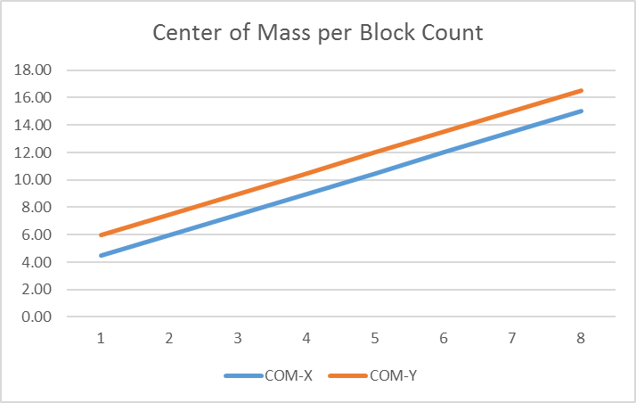
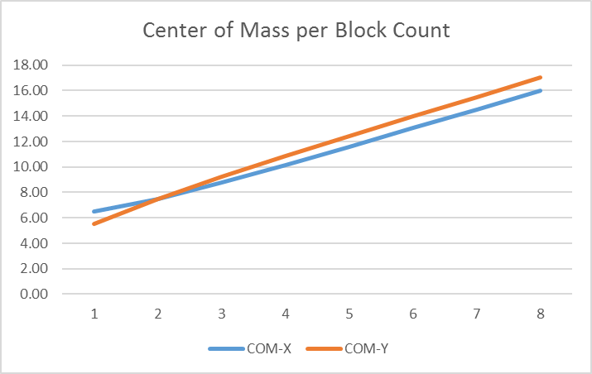
Functional Equations
Jenga 14 Block Cantilever
Jenga 15 Block Cantilever
Ensemble
Ensemble
The center-of-mass in the X & Y dimensions are closer in a 15 block cantilever so it can rotate (tip over) more easily than a 14 block cantilever

Slide 40
14 Block Jenga Cantilever
y+
(13.5, 15.0)
x+
(0,0)

