Slide 1

Design, Calculations, and Mechanical Measurements
Stefan Hoell

Slide 2


OUTLINE
Our three pillars
The expertise of each unit
Roadmap – from a simple idea to its final design

Slide 3
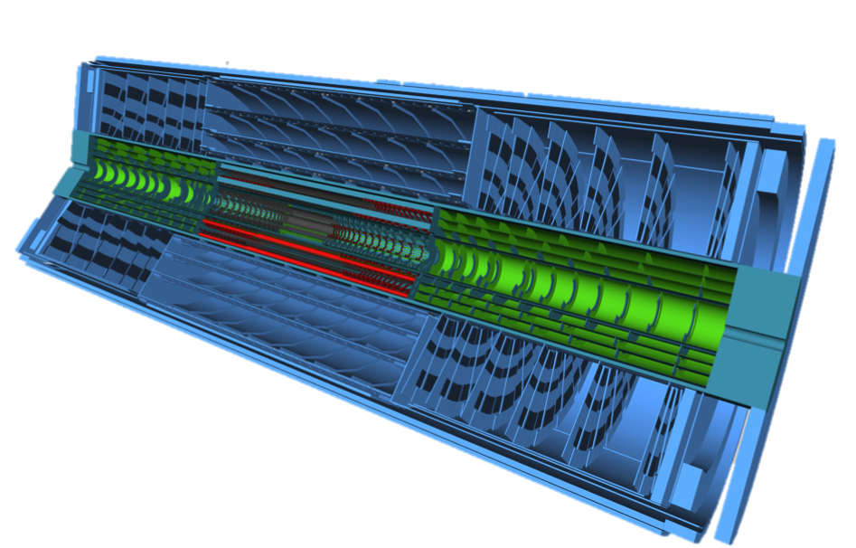
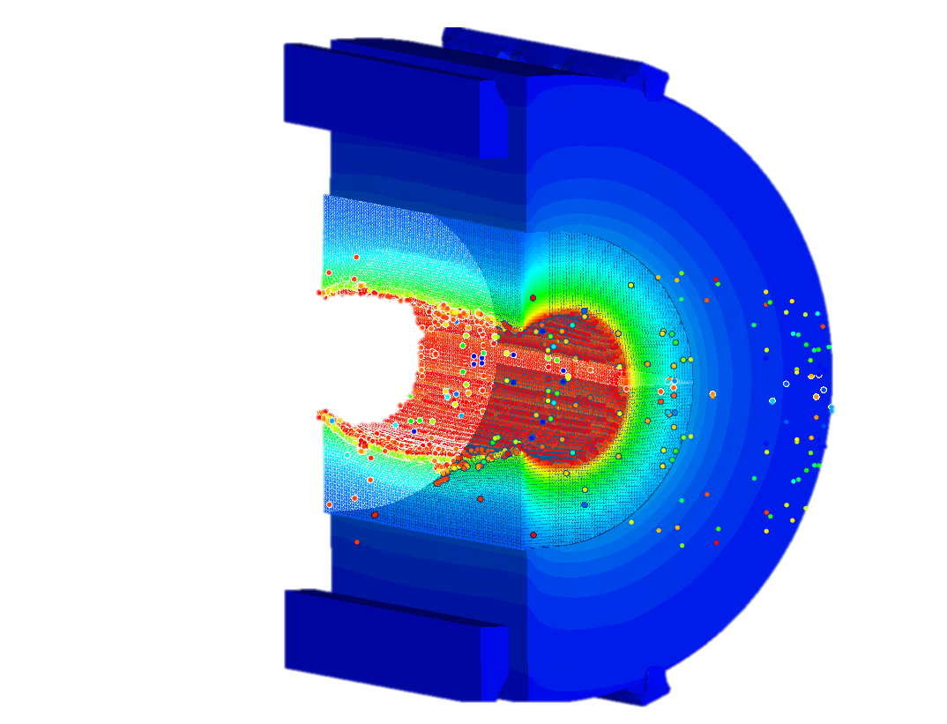
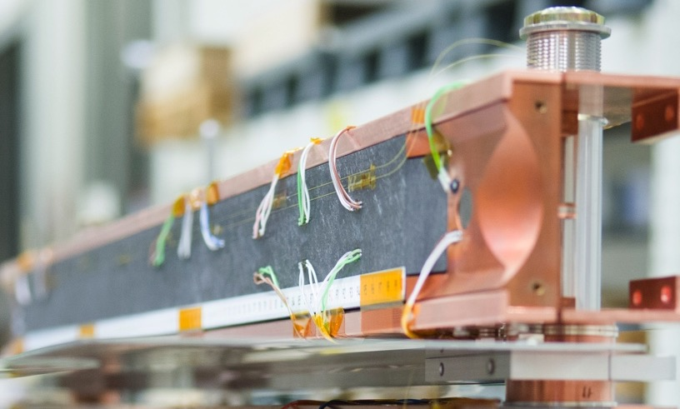
OUR THREE PILLARS
DESIGN
CALCULATIONS
MEASUIREMENTS

Slide 4




REMINDER – CERN AND ITS HARSH ENVIRONMENTS
Vacuum
Cryogenic temperatures
Radiation
Magnetic fields
The presence of these harsh environments requires the engineers to come up with advanced and complex solutions

Slide 5
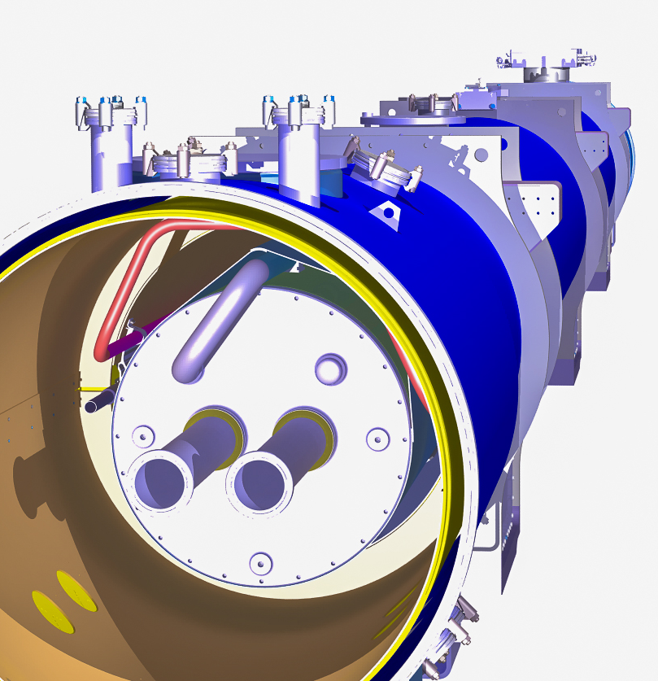
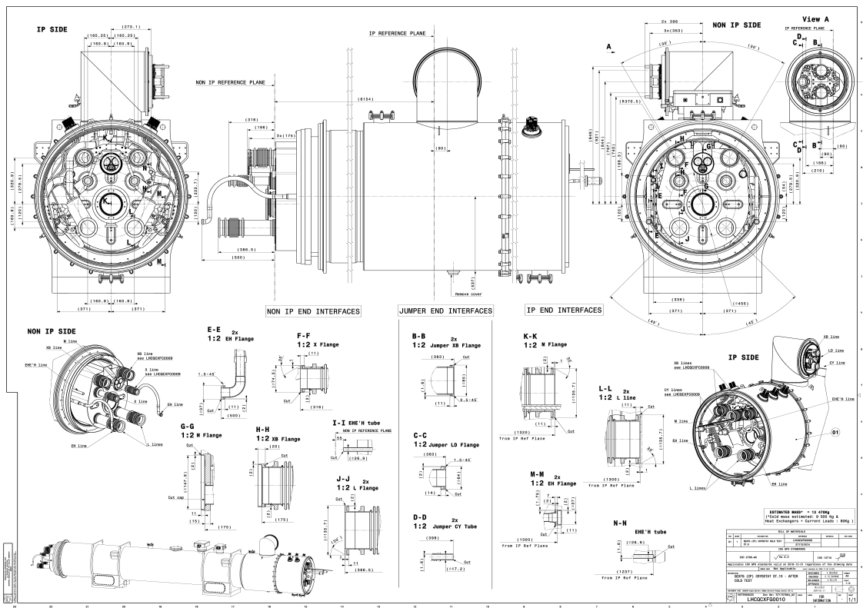
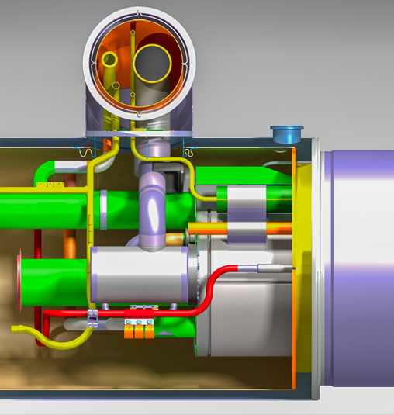

THE DESIGN OFFICE
3D
Creates designs and drawings based on design ideas and many boundary conditions
mechanics
thermal behavior
manufacturing
…
2D

Slide 6
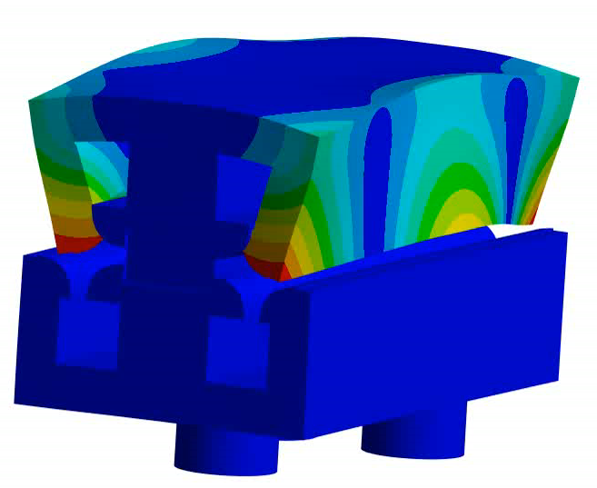
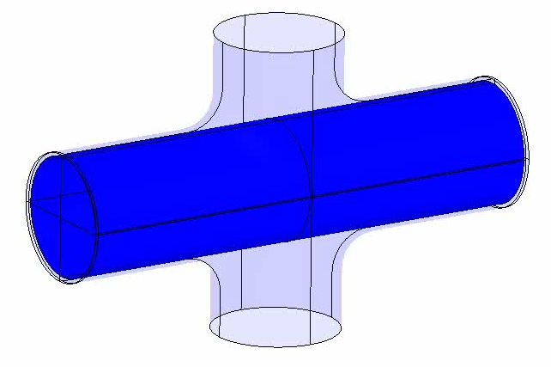

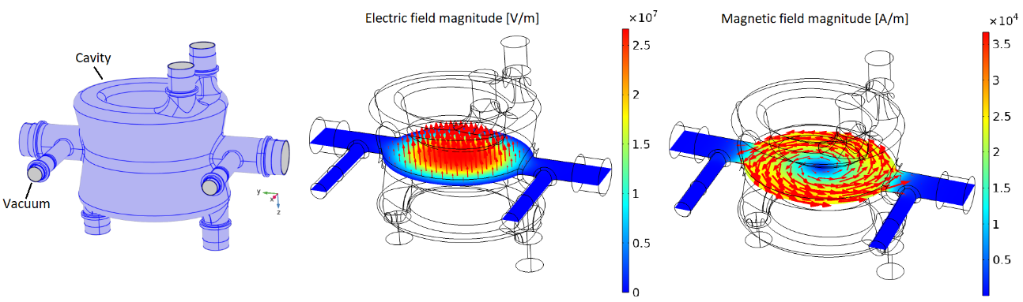
THE ENGINEERING UNIT
Performs advanced simulations of structures involving many fields of physics
Mechanical and thermal behavior
Dynamics such as vibrations
Electric and magnetic field
Coupling of these physics
…
Hydroforming simulations
Modal analysis
(FCC prototype quadrupole)
Electric and magnetic field simulations (crab cavities)

Slide 7
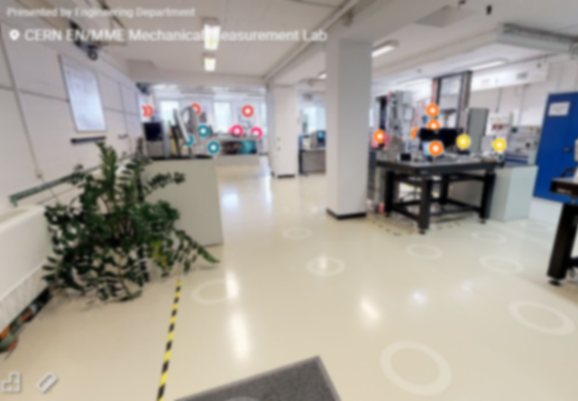
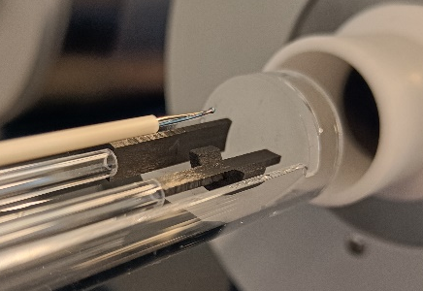
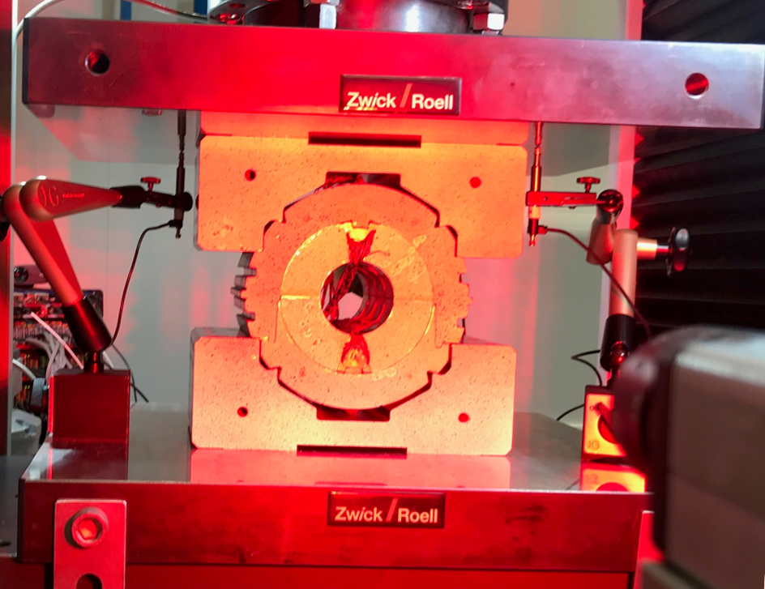
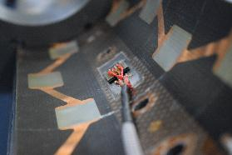

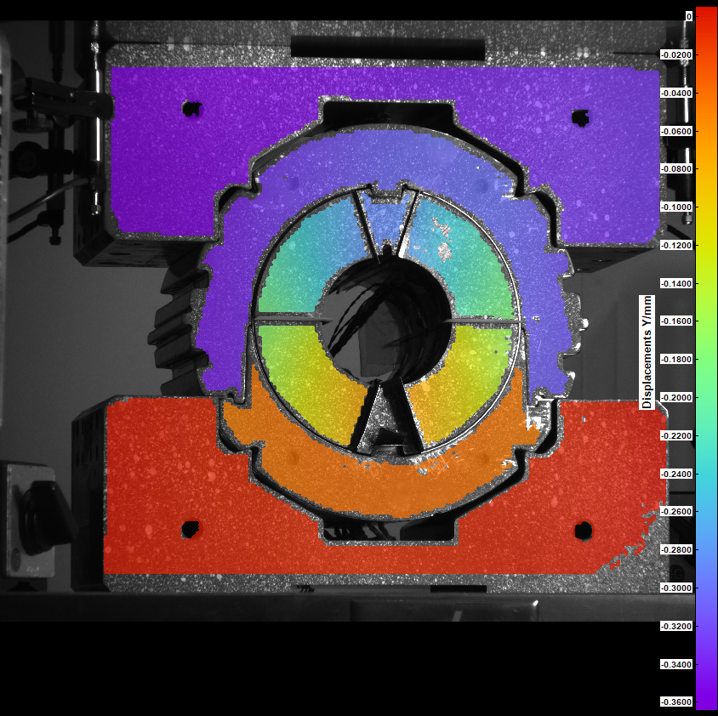
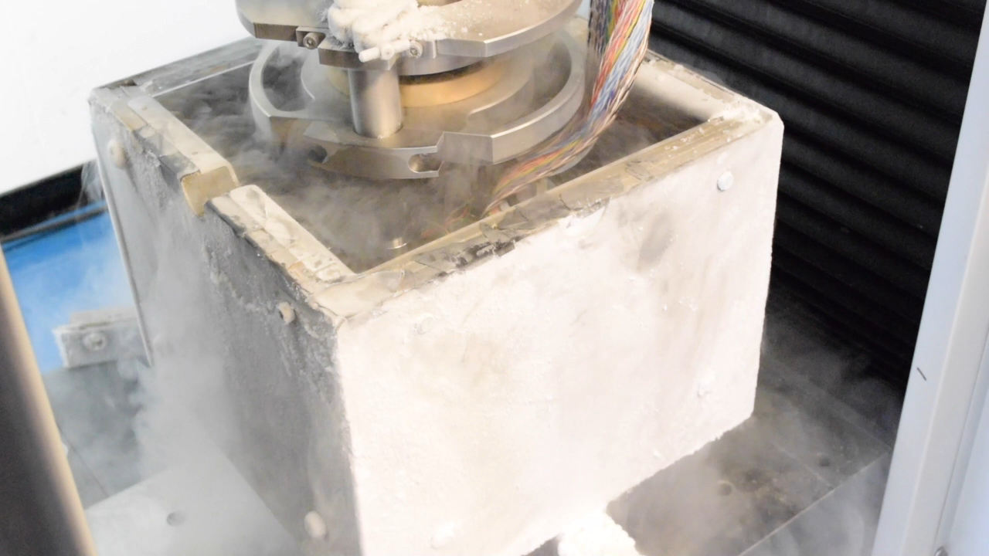

THE MECHANICAL MEASUREMENT LABORATORY
Thermal expansion up to 2000°C
The competencies of the laboratory stretches across several fields:
Measuring mechanical and thermal properties of materials and structures
In-situ measurements of the mechanical behavior
Optical fiber sensors
Seismic stations
…
VIRTUAL
LAB VISIT
Instrumentation of structures such as magnets
Compression testing in liquid nitrogen (77 K)
Mock-up testing

Slide 8













Roadmap – from a simple idea to its final design
ACQUIRING MATERIAL PROPERTIES
TESTING OF MOCK-UPS
SIMULATING
THE MODEL’S PHYSICS
CREATION OF A FIRST 3D MODEL
REVISION OF 3D MODEL
2D DRAWING

Slide 9


“SMALL” SUMMARY
Our working group is split in 3 pillars – DESIGN, COMPUTATIONS, and MEASUREMENTS
Each pillar is specialized in its field – but all of us are exposed to the same complex environments
From an idea to a final design is an iterative process, and requires all the three pillars to collaborate

Slide 10
Thanks for the material to O. Sacristàn, M. Guinchard,
O. Bahmane, A. Piccini, and all other colleagues involved

