Slide 1

Metallurgy and Material Science at CERN
Anité Pérez CERN EN-MME-MM

Slide 2
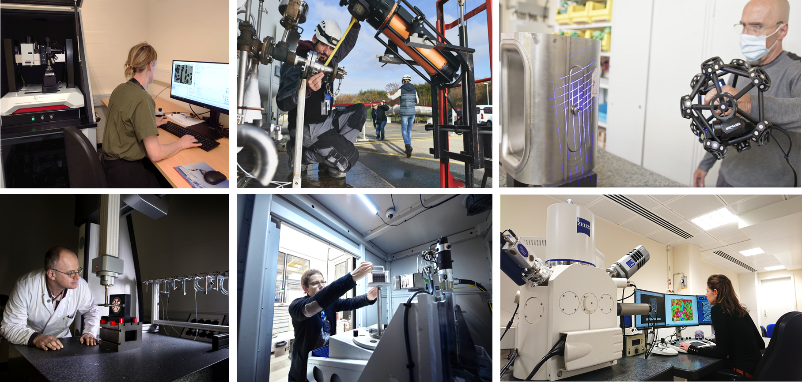
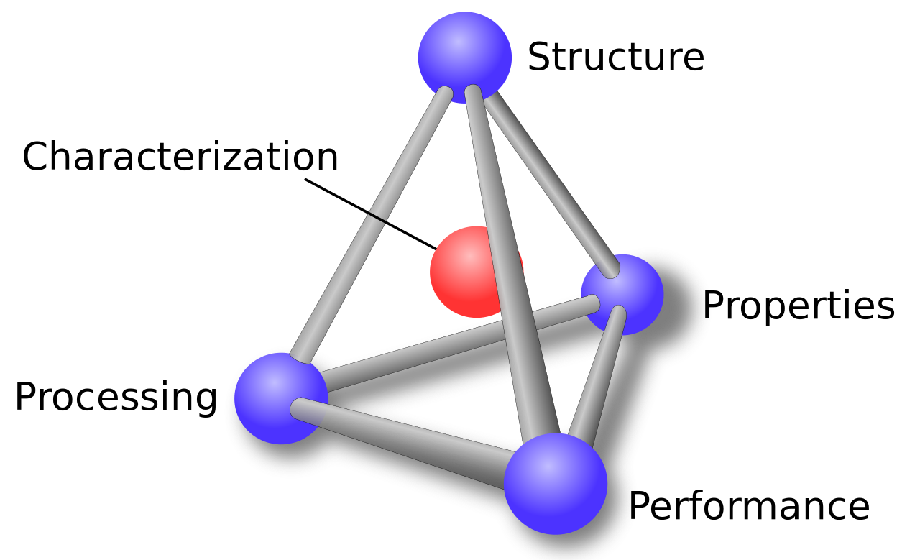

Metallurgy and Materials Science at CERN
  It covers metals, ceramics, polymers, composites…These materials are crucial for advancing technologies in all fields (energy, medicine, transport, computing…) and in accelerators
  The Materials service at CERN assists colleagues in studying existing materials (bulk, powder, 3D printed, coatings) and developing new ones to address engineering challenges within the scientific community
  Our main task as materials experts at CERN is to understand the structure and properties of the materials and predict/understand their performance in the accelerator environment as a function of their processing
Materials, Metrology and Non-Destructive Testing (MM) Section | EN-MME-MM (cern.ch)

Slide 3
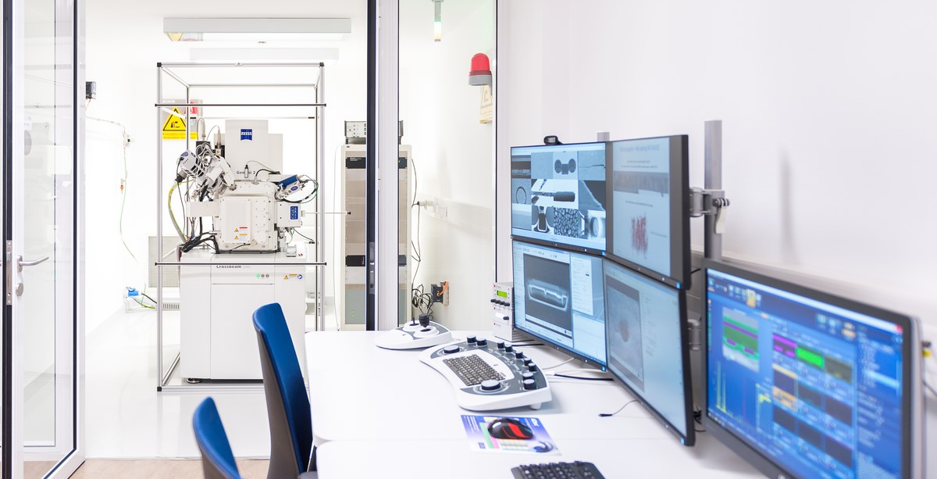
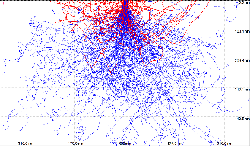
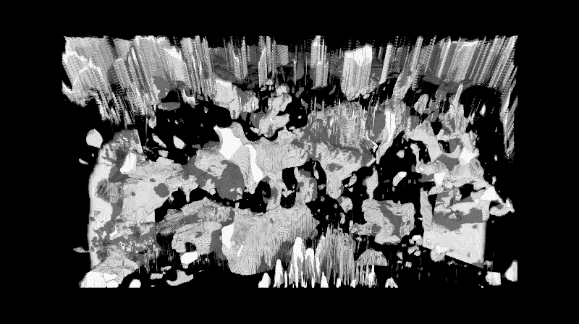
SEM-based microanalysis: Energy Dispersive X-ray Spectroscopy (EDS)
Requirements:
Specimen SEM inspectable
Non volatile/ hazarous particles
Nanometric to micrometric
Particles analysis at CERN
At CERN we need to characterize this internal structure (that can be crystalline or amorphous) and we need tools able to image in the nanometric to millimetric range
Microscopic characterization at CERN
Some examples of techniques
Topography analysis
Chemical analysis
Cross section
3D FIB Tomography
What is Microstructure?
What is Microscopy?

Slide 4

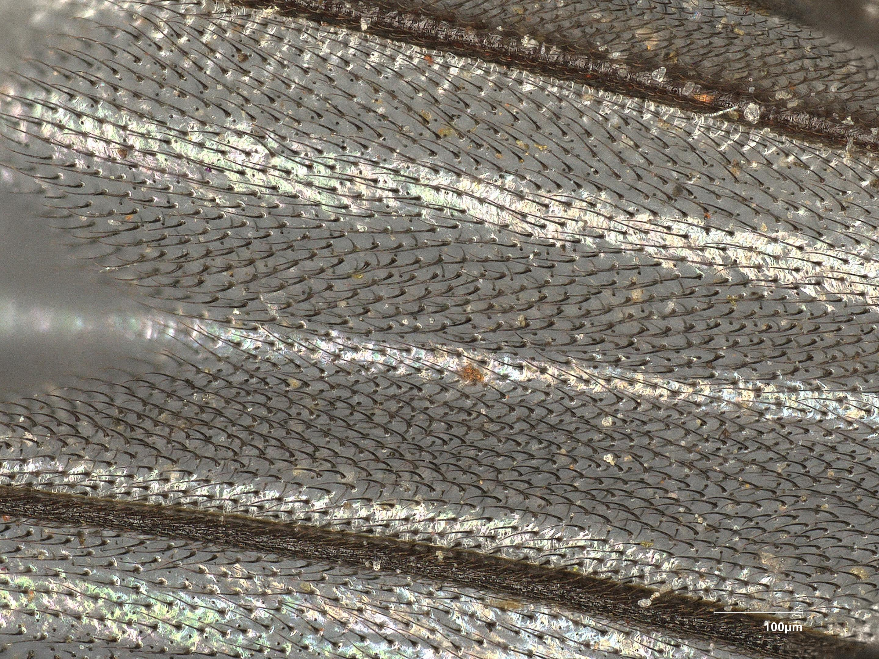
Microscopic characterization at CERN: Topography
  Sometimes the optical microscopy is enough to visualize what we want (~ 1 µm), and sometimes more resolution is needed
OM
100 µm
4

Slide 5
Microscopic characterization at CERN: Topography
  Sometimes the optical microscopy is enough to visualize what we want (~ 1 µm), and sometimes more resolution is needed
  Scanning Electron Microscopes (SEMs) are used to evaluate the surface at the nanometric level including analysis of X-rays emitted by the matter in response to being hit with charged particles → Energy Dispersive X-ray Spectroscopy (EDS)
OM
Microscopy
SEM
Detector
SAMPLE
100 µm
5

Slide 6
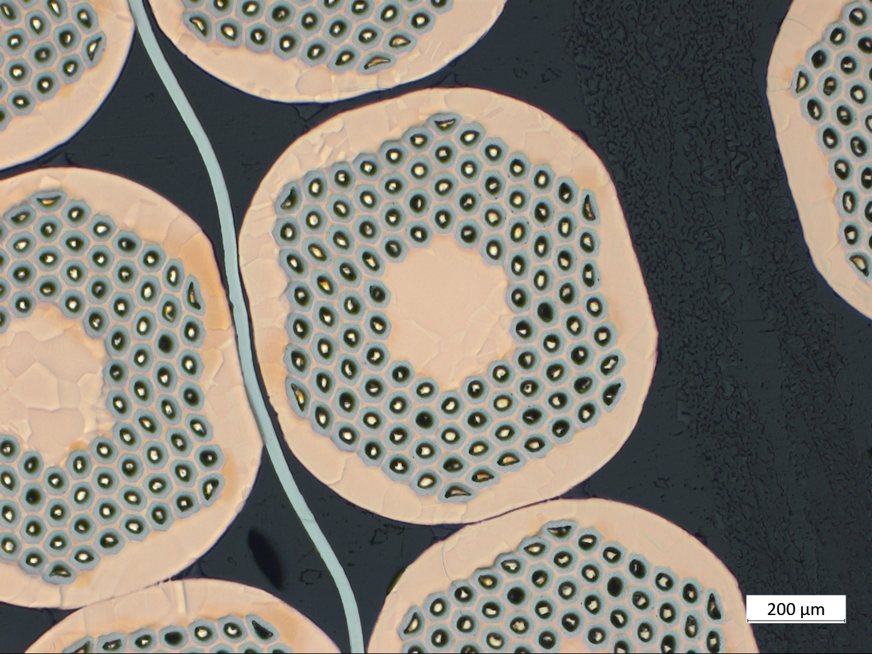
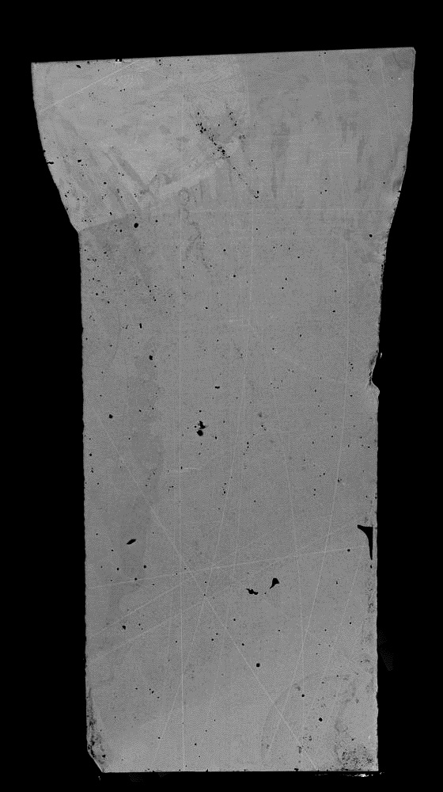
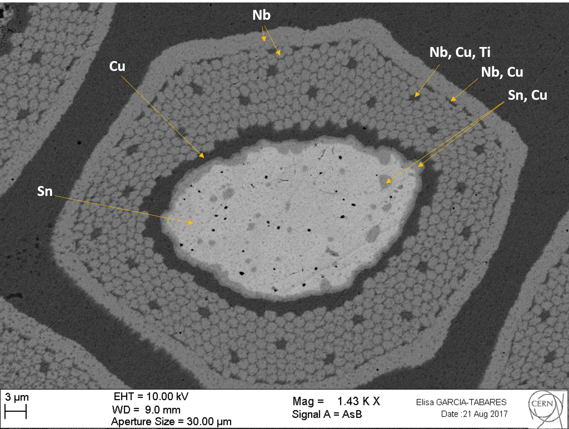
Microscopic characterization at CERN: Chemical analysis
  Sometimes the optical microscopy is enough to visualize what we want (~ 1 µm), and sometimes more resolution is needed
  Scanning Electron Microscopes (SEMs) are used to evaluate the surface at the nanometric level including analysis of X-rays emitted by the matter in response to being hit with charged particles → Energy Dispersive X-ray Spectroscopy (EDS)
OM
SEM
Investigation of the phases present into welds that are working at 4 K
Superconducting Nb₃Sn cables before reaction as part of the QA/QC at CERN
EDS
2 mm
100 µm
6

Slide 7
Microscopic characterization at CERN: FIB cross section
  Sometimes the optical microscopy is enough (~ 1 µm) to visualize what we want, and sometimes more resolution is needed
  Scanning Electron Microscopes (SEMs) are used to evaluate the surface at the nanometric level including analysis of X-rays emitted by the matter in response to being hit with charged particles → Energy Dispersive X-ray Spectroscopy (EDS)
  Focused Ion Beam (FIB) combined with SEM is used to characterize near surface microstructure and features
Surface treated with laser (LESS) as a novel solution for the in-situ treatment of the LHC beam screens for HL-LHC project to reduce the secondary electron yield (SEY)
Installation of Laser Engineered Demonstrator Chamber in the LHC | High Luminosity LHC Project (cern.ch)
7

Slide 8
Microscopic characterization at CERN: FIB cross section
  Sometimes the optical microscopy is enough (~ 1 µm) to visualize what we want, and sometimes more resolution is needed
  Scanning Electron Microscopes (SEMs) are used to evaluate the surface at the nanometric level including analysis of X-rays emitted by the matter in response to being hit with charged particles → Energy Dispersive X-ray Spectroscopy (EDS)
  Focused Ion Beam (FIB) combined with SEM is used to characterize near surface microstructure and features
FIB
SEM
SAMPLE
Installation of Laser Engineered Demonstrator Chamber in the LHC | High Luminosity LHC Project (cern.ch)
8

Slide 9
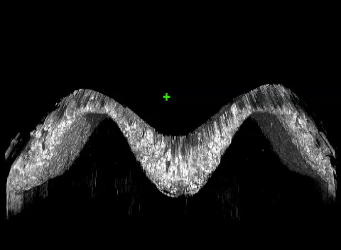
Microscopic characterization at CERN: 3D FIB-tomography
  Sometimes the optical microscopy is enough (~ 1 µm) to visualize what we want, and sometimes more resolution is needed
  Scanning Electron Microscopes (SEMs) are used to evaluate the surface at the nanometric level including analysis of X-rays emitted by the matter in response to being hit with charged particles → Energy Dispersive X-ray Spectroscopy (EDS)
  Focused Ion Beam (FIB) combined with SEM is used to characterize near surface microstructure and features
20 µm
FIB
SEM
SAMPLE
Installation of Laser Engineered Demonstrator Chamber in the LHC | High Luminosity LHC Project (cern.ch)
9

Slide 10
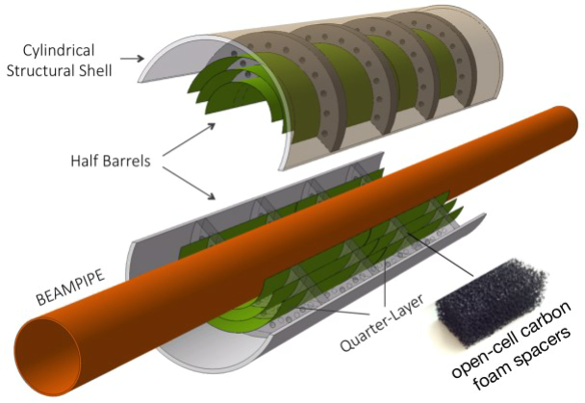
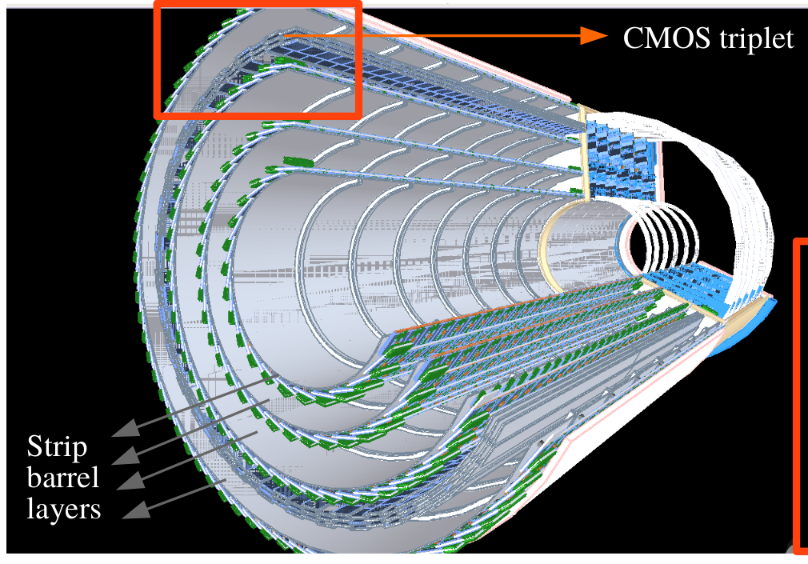
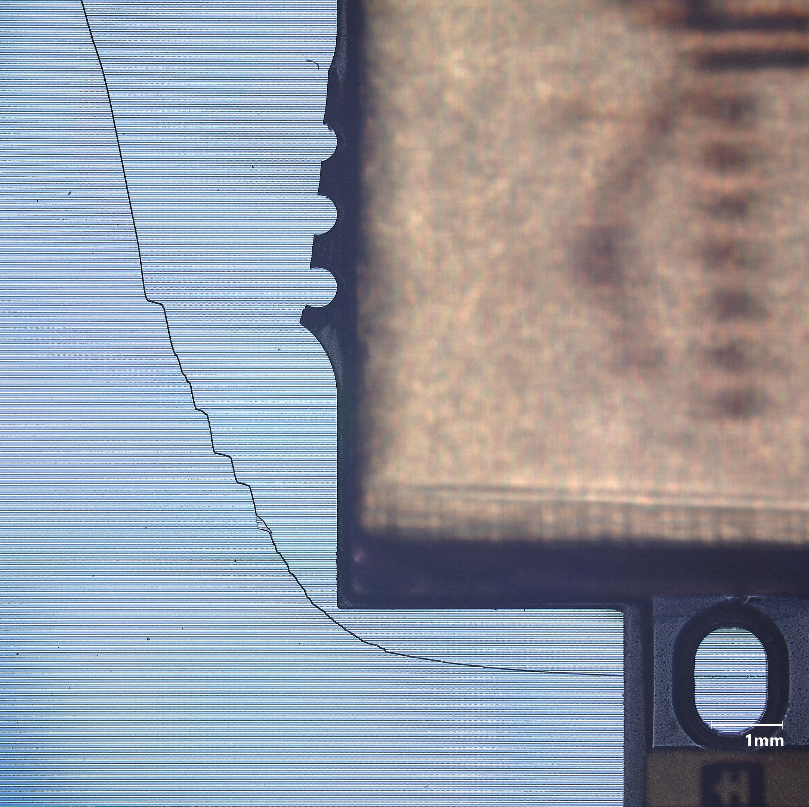
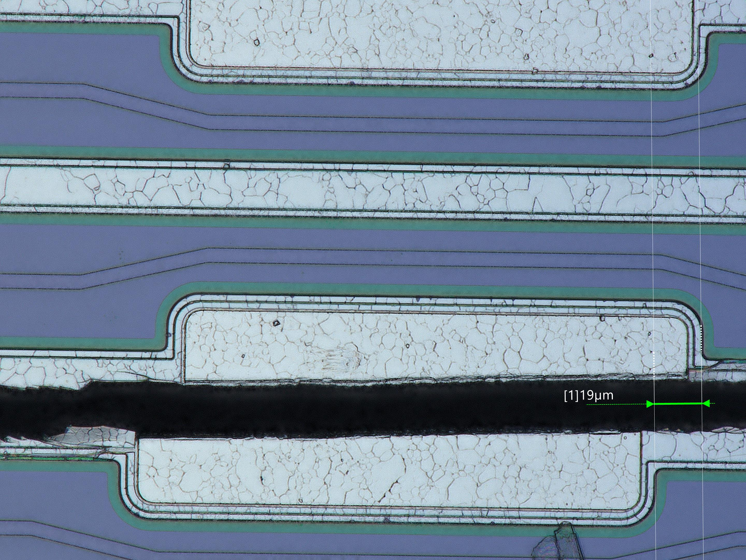
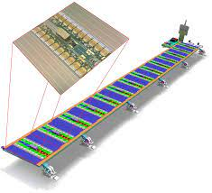
Microscopic characterization at CERN: Other applications
Testing of new materials: Carbon foams for the new Inner Tracking System (ITS3) for ALICE ITS upgrade. The goal is to use ultra-lightweight spacers, made of carbon foam to reduce the total weight of the experiment
Reverse Engineering: To analyse and gain knowledge about the way something works, and which materials were used to build it because we need to manufacture it again or to evaluate the irradiation effect (ex. commercial CMOS)
Failure analysis: Technical procedure to investigate the root cause of failure of a product or equipment during the design, manufacturing or service process (ex. Silicon module on ATLAS ITK stave failed during cooling test)

Slide 11
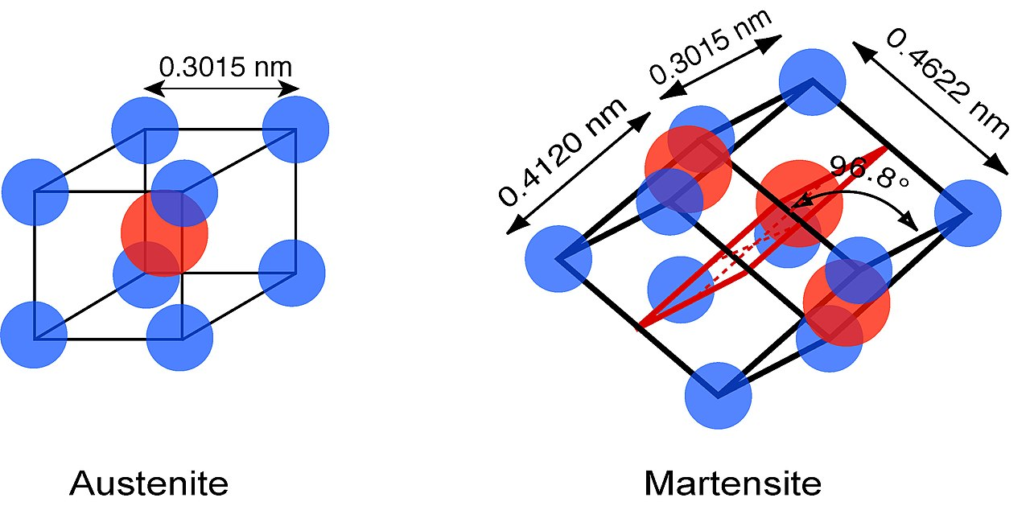
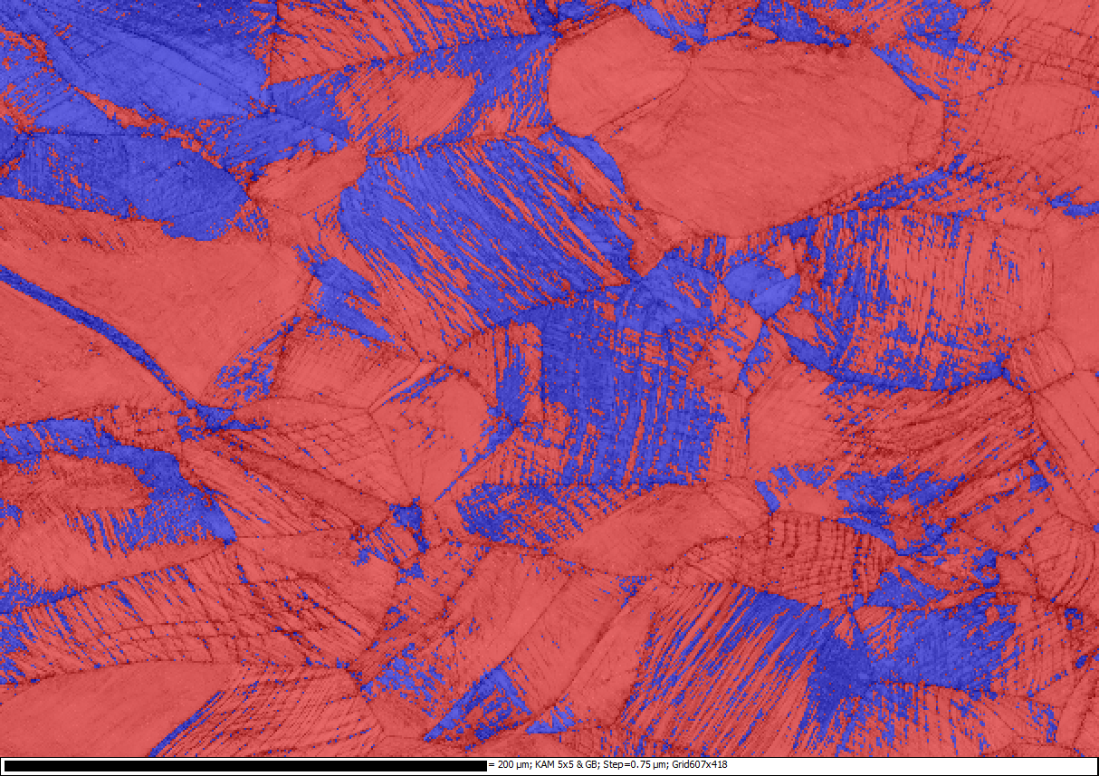
Microscopic characterization at CERN: Cryogenic studies
304L stainless steel with 23% deformation at 4K
316LN stainless steel with 32% deformation at 4K
Martensite (BCC)
Austenite (FCC)
The strain-induced martensitic content in the grades 316LN at a given temperature and for the same level of plastic strain, is much lower than in the grade 304 L.
observation of the dislocation substructure in the vicinity of a shear band formed in the single crystal during deformation

Slide 12
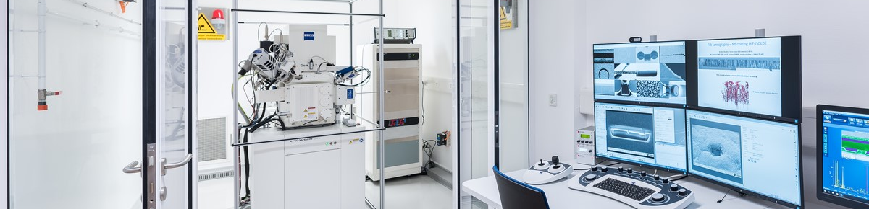
Summary
GENERAL:
The Materials service provides support to anyone at CERN that wants to study or control materials.
Metals, polymers, ceramics and composites are the most frequent in bulk, powder or coating format.
MICROSCOPY TECHNIQUES:
Different systems and techniques are available in the service to extract precise information in the nanometric to micrometric scale about morphology, chemistry and internal structure
APPLICATIONS:
Quality control, new materials research, new developments and technology, medical devices, reverse engineering, failure analysis…
19-Mar-24
Notes:
For FCC, simulations are required to understand if such small macro-particles could cause unacceptable beam losses.

Slide 13
Thanks for your attention!

