Slide 1
BSRH status and MD plan
In the scope of LHC beam halo monitoring working group
Jan Pucek, Daniele Butti
22.03.2024

Slide 2
Outline
BSRH status
  Current layout
  Alignment
  First “data”
MD plan (floating 4+4)
  First 4 hours
  Second 4 hours
Discussion

Slide 3
BSRH status

Slide 4
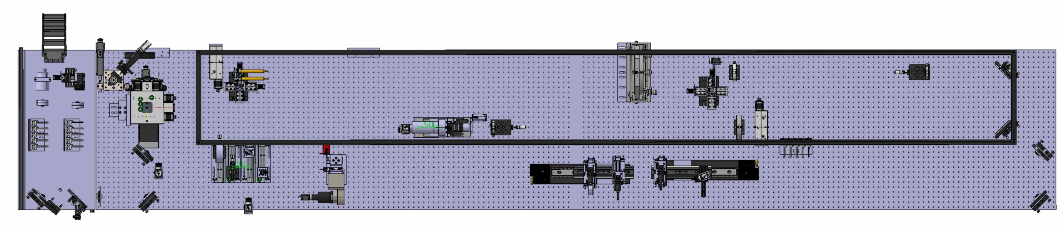
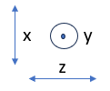
Current layout – beam 2
Occulter (masks)
Readout camera
Lyot’s stop
Light in
Possible configurations:
Regular telescope – imaging the SR
Telescope with occulter – masking the core enables longer exposure time/gain
Coronagraph – diffraction from the beam mirror can be mitigated

Slide 5
Alignment + first “data” acquired
Alignment:
  Local small laser pointer (when table out), very coarse alignment
  Laser pointer 30m away – alignment close to SR, but not useful for focusing,+550nm
  SR – only remote alignment
Focusing:
  Occulters must be focused by using a uniform illuminator → found a problem (resolved by mounting an additional translation stage)
Data:
  Alignment with SR → Imaging, occulter and Lyot’s stop movement for two different emittance beams

Slide 6
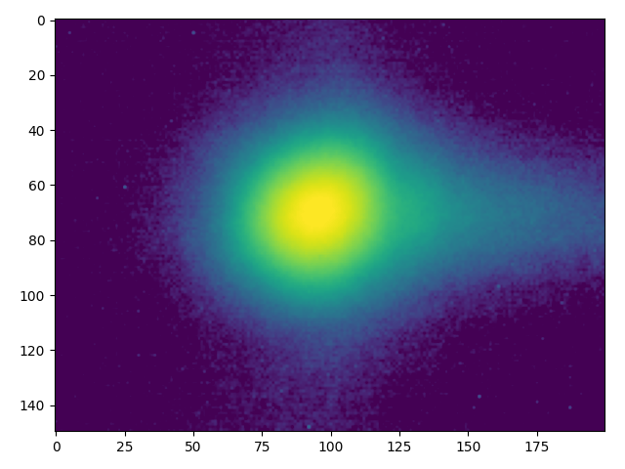
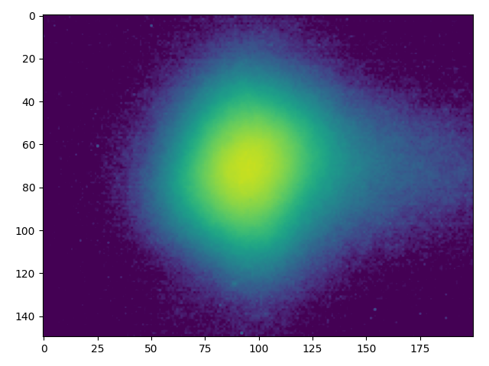
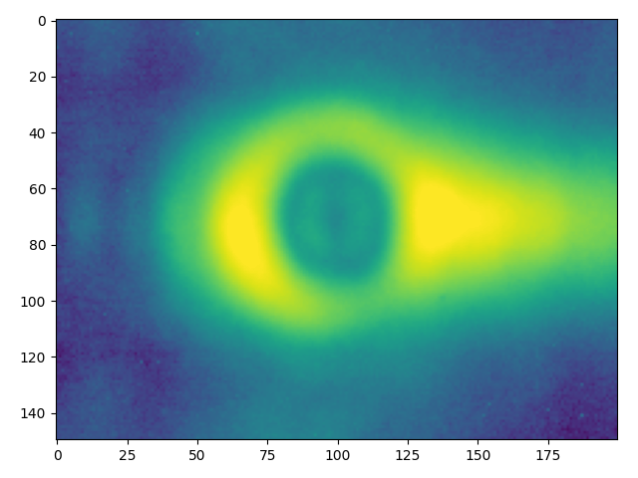
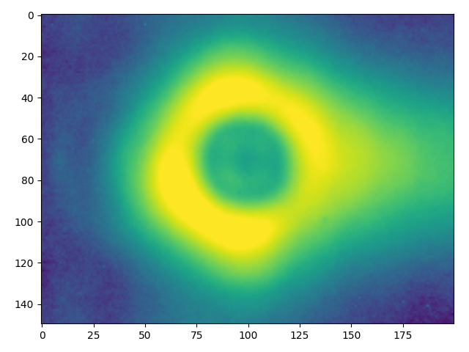
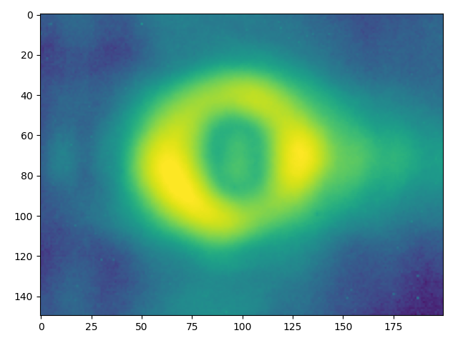
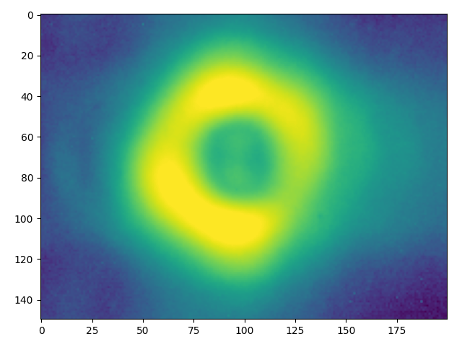
Data
Low ε
High ε
Imaging
    Clearly different size between low emittance and high emittance beams.
Occulted image
    Makes higher contrast measurement possible, but a diffraction tail present (in H)
  Occulted image + Lyot’s stop
    Right tail diminished

Slide 7
MD plan
Floating 4+4 hours

Slide 8
First 4 hours
Injection: Beam 2 – Nominal, 5xPilot, Nominal, 5xPilot at 2.5um emittance (safe beam mode), energy – flat top
Requirements: Inner collimator limits must be opened, high octupole settings?
DAQ steps:
Reference data = imaging, occulted image, occulter in and Lyot’s stop “closed”
Take BWS reference in both planes, increasing gain just bellow saturation
Collimate the beam, remeasure (coronagraph + BWS), choose an occulter size that will cover all light
Open collimators, use ADT to blow up a Pilot and check for differences on coronagraph + BWS
  If the halo is sufficiently high, close the collimators again and kick the pilots with ADT to lower their charge
Repeat steps 4 and 4.1

Slide 9
Second 4 hours
Plan depends on the results obtained from the first 4 hours

