Slide 1
A Novel Formulation for the Numerical Simulation of HTS Pancake Coils
D. Rinaldoni, B. Bordini
26/04/2024

Slide 2
The Framework
In the context of the 40 T Solenoid project and the study of HTS, numerical simulation is a powerful tool that provides invaluable insights into the phenomena under study.
This work aims to implement a 3D numerical model that can describe the complex electro-dynamics of HTS Pancake Coils.
The goal is to create a foundational tool that serves as a stepping stone toward a more elaborate model, which can incorporate thermal aspects in the future to understand the dynamics of magnets during quenches better.

Slide 3
The J-A Formulation
The model presented here is a 3D tool that employs the Finite Element Method (FEM) in COMSOL Multiphysics.
To this aim, we developed a novel mathematical formulation: the J-A formulation.
When compared to the classical H-φ approach (accurate but computationally heavy), this method is expected to be less demanding for solving 3D problems, thus offering a potentially reduced computational time.

Slide 4
The J-A Formulation
Starting point: the total electric field is the sum of two contributions:
$$E=− ∇V −\frac{∂A}{∂t}$$
Electrostatic
Magnetic
Thus, the model deals with two separate modules: the magnetic and the electric one.
This approach should be advantageous as it allows the two modules to operate independently within their respective domains.
Dependent variables: the magnetic vector potential A and the electric current density J.

Slide 5
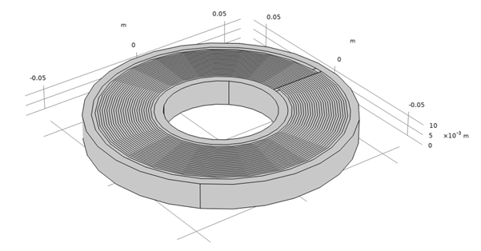
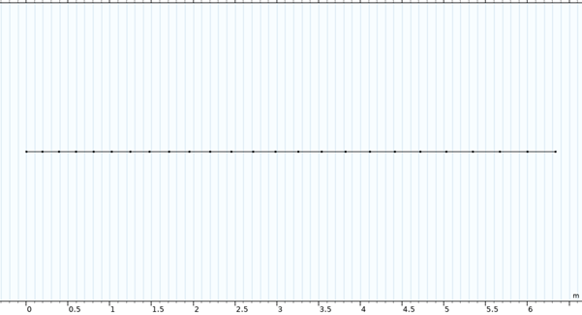





The J-A Formulation
Magnetic module
Electric module
Defined on a fully 3D domain
Equations:
Defined only on the 1D domain representing the unwound tape
Equations:
$$\frac{1}{µ_{0}}∇×∇×A=J$$
$$∇∙J=Q$$
$$J=σE+J_{e}$$
$$∇∙A=0$$
$$E=− ∇V$$
Geometry:
Geometry:
Notes:
Current inserted from the outer ring, using an equipotential surface, no magnetization, radial currents made thanks to connections between one layer and the following one

Slide 6
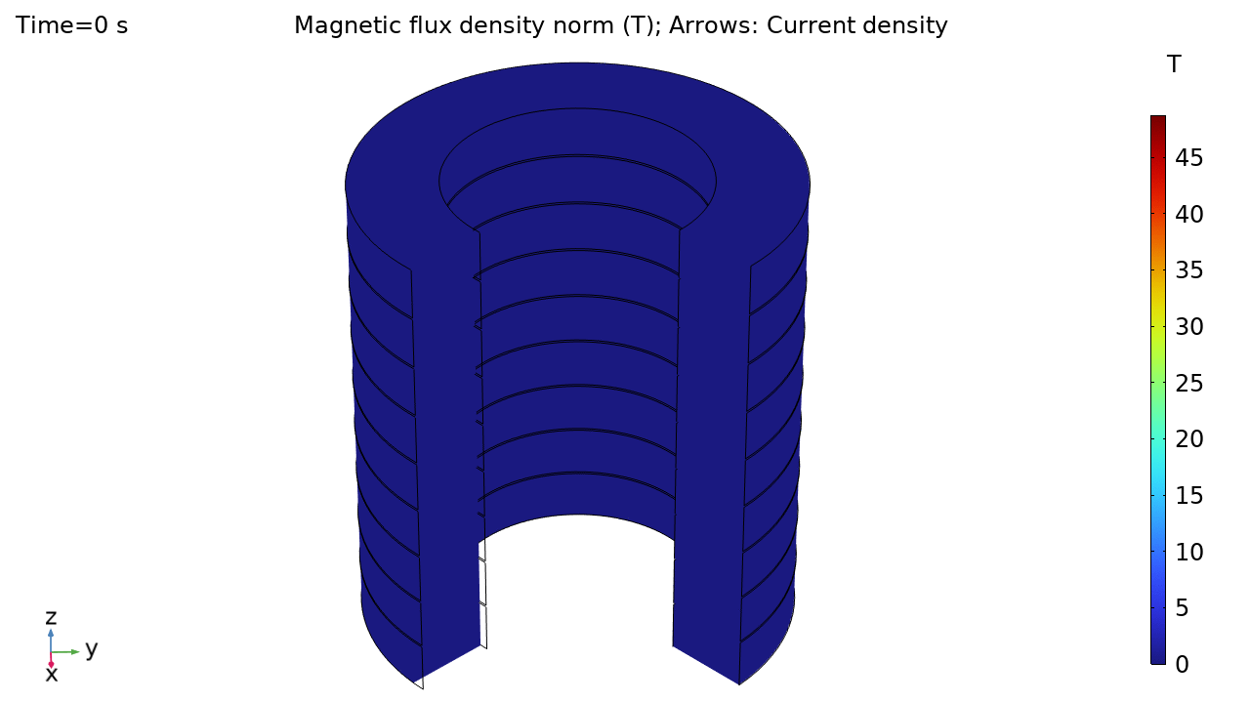
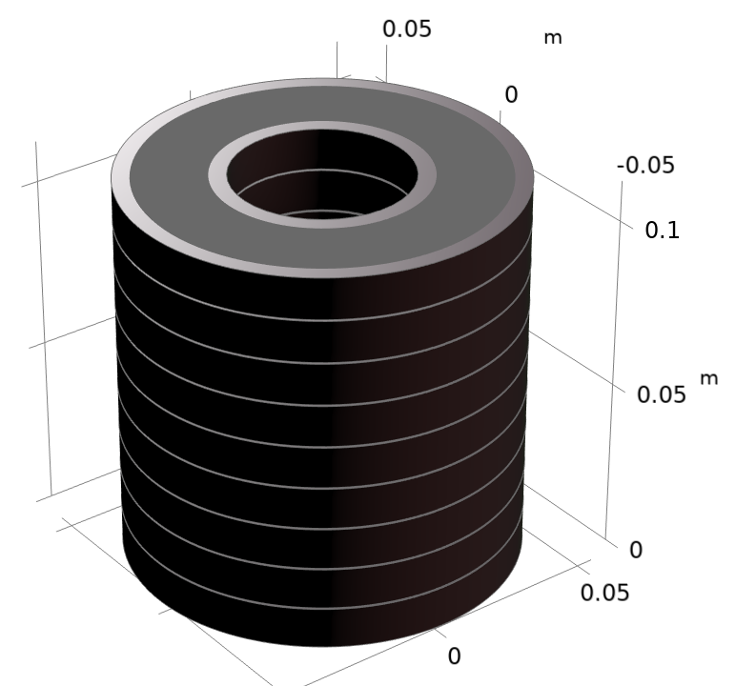
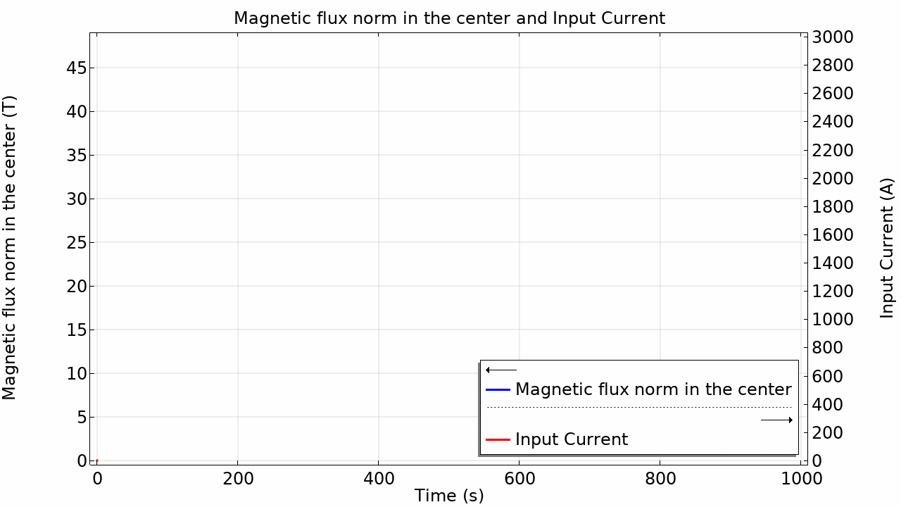
Case Study 1: a First Example
Infinite number of identical 3D pancakes
1 pancake simulated using periodic boundary conditions
Coil winding thickness 2 cm
Tape thickness 80 µm
250 turns
Tape width 12 mm
Contact resistance 10 μΩ cm²
1 mm of air between coils
Max input current 3000 A
Current injected radially from the outermost layer
The 3D current distribution indicates a tendency for higher current densities in the inner part of the solenoid during the energization.
By injecting a current that ramps until a plateau of 3000 A, we reach a center field > 40 T.

Slide 7
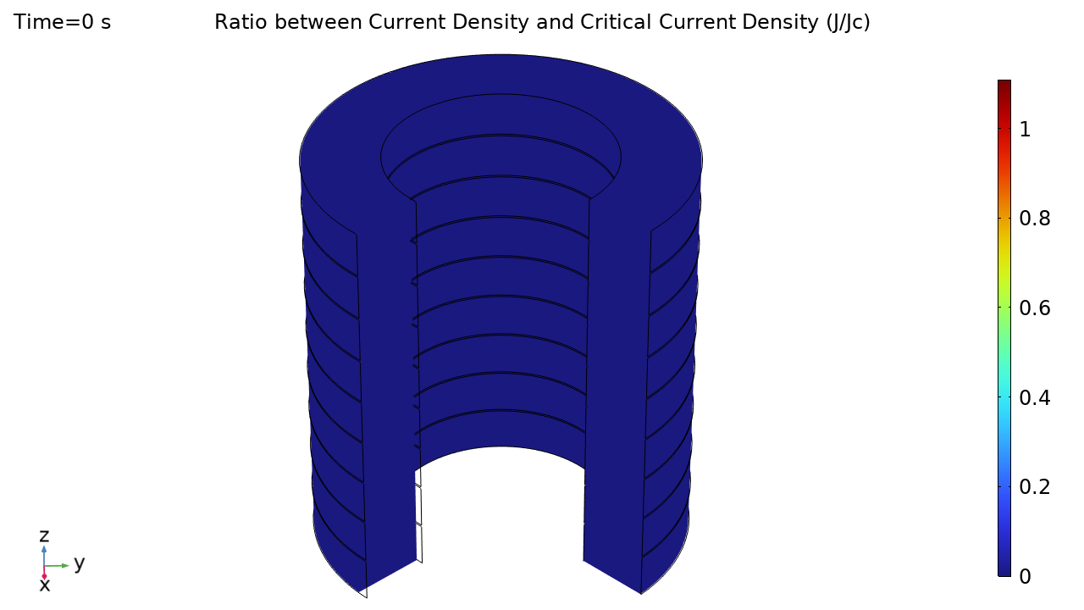
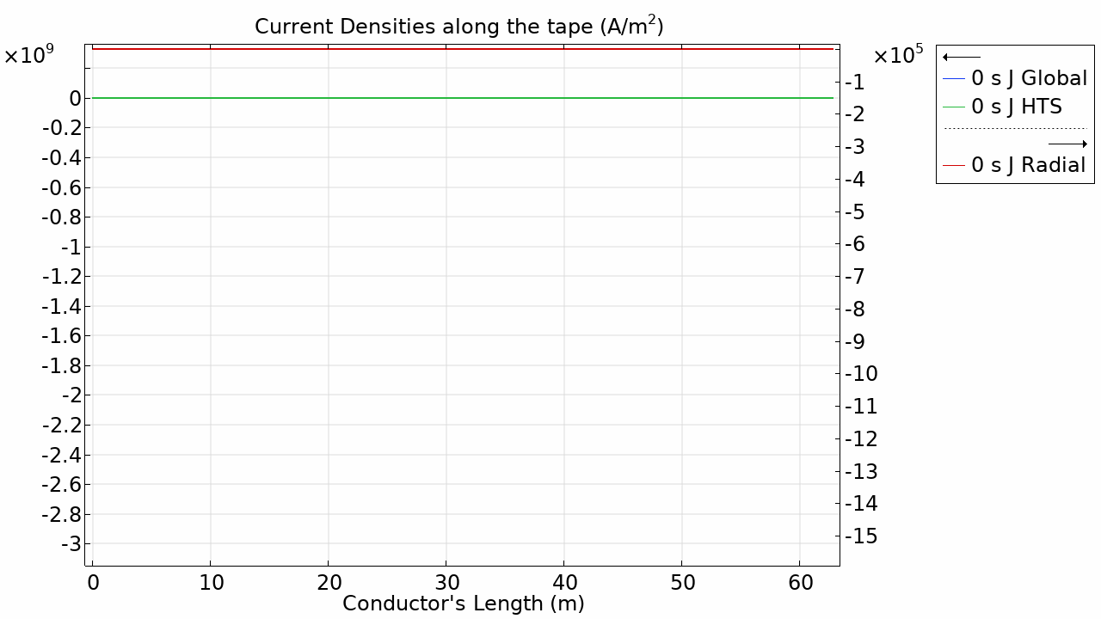
Case Study 1: a First Example
When the injection current is constant and we reach the critical current density J_{c}, the tangential (with respect to the tape) current density diminishes while the transversal current increases.
Current density distribution through the length of the conductor from the innermost to the outermost winding (about 60 m of tape needed for 1 pancake).

Slide 8

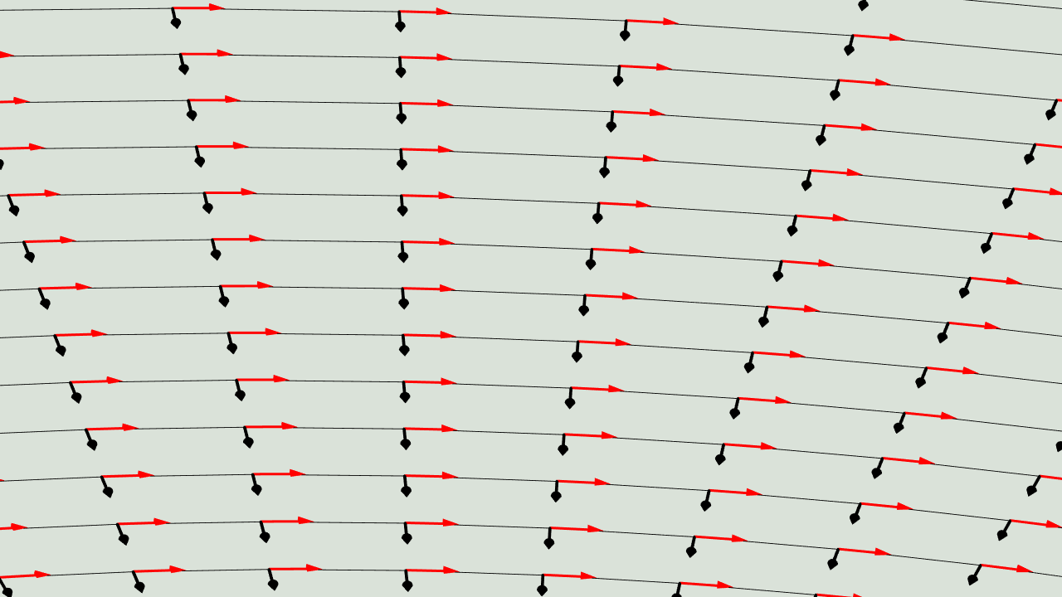
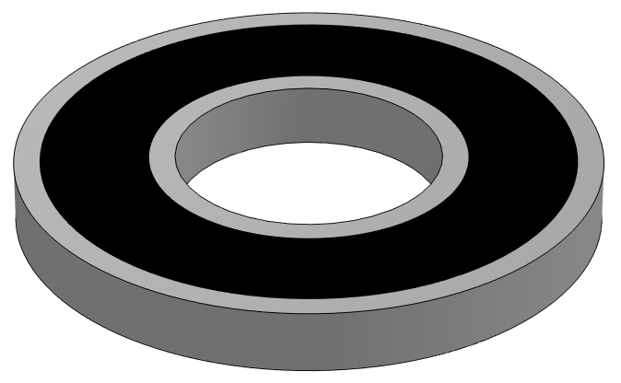
Case Study 1: a First Example
Remark: In the model, each 3D pancake consists of 250 turns, through which both radial and longitudinal (with respect to the tape) currents flow.
Zoom on some of the 250 layers. Examples of longitudinal (red) and radial (black) currents.
3D plot of the radial current distribution
Notes:
Each turn will be characterized by

Slide 9
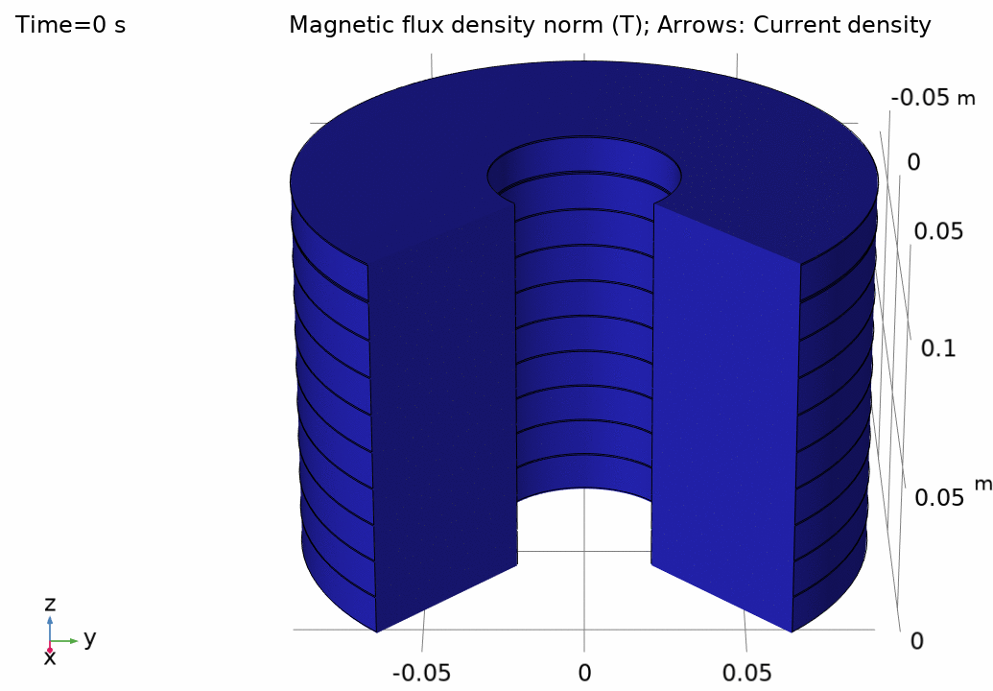
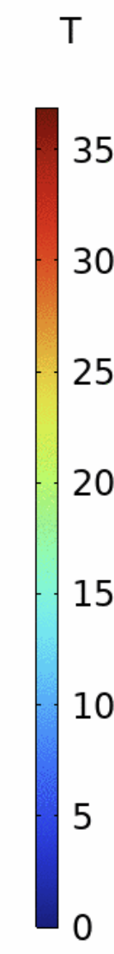
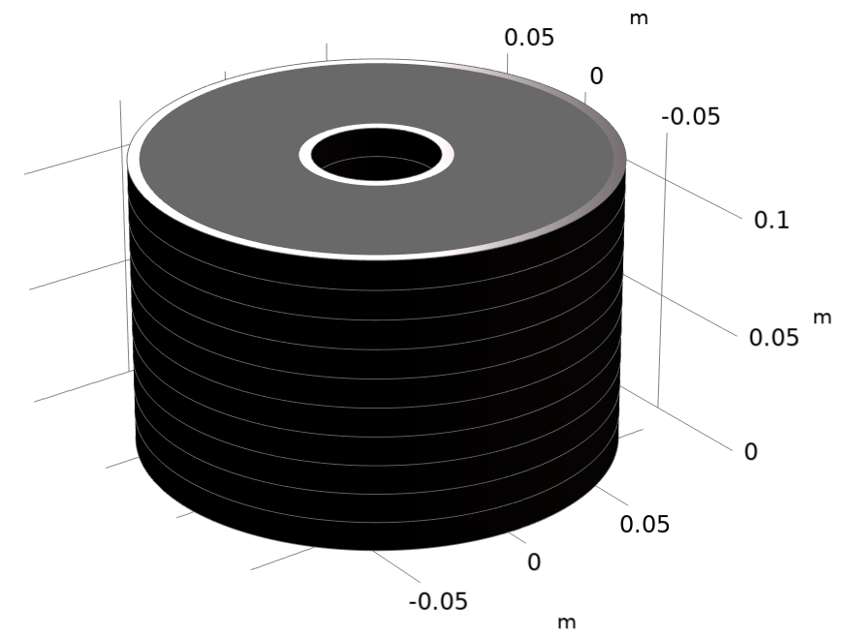

Case Study 2: the 40 T Solenoid
Infinite number of identical 3D pancakes
Coil winding thickness 6 cm
Tape height 160 µm
Conductor made of two tapes ( total thickness 160 µm)
375 turns
Tape width 12 mm
Contact resistance 10 μΩ cm²
1 mm of air between coils
Max injected current 1200 A
Current injected radially from the outermost layer
This time we stay well below the critical current of the conductor.

Slide 10
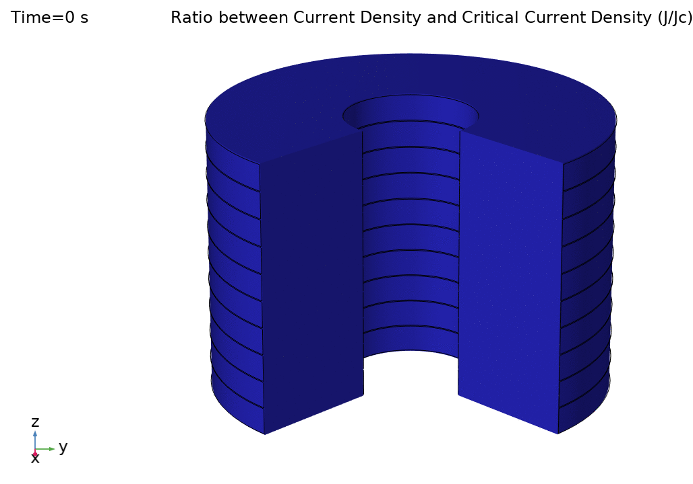
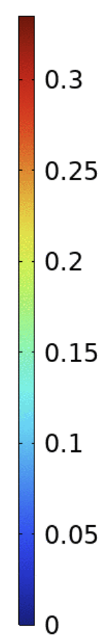
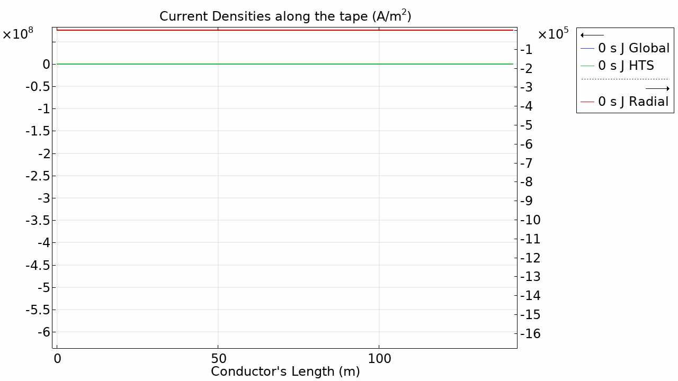
Case Study 2: the 40 T Solenoid
In this case, we are always under the critical current density so the radial currents remain small over the entire simulation.

Slide 11
Further Developments
The current model does not consider magnetization → currently working on that.
The thermal part is missing: it will be crucial to add it in order to have a tool that comprehensively analyzes the quench phenomenon.
A parametric study to analyze the relation between the contact resistance and the energization time constant in the coil.

Slide 12
Thank you for your attention.
Questions?

