Slide 1



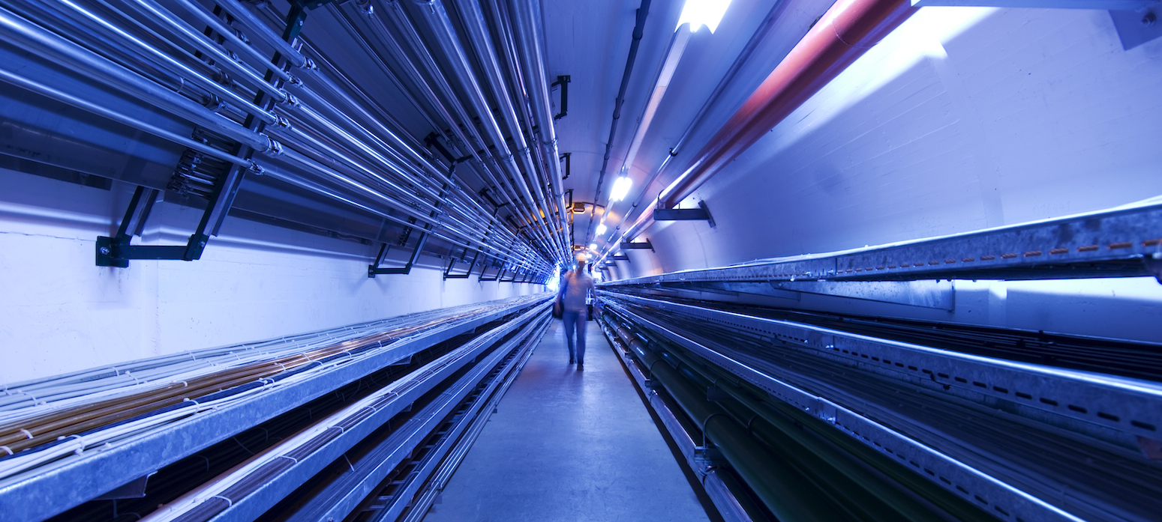
Pancake assembly
F. Sanda
Final cooling solenoid meeting
26/04/2024

Slide 2
Pancake assembly sequence
Assembly sequence acc. to the idea of B. Bordini

Slide 3
Pancake assembly sequence
Assembly sequence acc. to the idea of B. Bordini
Pancake interconnections

Slide 4
Pancake assembly sequence
Assembly sequence acc. to the idea of B. Bordini
Base plate lowered down
or
Central pin raised up

Slide 5
Pancake assembly sequence
Assembly sequence acc. to the idea of B. Bordini
Pancake interconnections

Slide 6
Pancake assembly sequence
Assembly sequence acc. to the idea of B. Bordini

Slide 7

Thank you
for your attention!
Your questions please?

