Slide 1



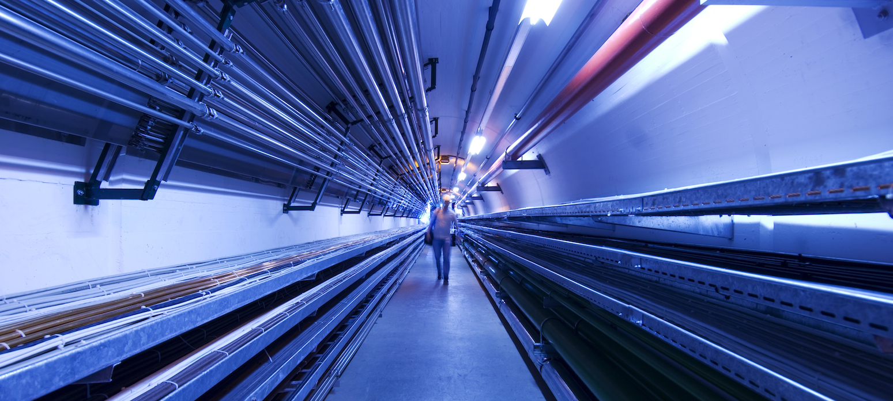
Final cooling solenoid assembly concept
F. Sanda
Final cooling solenoid meeting
17/05/2024

Slide 2
Base unit
Pancake with a 1st shrink disk
  Its assembly will not be discussed now

Slide 3
Assembly sequence – pancakes
Base plate with 3 guiding cylinders
Base plate with 3 guiding cylinders
Contact at the outer diameter of the shrink disk

Slide 4
Assembly sequence – pancakes
Pancakes and disk will be lowered down
Inner connections to be done
Non-conductive layer
Pancake interconnections

Slide 5
Assembly sequence – pancakes
Pancakes and disk will be lowered down
Conductive layer

Slide 6
Assembly sequence – pancakes
Pancakes and disk will be lowered down
Inner connections to be done
Non-conductive layer
Pancake interconnections

Slide 7
Assembly sequence – pancakes
Pancakes and disk will be lowered down
Conductive layer

Slide 8
Assembly sequence – pancakes
Pancakes and disk will be lowered down
Inner connections to be done
Non-conductive layer
Pancake interconnections

Slide 9
Assembly sequence – pancakes
Centering pin will be introduced

Slide 10
Assembly sequence – pancakes
Outer guiding cylinders will be removed

Slide 11
Assembly sequence – pancakes
2nd shrink fit cylinder will be assembled
Centering pin removed
-> New unit: assembly of 6 pancakes

Slide 12
Assembly sequence – magnet
Base frame
Centering on the outer diameter of the shrink disk

Slide 13
Assembly sequence – magnet
End cap
Assembly of 6 pancakes

Slide 14
Assembly sequence – magnet
Conductive layer
Assembly of 6 pancakes

Slide 15
Assembly sequence – magnet
Conductive layer
Assembly of 6 pancakes

Slide 16
Assembly sequence – magnet
Conductive layer
Assembly of 6 pancakes
End cap

Slide 17
Assembly sequence – magnet
Threaded rods to fix the magnet

Slide 18

Thank you
for your attention!
Your questions please?

