Slide 1


Overview of tests of ReBCO stacks and coils
C. Accettura, F. Sanda, A. Kolehmainen
Final Cooling Progress Meeting
https://indico.cern.ch/event/1390337/
23/05/2024, CERN

Slide 2
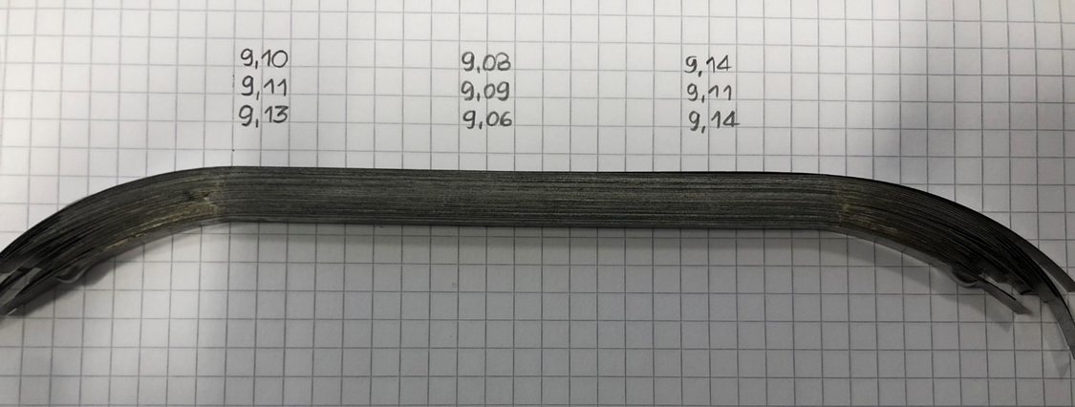
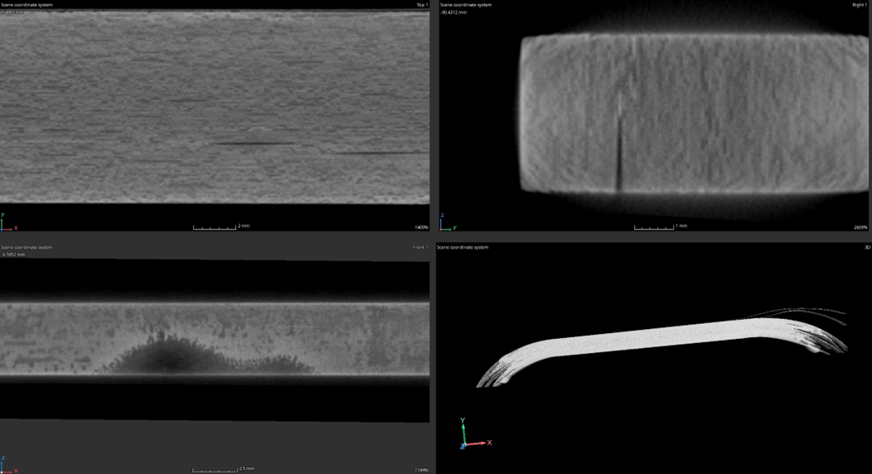
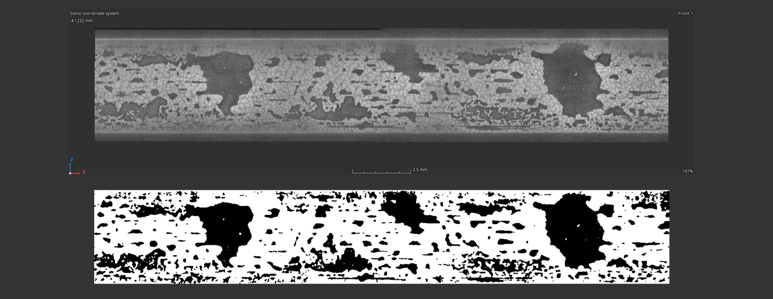
Sample 1
Sample 1: THEVA tape, 100 stacks, solder made of Tin-Lead, Tmax~200°C in air
Visible delamination
High quantity of residual solder from the thickness measurement
Porosity detected in the tomography
The range of calculated fill factor values made on 3 random sections was from 67 to 71%.
 | Position
 | 1 | 2 | 3
Soldering-max [mm] | 2.81 | 2.78 | 2.83
Soldering-min [mm] | 0.21 | 0.18 | 0.23
Courtesy of M. Celuch

Slide 3
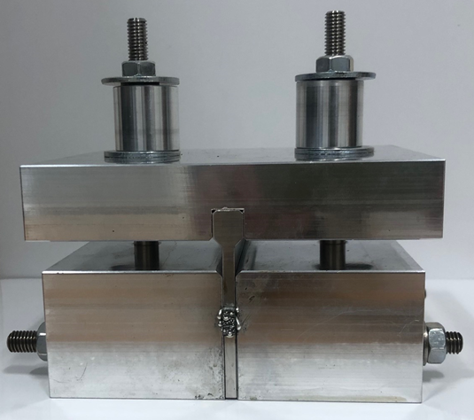
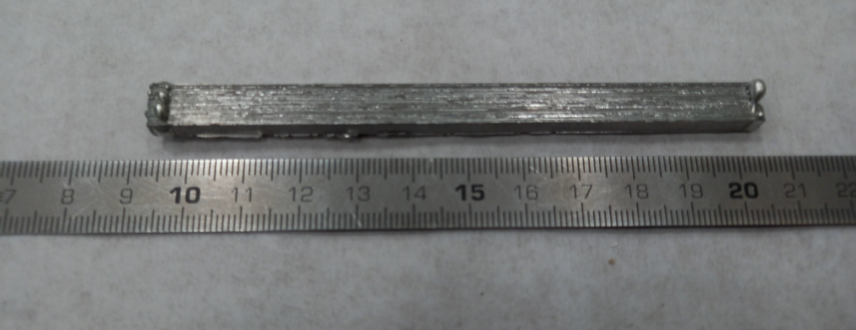
Sample 2
In order to minimize the porosity, the stacks is heated under vacuum
Sample cut for thermo-mechanical test (ongoing)

Slide 4
Sample 3
Coil – under test tomography

Slide 5
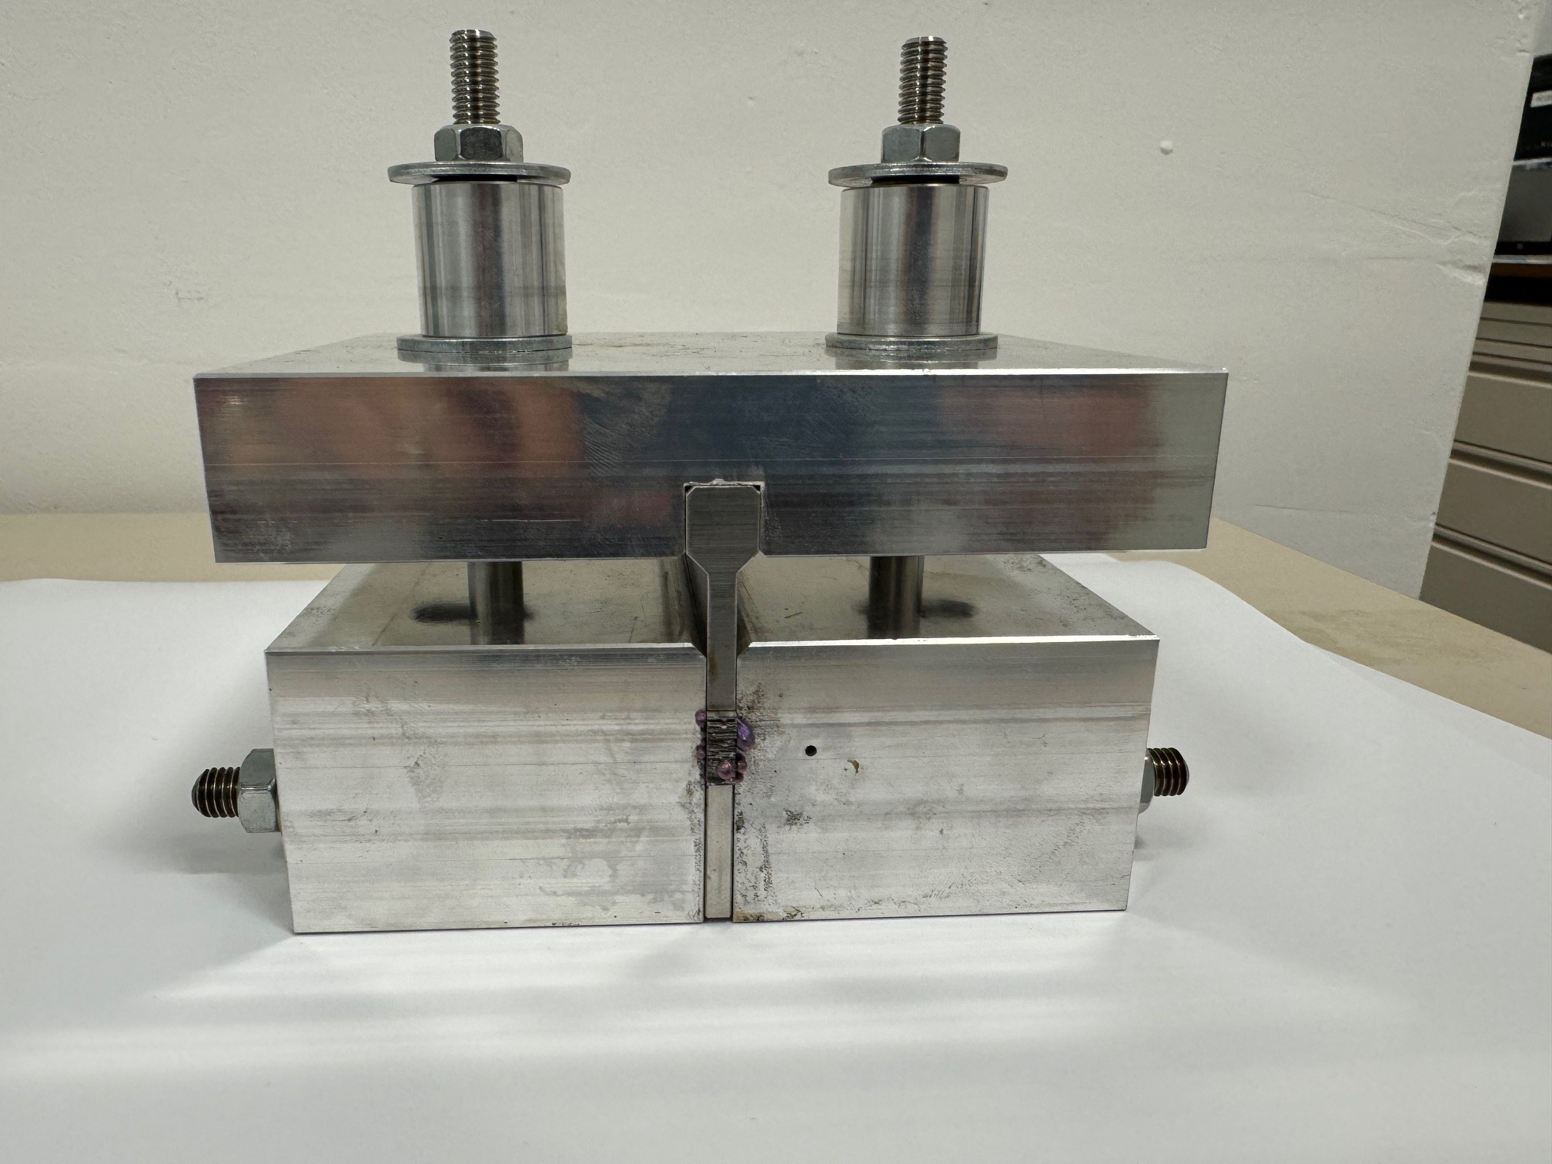
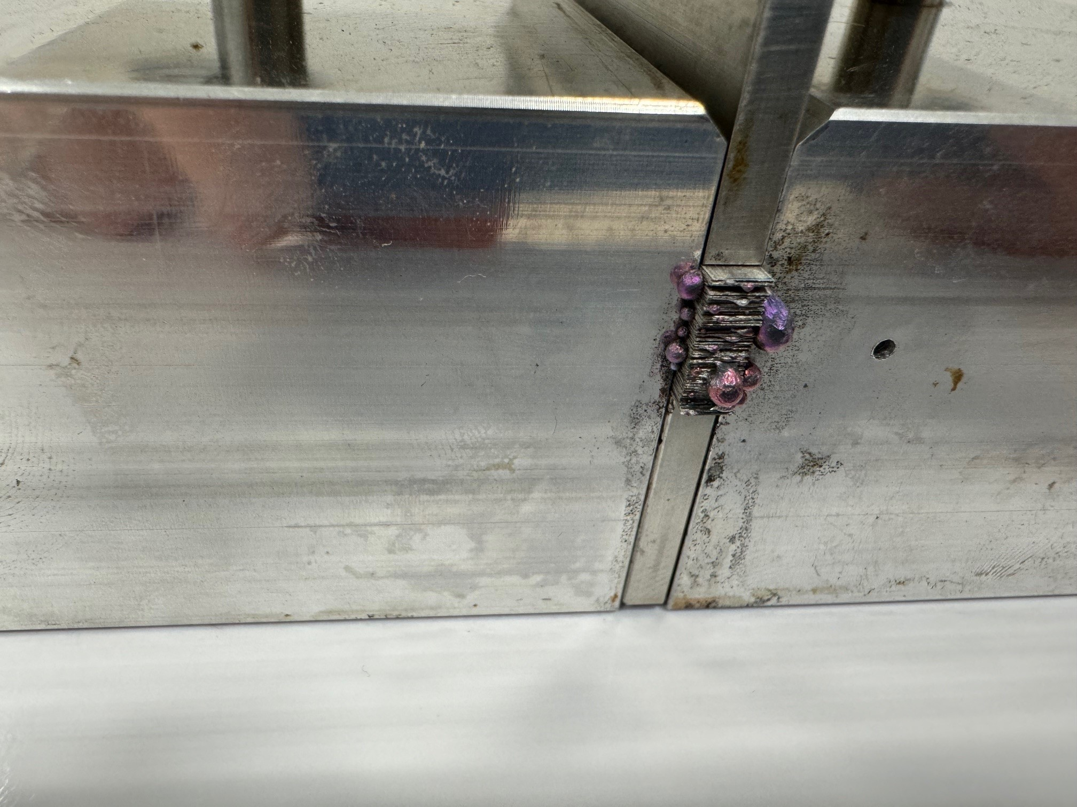
Sample 4
Same procedure of Sample 2?
Tomography?

Slide 6
What’s next
Planning for other stacks
Planning for coil

