Slide 1


Overview of tests of ReBCO stacks and coils
C. Accettura
Final Cooling Progress Meeting
https://indico.cern.ch/event/1390341/
02/08/2024, CERN

Slide 2
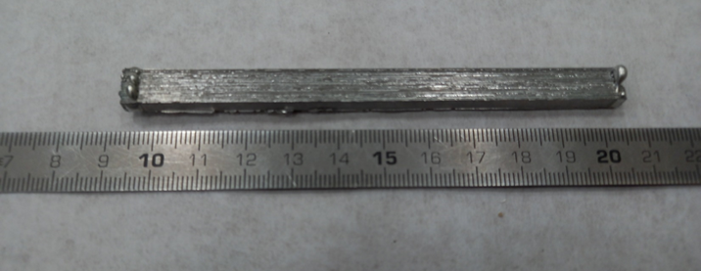
Overview of the tests
Material | Type | # sample | Dilatometer (-150-100°C) | IET | Compression | Diffusivity
SS304 for proof-of-concept | Single tape | 2
Fujikura FESC-SCH04 | Single tape | 2
Fujikura FESC-SCH04 supposedly substrate, likely it is SS304 | Single tape | 2
THEVA TPL4421 | Single tape | 2
THEVA TPL4421 | TP/IP stacks from sample #2 | 2 |  |  |  | to be discussed
Hastelloy | Single tape | 2
Fujikura FESC-SCH04 ETCHED | Single tape | 2
Faraday | Single tape | 2
SST | Single tape | 2
THEVA TPL4421 | TP/IP stacks from sample #5 | 2
Fujikura FESC-SCH04 | TP/IP stacks from sample #6,7,8 | 6
Faraday | TP/IP stacks from sample #9,10,11 | 6
SST | TP/IP stacks from sample #12,13,14 | 6
Sample #2

Slide 3
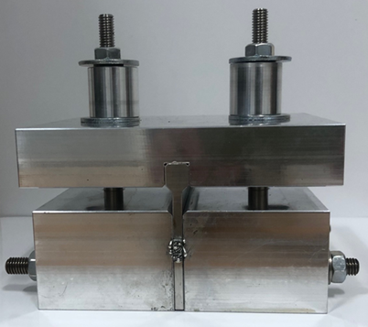
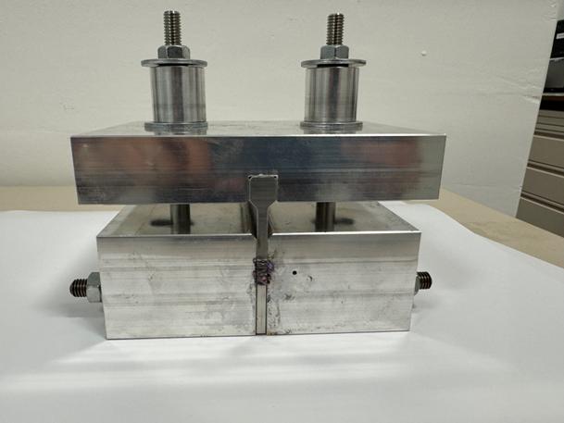
Production of stacks
Sample 2/4 showed a good reproducibility→ froze the procedure to make it
~10 stacks to be produced (1xTHEVA, 3xSST, 3xFaraday, 3xFujikura) for a complete thermo-mechanical characterization→ delay to be communicated to mechanical lab to plan
MME mechanical lab will take care of sample preparation
All the stacks to be controlled with tomography before testing

Slide 4
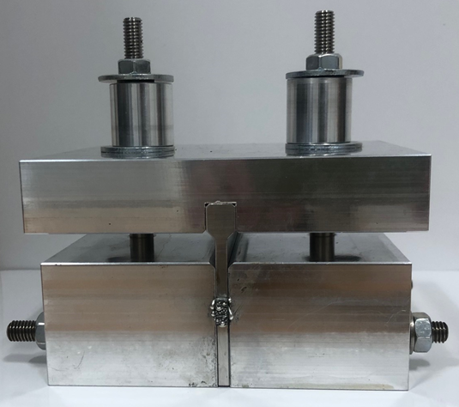
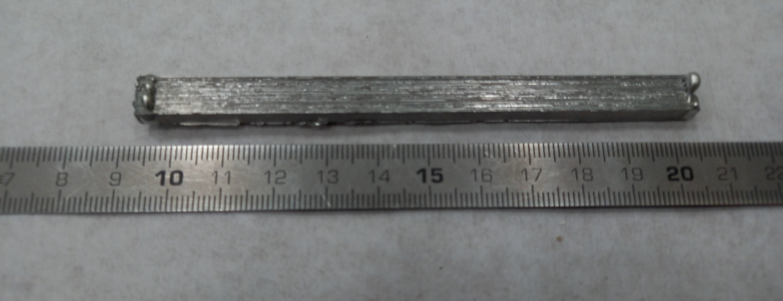
Sample 2
In order to minimize the porosity, the stacks is heated under vacuum
Sample cut for thermo-mechanical test (ongoing)

Slide 5

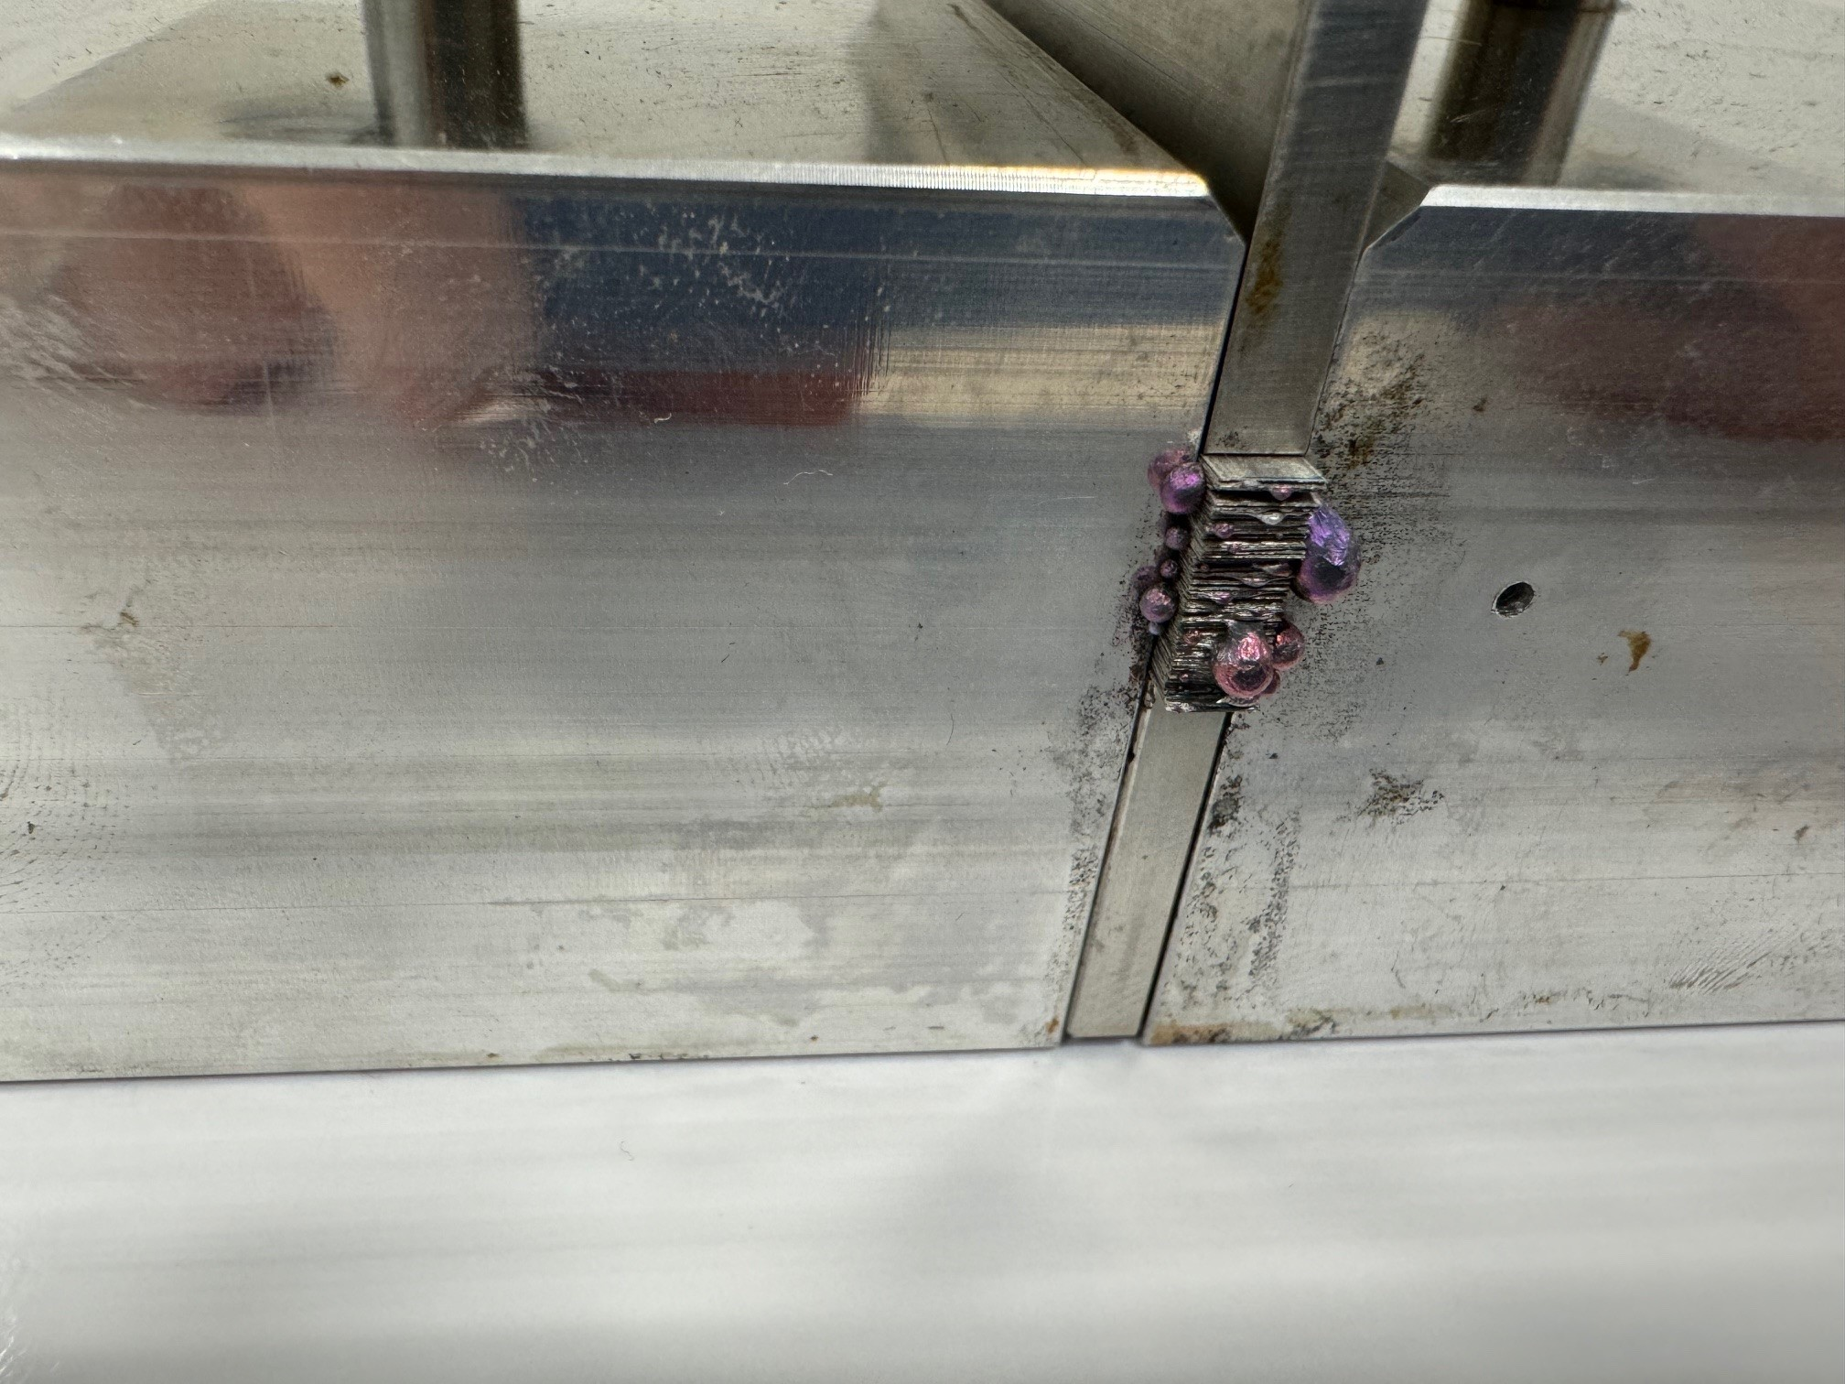
Sample 4
Same procedure of Sample 2?
Tomography?

Slide 6
What’s next
Planning for other stacks
Planning for coil

