Slide 1
Joint Modelling Updates
D. Rinaldoni, B. Bordini
02/08/2024

Slide 2
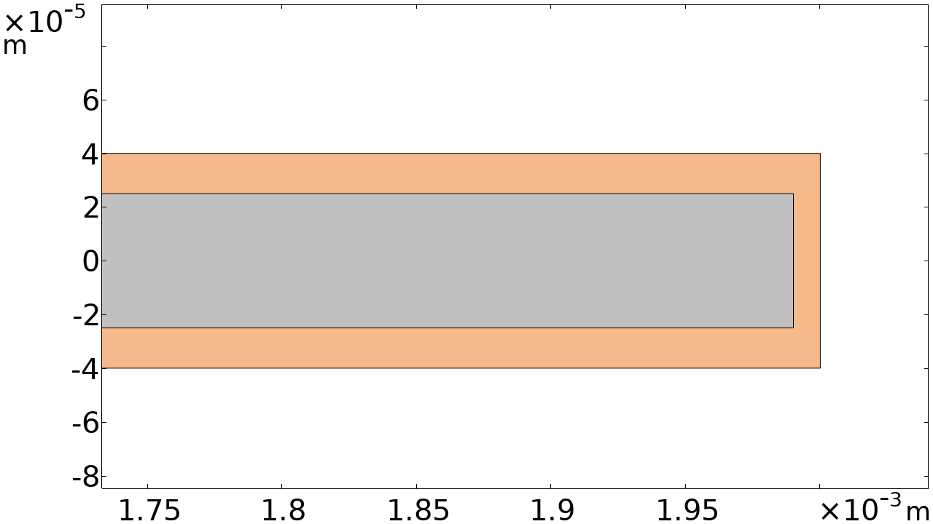
Analytic Study on Contact Resistance
w_{Cu}=10 µm, h_{Cu}=15 µm
RRR | R_{ct} (µΩ cm²)
1 | 0.679
5 | 0.224
10 | 0.134
20 | 0.075
40 | 0.040
Thickness 80 µm
Width 4 mm
T = 4.2 K
h_{Cu}
w_{Cu}
h_{Cu}
Values for HTS tape ~ 10 µΩ cm2 (Yoon et al.)
We lose 2-3 orders of magnitude

Slide 3
Analytic Study on Contact Resistance
w_{Cu}=10 µm, h_{Cu}=15 µm
RRR | R_{ct} (µΩ cm²)
1 | 0.679
5 | 0.224
10 | 0.134
20 | 0.075
40 | 0.040

Slide 4
Analytic Study on Contact Resistance
Changing the Copper thickness:
w_{Cu}=10 µm, h_{Cu}=15 µm
w_{Cu}=20 µm, h_{Cu}=25 µm
w_{Cu}=30 µm, h_{Cu}=35 µm
RRR | R_{ct} (µΩ cm²)
1 | 0.679
5 | 0.224
10 | 0.134
20 | 0.075
40 | 0.040
RRR | R_{ct} (µΩ cm²)
1 | 0.481
5 | 0.084
10 | 0.048
20 | 0.024
40 | 0.013
RRR | R_{ct} (µΩ cm²)
1 | 0.293
5 | 0.022
10 | 0.012
20 | 0.006
40 | 0.003

Slide 5
Analytic Study on Contact Resistance
w_{Cu}=10 µm, h_{Cu}=15 µm
w_{Cu}=0 µm , h_{Cu}=15 µm
RRR | R_{ct} (µΩ cm²)
1 | 0.679
5 | 0.224
10 | 0.134
20 | 0.075
40 | 0.040
RRR | R_{ct} (µΩ cm²)
1 | 0.691
5 | 0.616
10 | 0.616
20 | 0.616
40 | 0.615
We gain at maximum 1 order in the case of etched tape.
Remark: True only for joints (Cu+Ha), not for the HTS tape ➔ In that case R_{ct} increases more because of the buffer layers.

Slide 6
Analytic Study on Contact Resistance
We can estimate the radial resistance of the entire joints:
N_{joints} = 7
RRR = 20
RRR | R_{in} (µΩ) | R_{out} (µΩ)
1 | 0.727 | 0.239
5 | 0.240 | 0.079
10 | 0.143 | 0.047
20 | 0.080 | 0.026
40 | 0.046 | 0.014
N | R_{in} (µΩ) | R_{out} (µΩ)
5 | 0.060 | 0.020
10 | 0.111 | 0.036
20 | 0.214 | 0.069
30 | 0.321 | 0.101
50 | 0.543 | 0.165

Slide 7
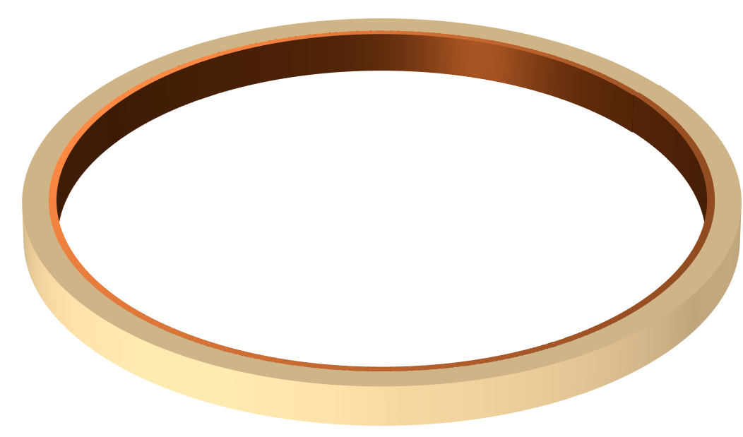
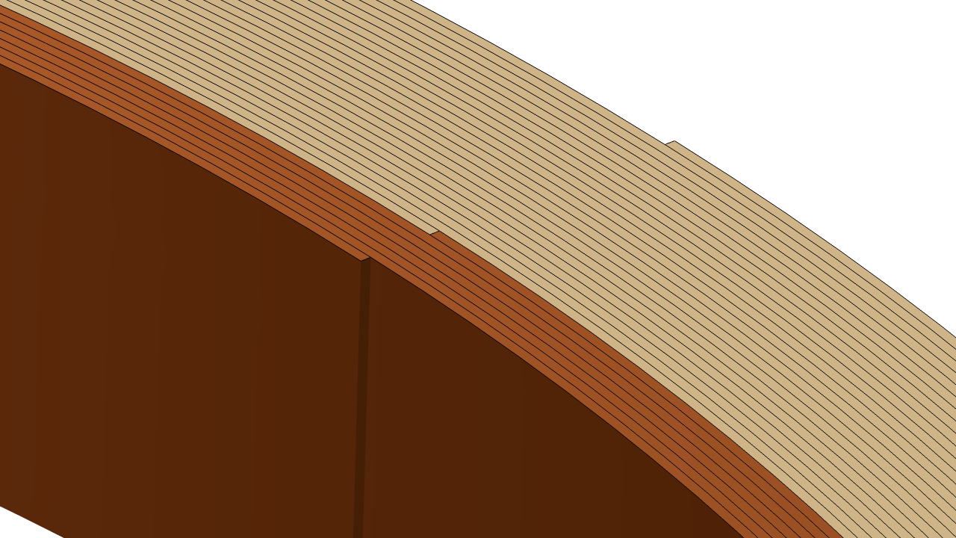
Ongoing Studies
Currently working on the fully 3D model aiming to know the current distribution in the joints in 3D.

Slide 8
Thank you for your attention.
Questions?

