Slide 1
Pancakce 1&2 and Stacks 01&02 measurements
High-field solenoid technology for the Muon Collider
ABDEL HAFIZ Mahmoud
02/08/2024

Slide 2
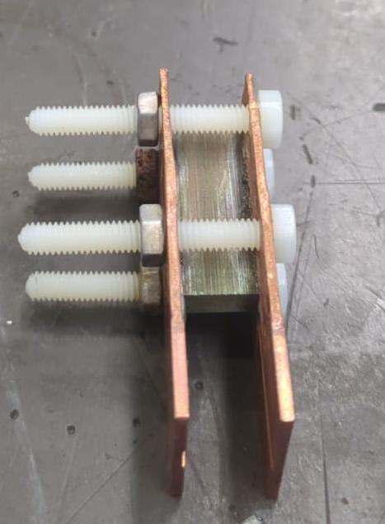
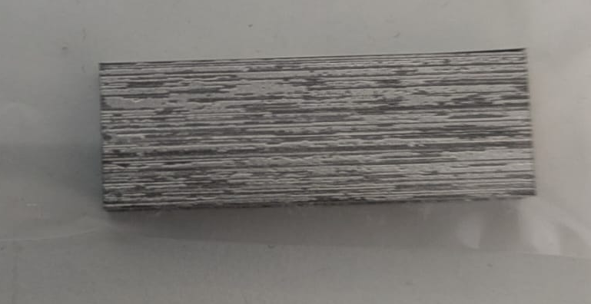
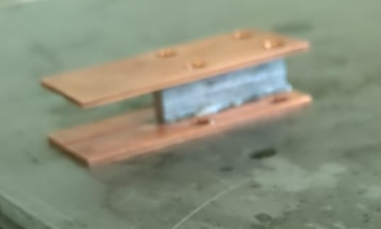
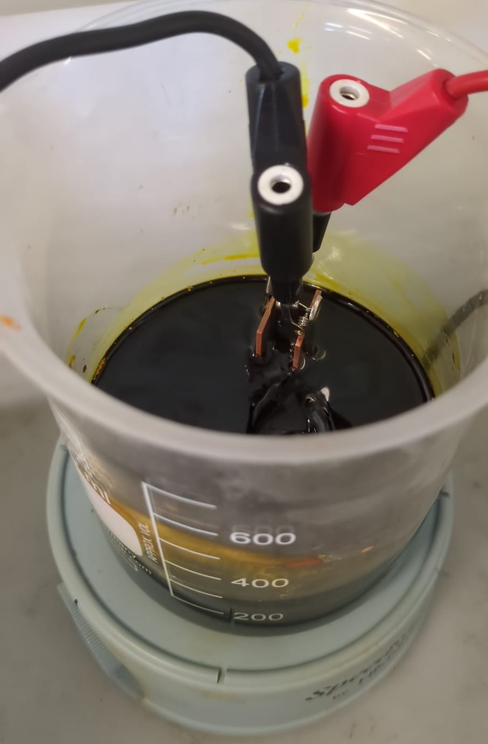
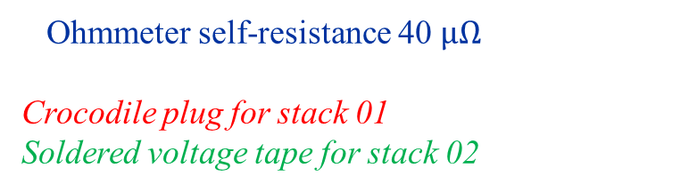
Stacks
Stack soldered to copper plate with BiSn solder (melting temperature 137°C)
Stack 01 & 02
132 tapes
4 insulating screws to apply small pressure and prevent from delamination
Stack 02 showed that screws are unnecessary
Ohmmeter self-resistance 40$μΩ$
Crocodile plug for stack 01
Soldered voltage tape for stack 02
Magnetic stirrer

Slide 3
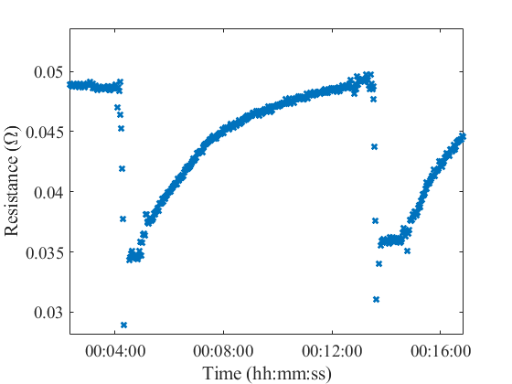
Stack 02 – resistance before etching
Resistance mesured before etching
Sample in LN
Value here has a low reliability has it is a 2 points measurements.
Please consider evolution of the resistance

Slide 4
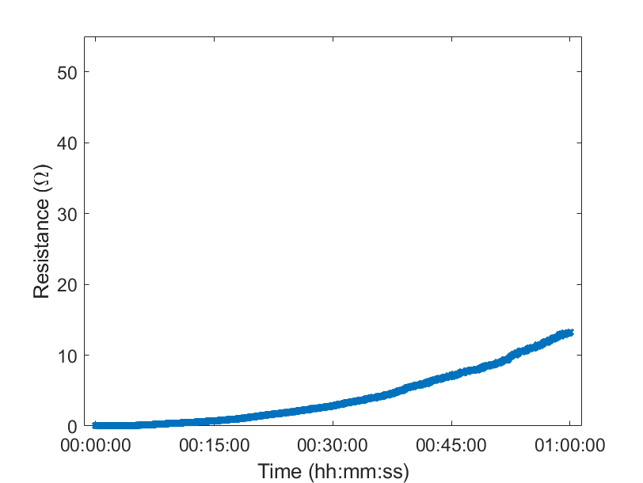
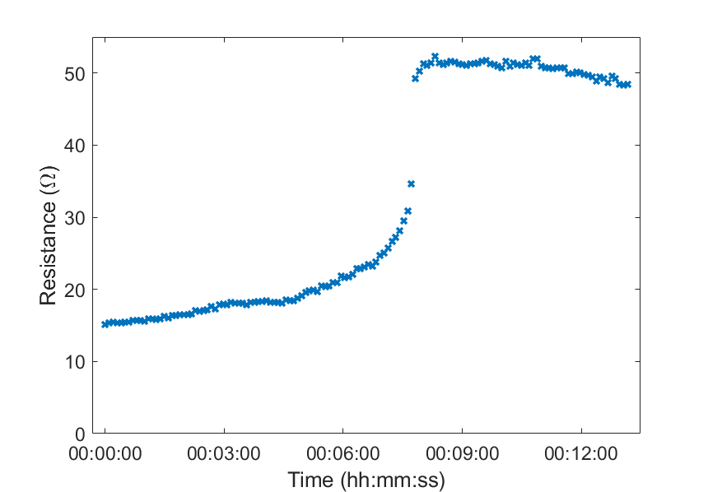
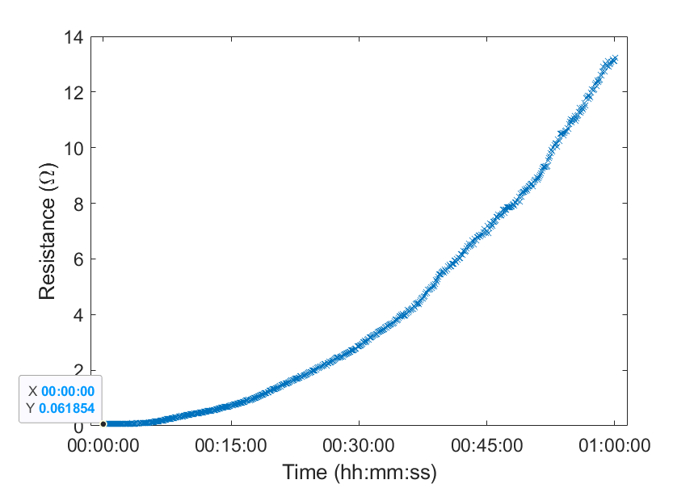
Stack 01 – transverse resistance during the etching
Part 1
Program shut down for a few minutes

Slide 5
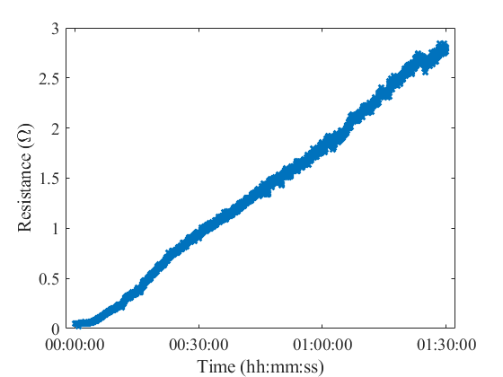
Stack 01 & 02 – resistance during etching
Stack 01
Stack 02

Slide 6
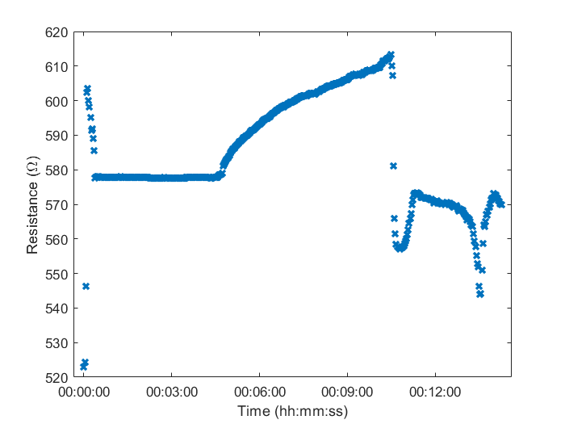
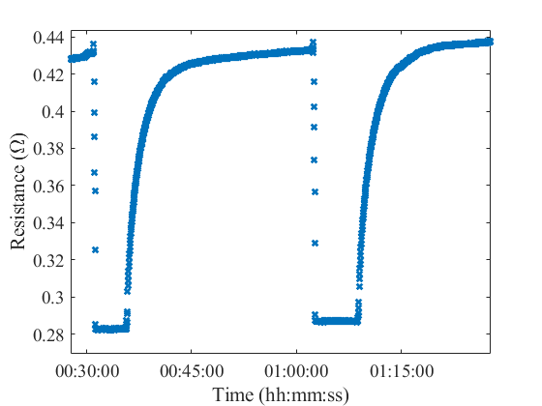
Stack 01 & 02 – cycles after etching
Stack 01
Stack 02

Slide 7
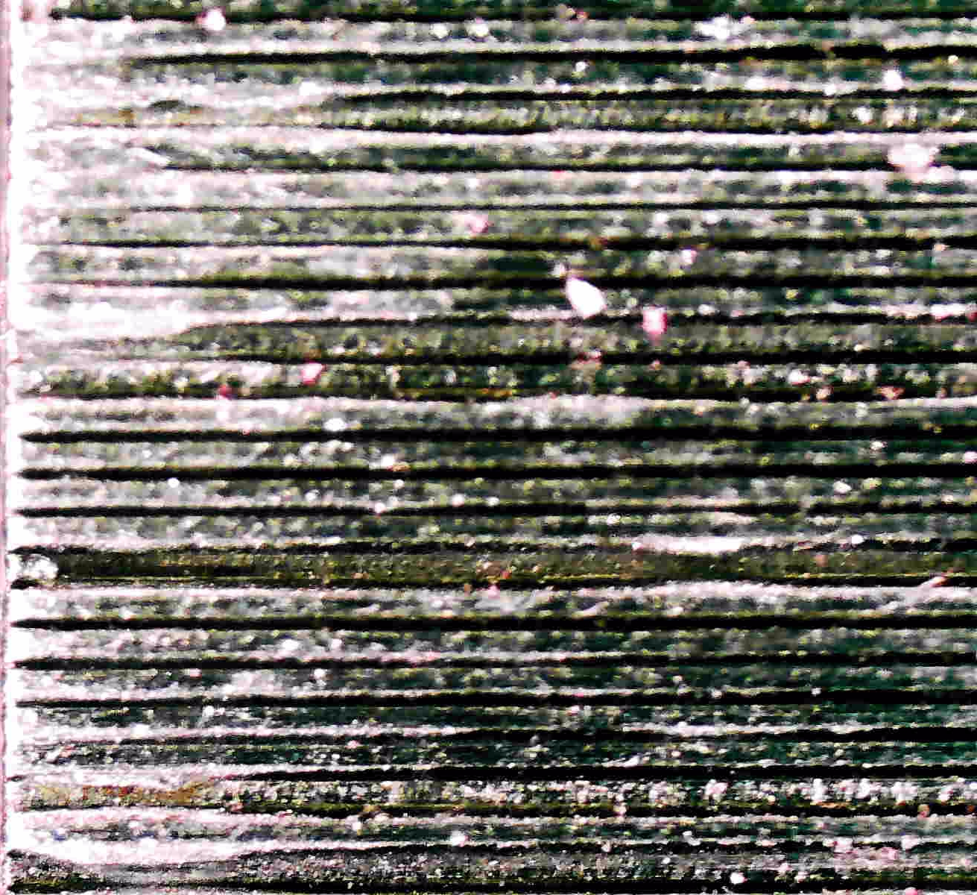
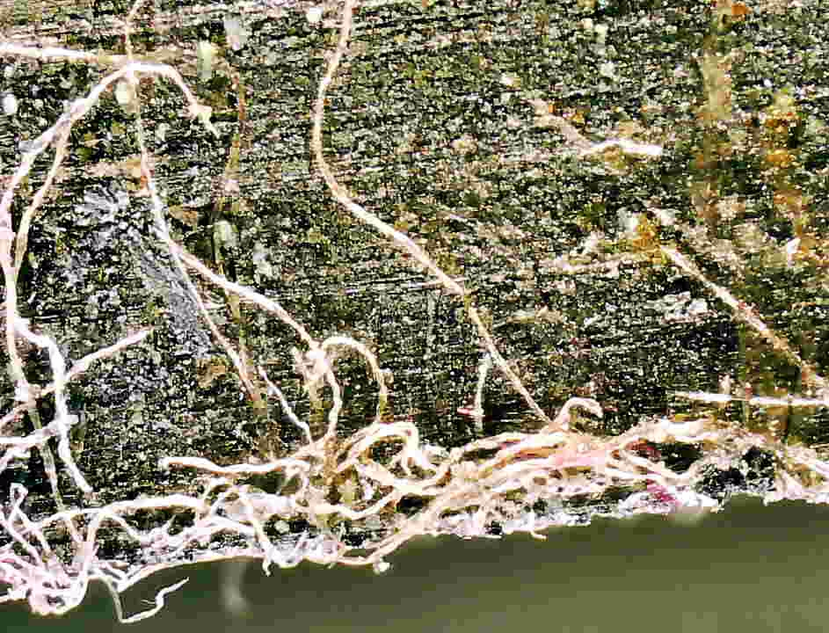
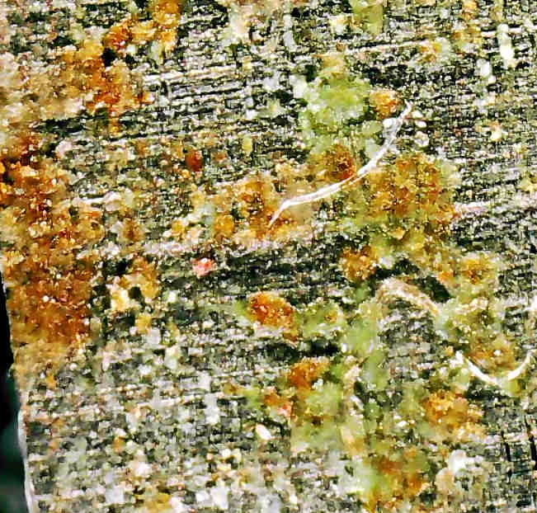


Stack 01 & 02 – Microscopic observations
Stack 01 after etching ~ 500 $Ω$
Stack 02 after etching ~ 0.5 $Ω$

Slide 8
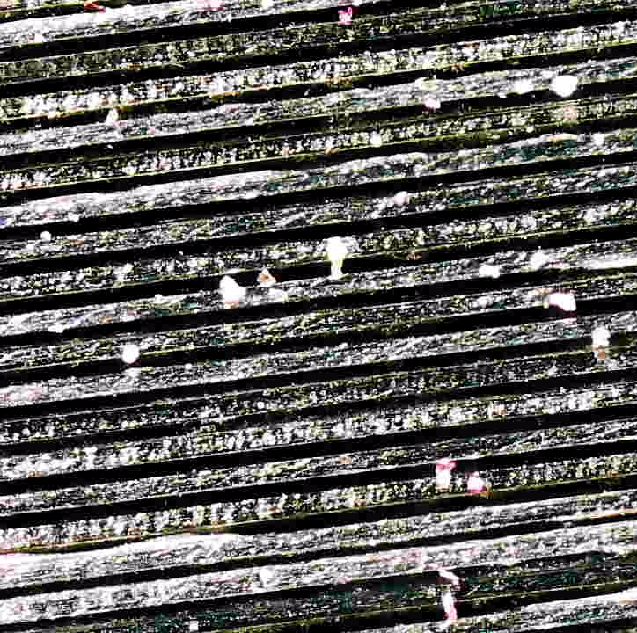
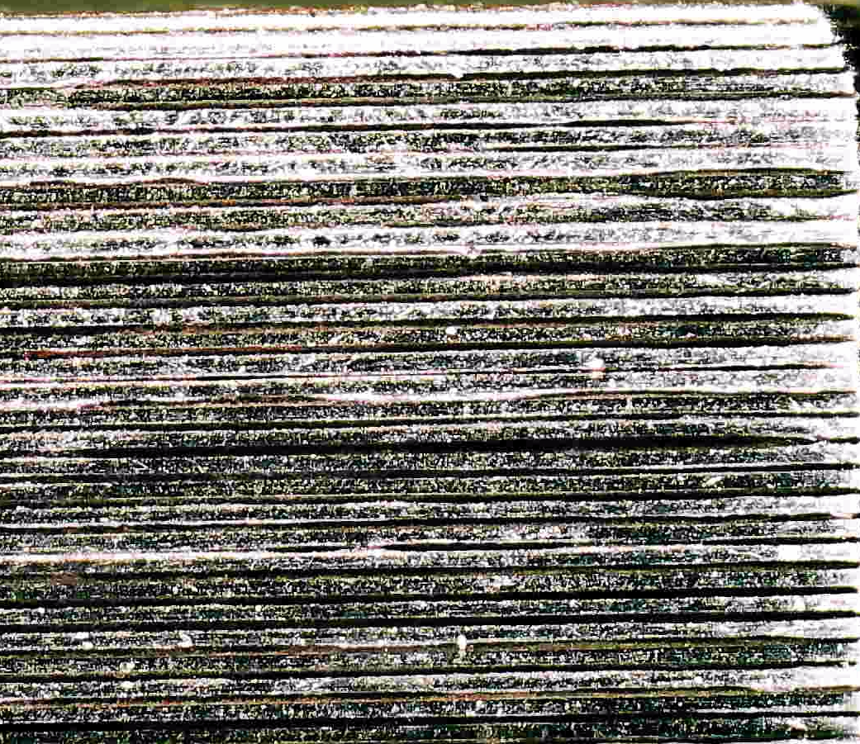



Stack 01 – Microscopic observations
Stack 02 after etching + brushing ~ 15 $Ω$
Stack 02 after etching + (more) brushing ~ 150 $Ω$

Slide 9
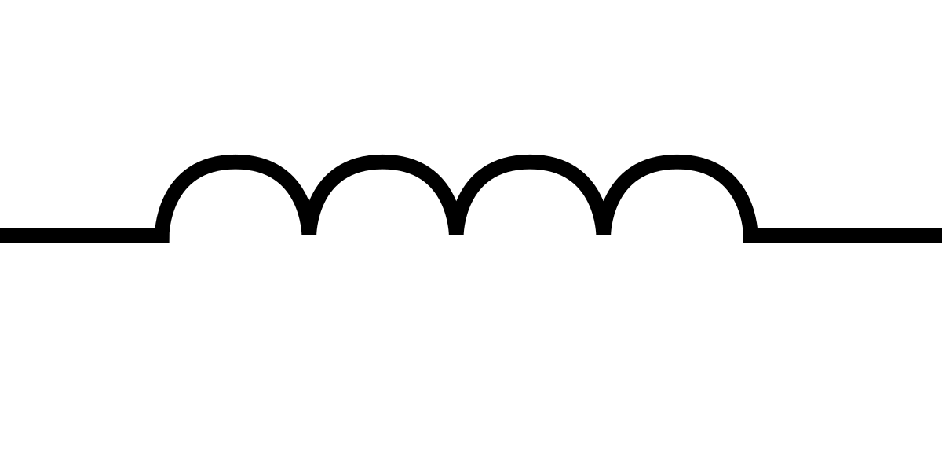

Pancakes set up
In case of protection needed
$i$
U1
R_cables
R_Shunt
R_cables_2
R_T
R_series
L
U2
U3
Hall probe

Slide 10
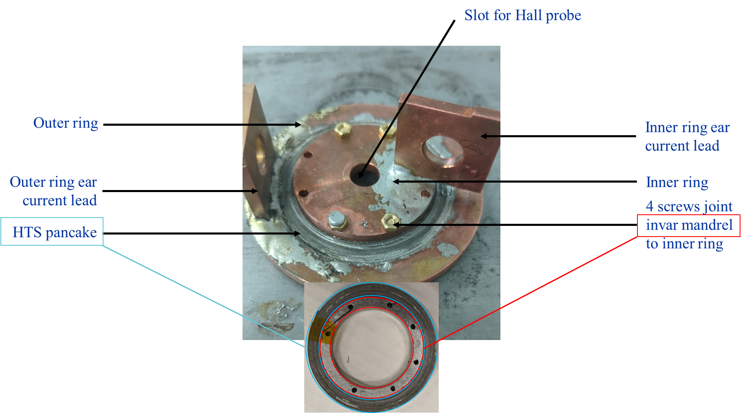
Pancake 1

Slide 11
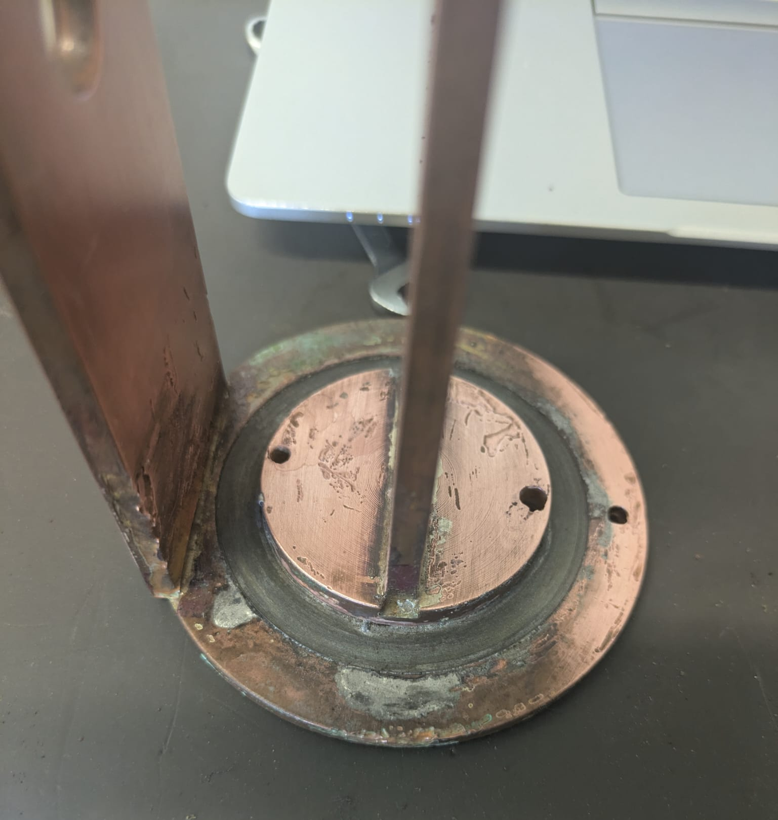
Pancake 2
Longer copper plates (current leads)
Plates welded to copper ring
Voltage tape slots dedicated
Copper inner ring soldered to mandrel (highly improving joint resistance)

Slide 12
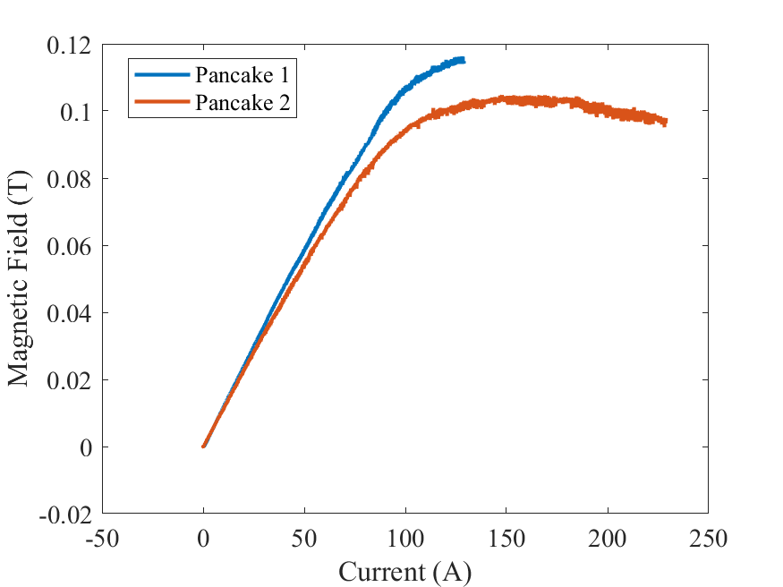
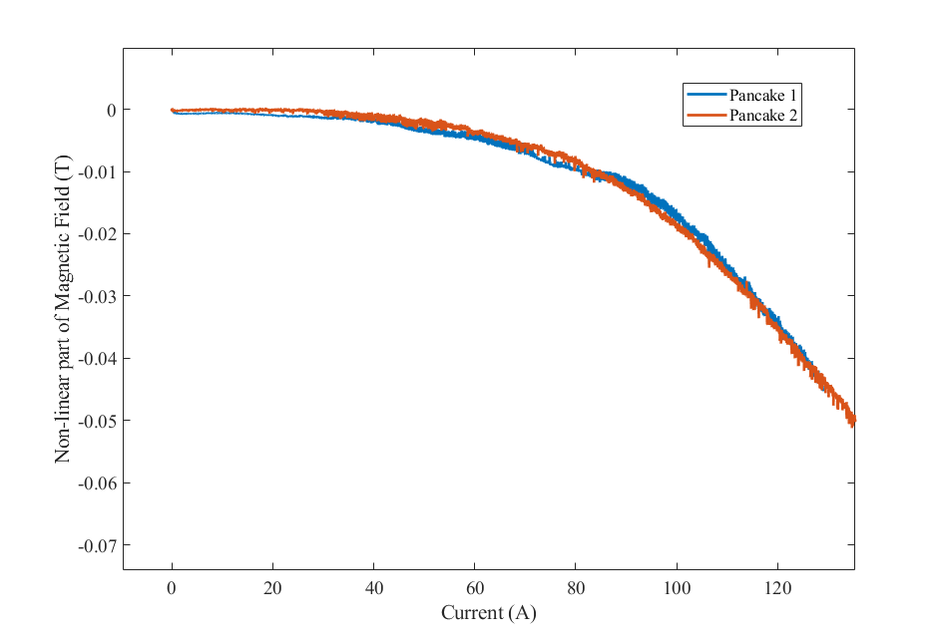

Pancake 1 & 2 – Compare IC
$$\sim 65 A$$

Slide 13
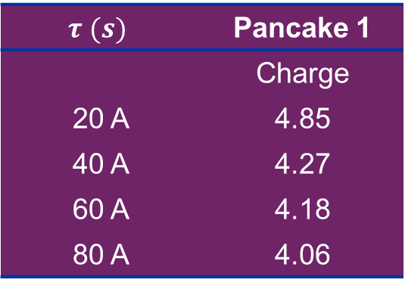
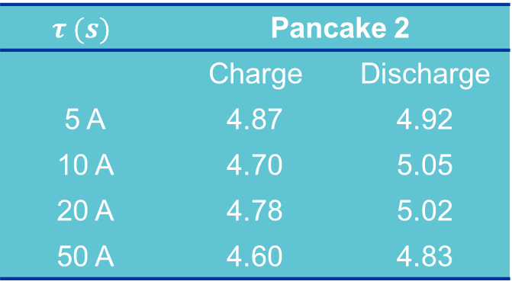


Pancake 1 & 2 – Compare Time constant
$$τ (s)$$ | Pancake 1
 | Charge
20 A | 4.85
40 A | 4.27
60 A | 4.18
80 A | 4.06
$$τ (s)$$ | Pancake 2
 | Charge | Discharge
5 A | 4.87 | 4.92
10 A | 4.70 | 5.05
20 A | 4.78 | 5.02
50 A | 4.60 | 4.83
$$\sim 4.5 s$$
$$\sim 4.8 s$$

Slide 14
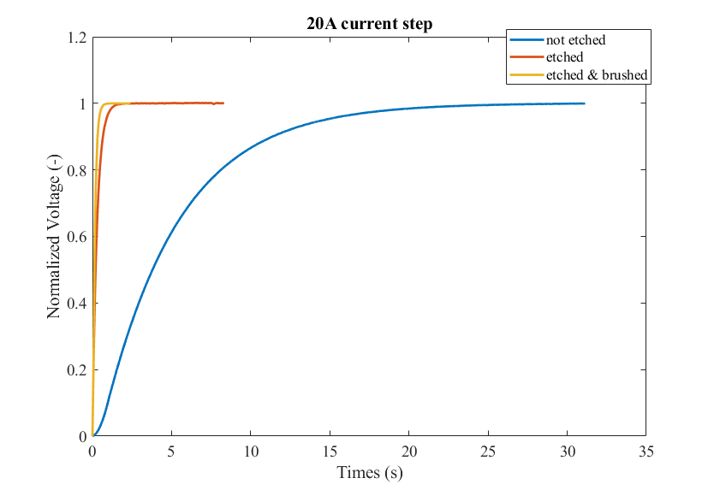



Pancake 1 – Compare Time constant
  $$τ=0.14 s$$
  $$τ=0.34 s$$
  $$τ=4.3 s$$
Etching
  Whole pancake drowned into iron chloride
  Cleaned into water
  Dried with pressurized air
Brushing
  Brushed after ~ 1 month with electrical drill like brush

Slide 15
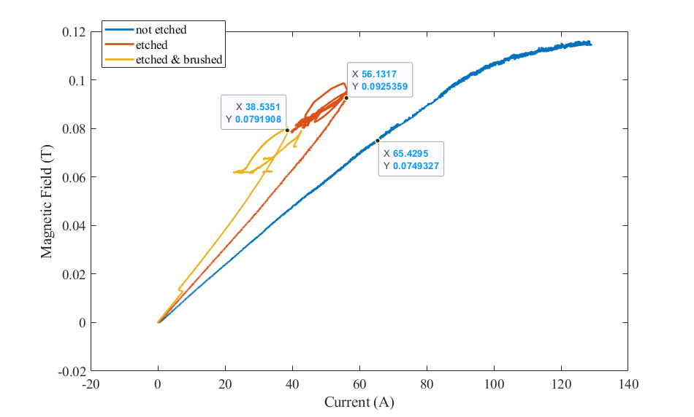



Pancake 1 – Compare IC
  $$I=38 A$$
  $$I=56 A$$
Slow ramp rate
  0.02 A/s to 0.1 A/s
  Cleaned into water
  Dried with pressurized air
  $$I=65 A$$

Slide 16
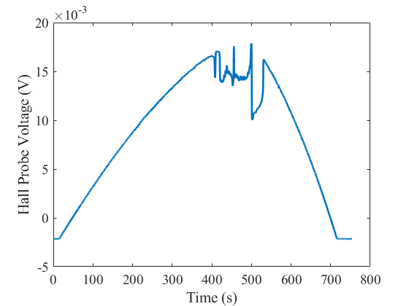
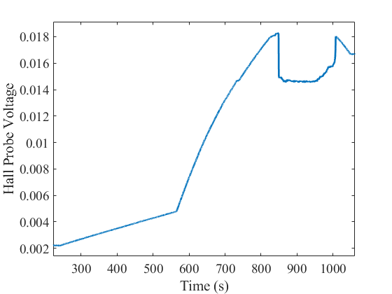
Pancake 1 – Shape of voltage during ramp
Before brushing
After brushing

Slide 17
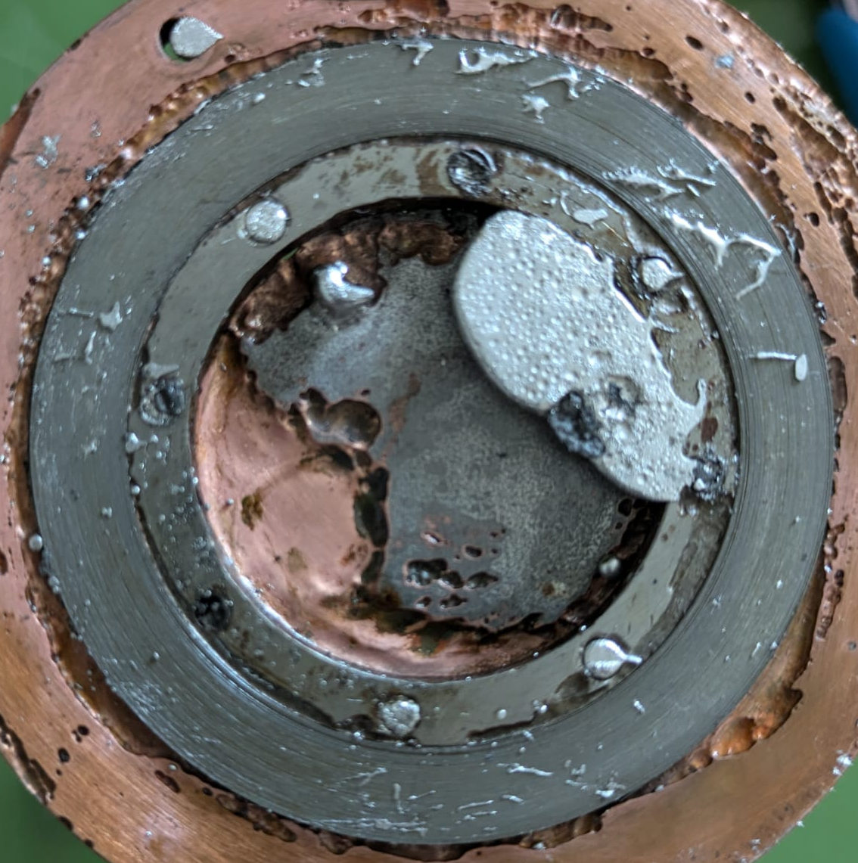
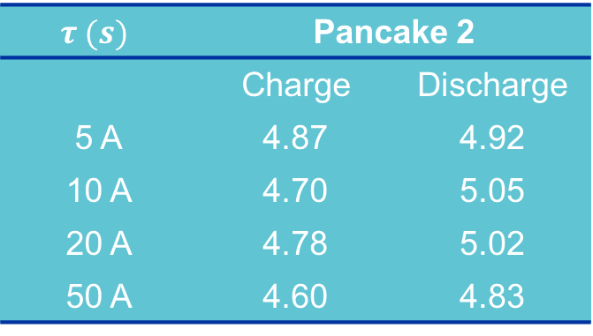
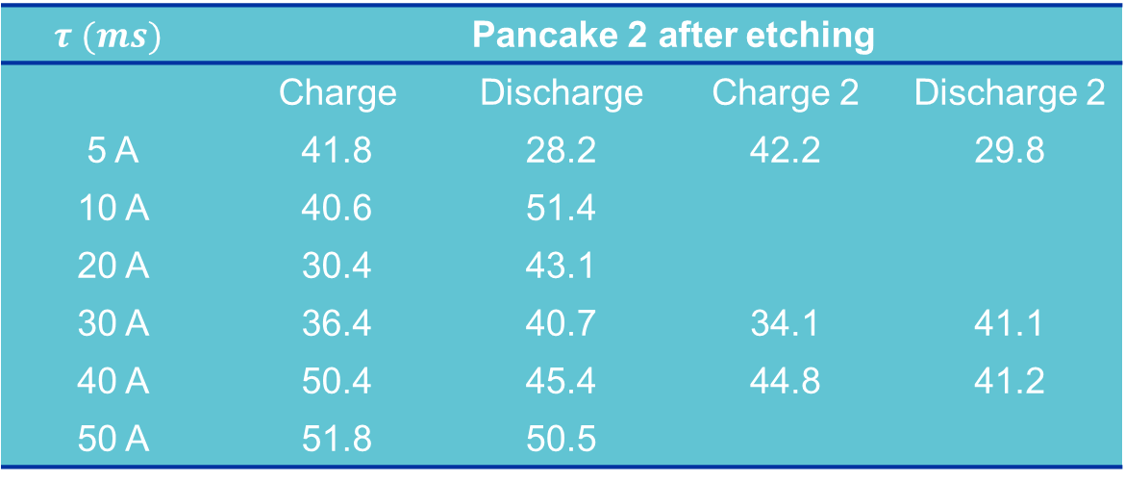


Pancake 2 – Compare Time constant
Etching
  Parts protected with silicon coating
  Whole pancake drowned into iron chloride
  Cleaned into sodium becarbonate
  Dried with pressurized air
  Cleaned with acetone
  Cleaned with water
  Dried with pressurized air
$$τ (s)$$ | Pancake 2
 | Charge | Discharge
5 A | 4.87 | 4.92
10 A | 4.70 | 5.05
20 A | 4.78 | 5.02
50 A | 4.60 | 4.83
$$\sim 4.8 s$$
$$τ (ms)$$ | Pancake 2 after etching
 | Charge | Discharge | Charge 2 | Discharge 2
5 A | 41.8 | 28.2 | 42.2 | 29.8
10 A | 40.6 | 51.4
20 A | 30.4 | 43.1
30 A | 36.4 | 40.7 | 34.1 | 41.1
40 A | 50.4 | 45.4 | 44.8 | 41.2
50 A | 51.8 | 50.5
$$<40 ms$$

Slide 18
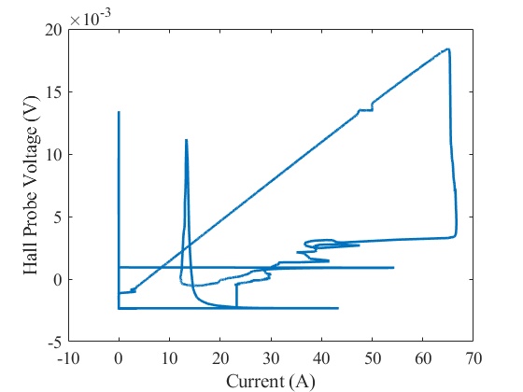
Pancake 2 – Compare IC
Post treatment to be continued …

