Slide 1
Double Pancake
High-field solenoid technology for the Muon Collider
ABDEL HAFIZ Mahmoud
20/09/2024

Slide 2
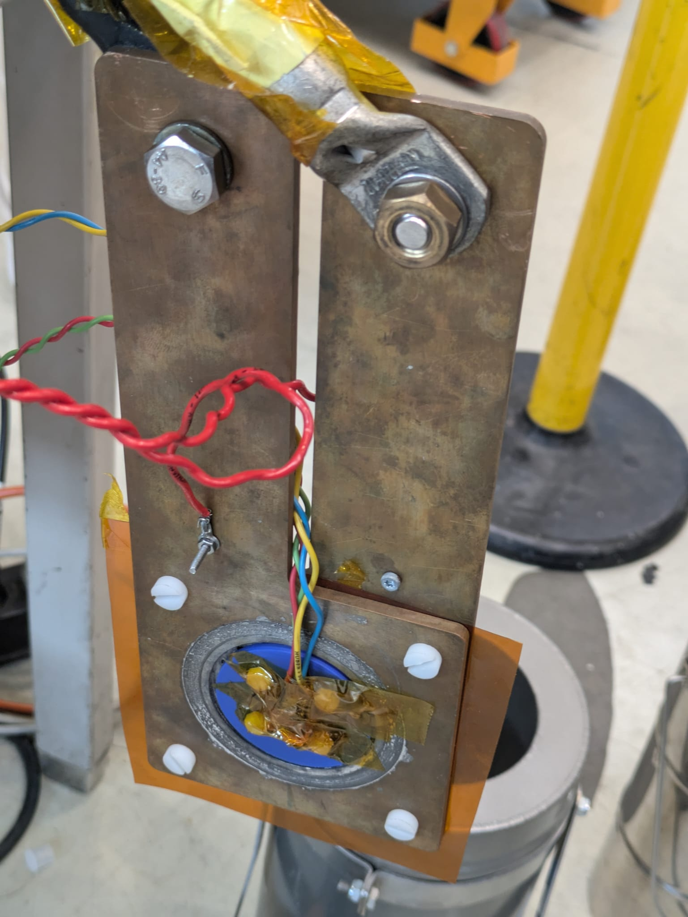
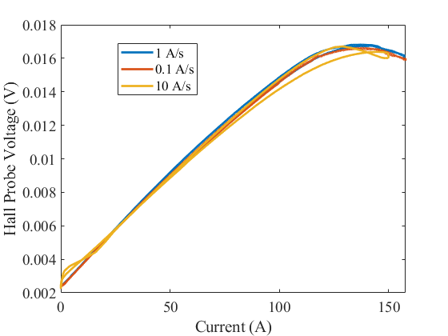

Slide 3
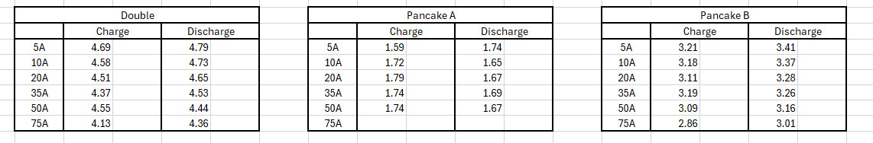
Time constant

Slide 4
