Slide 1


Overview of tests of ReBCO stacks and coils
C. Accettura
Final Cooling Progress Meeting
https://indico.cern.ch/event/1390350/
22/11/2024, CERN

Slide 2
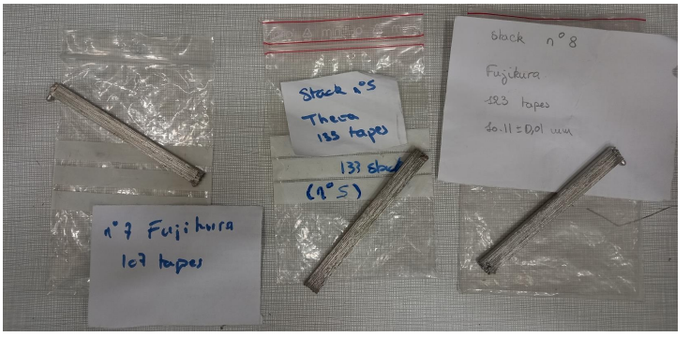
Tomography
3 additional stacks were tested
S5→ 133 stacked tapes from THEVA
S7→107 stacked tapes from Fujikura
S8→123 stacked tapes from Fujikura
Results significantly worst compared to the previous one (THEVA)
EDMS 3181512

Slide 3
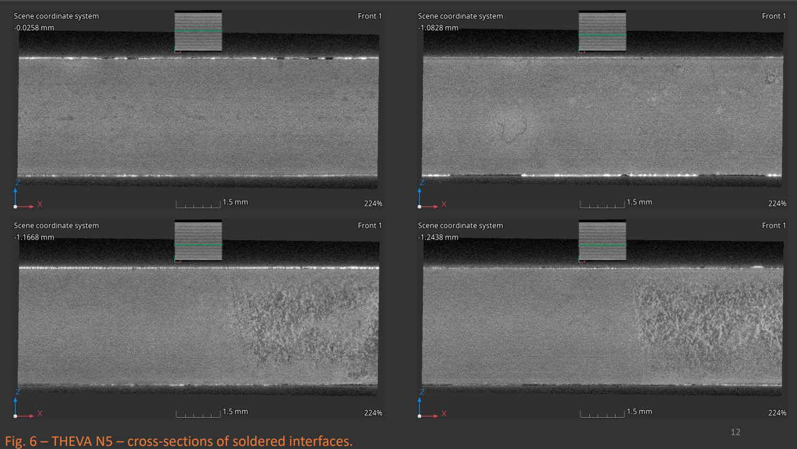

Slide 4
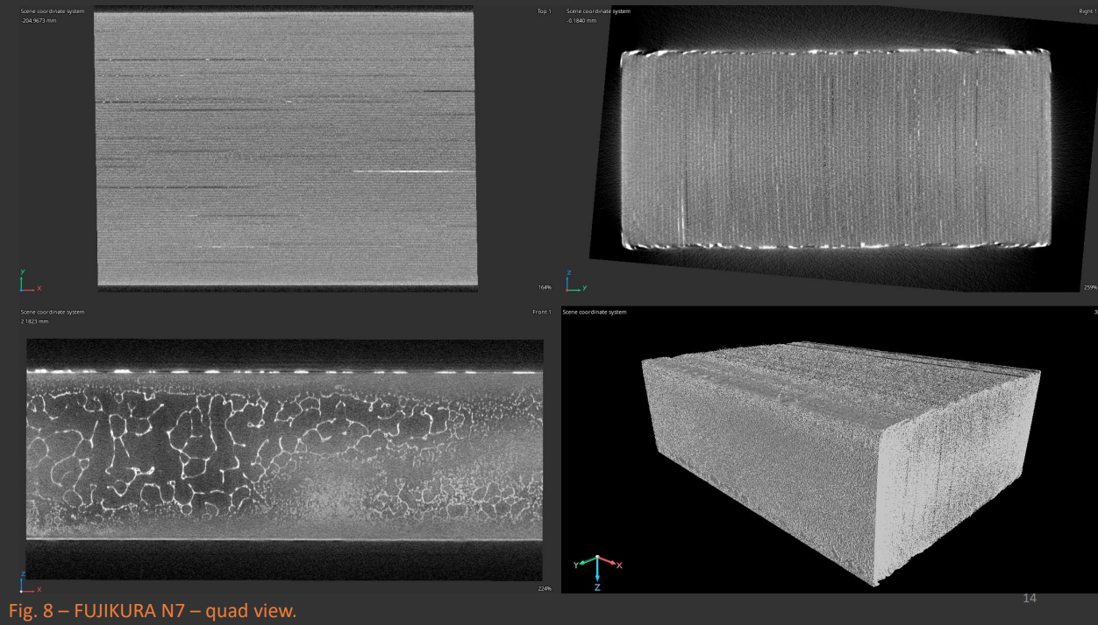

Slide 5
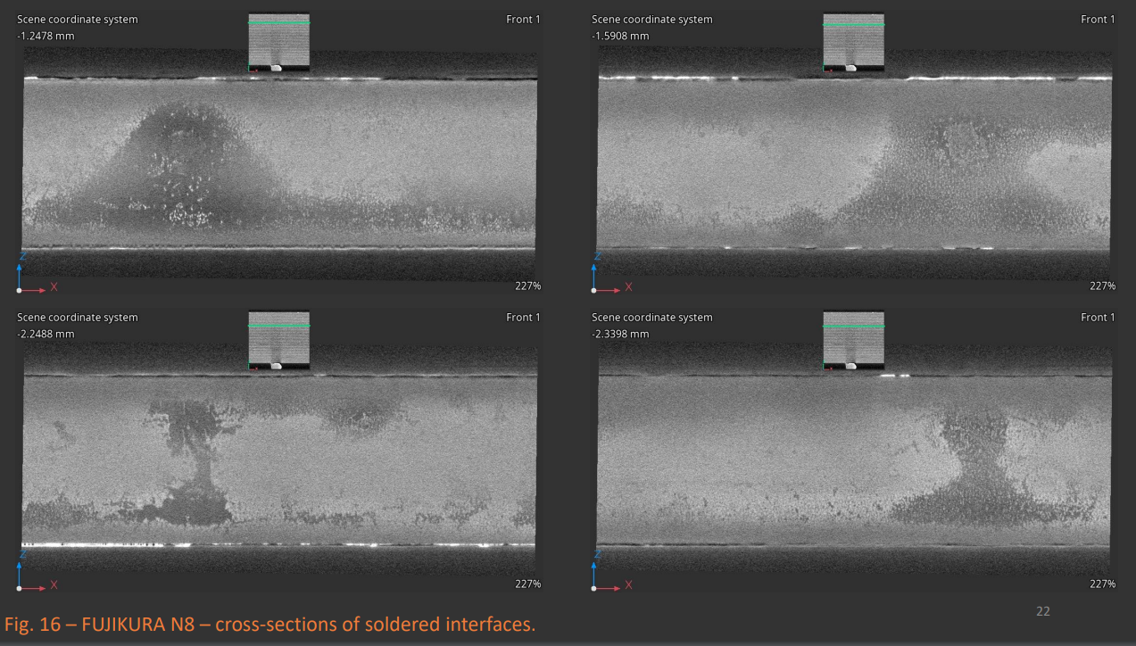

Slide 6
Tomography
What is the origin of the problem?
Difference status of copper surface (oxidation, grain size) impact the adhesion of coating
Coating process not reproducible
Problem during thermal treatment

Slide 7
Planning of test
Stacks:
Sample 2 THEVA (good)--> optical to check where is the failure, solder quantity
Sample 7 Fuji (bad)--> optical to check where is the failure, solder quantity
Tape:
Theva uncoated 10cm--> SEM+FIB copper structures, impurities, oxide
Fuji uncoated--> SEM+FIB copper structures, impurities, oxide
Theva coated A--> XRF to check homogeneities, coating thickness
Theva coated B--> XRF to check homogeneities, coating thickness
Fuji coated A--> XRF to check homogeneities, coating thickness
Fuji coated B--> XRF to check homogeneities, coating thickness

